Slide 1
APEX – early background studies
Eric Church
APEX mtg
7-March-2024

Slide 2
Motivation
We’d like to broaden physics scope – and do Low Energy Physics -- in a module 3
ala APEX
The expanded light coverage might offer this possibility
But backgrounds need to be understood and controlled
here we consider two particular bkgds
Cavern gammas (from just one long wall, for now)
From 238U/232Th chains in rock
FRP vertical supports for Arapucas (from just the long walls, for now)
These sit on the inside in the fiducial volume
Yet to consider, say,
Exterior neutrons and the Arapucas themselves, etc …

Slide 3
Supernovae, solar νs
Supernovae burst detection is in the DUNE physics charge
solar νs are part of a new hoped-for program at lower energy for all modules and give a broad low-energy spectrum of events to show our capabilities, or lack thereof.
Thus, as a start, I generate ⁸B solar Marley events in our new APEX standalone geometry
Thanks, Franciole for the geometry!
github.com:fcmarinho/module3_standalone_sim.git
I have iterated to add an outer cryostat
I take the DetectorConstruction.* files giving latest geometry as of a couple wks ago, and drop them into my sndwrm simulation
sndwrm – simulation of a neutrino detector with radiopure materials)
github.com:echurch/sndwrm/tree/liquid_deception

Slide 4
8B as a metric

Slide 5
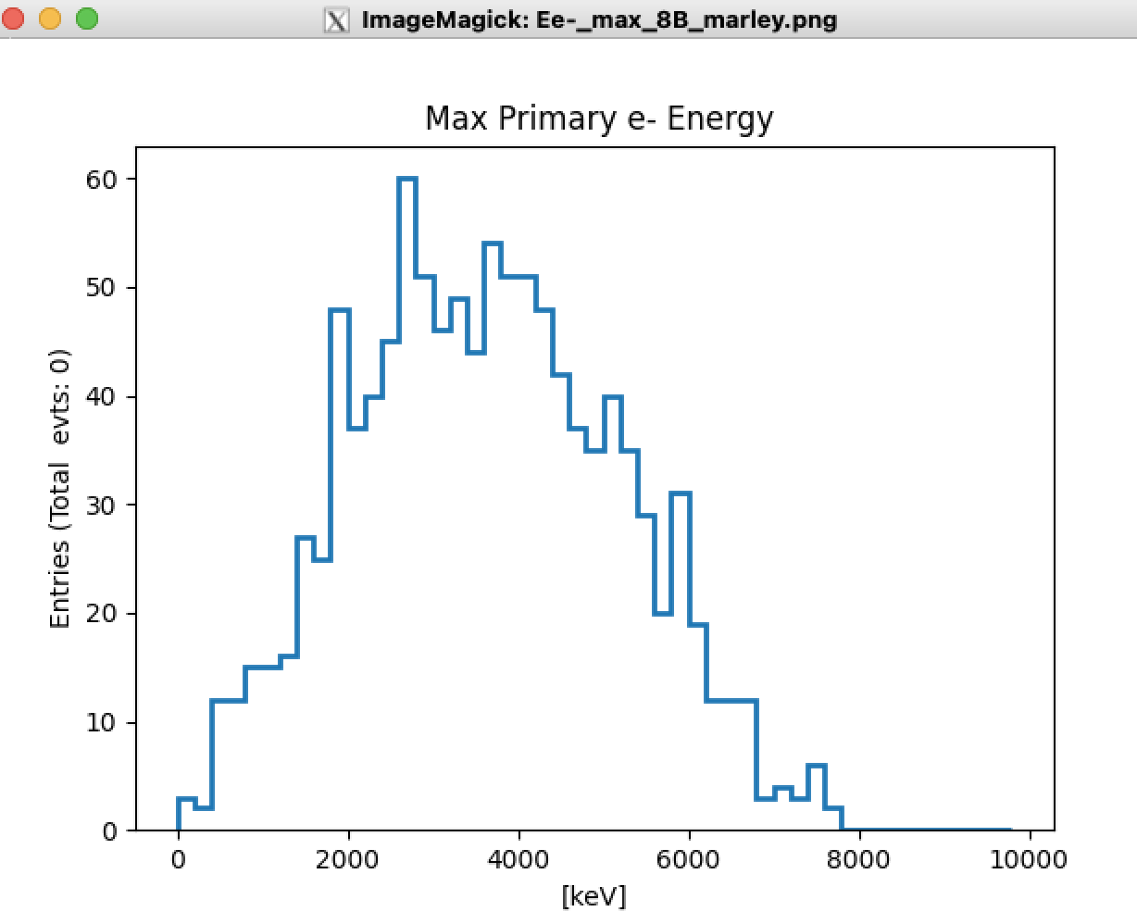
Primary ⁸B e-s
This is the max (first in stack) e- primary KE.
Anybody who understands
all these primary Marley e-s please explain
to me.

Slide 6
Standalone simulation
For now I will just count Arapuca hits
Impose pde=0.03
There’s no signal formation, just hits
So, no noise yet whose signals could conceivably be counted as hits
No charge drift, no charge hits
No reconstruction
However, the upside is no photon lookup library is used in this work.
All photons are tracked by G4
It’s easy to change the geometry and re-run

Slide 7
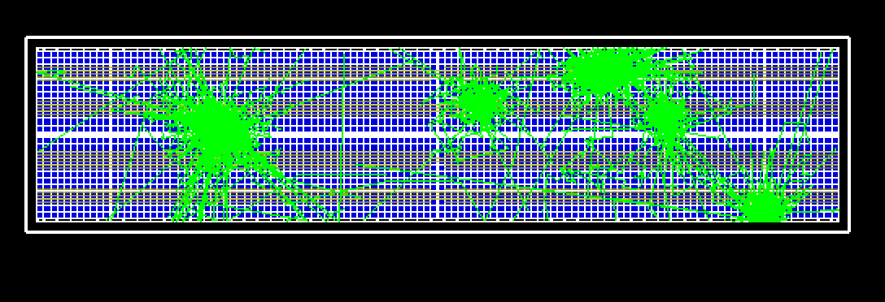
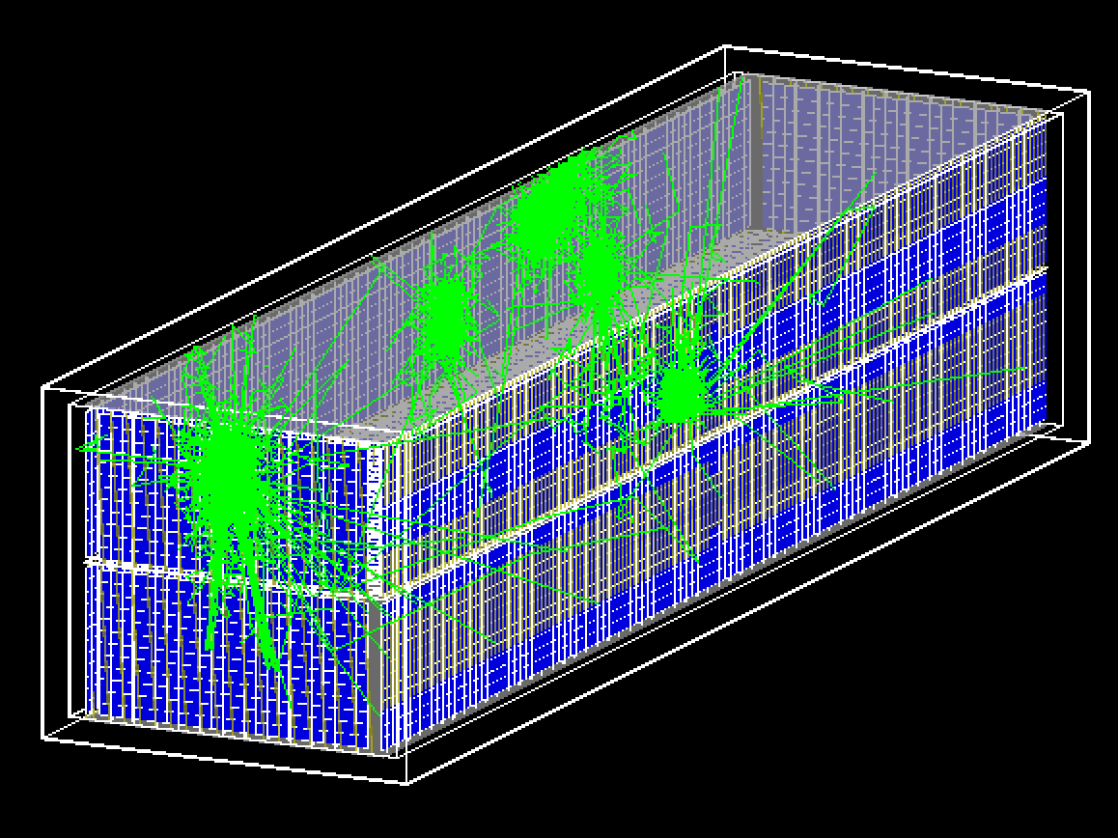
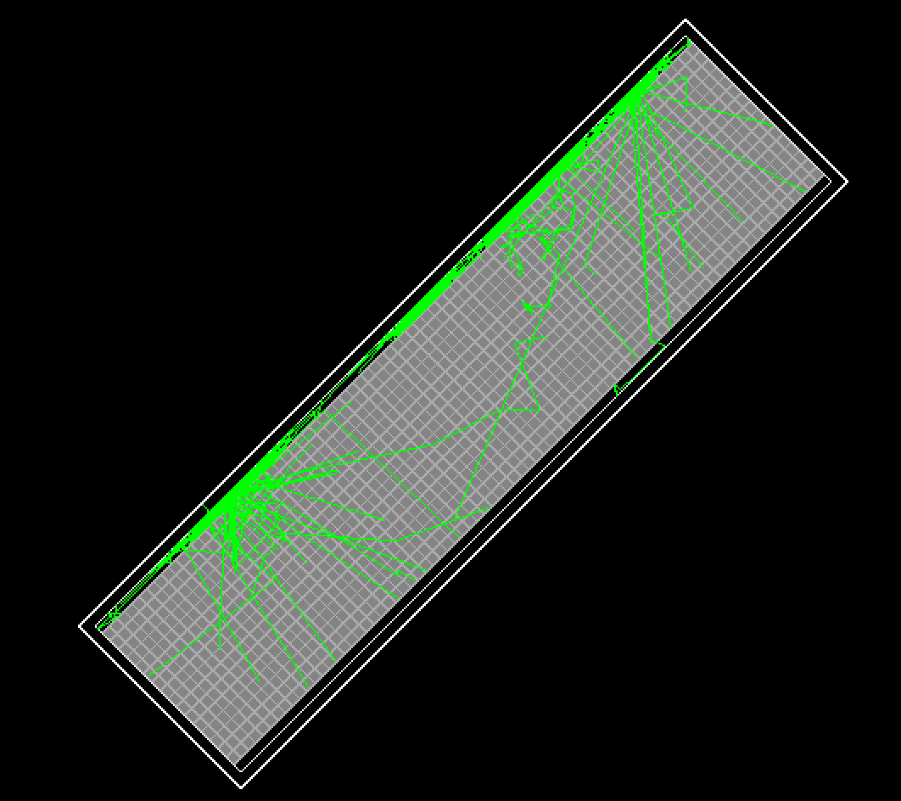
Typical external rock γ events
green are optical photons
Looking from the side
Looking down from above

Slide 8
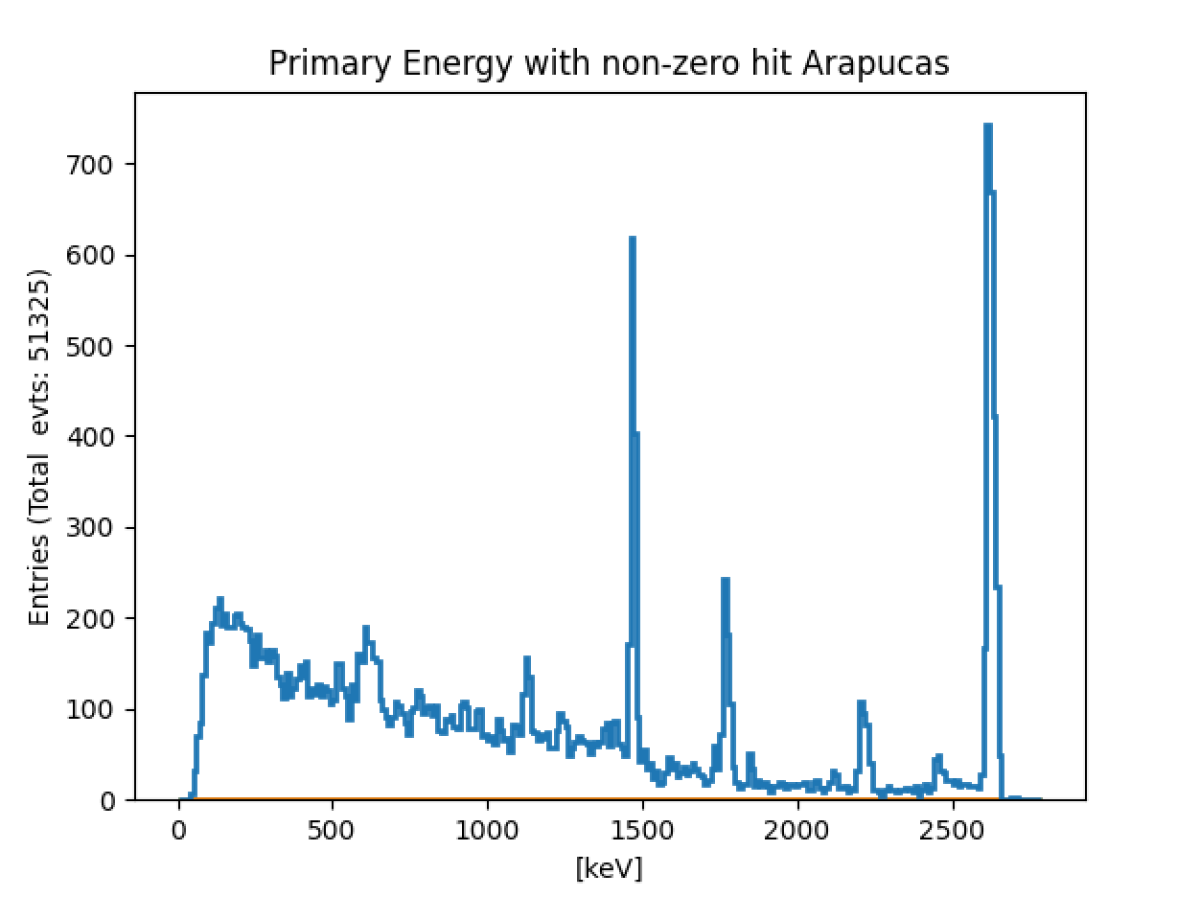
Initial γ spectra
From the rock
γs which produce photons that hit Arapucas

Slide 9
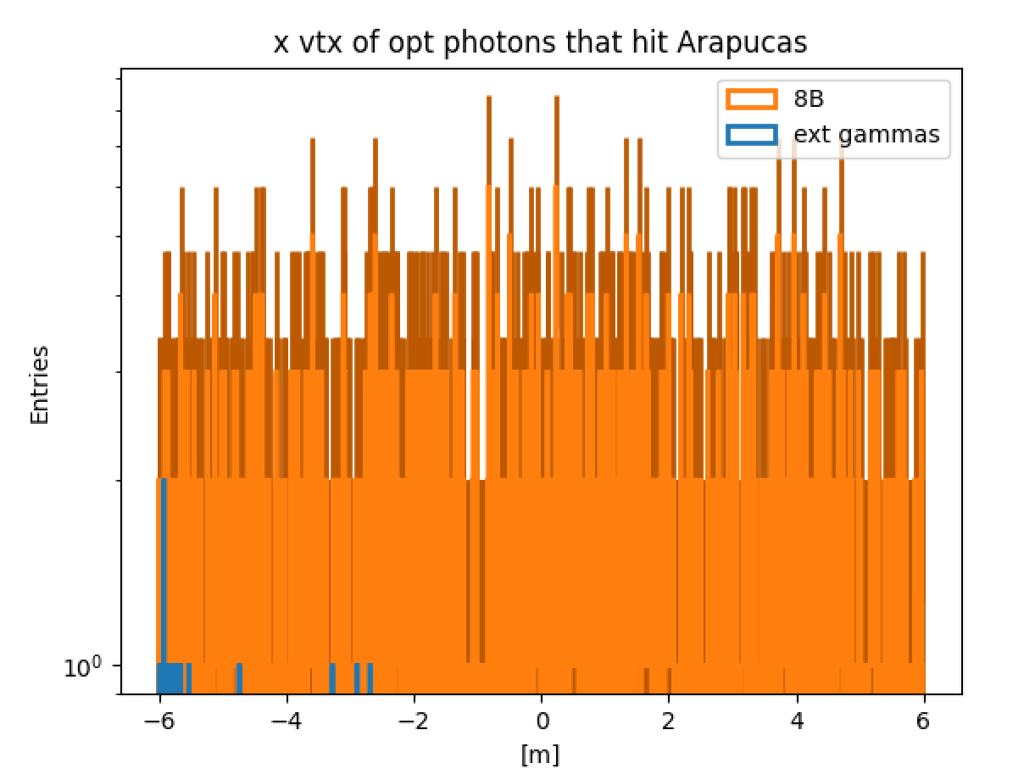
x (horiz) optical photon origin
This is wrong/incomplete!
In fact, most photons that hit arapucas, come
from large abs(x) -- behind the Arapucas!
Discovered as putting this talk together this morning!
Big implication to count rate!

Slide 10
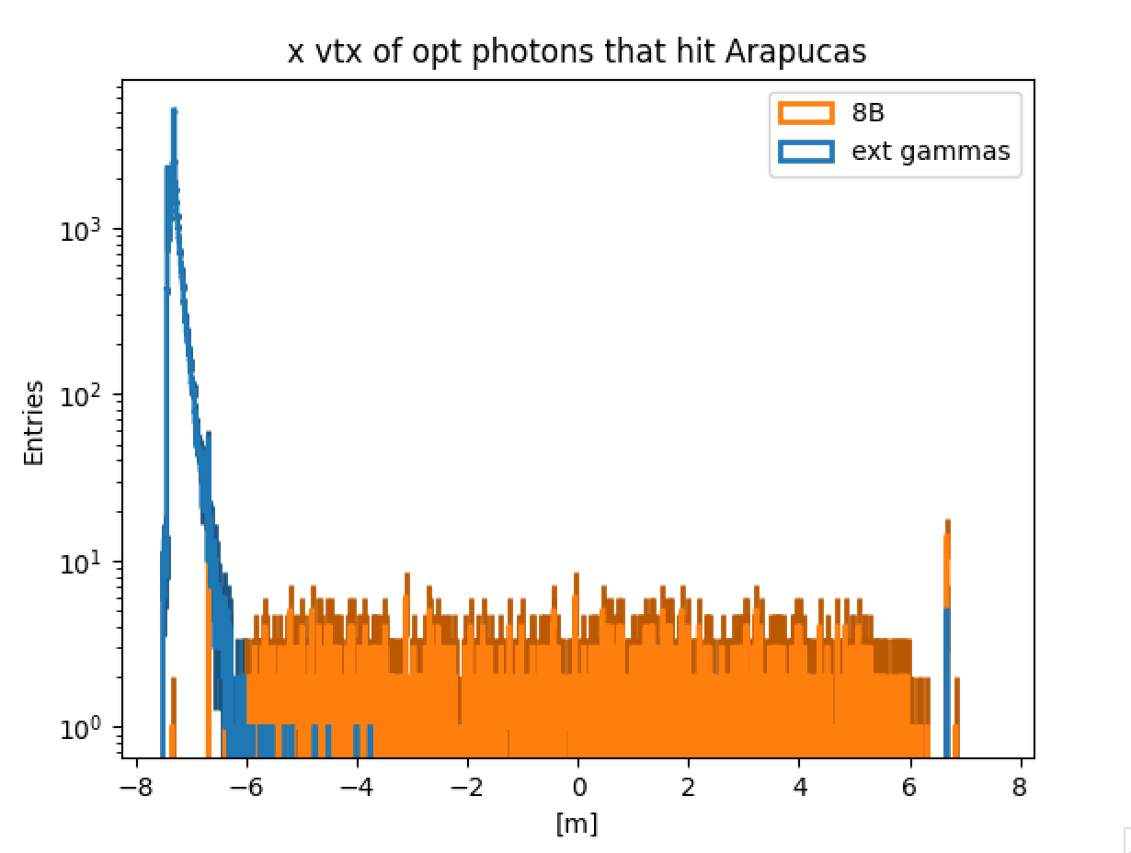
x (horiz) optical photon origin
This one is correct! So, there may be a bug – and I am counting backside Arapuca hits, which is wrong and can be avoided and which I thought I had avoided.
OTH, some of these photons may be hitting Arapucas on other side and properly being counted.
Stay tuned.

Slide 11
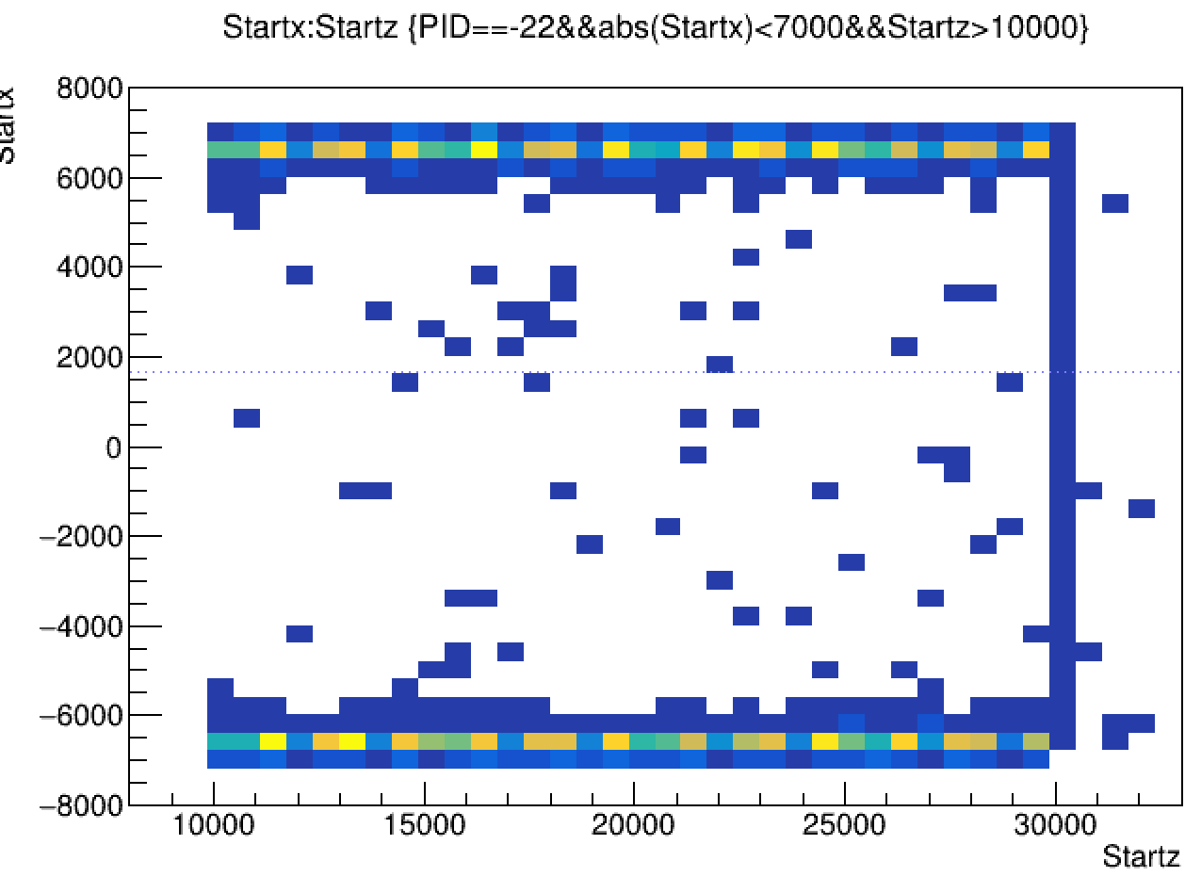
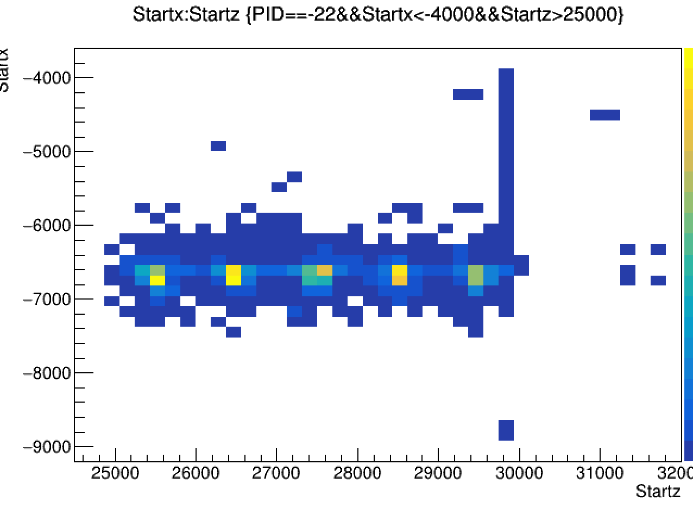
vertical bar events
x,z point of origin of optical photons
rhs zoomed
further zoomed

Slide 12
FRP vertical bars
Fiber Reinforced Poly
I find a SCDMS assay in radiopurity.org of
CFRP
This is not what BNL is proposing to use, but for now
Use: .8, 2.93, 8.21 mBq/kg: U, Th, K
I suspect this is too low
For now use the same Eγ spectrum as for cavern γs, lhs pg 8
And scale according to the sum
11.9 mBq/kg

Slide 13
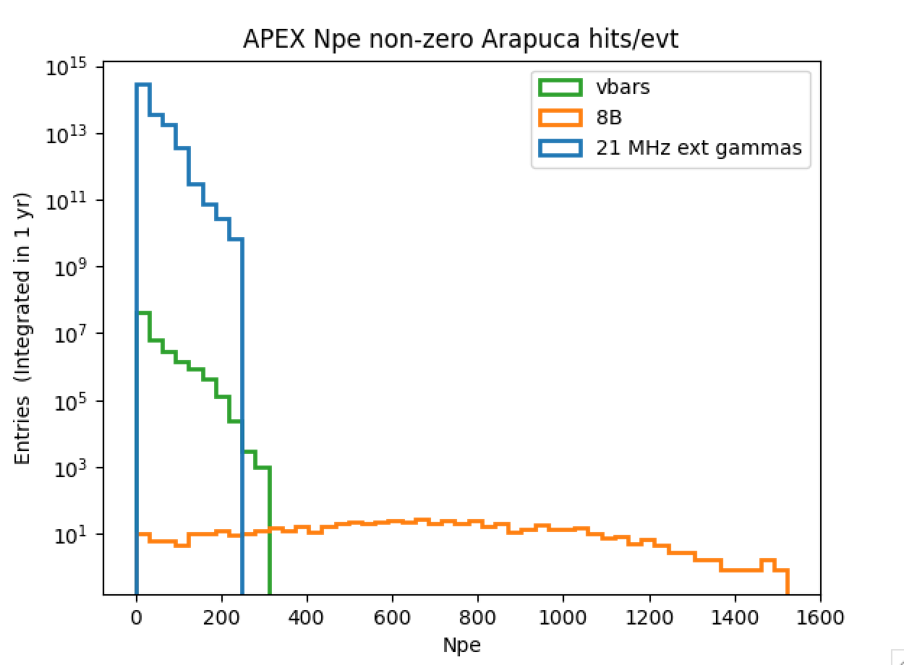
Npe
Impose a 3% pde
From slide 5 and ²⁰⁸Th line this looks like about 3 MeV

Slide 14
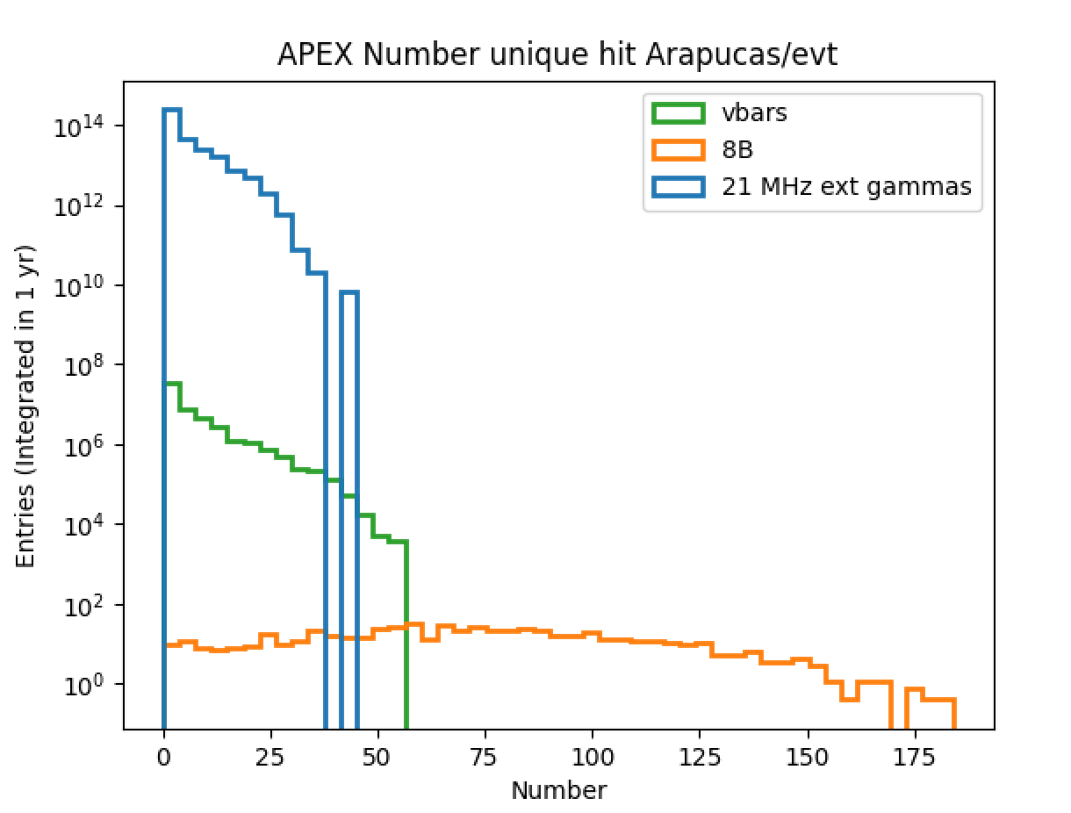
Nhit_{Arapucas}

Slide 15
Subsequent work
I would like to add neutrons
Will produce capture gammas in LAr at ~6 MeV
The cavern neutron rate will be 3-4 orders of magnitude reduced if we can put in water shielding outside the cryostat
Or use borated foam in cryostat walls, e.g.
This will also benefit the cavern gamma rate I showed today
Cold cryostat wall neutrons can not be shielded.
Clearly, the γs shown here need better statistics
Since the rate is very high the falling edge needs to be understood all the way down where it crosses into signal
These rates would also be reduced by water shielding outside
Are the CRPs in and do they have correct reflectivity?

Slide 16
Eventually: E_{res}
Getting the Energy resolution in our standalone simulation(s) will take work
We need to add event-by-event the charge and light signals
Unlike in LArSoft there is not readily an e- drift model and wire/CRP signal simulation
Nor the Nq and Npe reconstructions
Happy to discuss how we can get there.
Or when it’s time to go back to LArSoft for these studies
Or whatever the new framework is!

