Slide 1
Advancing Targetry R&D for
The US Muon Collider
Katsuya Yonehara
TSD Topical Meeting
3/21/2024

Slide 2
Begin of the story: Why Muon Collider?

Slide 3
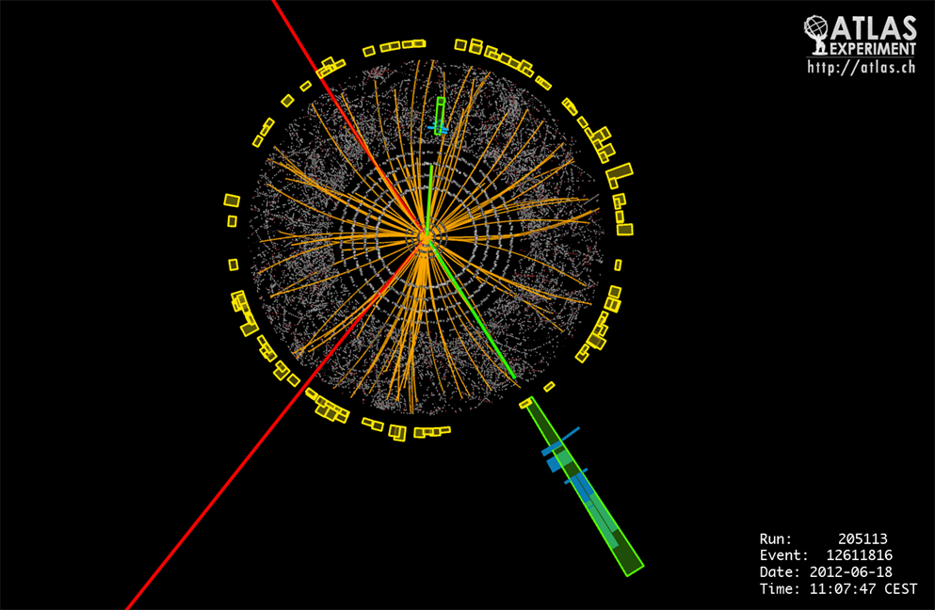
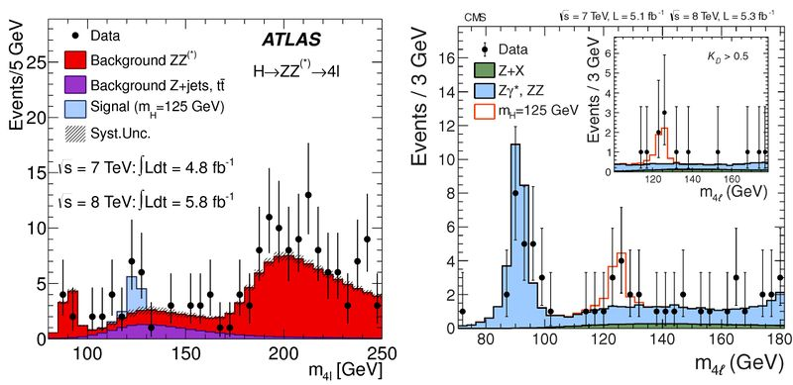
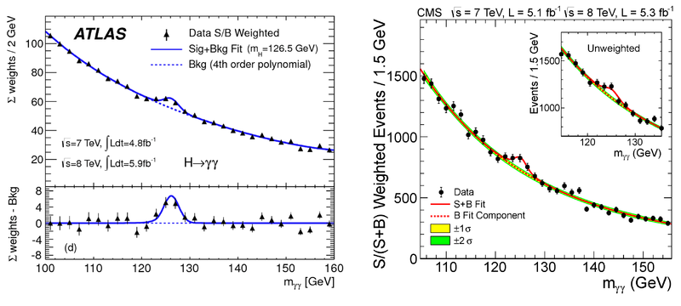
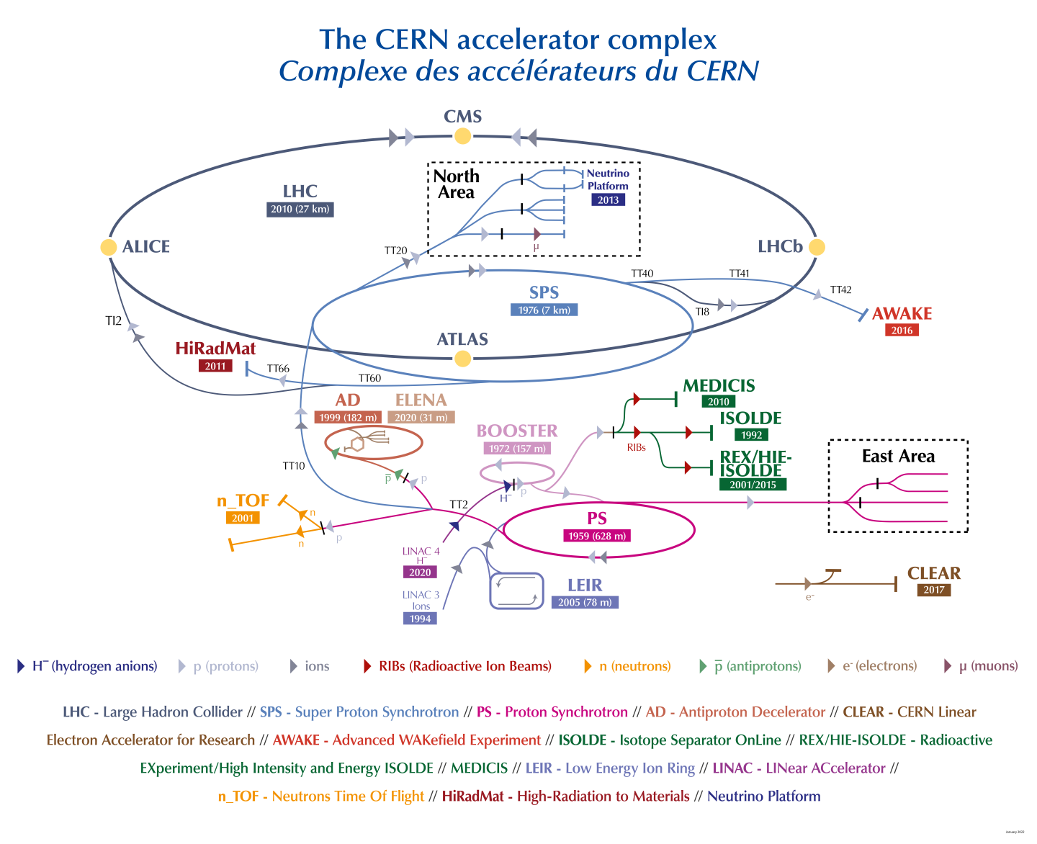
Discovery of Higgs boson!
Higgs boson was discovered in 2012 at CERN
LHC is 14 TeV COM p-p collider
Event plot shows $H→4l$
Bottom histogram plots show the event rate of $H→2γ$

Slide 4
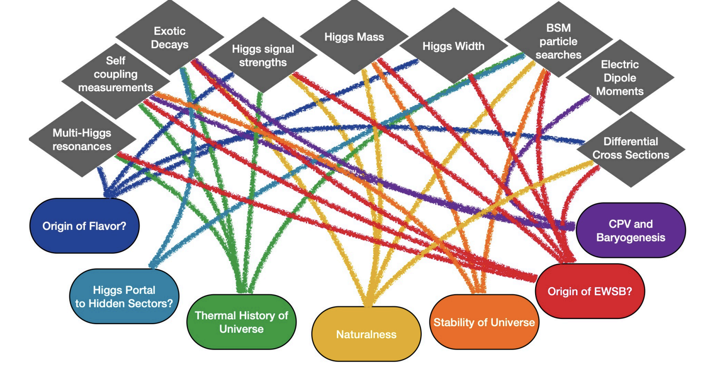
What we know and what we don’t know about H?
The Standard Model predicts the existing of Higgs boson which provides a mass to elementary particles with the Higgs mechanism
Higgs boson has been investigated
Observed Higgs character is similar as the SM prediction
Higgs mass is measured $m_{H}=125.11±0.11 GeV$
Still several questions
How top quark ($m_{H}=172.76±0.3 GeV$) has heavier mass than Higgs?
What is the origin of neutrino mass?
Higgs for theorists
Need more Higgs to investigate its property

Slide 5
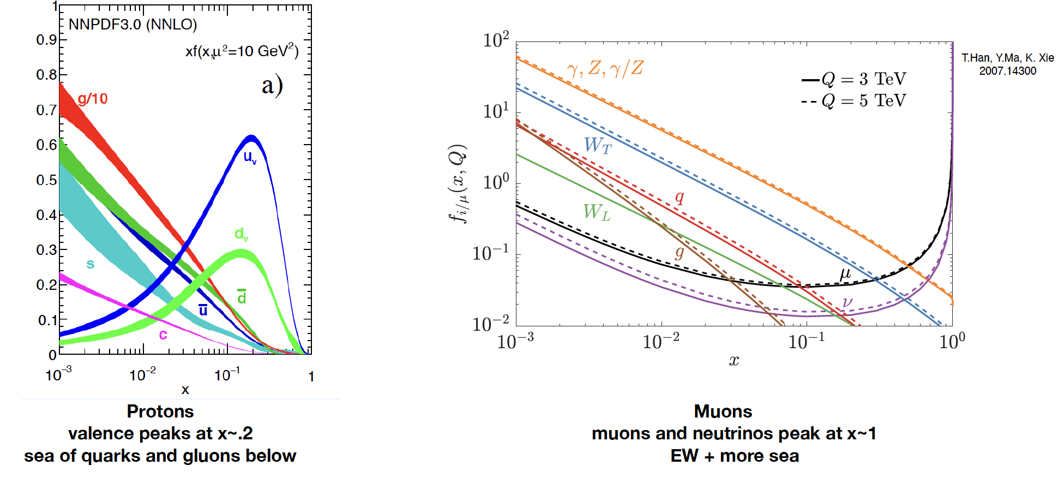
Muon Collider has potential to the Higgs factory
$μμ→nX$: $X$ can be Higgs, or new discovery particle
Muons are coated with vector bosons, which are suddenly stripped by collisions, and creates multiple Higgs (Vector boson fusion): This is the analogy of synchrotron light emission from electrons

Slide 6
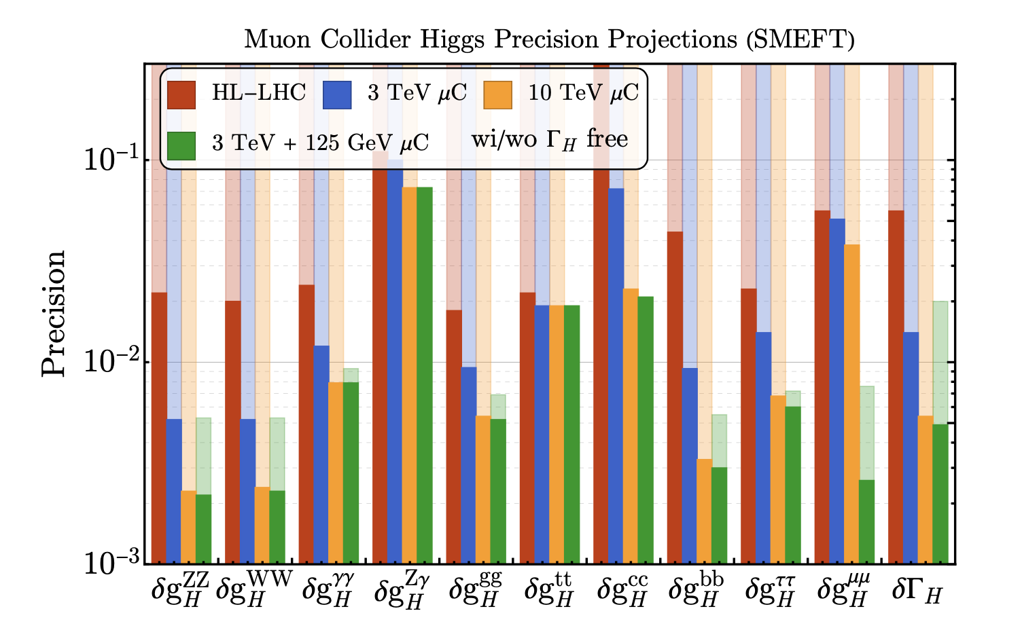
Muon Collider has potential to the Higgs factory
$μμ$ collision event is typically clean by comparing a hadronic collision event
High Luminosity LHC (HL-LHC) will provide $3 {ab}^{−1}$
X-section of $qq→H$ is $\sim 50 pb$

Slide 7
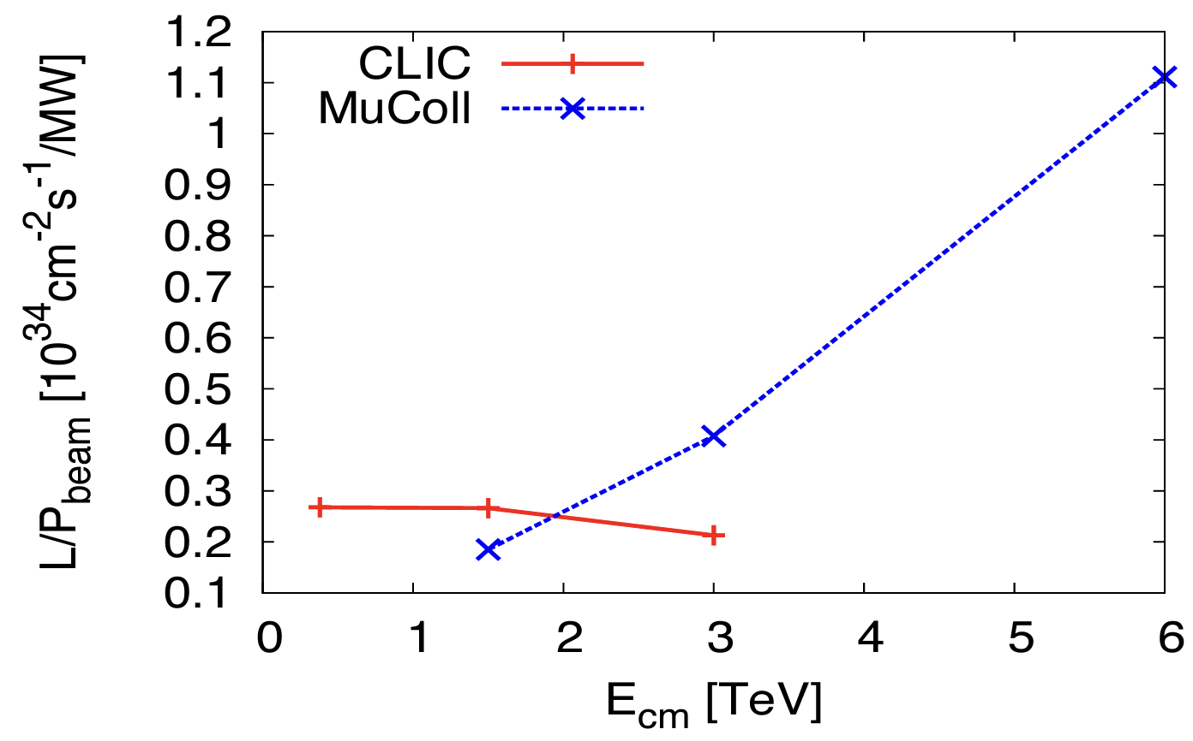
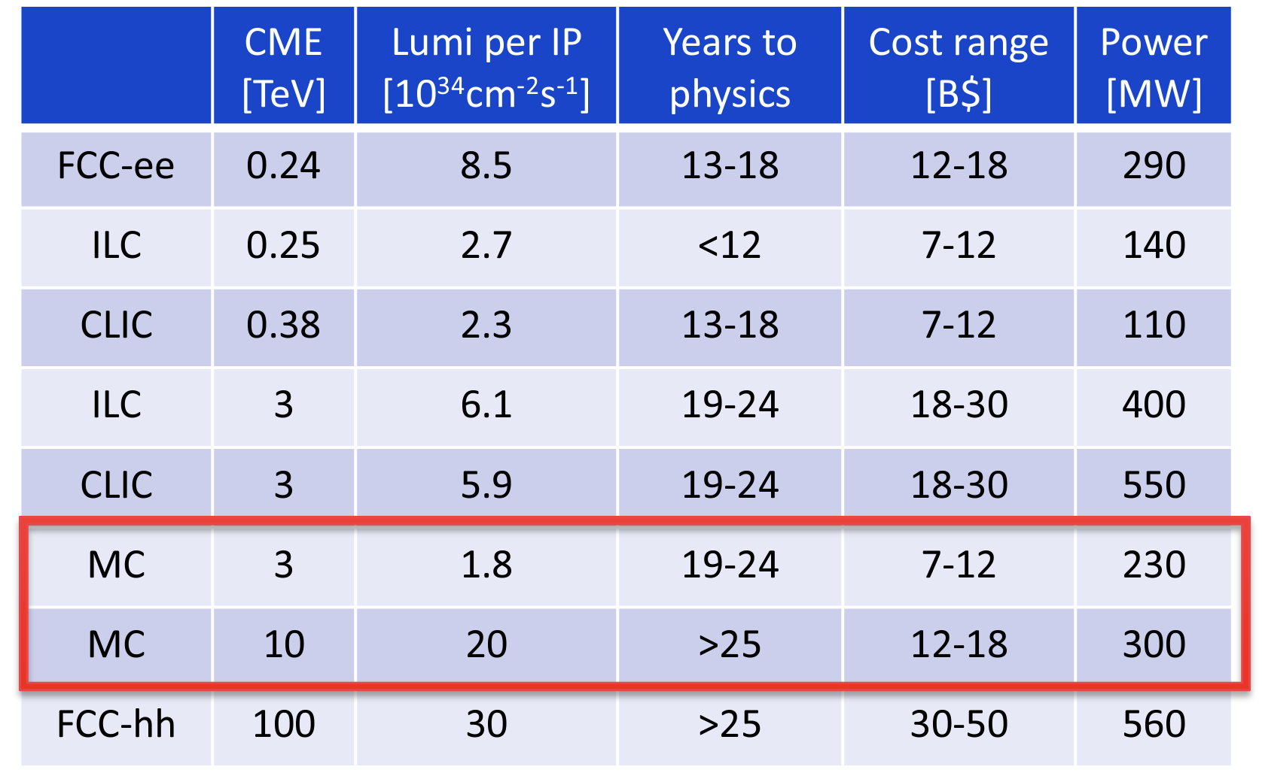
Muon Collider is energy efficient
Efficiency becomes better at higher COM energy in case of muon collider
(Very) preliminary cost estimation for various collider projects

Slide 8
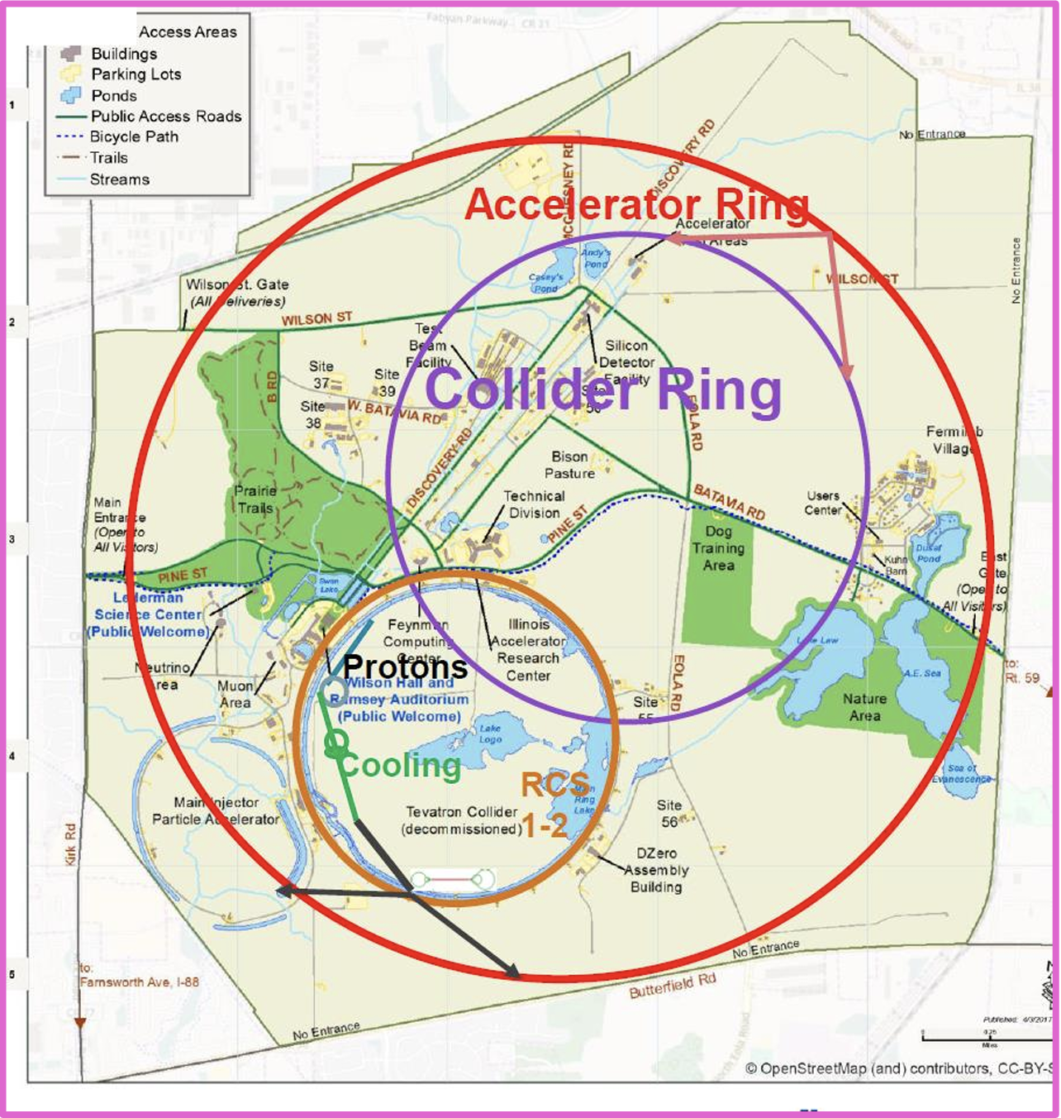
Muon Collider at Fermilab Site
Layout shows a 10 TeV COM muon collider inside Fermilab campus
Totally three RCS rings needed
Two RCS rings is in one tunnel

Slide 9
Challenge of muon acceleration
Muon is tertiary particle
$p+N→π→μ+ν$
Dominant phase space of muons, $p=100\sim 400 MeV/c$
Muon has a finite lifetime, $t=2.2γ$ μs
Need rapid acceleration to reach TeV scale
Pions have a large angular momentum, $p_{t}<300 MeV/c$, thus muons
Need to reduce their phase spaces by, ${10}^{6}\sim {10}^{7}$ for producing desired collider luminosity, $ℒ={10}^{34}\sim {10}^{35} {cm}^{−2}s^{−1}$
Need muon emittance cooling

Slide 10
Layout of muon accelerator complex for colliders
The US physics community had Muon Accelerator Program (MAP) in 2010-2016
Targetry (cover in this talk)
MAP baseline design (based on simulation study)
Proton driver: 10¹⁴-10¹⁵ protons within 1-3 ns bunch length
Front end: π/μ capture section (μ/p efficiency 10-15 % for each sign)
MW-Class Target: Interface between proton driver and Front-end

Slide 11
Characteristics of Proton beam parameter at intense beam facility
 | Neutron spallation source (ESS, SNS, CSNS) | Accelerator Neutrino beam (T2K, CNGS, NuMI, SBN, LBNF) | Muon collider (MAP, IMCC design)
Proton beam energy | Low (1-3 GeV) | Wide range (8-400 GeV) | Medium (5-20 GeV)
Proton beam bunch length | Short (105-700 ns) | Long (4.2-10.5 μs) | Extremely short (1-3 ns)
Proton beam intensity per bunch | Medium (1e13-1.5e14) | Medium (4.8e13-3.2e14) | High (1e14-1e15)
Repetition rate | High (14-60 Hz) | Low (0.4-2 Hz) | Medium (5-15 Hz)
Target material | Liq. Hg, W, Liq. Li etc | graphite | ?
Is there any target capable of withstanding such an exceptionally high thermal shock?

Slide 12
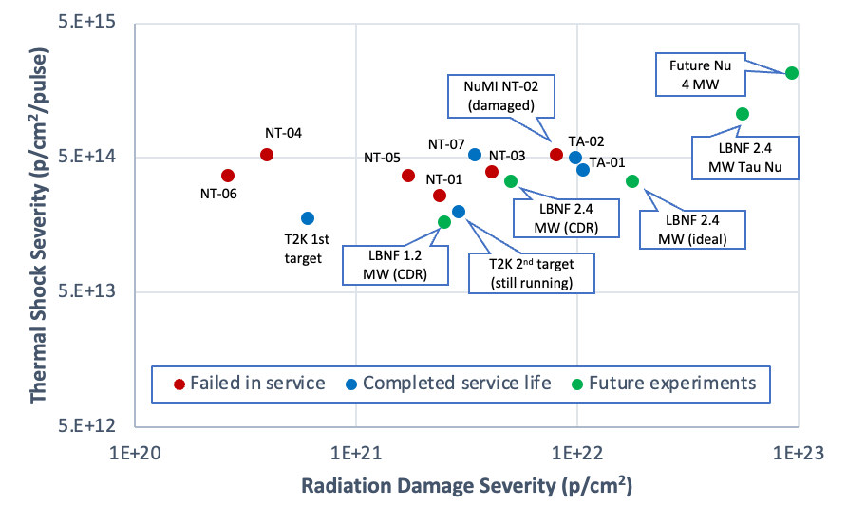
Thermal shock is a key parameter for survivability of High-Power Target
Neutrino HPT R&D Materials Exploratory Map (Graphite)
Boundary represents operational threshold for thermal shock on graphite targets

Slide 13
Past Muon Collider Target Study

Slide 14
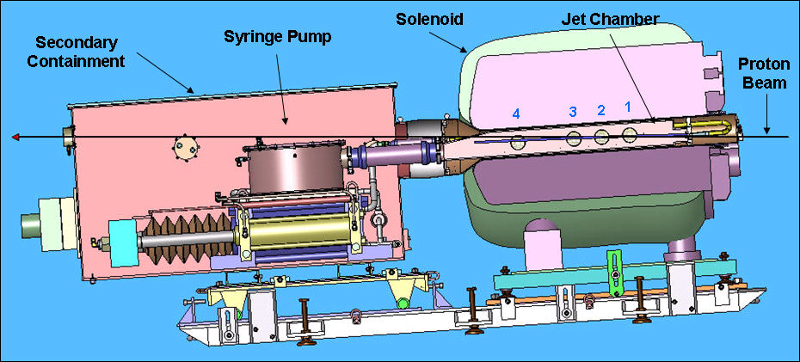
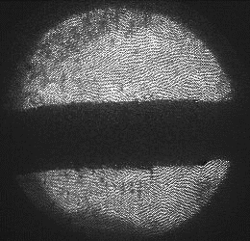
Demonstrate liquid (Hg) target
Layout of MERcury Intense Target (MERIT)
1 cm
Proof-of-principle demonstration of a free Hg jet target for a 4-MW proton beam, contained in a 15-T solenoid
MERIT was carried out in 2007 by using CERN nTOF11 beam line
14 & 24 GeV protons up to 16 bunches/pulse, up to 3.5e12 protons/bunch with beam angle 67 mrad w.r.t. magnet
360 beam pulses in total
3/21/24
Target R&D for Muon Collider, Yonehara

Slide 15
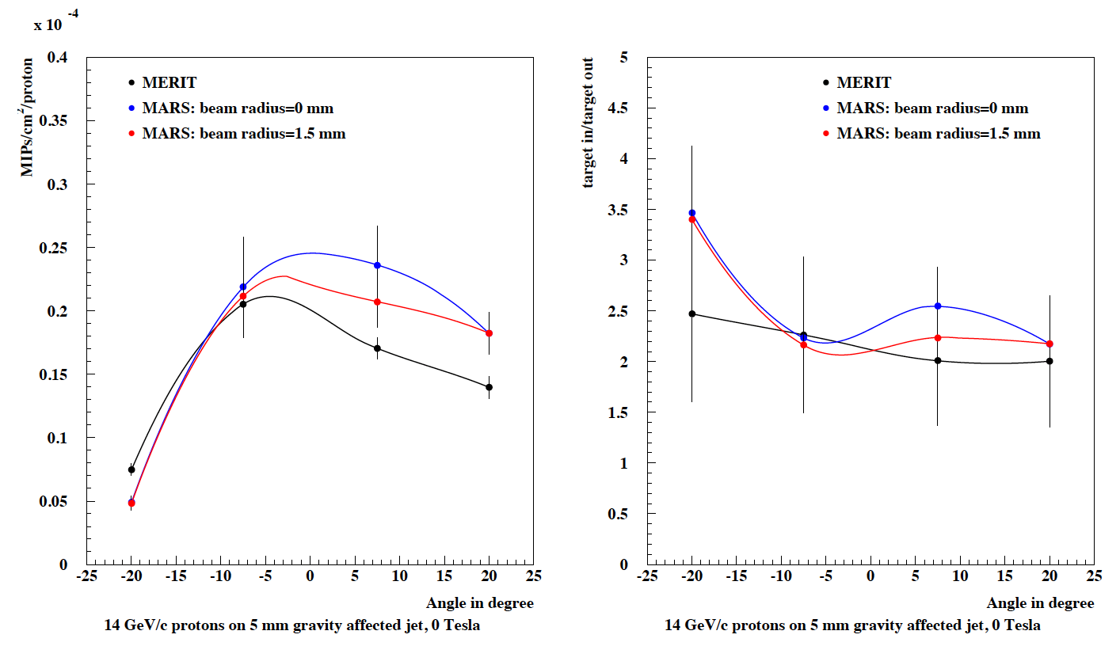
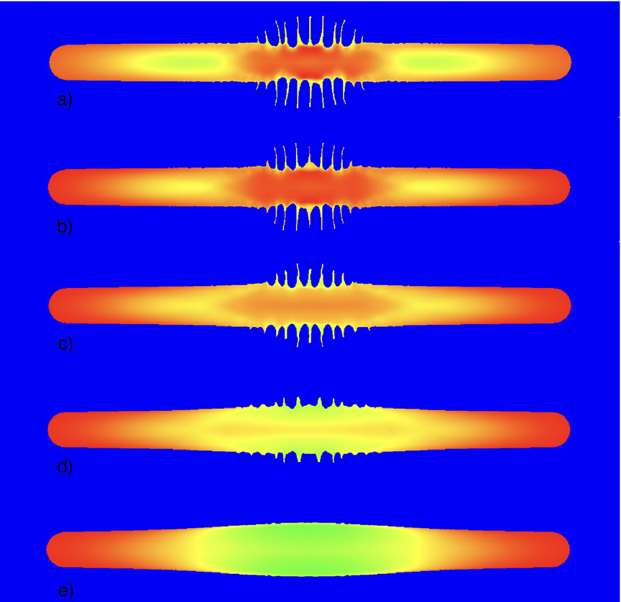
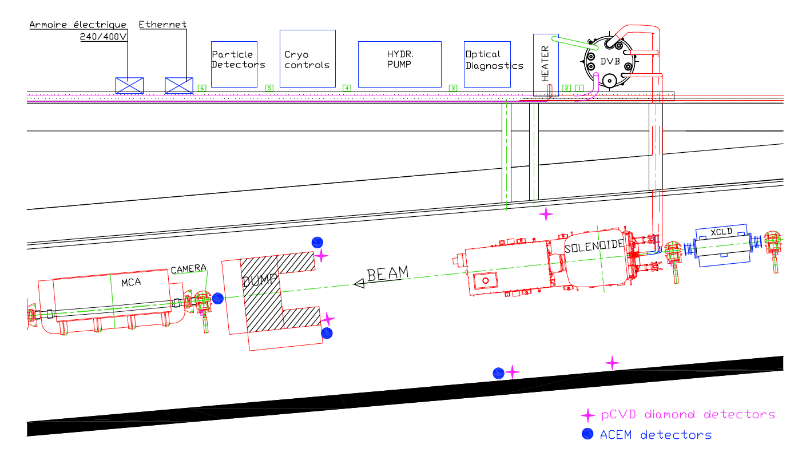
Jet splash in Magnet and Secondary yield measurement
0 Tesla
2 Tesla
4 Tesla
6 Tesla
10 Tesla
Plots show the observed integrated signal in pCVD detectors (position of detectors are shown a magenta cross mark below)
Plot shows side view of Hg jet profile with proton beam impact in a solenoidal field (simulation)

Slide 16
Summary of MERIT
Jet surface instability is significantly reduced at higher magnetic field strength
Jet disruption length is less than length of beam overlap with the jet
There is no jet disruption for pulses of less than 1 Tp (or higher in higher magnetic field)
Bunches more than 5 μs apart act separately in causing disruption
While visible disruption begins 50 μs after a proton pulse, secondary particle production is the same for pulses that follow at several times this value
A liquid (or granular) target is an attractive method for intense muon sources
Are there any alternative materials besides mercury?

Slide 17
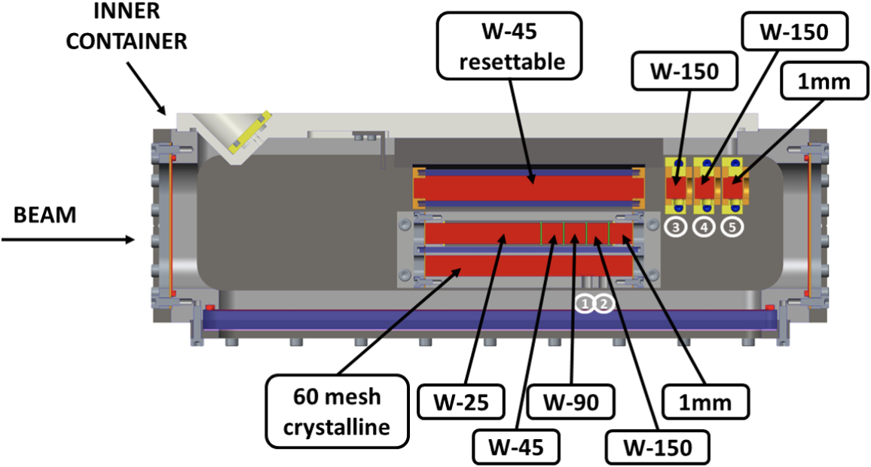
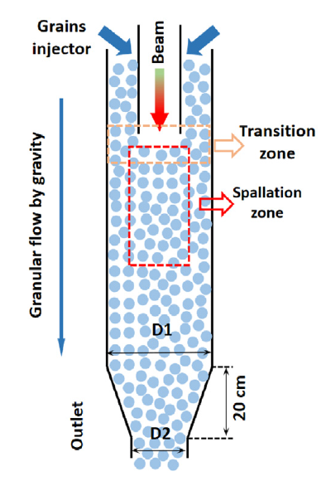
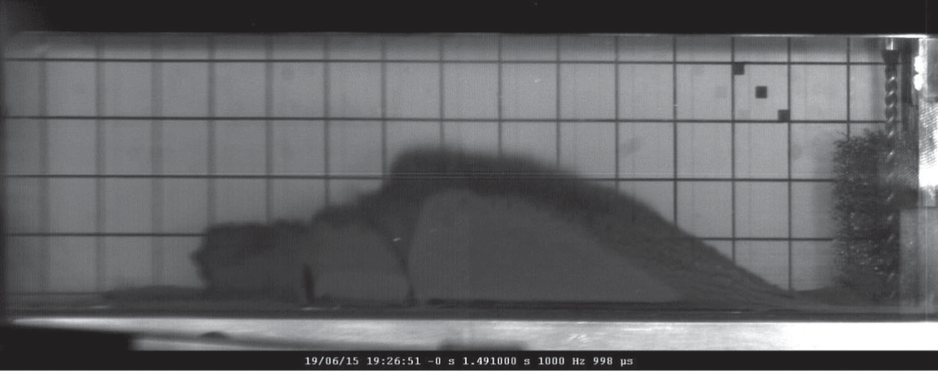
Granular Tungsten
Potential candidate for High Power Target
Mitigate thermal stress & Maintain fresh material
No cavitation issue & no beam window (C-ADS scheme)
Comprehensive studies led by STFC, CERN, and C-ADS
Layout of granular W beam test at HiRadMat
C. Caretta et al.
Phys. Rev. AB 21, 033401 (2018)
T. Davenne et al.
Phys. Rev. AB 21, 073002 (2018)
Powder lifted by beam
due to electrostatic or electromagnetic force
Neutron source proposed by C-ADS
W-25
W-45
W-90
W-150
1 mm
Han-Jie Cai et al.
Nucl. Eng. Tech. 54 (2022) 2650

Slide 18
Strategic plan for Future MuC Target R&D

Slide 19
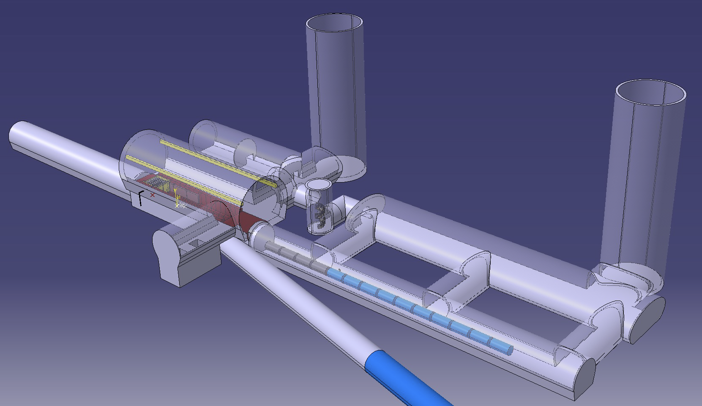
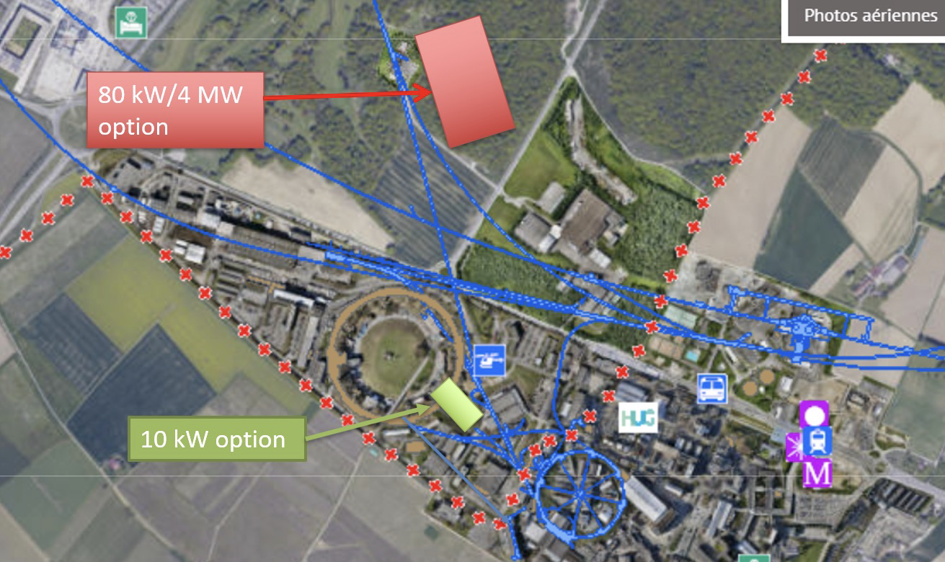
International Muon Collider Collaboration (IMCC)
CERN has head(?) started the feasibility study of muon collider since 2021
They will evaluate the collider design by 2026
They will decide either FCC-ee, CLIC or muon collider
If muon collider is selected, the demonstrator will start constructing around 2028
They need a target for the demonstrator
Layout of demonstrator facility
Possible location of demonstrator facility

Slide 20
(Rough) Timeline of the US MuC activity
P5 suggests to develop the feasibility of MuC in the next 5-7 years
They encourage to design the demonstrator
The demo target will be designed for low power beam, if the technology is extendable to multi-MW
So far, we have no resource for MuC
No money in FY24
Expect some support in FY25, but we do not know…
What I propose
Form the MuC target R&D working group
Simulation study
Performance test

Slide 21
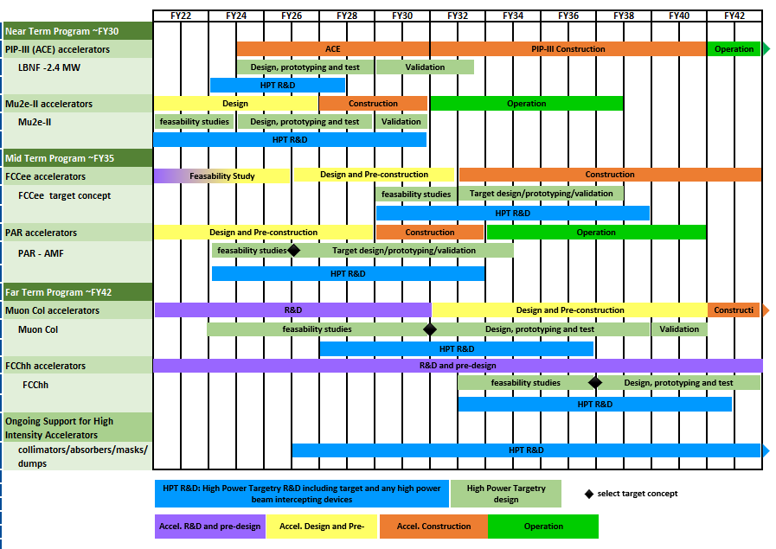
DOE suggests to make a roadmap for HPT R&D
HPT R&D is aligned with timeline of HEP Accelerators
NOTE:
Each project set a specific target parameter, thus
each target has a specific challenge and specific R&D.
Current HPT R&D plan works on a generic item.
We should identify a specific issue on MC.
HEP HPT R&D Workshop
April 11-12 2023

Slide 22
R a D I A T E Collaboration
Radiation Damage In Accelerator Target Environments
RaDIATE collaboration created in 2012, with Fermilab as the leading institution. The collaboration has grown up to 20 institutions over the years.
First MoU was signed with 5 institutions 10 years ago!
Objective:
Harness existing expertise in nuclear materials and accelerator targets
Generate new and useful materials data for application within the accelerator and fission/fusion communities
Activities include:
Analysis of materials taken from existing beamline as well as new irradiations of candidate target materials at low and high energy beam facilities
In-beam thermal shock experiments
Contact:
Frederique Pellemoine, fpellemo@fnal.gov
Web: radiate.fnal.gov
Join RaDIATE
Notes:
To address these material challenges, the HPT community formed the RaDIATE collaboration in 2012, with Fermilab as the leading institution. The goal was to bring experts from the accelerator and fission/fusion communities together to generate new data for accelerator materials. The collaboration has grown up to 14 institutions over the years.

Slide 23
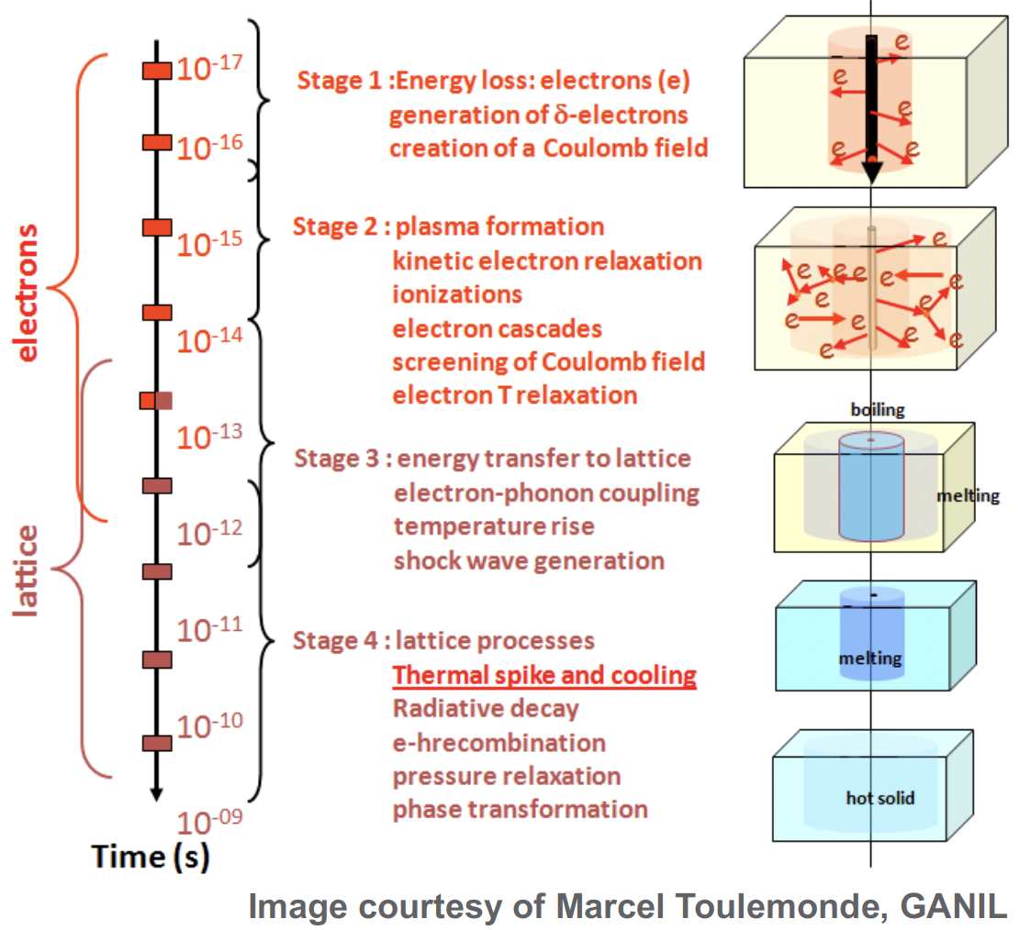
Specific subject on the MC Target R&D
Utilize High Performance Computing Facility
Build AI to enhance target performance
Look into the MC target system from multiple view-point
Develop simulation to study sub-pico second evolution of defect
Apply ML to learn discrepancy Models from Experimental Data
Develop pico-sec radiation damage sensor (LDRD)
Collaborate with UW Madison and SNS to enhance computing radiation material science

Slide 24
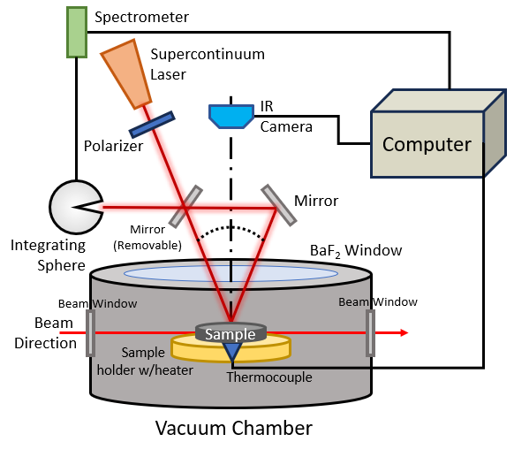
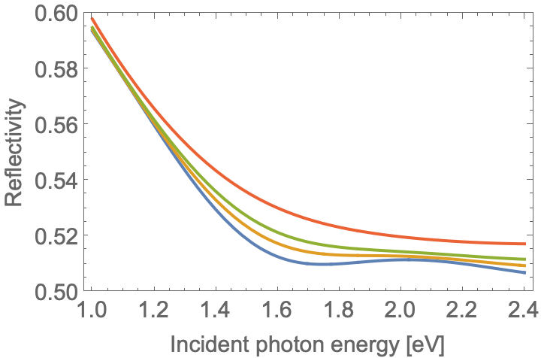
LDRD: Fast non-contact radiation damage sensor
Observe time evolved reflectivity of material using probe light
Reflectivity represents a material structure
Proposed test stand
Predicted reflectivity change
(typical metal)

Slide 25
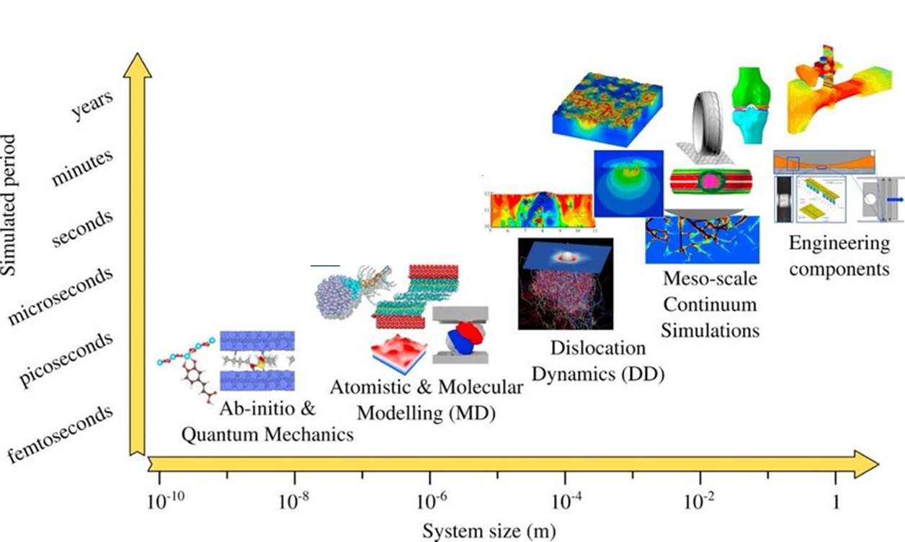
Types of simulations: Time vs. system size
Macroscopic phenomena
Microscopic phenomena
Goel, Saurav, et al. Materials Today Chemistry 18 (2020): 100356
Arora, Gaurav, et al." Materialia 15 (2021): 100974
Density functional theory (DFT): Defect formation energies, band gap, etc.
Apply this technique to design HEA
Molecular dynamics (MD): Radiation damage such as void formation, evolution of system with respect to temperature, etc.
DFT is capable to simulate defect annihilation, clustering and mobility in sub-pico-sec time step
Notes:
David senor PNNL
Give example of formation energy of defect.

Slide 26
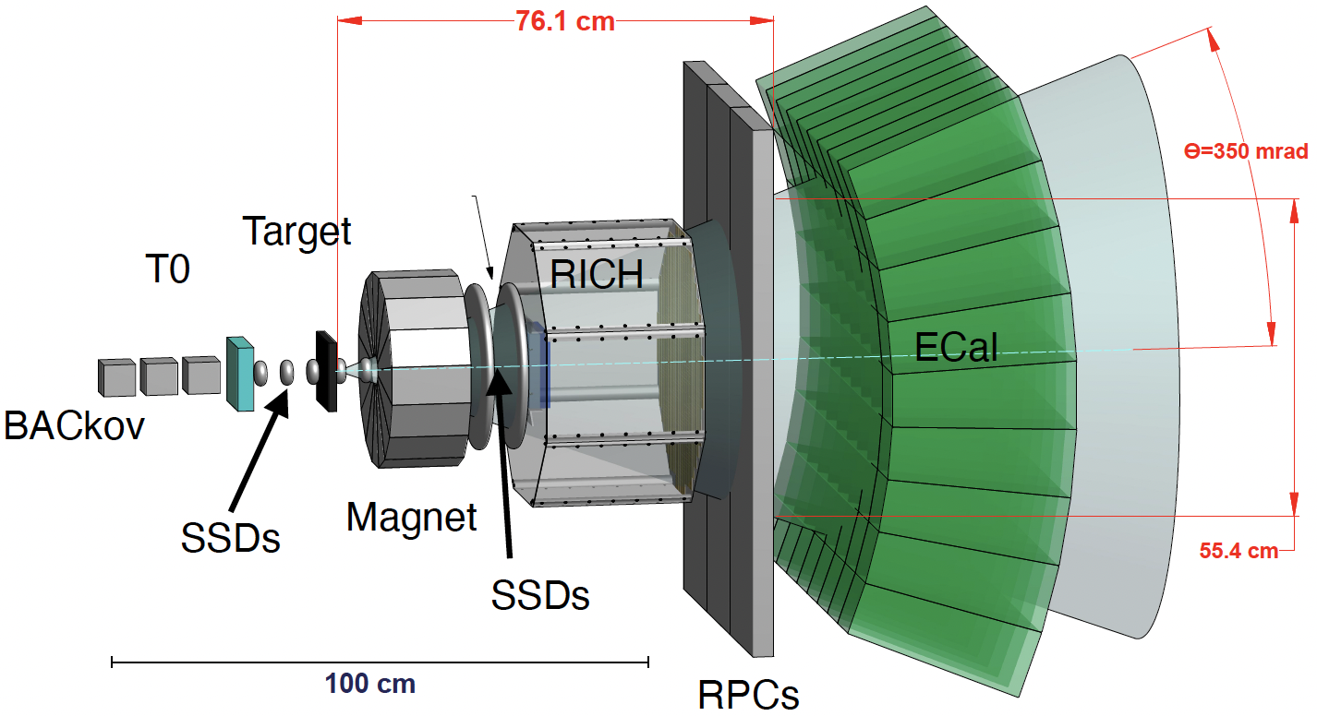
Pion yield measurement at Fermilab
Study beam interactions in beam intercepting devices
Because the EMPHATIC spectrometer is compact, it realizes
Large angular acceptance
Small dead space
Fine position detection
Precise angular distribution measurement
Pico sec fast counter
Precise energy measurement
US-Japan collaboration
FY25 budget requested
EMPHATIC spectrometer

Slide 27
Enhance MuC target performance
Manage mechanical stress within specified tolerances
Maximize pion yield with preferred energy band
Find most effective configuration of low Z (to reduce edep and pion recapture) and high Z materials (to increase and localize pion yield)
Determine optimal dimensions to satisfy engineering tolerance as well as pion yield
Capture pions & muons
Ideally capture both signs → Solenoid or FODO cell magnet
Transport them into the downstream channel
Remove primary proton beam from muons
Manipulate phase space of pions and muons if needed
Develop AI technology to enhance target performance

Slide 28
Propose MuC High Power Targetry R&D

Slide 29
Plan
Forming MC Targetry R&D working group
Scientist + Target engineer + AI scientist
Join RaDIATE collaboration
Utilize their expertise and facility to develop the MC target technology (next slide shows the current world RaDIATE map)
Gain resources
FY25 LDRD approved to make an ultra-high-speed non-contact radiation damage sensor for future HPT system
FY25 US-Japan collaboration requested
Anticipate more resources from the GARD HPT
Budget for utilizing Beam Irradiation Facility & PIE Facility
Longer term
Add more collaborators
Beam irradiation tests

