Slide 1
DAPHNE V3 Update
Jamieson Olsen, Miguelangel Marchan, Tom Deline, Jacques Ntahoturi, Terri Shaw, Dave Christian
29 January 2024

Slide 2
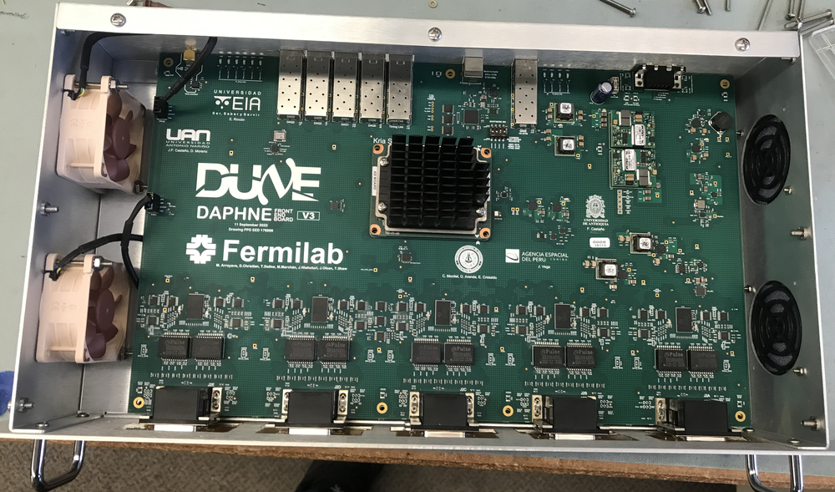

Slide 3
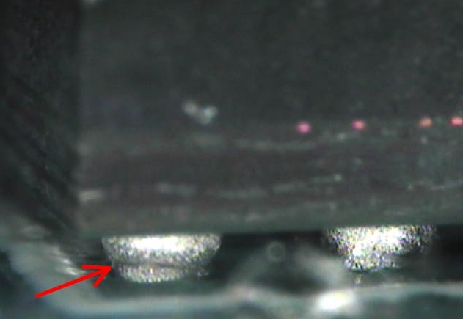
Prototype Run Status
10 boards made in one run, no first articles.
ATI detected solder ball reflow issues on all boards
  Looks like “head in pillow” defect
ATI sent two boards to us for testing
We found opens on Kria connectors
The 2 boards were sent back to ATI for reflow
The 2 boards sent back to us for retest
Looks good, no opens are observed
Give ATI go ahead for reflowing remaining 8 boards.
8 boards received are here, tested good.

Slide 4
Firmware Status 1
Kria is talking to all board level components/peripherals
SPI master is working
  AFE chips and multiple daisy-chained DACs share an SPI bus
  Current monitor (MUX + PGA + ADC)
I2C master is working
  Communication to Clock Generator, Temp sensors, and two 8 channel ADCs
  Nice to have but not essential: Multiplexor + SFP modules, Switching Power Supplies (PMBUS)
Timing Endpoint is working
  Testing at FNAL PAB lab

Slide 5
Firmware Status 2
High speed AFE data alignment redesign (in progress)
  Significant redesign due to FPGA architecture changes on Zynq UltraScale+
  AXI Lite bus interface for control/status registers
  Less “automatic” compared to DAPHNE V2 firmware
  Kria processor will handle all calibration functions now
Spy Buffers (in progress)
  Switch to AXI Lite bus interface

Slide 6
Firmware Status 3
10G Ethernet Sender
  We now have the design from UK/Rutherford FW developers
  Similar to WIB sender design
Streaming Mode Sender
  DAPHNE V2 has 4 channel sender working now
  Update this to 8 channel version, 1024 samples/channel
  Looks like we don’t have the “dense pack” the samples anymore
Self Triggered Mode Sender
  40 channel version is working now with DAPHNE V2
  10G Ethernet Sender will now handle the “merge” functions
  This should simplify the Self Triggered core logic quite a bit

Slide 8
Software Status
Networking is in good shape
  DHCP is the default
  Fiber Gigabit Ethernet interface
TFTP Booting (in process)
  On power up the Kria fetches the OS image and FW image from a server
  Configures automatically
Writing shell scripts and python programs to talk to board components
  Set DACs, configure AFEs, configure clock generator, etc.
  “expert level” tools run from the command line
DAQ interface development in very early stages
  Looking to see how it is done on the WIB…

Slide 9
BACKUP SLIDES

Slide 10
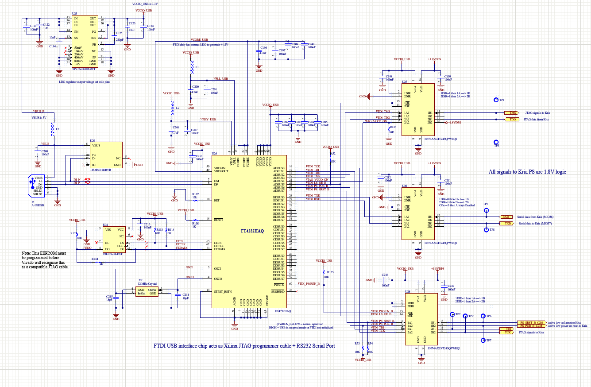
Changes For Next Revision
FTDI USB chip used for JTAG programming + serial console port
  Vivado under Linux has driver issues with the automotive “HA” version part we used
  Miguel did a deep dive into Linux drivers to understand this issue. Not fixable with user space hacking.
  But it works OK under windows
  Future designs should use the “regular” FT4232A device, which is footprint compatible

Slide 11
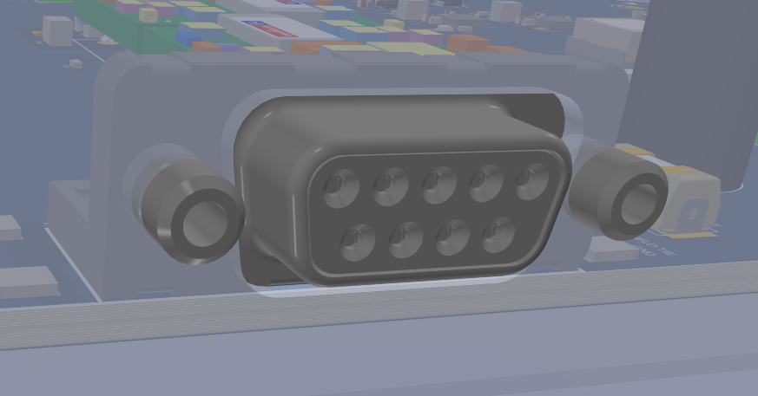
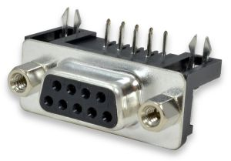
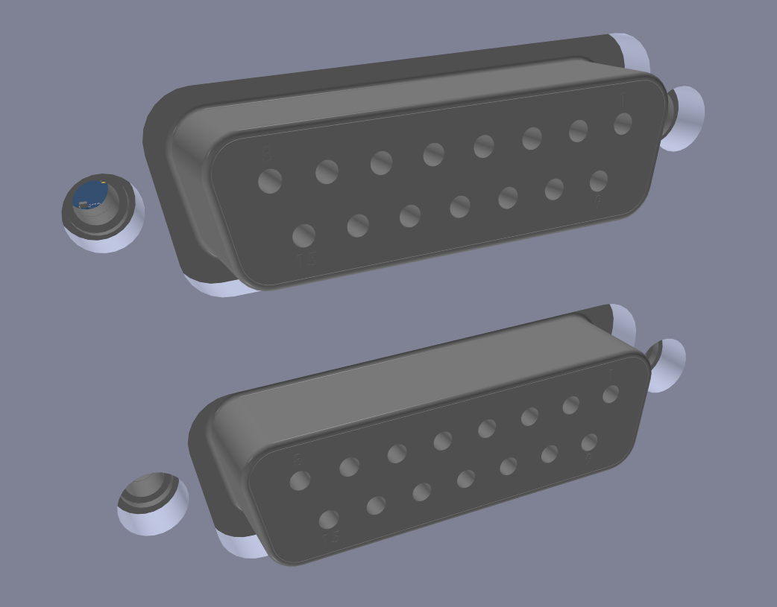
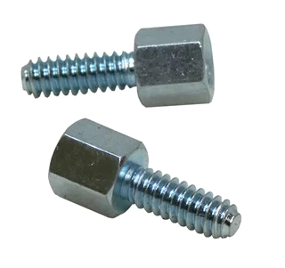
Changes For Next Revision
Rear DB9F power connector
  jack screw is non-removable in the parts we have
  Prevents rear panel assembly
  Switch to different DB9 right angle part with removable jack screws
Front panel double stack DB15F connector
  Low profile jack screws needed

Slide 12
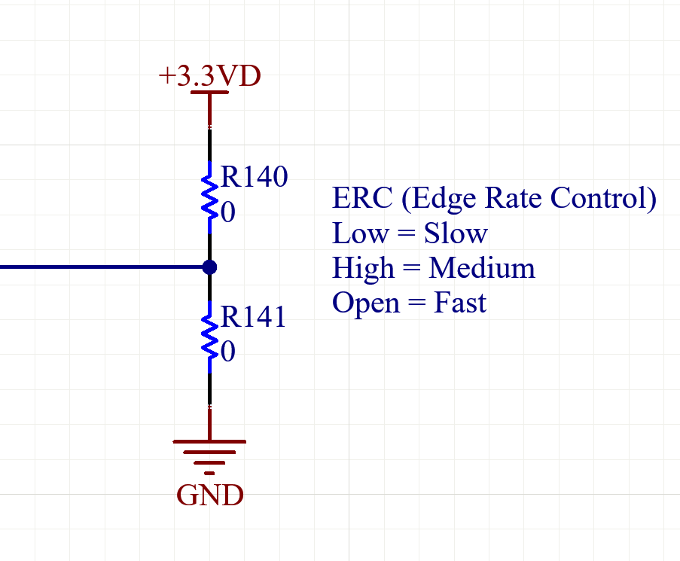
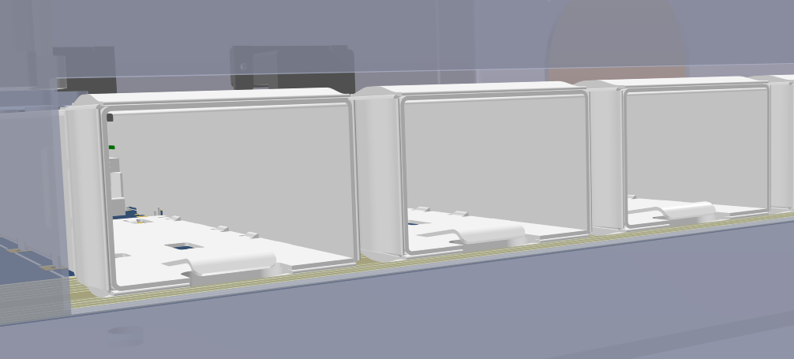
Changes For Next Revision
Isolated power supply enable pin tie to (-) input
  See Jacques slides
Resistor R140 mark as “do not stuff”
  R140 and R141 causing short +3.3VD to GND
Other Grounding options?
  SFP cages are tied to digital ground currently, change this to chassis ground, then tighten up clearance gap on rear panel…
  We’ll learn more once testing begins at CERN this spring…

