Slide 1
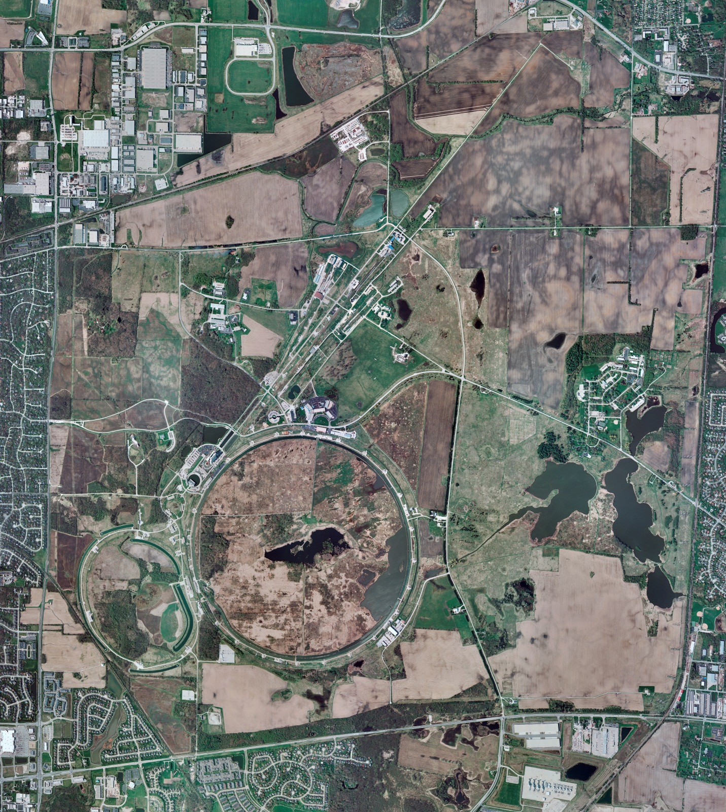
Helium Cryogenics
Status 3/1/2024 J.Makara
CMTF: SCP is shut down completely; temptative bldg. power outage for elec maintenance 3/19-21
CMTS: HECM28 removed; HECM29 install late March
PIP2IT: SSR1 pCM was removed; test stand being modified for SSR2 pCM
North CM stand empty but HB650 installation mid March
MCTF: cryo system is warm with ! Compr running on Purifier
MDB/HTS: at RT
MDB/STC: at RT after SSR2 cavity RF testing done
MDB Magnet: at RT
NML/FAST: Cryo system is shut down and isolated for extended shutdown period
CC1: at RT
CC2: at RT
CM: at RT
IB1: cryo system cold at 5 K and 2 K operations
Muon Campus: at RT with comprs off and system depressurized; LN2 off with LN2 Tank 50 being warmed up
Misc:…

