Slide 1
Project Activities in MSD
Mayling Wong-Squires
AD Operations Friday 9am Meeting
1 March 2024

Slide 2
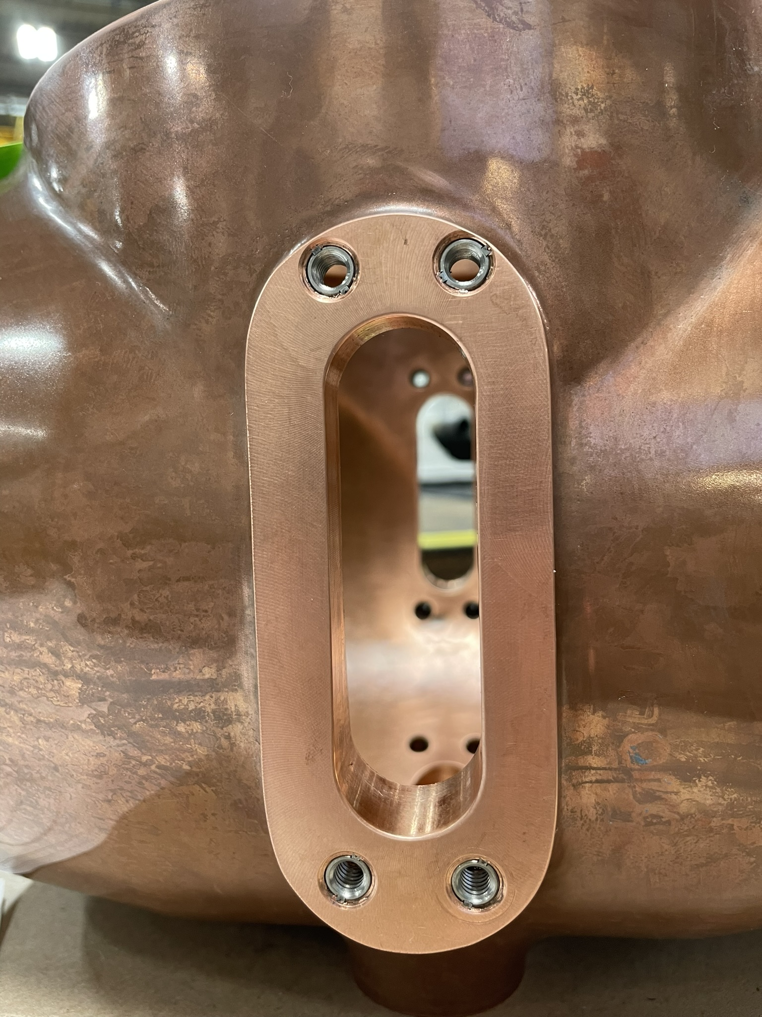
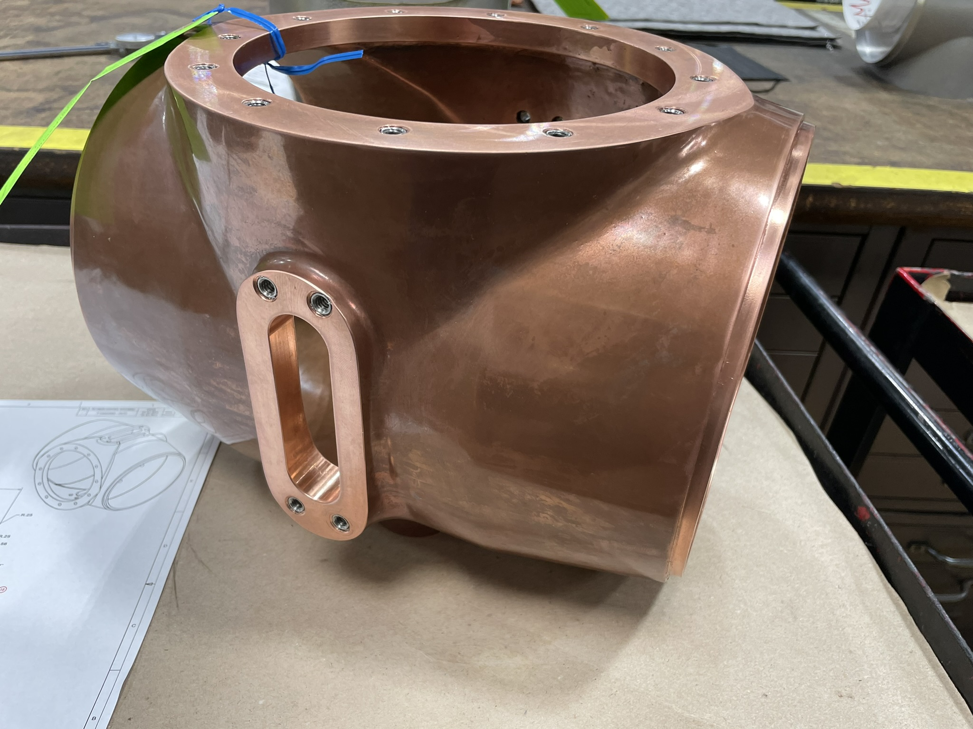
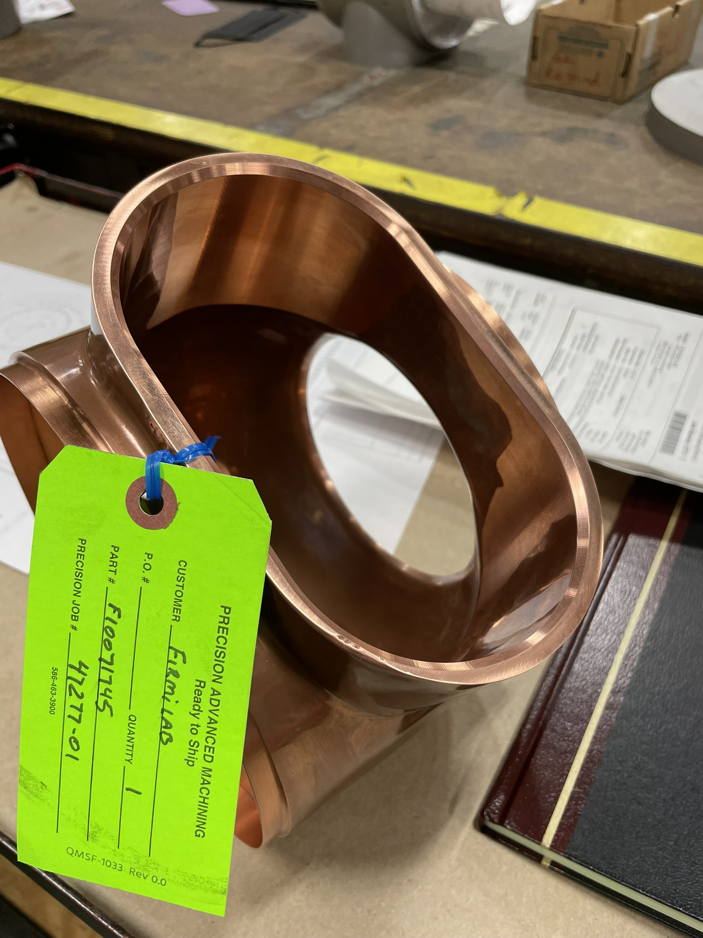
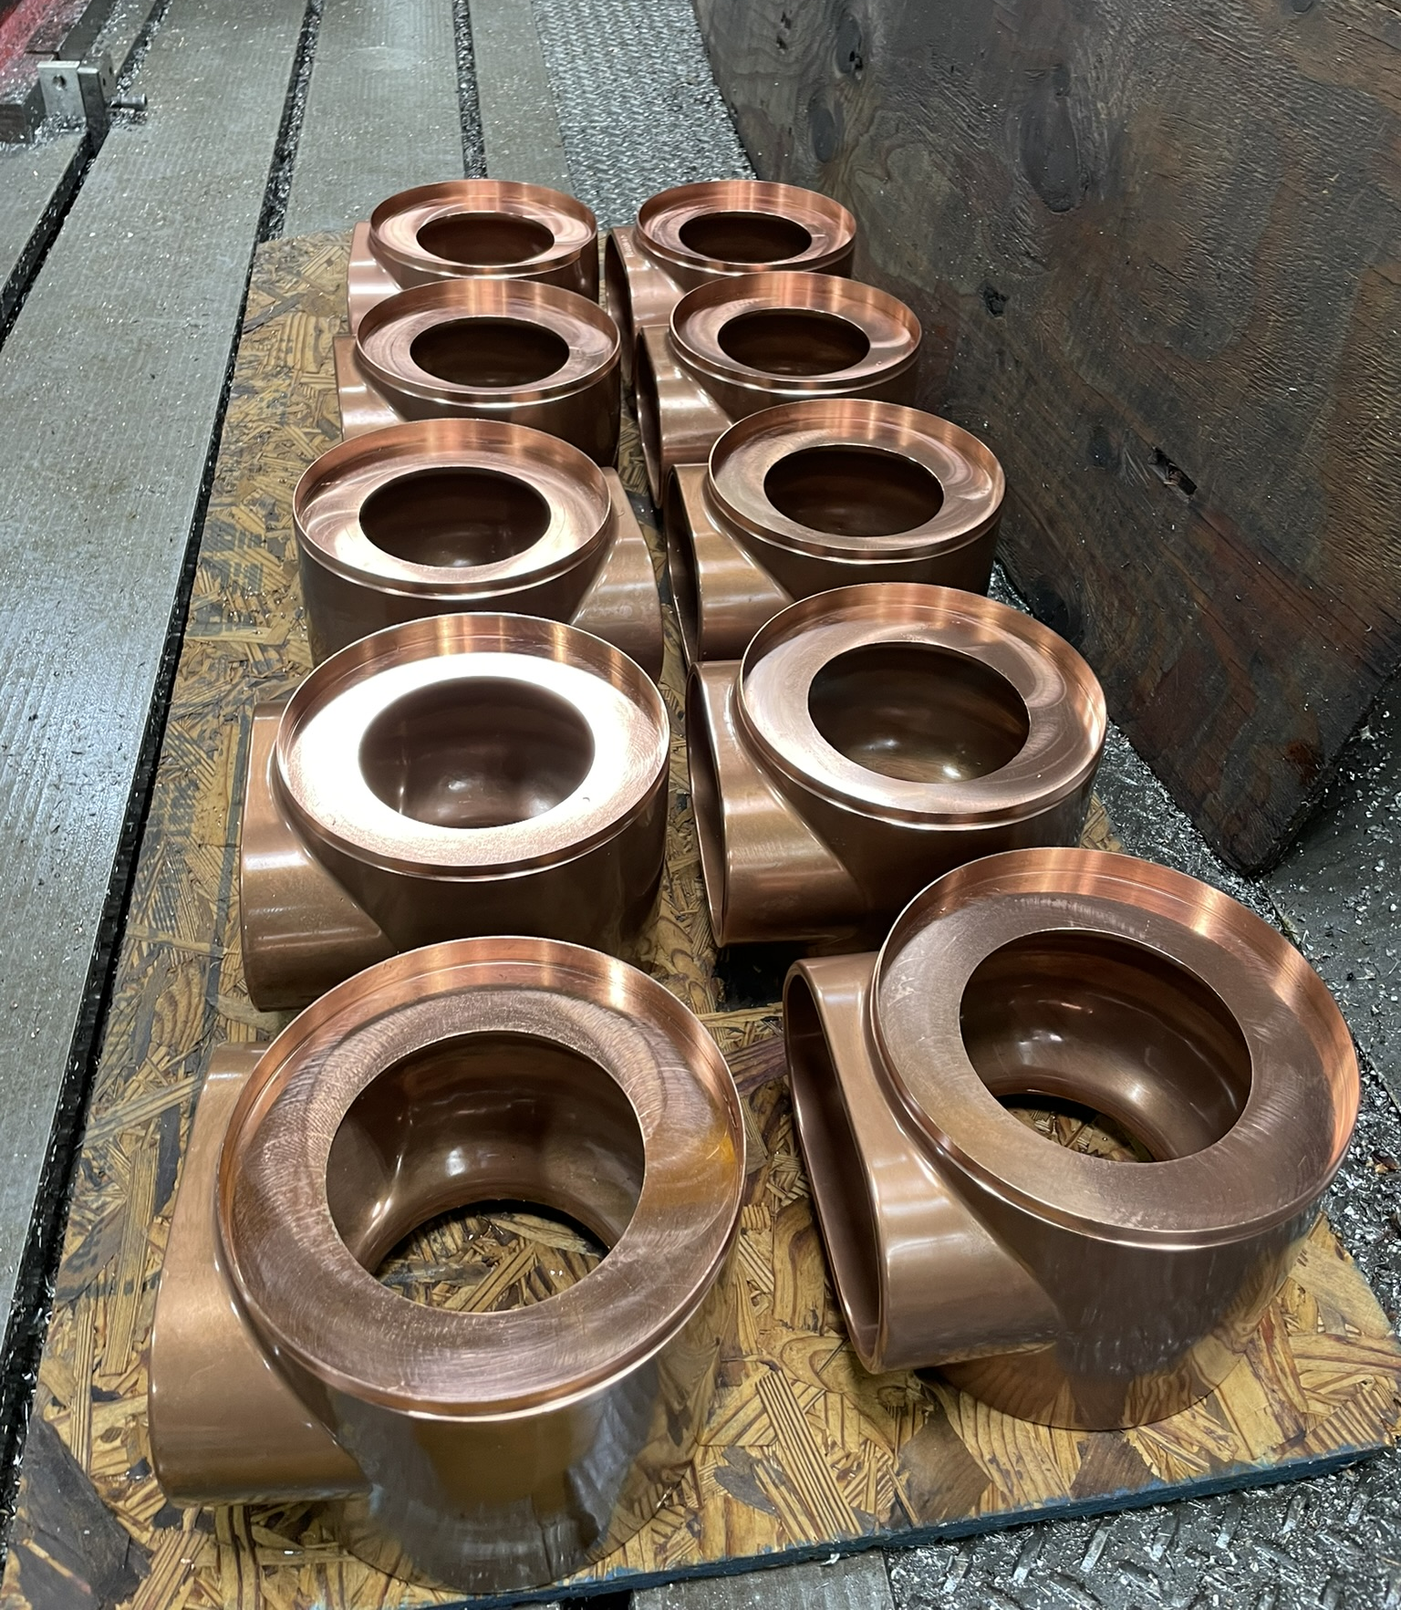
PIP-II – Booster RF Cavity Builds Patrick Minton (lead engineer), Rafal Dlugopolski, Mike Piekarski, Ken Klotz, M. (Rocky) Rauchmiller
Fabrication is beginning on plumbing for girder one.
New components are starting to finally arrive.
Production of new tuner cones has begun with new cone skin being welded in the weld shop onsite.
Bus bar tubing are being prepped for brazing.

Slide 3
Hi-Lumi – LHC – Accelerator Upgrade Project Bob Steinberg (primary engineer), James Williams, Alex Chen
Remaining list of tasks include approved leak testing procedure, receiving and testing remainder of vacuum equipment, overseeing CA02-CA10 tests
Received comments from CERN on initial release of vacuum leak test procedure. Procedure was revised and is currently out for final review.
CA02 leak test was scheduled for January, but due to delays in assembly is now expected mid/late March.
Inventorying and testing of vacuum equipment to take place at NWA
Projected hours for FY24 have increased slightly
Primary engineer involvement ~ 240 hrs
Vacuum technician consulting by James Williams ~ 120 hrs
Vacuum engineering consulting by Alex Chen ~40 hrs
Background:
Quantity 10 cryo-assemblies are being built by APS-TD at ICB-A for CERN (pictured above)
CA01 did not pass the leak check requirements, prompting assistance from AD-MSD

