Slide 1
Mu2e report
Tom Diehl (FNAL), Greg Rakness (FNAL)
Friday 9am AD meeting
01-Mar-2024
https://indico.fnal.gov/event/63580/

Slide 2
Recall: 2024 is a busy year for Mu2e
Upstream and downstream Transport Solenoids in building
  Work ongoing towards mating them together
Week of 11 March: Global Run #1 at IERC
  First horizontal integration of subsystem data acquisition
Week of 18 March: Collaboration meeting
Later in 2024: Calorimeter to arrive, followed by Tracker
  Equipment Chilled Water cut into CUB week of 18-March
  Installation of Calo and Trk cables ongoing

Slide 3
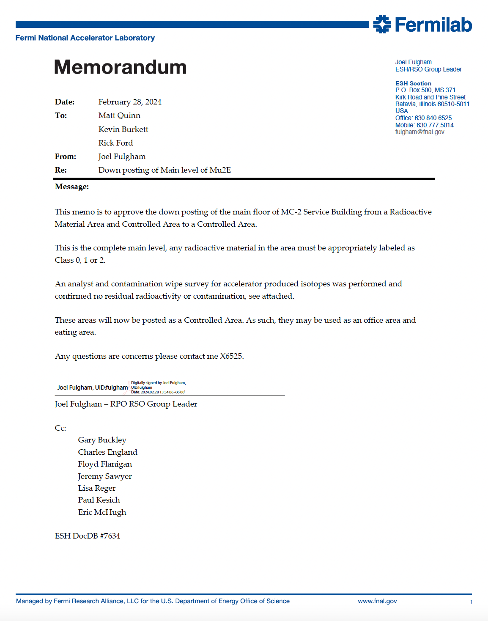
Upper level of Mu2e building (MC-2) has been down posted to a Controlled Area

