Slide 1
302.02.07 Structures Status
Magnet | Status | Notes
Pre-Series
MQXFA03 | Complete; report released
MQXFA04 | Complete; report released
MQXFA05 | Complete; report released
MQXFA06 | Complete; report released
MQXFA07b | Complete | Prepping to ship to FNAL
MQXFA08b | Complete; report released | No coil SG data with 2nd thermal cycle
Series
MQXFA10 | Complete; report released
MQXFA11 | Complete; report released
MQXFA14b | Test complete | Fab & Test report drafts completed

Slide 2
302.02.07 Structures Status
Magnet | Status | Notes
Series
MQXFA09 | Disassembled | Two coils no longer available (in A14b, A15); Structures used in MQXFA11; will be renamed MQXFA24
MQXFA12b | Rods & shells instrumented; dressed coil operations | Shims & Loading Review scheduled for 3/6
MQXFA13b | Final Coil pack build this week w/Coil 150, MM measurements added to our builds | Coil 150 replaces Coil 241
MQXFA15 | At BNL, being tested | SG data available to show
MQXFA16 | At FNAL10/13 | Fabrication Report drafts edited
MQXFA17 | On hold for splice joint analysis; metallography and magnetization results this week | Will be redirected to BNL when complete
MQXFA18 |  | Expected to be shipped direct to FNAL

Slide 3
302.02.07 Structures Status 2
Series Magnets (cont.)
Updated Magnet specifications to allow for 120 MPa excursions, increased from 110 MPa
MQXFA07b, MQXFA16, MQXFA15 reload did not require 120 MPa
MQXFA17 reached 120 MPa during preload

Slide 4
Coils in Storage at LBNL
 |  | LE CMM | Nom. CMM | RE CMM
224 ( A12 Q1) | Extracted from MQXFA12; for MQXFA12b | ✓* | ✓, ✓* | ✓*
225 (A12 Q3) | Extracted from MQXFA12; for MQXFA12b | ✓* | ✓, ✓* | ✓*
150 | Designated for MQXFA13b | ✓ | ✓ | ✓
241 | (Was) Replacement coil for MQXFA13b (large) | ✓ | ✓ | ✓
158 | Planned for MQXFA12b | ✓ | ✓ | ✓
159 | Planned for MQXFA12b | ✓ | ✓ | ✓
242 | Spare (was for MQXFA17 and/or MQXFA13b) | ✓ | ✓ | ✓
148 | Spare for MQXFA12b | ✓ | ✓ | ✓
234 | On Hold. (Too small spare for MQXFA16) | ✓ | ✓ | ✓
240 | Arrived from BNL 12/4; CMM complete | ✓ | ✓ | ✓
248 | Arrived from BNL 12/4; CMM complete | ✓ | ✓ | ✓
243 | Arrived from BNL 2/5/24
244 | Arrived from BNL 2/5/24
160, 161 | Arrived from FNAL this morning
✓* Extra measurements taken post-preload or post-test

Slide 5
302.02.07 Structures Status
Other topics
Technicians
New techs are getting up to speed
Bladders:
200 pcs order fabrication and testing is complete, to be received this month
Working with CERN to source tubing for their style bladders for MQXFA lengths
Planning upgrade for HP cart to accommodate additional circuits
FY22 Procurements
Extra ARMCO is stored in Berkeley
BCR approved for $33k duty and shipping costs
Additional, non-MA, procurements have been placed; ongoing for consumables
Property Transfer from LBNL to FNAL
MQXFA07b property documents processing will start
Transfers to happen in “bulk”
MQXFA spare parts scope
Obtained new updated quotes from vendors for spares and compiled for BCR

Slide 6
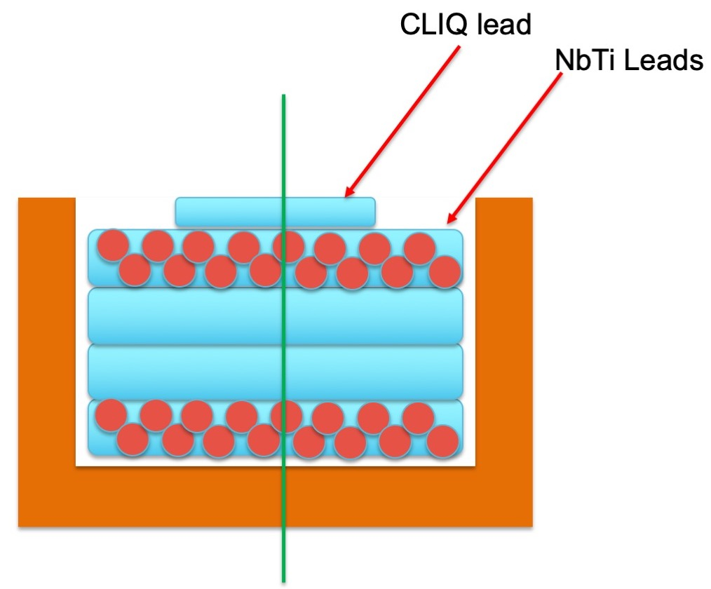
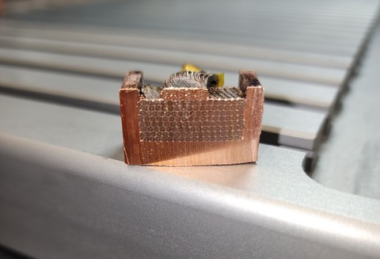
MQXFA17 Splice Sample
MQXFA17 splice joint
Off-normal work document prepared
~6mm Sections will be taken of “normal” joint, overheated joint
Joint examination plan
Metallography, magnetization, etc.
Sample has been cut; strands being extracted
MQXFA17 Magnet will be on hold
Will place into shipping crate so that preparations for MQXFA12b can start
Potential plan for replacement has been prepared, if needed
Cut Line
Metallography
Magnetization

