Slide 1
AUP Over Heated Splice Investigation
Manish Mandel, PhD student under the DOE-HEP conductor grant led by Larbalestier, Lee, Tarantini
Samples | Lengths (mm) | Mass (mg)
Non Heated splice Cable | 3.95 + 4.06 | 55.22
Control Splice Near Heater | 4.03 + 4.05 | 54.55
Control Splice Far From Heater | 3.7 + 3.8 | 59.55
Over Heated Splice Near Heater | 3.98 + 4.10 | 57.42
Over Heated Splice Far From Heater | 3.80 + 4.07 | 54.95

Slide 2
Normalized Moment vs Magnetic Field Plot
Measurement done at 4.2K.

Slide 3
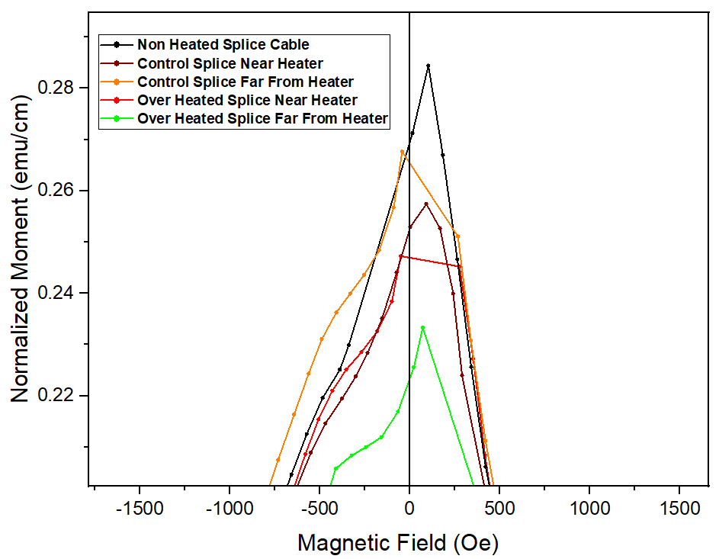
Normalized Moment vs Magnetic Field Plot
Zoomed area

Slide 4
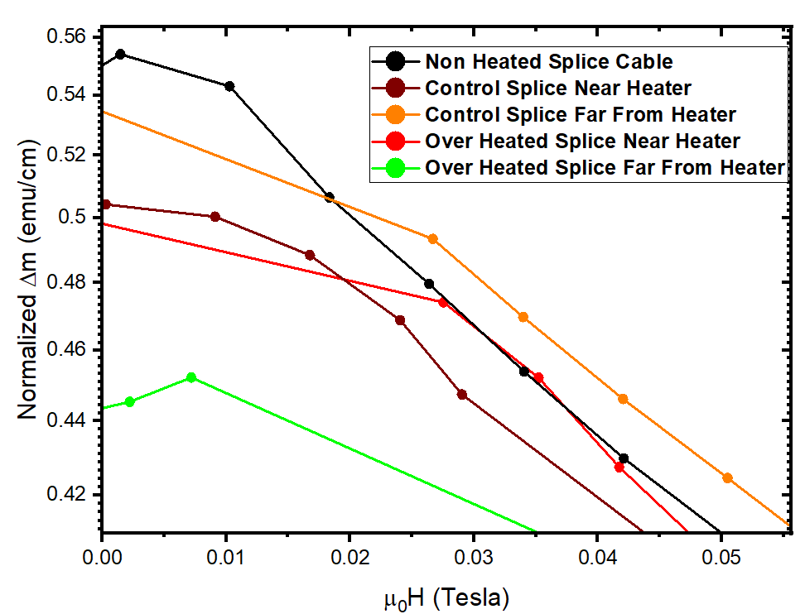
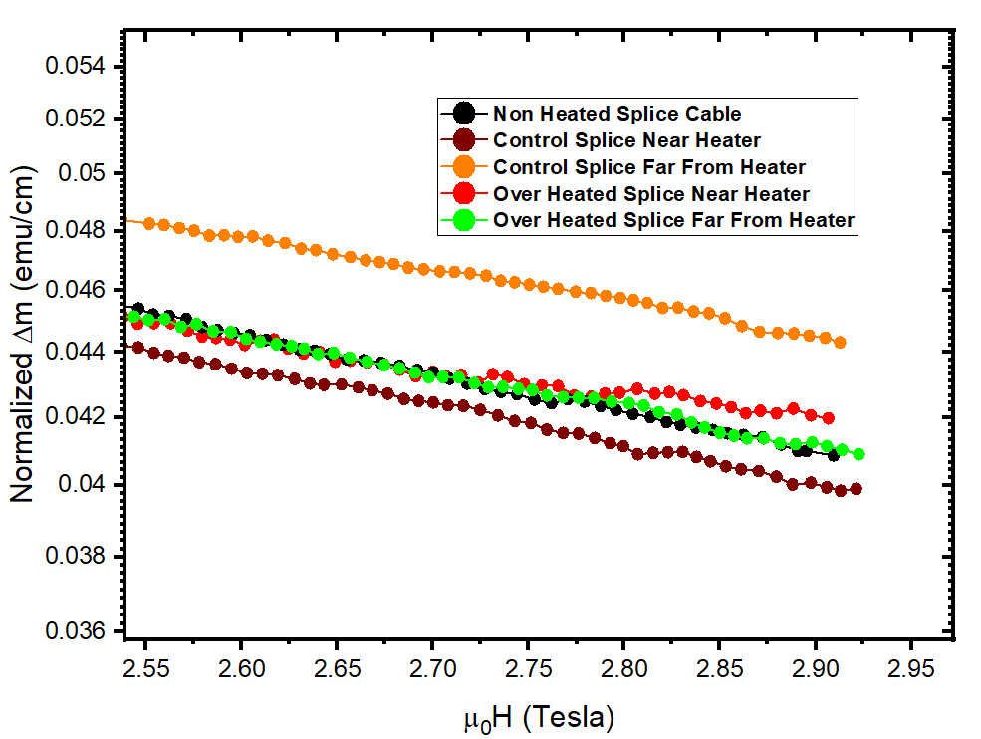
Normalized $Δm$vs $μ_{0}H$ Plot

