Slide 1
FD1/FD2 Installation Engineering Update
Nicholas Joniak
05/14/2024

Slide 2
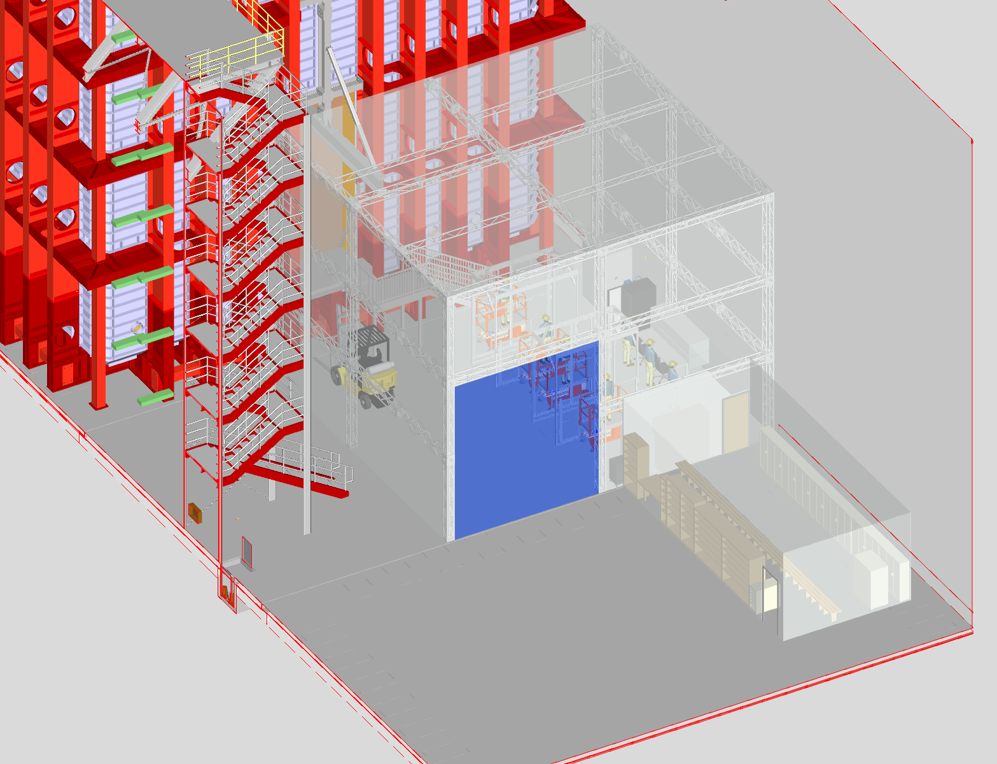
FD2 Cleanroom – Updated Layout
Cleanroom size reduced due to:
  Revised staircase location.
  Revised cleanroom assembly area requirements.
Changing room rotated to accommodate new “centrally-located” entranceway.
  New cleanroom entrance located in-line with TCO opening.
Proposed Updated Dimensions:
  Depth: 11.58 m
  Width: 12.50 m
  Height: 9.75 m
  Entranceway: ~6.10 m Tall x 5.49 m Wide

Slide 3
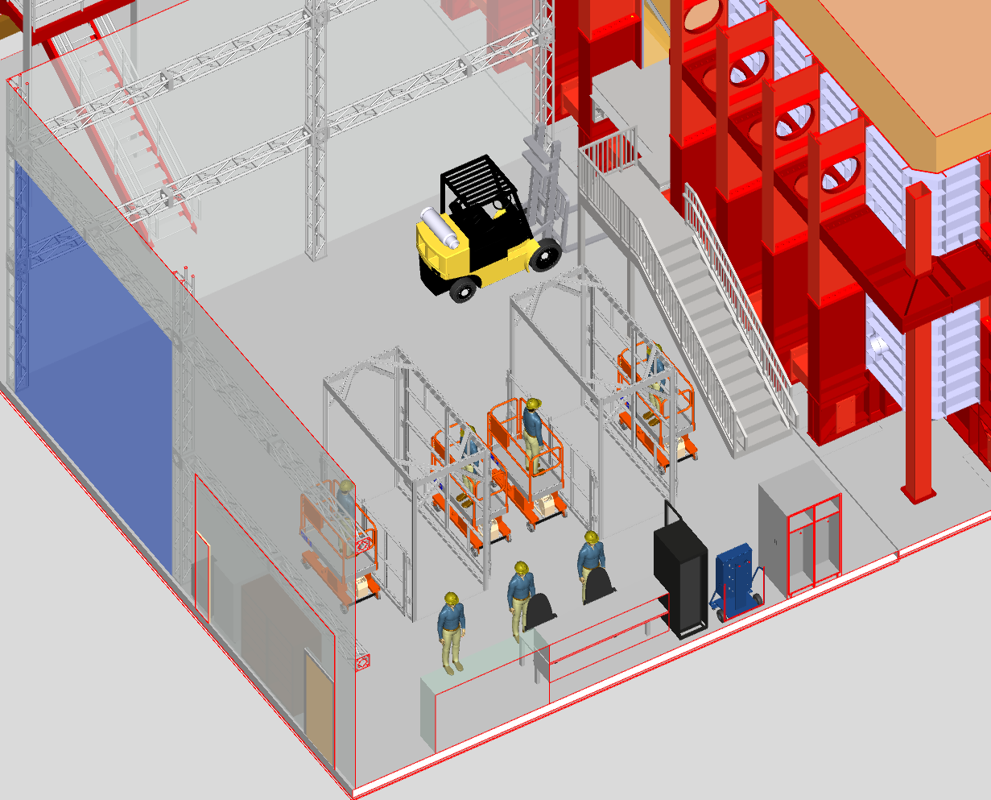
FD2 Cleanroom – Updated Layout (Cont.)
TCO Entrance
Stairway
Transport/
Unloading Area
Main Entrance
Misc. Storage
Changing Room Entrance
Cathode Assembly Area
(2 CARTW Capacity)
PD Testing Area

Slide 4
Misc. Updates
Meeting with Filippo/Benoit/Gianluigi/Olga later this week to further discuss CERN test structure design updates.
Images required for FD2 FC tripod/lifting requirements document.
Continue to update installation models for images.

