Slide 1
FD1/FD2 engineering update – 5/14/2024
Working on getting updated information for the cryo relief valve and system from cryo team
Meeting scheduled for Friday (5/17)
Working on air handling underground procurement documents
Currently in review
Need additional details on the air flow requirements and sequencing
Received roof/decking updated model (5/13). Working on updating the south cavern stairs rotated layout and will finalize with the side access ladders as well by end of week.
Underground BSI coordination beginning zone 2 (South cavern)
Major interference checks will be East/West drift entrances and bridge crane

Slide 2
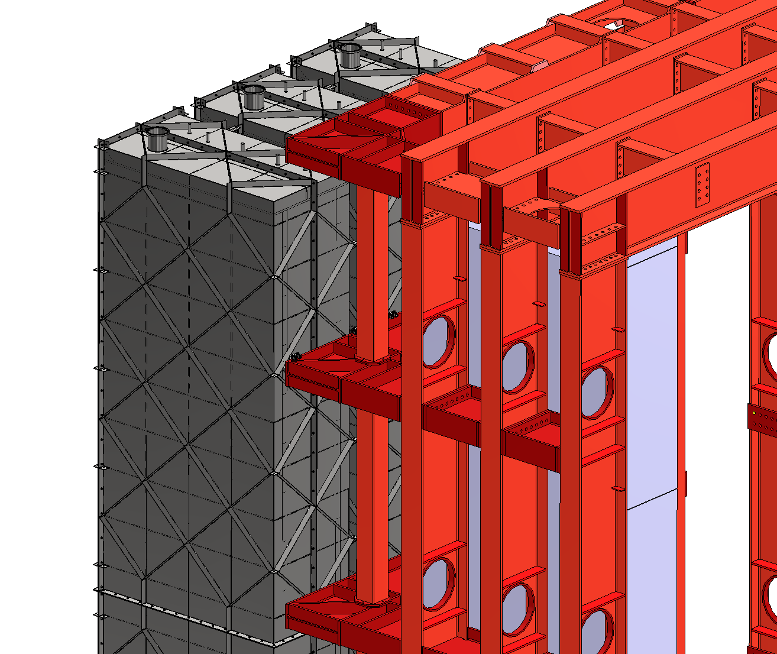
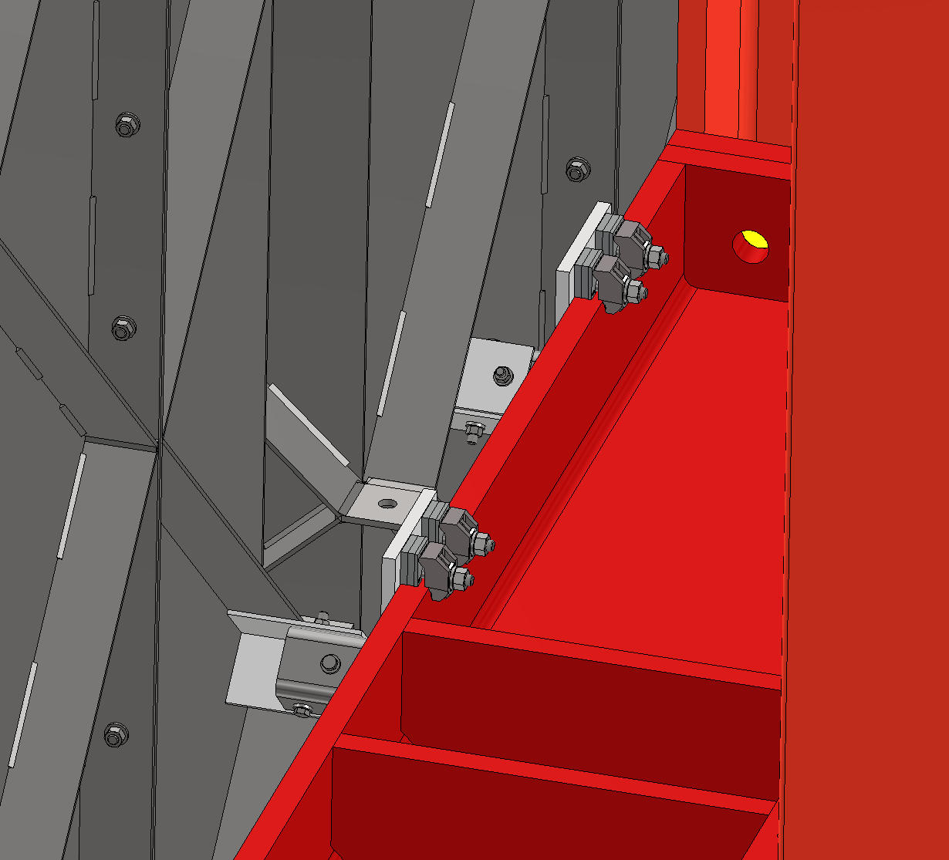
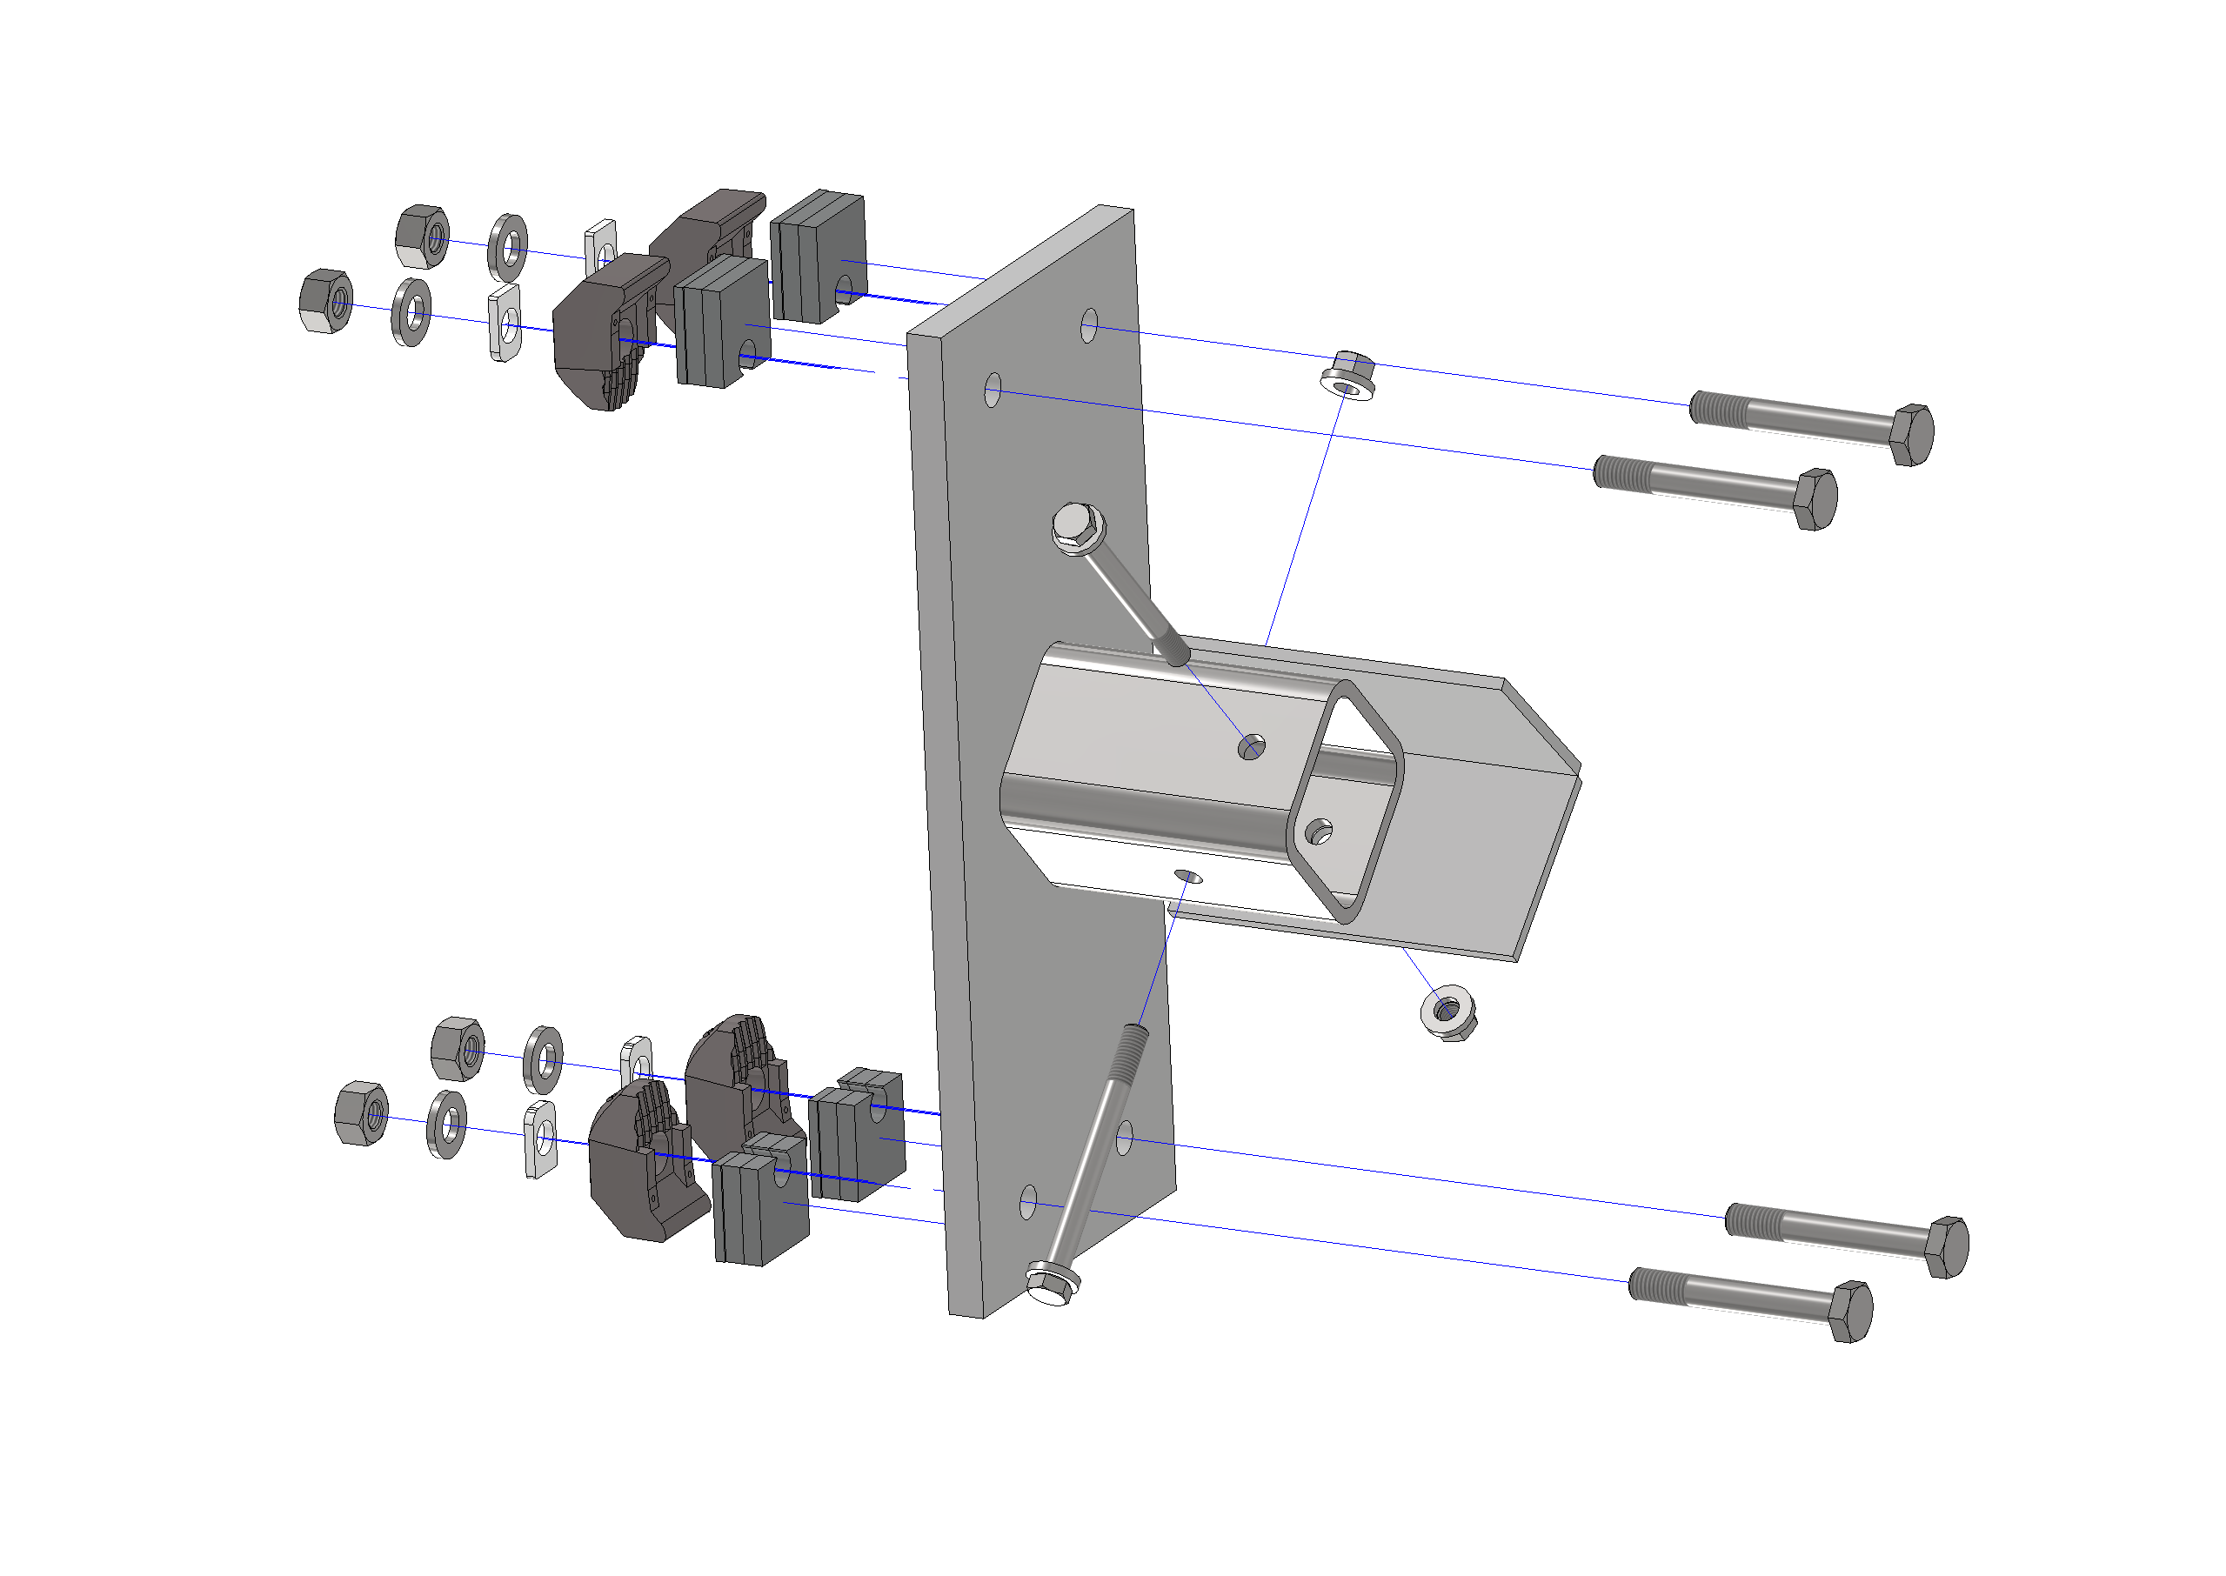
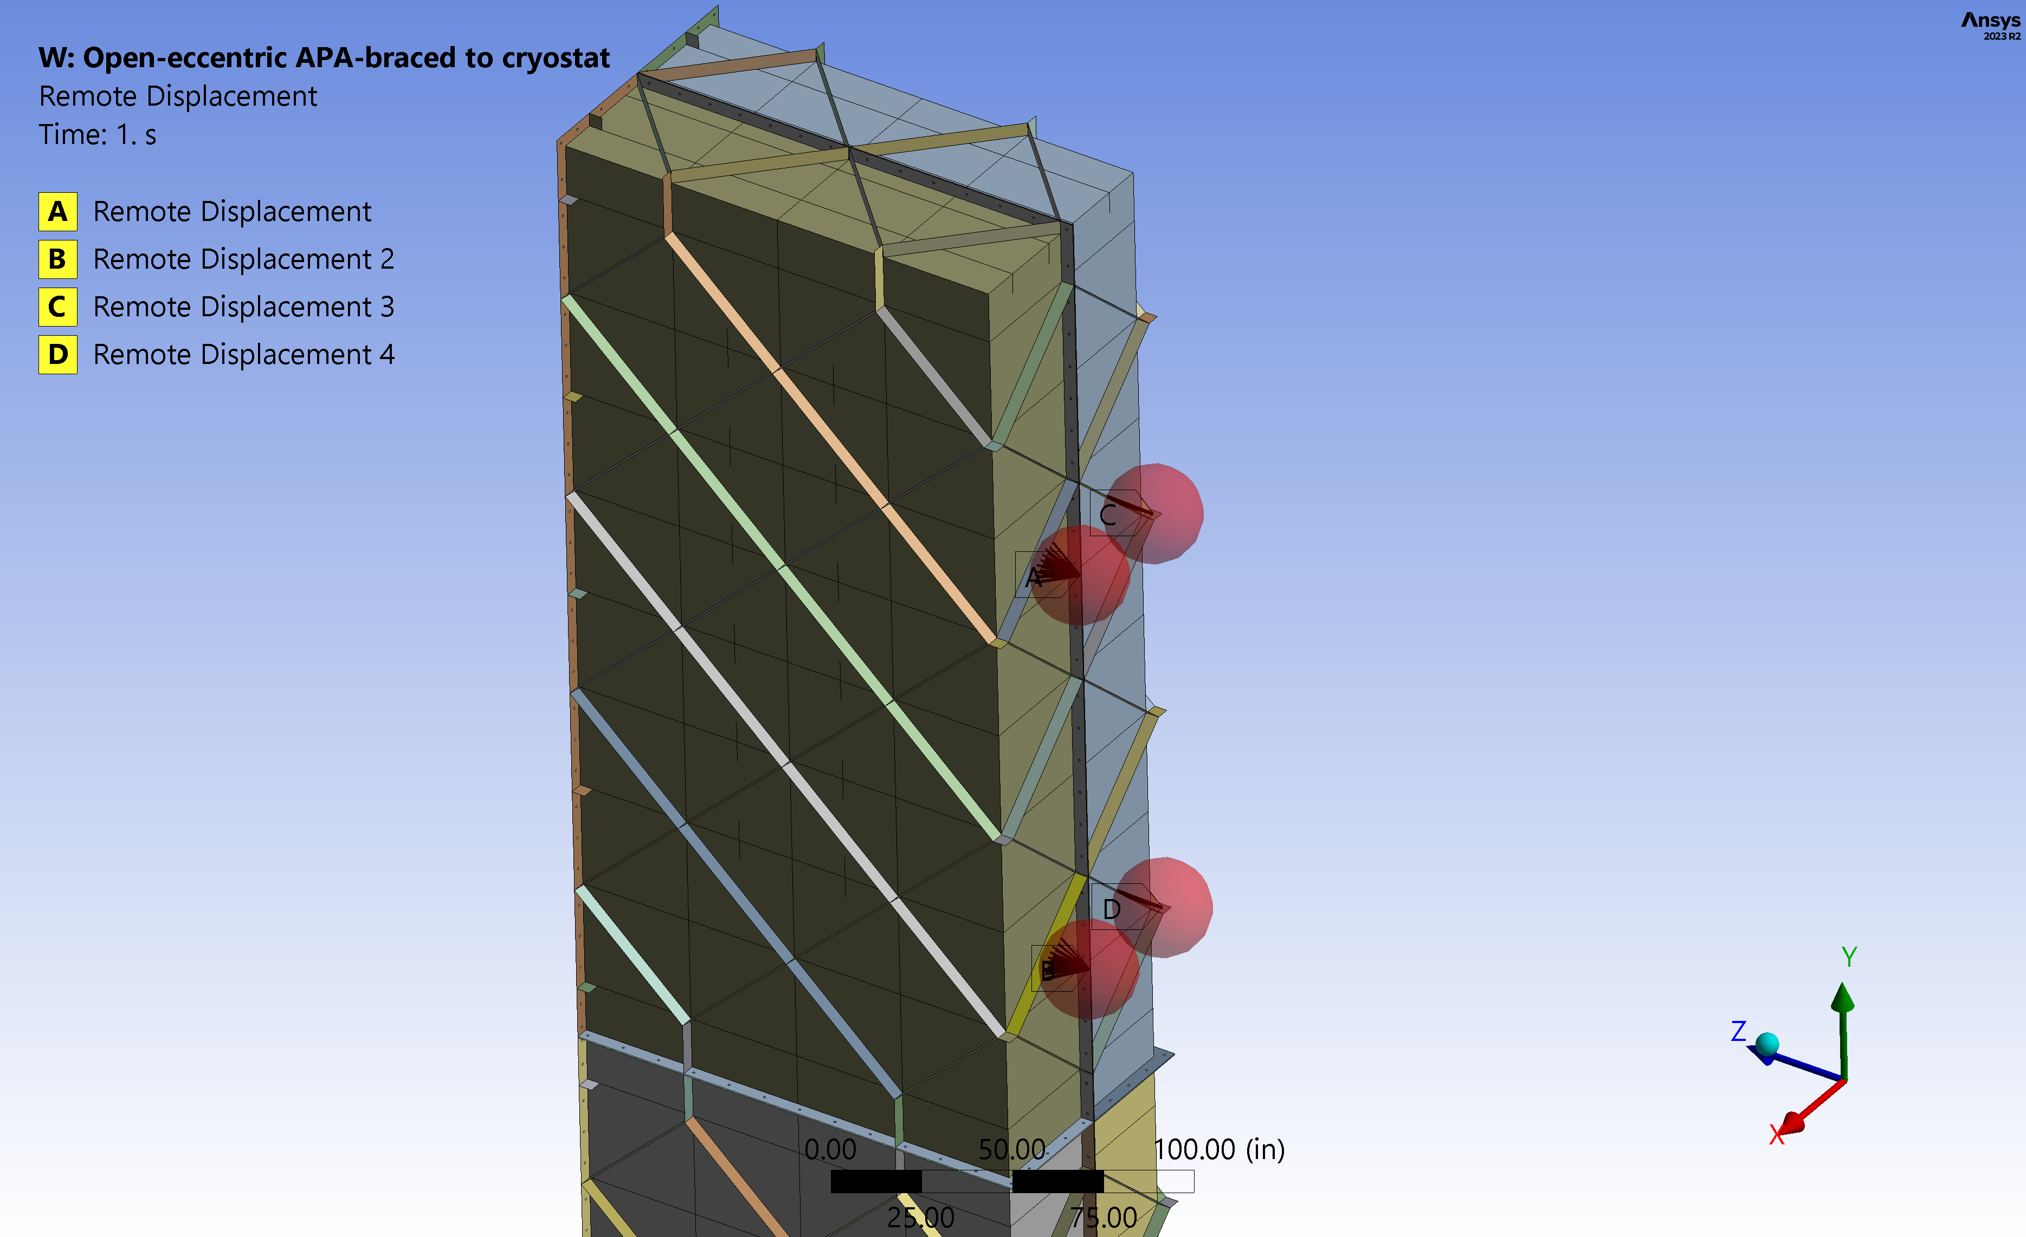
FD1/FD2 engineering update – 5/14/2024
Updating boundary conditions for coldbox with cryostat lateral bracing

Slide 3
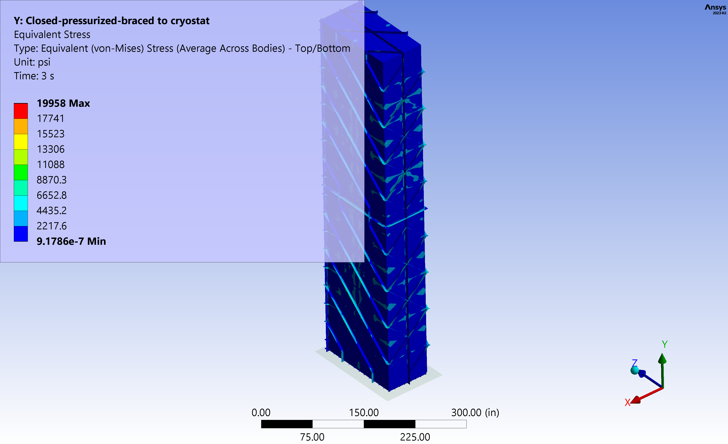
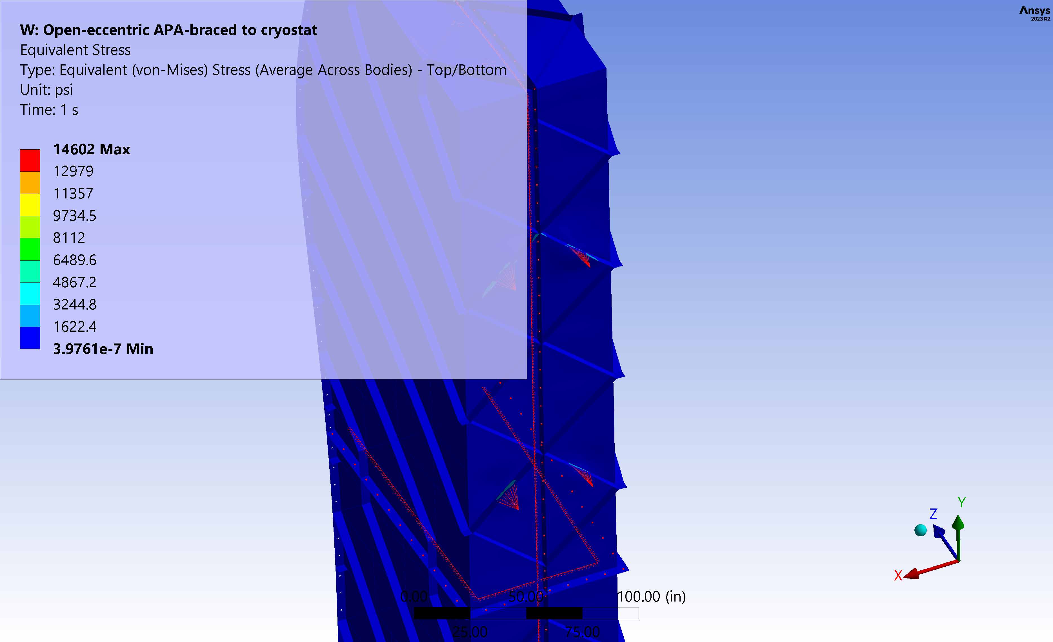
FD1/FD2 engineering update – 5/14/2024
Updating boundary conditions for coldbox with cryostat lateral bracing

