Slide 1
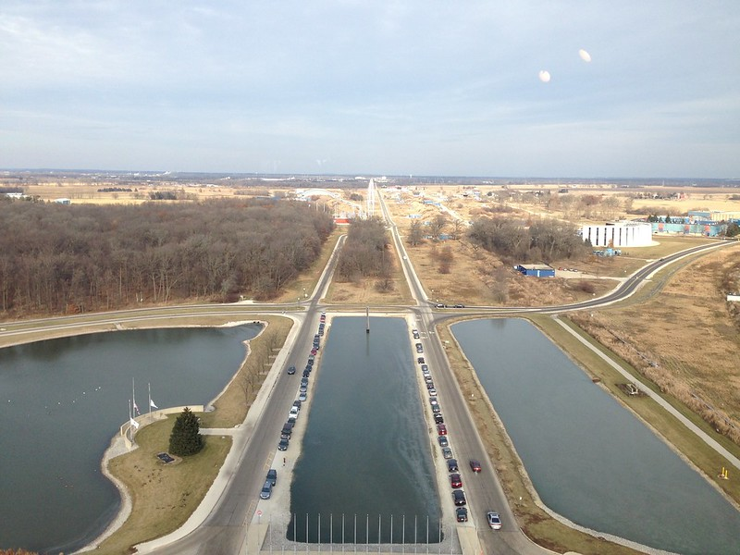
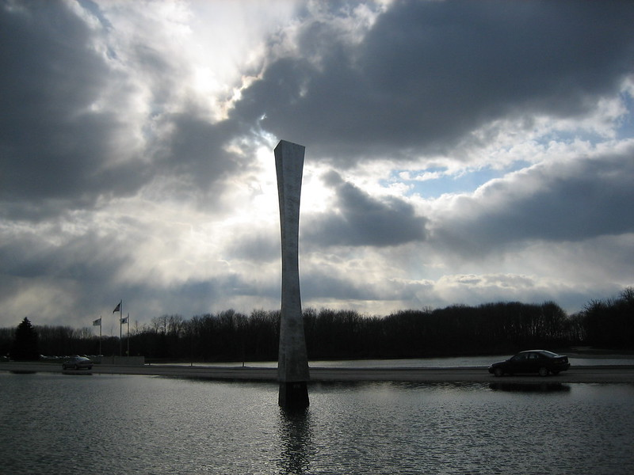
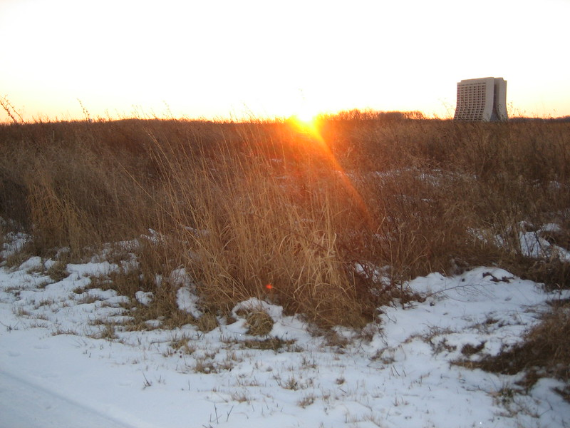
Experimental measurements of Standard Model Properties
HCP Summer School 2024
Matthew Herndon
2024-07-29,30

Slide 2
In this talk, QCD+EW
Measurement of SM Properties
  Introduction to the SM
  Predictions using the SM
  Experimental measurements
QCD measurements
  Jets, PDFs, α_{s}
more QCD
  W and Z + jets
High Precision EW measurement
  W and Z cross sections
  Parameters: sin²θ^{l}_{eff} , m_{W}
Multiboson physics
  di-boson, tri-boson, VBS, polarization, TGC, QGC
Summary

Slide 3
Measurement of SM Properties
  Nearly every diagram you find like this is wrong!
  In this case the ZγWW vertex not represented
and other introductory material

Slide 4
The Standard Model of Particle Physics
Exploring the fundamental theory that explains 3 (of 4) of the forces of nature.
This talk will focus on selected measurements QCD and EW physics performed using high transverse momentum (p_{T}) and/or massive SM particles.
Only covers a tiny fraction of the SM measurements made at the LHC (and elsewhere)
See recent reviews from: ATLAS, CMS

Slide 5
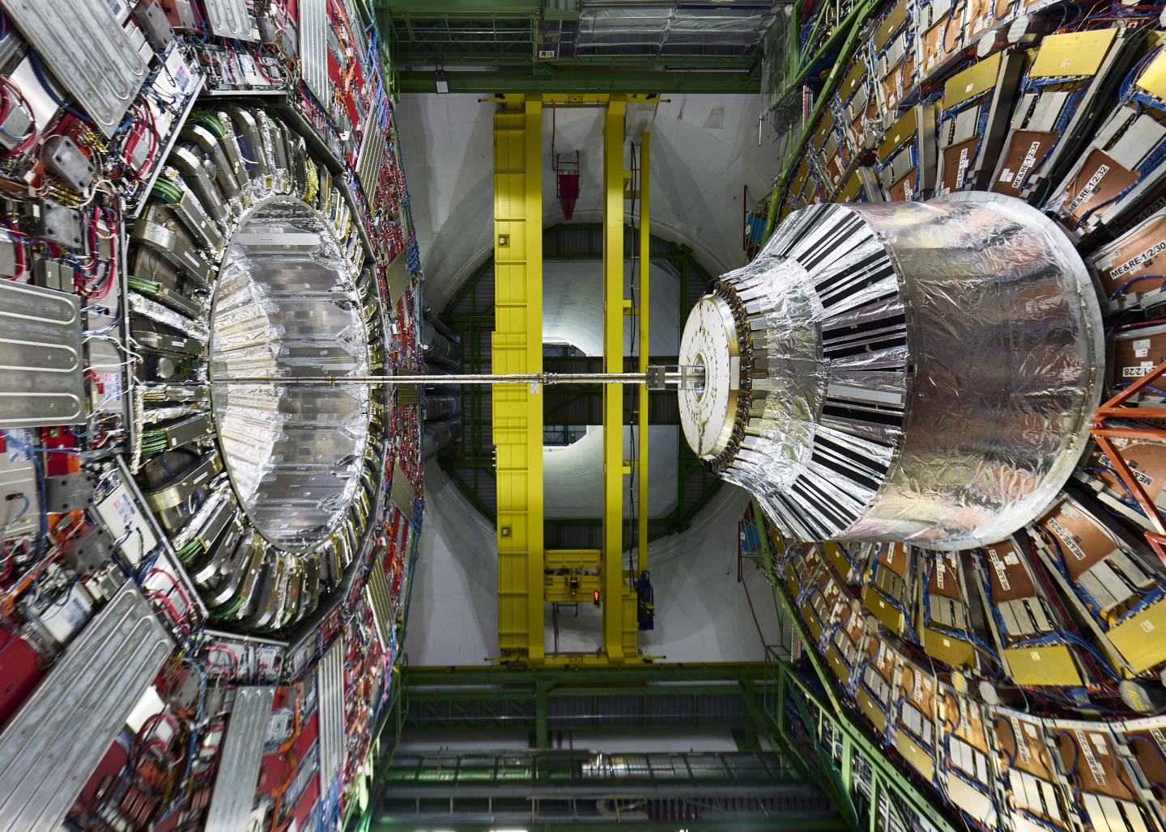
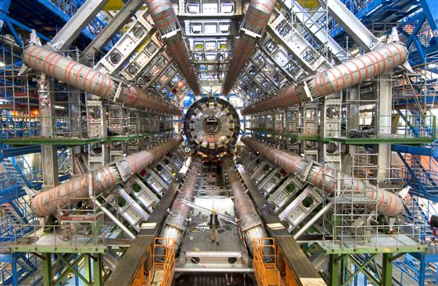
As measured by the ATLAS and CMS Experiments (+1 from LHCb)
CMS
ATLAS
Choice of images is biased – I work on muon systems ☺.

Slide 6
Some qualitative remarks on the performance of these detectors
The efficiency, angular coverage, granularity, resolution and identification capabilities of the detectors are good enough that most activity from a collision can often be attributed to individual: electrons, muon, taus, photons, charged hadrons or neutral hadrons.
Electrons and muons
  Identified with low background and near 100% efficiency over large ranges of pseudo-rapidity and momentum
  Often as much as twice the pseudo-rapidity compared to previous collider detectors.
  Enables the precision measurements in single and multi-boson physics and searches for rare processes
Photons
  Identified efficiently with low background
  Enables the precise cross section measurements in modes with photons and searches for rare processes
Jets
  Particle flow jets measure and identify most of the jet constituents
  Near hadron level jets
  Excellent jet energy scale and resolution calibrations
  Corrections between reconstructed and hadron level jets fairly diagonal
  Enables an extensive program of comparison with theory, PDF and α_{S} determinations, and tuning of MC performance
Missing energy resolution is decent with reduced tails
All this in turn enables many precision measurements: m_{W}, sin²θ^{l}_{eff} …
The performance of the previous generations of detectors were nothing like this!
and the accelerator and theory communities have accomplished equivalent improvements!

Slide 7
Predictions - Measurements
CMS xs review
Scientific exploration
  build an experiment → take data → formulate a theory
  theory → make predictions
  build a new experiment → test the predictions
The theory is not really that useful if it’s not predictive!
The Standard Model is one of the ultimate predictive theories
We need a strong understanding of the SM and calculations within the SM:
  What is interesting to measure
  How precisely can we predict measurables
  How precisely can/should we measure them
  How to build our detector
Theory/Experiment - pushing each other to higher precision
ATLAS summary plots

Slide 8
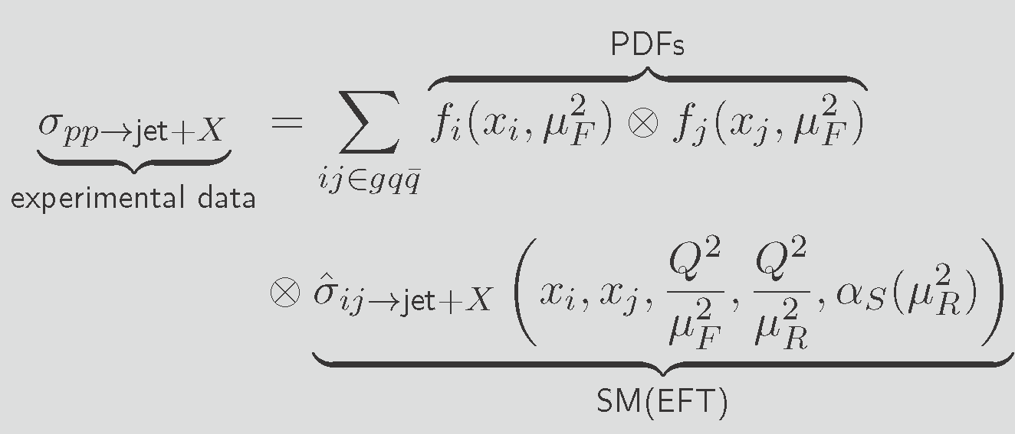
Elements of a SM Prediction: the cross section
The basic measurable prediction of the SM at a collider is a production cross section
Hadron collider: colliding partons: quarks and gluons
  QCD interactions are ubiquitous
  QCD factorization allows us to separate perturbative and non/semi- perturbative physics and make precisions –
  introduces factorization scale
Perturbative calculation hard collision
  Evaluation of Feynman diagrams - α_{s}, α
  LO: Almost useless: can be off by factors of 3 (gg→H)
  NLO QCD: large increase in cross sections: 10-100%
    New initial/final states (involving jets), loop diagrams
    Renormalization necessary - renormalization scale
    Minimum necessary for reasonable accuracy
  NNLO QCD: large increase in cross section: 5%-50%
    Generally, achieves several percent accuracy
    Necessary for many analyses
  NLO EW: increase (or decrease) the high energy tails of distributions: 5-30%
  Can also incorporating a logarithmic resummation calculation - helps low p_{T} or p_{T} thresholds of objects, systems,
SM calculation of the inclusive jet cross section

Slide 9
Elements of a SM Prediction: the cross section
Non/semi-perturbative physics
Colliding partons
  Proton distribution functions, PDFs, structure of the proton
  Non-perturbative at lowest energies
  Evolved up to the perturbative collision scale, factorization scale, μ_{F}
QCD NXLO → Jets
  Fragmentation functions and partons showers (PS)
  Hadronization
  Introduces a matching scale, jets produced in the hard
    collision vs PS jets
Proton remnants
  Underlying events (UE)
  Multiparton interactions (MPI)
  PS, UE, MPI treated with tunes and/or transverse momentum dependent TMD-PDFs
These issues must be corrected for when measuring a cross section and represent important ancillary measurements
SM calculation of the inclusive jet cross section

Slide 10
Proceeding down the stairway to discovery!
CMS xs review

Slide 11
QCD Measurements
CMS xs review
Jets, PDFs, α_{s}

Slide 12
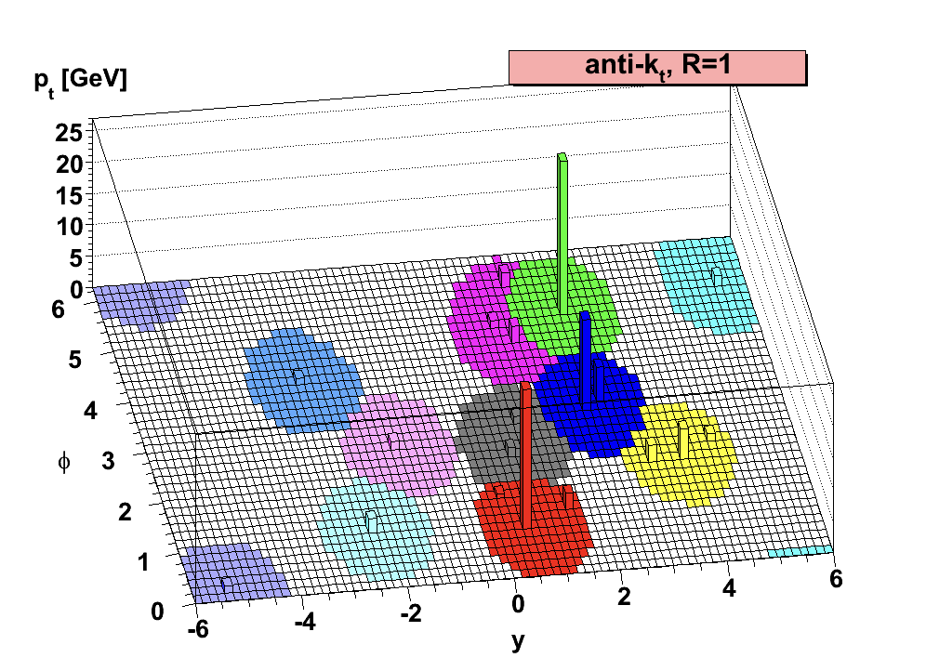
SM measurement: inclusive jet cross section
The measurable
  Cross section to produce one jet. Multijet events → multiple contributions per pp collision
  Fiducial: p_{T}(jet) and y(jet) requirements. Typically differential: p_{T}(jet) and |yj(jet)| bins
Defining a jet
  Parton level: original quark or gluon p_{T}, y
    Advantages: What was directly calculated in the cross-section calculation
    More independent of detector or jet clustering details
    Solid understanding of perturbative accuracy of the calculation
    How to consider the jets formed in PS process
    Disadvantages: Must correct for non/semi-perturbative effects to/from the parton level
  Particle level
    Cluster jets using MC particles (mostly hadrons)
    Use infrared/collinear safe jet clustering algorithm.
    Advantage: closer to what is measured - detector PF objects and/or calorimeter energy clusters
    Disadvantage: depends on clustering
Unfolding
  Account for acceptance and migrations in differential measurements – using MC
    Finite resolutions – events outside of fiducial (or a bin) can migrate into the region and or vice versa
    Typically iterated. Amount of migration depends on the underlying distribution. Correct the MC to the distribution observed in the data and recalculate migrations.

Slide 13
Inclusive Jet Cross Section - CMS
JHEP 02 142, JHEP 12 035 (2022)
Prediction: NNLO QCD with NLO EW corrections
  Corrected for NP effects to particle level jets
  NP corrections based on several MCs and tunes
Data: Unfolded to particle level using full detector simulation
Unfolding Matrix: Reconstructed to hadron level gen jets
Excellent agreement seen with NNLO QCD + NLO EW prediction

Slide 14
Inclusive Jet Cross Section, NLO vs NNLO
Predictions:
NNLO QCD with NLO EW corrections
NLO+NLL QCD with NLO EW corrections
(since NLL was used corrections for PS have to account for that)
NLO, even with NLL, is not enough to achieve agreement with the data
10-20% disagreements unsurprising.
Different predictions from NLO PDFs inconsistent
NNLO calculations necessary to demonstrate consistency with SM at the precision of the LHC data for many analyses.

Slide 15
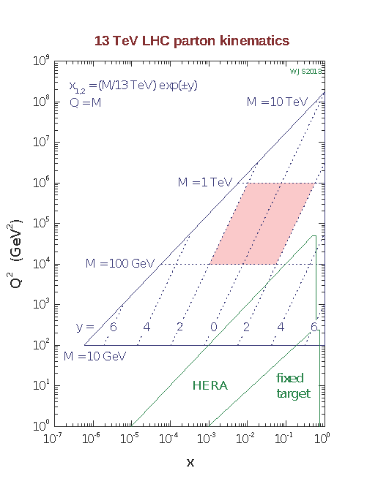
The “QCD Analysis”
Requirements for comparison of SM predictions to LHC data
  NNLO QCD calculations
  NNLO PDF determinations
  NNLO α_{S} determination
PDFs
  LHC probes Q² and x regions of PDFs not accesses by previous accelerators
  Needs HERA data, fix lower Q² and x,
  where the PDF parameterization is typically defined
One solution, to assemble these elements: “QCD Analysis”
  Analysis of LHC QCD Jets data (and often other useful data sets)
  Determination PDFs and α_{S}
  Using HERA I, II datasets with LHC Jets data
  fitting framework available as open-source software - xFitter
Plot courtesy of W.J. Sterling

Slide 16
QCD Analysis, PDFs - ATLAS
Combined PDF fit of ATLAS data
  Inclusive Jets → strongly impacts valance quark and gluon distributions
  W, Z/γ∗ → strange and anti-quark, W+Jets, Z+jets → strange and anti-quark
  ttbar → high-x gluon distribution
  Inclusive isolated photon – well fit by data (has often not been the case)
xFitter framework: ATLASpdf21
  NNLO QCD + NLO EW
  Parameterization at initial Q² evolved
    up to relevant scale using DGLAP equations
  Correlations carefully treated
    Luminosity, jet related uncertainties
Significant improvement over HERAPDF (where expected). Equivalent performance to Global PDF fits
Eur. Phys. J. C 82 (2022) 438

Slide 17
QCD Analysis, PDFs and α_{S}
- CMS
Combined PDF and α_{S} fits
  Separate analysis with sensitivity to specific PDFs and/or α_{S}
Most precise α_{S} results from NNLO QCD Analysis of 13 TeV inclusive jet and differential di-Jet data
In general, the ultimate measurements of SM parameters that depend on PDFs will benefit from simultaneous QCD Analysis of the PDFs using appropriately chosen datasets for the parameter(s) of interest – m_{W}, sinθ_{Weff} …
CMS xs review
13 TeV DiJets 2D/3D Sub. EPJC

Slide 18
More QCD Measurements
CMS xs review
W+jets and Z+jets

Slide 19
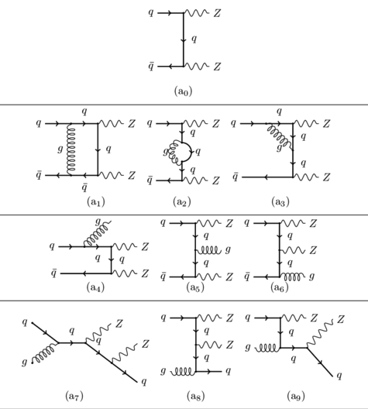
W+jets, Z+jets
LO QDC
Interference between loop and LO diagram is NLO
Excellent data-sets for QCD studies
  Easily triggered pure data samples (W→lν, Z→l⁺l⁻)
  Interesting array of final states
    Large numbers of jets
    Heavy flavor jets
    Topologies important in ttbar, Higgs, NP searches
  Study of the recoiling jets system via well measured vector boson (Z) properties - tunes
SM predictions of V+jets
  Interested in exclusive final states (V +njets) or inclusive (V + ≧ n jets)
  Calculation of all diagrams with final states up to V + n jets. If using MC, additional jets from PS
What does this mean? Some examples
  NLO ZZ+”0” jets production (I work on ZZ physics, so these diagrams were available)
    LO ZZ prediction poor, neglects large contributions from NLO gq initial states
    Inclusive ZZ production NLO QCD accuracy
    Z+0 at NLO QDC accuracy
    Renormalized NLO α_{S} captures some higher order behavior
    Neglects contributions from NNLO gg initial states (add separately)
    ZZ+1jet production LO QCD accuracy, + ≧ 2 jets depends on accuracy of PS (if used) tune
    Portions of the phase space of a calculation (ZZ+1jet) less accurate than the full inclusive calculation
    Typically normalize the cross section after PS back to NLO results
New initial states
Real emission. Negative contribution from loop diagram cancels infrared divergence in this NLO diagram

Slide 20
W+jets, Z+jets
LO QDC
Interference between loop and LO diagram is NLO
Excellent data-sets for QCD studies
  Easily triggered pure data samples (W→lν, Z→l⁺l⁻)
  Interesting array of final states
    Large numbers of jets
    Heavy flavor jets
    Topologies important in ttbar, Higgs, NP searches
  Study of the recoiling jets system via well measured vector boson (Z) properties - tunes
SM predictions of V+jets
  Interested in exclusive final states (V +njets) or inclusive (V + ≧ n jets)
  Calculation of all diagrams with final states up to V + n jets. If using MC, additional jets from PS
What does this mean? Some examples
  NLO Z+0,1,2 jets production (three samples generated separately and combined)
    Inclusive Z production NLO QCD accuracy
    Z+0,1,2 at NLO QDC accuracy
    Renormalized NLO α_{S} captures some higher order behavior
    Neglects contributions from higher order initial states
    Z+3jet production LO QCD accuracy, + ≧ 4 jets depends on accuracy of PS (if used) tune
    Portions of the phase space of a calculation (ZZ+3jet) less accurate than the full inclusive calculation
    Typically normalize the cross section after PS back to NLO results
    This is the limit of a reasonable computing time budget
New initial states
Real emission. Negative contribution from loop diagram cancels infrared divergence in this NLO diagram

Slide 21
W+jets, Z+jets
LO QDC
Interference between loop and LO diagram is NLO
Excellent data-sets for QCD studies
  Easily triggered pure data samples (W→lν, Z→l⁺l⁻)
  Interesting array of final states
    Large numbers of jets
    Heavy flavor jets
    Topologies important in ttbar, Higgs, NP searches
  Study of the recoiling jets system via well measured vector boson (Z) properties - tunes
SM predictions of V+jets
  Interested in exclusive final states (V +njets) or inclusive (V + ≧ n jets)
  Calculation of all diagrams with final states up to V + n jets. If using MC, additional jets from PS
What does this mean? Some examples
  NNLO ZZ+0 Jets (three samples generated separately and combined)
    NNLO overall, Z+0 Jets; NLO Z+1jets; LO Z+2 Jets; + ≧ 3 jets depends on accuracy of PS tune if used. Few NNLO + PS implantations available.
    Should include most important new initial states
    This is the limit of a reasonable computing time budget
New initial states now include a gg diagram
Real emission. Negative contribution from loop diagram cancels infrared divergence in this NLO diagram

Slide 22
Exclusive Z+jets
EPJC 78 (2018) 965
Comparison to LO, NLO and NNLO calculations/MCs
  (if there is a preference for CMS results it’s only because I know where to find the plots to make my points – no reflection on the quality of the results)
  LO Magraph 0-4 jets with Pythia 8 PS
    Why does this look so good? It’s up to 4 jets. Most new initial states included.
    Pythia tunes of the non/semi–perturbative physics heavily leverages Z data
      UE, MPI and the PS behaviors
    Note that only statistical uncertainties are shown
    It’s difficult to assess the uncertainty of the MC simulation or interpret the source of differences when observed. This distribution looks good, but others may/do not
  NLO Magraph 0,1,2 jets with Pythia 8 PS
    Consistent with data and reasonable uncertainties to up to 2 jets
    Third hard jet calculated at LO looks good
    Does not interface well with Pythia 8 PS after that
    Needs an NLO Tune (see ATLAS AZNLO later!)
  NNLO+NNLL Geneva “0” jets with Pythia 8 PS
    Better uncertainty in the zero jets bin. Inclusive calculation is great!
    Consistent with the data with reasonable uncertainties for 1 Jet (NLO) and 2 jets (LO)
To see good agreement and well understood uncertainty you need NLO up to the number of jets of interest
NNLO with jets would be better, but is often prohibitive to generate

Slide 23
W and Z cross sections
CMS xs review
The hadron collider precision cross section frontier

Slide 24
Precision pp collider cross sections
W and Z cross sections
  Easily triggered pure data samples (W→lν, Z→l⁺l⁻)
  Performance of lepton triggering, reconstruction, and Id calibrated using tag and probe on large data samples.
  Can define both fiducial and total cross-section measurements.
  Dominant uncertainties
    luminosity uncertainty
    Extrapolation from measurement phase space to fiducial region (small) or total cross section (larger)
    Ratios can reduce uncertainties: especially luminosity uncertainty
The SM calculations
  NNLO, N3L0, N3LO+N3LL, even approximate N4LO+N4LL (DYTurbo)
  Logarithmic resummation of vector boson pT
  Dominant uncertainties
    PDF and scale uncertainty
    Especially when phase space limited to fiducial cross-section region
The precision frontier in hadron collider cross-section measurements and predictions
Interesting dichotomy of uncertainties fiducial vs. total/ exp vs. theory cross section measurement comparisons.

Slide 25
W and Z cross sections - CMS
5, 13 TeV CMS: to be submitted to JHEP
CMS xs review
Inclusive cross section comparison to N3LO QCD with approximate N3L0 PDFs
5 energies shown. 13.6 W,Z PLB 854 (2024) 138725 (ATLAS) and 13.6 Z (CMS) results newly available.

Slide 26
W and Z cross sections historical
Context
Takes a few minutes to collect a UA1 sized dataset at the LHC

Slide 27
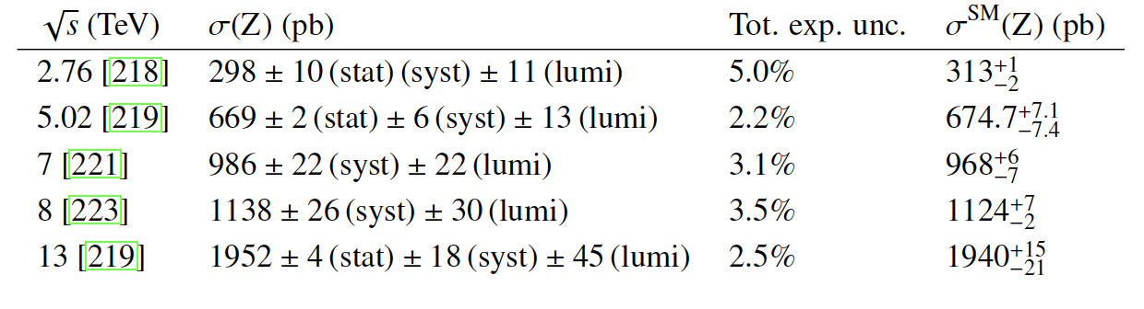
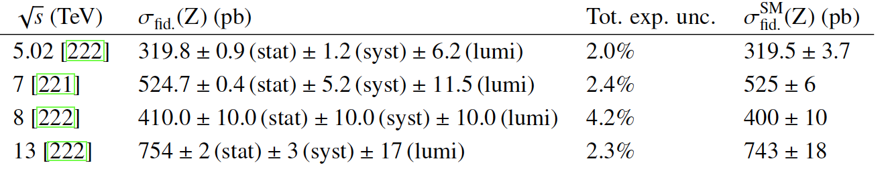

W and Z cross sections - CMS
Experimental results
Additional theory uncertainty to extrapolate to total cross-section substantial
2% fiducial Z result at 5TeV
Special short run with reduced instantaneous luminosity
still dominated by luminosity uncertainty
Theory Calculations
Calculations in a limited phase space less accurate
Exp.-theory pattern of uncertainties best seen in measurements with the same data set
New ATLAS Run 2 luminosity measurement achieves 0.83% uncertainty. Sub 1% cross section measurements possible!
Inclusive cross sections, N3LO calculation
Fiducial cross sections, NNLO calculations
CMS xs review

Slide 28
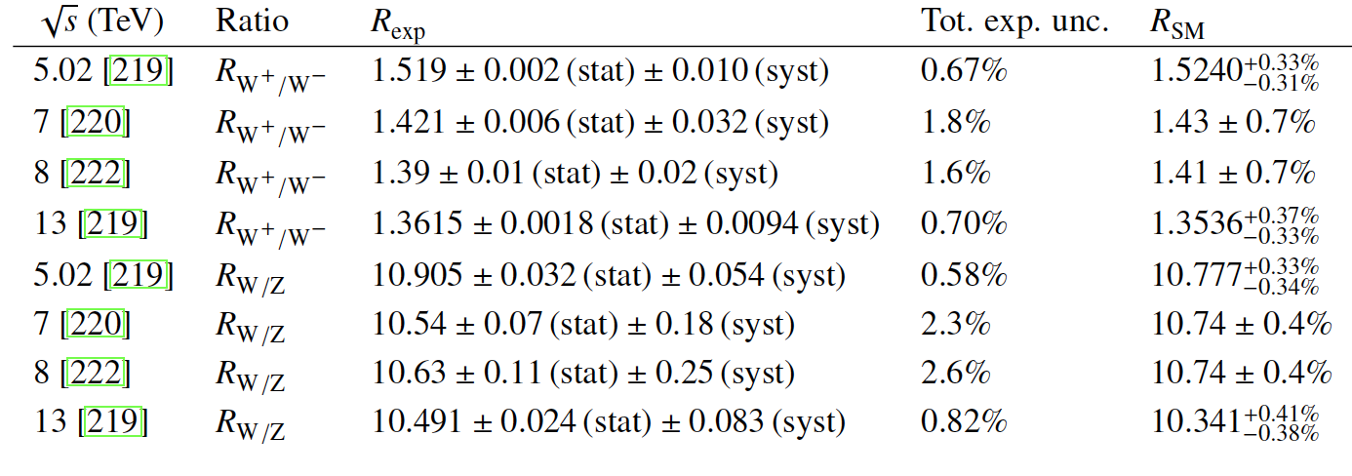
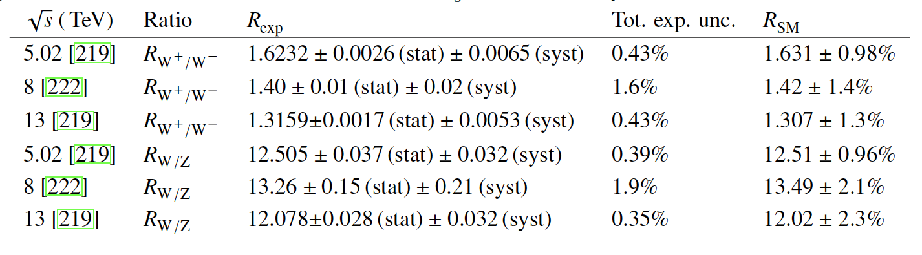
W and Z cross section ratios - CMS
CMS xs review
Inclusive cross section ratios, NNLO calculation
Fiducial cross sections ratios, NNLO calculations
Experimental measurements
Luminosity uncertainty cancels out. Other uncertainties reduced.
Theory calculation
Scale uncertainties reduced
Both achieve sub 0.5% uncertainty in best cases!
Not the same best cases.
Fid exp best - Total theory best

Slide 29
Measurements of EW Parameters
CMS xs review
m_{W}, sin²θ^{l}_{eff}

Slide 30
W mass – ATLAS Improved measurement of m_{W} and also Γ_{W}
It would be interesting to see if AZNLO does well with nJet. Focused on pT(Z)
  Profile likelihood fit of p_{T}(l) and m_{T}(W)
  Best modeling of W production kinematics and hadronic recoil
    NLO Powheg reweighed with NNLO calculations, NNLO PDFs, Pythia 8 with AZNLO tune based on Z data
    Predicts W pT distribution well at 5.02 and 13 TeV, Critical element for extracting m_{W} from p_{T}(l) and m_{T}(W)

Slide 31
W mass - ATLAS
submitted to EPJC
Uncertainties – p_{T}(l) measurement dominates
Statistical component substantial
Systematic distributed over several components
Probably difficult, but possible, to match CDF uncertainty

Slide 32
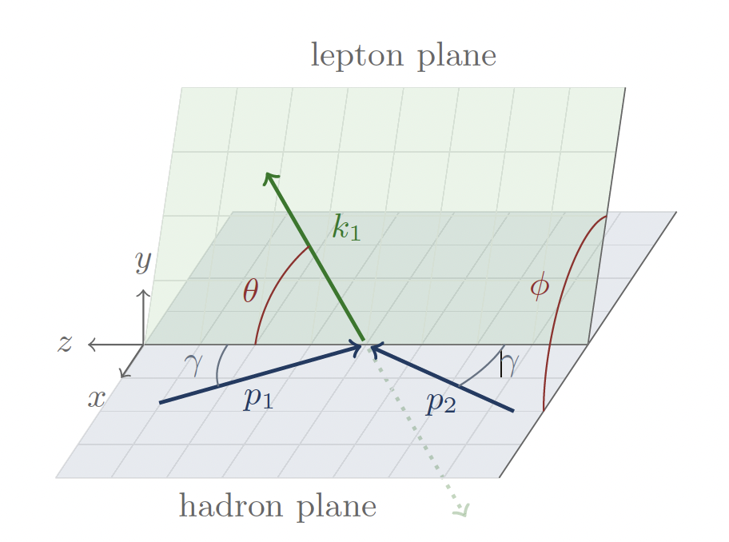
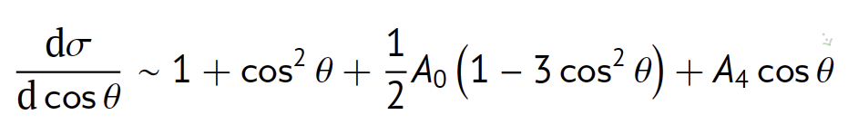
Effective weak mixing angle – CMS, LHCb
Drell Yan, pp→l⁺l⁻ forward backward asymmetry
  A_{FB} used to determine sin²θ^{l}_{eff}
  A_{FB} due to A₄ term which depends on sin²θ^{l}_{eff}
  Quark direction in the hadron plane inferred from the DY pair rapidity
  Events with forward rapidity leptons more useful for determining sin²θ^{l}_{eff}
CMS includes forward HF electrons 3.14 < |η| < 4.36
LHCb muon reconstruction 2.0 < |η| < 4.5
CMS Preliminary PAS-SMP-22-010
LHCb preliminary - paper in preparation

Slide 33
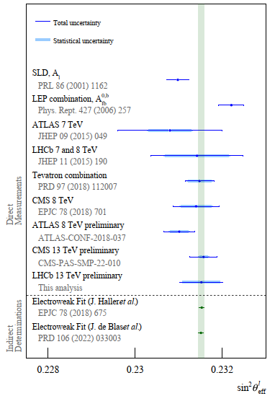
Effective weak mixing angle – CMS, LHCb
Nearing precision of SLD and LEP combination results
Hadron collider results midway between e⁺e⁻ collider results ☺
Difference in results from various global PDF sets
PDF were profiled but a more global simultaneous QCD Analysis of PDFs likely beneficial

Slide 34
Multi-boson Physics
CMS xs review
Di-boson
Weak boson polarization, TGCs

Slide 35
Di-boson production cross sections
Di-boson cross sections also near the pp precision frontier
  Same advantages as W and Z physics
  Easily triggered pure data samples (typically at least one Z→l⁺l⁻)
  Performance of lepton triggering, reconstruction, and Id calibrated using large tag and probe on large data samples.
  Good statistics due to large integrated luminosities
  Dominant uncertainties
    luminosity uncertainty
    Extrapolation from measurement phase space to fiducial region (small) or total cross section (larger)
The SM calculations
  NNLO QCD + NLO EW
  Dominant uncertainties
    PDF and scale uncertainty
    Especially when extrapolating to fiducial cross-section
ZZ, Zγ and WZ measurement achieving precision near that of W and Z cross sections

Slide 36
Di-boson production cross sections
Leading precision from ATLAS Zγ, ZZ and CMS WZ measurements
  ZZ: 2.6% precision: 49.3 ± 0.8(stat) ± 0.8(stat) ± 0.8(lumi) (1.3 total) fb
  Zγ: 2.9% precision: 533.7 ± 2.1(stat) ± 12.4(stat) ± 9.1(lumi) fb
  WZ: 3.6% precision: 298.9 ± 4.8 (stat) ± 7.7 (syst) ± 5.4 (lumi) ± 2.7 (theo) fb
  Luminosity precision the second dominant uncertainty,
  ZZ: 2.2, Zγ: 2.5% achievable with new ATLAS luminosity. (my calculation)
ATLAS should recalculate their Run 2 cross sections with updated luminosities! ☺

Slide 37
Di-boson production cross sections
Good precision achieved over a wide array of di-boson final states
Also now 13.6 TeV WZ and WW results

Slide 38
Di-boson differential production cross sections
Example CMS: ZZ
Disagreement in high mass tail m4l distribution
Improved by EW corrections
Disagreement in Njet distribution
Improved by nNNLO+PS MC. NNLO MC combined with PS using the MiNNLO method
QCD now extensively investigated in di-boson physics also
These disagreements were observed in previous analysis and were improved by advances in theory techniques

Slide 39
Di-boson production, weak boson polarization
Vector boson polarization in di-boson production
  An important step toward using polarization to establish longitudinal vector boson scattering
  Longitudinal polarization state is a basic property of the weak bosons from EW symmetry breaking
  Correlations in polarization can test quantum entanglement
  CMS: Observation of individually longitudinally polarized W and Z bosons in WZ production
  ATLAS: Observation longitudinally polarized boson pairs in WZ and evidence in ZZ production (4.3σ)
Single boson polarization extracted from cos(θ)
θ of the lepton relative to boson flight direction in the boson CM frame
Joint polarization required a multivariate discriminant

Slide 40
Di-boson production, WZ, polarization, RAZ, TGCs
WZ Radiation Amplitude Zero (RAZ)
  LO WZ production occurs via interfering t channel and triple gauge coupling (TGC) vertex s channel diagrams
  In the transverse-transverse polarization state there is an exact RAZ when W boson is scattered at 90º with respect to the incoming antiquark direction in the 𝑊𝑍 rest frame
  This occurs because of an exact cancelation due to interference with the TGC diagram.
  The RAZ is inexact at NLO
  Most easily observed as a dip near zero in ΔY(WZ)
  This represents one of the few ways in di-boson production to directly observe a TGC and thus a predicted effect of the gauge structure of the SM
TT signal only – TL, LT, LL subtracted as a background, pT(WZ) < 20 GeV (more LO like)
Approximate RAZ clearly observed!

Slide 41
Multi-boson Physics
Tri-boson

Slide 42
Tri-boson production
Tri-boson production many states only accessible at LHC
  Most interesting states, the most difficult to observe, are VVVs. Three weak bosons
  Collectively observed by the CMS experiment. WWW observed at ATLAS. WWW, WWZ evidence CMS.
  Extensive analyses pursing all accessible leptonic and hadronic decay modes
VVV production collectively observed. CMS
WWW observed ATLAS.

Slide 43
Tri-boson production
Several states with two weak bosons and all but one state with three yet to be observed.
  CMS WWγ: 6.0 ± 0.8 (stat) ± 0.7 (syst) ± 0.6 (modeling) fb, 5.6σ
  ATLAS WZγ: 2.01 ± 0.30(stat) ± 0.16(stat) fb, 6.3σ
CMS : WWγ observed!
ATLAS: WZγ observed!

Slide 44
Multi-boson Physics
Vector boson Scattering
Weak boson polarization, QGCs

Slide 45
Vector boson scattering
Vector boson scattering (VBS) physics currently unique to the LHC
  Cross sections as small as fb or a fraction of a fb require LHC luminosities to produce observable signals
  VBS diagrams - purely EW interactions.
  Possible to isolate areas of phase space where interference with ”QCD” diagrams is minimal
  Production Diagrams include
    Double TGC in t (and s) channel
    Quartic gauge coupling (QGC) diagrams: possible to directly measure quartic couplings
    Higgs scattering: scattering via the Higgs necessary to unitarize the cross section of longitudinal VBS
    Interfering QCD diagrams
  Final state: forward scattered jets with a large rapidity difference and centrally produces boson pair
First observed CMS W±W± 5.5σ

Slide 46
Vector boson scattering
With the full Run 2 data set all VBS final states observed
Onward to polarized VBS

Slide 47
Search for polarized VBS in W±W± - CMS
Searches now starting for longitudinal VBS
  Use W±W±, final state used for first observation
  Distinctive same charge final state
  Smaller background of QCD induced W±W±
  Multivariate discriminant needed to maximize sensitivity
Expected (observed) significance for one longitudinal boson 3.1(2.3)σ
Expected σ_{LLSM} = 0.44 fb
Limit 95% C.L. σ_{LL} < 1.06 fb,

Slide 48
Summary
CMS and ATLAS have measured a wide array of SM cross section
  Almost every basic QCD+EW final state you expect to produce at the LHC
  The highest precision cross section measurement have reached 2% uncertainty and 1% is likely achievable
  Measurements of fundamental SM parameters are becoming competitive and will soon surpass those of previous experiments
  The complex gauge structure of the SM is being explored with many new measurements
  There are no substantial hints of deviations from the SM in the current set of SM measurements
    Deviations are often seen in complex final states involving one or many vector bosons and multiple jets
    These are areas we expect our current calculations to be inadequate
    However, these calculations and techniques are advancing and resolving observed discrepancies

Slide 49
ATLAS SM Summary

Slide 50
CMS SM Summary

Slide 51
CMS SM Summary (QCD+EW)

