Slide 1
TMS Magnet & Coil: Introduction
8 March 2024

Slide 2
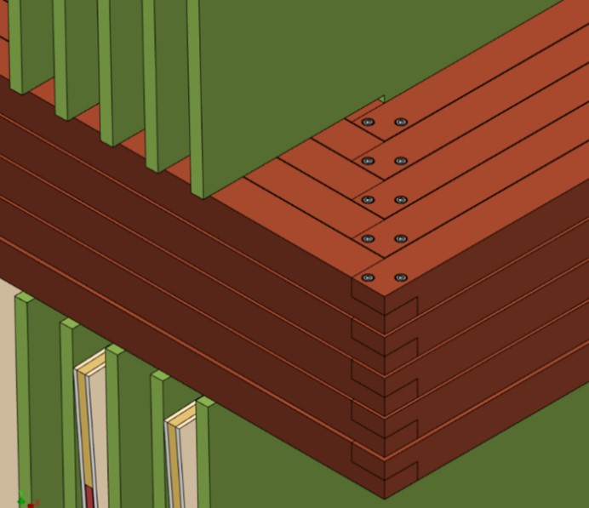
CDR Design Series connected 200mm x 200mm Coil Package Inserted into 220mm x 220mm Notch

Slide 3
Plan: Avoid 4x25 in-situ installed corner joints and jumpers per coil
Vendor pre-assembled coil, boxed and pre-tested. Lowered/raised through 30cm x 90cm slots. Center pairs of slots 62cm x 60cm must be “patched” closed afterwards.
CDR Steel Plate Design but MINOS ND style coil “planks” of 5 bars installed in-situ in 30cm x 30cm notches after plates assembled, joined and tested in pit

Slide 4
ANL Design is sound but relies on in-situ coil assembly after plates are assembled
Notches in magnet plates support upper and lower coils
Each of 6 Coils is composed of 4 legs of 25 pieces of electrically insulated 40mm x 40mm copper bar field-joined with 4 x 25 corner lap joints w/ screws + jumpers to form one continuous 25 turn loop
Coils cannot be inserted until steel plates and trapped detectors + front end electronics are assembled
Coils and Magnet cannot be tested until assembly complete
3.7m wide center plates over the size limit (102”=2.6m) for US roads
Max weight is 20000 kg = 20 truck loads of 3 5809kg 40mmx3.7mx5m plates (# special transports)
Z-struts proposed to limit z-deflection of plates rely on leaving space between detector panels
These spacer bolts/struts are meant to restrict both x and z motion. TWM does not understand how they work in x
Support structure design mechanically robust but
magnetic interaction with spectrometer not studied
1.5-degree strongback forcing a z tilt of each plate seems unnecessary
No guidance as to how support structure is held together (welds, bolts, ??)
No guidance as to how to locate and perhaps trap each steel plate

Slide 5
Proposed Modifications to Design (1)
Use CDR design but cut 3.7m wide plate in half for transport
Pre-build & pre-test coils in steel boxes, preferably by vendor
Baseline: CDR: 100 ANL lap joints and jumpers to make a 25-turn series coil
MINOS-like Corner pieces joining 5 bars in parallel to form a “plank”
Can this be done in-situ as for MINOS, keeping CDR “notch” design?
Vendor-cut 30cm x 90cm slots in plates for coil box insertion rather than vendor-cut 30cm x 30cm notches
Support each lower coil with ~2 x 10 pedestals and provide a low reluctance path to return the magnetic flux
PATCH the gaps in the slots below the center coils with 600mm x 620mm x (40 or 15mm) steel plates presumably welded as in MINOS
Lower upper coil packages into slots resting on the steel plates and fill gaps above the coils with patches
Outer coils of side plates probably do not need patches

Slide 6
Proposed Modifications to Design (2)
Keep plates vertical (not tilted 1.5 degrees)
Use temporary vertical strongback for last plate or group of plates. If possible (needs study):
In each 40mm detector gap, provide a surface (Aluminum U-channel) to support cassette and protect lower coil

Slide 7
Details: Forces on plates and coils
New pattern of spacer bolts to prevent bowing in z needs to be developed freeing central region from spacer bolts for cassettes
2 rows of spacers above and below coils?
Each side plate has a significant lateral force towards the center plate that needs restraint
2550-kg for the 40mm plates (side plate weight 2900 kg)
450-kg for the 15mm plates (side plate weight 1100 kg)
Design the interface between the support structure and the plate bottoms to lock in the bottom of the plates

Slide 8
Details: Field Studies: Optimize Plate dimensions and Patching
Add steel box to coil
Short stack studies seem to indicate that if 2cm gap can be BRIDGED to 0, less steel is required above and below the coils
Study if gap-filling patches permit 676mm dimension to be reduced
ANL studied a “Short Stack” inserting a 7.4m x 676mm x 7m Layer of Solid Steel below the vertical plates and reduced plate height by 676mm, for an overall net increase of 150k kg more steel and B~1.3T at I=30k A-turns.
Optimize “solid layer” vs. reduction in plate height
For the TOP Center Coils, there is some evidence that laying a ~80mm high plate across the slots serves the same effect as patching the gaps (see Craddock talk)
Optimize steel height above coil versus this bridging element
Once “patches” close the (CDR) 20mm inter-plate gap above and below the coils, perhaps optimize field with larger than 20mm plate-plate gap between coils

Slide 9
ANL Step File of CDR Design
Smaller coil box 225mm than that quoted in CDR text

Slide 10
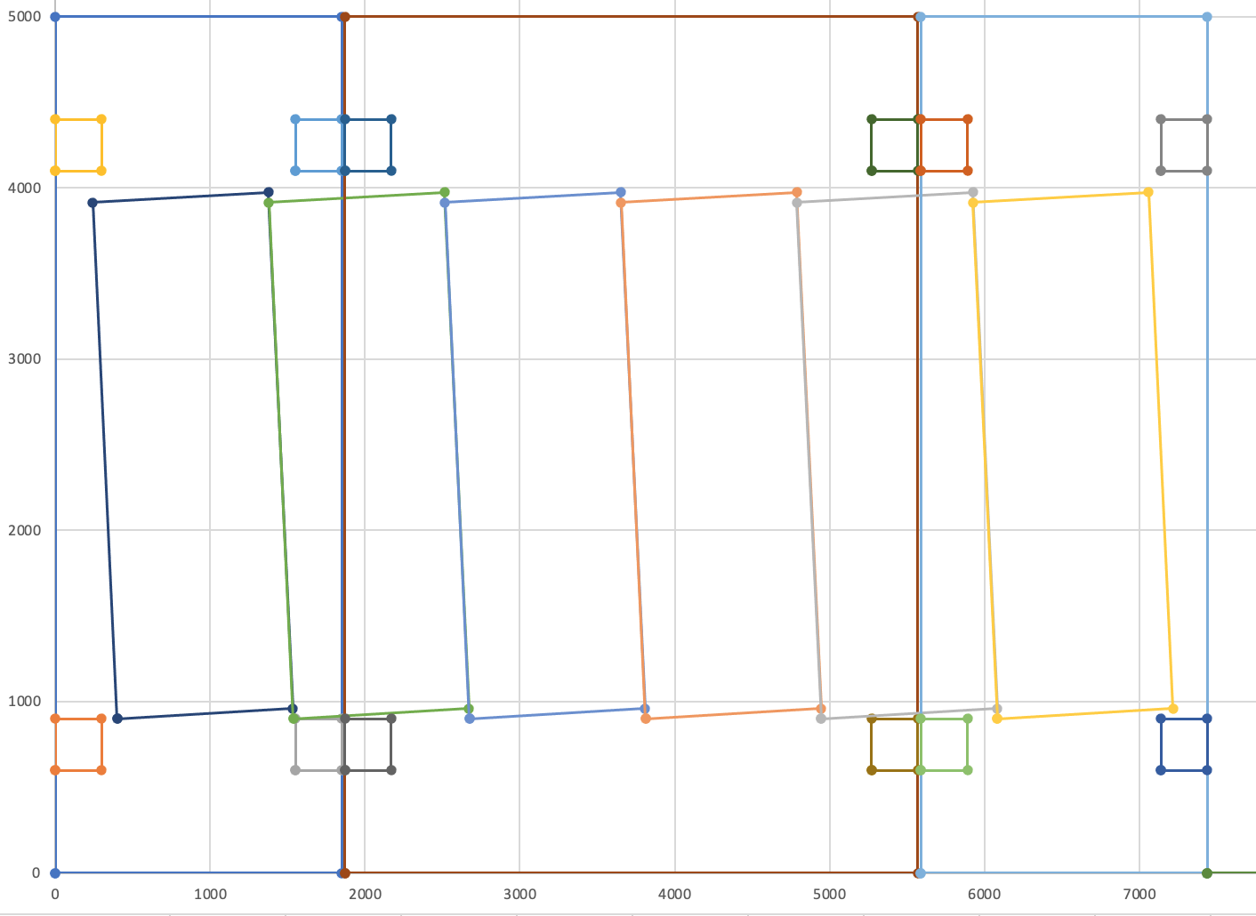
CDR w/ 300mm x 300mm notches and 3200mm between coils

Slide 11
CDR w/ 300mm x 900mm slots
and 3200mm between coils
Blue indicates steel patches above & below coils
Detector panels drawn as
32*35.4+2*2mm

Slide 12
On the Coil Supports for CDR
coil
Coil x-section 200 x 200 mm2
Mass of the central coil:
~9 metric tons
10 support per side,
20 support ~4500 N/ea
700 mm
X 10 coil supports
7 m
Coil
Support

Slide 13
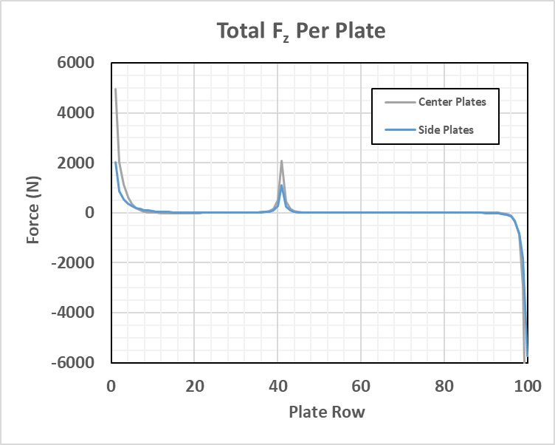
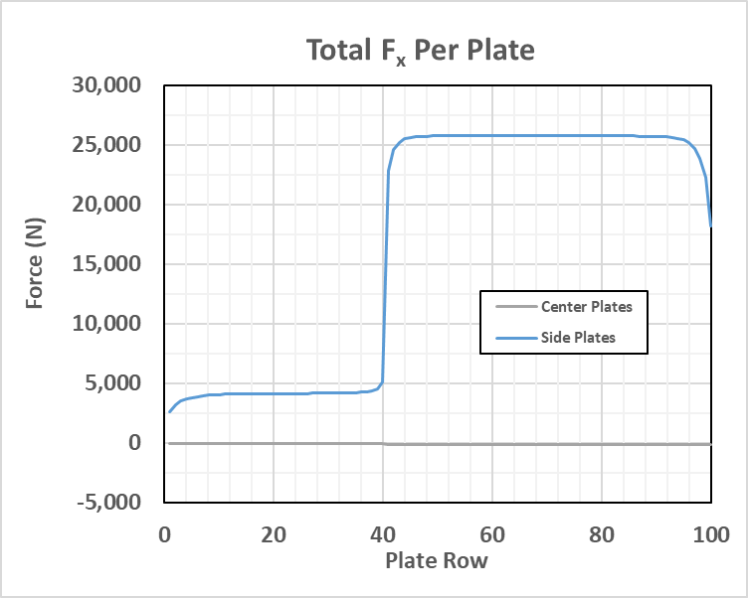
Structural Analysis: magnetic force on steel plates
Magnetic forces are summed on each of the steel plates

Slide 14
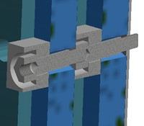
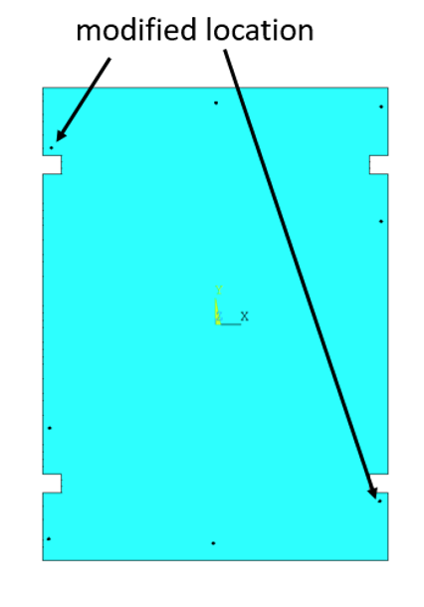
CDR Concept of Spacers to Maintain Plate Separation under Magnetic Forces 8 per plate
Interfer w/ detectors

