Slide 1
TMS Engineering Work Plan
M.Oriunno 3/8/2024

Slide 2
Magnet - Steel:
Key decision: 5/1/2024
CDR, Short Stack, other configurations
Required work :
B-field analysis, full 3D
Magnetic forces distribution (Fx, Fy, Fz, Mx, My, Mz)
Support of the steel stack on the frame
Preliminary Assembly procedures surface to cavern: handling, tooling at al.
Work with vendors to define machining, tolerances, supply logistic, cost, lead time
Magnet Internal Review, 7/15/2024

Slide 3
Magnet - Coil
Key decision: 5/1/2024
Planks assembly a-la Minos vs. Winding of thick plates vs. Winding of strand cables
Manufacturability and performance studies for each option
Required work:
Preliminary mechanical box design of the selected concept
Magnetic Forces acting on the Coils (Fx,Fy,Fz,Mx,My,Mz)
Structural and thermal FEA
Support and mechanical mounting on the steel
Preliminary Assembly procedures
Work with vendors to understand procurement, cost and availability.
Develop QA/QC procedures at assembly site (vendor, ND site, SLAC )
30kA electrical connections and cable to the power supplies
Coil Energy management at transients On-Off [ ½ L* i2] (can be managed through PS ?)
Energy dump in case of PS failure
Magnet Internal Review, 7/15/2024

Slide 4
Detector-Modules
Key decision: 6/1/2024
Counters packaging modularity (4,6, more..)
Orientation Stereo’s vs H & V
Required work:
General architecture of the patch panel (SiPm mounting, cables attachment, cable routing to one of the two sides)
CAD ad prototype work starting at U.Minnesota in June
Detector Modules Internal Review, 6/15/2024

Slide 5
Detector-Cassette
Key decision:
Insertion from the top or from the side of the steel stack
Top assembly possible only if top coils are not installed.
Required work:
Mounting scheme on the steel plates
Insertion mechanism
Steel plates flatness ( mechanical tolerances and B-filed deformation)
Cassette structural and thermal FEA
Patch panels, side, top, cables slack
Connections and R/O electronic location
From Assembly site to Experimental cavern: handling and logistic.
Timeline for the production of 100 cassette + spares: where and how
Detector Module Internal Review, 6/15/2024
Mini review 9/2024 (proposal)

Slide 6
Support Frame
Key decision: 7/1/2024
CDR vs ND-Lar
Work required:
Collecting Prism requirements and interface with Rollers
FEA validation
Adding mounting interface with Steel and coils
TMS electronic racks: requirements and location
PRIMS movers : electronic racks requirements and location
Supply and logistic form vendor site to ND site
Assembly procedure, Surface
Assembly procedure, Cavern
Energy chain services interface
Support Frame Internal review 8/15/2024

Slide 7
Spare Slides

Slide 8
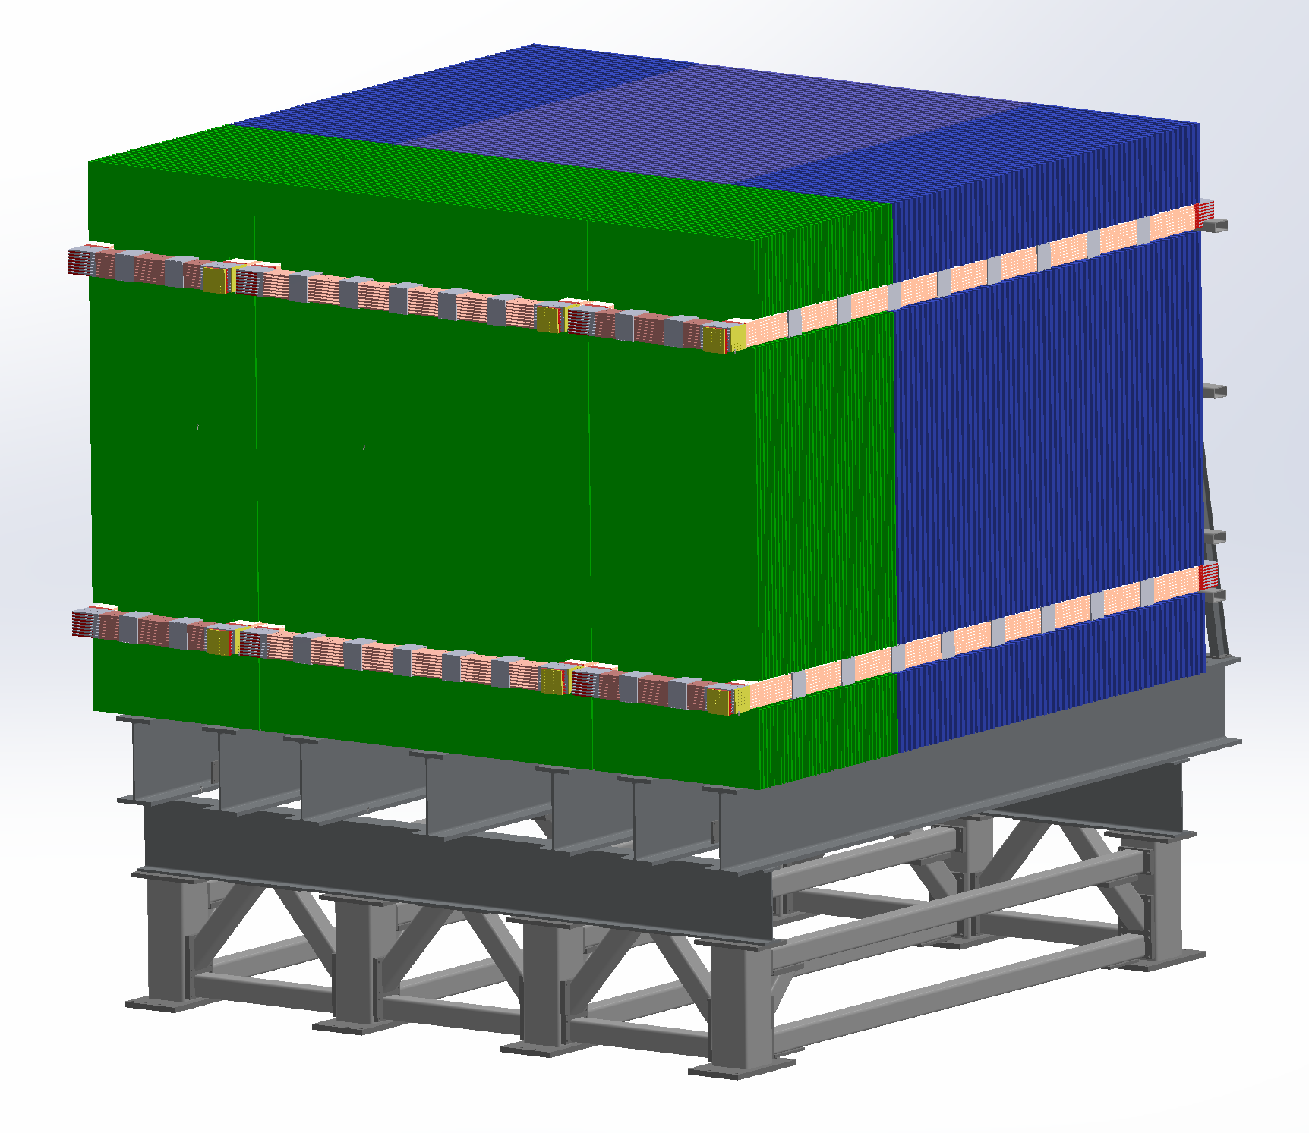

Slide 9
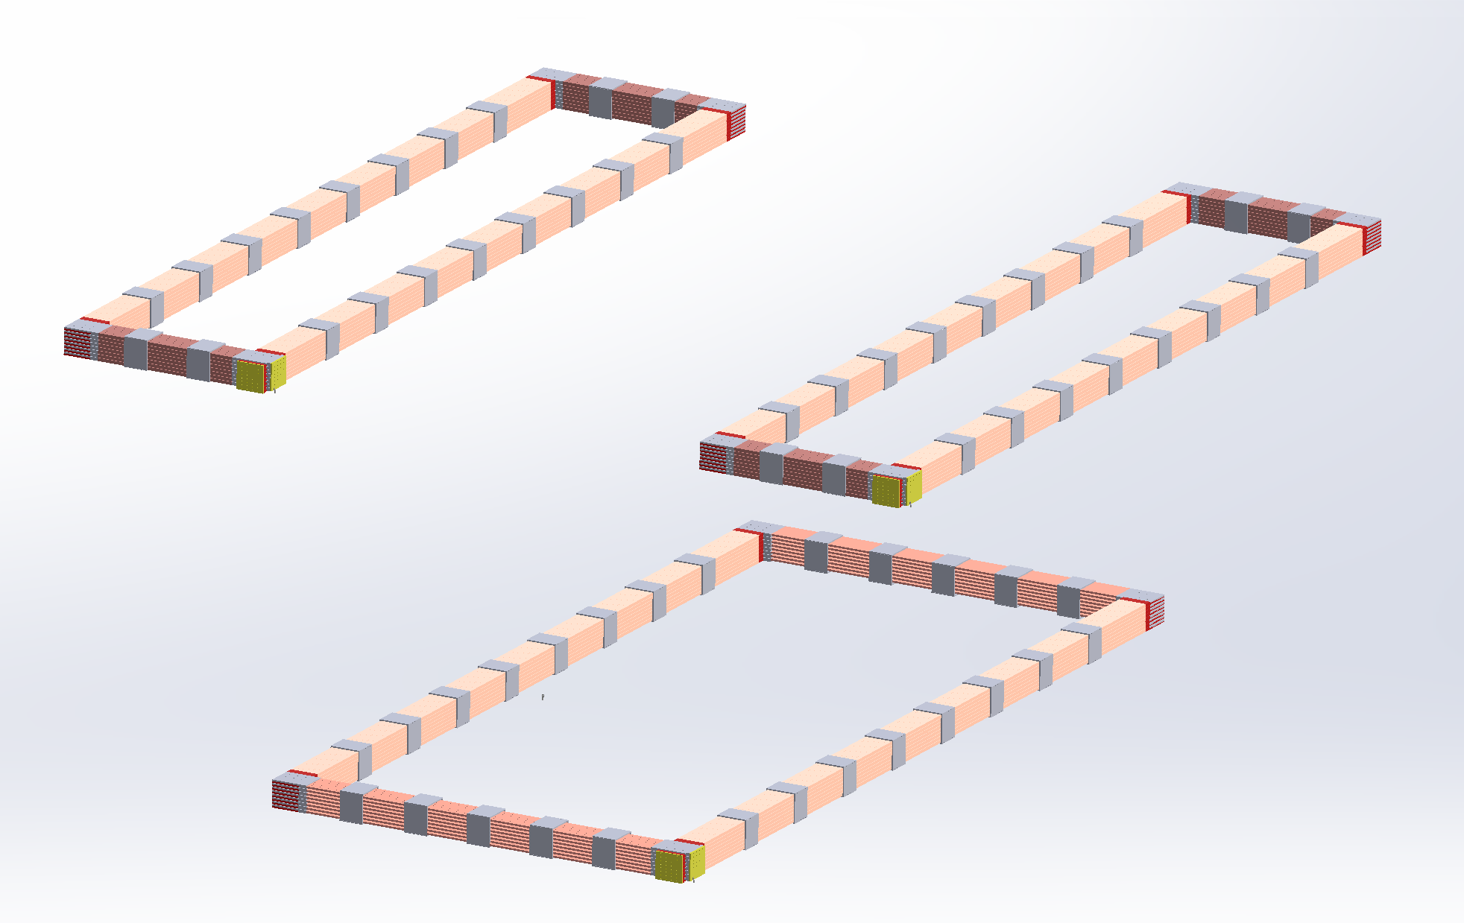

Slide 10
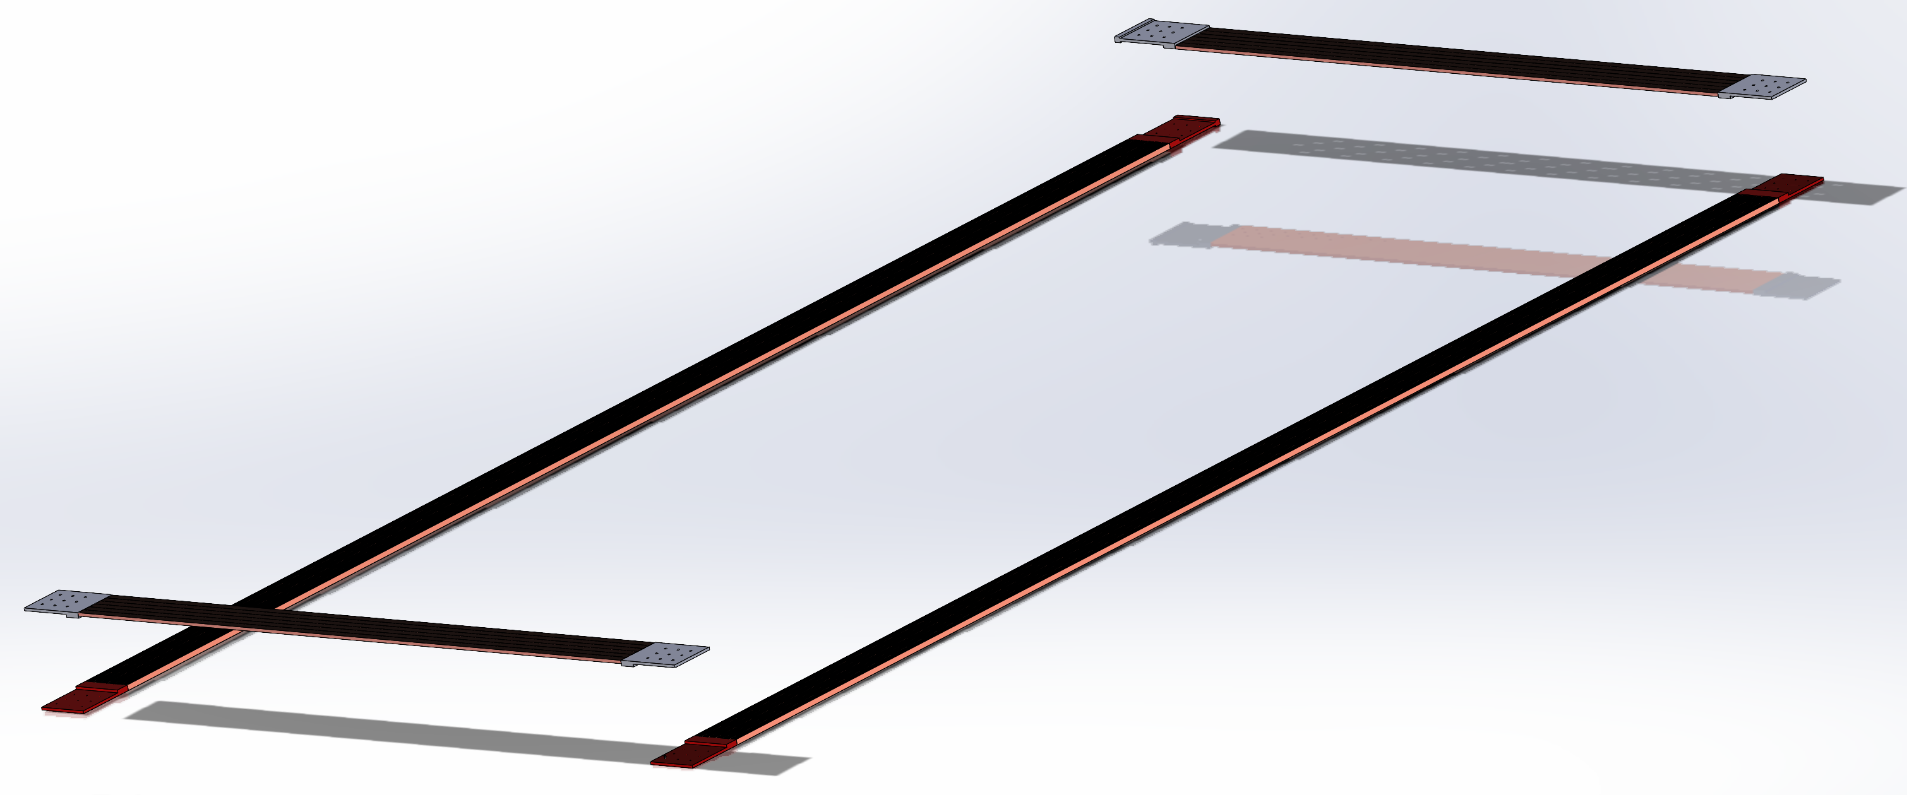

Slide 12
