Slide 1
TMS MAGNET DESIGN UPDATE
Wes Craddock SLAC
March 8, 2024

Slide 2
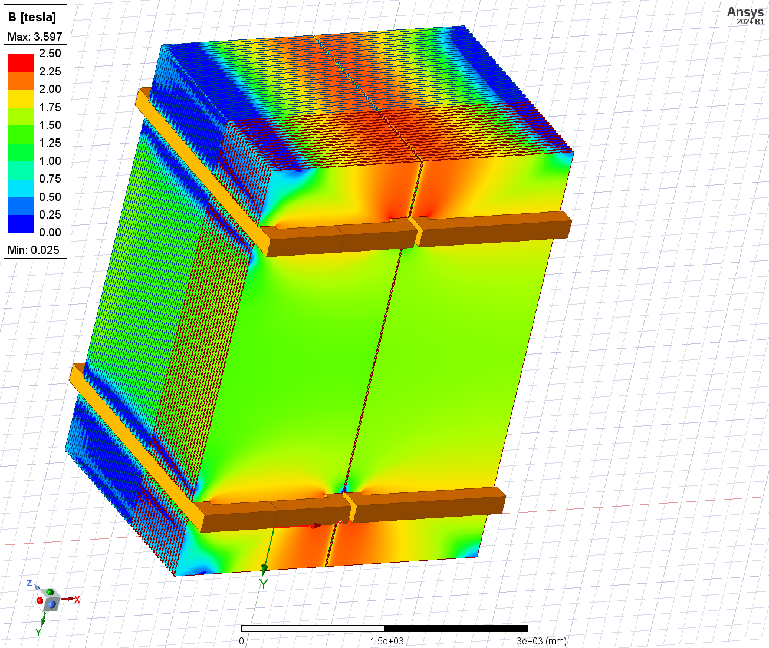
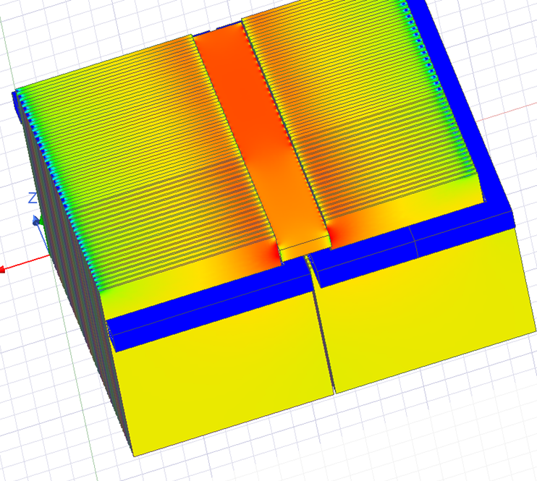
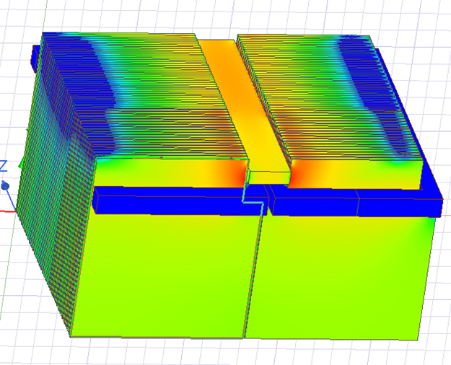
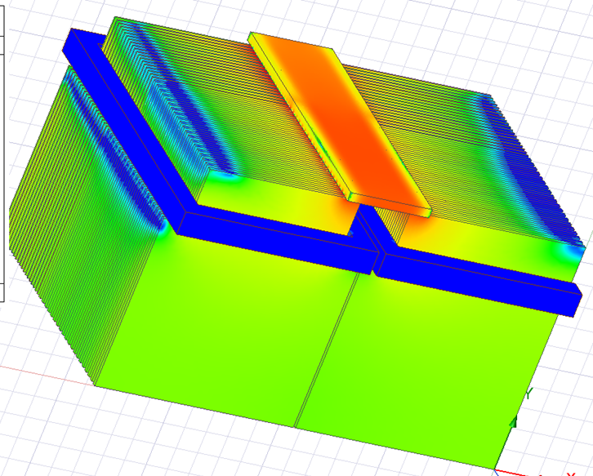
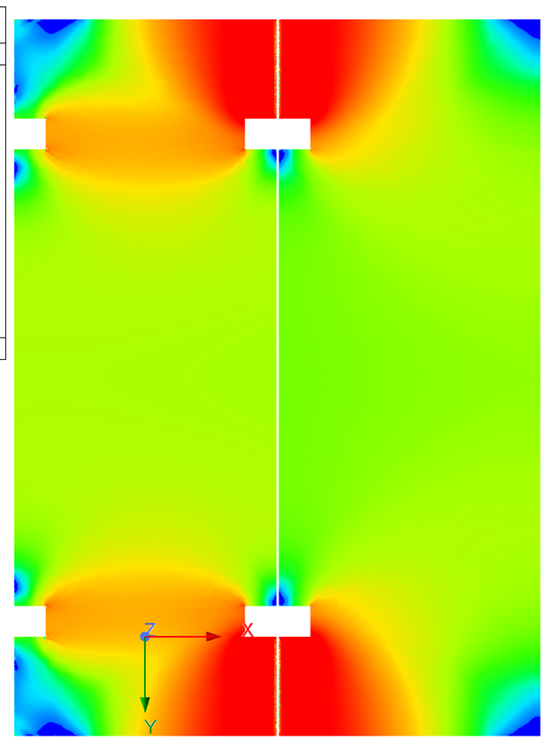
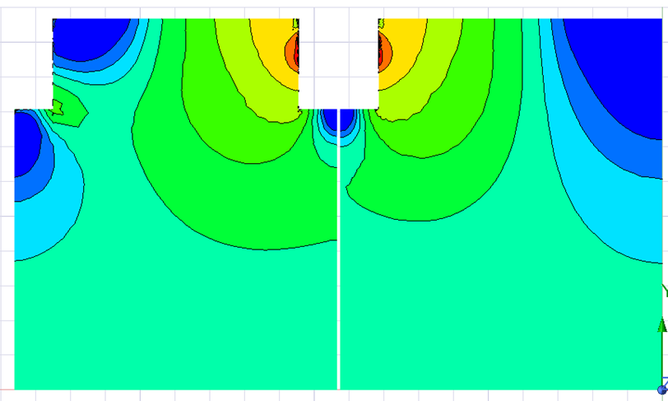
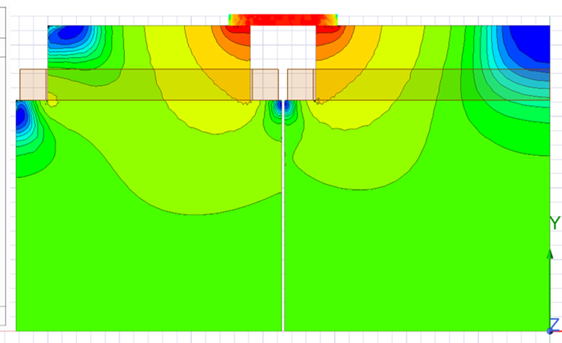
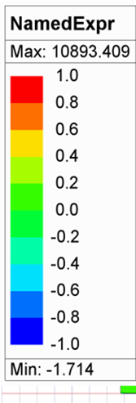
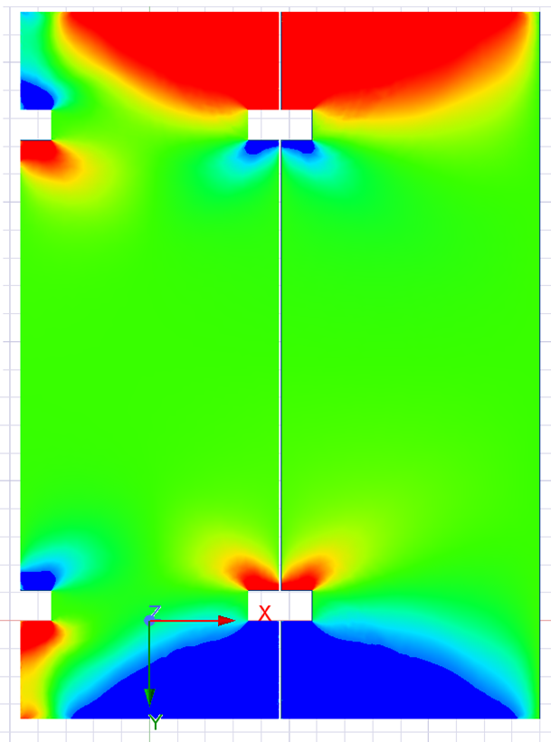
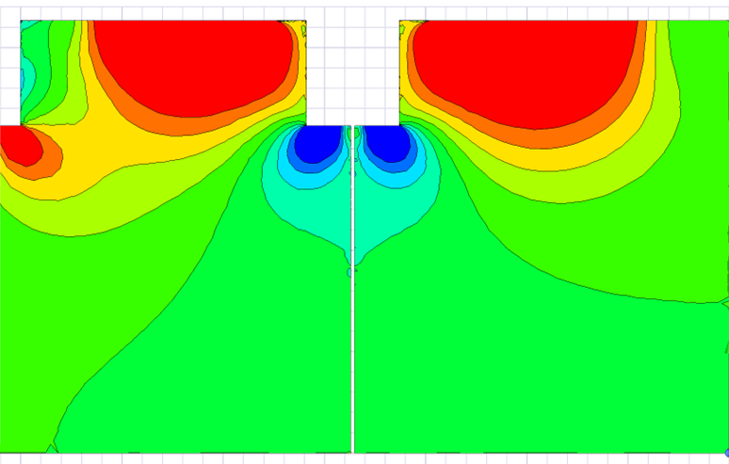
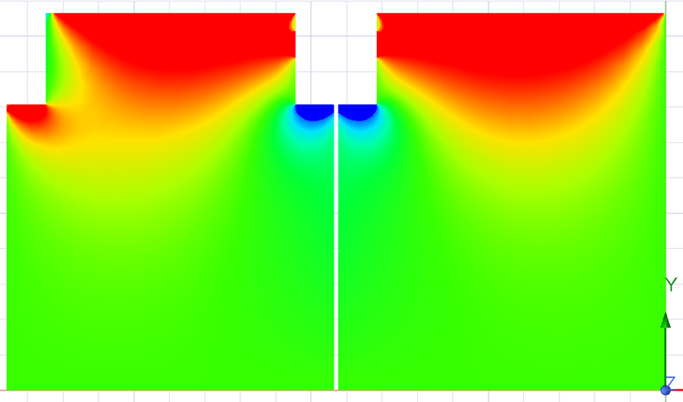
Summary Cases
20+20 Plates ½ and 1/4 Models
Baseline Case
Case 1: Slot Iron Touching
Case 2: Slot Iron 1+1 cm gap
Case 3: Iron Plate on Top
Bmag Middle 40 mm Plate
Bx Fraction Middle 40 mm

Slide 3
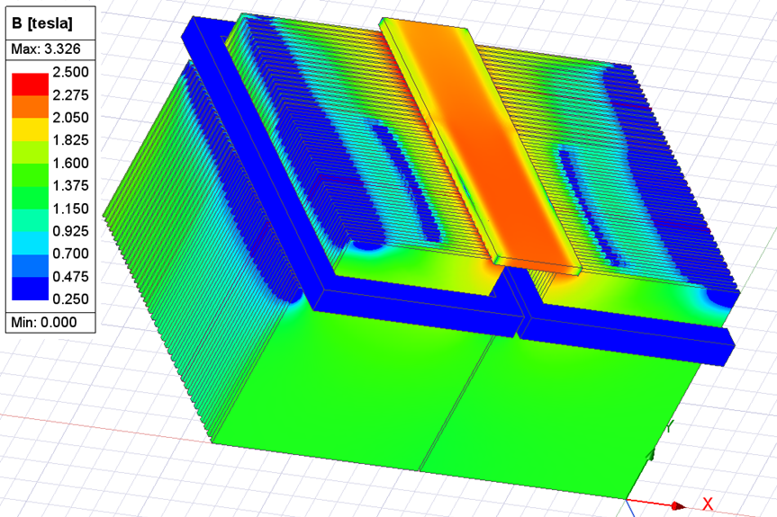
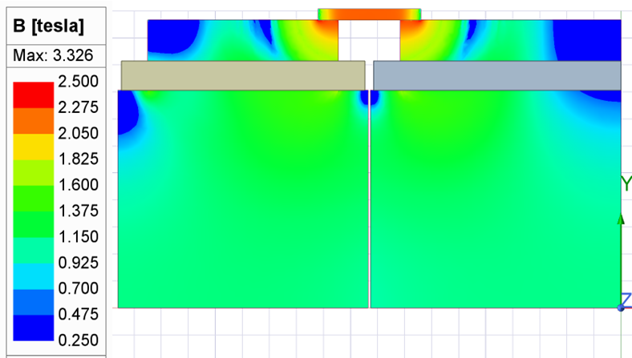
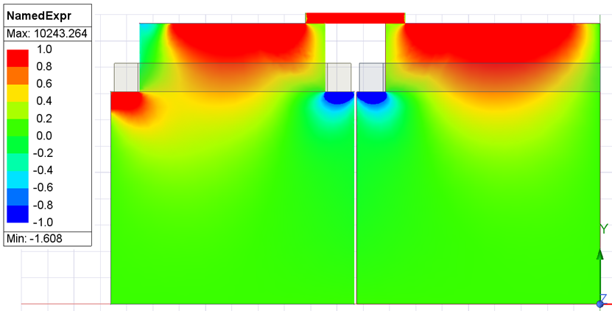
Summary Cases
20+20 Plates 1/4 Models
Case 4: Iron Plate on Top 20kA
Case 3: Iron Plate on Top
Model Currently Running
Bmag Middle 40 mm Plate
Bx Fraction Middle 40 mm

Slide 4
FINDINGS AND SUMMARY
Bridging the iron plates at the top and bottom provide a big benefit
Depending on the bridging the field uniformity can be degraded
Reducing the plate height by 800 mm (400 at top and bottom) is doable
It appears that the coil current can be reduced to 20 kA if MINOS iron is used. This is probable due to a MINOS extrapolated iron curve that I used.
Choice of filling in the central slots depends upon coil installation
With an open slot bridging iron can be optimized. The gap shape between vertical plates can also be optimized for field uniformity.
Magna Power Type TS power supplies seem to be a good choice. A 1250 A/20 volt or 625/40 volt supply both cost $18,415. The cabinet for 6 units is an extra $6995. These are 25 kW units. Magna Power makes supplies up to 100 kW. DynaPower is another source for power supplies.

Slide 5
Baseline Case
Solid Edge 20+20 Plates 1/2 Model
WorkBench 20 + 20 Plate Half Symmetry and 2 cm Plate Gap
Bmag on Region
Plate Height = 5066 mm
2 cm gap between plates
30 kA
Iron Center Bmag = 1.17 T

Slide 6
Solid Edge 20+20 Plates 1/2 Model
WorkBench 20 + 20 Plate Half Symmetry and 2 cm Plate Gap
Baseline Case
10th 15 mm Plates Bx Fraction
10th 40 mm Plates BxFraction

Slide 7
Solid Edge 20+20 Plates 1/2 Model
WorkBench 20 + 20 Plate Half Symmetry and 2 cm Plate Gap
Baseline Case
10th 15 mm Plates Bmag
10th 40 mm Plates Bmag

Slide 8
Case 1
Combined 20+20 Plates ¼ Model with SE Plate in Gap Rev 2d
Middle Plate Touching Vertical Iron Plates
TMS Quarter Model 3
Plate Height = 4266 mm
(Plate height reduced by 800 mm)
2 cm gap between plates
Center Slot Plate 460 mm X 150 mm
30 kA
Bmag on Region

Slide 9
Combined 20+20 Plates ¼ Model with SE Plate in Gap Rev 2d
Middle Plate Touching Vertical Iron Plates
TMS Quarter Model 3
Case 1
10th 15 mm Plates Bx Fraction
10th 40 mm Plates BxFraction
Bmag

Slide 10
Case 1
Combined 20+20 Plates ¼ Model with SE Plate in Gap Rev 2d
Middle Plate Touching Vertical Iron Plates
TMS Quarter Model 3
Bmag on Box 30 cm away from coils and top of iron plates
Bmag on Region

Slide 11
Case 2
Combined 20+20 Plates ¼ Model with SE Plate in Gap Rev 2d
Middle Plate 1cm + 1cm Gap On Vertical Iron Plates
TMS Quarter Model 3d
Plate Height = 4266 mm
(Plate height reduced by 800 mm)
2 cm gap between plates
Center Slot Plate 460 mm X 150 mm
30 kA
Bmag on Region

Slide 12
Case 2
Combined 20+20 Plates ¼ Model with SE Plate in Gap Rev 2d
Middle Plate 1cm + 1cm Gap On Vertical Iron Plates
TMS Quarter Model 3d
Bmag on Box 30 cm away from coils and top of iron plates
10th 40 mm Plates
Bmag on Region

Slide 13
DUNE TMS 3D ANSYS MAXWELL Modeling
Combined 20+20 Plates ¼ Model with SE Plate On Top Rev 3f
TMS Quarter Model 3b
Case 3
Plate Height = 4266 mm
(Plate height reduced by 800 mm)
2 cm gap between plates
Top Plate 460 mm X 150 mm
30 kA

Slide 14
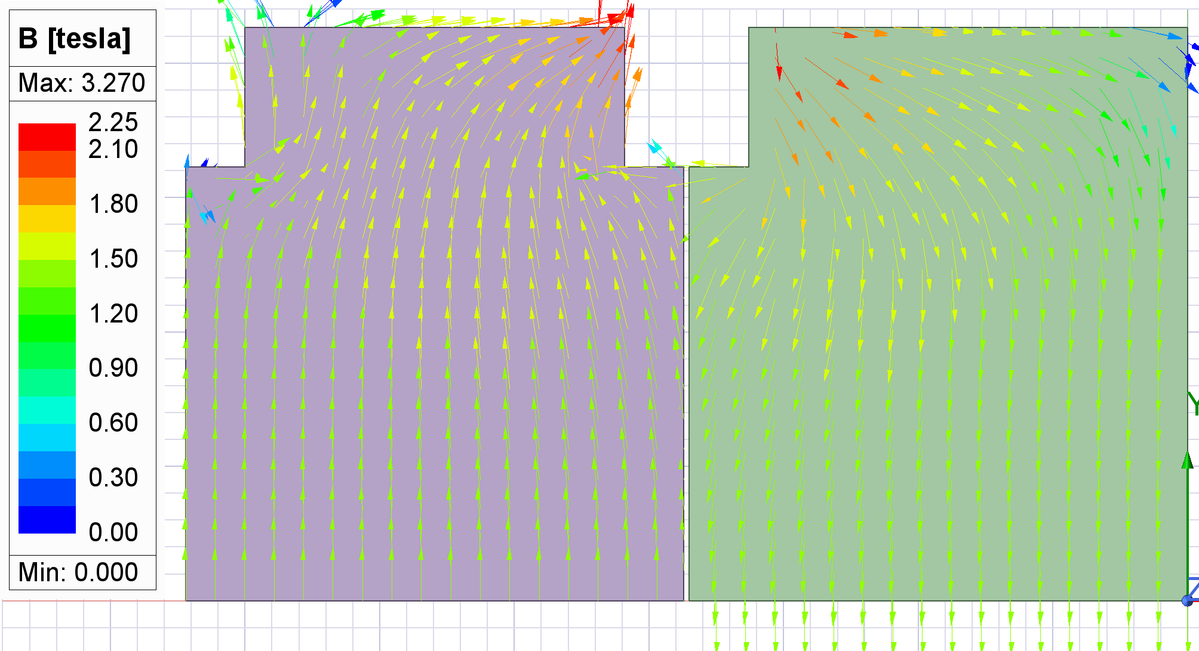
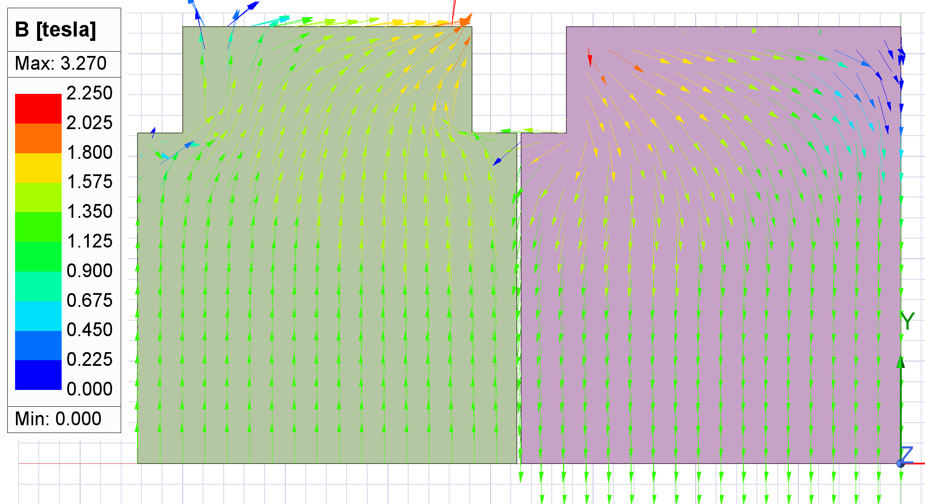
DUNE TMS 3D ANSYS MAXWELL Modeling
Combined 20+20 Plates ¼ Model with SE Plate On Top Rev 3f
TMS Quarter Model 3b
Case 3
10th 15 mm Plates Bmag
10th 40 mm Plates Bmag

Slide 15
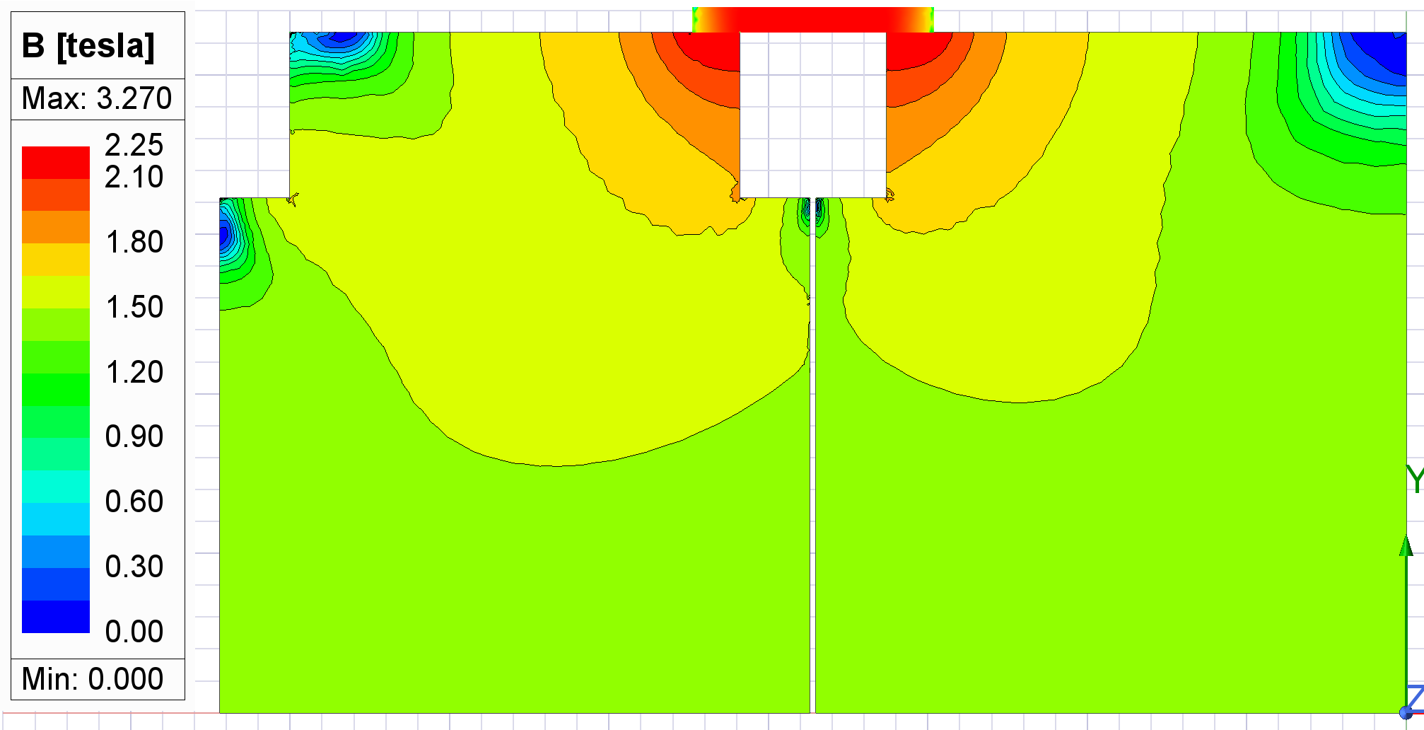
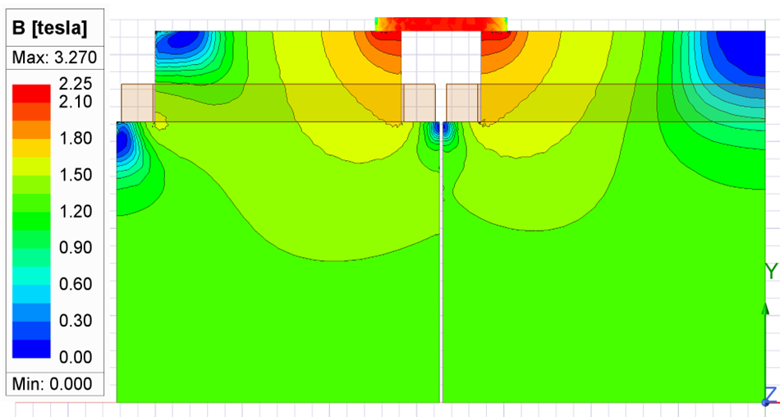
DUNE TMS 3D ANSYS MAXWELL Modeling
Combined 20+20 Plates ¼ Model with SE Plate On Top Rev 3f
TMS Quarter Model 3b
Case 3
10th 15 mm Plates Bmag
10th 40 mm Plates Bmag
Bmag

Slide 16
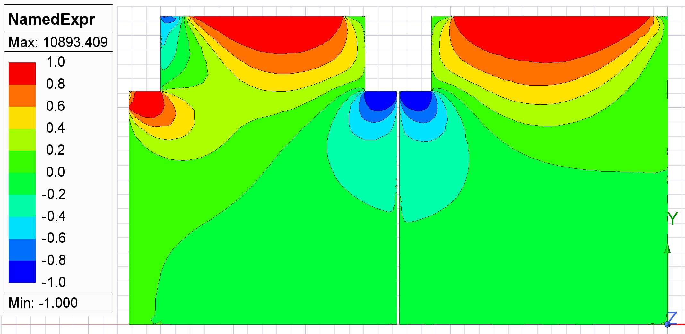
DUNE TMS 3D ANSYS MAXWELL Modeling
Combined 20+20 Plates ¼ Model with SE Plate On Top Rev 3f
TMS Quarter Model 3b
Case 3
10th 15 mm Plates Bx Fraction
10th 40 mm Plates BxFraction
Bmag

Slide 17
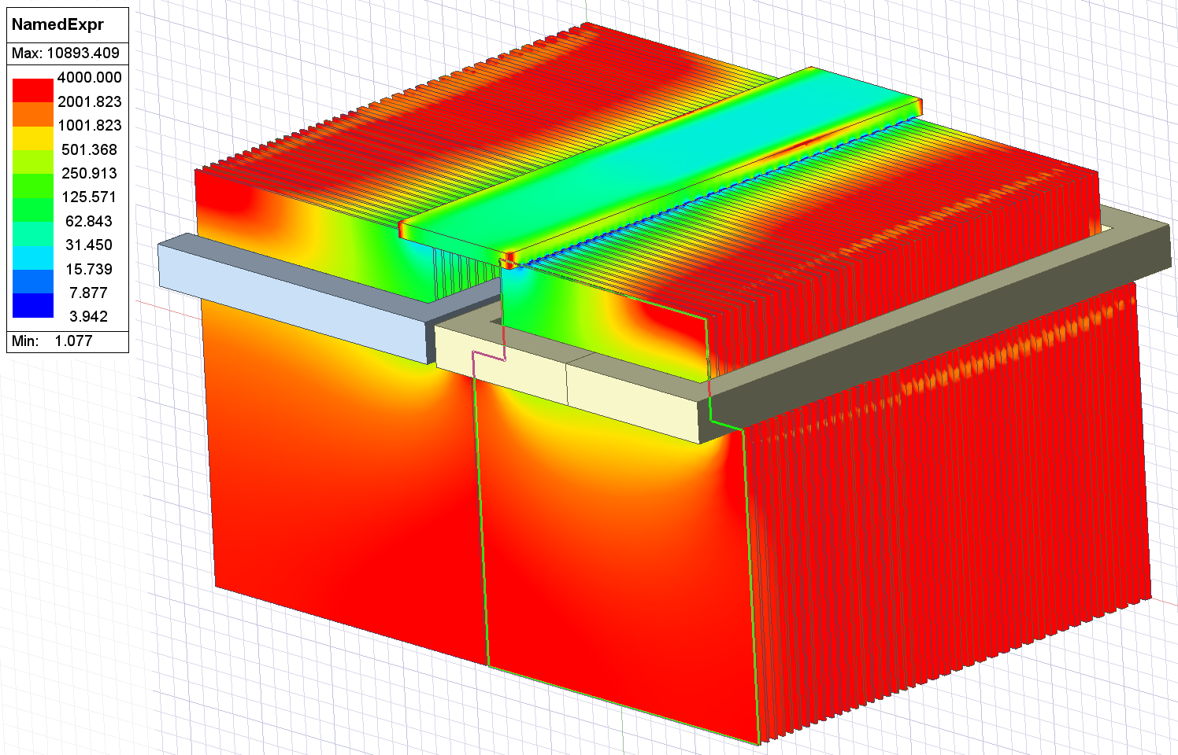
DUNE TMS 3D ANSYS MAXWELL Modeling
Combined 20+20 Plates ¼ Model with SE Plate On Top Rev 3f
TMS Quarter Model 3b
Case 3
Mu relative log scale

Slide 18
DUNE TMS 3D ANSYS MAXWELL Modeling
Combined 20+20 Plates ¼ Model with SE Plate On Top Rev 3f
TMS Quarter Model 3b
Case 3
10th 15 mm Plates Mu relative
10th 40 mm Plates Mu relative

Slide 19
DUNE TMS 3D ANSYS MAXWELL Modeling
Combined 20+20 Plates ¼ Model with SE Plate On Top Rev 3f
TMS Quarter Model 3b
Case 3
Bmag on Region
Bmag on Region

Slide 20
DUNE TMS 3D ANSYS MAXWELL Modeling
Combined 20+20 Plates ¼ Model with SE Plate On Top Rev 3f
TMS Quarter Model 3b 20 kA
Case 4
Bmag on Region

Slide 21
DUNE TMS 3D ANSYS MAXWELL Modeling
Combined 20+20 Plates ¼ Model with SE Plate On Top Rev 3f
TMS Quarter Model 3b 20 kA
Case 4
Mag B 10th 15 mm Plates
Mag B 10th 40 mm Plates
Bmag on Region

Slide 22
DUNE TMS 3D ANSYS MAXWELL Modeling
Combined 20+20 Plates ¼ Model with SE Plate On Top Rev 3f
TMS Quarter Model 3b 20 kA
Case 4
BxFraction 10th 15 mm Plates
Mu relative 10th 15 mm Plates
Mu relative 10th 40 mm Plates
BxFraction 10th 40 mm Plates

