Slide 1

Cathode Design and Status
Cathode overview
½ Frame Production
Resistive Mesh Production
Conclusion
PRR Cathode Frame and Resistive mesh
Fabien Cavalier on behalf of IJCLab team,
April 5th 2024

Slide 2
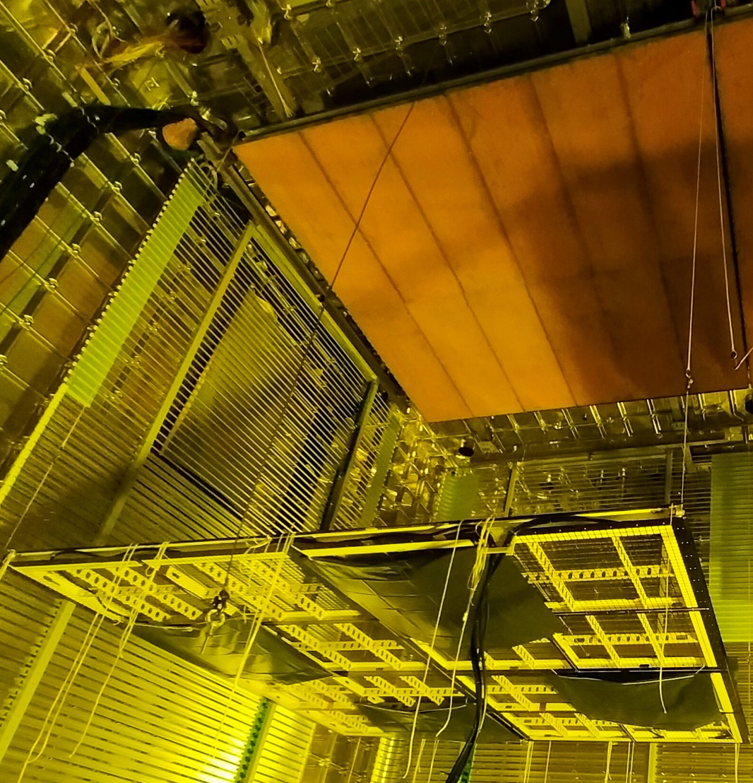
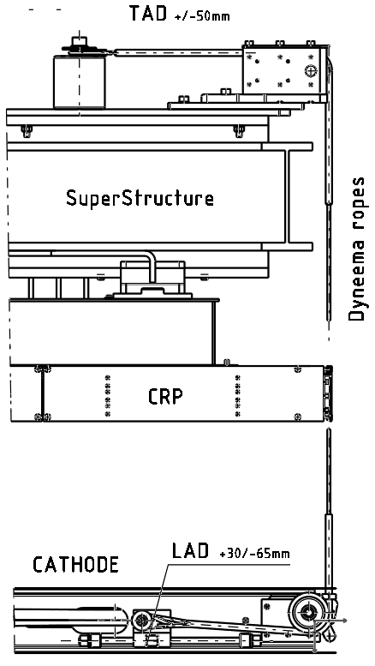
Cathode Overview
Module-0 Cathodes
Cathode Components

Slide 3
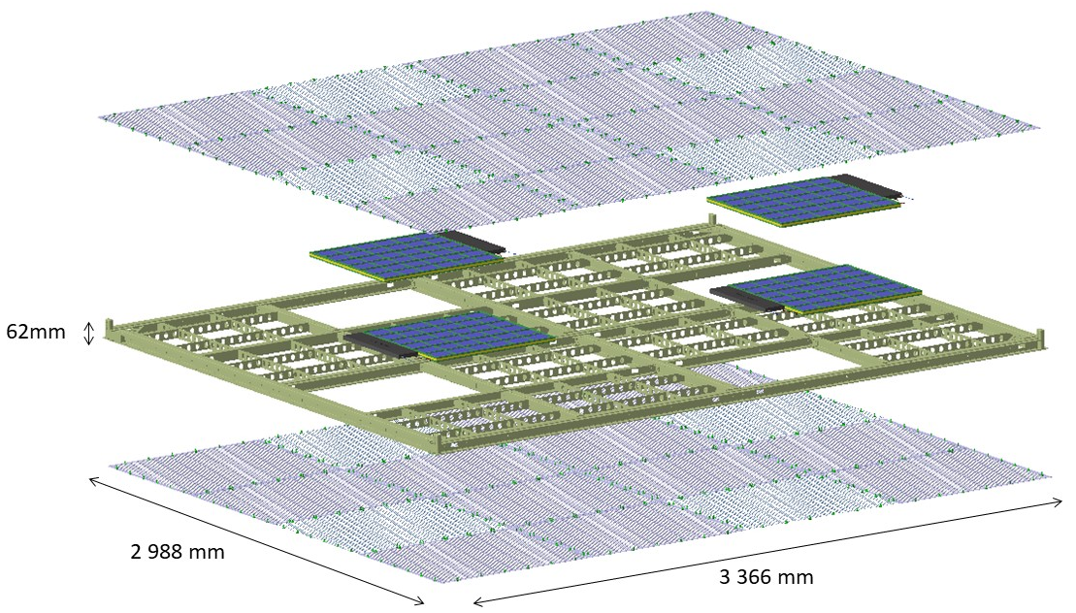
The Requirements
  Nominal Drift Field: 450 V/cm => Cathode at -290 kV
  Drift Field uniformity < ±1% [in 99.8% volume]
  Local electric field < 30 kV/cm
  Cathode Resistivity (to slow down possible discharges) : ~ 1 GΩ/sq. (lower limit 1 MΩ/sq., upper limit 10 TΩ/sq.)
  Dimension : 2988 mm x 3366 mm x 62 mm (footprint of CRP)
  Weight < 150 kg in air (including Photon Detector to minimize deformation of CRP )
  Bending < 20 mm in LAr
  Mesh transparency > 85% over Photon Detector and
  60% elsewhere for LAr flow
  Mesh pitch < 30 mm for field uniformity

Slide 4
Why a PRR now ?
Charge Question #4
Reason of the PRR: launch of call for tenders for cathode frames and resistive meshes
Some infos about call for tenders at CNRS
  Open calls that cannot be restricted to the prototype providers
  Once the call is launched,
    Private communication with companies is strictly forbidden
    All questions from companies and our answers are public on the submission site
  The documents (Drawings, QA …) cannot be changed and are the core of the contract between CNRS and the provider
Design must be the final one (modifications will be possible after signing the contract but will require addendums leading to extra costs most of the time)
Specifications have to be carefully written to reject non-serious providers and avoid trapdoors
Scoring grid which takes into account technical answers, price, delays, ecological impact
Long tendering process (4-5 months)
Long production time (> 1 year after ordering)

Slide 5
Scope of the review
Production of the ½ cathode frames in the industry (~600 k€)
Production of the resistive meshes in the industry (~350 k€)
Out of the scope
Cathode suspension system (TAD, LAD, ropes) which requires final validation during integration test at CERN Bat 185
Electrical connection
Assembly and final tests at IJCLab
Transportation to SURF
Installation at SURF

Slide 6
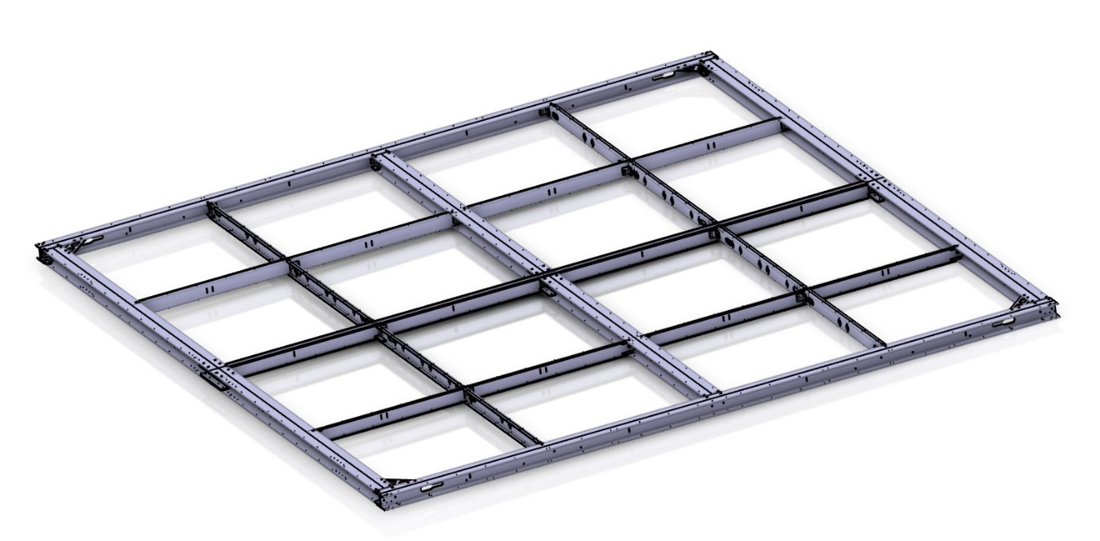
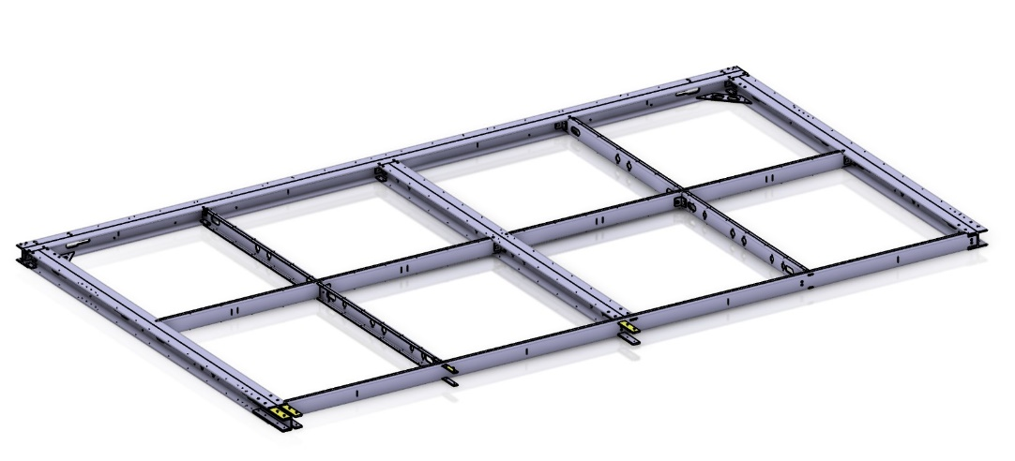
Cathode ½ Frame Reminders
Same concept (glued and screwed assembly of FRP H-shape and C-shape beams) since ColdBox prototype
½ frames to be assembled on site for easier transportation
=
+

Slide 7
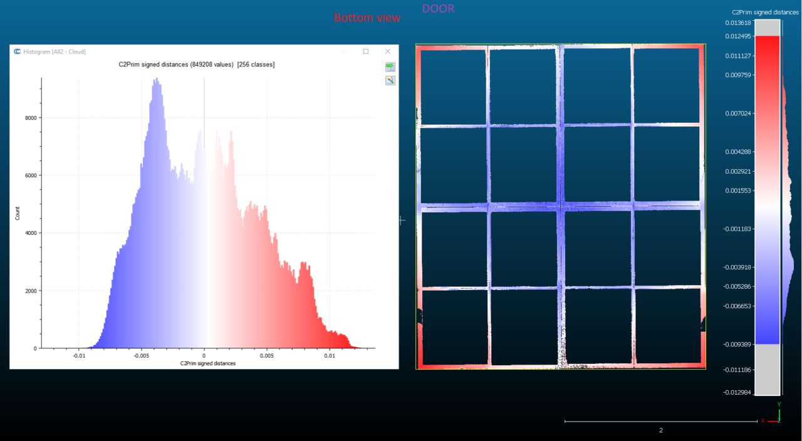
Coldbox and Module-0 Validations
Charge Question #3
ColdBox
Tens of cryogenic cycles since November 2021
=> no visible aging (cracks, fractures, delamination, blisters)
Module-0
3D scan after one year of hanging:
Deformation at the center slightly better than simulated: 21.9 mm versus 26.9 mm
  Final deformation in LAr will be about 7 mm
Deformation constant over one year (with a millimeter sensitivity for the few initial measurements with a laser meter )
=> no visible aging

Slide 8
Charge Question #2
Modifications since FDR
Value engineering to take into account the lessons in Module-0 installation and in view of an optimization for SURF installation:
Use of screws (with tooth lock washers) only for ½ frames assembly instead of glue and screws. Measurements at IJCLab with remaining prototype show no change in the deformation at the millimeter level
Shape modification of interlocking parts to ease the insertion and screwing
Reduction of the numbers of crossribs: only one rib per square => cathode plane deformation still within specifications
Reduction of the numbers of holes for resistive mesh screwing
Additional holes for LAD fixation and handling tools
Holes have been added or modified for PDS to take into
account their requests (see next slides)
Notes:
Dire ici que l’on ne présente pas le process d’installation mais qu’il est déjà pris en compte dans le design

Slide 9
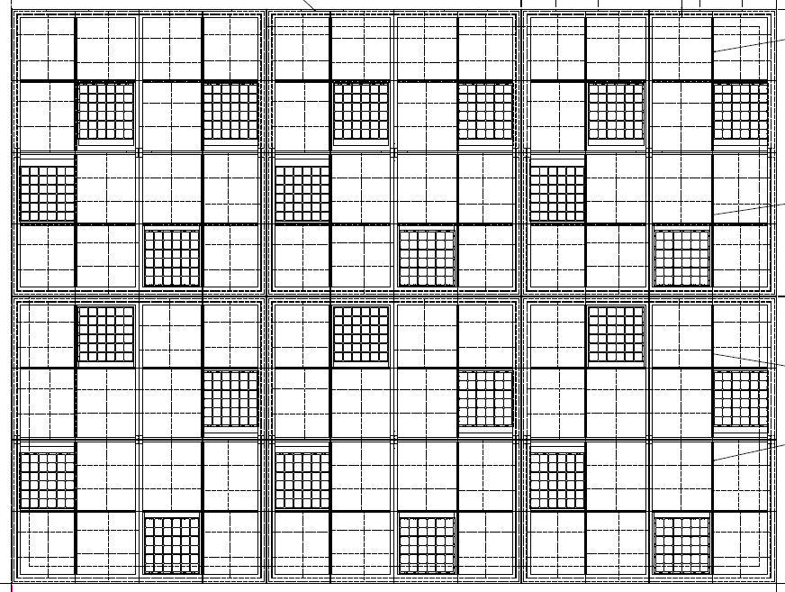
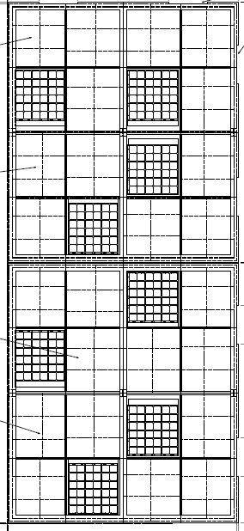
Interfaces with PDS
No Modification in X-Arapuca positioning
Row 2-19
Row 1 & 20

Slide 10
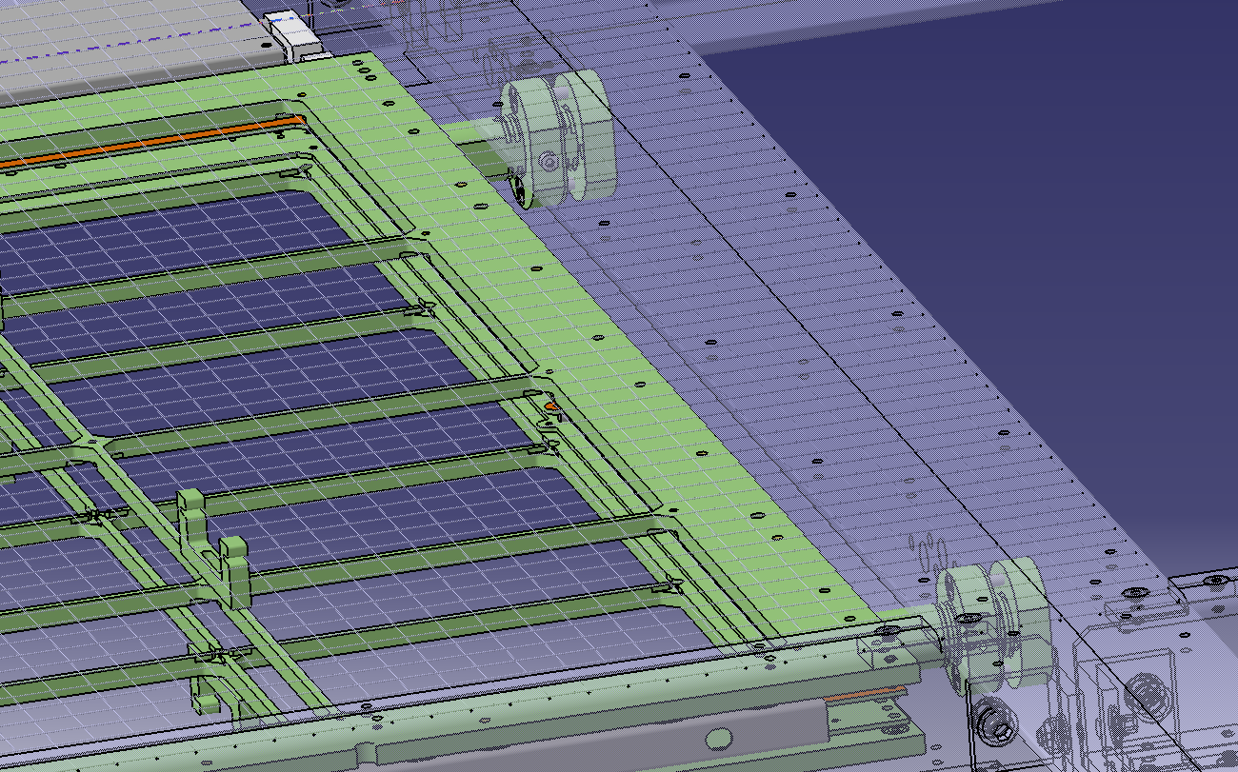
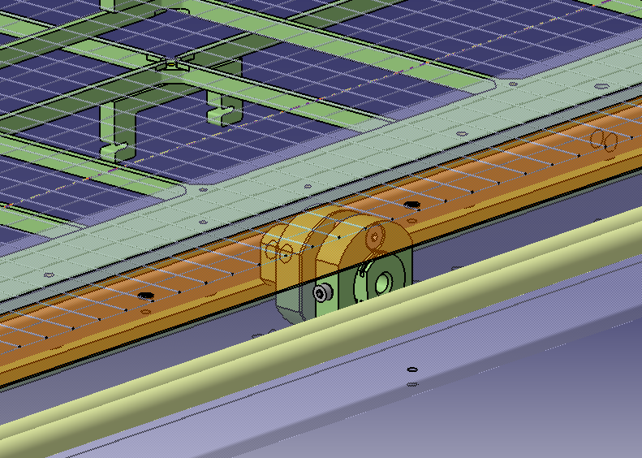
Interfaces with PDS
Charge Question #1
New design by PDS team of X-Arapuca support
Allows a simpler installation with less stringent tolerances
=> Just a change of hole size with respect to previous cathode design
Access from side for perimeter modules
Adjustment access from below for internal modules
Interface drawing: https://edms.cern.ch/document/2619007/3

Slide 11
Interfaces with PDS
Charge Question #1
Fiber routing similar to Module-0 one
Fixation holes added on the perimeter
Several possible positions for the support bracket and possibility to flip it
Interface drawing: https://edms.cern.ch/document/2619007/3
©Manhong Zhao

Slide 12
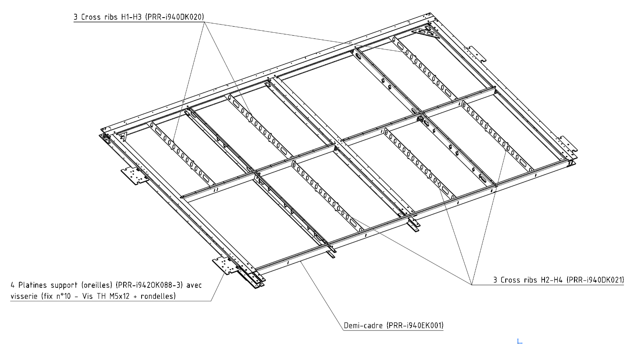
Charge Question #4
Produced Objects
172 ½ identical frames will be ordered (12 spares)
516 cross ribs H1-H3
516 cross ribs H2-H4
Remark:
Support plates for handling provided by IJCLab
Transport boxes provided by IJCLab
=> To be validated at the final Cathode PRR after Bat 185 tests@ CERN

Slide 13
Charge Question #5
QA/QC at the production site
Provider should be ISO 9001 V2015 certified (as a minimum), or must have an equivalent quality organization, which it must justify in its application
Material certificate
Dimensional inspection
Cleanliness
Gluing assembly
Screw assembly
Labelling
Acceptance tests for each batch
Non-compliant parts will be rejected
See examples hereafter and https://edms.cern.ch/document/3067365/1 for details

Slide 14
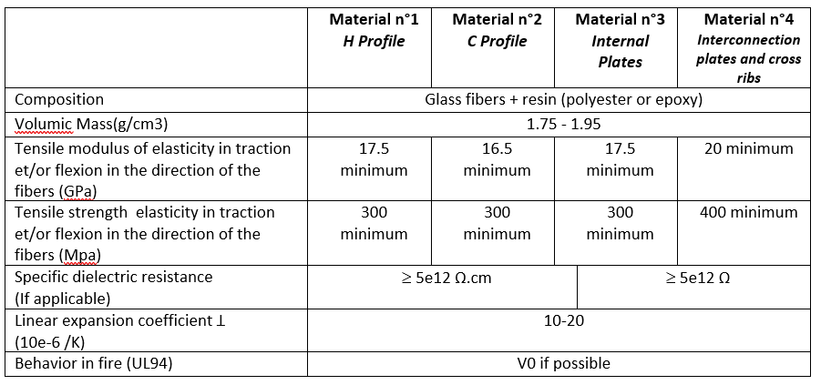
Technical specifications for manufacturing (1)
Charge Question #5
Nature of materials
The materials follow the recommendations of standard EN60893 or EN13706.
[A1]
Material certificates will be supplied in accordance with standard EN 10204 2.1 by default and for all the characteristics specified in [A1]
Exceptions:
modulus of elasticity and strength for materials n°1 and 2 : certificate 3.1 based on tests on samples taken for each production batch before processing
strength for materials n°3 and 4 : certificate 3.1 based on tests on samples taken for each production batch before processing

Slide 15
Charge Question #5
Technical specifications for manufacturing (2)
Dimensional inspection
Dimensional check of all dimensions for all the first parts of a series machined by numerical programming → inspection report.
Dimensional check for framed dimensions or dimensions with tolerances : 2% of samples from the same series out of the entire production run → inspection report.
After dimensional inspection, a stop point may be requested before factory acceptance.
Cleaning and cleanliness control
Cleaning method: use a white cotton cbatchh soaked in denatured alcohol to be rubbed on each part
After completion of the manufacturing operations and before assembly, the parts must be cleaned, if necessary, to remove all traces of contamination, dust, grease, hydrocarbons and any other substances which could pollute and dissolve in the liquid argon.
Test, inspection and handling equipment must be thoroughly cleaned and degreased before use.
Particular care must be taken to prepare and clean the parts and surrounding areas before and after bonding.
After cleaning, the various components must be handled in such a way as to maintain their cleanliness.
The cleanliness check will be validated on receipt at the factory. During the inspection, the mechanical part is rubbed to check that no heavy dark marks are visible on a damp white batch. If this is not the case, the Contractor must proceed with cleaning to achieve the objective.

Slide 16
Charge Question #5
Technical specifications for manufacturing (3)
Handling and packaging
After cleaning, parts should be handled using clean gloves. They should be protected as far as possible from the ambient pollution of the workshop when stored for long periods.
Gluing assembly
Gluing must be carried out exclusively with araldite 2011 glue
Particular care must be taken in preparing (sanding) and cleaning the parts before (dusting and degreasing) and after bonding (removal of excess adhesive), as well as the surrounding areas. In particular, pads should be added under M4 tappings to prevent glue build-up.
The contractor is advised to pre-assemble the system in order to check the conformity of the mechanical elements and screws. It must be ensured that the half-frames are easy to assemble, without having to force all the parts together.
Screw assembly
Components must be screwed together in compliance with the rules of the art relating to composite materials (tightening torques defined in appendix [A3]).

Slide 17
Charge Question #5
Technical specifications for manufacturing (4)
Interlocking check
All half-frames must undergo an interlocking check, done at reception at IJCLab and by IJCLab. The checking and adjustment method is defined in document [A3] on the dedicated technical plan. Test equipment will be supplied by IJCLab.
It is imperative that the quality of the interlocking is checked, can be adjusted during assembly, and the result must appear in the test report. A stop point may be requested before the factory acceptance test.
Deformation test
All half-frames must be tested for bending deformation under load, done at reception at IJCLab and by IJCLab. The test method is defined in document [A3] on the dedicated technical plan. Test equipment will be supplied by IJCLab.
During the deformation test under load, a visual examination and an out-of-limit deformation value should enable us to detect, if necessary, any problems of material resistance, or assembly by screwing and/or gluing.
Labeling control
The Contractor will propose a method for labelling and identifying the series of half-frames and their transport boxes. This labelling must remain visible and legible.
This control will be validated on acceptance at the factory and must also be archived on a computer file of the type indicated in §13.1, attached to the manufacturing and control file.

Slide 18
Charge Question #5
Technical specifications for manufacturing (5)
Storage of half-frames out of packaging
The Contractor must use specific dry and clean storage areas to prevent damage and deterioration of raw materials, articles made by service providers and equipment awaiting use or delivery, in compliance with paragraph §10.5 and the schedule execution of paragraph §15.
Packaging
The packaging of the half-frames for transport is the responsibility of the Contractor. The principle is defined on a dedicated technical plan in document [A4] and shows its principle: 1) the packaging must provide protection against dust by winding plastic stretch film around each half-frame (except around the ear supports); 2) the fixing of the half-frames by the ear supports on the internal racks of the transport box guarantees any possible shocks inherent to handling and transport.
The closed box will be referenced following the remarks in §9.10.

Slide 19
Production and delivery Schedule for ½ frame
Call Opening
Contract Signature
Deliveries
Providers are responsible up to the delivery at IJCLab
Providers can propose a more aggressive planning => better score in the evaluation
Providers can anticipate some deliveries but cannot go below the average rate
Penalties foreseen (1000 € per day) in case of delays
See example hereafter and https://edms.cern.ch/document/3067365/1 for details

Slide 20
Example of planning for the frame production & delivery
• T0 : notification date.
• T1 (T0+2 weeks): Preparatory meeting between the Contractor and the IJCLab
• T2 (T1+3 weeks): Submission of the detailed manufacturing and final delivery schedule.
• Before T3: provision of material certificate 3.1 of the material supplied (see §9.1)
• T3 (T2+16 weeks max): Factory pre-acceptance testing of the first half-frame (§10)
• T4 (T2 + 26 weeks): Factory acceptance testing for batch no. 1 of 12 half-frames between Contractor and IJCLab
• T4 bis (T4 + 2 weeks): Delivery to IJCLAB of batch no. 1
• T4 ter (T4 bis + 4 weeks): end date of the IJCLab control period to declare conformity and final receipt of the batch.
• T5 (T4 + 8 weeks): Acceptance testing for batch no. 2 of 36 half-frames between Contractor and IJCLab
• T5 bis (T5+ 2 weeks): Delivery to IJCLAB of batch no. 2
• T5 ter (T5 bis + 4 weeks): end date of the IJCLab control period to declare conformity and final receipt of the batch.
• T6 (T5+8 weeks): Acceptance testing for batch no. 3 of 36 half-frames between Contractor and IJCLab
• T6 bis (T6+ 2 weeks): Delivery to IJCLAB of batch no. 3
• T6 ter (T6 bis + 4 weeks): end date of the IJCLab control period to declare conformity and final receipt of the batch.
• T7 (T6+ 8 weeks): Acceptance testing for batch no. 4 of 36 half-frames between Contractor and IJCLab
• T7 bis (T7+ 2 weeks): Delivery to IJCLAB of batch no. 4
• T7 ter (T7 bis + 4 weeks): end date of the IJCLab control period to declare conformity and final receipt of the batch.
• T8 (T7+ 8 weeks): Acceptance testing for batch no. 5 of 36 half-frames between Contractor and IJCLab
• T8 bis (T8+ 2 weeks): Delivery to IJCLAB of batch no. 5
• T8 ter (T8 bis + 4 weeks): end date of the IJCLab control period to declare conformity and final receipt of the batch.
• T9 (T8+ 4 weeks): Acceptance testing for batch no. 6 of 16 half-frames (or the remaining number in the event of intermediate deliveries) between Contractor and IJCLab
• T9 bis (T9+ 2 weeks): Delivery to IJCLAB of batch no. 6
• T9 ter (T9 bis + 4 weeks): end date of the IJCLab control period to declare conformity and final receipt of the batch.

Slide 21
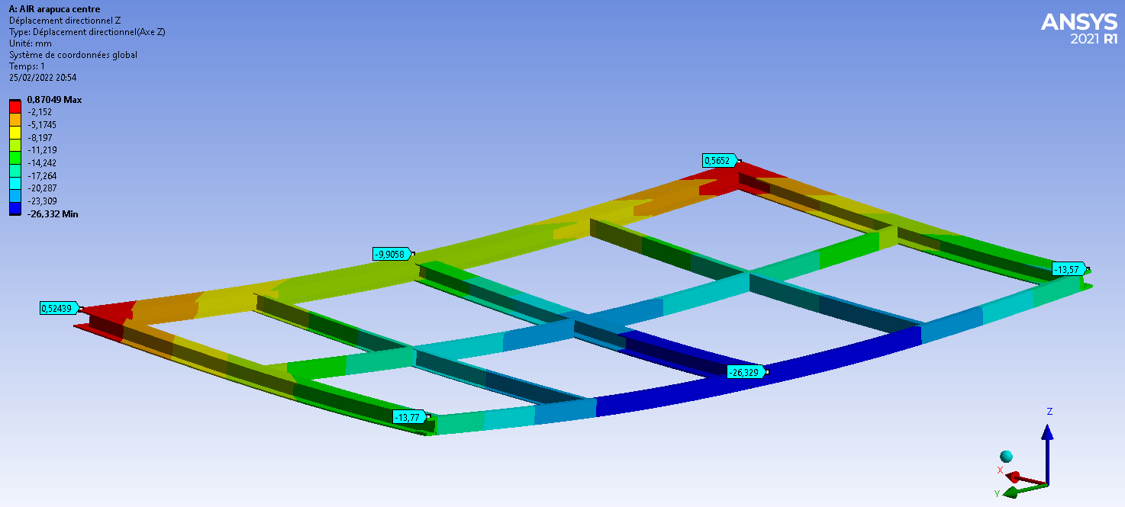
Compliance Office Validation
New analysis (compared to FDR) to take into account design changes (no glue and only screws)
Clarification on materials:
  STTC requirements are more stringent than the ones used in the structural analysis
  Request 3.1 certificates on all critical data used in FEA analysis
Information on tests (see next slide)
Same conclusions about deformation and safety margins
Validation from Compliance Office

Slide 22
Charge Question #6
Reception and Validation tests @ IJCLab
Tests for all ½ frames
  Dimension
  Interlocking check
  Deformation test under load
3 Weeks foreseen between reception and validation

Slide 23
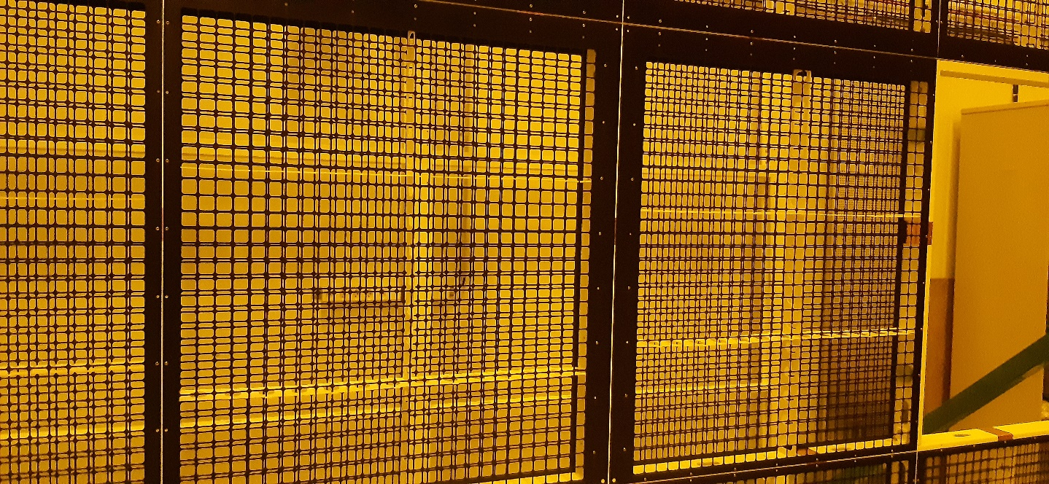
Cathode Meshes and Surmeshes reminders
Perforation pattern identical since first prototype installed in ColdBox since April 2022
Hole size: 24.5x 24.5 mm² spaced by 2.5 mm
Installed in Module-0
No issue encountered during mounting and PDS installation

Slide 24
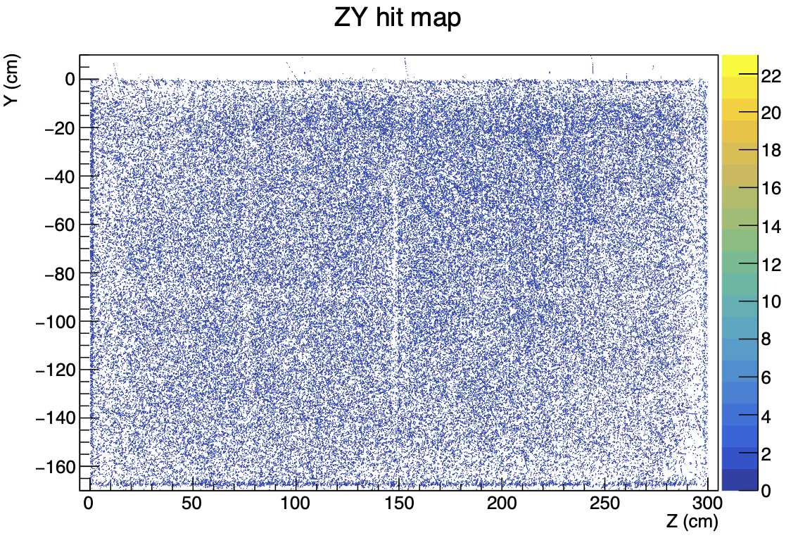
ColdBox validations
Charge Question #3
Tens of cryogenic cycles since April 2022
=> no visible aging (cracks, fractures, delamination, blisters)
Drift field in the ColdBox in agreement with expectations
No spark or large distortion have been observed
Non-uniformity in the first centimeter above the cathode in agreement with simulations

Slide 25
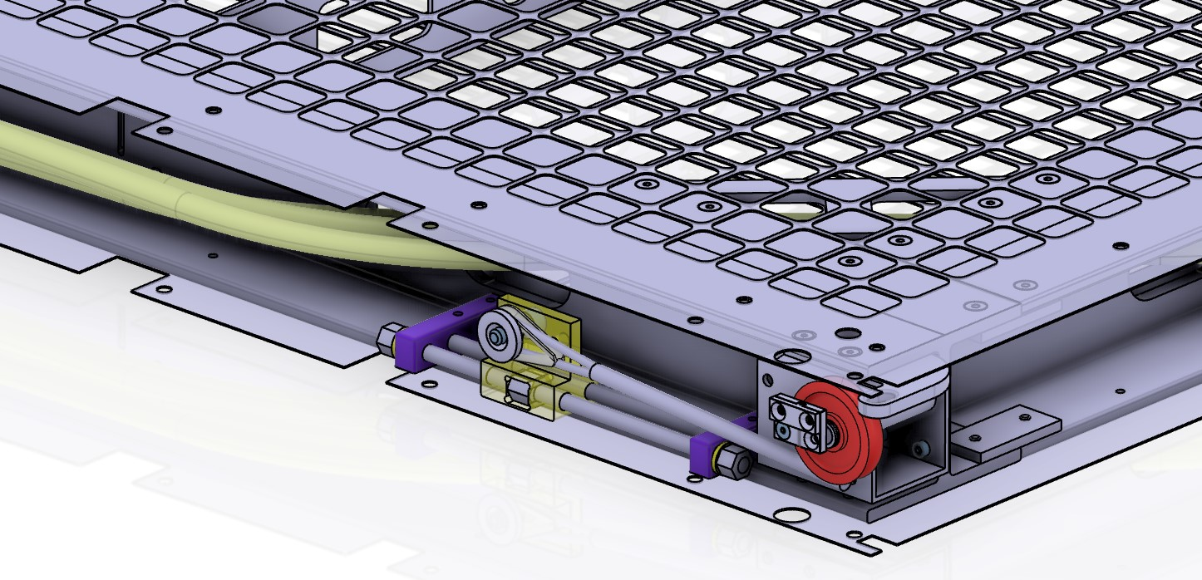
Modifications since FDR
  Reduction of the numbers of holes for fixation
  Slot for Dyneema ropes
  Technical access for LAD tuning
Charge Question #2

Slide 26
Produced objects
Charge Question #4
2 types of meshes:
  672 for frames corners with ropes and TAD access
  1344 for the other places on the cathode frame
Surmeshes:
  needed to cover the edges of the metallic mesh above X-Arapuca for the ones placed on the edge of the cathode frame
  3 types with different lengths as the frame is rectangular and for rows 1 and 20 (respectively 324, 248 and 12 units)
5% of spares included in the preceding numbers
A surmesh

Slide 27
Surmesh positioning
Type 1
Type 3
Type 2
Row 2-19
Row 1 & 20

Slide 28
Charge Question #5
QA/QC at the production site
Provider should be ISO 9001 V2015 certified (as a minimum), or must have an equivalent quality organization, which it must justify in its application
Material certificate: standard EN 10204 2.2 by default, except for the surface resistivity which must be on certificate 3.1 based on tests on samples taken for each production batch before processing
Dimensional and electrical inspection
No delamination or asperity
Cleanliness
Labelling
Acceptance tests for each batch
Non-compliant parts will be rejected
See https://edms.cern.ch/document/3067378/1 for details

Slide 29
Production and delivery Schedule for mesh
Call Opening
Contract Signature
Deliveries
Providers are responsible up to the delivery at IJCLab
Providers can propose a more aggressive planning => better score in the evaluation
Providers can anticipate some deliveries but cannot go below the average rate
Penalties foreseen (1000 € per day) in case of delays
See https://edms.cern.ch/document/3067378/1 for example and details

Slide 30
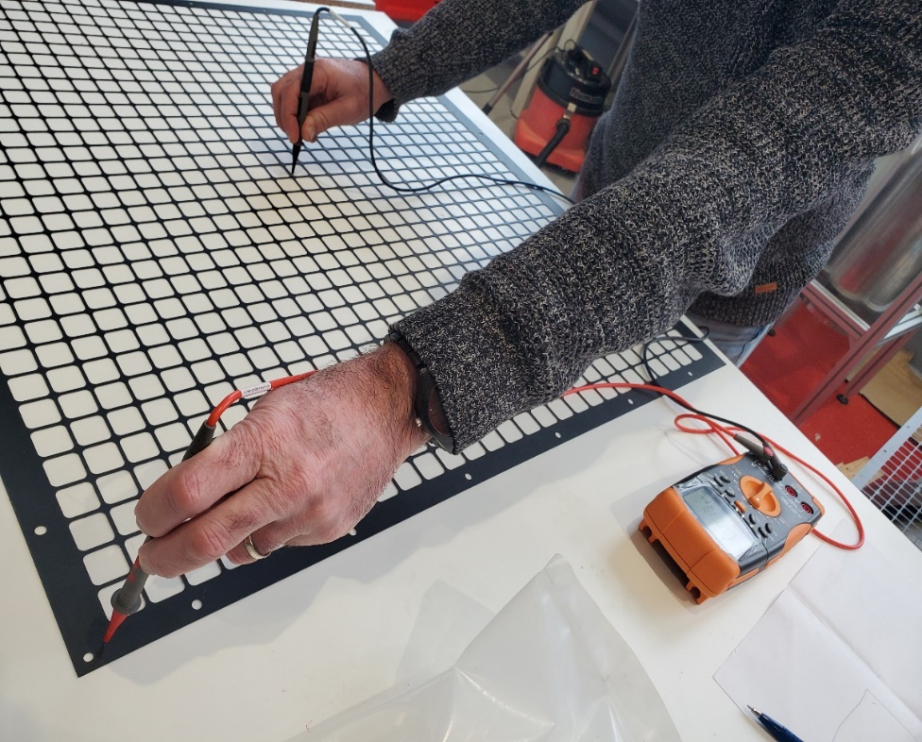
Charge Question #7
Reception and Validation tests@ IJCLab
Tests on a subsample (typically 20 % of a batch):
  Visual inspection for asperity and delamination
  Dimensional
  Electrical
  Cleanliness
3 Weeks foreseen between reception and validation

Slide 31
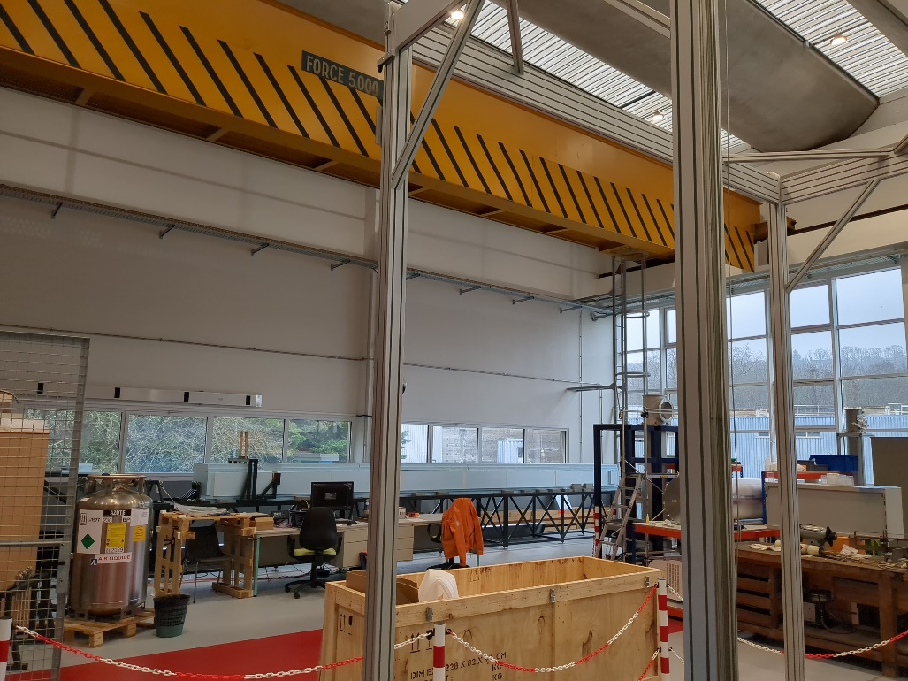
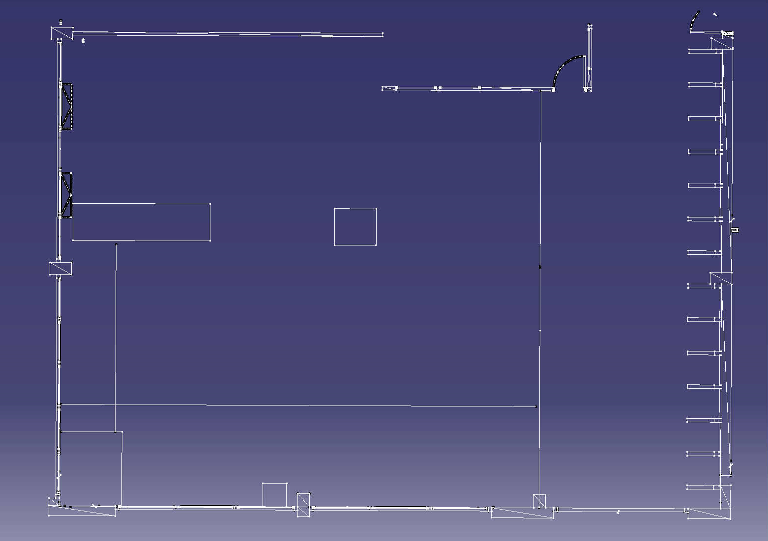
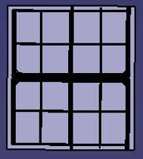
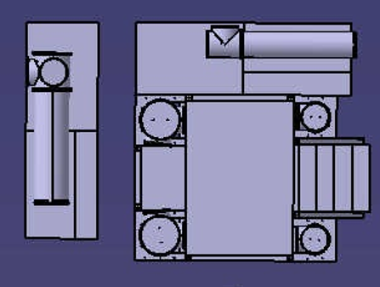


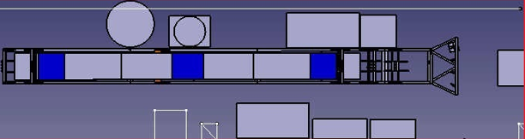
Charge Question #6
Reception and Validation resources @ IJCLab
70 m² (+ circulation) in one hall:
  dedicated to storage with a crane and large doors for truck unloading
  Able to store ¼ of the total production before its shipping to CERN
~ 130 m² (+ circulation) in one hall:
  crane and large doors for truck unloading
  dedicated to assembly and test of cathodes, Dyneema ropes and TDE chimneys
  Possible extension if needed (~60 m²)
3 FTE foreseen over a team of 12 people
Already 6 people trained for crane use
4,6M
4,9M
7,85M
14M

Slide 32
Conclusion
Robust design used in cryogenic conditions in ColdBox for 2 years without problem
Validation of the design after first “real installation” in Module-0:
  Deformation better than predicted and within the requirements
  No additional deformation after one year of hanging
Interface with PDS taken into account
  Correct integration of X-Arapuca in Module-0
  PDS fiber routing OK in Module-0
Current design already takes into account installation constraints
Structural analysis note, materials and mechanical tolerances validated by the Compliance Office
QA/QC plan & procedures defined
IJCLab resources (facilities, infrastructure, and workforce) ready
Fabrication & assembly drawings, STTC, scoring grid ready => green light needed to launch the calls for tender

Slide 33
Towards the final cathode PRR
Value engineering on suspension system to be validated with Bat 185 tests
Interface with PDS: Installation strategy to be validated with Bat 185 tests
  Additional holes and flexibility on bracket positioning on the frame to allow modifications in the current installation plan
Installation:
  Useful lessons on Module-0
  Support plates screwed on the frames to ease connections to other components (transport box, cartwall, TCO transfer tool …)
  Installation strategy to be validated with Bat 185 tests

Slide 34
Backup

Slide 35
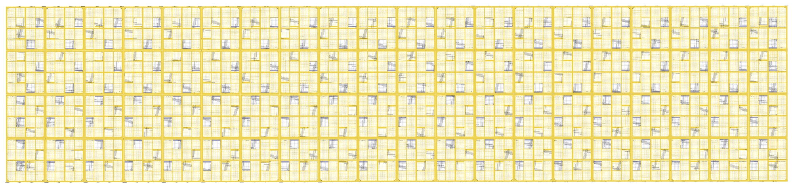
non field cage CATHODE
SUPERCATHODE CENTRAL – Row 2 to 19
36 pairs
72 cathodes (144 half frames)
72 T1 half frames
36 B1 half frames
36 B2 half frames
1
2
3
4
8 Mesh x2
4 Mesh corner x2
2 Mesh metal 1 bottom field middle x2
2 Mesh metal 2 side x2
2 surmesh side x2
2 surmesh bottom x2
TOP T1
5
6
7
8
8
7
6
5
BOTTOM B1
4
3
2
1
field cage CATHODE
1
2
3
4
TOP T1
5
6
7
8
8 Mesh x2
4 Mesh corner x2
1 Mesh metal 1 bottom field middle x2
2 Mesh metal 2 side x2
1 Mesh metal 3 center x2
2 surmesh side x2
1 surmesh bottom x2
8
7
6
5
BOTTOM B2
4
3
2
1
Xar TOP in a hole towards middle bar
Xar BOTTOM in a hole towards top bar

Slide 36
SUPERCATHODE Row1 C1-2 and Row20 C3-4 “Yplus”
2 pairs
4 cathodes (8 half frames)
4 T1 half frames
2 B3 half frames
2 B4 half frames
Non field cage CATHODE
8 Mesh x2
4 Mesh corner x2
2 Mesh metal 1 bottom field middle x2
1 Mesh metal 2 side x2
1 Mesh metal 3 center x2
1 surmesh side x2
2 surmesh bottom x2
1
2
3
4
TOP T1
5
6
7
8
Row 20
8
7
6
5
BOTTOM B3
4
3
2
1
field cage CATHODE
TCO SIDE
1
2
3
4
TOP T1
8 Mesh x2
4 Mesh corner x2
1 Mesh metal 1 bottom field middle x2
1 Mesh metal 2 side x2
2 Mesh metal 3 center x2
3 surmesh side x2
1 surmesh bottom x2
Column 4
5
6
7
8
8
7
6
5
BOTTOM B4
4
3
2
1
Xar TOP in a hole towards middle bar
Xar BOTTOM in a hole towards top bar

Slide 37
SUPERCATHODE Row1 C3-4 and Row20 C1-2 “Yminus”
2 pairs
4 cathodes (8 half frames)
4 T2 half frames
2 B1 half frames
2 B2 half frames
Non field cage CATHODE
8 Mesh x2
4 Mesh corner x2
2 Mesh metal 1 bottom field middle x2
1 Mesh metal 2 side x2
1 Mesh metal 3 center x2
1 surmesh side x2
2 surmesh bottom x2
1
2
3
4
TOP T2
5
6
7
8
8
7
6
5
BOTTOM B1
Row 1
4
3
2
1
NON TCO SIDE
field cage CATHODE
1
2
3
4
8 Mesh x2
4 Mesh corner x2
1 Mesh metal 1 bottom field middle x2
1 Mesh metal 2 side x2
2 Mesh metal 3 center x2
1 surmesh side x2
1 surmesh bottom x2
2 surmesh bottom Yminus x2
Column 4
TOP T2
5
6
7
8
8
7
6
5
BOTTOM B2
4
3
2
1
Xar TOP in a hole towards middle bar
Xar BOTTOM in a hole towards top bar

Slide 38
Interfaces with PDS
©Zach Rautio

Slide 39
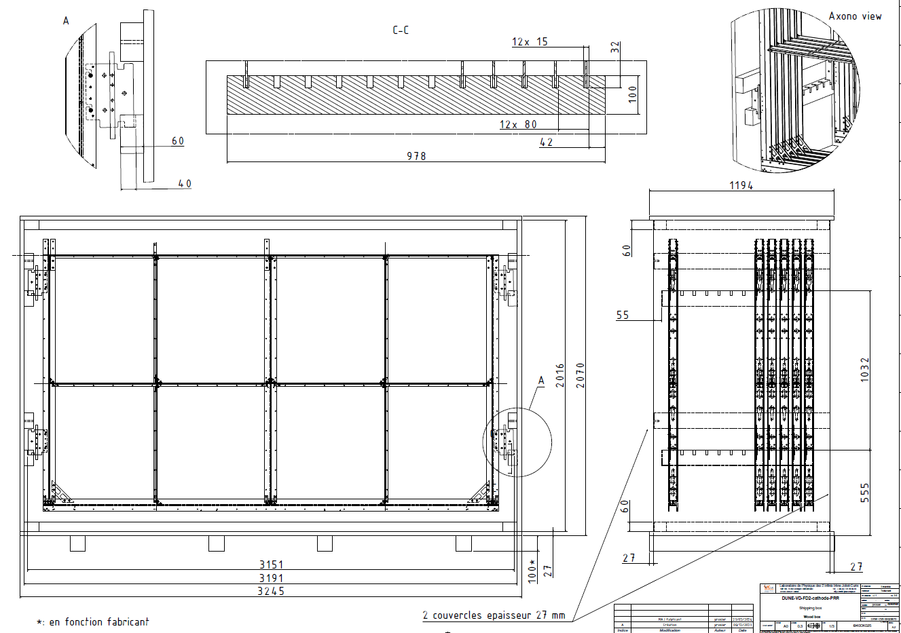
Boxes
Remark: Foam not shown

Slide 40
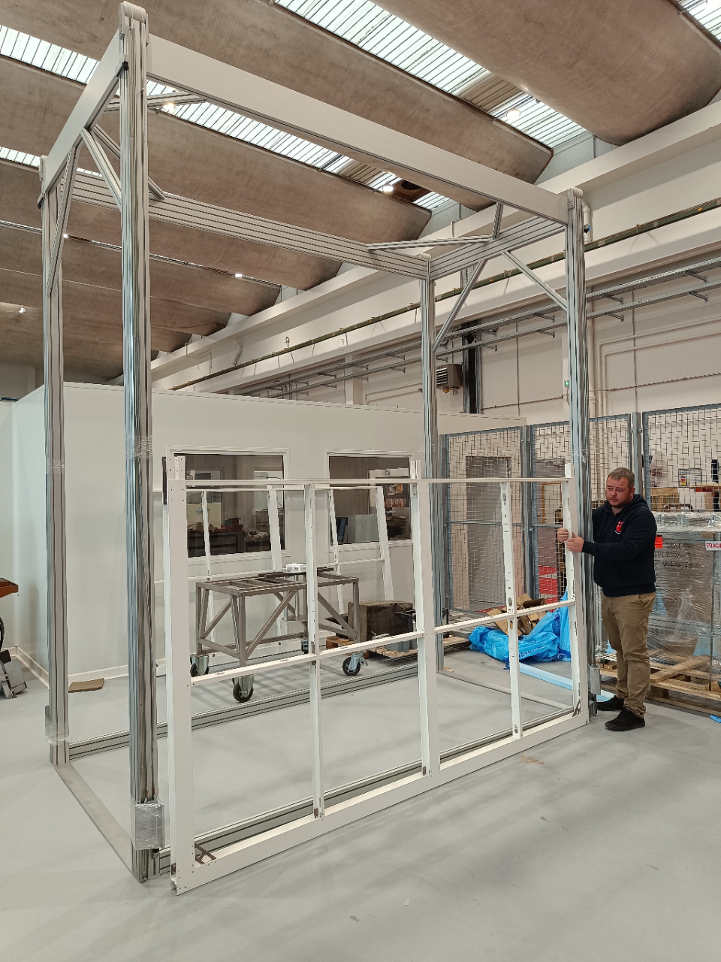
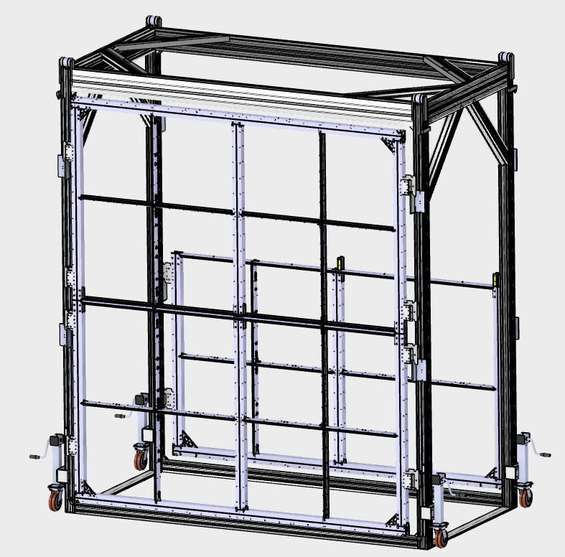
New Cartwall for Assembly at IJCLab and SURF

Slide 41
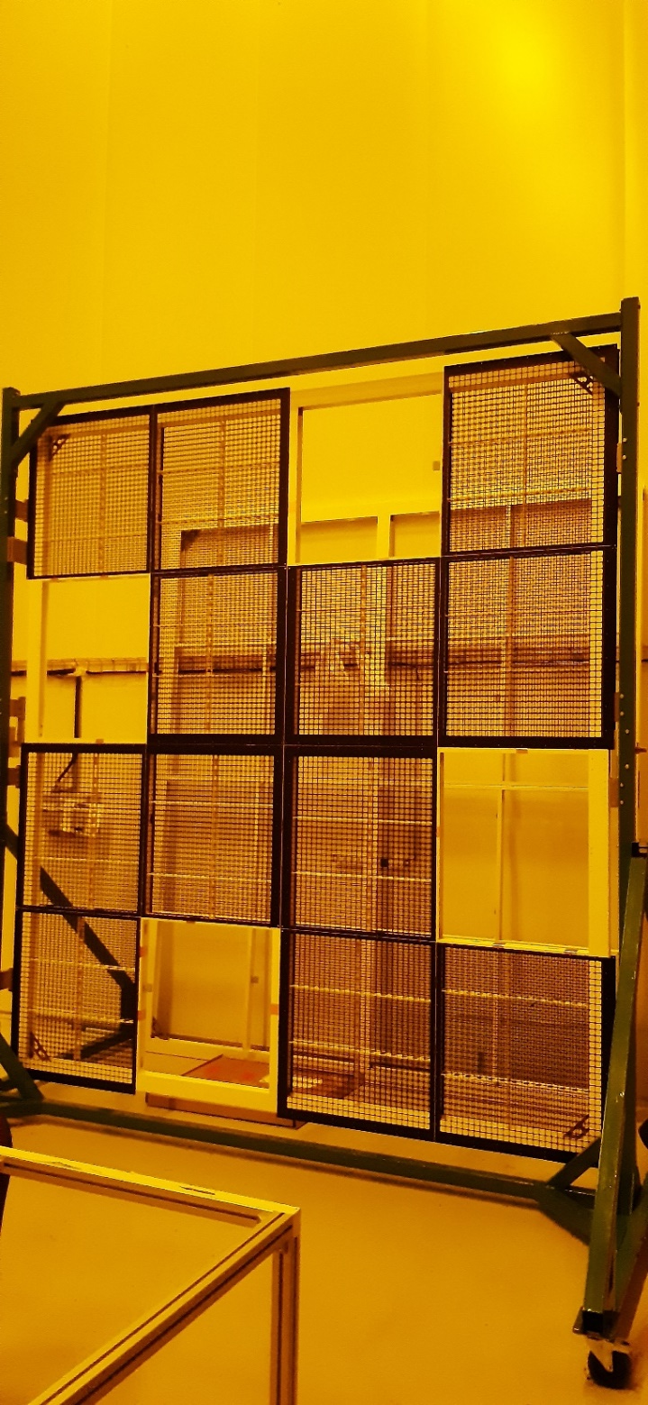
Insertion in Cryostat
Assembly for Module-0 using the cartwall prototype
=> Value engineering with new cartwall (previous slide) and new support plates

Slide 42
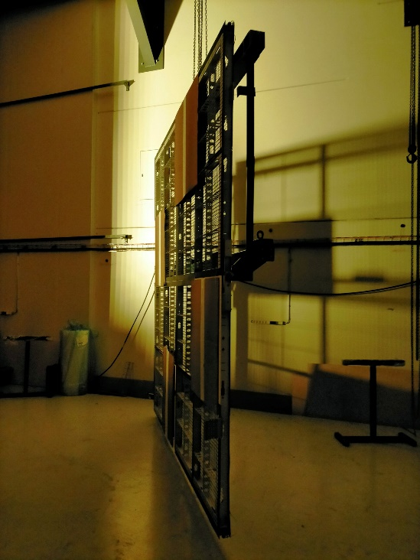
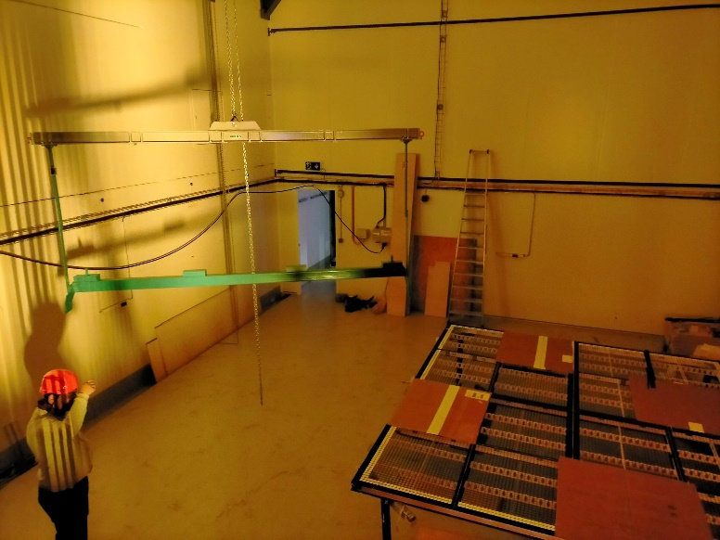
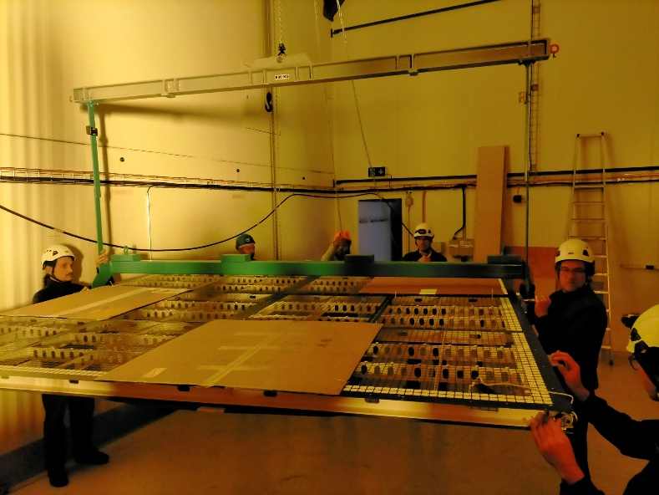
Cryostat Introduction
Cart Removal
Cart Arrival
Lifting tool connection

Slide 43
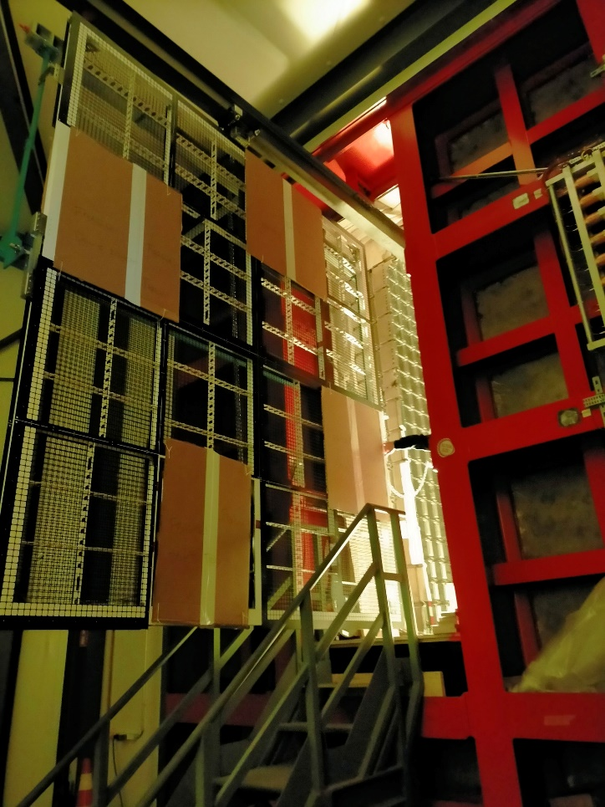
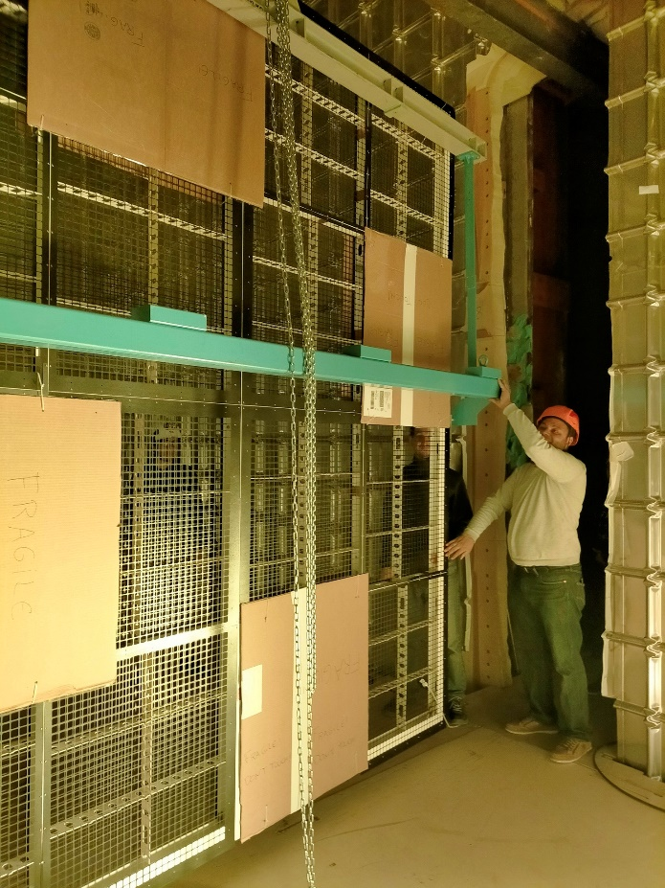
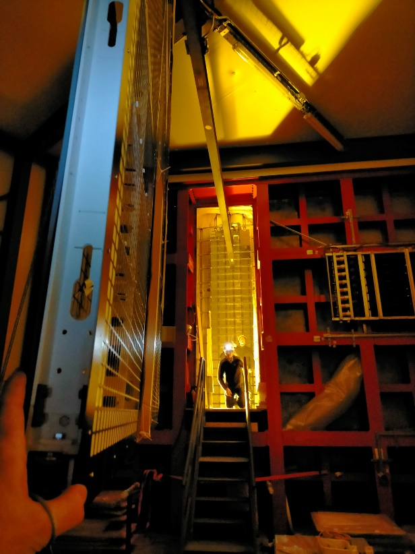
Cathode Lifting
Cathode in the cryostat
Cathode Lifting down In the cryostat

Slide 44
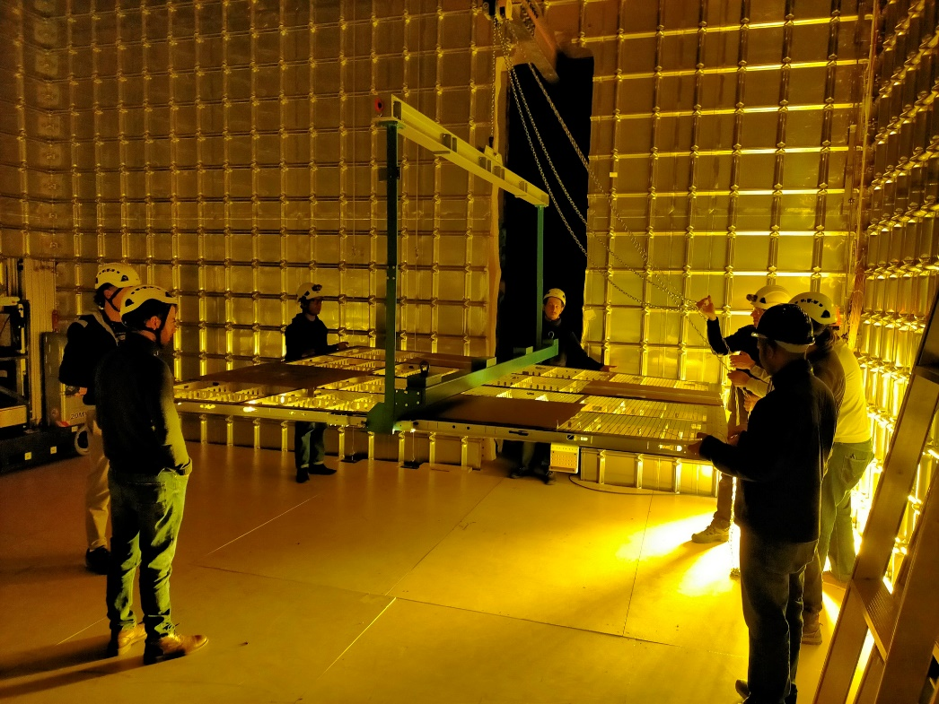
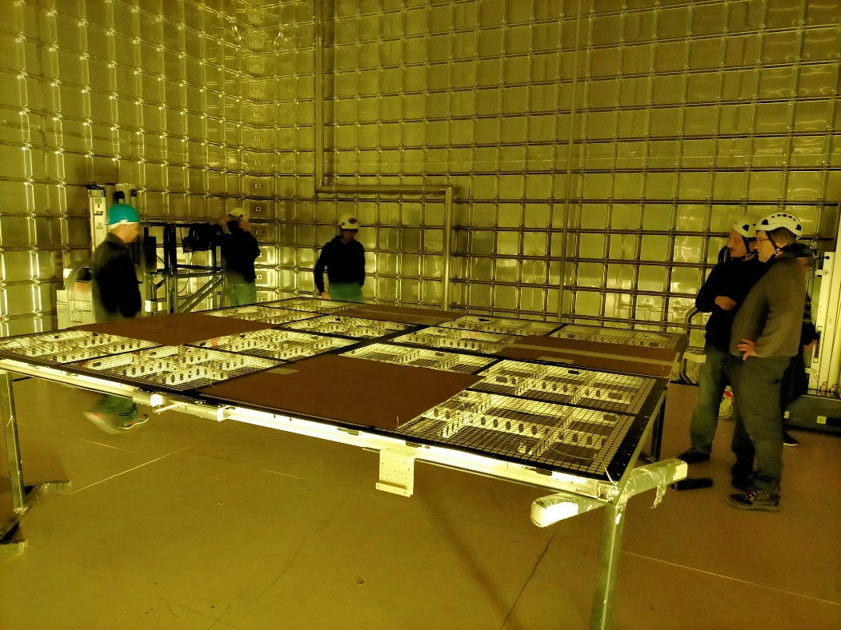
Cathode
on installation table
Cathode rotation

Slide 45
Connection to CRP SuperStructure
Step 1: Cathode raised one by one by a scissorlift with a support table and attached to Dyneema ropes for storage

Slide 46
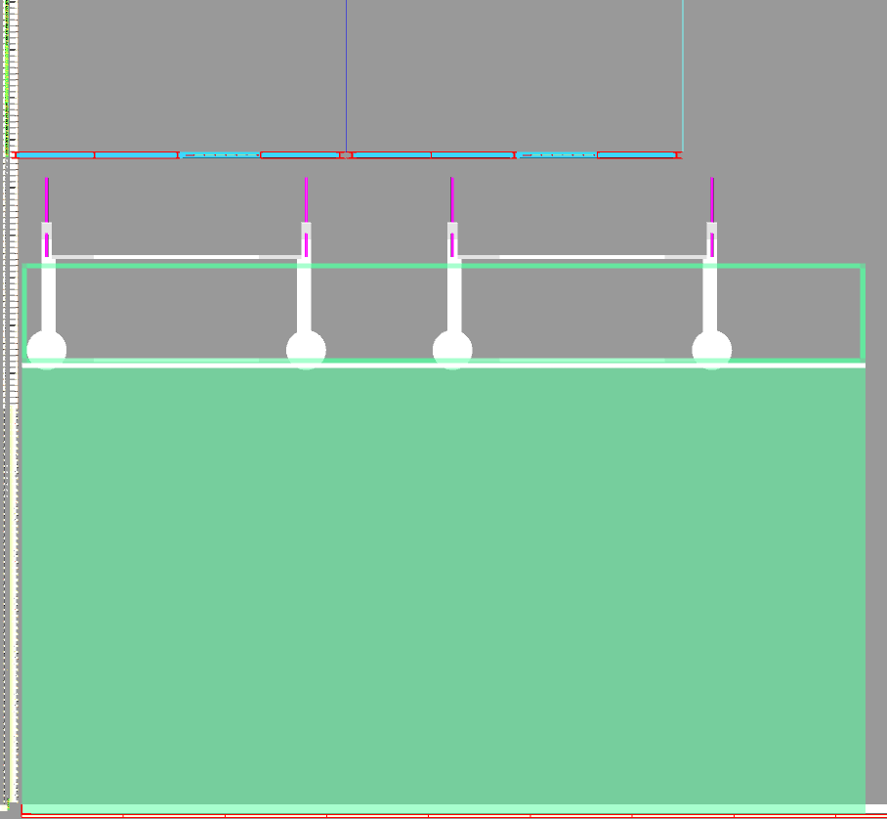
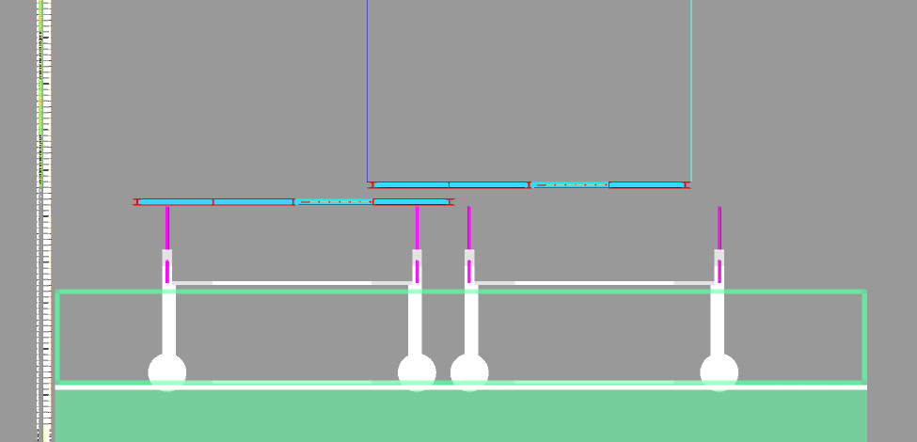
Potential Cathode Installation Methods - #3) Hybrid Lift Table/Scaffold [STEPS]
Stored Cathodes
Tables
70cm Shift
FC
Scaffold
Step 3: The scaffold is placed in position with the XYZ tables in low position. The upper support points on each cart are independently raised until connection is made with cathode to de-load and disconnect Dyneema (1st cathode only).
Step 4: Start of fiber filling on FC-side cathode. 70cm shift required.
©Nick Joniak

Slide 47
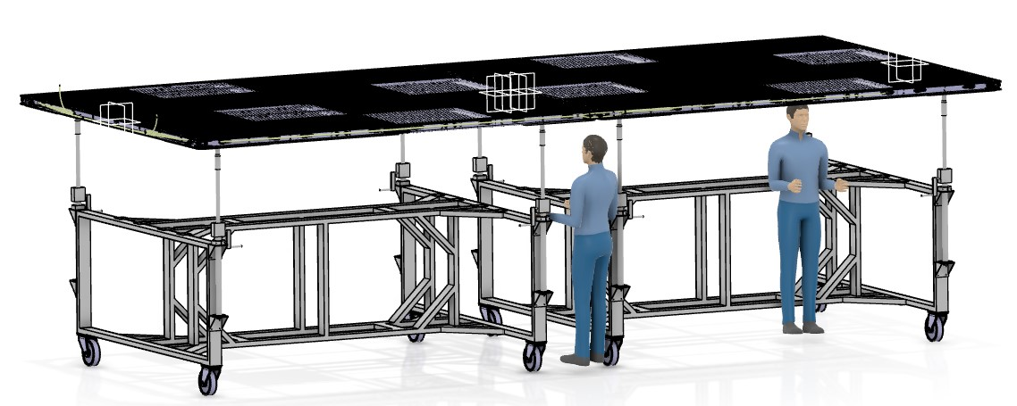
XYZ carts designed by IJCLab

Slide 48
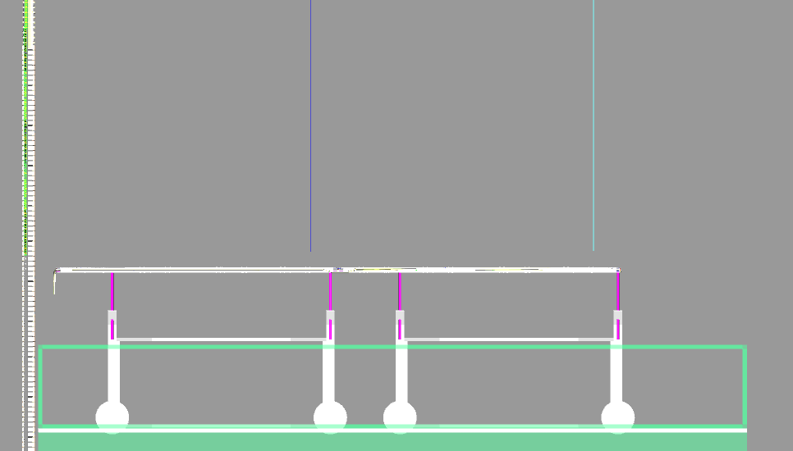
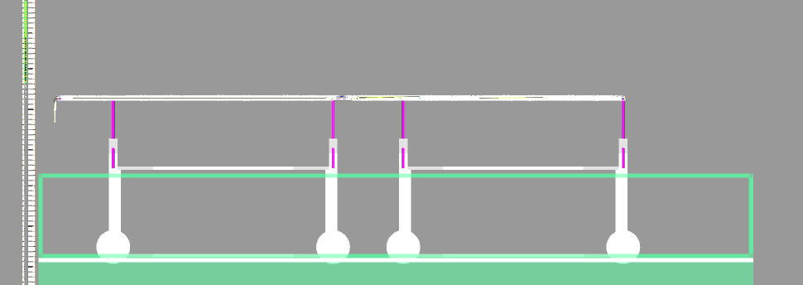
Potential Cathode Installation Methods - #3) Hybrid Lift Table/Scaffold [STEPS]
Step 5: Connection of the second cathode to the XYZ cart (Dyneema de-loaded and disconnected). The two carts will need to be aligned and connected. The LAD connections on the cathode need to be made. Cable filling in the second cathode to commence.
Step 6: The integral cart XYZ table is used to align the cathodes under the Dyneema cables. They will be raised to the maximum Z position for Dyneema connection to the LADs. The XYZ table is then lowered, and height adjustment done with the LAD.
©Nick Joniak

