Slide 1
CERN implementation of nuSTORM
Elena Wildner, CERN
Finalizing the proposal
  Line up with NESSiE/ICARUS
  Use the same availibility of beam
  Lay out the facility in the north area
10 mu sec beam from SPS: cannot use the first straight
How can we use the North Area efficiently?
Do we save detector halls, target station or beam lines?
  Detector halls not a cost driver (3000 CHF per m²)
  Target station should be designed with the existing in mind
  Proton beam lines to minimize (30 k CHF/m 10 years ago)
Meeting with civil engineering, to check layouts
Magnets: waiting for data from Alan and a meeting with magnet group
CERN meeting scheduled and will be up next week on indico

Slide 2
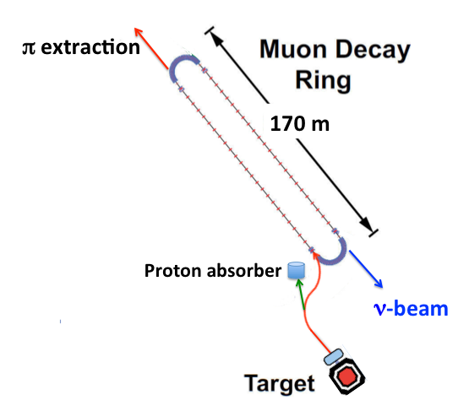
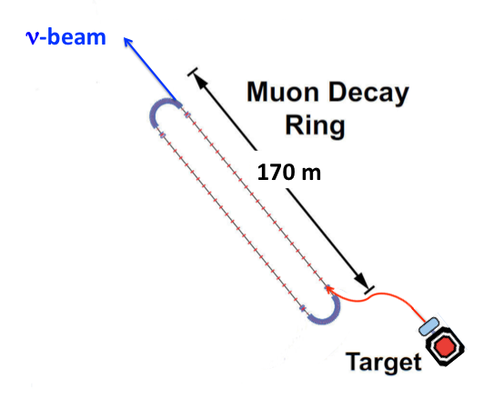
10 ms (SPS) and 1 ms (Main Ring) beam

Slide 3
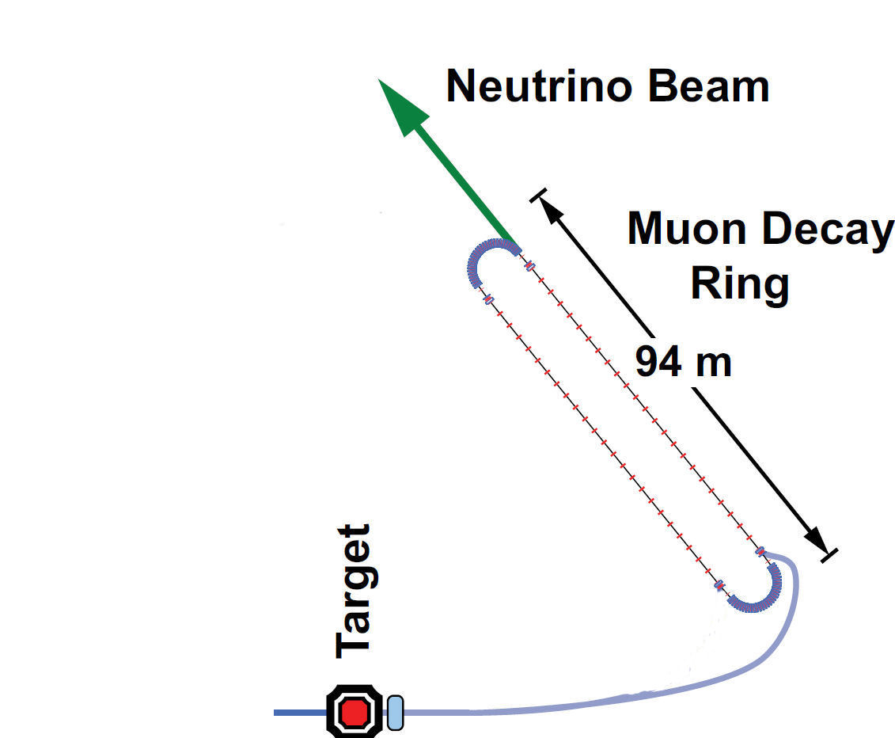


Can we make a 180 degree bend?
ν-beam
Proton absorber
170 m
π extraction

Slide 4
Dimensions of the pion transfer part
p (60 GeV/c)
Target/Horn
π⁺ (5 ± 0.5 GeV/c)
π⁺_{n} / P_{n} = 0.112
Injection
0.21
Acceptance 2 mm rad
11 cm beam pipe radius
2.0
31 m

Slide 5
Option long far detector
~ 2700 m

Slide 6
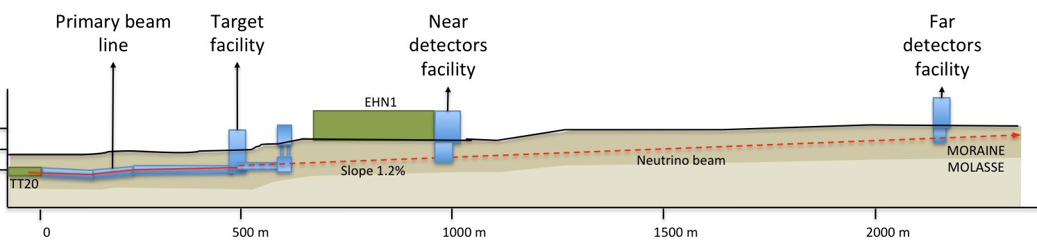

Slide 7
