Slide 1
Low energy muons for cooling experiments
Ao Liu
nuSTORM weekly meeting

Slide 2
Low Energy Muons Required
The low energy muons which peak at ~200 MeV/c are requested to perform muon cooling experiments;
Muons in the decay straight that are around the same rigidity of 5 GeV/c pions are extracted from the ring together with pions.
Passing through a certain length of iron, these muons are slowed down to energy we want.

Slide 3
Simulation In G4Beamline
Assume that muons with 4.5 ~ 5 GeV/c total momentum can be extracted(First order assumption). Run through different lengths of iron in G4beamline to peak the residual low energy muons at 200 MeV/c.

Slide 4
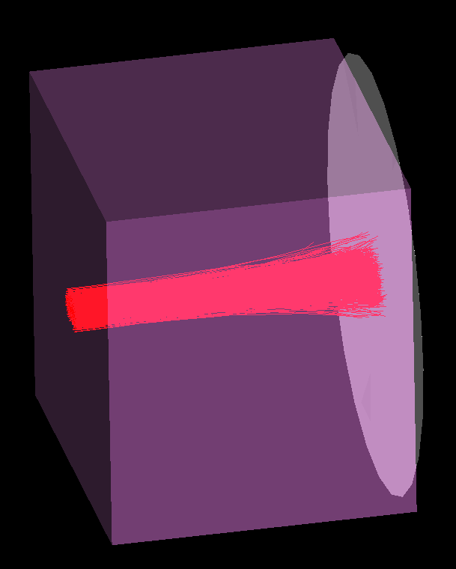
Simulation In G4Beamline(Cont’d)

Slide 5
Simulation In G4Beamline(Cont’d)
With the iron length = 3.48 meters, we were able to peak the residual muons at 200 MeV/c. See figure below.

Slide 6
Rough Estimation
From the PDG:
  Muon Energy Loss in Fe:
    At 5 GeV/c: -1.8 MeV cm²/g⁻¹
  Room Temperature Fe density:
    7.874 g cm⁻³
  348*7.874*1.8 = 4932.3 MeV/c

Slide 7
Momentum Distribution

Slide 8
X-Y Distribution

Slide 9
X-X’ Distribution

Slide 10
Simulation In G4Beamline(Cont’d)
Put 117K muons into iron;
  Get 61903 muons by the end of iron;
  25806 of them are within 100 ~ 300 MeV/c
  Roughly 22% assumed extracted muons.

