Slide 1
Cryostat Update
R. Rabehl
March 11, 2024

Slide 2
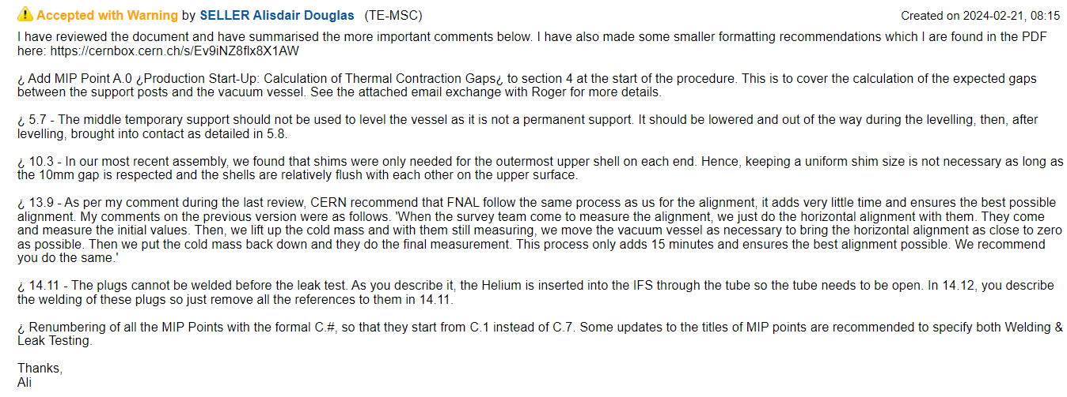
Cryostat – Traveler
Vector 464654
CERN has requested additional steps in our assembly traveler
Updated traveler approved internally, CERN Engineering Check review kicked off this morning with a close date of this Sunday, Feb. 25.
Only comments received were from Ali Seller. Will be addressed in the FNAL traveler.
Updates sent to Adam Bracero Wednesday, 2/28. To be worked on today.

Slide 3
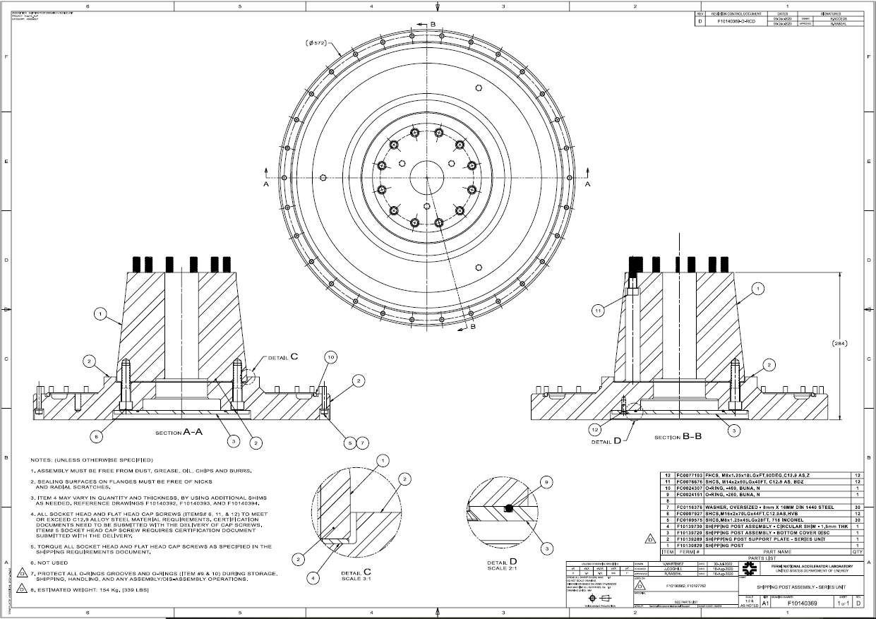
Cryostat – Shipping Posts
Teamcenter Engineering Order Form ED0033225 submitted
Remaining 2 sets of shipping posts/support plates/cover discs (Req. 354738 / P.O. 712185)
All bolting hardware for the remainder of the project.
One bidder has said they cannot find A36 steel in these sizes. Requested to use 1018 steel instead. After consulting with Tom Nicol and Erik Voirin, I approved. Not sure if they will be the only bidder or if other bidders have been able to find A36 - will update analysis and drawings if material change is confirmed by selected vendor.

Slide 4
Cryostat – Documentation
Updating engineering notes
Test Stand 4 LHe supply U-tube (EN03233)
Pressure test completed
Responded to all reviewer comments, requested OK to start Teamcenter workflow for review/approval of engineering note – Teamcenter review/approve process completed
Cryostat piping
CERN redesign of triple flange – EN04771 pressure test permits signed by reviewer
Second set of Fermilab pipe extensions – EN04901 and pressure test permits submitted in preparation for pressure tests
Replied to reviewer comments; signed pressure test permits received.
New note EN12027 for CA-02 vacuum vessel – submitted for review
No comments from reviewer.
Pressure test not required, only need to demonstrate that it is sufficiently protected which is already included in the vacuum vessel engineering note..
Teamcenter workflow submitted for reviewer/approver sign-off of vacuum vessel engineering note.

