Slide 1
Vacuum Equipment Update
R. Rabehl
March 11, 2024

Slide 2
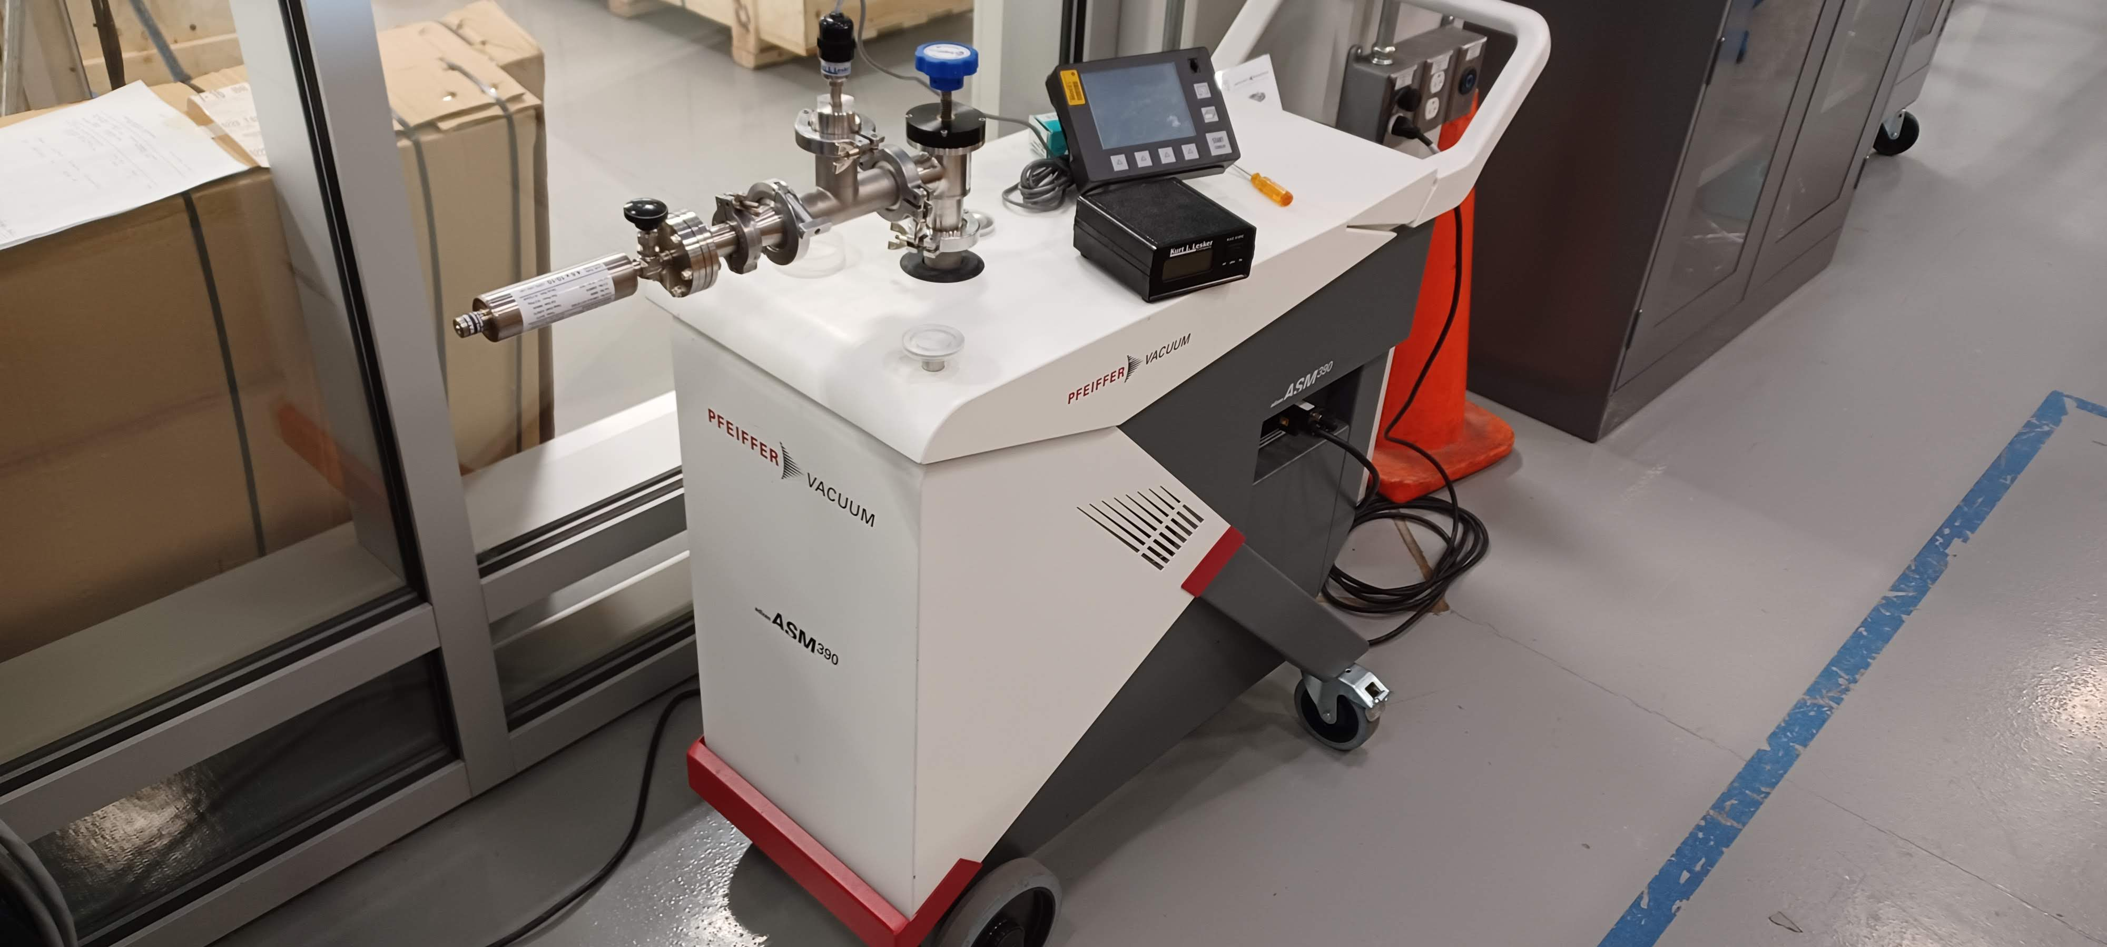
Cryostat – Leak detectors
Evaluated the ICBA leak detector using a calibrated leak
Leak detector saw the calibrated leak 3 of the 4 times the calibrated leak was brought on-line
One time the leak detector went down to < 1 x 10⁻¹² Torr-liter/s, two orders of magnitude lower than the calibrated leak (4.6 x 10⁻¹⁰ Torr-liter/s)
Submitted a purchase req. for a new unit (Req. 354301, $50k, 14 weeks ARO) – P.O. 711412
Received a quote for evaluation of the ICBA unit ($1.6k for evaluation, up to $10k for refurbishment – Req. 354494/P.O. 710456).
Declaration of Contamination was sent, waiting for RMA information – requested update on RMA status, no response from vendor

Slide 3
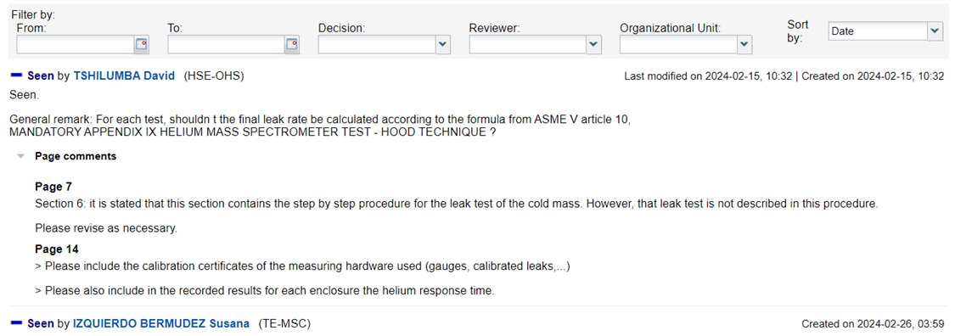
Cryostat – Leak check equipment and procedures
Leak check procedure (doc 4961)
Uploaded to docdb and CERN engineering review process initiated (Jamie)
Comments received; reviewed by Bob.
Formal response to CERN required? Meeting with CERN tomorrow morning to discuss.
Recommended purchase of 2 additional calibrated leaks ($2k total, 6 weeks) – Procard order placed

Slide 4
Cryostat – Leak check equipment and procedures
Remaining equipment
Most of remaining equipment shipped on Jan. 4
Not received
E-mailed and left voicemail requesting for tracking number – no response from vendor
Roots blowers due in early February
Small turbo due TBD
Equipment sorted on ICBA 3rd floor; meeting with Bob Steinberg and Charles Orozco later this week to discuss system assembly, remaining hardware needed, etc.
Arrived at a shopping list of components needed to assemble the equipment received so that we can accomplish what we specified in the leak check procedure.
Req. 355677 / P.O.711609 (LDS Vacuum Shopper) – 80% received
Req. 355737 / P.O. 711659 (Lesker) - received

