Slide 1
302.4.01 Magnets Vertical Test at BNL Weekly Report
Anis Ben Yahia
11-March-2024

Slide 2
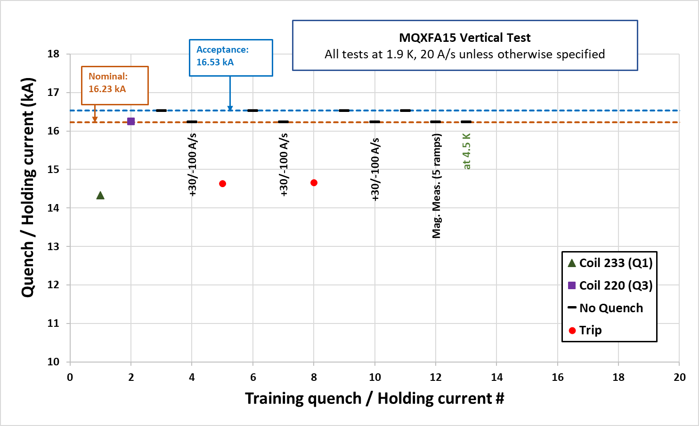
MQXFA15
Ramp to 16230 A (+30 A/s, -100 A/s), 5 minutes hold. NO QUENCH.
Ramp to 16530 A, 60 minutes hold. NO QUENCH.
Magnetic measurements: z scans at 960 A and 16230 A.
Magnetic measurements: DC loop and special z scan at 16230 A.
Ramp to 16230 A at 4.5 K, 30 minutes hold. NO QUENCH.
Magnet warmup (Currently at room temperature)

Slide 3
CRYOGENICS UPDATES
CTI4000 system status:
Running.
Linde 1610 system status:
Shutdown.
Installation of the new purifier:
Waiting on the electrical power connection.

Slide 4
MQXFA07b
Final horizontal electrical checks in progress.

Slide 5
2nd top hat
2 heaters connectors done.
VT connectors:
1st connector done (1 pin failed hipot and need to be repaired).
2nd connector done (awaiting hipot).
1 connector remaining.

