Slide 1
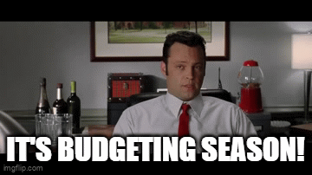
FY25 Budget Planning Exercise – COMING SOON!
Things to think about for labor resources:
What work needs to be done in FY25?
Will any of this work be completed in FY24?
Will any tasks scheduled to be completed in FY24 slip into FY25?
What specific skill sets and roles are anticipated to be in high demand across various projects?

Slide 2
FY25 Budget Planning Exercise – COMING SOON!
Things to think about for indirect requests:
Workspace configurations (mailboxes, name plates/decals, non-moveable furniture, etc.)
Break room outfitting (refrigerators, microwaves, toasters, etc.)
General office supplies
Vehicle leases
Widely-used software (Matlab, Canvas, Mathematica, etc.)
Janitorial requests

