Slide 1

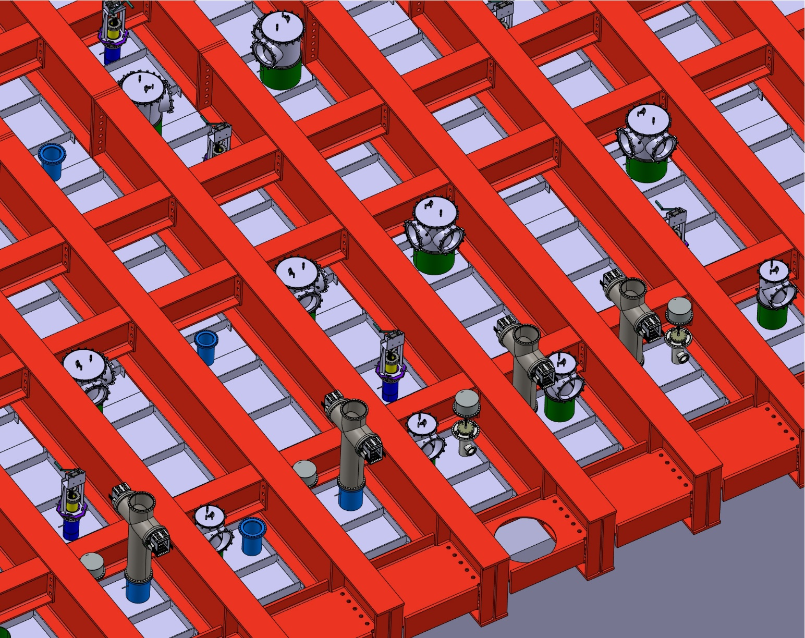
Chimney Vessel Design and Status
Chimney overview
Chimney Design
Chimney Vessel Production
Conclusion
PRR Chimney Vessel
Fabien Cavalier on behalf of IJCLab team,
April11th 2024

Slide 2
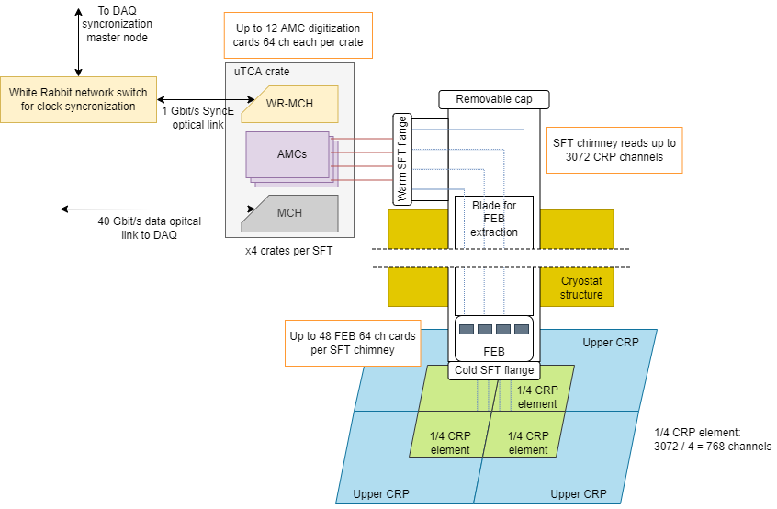
Chimney Overview
Carrying signals over ~2.3 meters from 80 K LAr to 270 K atmosphere
Allows the replacement to Top Front-End electronics boards at any time over 20 years of operation
Should avoid water deposition (flushing ability) at board insertion
Ensure cooling of the electronics inside (110 -10/+30 K)

Slide 3
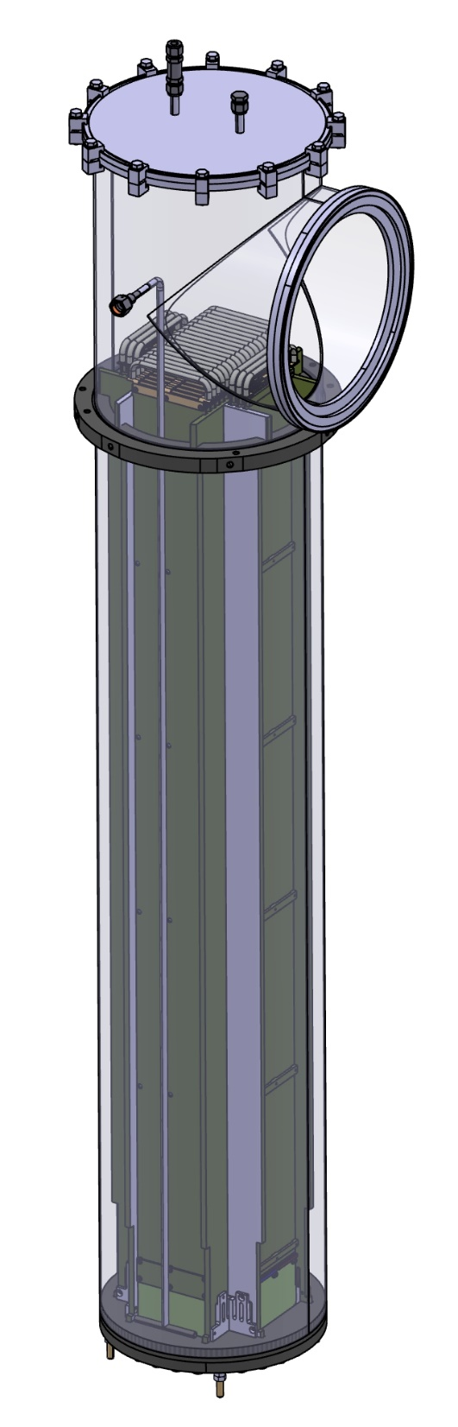
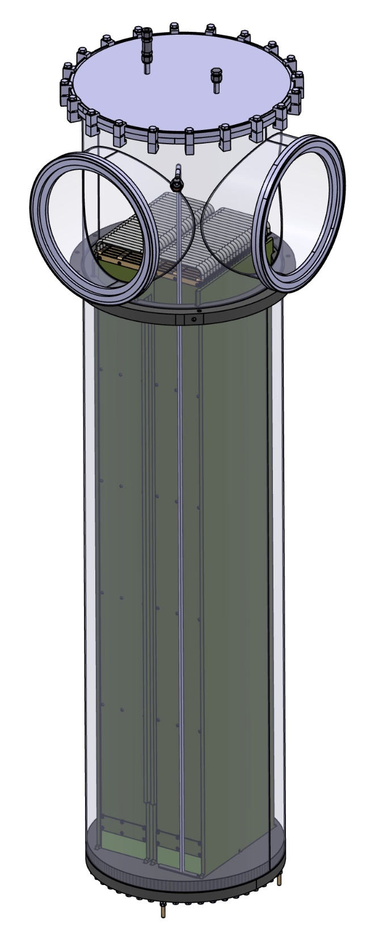
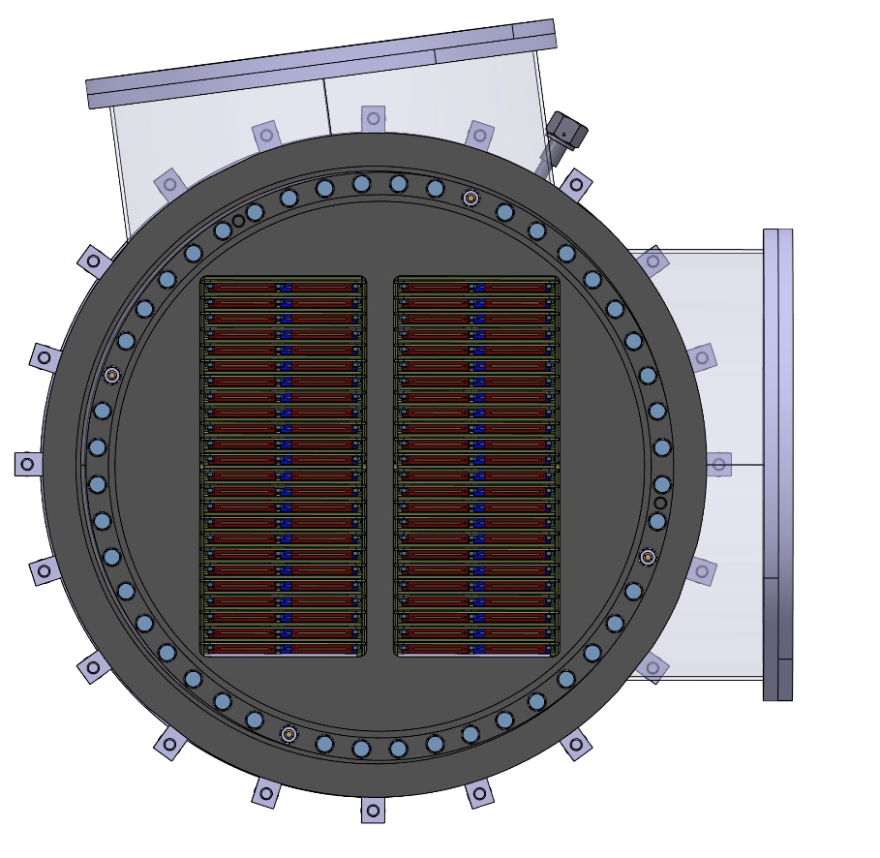
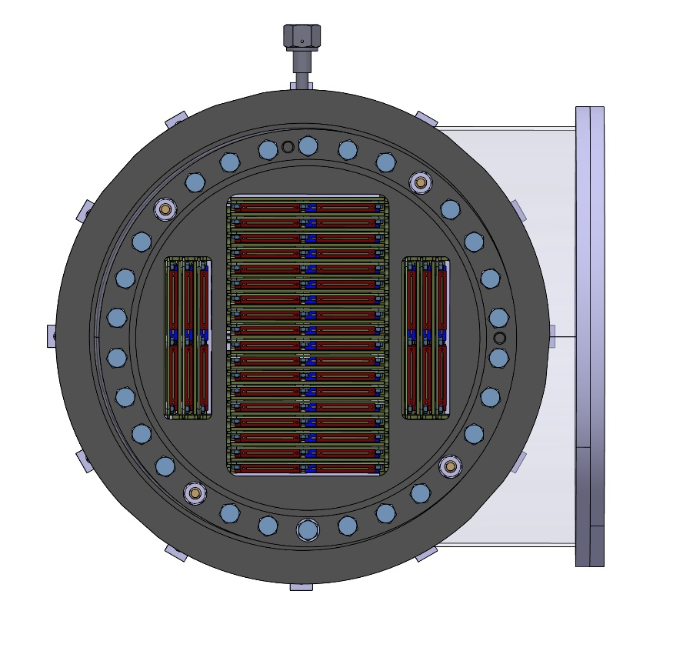
V24
V48

Slide 4
Why a PRR now ?
Charge Question #4
Reason of the PRR: launch of call for tenders for Chimney Vessels (V24 and V48)
Some infos about call for tenders at CNRS
  Open calls that cannot be restricted to the prototype providers
  Once the call is launched,
    Private communication with companies is strictly forbidden
    All questions from companies and our answers are public on the submission site
  The documents (Drawings, QA …) cannot be changed and are the core of the contract between CNRS and the provider
Design must be the final one (modifications will be possible after signing the contract but will require addendums leading to extra costs most of the time)
Specifications have to be carefully written to reject non-serious providers and avoid trapdoors
Scoring grid which takes into account technical answers, price, delays, ecological impact
Long tendering process (4-5 months)
Long production time (> 1 year after ordering)

Slide 5
Scope of the review
Production of the 42 V24 chimney steel tanks in the industry (~300 k€)
Production of the 63 V48 chimney steel tanks in the industry (~750 k€)
Out of the scope
PCB
Cables
Blades and associated guiding system
Assembly and final tests at IJCLab
Transportation to SURF
Installation at SURF

Slide 6
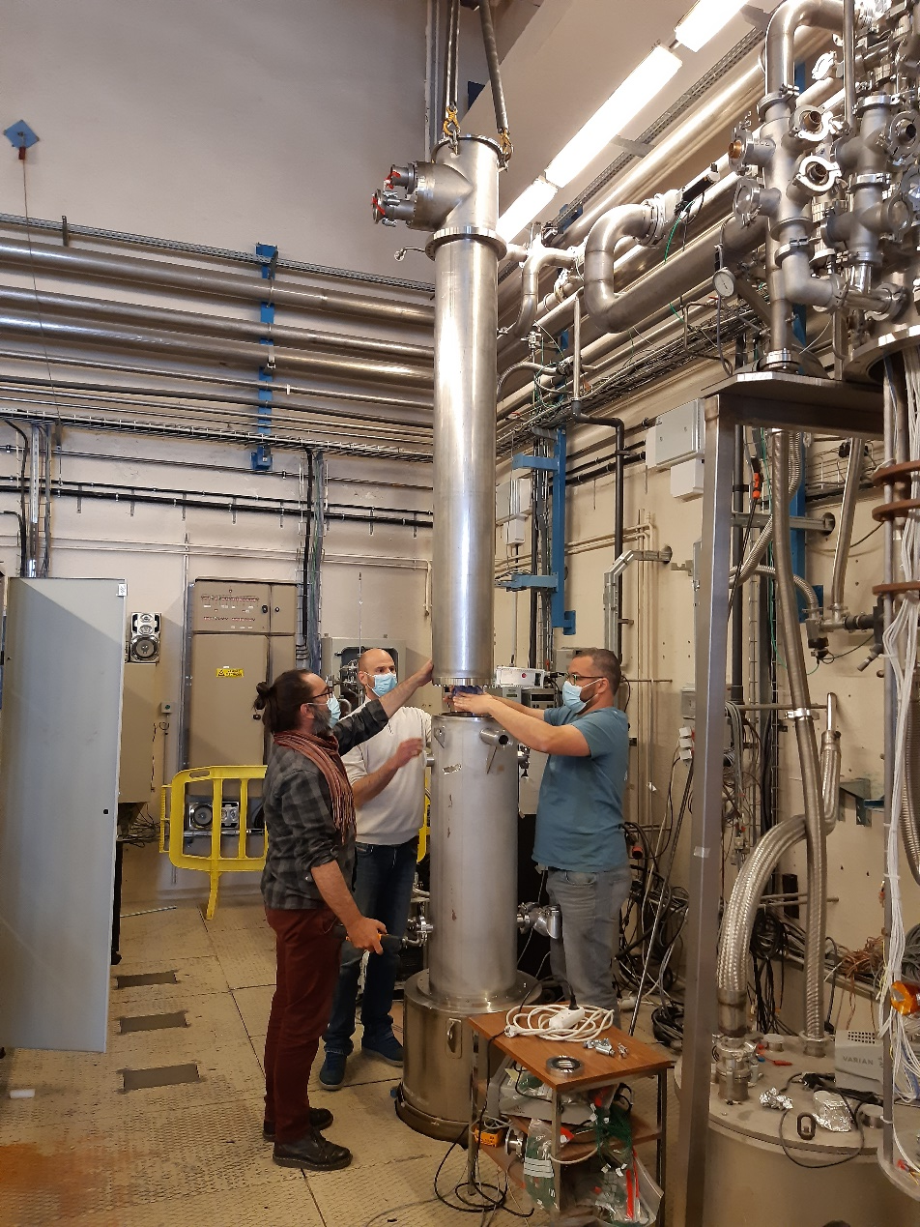
Chimney Reminders
Evolution from Double Phase Design
  CERN Version (v1) with 10 cards working in NP02 for years
  Production prototype (v2) with value engineering and cost reduction of CERN design
  Tested in cryogenic conditions at IJCLab

Slide 7
Chimney Diameter Definition
2 types of chimneys for global optimization of the CRP cabling
  63 penetrations on the center ∅ 506 mm (inner diameter)
  42 penetrations on the sides ∅ 361 mm (inner diameter)

Slide 8
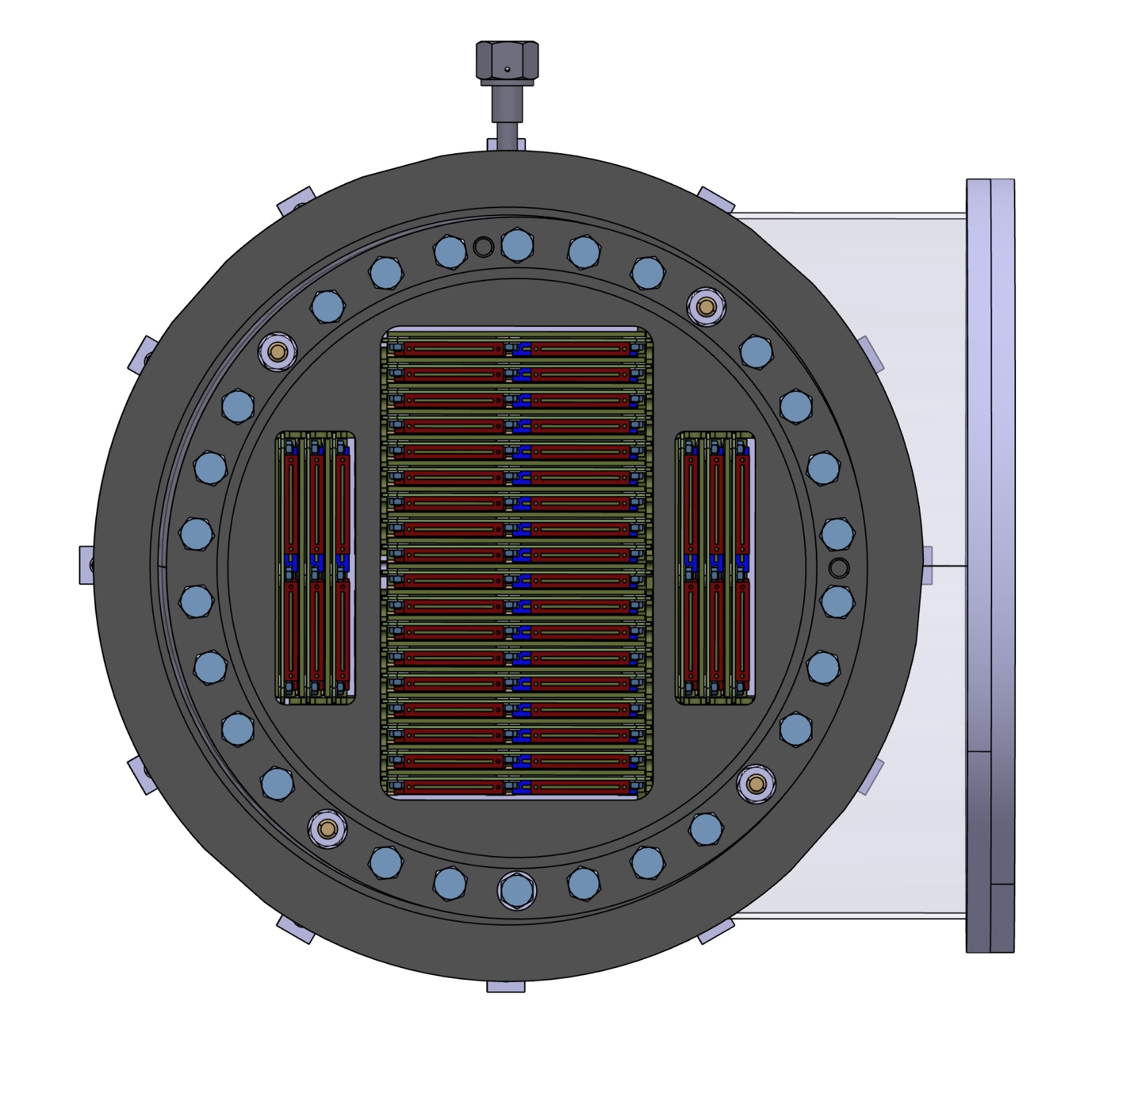
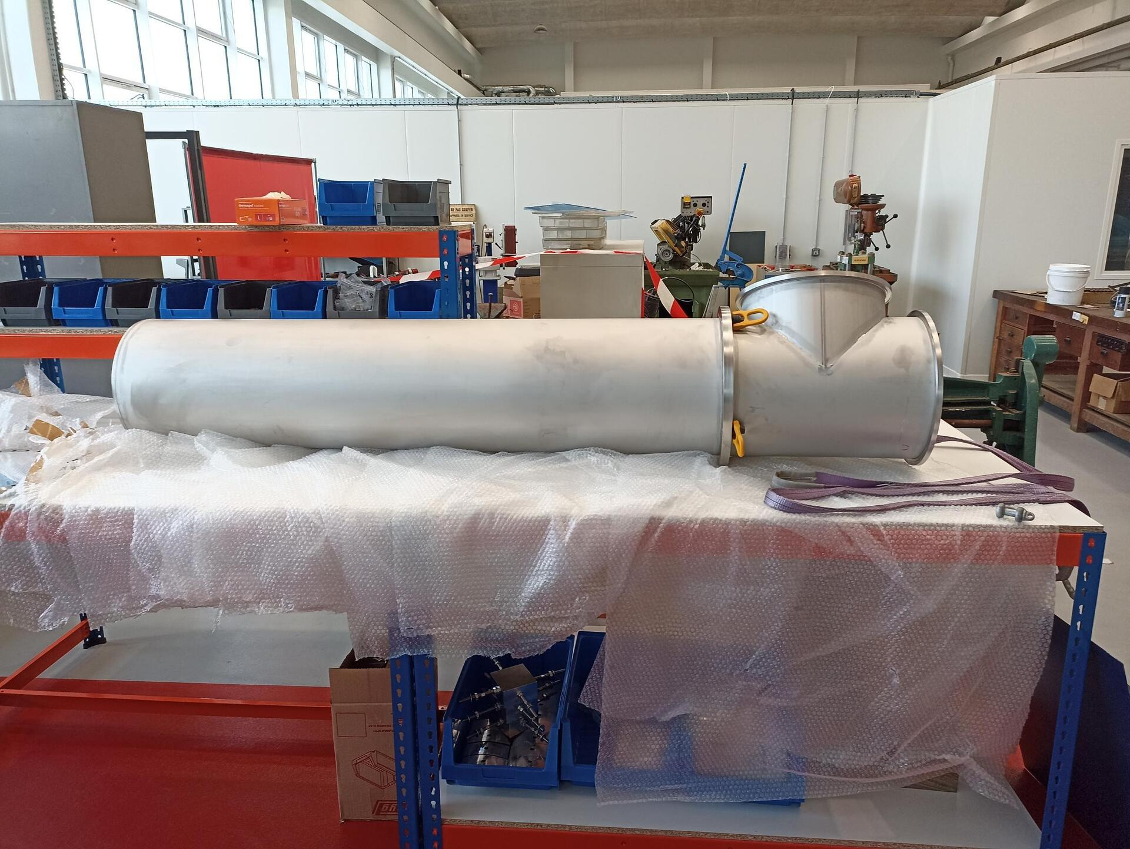
V24
Chosen Solution : standard tube ∅ 354 mm, thickness 2 mm
=> 7 mm of margin between penetration and chimney diameters
Will host 24 FE boards
View from bottom

Slide 9

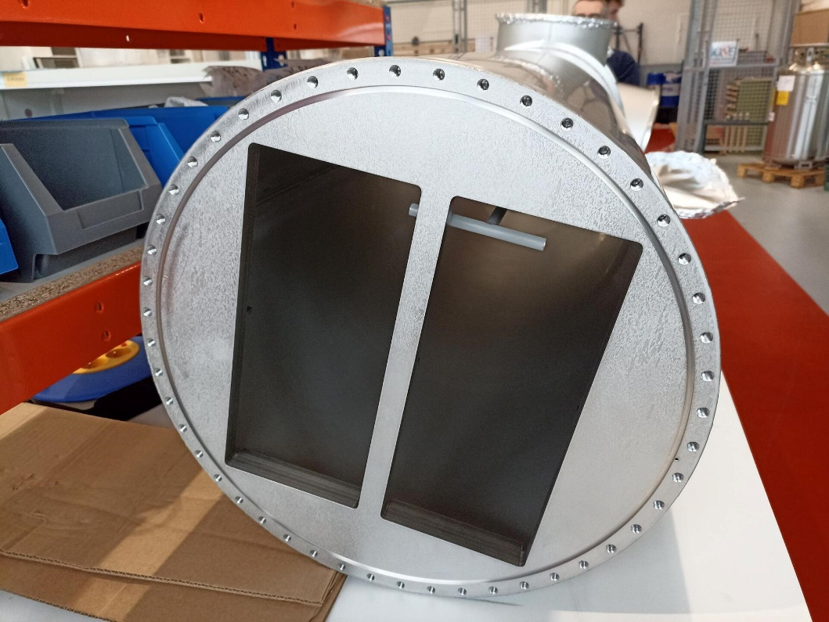
V48
Chosen Solution : tube ∅ 486 mm, thickness 3 mm
=> 20 mm of margin between penetration and chimney diameters
Will host 48 FE boards in two rows
Same Warm flange for V24 and V48
View from bottom

Slide 10
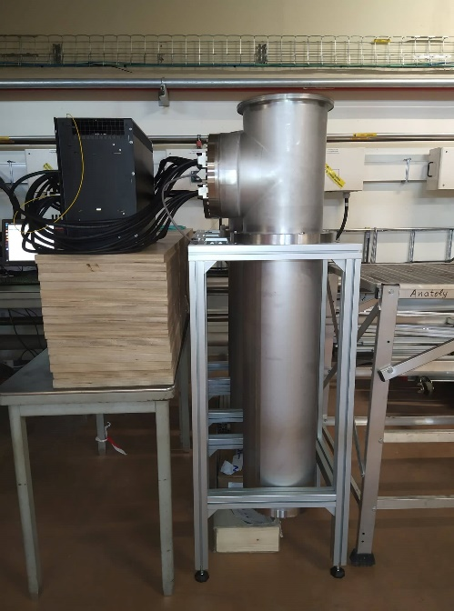
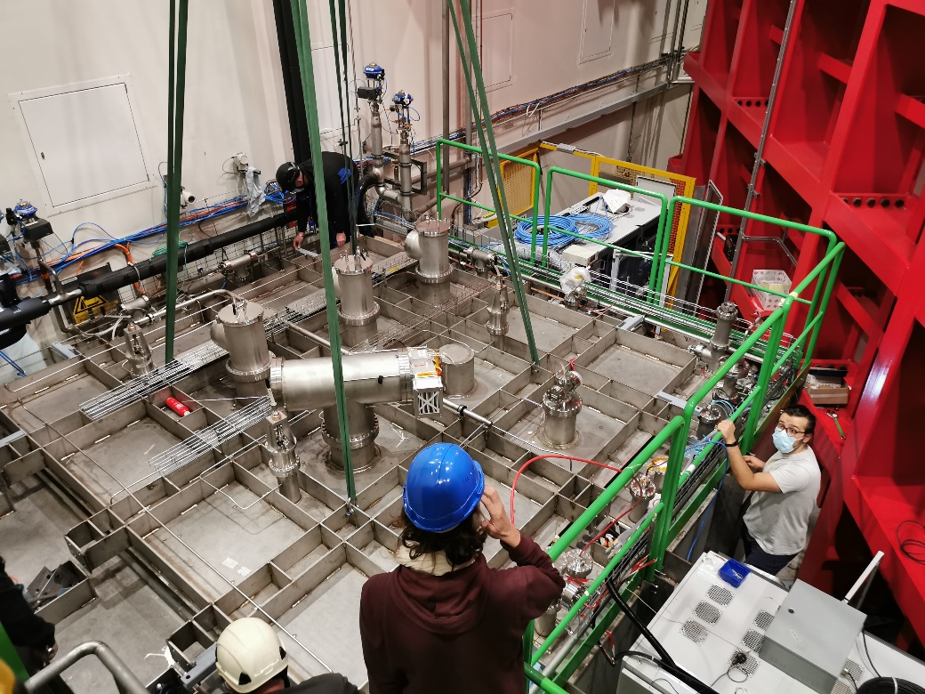
Coldbox Validations
Charge Question #3
Production of 5 chimneys for ColdBox tests
  Similar to v2 version (10 FE boards), just length adaptation
  5 chimneys extensively used for ColdBox tests without any problem
10

Slide 11
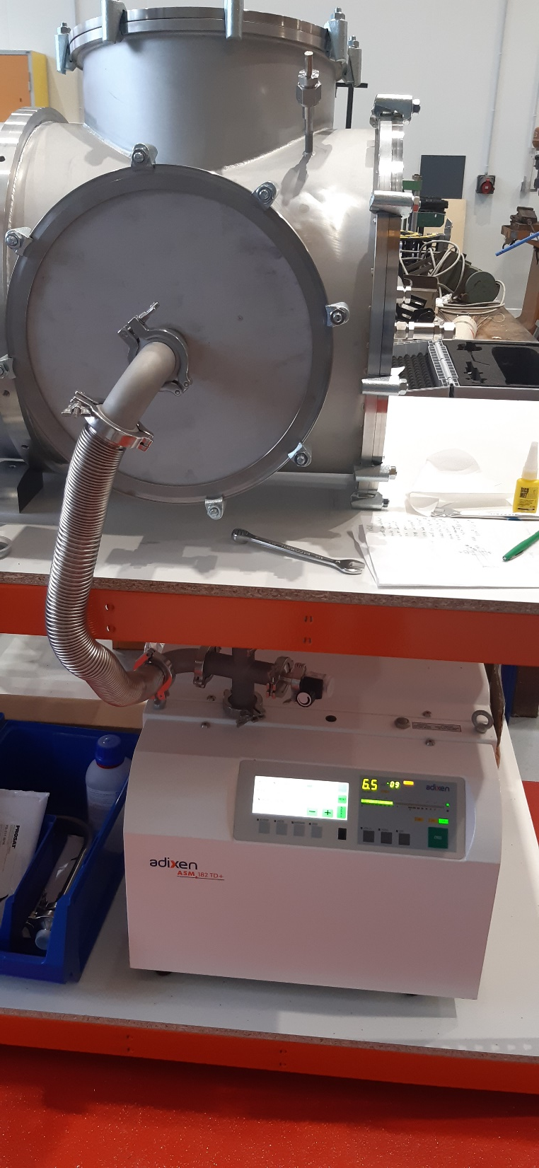
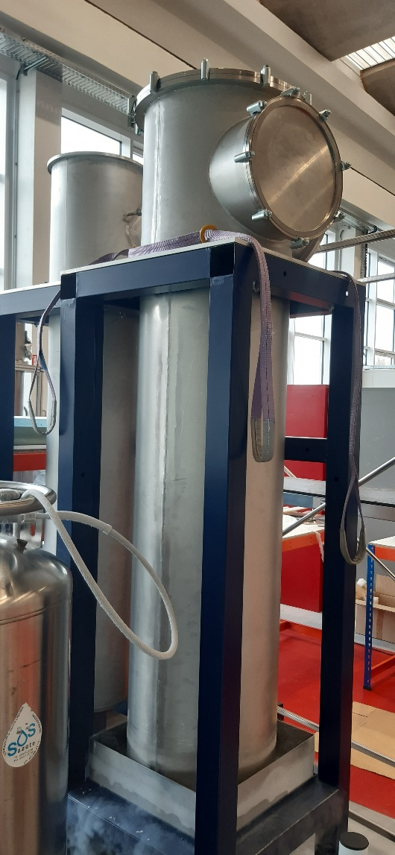
IJCLab Validations
Charge Question #3
Production of one V24 prototype (delivery in June 2023) and one V48 prototype (February 2024) by two different companies
Leak tests:
  For V24, measured leak was lower than 10⁻¹⁰ mbar.l/s
  For V48, measured leak was 5.8 10⁻⁹ mbar.l/s
Within specifications
Cryogenic stress of the bottom part
=> No impact on vacuum properties

Slide 12
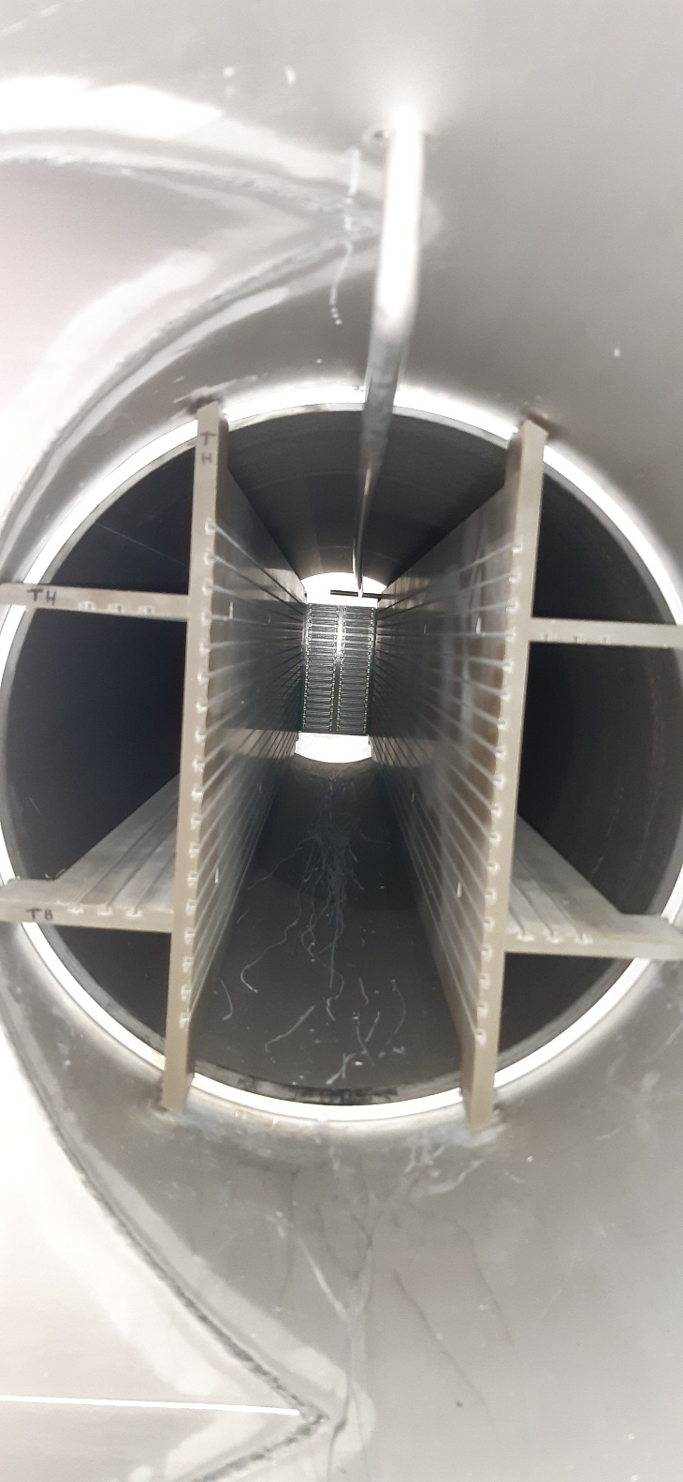
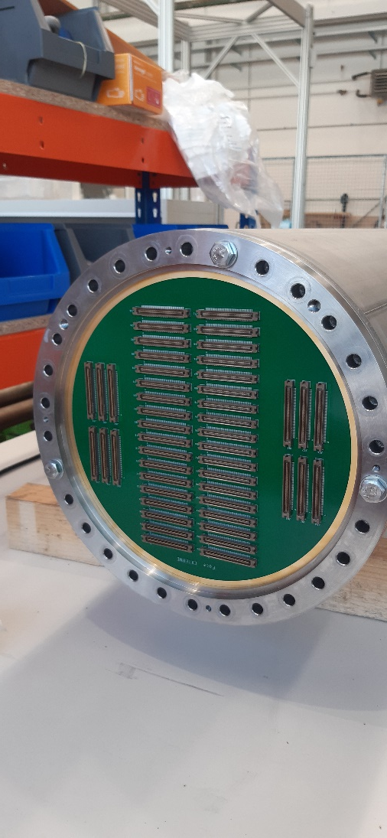
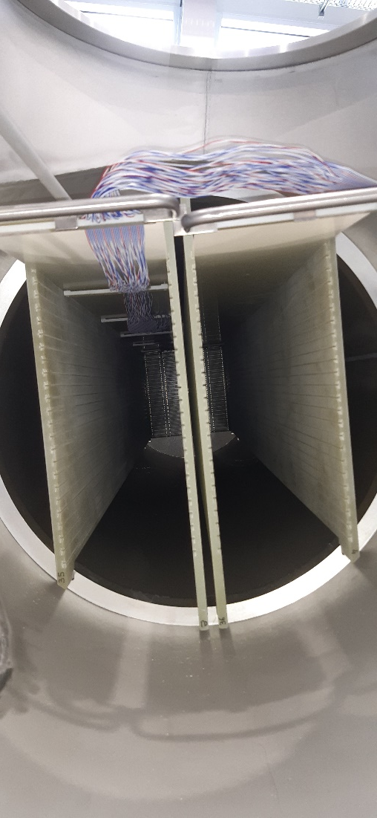
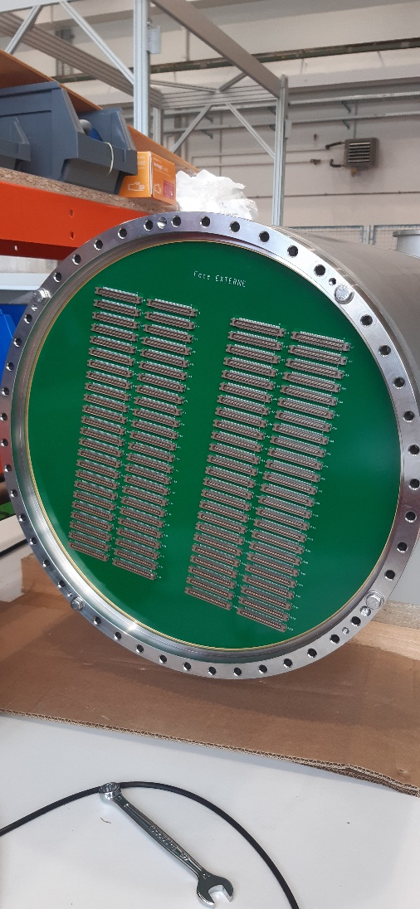
IJCLab Validations
Charge Question #3
Mounting of Cold and Warm PCBs
Installation of Guiding system for the blades supporting the FE boards
Correct plug of the FE in all positions for V24 and V48

Slide 13
Charge Question #2
Modifications since FDR
The interface flange with the penetrations has been changed from clamped version to welded version
The warm flange opening has been enlarged to give more space for connectors mounted on the Warm PCB which was not designed at the FDR date
Addition or removal of few holes for handling and interfaces
Notes:
Dire ici que l’on ne présente pas le process d’installation mais qu’il est déjà pris en compte dans le design

Slide 14
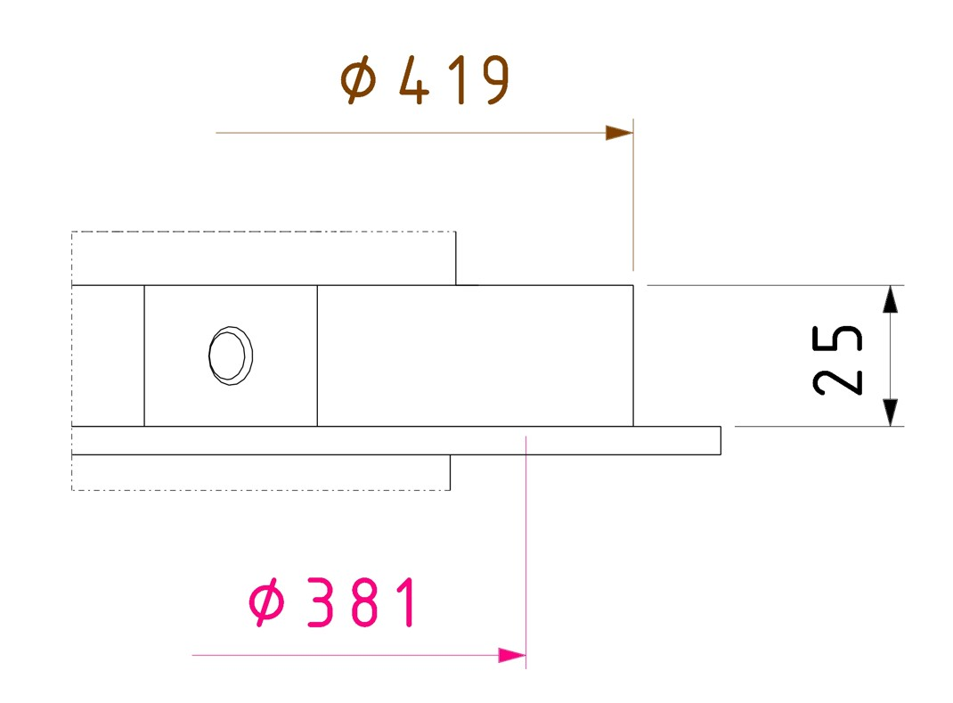
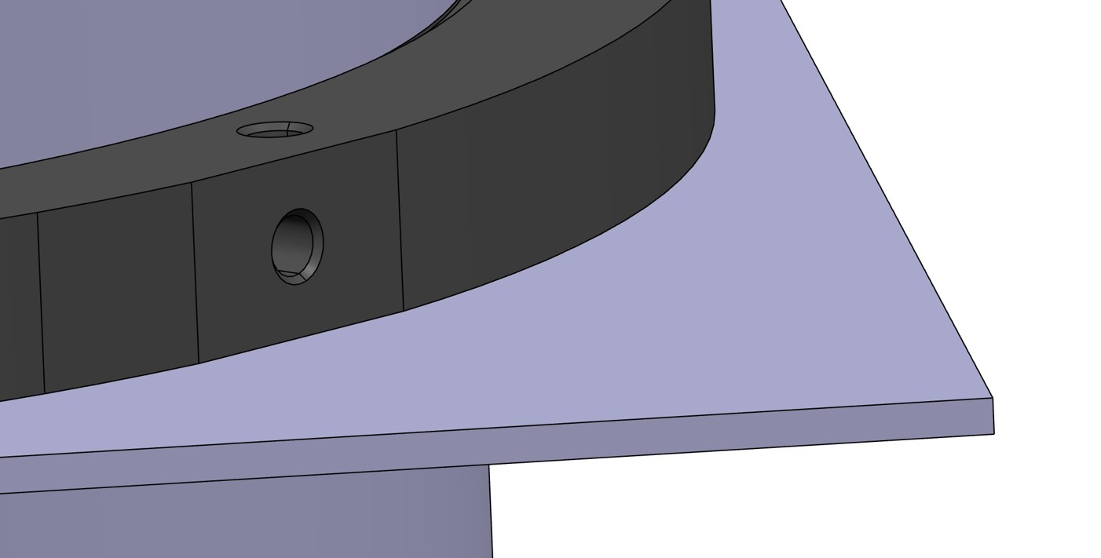
Interfaces with Cryostat for V24
Connection with the cryostat:
  Welding with material addition
  Current diameter (419 mm) and thickness (25 mm) of the interface chimney flange allows handling, it can be increased if needed from the Cryostat team
  Shape and dimensions of the plate on the penetrations to be decided by the Cryostat team
  Chimney outer diameter
∅ 354
∅ 361
  Tight welding with added material
  Penetration inner diameter

Slide 15
Interfaces with Cryostat for V24
Deformations of the cryostat in the first and last 4-5 rows require a new design for these penetrations
Current diameters of the penetration (inner ∅ 361 mm) and the chimney (outer ∅ 354 mm)
  7 mm of total margin => cannot be reduced
  The Cryostat team insures that the penetration diameter will be compatible with the chimney diameter in the new design
  Chimney outer diameter
∅ 354
∅ 361
  Penetration inner diameter

Slide 16
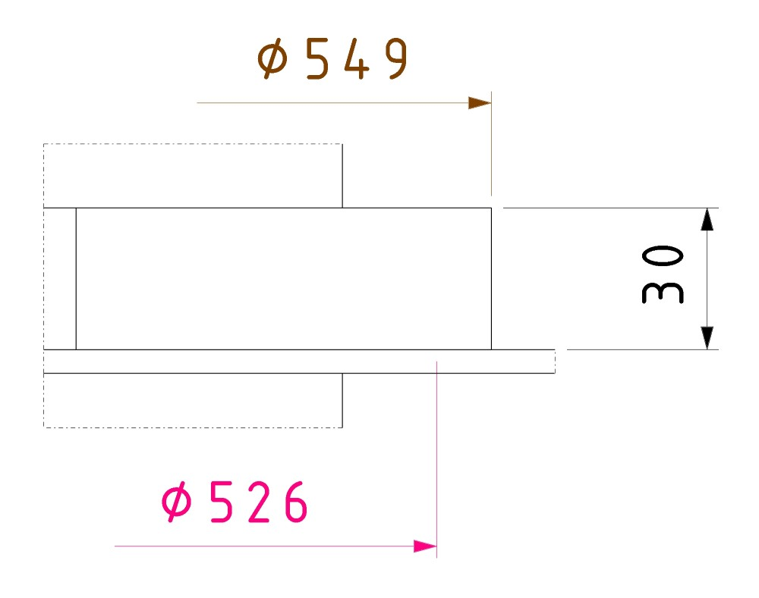
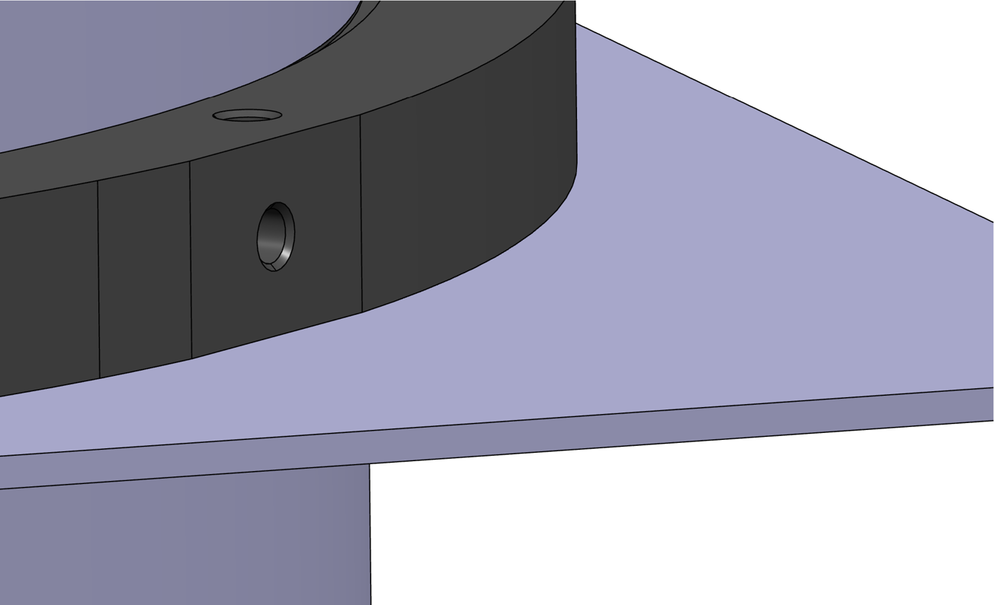
Interfaces with Cryostat for V48
Connection with the cryostat:
  Welding with material addition
  Current diameter (549 mm) and thickness (30 mm) of the interface chimney flange allows handling, can be increased if needs from the Cryostat team
  Shape and dimension of the plate on the penetrations to be decided by the Cryostat team
  Chimney outer diameter
∅ 486
  Tight welding with added material
∅ 506
  Penetration inner diameter

Slide 17
Interfaces with Cryostat for V48
Deformations of the cryostat in the first and last 4-5 rows require a new design for these penetrations
Current diameters of the penetration (inner ∅ 506 mm) and the chimney (outer ∅ 486 mm):
  20 mm of total margin
  The Cryostat team insures that the penetration diameter will be compatible with the chimney diameter in the new design
  Inside diameter of the penetration can be reduced (7 mm margin like V24) if needed by the Cryostat team
  Chimney outer diameter
∅ 486
∅ 506
  Penetration inner diameter

Slide 18
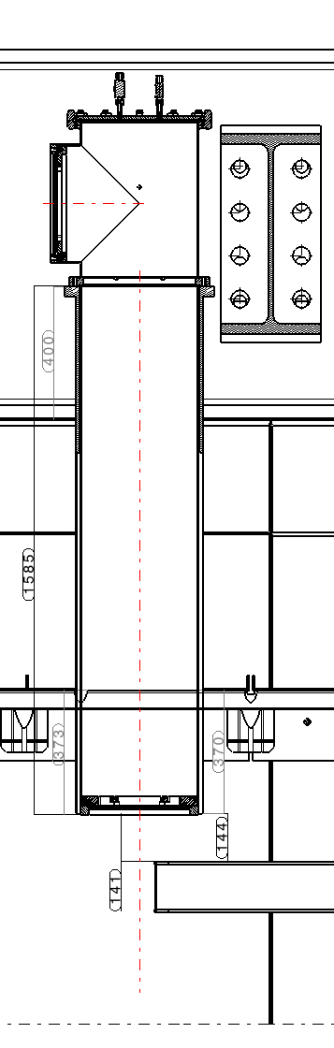
Interfaces with Cryostat for V24 and V48
Position of the chimney bottom cold flange agreed with CRP since May 2022 (141 mm from the CRP SS)
This position depends on the height of the penetration outside the cryostat (currently 400 mm) and the length of the bottom tube (+ cold flange thickness) of the chimney (currently 1585 mm)
Possible change of the height of the penetration if needed by the new penetration design
Change by the same amount of the bottom tube length
To be decided before the end of April 2024

Slide 19
Conclusions about Interfaces with Cryostat for V24 and V48
Welding: Agreed
Diameter of the interface flange: To be agreed before end of April 2024
Inner diameters of the penetrations: Minimal diameters agreed
Penetration height and bottom tube length: To be agreed before end of April 2024

Slide 20
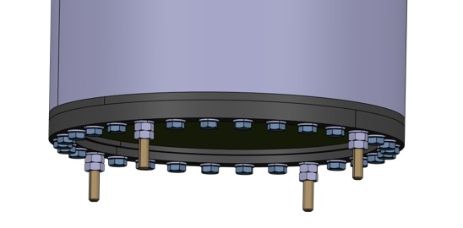
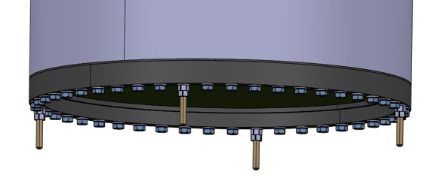
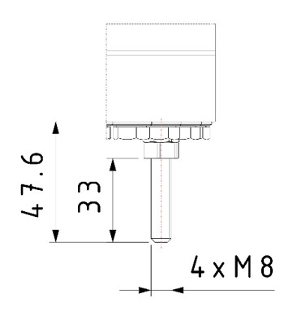
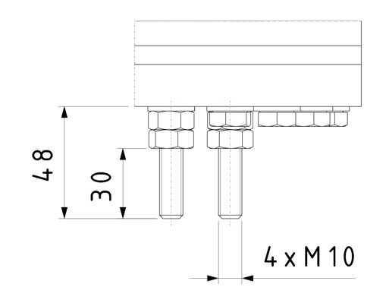
Interfaces with CRP
Agreement on the distance between the surface of the chimney bottom flange and the top of the CRP SS: 141mm but impact of Cathode TADs in this area to be carefully evaluated
Previous design with 4 dedicated threaded holes on the chimney bottom flange
Chimney orientation depends on its position on the roof => less flexibility to connect cable trays with a regular pattern
Engineer in charge of cable trays will arrive this summer => no available final design at the PRR date
Agreement with CRP team to put 4 threaded rods (or more if needed) instead of screws on the bottom flange
=> Final position of the rods to be defined with the cable tray final design: no impact on chimney vessel design

Slide 21
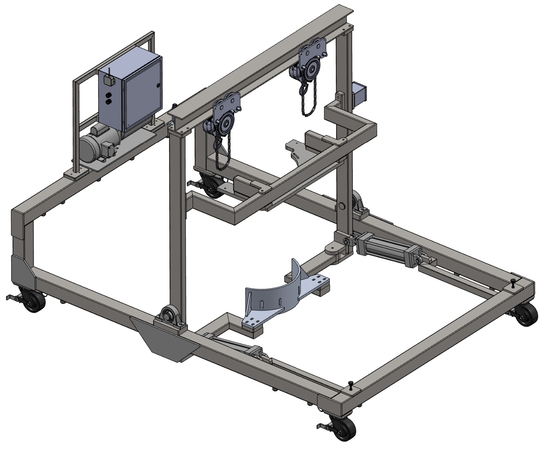
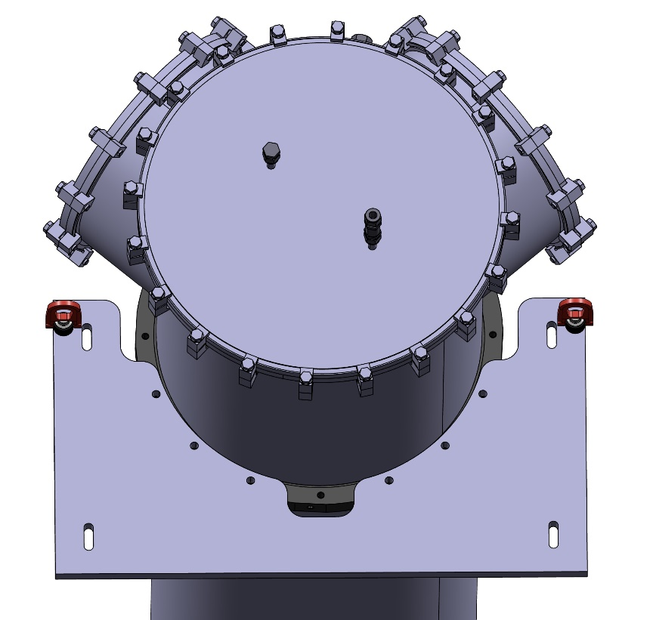
Interfaces with I&I
Installation sequence unchanged
New version of the cart (I&I responsibility)
Interface plate: redesign in progress (IJCLab responsibility)
=> Holes in the interface flange already foreseen to connect the interface plate

Slide 22
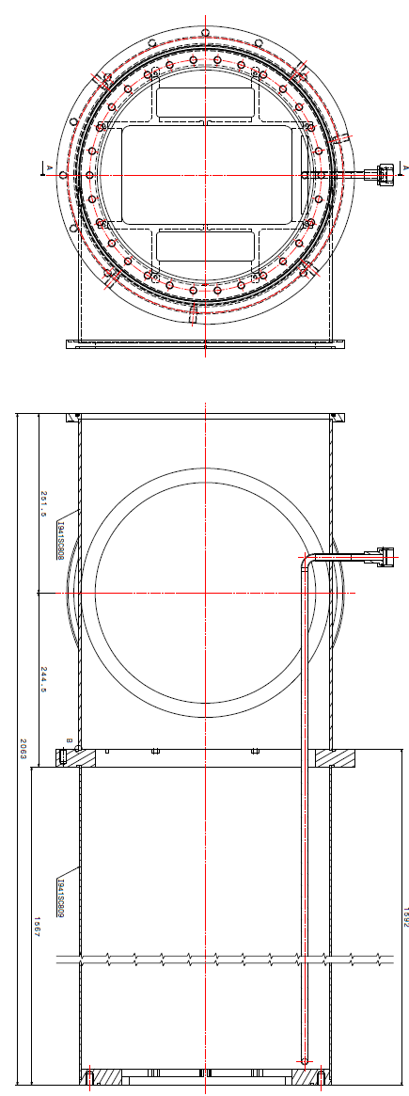
Charge Question #4
Produced Objects
43 V24 chimneys tanks will be ordered (1 spare)
64 V48 chimneys tanks will be ordered (1 spare)
2 different providers for prototypes
Answers from several companies for prototypes but large price dispersion
Drawings available here: https://edms.cern.ch/document/3071588/1 and https://edms.cern.ch/document/3071589/1

Slide 23
Charge Question #5
QA/QC at the production site
Provider should be ISO 9001 V2015 certified (as a minimum), or must have an equivalent quality organization, which it must justify in its application
Material certificate
Dimensional inspection
Cleanliness
Labelling
Acceptance tests for each batch
Non-compliant parts will be rejected
See examples hereafter and https://edms.cern.ch/document/3071594/1 , https://edms.cern.ch/document/3071596/1 and https://edms.cern.ch/document/3073961/1 for details

Slide 24
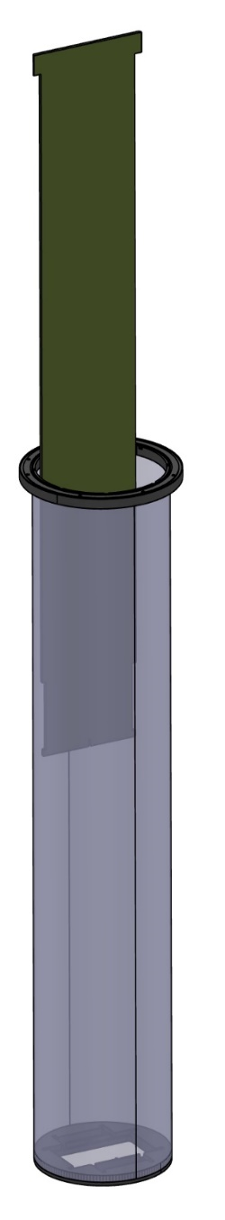
Charge Question #5
Chimney : Technical specifications for manufacturing (1)
Nature of materials
Stainless-steel 304 and 316
Material certificates will be supplied in accordance with standard EN 10204 2.1 by default
General specifications
Conventional machining should be carried out with a lubricant containing the lowest possible concentration of chlorine, fluorine or silicone
Degreasing should be carried out as soon as possible after machining
Internal surfaces should preferably be cold-rolled sheet metal
Mechanical polishing, bead-blasting and sandblasting are prohibited on all internal surfaces of the chimney
Brushing of tube or chamber surfaces outside the weld seam is forbidden.
Assembly checks before welding
Pre-assembling of the lower part of the chimney before welding, using the template → check that the grooves are aligned with each other, in accordance with the procedure. It must be ensured that the template is fitted before and after welding.
This check will be carried out on delivery to the factory

Slide 25
Chimney : Technical specifications for manufacturing (2)
Charge Question #5
Making and checking welds
Welding locations and specifications (adjustments, beads, ....) are to be defined and validated by IJCLab prior to manufacture. Heat treatment operations (such as stress relieving, stress relaxation, straightening) must be specified.
Surfaces to be welded must be degreased before welding
Welding is carried out by qualified personnel, using the appropriate technique and in a neutral atmosphere
Beads thicker than 0.3 mm and welding tips on the outside of the chimney should be avoided. No mechanical action may be exerted on the beads, and they must not be blasted, ground or polished. To remove superficial traces of corrosion on weld beads, light brushing of the bead is tolerated (stainless steel wire brush only).
There will be no reworking of welds. Mechanical stress-relieving operations (using a vibrating pot) may be considered, if necessary, to compensate for any deformations that may occur during transport.
Welds must be free from defects such as micro-cracks or traces of inclusions, they have to be vacuum-tight, and will only be accepted after leak testing. Dye penetrant testing of welds is strictly forbidden. All welds must be visually inspected.
The final appearance of the parts must be checked, and a report drawn up specifying the inspection.
Geometric conformity test on the bottom of the chimney
A check after welding of the lower part of the chimney must be carried out with the template provided by IJCLab to check the angle between the interface flange and the tube as indicated on plan I941SC809 (provided in appendix A1).
It must be ensured that the bottom of the chimney passes through the two spacers and that the interface flange is in good contact with the entire surface of the template. This check will be carried out upon receipt at the factory.
A certificate of conformity for this test must be issued by the Contractor.

Slide 26
Charge Question #5
Chimney : Technical specifications for manufacturing (3)
Cleaning and cleanliness control
During manufacturing : degreasing should be carried out as soon as possible after machining.
Before welding : after completion of the manufacturing operations and before welding, the parts must be cleaned to remove all traces of contamination, dust, grease, hydrocarbons and any other substances which could affect the vacuum and pollute the liquid argon. Particular care must be taken when preparing and cleaning parts for helium testing.
After welding: surfaces must be clean, free of all contamination, solder flux, traces of scale, dust, incrustations, grease or other foreign matter.
To remove superficial traces of corrosion on weld beads, light brushing of the bead is tolerated (stainless steel wire brush only). Brushing of tube or chamber surfaces outside the weld seam is not permitted.
Test, inspection and handling tools must be thoroughly cleaned and degreased before use.
The cleaning procedure must be sent to us for validation, and must include the type of products used, the order of operations, the controls chosen and, if applicable, the name of the subcontractor.
After cleaning, the various components must be handled with clean gloves so as to maintain their state of cleanliness. Connections must be sealed (the sealing method must be approved by the IJCLab) to prevent any external pollution when they are on hold for long periods.
If any traces remain, degrease with a lint-free cloth and a solvent such as absolute ethanol, cyclohexane or acetone.
The cleanliness check will be validated by a report at the time of acceptance at the factory.

Slide 27
Charge Question #5
Chimney : Technical specifications for manufacturing (4)
Leak test
All chimneys must be thigh. No leaks must be detected when the tracer gas is applied by spraying (helium at 1bar) : helium leak rate <10⁻⁷ mbar.l/s.
Leak test must be carried out:
after cleaning
with a calibrated leak detector (sensitivity > 10⁻⁸ mbar.l/s). The detector calibration certificate will be issued.
with reinforcement centering bridges made according to plans, assembled and positioned as indicated
If a leak is identified during testing, it must be repaired in agreement with the IJCLab representative on the repair procedure.
After the check, the connections and the VCR output must be closed (the method of closing must be approved by the IJCLab) so as to ensure a seal to avoid any external pollution (intrusion of dust, dirt or liquid).
The leak test will be the subject of an acceptance report, specifying the test procedure, the type of detector (with its certificates) and the equipment used, the results obtained as well as the recordings during of the measurement.
Handling
After cleaning, parts should be handled using clean gloves. They should be protected as far as possible from the ambient pollution of the workshop when stored for long periods.

Slide 28
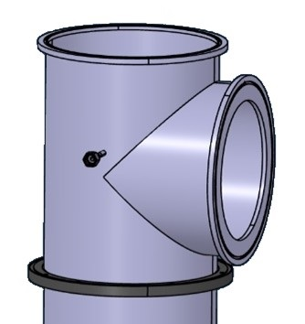
Chimney : Technical specifications for manufacturing (5)
Charge Question #5
Identification rule for traceability and identification
The Contractor will propose a permanent (indelible) identification, which must remain visible and legible, for the identification of V24 chimneys in order to ensure their traceability throughout the life of the chimneys (this identification will be used in all the control reports
Engraving, punching or inserting an identification plate on the chimney tee must be done in the area indicated
Dimensional inspection
Dimensional check for all the parts → inspection report.
Dimensional check for framed dimensions or dimensions with tolerances → inspection report.
After dimensional inspection, a stop point may be requested before factory acceptance.

Slide 29
Chimney : Technical specifications for manufacturing (6)
Charge Question #5
Storage of half-frames out of packaging
The Contractor must use specific dry and clean storage areas to prevent damage and deterioration of raw materials, articles made by service providers and equipment awaiting use or deliver
It is forbidden to store chimneys in a vertical position.
Protected chimneys awaiting transport must be placed and secured on wooden pallets.
The packaging of chimneys for transport is defined in appendix A7. It must provide protection against dust, humidity, splashes, bad weather, friction and any shocks inherent in handling and transport that could damage their surfaces.

Slide 30
Chimney : Technical specifications for manufacturing (7)
Charge Question #5
Packaging
The packaging must provide protection against dust, humidity, projections, bad weather, friction and any possible shocks inherent to handling and transport which could damage their surfaces.
• The connections and the VCR output must be sealed (the closing method must be approved by IJCLab) so as to ensure a perfect seal to avoid any external pollution (intrusion of dust, dirt or liquid)
• The counter flange must be mounted and screwed onto the chimney to facilitate handling.
• Wrap each chimney in a hermetically sealed bag (waterproof vinyl cover, polyane, etc.) or wrap them tightly with stretch film to avoid scratches. The protective bag must carry a label allowing the identification of the chimney.
• Carefully place the chimneys in the wooden box
• Add, if necessary, reinforcements and internal supports if the chimneys move too much and ensure that the chimneys are well fixed in the box. Secure to prevent any possible shocks inherent to handling and transport by using specific materials for protection against shocks and vibrations.
• Fill the gaps between the chimneys and the walls of the box with packaging material (foam cushioning, air bubble, bubble wrap, etc.) to prevent any movement during transport and protect the connections and the end flanges.
• Include all documentation, certificates, inspection reports, etc.
• Close the crate securely and ensure the crate is properly sealed to prevent intrusion of dust or moisture.
• Add shipping labels with necessary information (address, tracking number, special instructions, etc.)

Slide 31
Charge Question #4
Production and delivery Schedule for V24
Object | Number | 2024 |  |  |  |  |  |  |  |  |  |  |  |  |  |  |  |  |  |  |  |  |  |  |  | 2025 |  |  |  |  |  |  |  |  |  |  |  |  |  |  |  |  |  |  |  |  |  |  |  | 2026
 |  | 1 |  | 2 |  | 3 |  | 4 |  | 5 |  | 6 |  | 7 |  | 8 |  | 9 |  | 10 |  | 11 |  | 12 |  | 1 |  | 2 |  | 3 |  | 4 |  | 5 |  | 6 |  | 7 |  | 8 |  | 9 |  | 10 |  | 11 |  | 12 |  | 1 |  | 2 |  | 3 |  | 4 |  | 5 |  | 6 |  | 7 |  | 8 |  | 9 |  | 10 |  | 11 |  | 12
V24 Chimney | 43
V48 Chimney | 64
Call Opening
Contract Signature
Deliveries
Providers are responsible up to the delivery at IJCLab
V24: 64 weeks maximum (from the call for tender to the last delivery), typically 8 batches
V48: 80 weeks maximum (from the call for tender to the last delivery), typically 13 batches
Providers can propose a more aggressive planning => better score in the evaluation
Providers can anticipate some deliveries but cannot go below the average rate
Penalties foreseen (1000 € per day) in case of delays
See example hereafter and https://edms.cern.ch/document/3071594/1 and https://edms.cern.ch/document/3071596/1 for details

Slide 32
Example of planning for the frame production & delivery
T0: Contract notification date
T1 (T0 +2 weeks): Preparatory meeting between contractor and CNRS
T2 (T1 + 3 weeks): Submission of detailed schedule and final production file by contractor
T3 (T2 +1 week): Validation of the final manufacturing file + launch of manufacturing.
T4 (T3 + 5 weeks max): Factory acceptance test of first chimney
T5 (T3 + 8 weeks): Acceptance test of batch n°1 of the first 2 V24 chimneys between the Holder and CNRS
T5 bis (T5 + 2 weeks): Delivery of batch n°1 to IJCLAB
T5 ter (T5 bis + 4 weeks): End of IJCLab inspection period to declare conformity and final acceptance of batch.
T6 (T5 + 5 weeks): Acceptance test of batch n°2 of 6 V24 chimneys between Holder and CNRS.
T6 bis (T6 + 2 weeks): Delivery of batch n°2 to IJCLAB.
T6 ter (T6 bis + 4 weeks): End of IJCLab inspection period to declare conformity and final acceptance of batch.
T7 (T6 + 5 weeks): Acceptance test of batch n°3 of 6 V24 chimneys between Holder and CNRS.
T7 bis (T7 + 2 weeks): Delivery of batch n°3 to IJCLAB.
T7 ter (T7 bis + 4 weeks): End of IJCLab inspection period to declare conformity and final acceptance of the batch.
…
T12 (T11 + 5 weeks): Acceptance test of batch n°8 of 5 V24 chimneys between Holder and CNRS.
T12 bis (T12 + 2 weeks): Delivery of batch n°8 to IJCLAB.
T12 ter (T12 bis + 4 weeks): End of IJCLab inspection period to declare conformity and final acceptance of the batch.

Slide 33
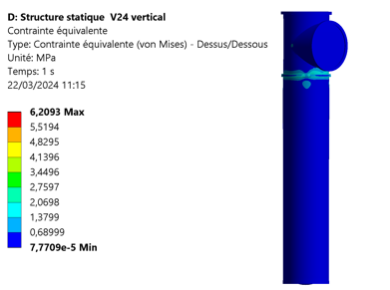
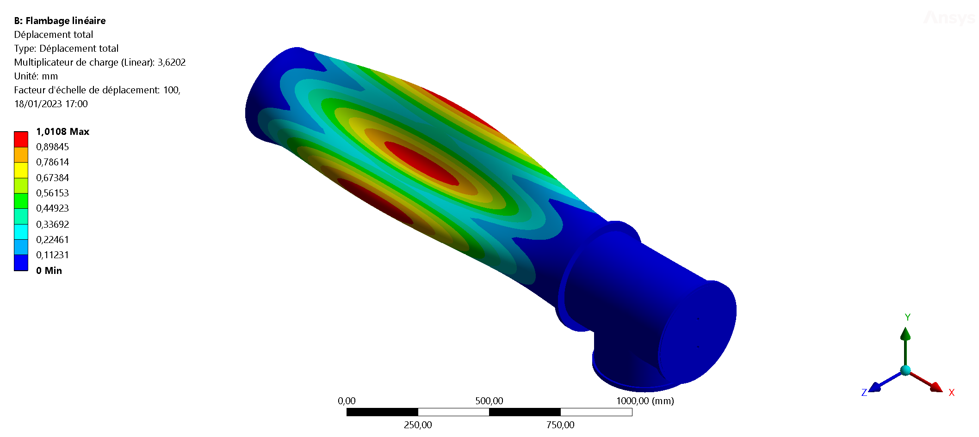
Compliance Office Validation
Discussion started too late due to delays on IJCLab side
Specifications in STTC: to be carefully checked and validated but preliminary list seems close to OK
  Material certificates
  Welding
  Dimensional tests
  Leak tests
  Visual inspection
Load cases to be better defined and analyzed
  during handling: DONE
  for leak tests: DONE
  Critical case of high pressure in the cryostat:
    Limit case : ΔP = 250 mb => ~400 kg on the flange
    PCB is the weak part but reinforcement thanks
    to the steel flange (30 mm thick) behind
    To be carefully calculated and validated: in progress

Slide 34
Charge Question #7
Reception and Validation tests @ IJCLab
Tests for all chimneys
  Dimension
  Visual Inspection (in particular weldings)
  Cleanliness
  Leak tests
4 Weeks foreseen between reception and validation

Slide 35
Reception test @ IJCLab
Charge Question #7
Visual Inspection
Cracks Fractures Assembly aspect Welding quality Roughness in seals grooves
Check of the tightness:
Place the chimney tank on the table, attach it
Insert the cimblot bracket and close the chimney tank with stainless-steel caps
Pump in order to obtain a vacuum (less than 10⁻³ mbar)
Check the tightness with Helium
Put the chimney tank back to atmospheric pressure
Install the chimney tank at the vertical position
Fill the vessel at the bottom of the chimney with liquid Nitrogen
Pump in order to obtain a vacuum (less than 10⁻³ mbar)
Check the tightness with Helium
Put the chimney tank back to atmospheric pressure
Put it back on the table, attach it
Dismount the cimblot bracket and the caps
Mechanical measurements
Characteristics to be measured | Used tool or instrument (accuracy of the measurement)
Length | Tape measure (mm)
Straightness | Sampling : Romer arm (0.03°) Check that it fits in the template
Diameter | Check that it fits in the template
Groove alignment | Check with the mounting of the FR4 guides
Flatness of the interface flange | Sampling : Romer arm (50 µm) Check that it fits in the template

Slide 36
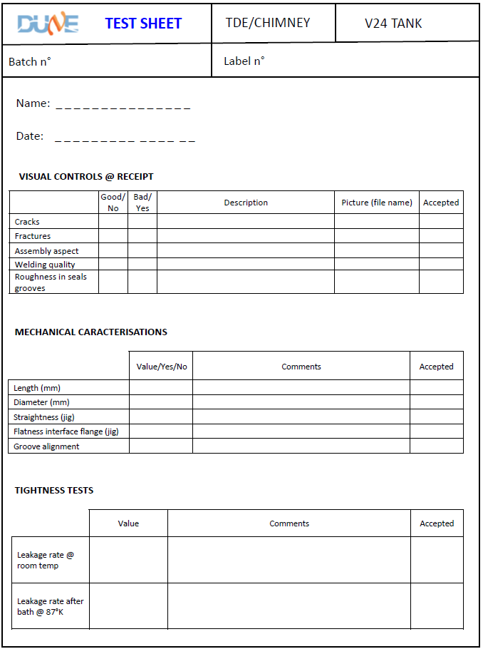
Reception test @ IJCLab
Charge Question #7

Slide 37
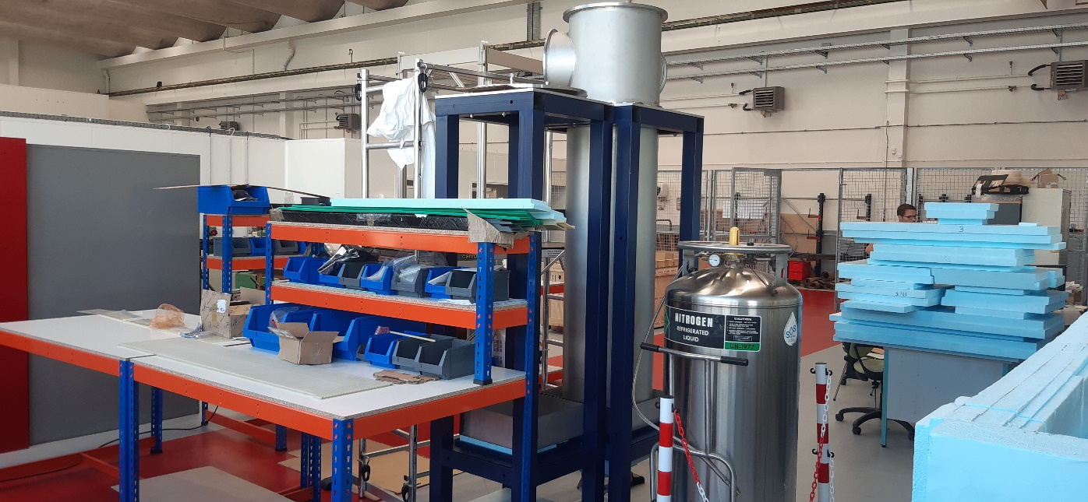
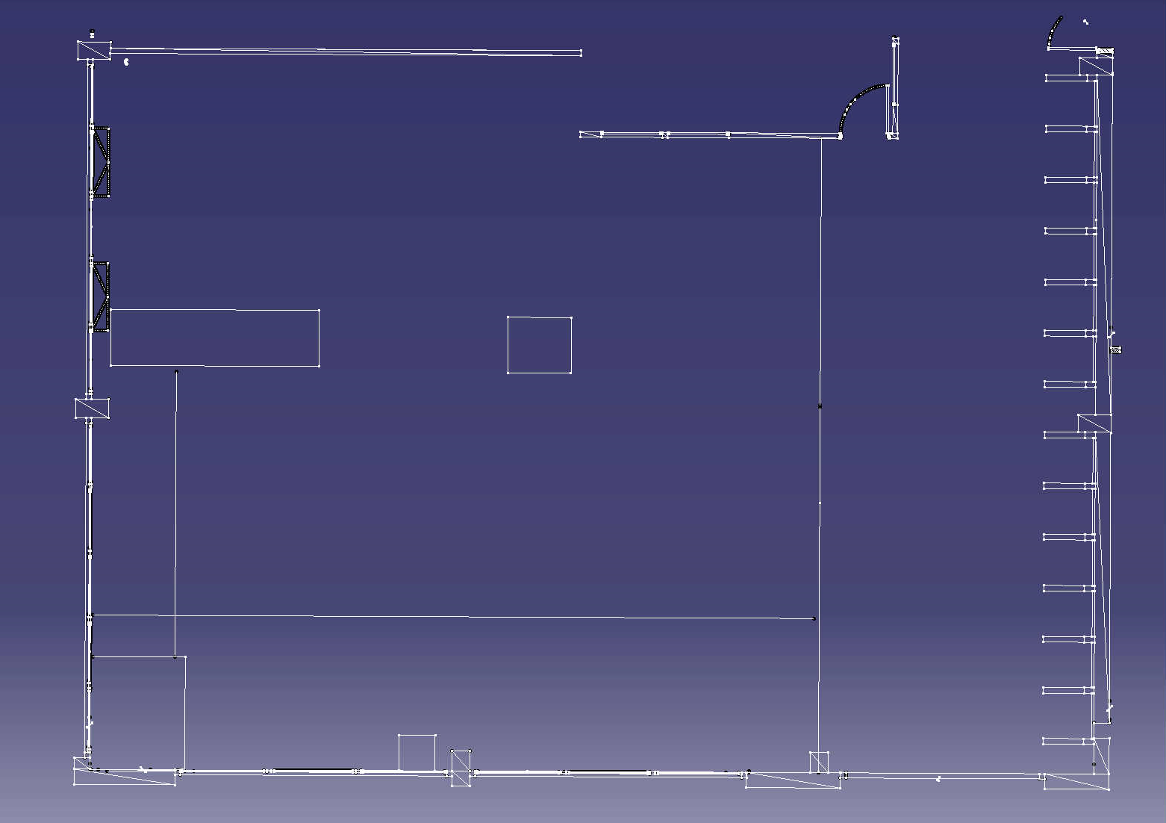
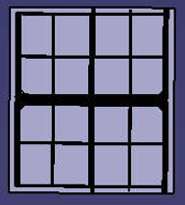
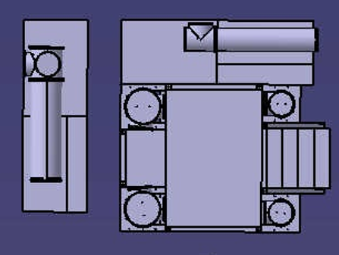


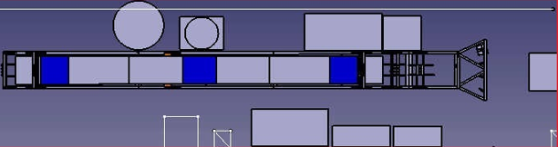
Charge Question #6
Reception and Validation resources @ IJCLab
70 m² (+ circulation) in one hall:
  dedicated to storage with a crane and large doors for truck unloading
  Able to store ¼ of the total production before its shipping to CERN
~ 130 m² (+ circulation) in one hall:
  crane and large doors for truck unloading
  dedicated to assembly and test of cathodes, Dyneema ropes and TDE chimneys
  Possible extension if needed (~60 m²)
3 FTE foreseen over a team of 12 people
Already 6 people trained for crane use
4,6M
4,9M
7,85M
14M

Slide 38
Conclusion
Chimney vessel design
  Natural evolution of NP02 and ColdBox designs used for years
  Production of prototypes for V24 and V48 version => meet the specifications (dimension and leak tests)
Interfaces:
  To be quickly agreed with Cryostat => foreseen before the end of this month
  OK with CRP but impact of Cathode TADs to be checked carefully
  OK with I&I
Validation from CO to be obtained
QA/QC plan & procedures defined
IJCLab resources (facilities, infrastructure, and workforce) ready
Fabrication & assembly drawings, STTC, scoring grid ready => green light needed to launch the calls for tender

Slide 39
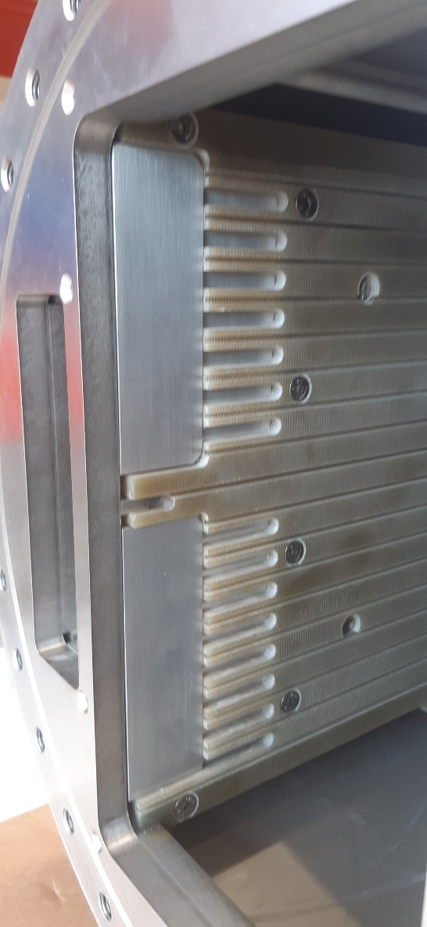
Towards the final chimney PRR
Charge Question #1
Tests at CERN in the coming weeks with full TDE electronics in order to check thermal behavior for V24 and V48
Test of four guiding system configuration (standard design, improved air flow, cooling metallic plates, combination of both)
No impact on vessel design

Slide 40
Backup

Slide 41
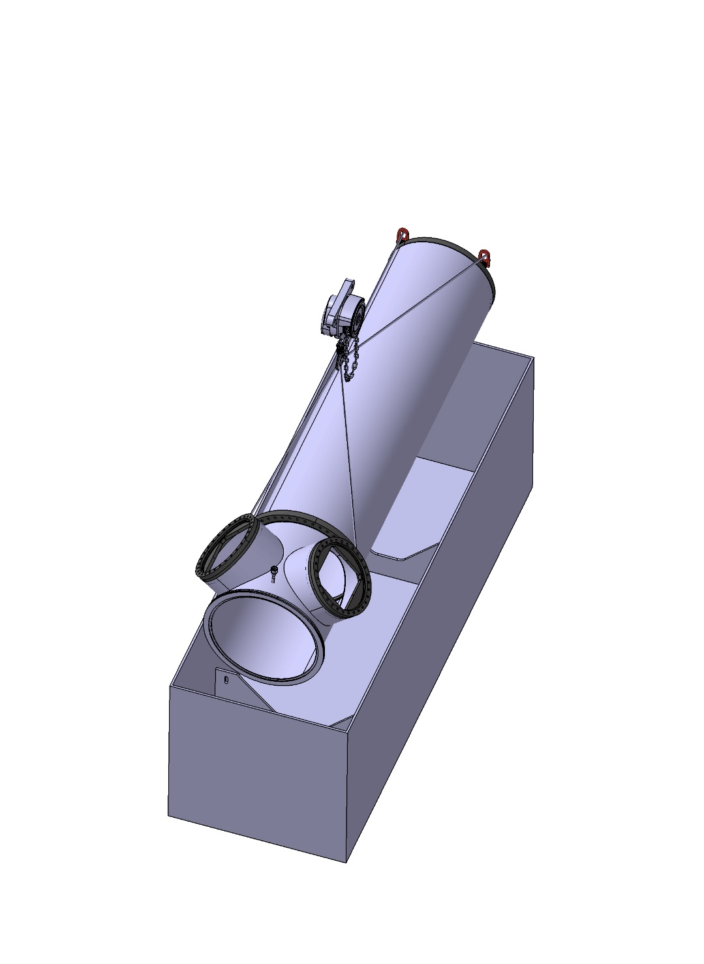
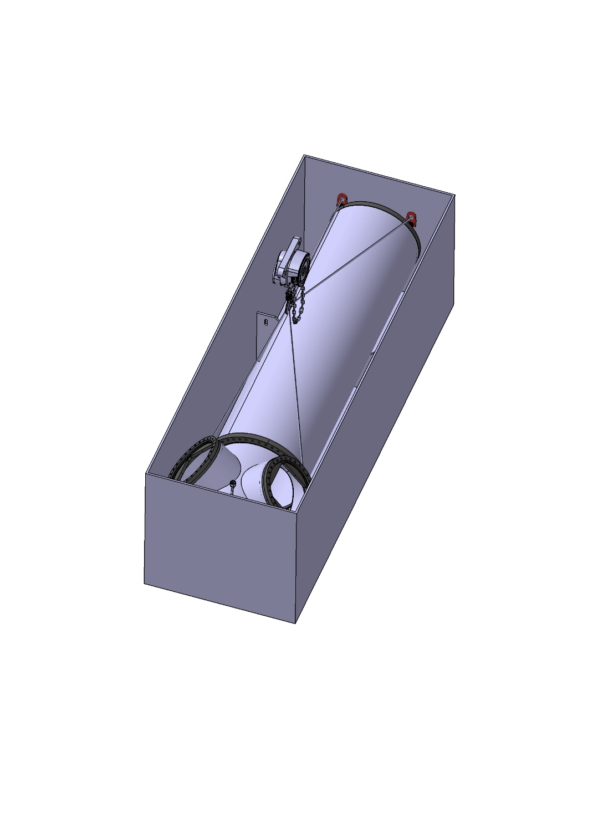
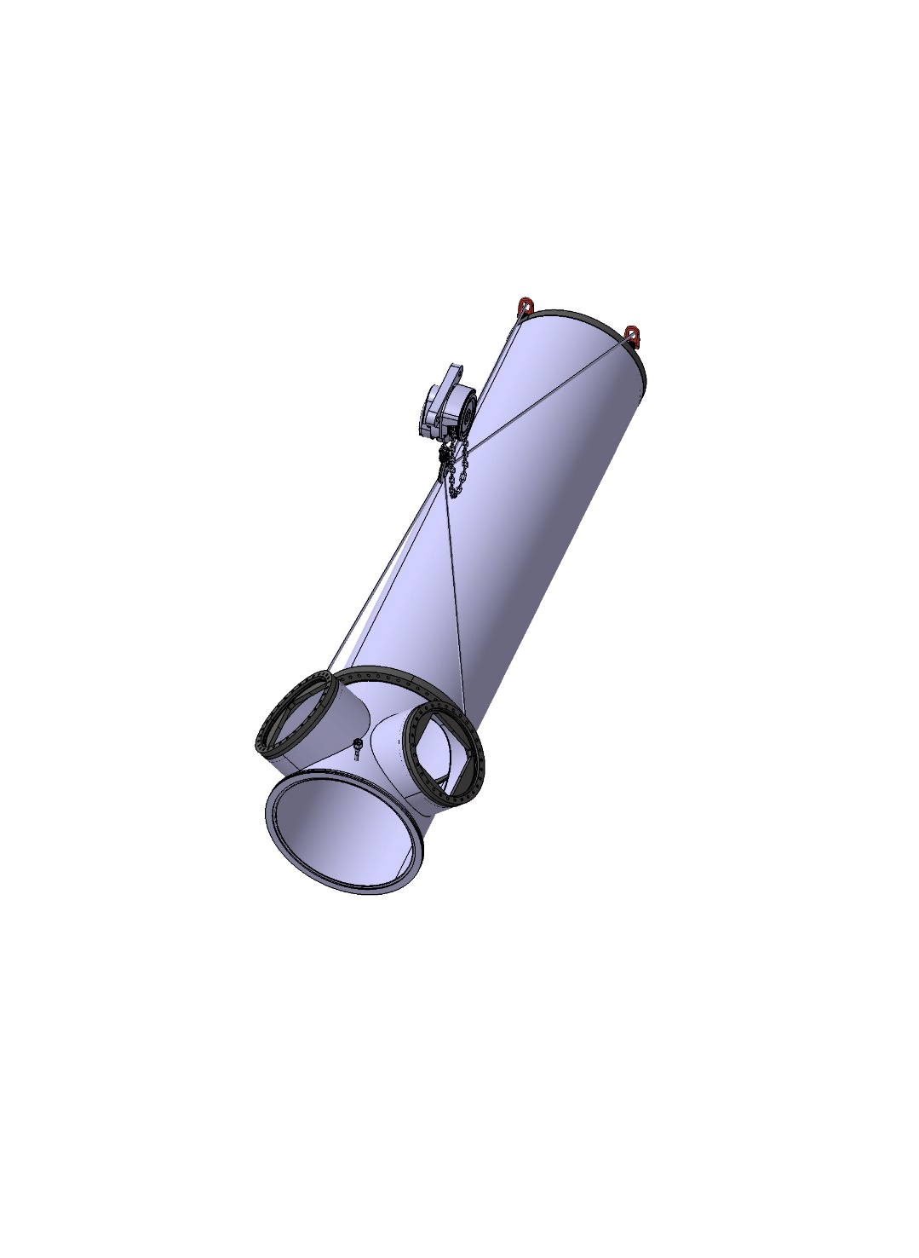
Step 1:
Screw 4 eyebolts in the flanges
Connect slings
Step 2:
Out of its box
Step 3:
Take away from the box

Slide 42
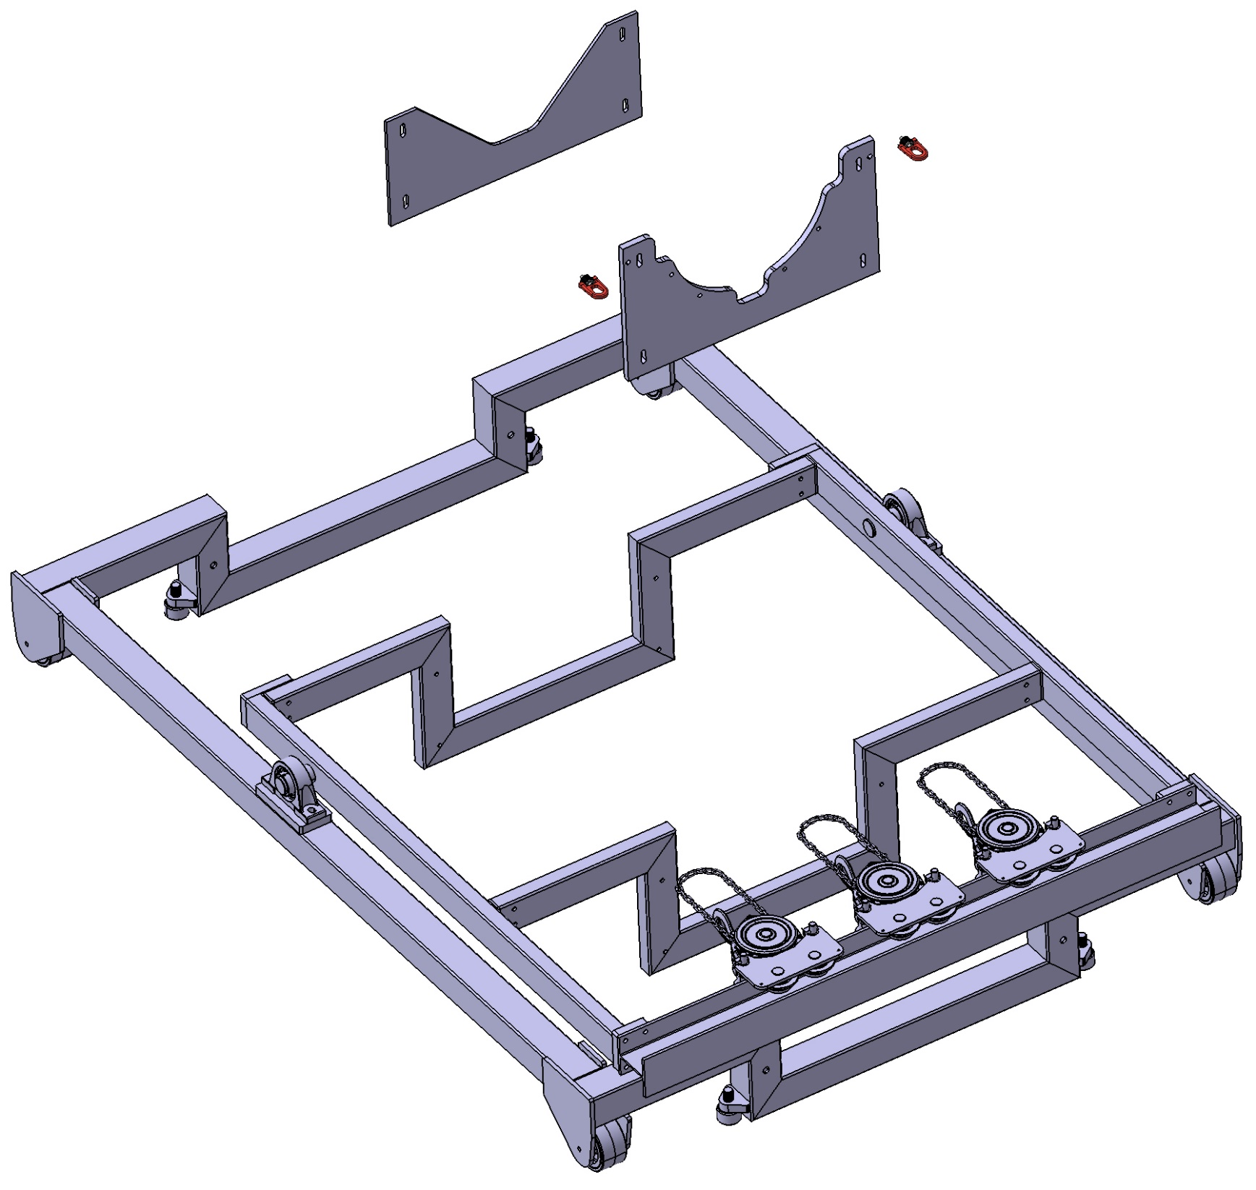
The Cart and toolings
Support plates screwed on the cart
One plate to screw the middle flange
2 types of plates for the two diameters
Eyebolt
Support plate
Flange support plate

Slide 43
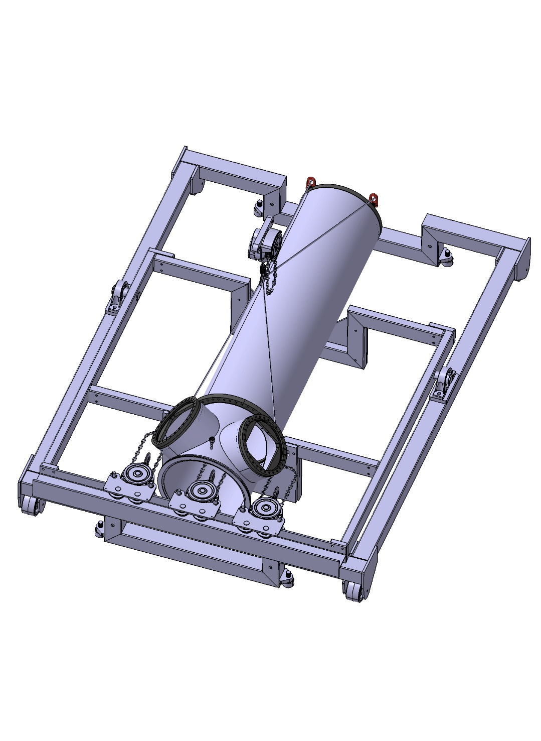
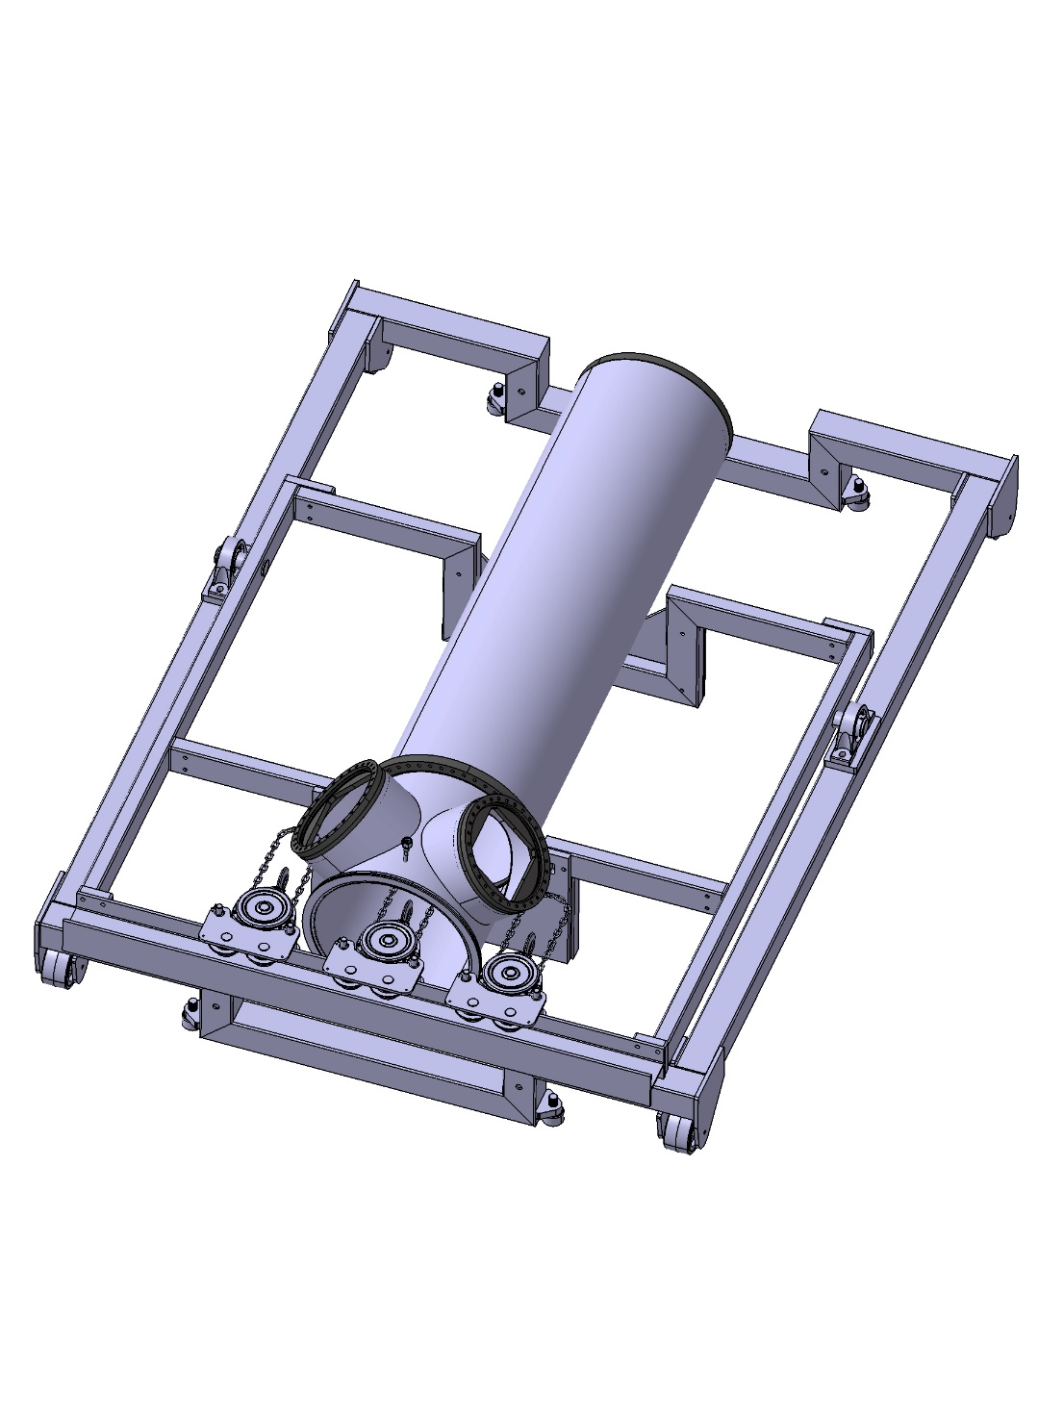
Step 5:
Screw the flange to the Flange support plate
Remove eyebolts and slings
Step 4:
Installation on the cart

Slide 44
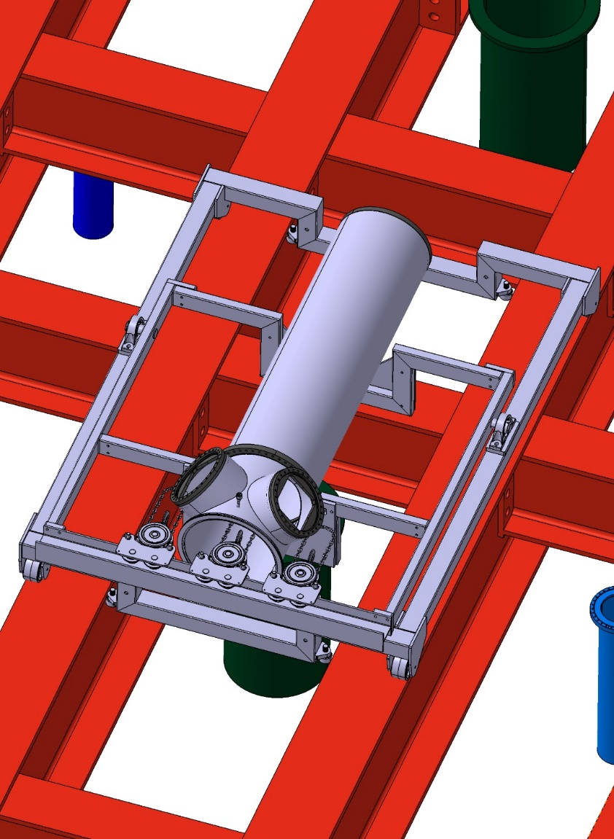
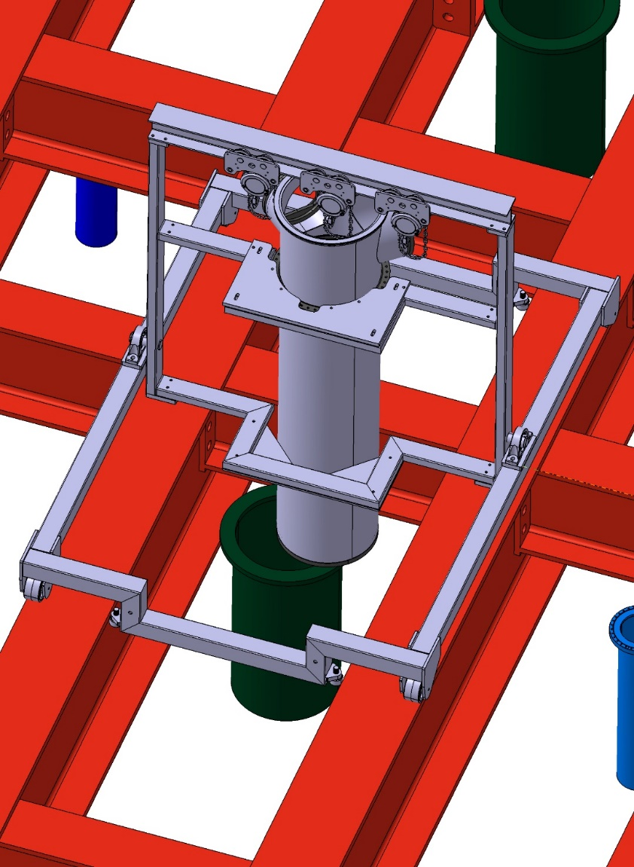

Step 6 : Bring to the right position
Step 7 : Rotate the cart
Step 8 : Screw 2 eyebolts in the Flange support plate and connect sides cranes

Slide 45
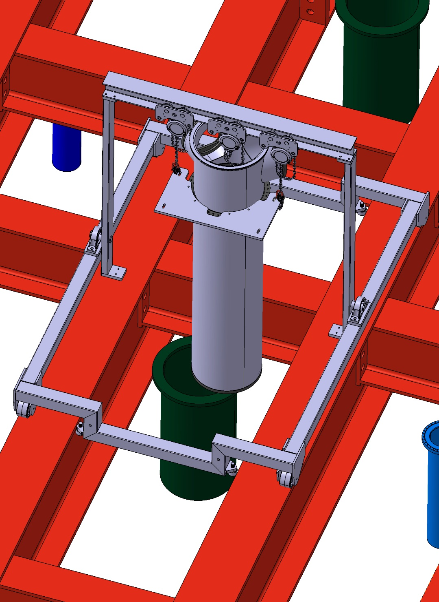

Step 9 : Remove supports keeping the Flange support plate
Step 10 : Translation of the chimney

Slide 46


Step 11 : Lower the chimney, put on the penetration
Step 12 : Screw 4 eyebolts in the central flange and connect central crane with hoist and slings

Slide 47



Step 13 : Raise a few centimeters with the central crane to release the 2 sides cranes
Step 14 : Remove the 2 sides cranes and eyebolts
Step 15 : Remove Flange support plate

Slide 48


Step 16 : Rotate in right position
Step 17 : Lower in the right position

Slide 49



Step 18 : Remove hoist, slings and eyebolts
Step 19 : Remove central crane
Step 20 : Fold cart

Slide 50


Step 21 : In place
Notes:
Analysis plan for the handling (possible deformation) with compliance office. Trous pour cables cathode

