Slide 1
MI8 Beam Position Monitor AIP Update
Kyle J. Hazelwood
PMG Meeting
2024-04-04

Slide 2
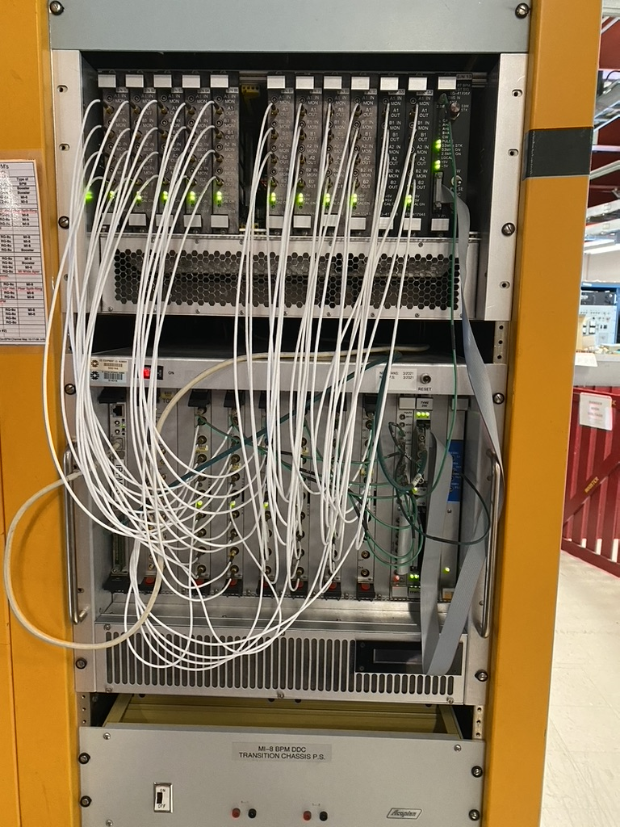
Introduction
The AIP will replace the electronics (crates, digitizers, etc) for the 8 GeV and BNB beamlines
AIP funding is $5M
Started Q2 FY24, ends Q3 FY27
Most R+D done for the PIP-II BPM system, the AIP will adapt that design to the beamlines
More modern uTCA based system
Replenishable VadaTech AMC digitizer cards
Streamed readings
AIP BPM hardware will replace 8 GeV and BNB beamline electronics
Existing VME system EOL
Existing Echotek digitizer boards EOL, no useable spares
AIP will support additional readings, improved user experience
New bunch by bunch measurement
Modern user client and API
Will help inform design choices for near future BPM and BLM upgrades in MI/RR
Organization
Mary Convery – AD AIP Program Coordinator, AD Beam Division Director
Robert Zwaska – Project Director, AD ACT Division Director
Kyle Hazelwood – Project Manager, AD MI Department Head
Craig Drennan – Project Engineer, AD INST Department Head
Existing 8 GeV BLM Crate
2
Kyle J. Hazelwood | MI8 BPM AIP | PMG Meeting

Slide 3
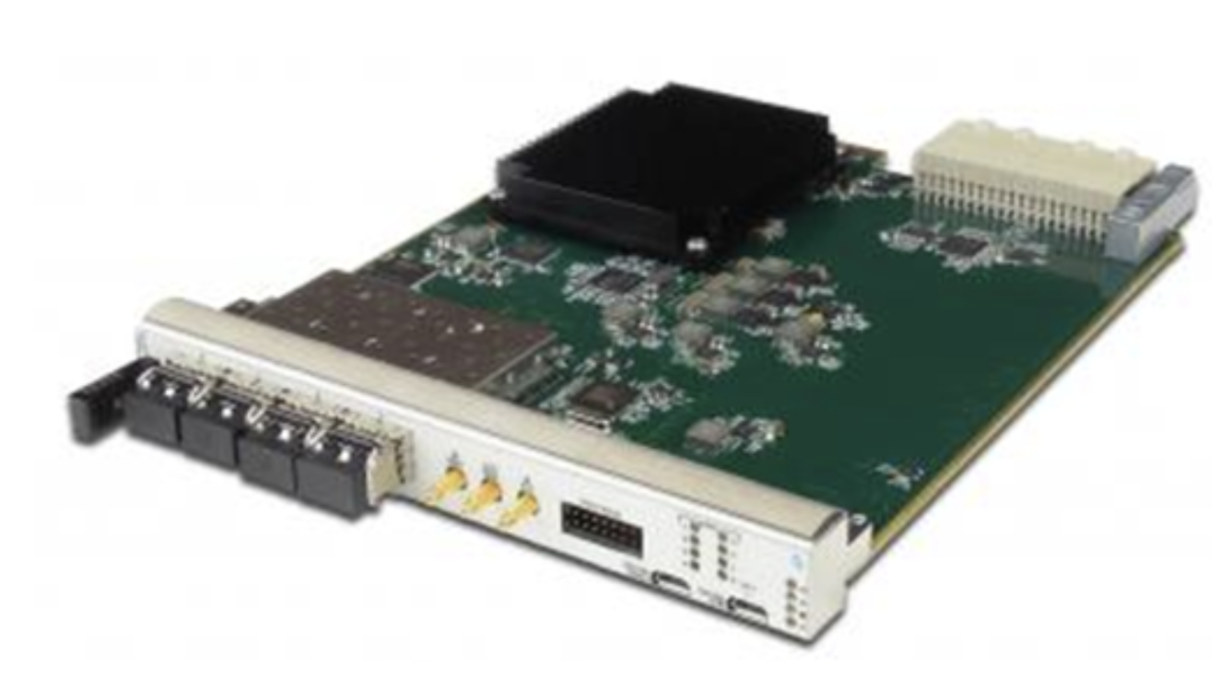
Update
Project began mid January, baselined in March
Initial progress slow
Personnel availability
Ongoing work
Documentation
Digital specifications near ready for review (digitizers, crates)
Analog specifications ready for review (rear transition module)
User requirements under development
Timing module specifications started
Digital product procurement testing procedures being developed
Analog electronics
Rear Transition Module (RTM) board being designed and laid out
Planned work for the quarter
Begin procurement of prototype crate components
VadaTech AMC board
2
Kyle J. Hazelwood | MI8 BPM AIP | PMG Meeting

