Slide 1
MQXFA17 Overtemp excursion on NbTi splice And Proposed Recovery Options Updated 3/15/24
D. Cheng, for the AUP team
February 22, 2024

Slide 2
Background
During the magnet splice operations two experienced technicians were assigned to make the second layer splice (“3/4” joint between Q1 and Q4)
When the operation was completed both technicians moved on to other tasks
Assumed that the other would turn off the variac that was controlling the heater
Approximately ~10 min. passed before building occupants started smelling burning G11
The variac was then powered off, but the G11 around the splice block was blackened by that time
No alarms or thermal protection were built into the splice tooling, since it was always supposed to be monitored for solder flow at ~200C, etc. when powered on
G11 discoloration was sanded/stoned for clean up, splice was packaged up as normal to stay stable while conditions were examined

Slide 3
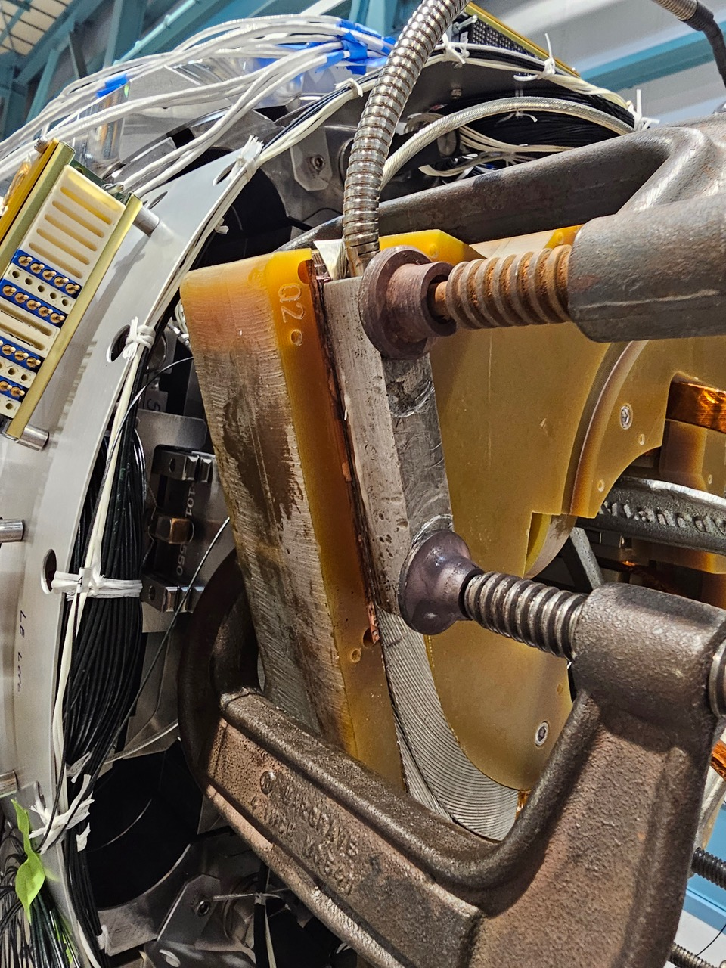
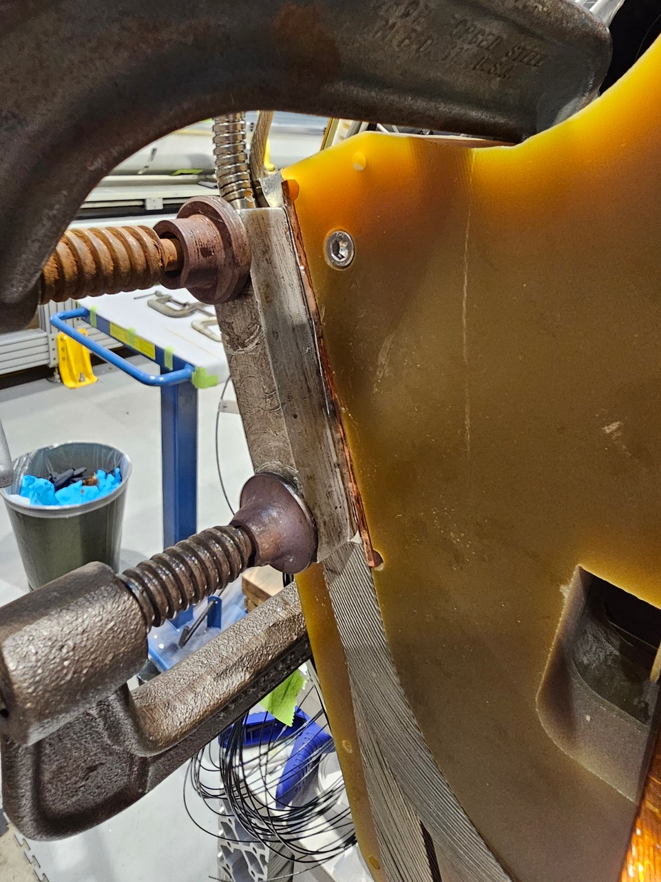
Background (2)
Splice joint setup

Slide 4
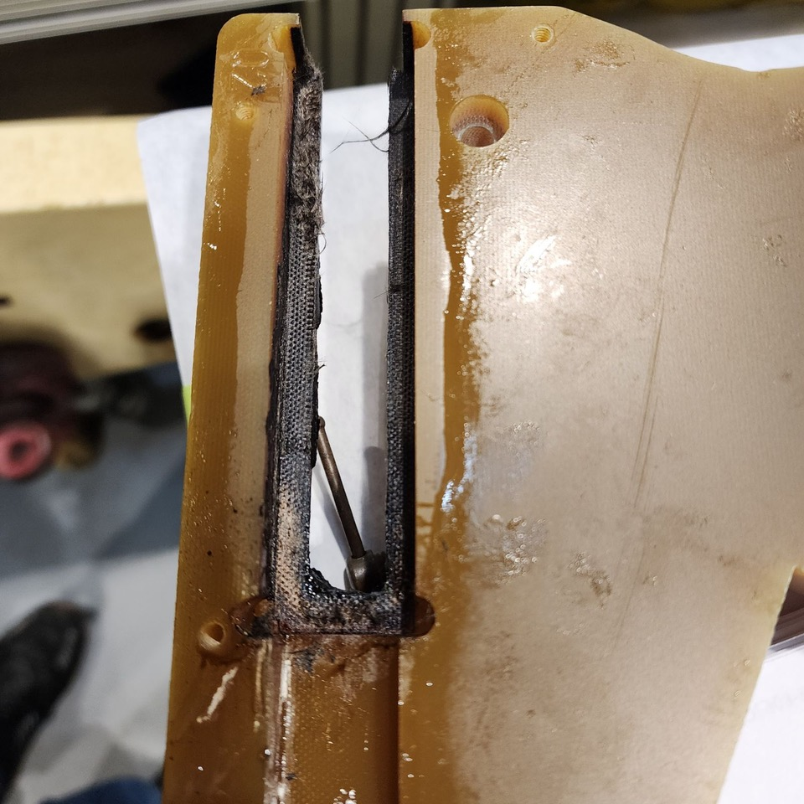
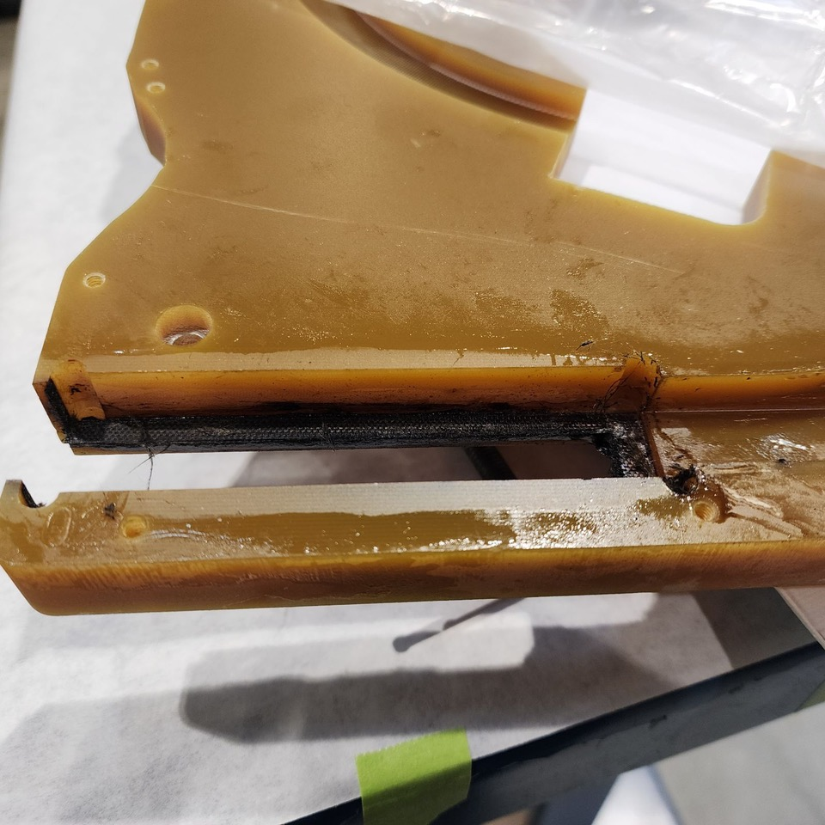
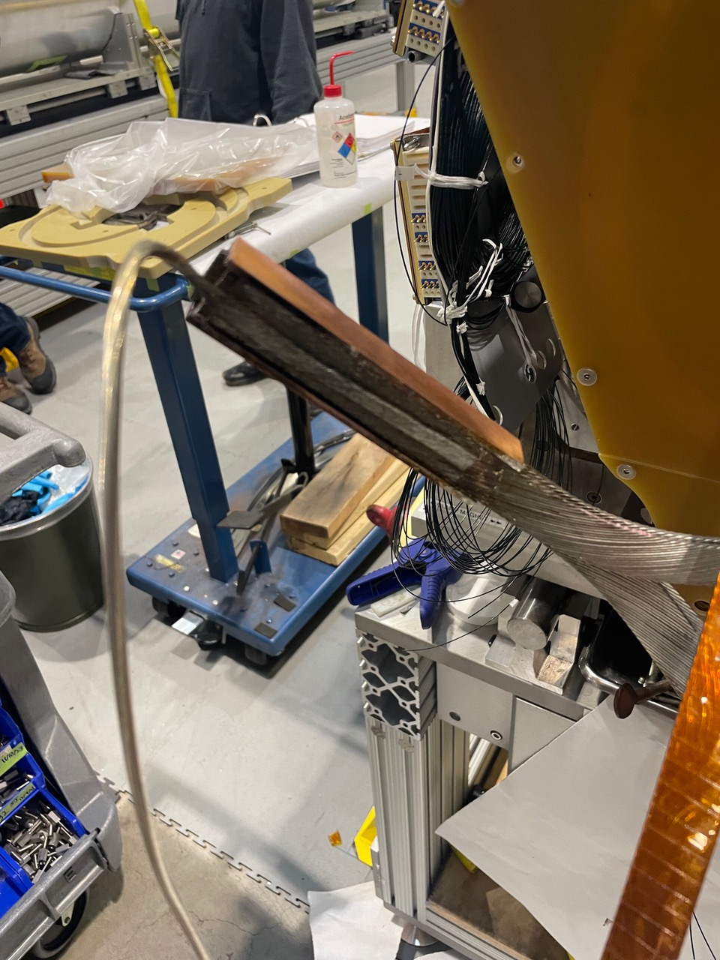
Background (3)

Slide 5
Preliminary Examination
Because no temperature monitoring was present the actual excursion was unknown
Flux burns off ~380 C, so temperature must have exceeded this value
Some sample G11 ”burn tests” were performed
One G11 pole key (bulk)
solder melts @ 190C approx 1 min 30 sec
Flux is gone @ 3 min 45 sec 380C
Discoloration @approx 380C-410C
Burnt G11 smell @ 410-415C
Visibly G11 burnt @ 480C
520c @6 min 30 sec
One thinner piece (~1/8” plate)
solder melts @ 190 1min 30sec
Flux is gone @ 3 min 45 sec 380C
~400 C visibly discoloring @ 4 min, and delaminating
Same clean up method Acetone and a wire brush after cool down
Preliminary conclusion from these tests is the the joint may be reached anywhere from 400C - 500C

Slide 6
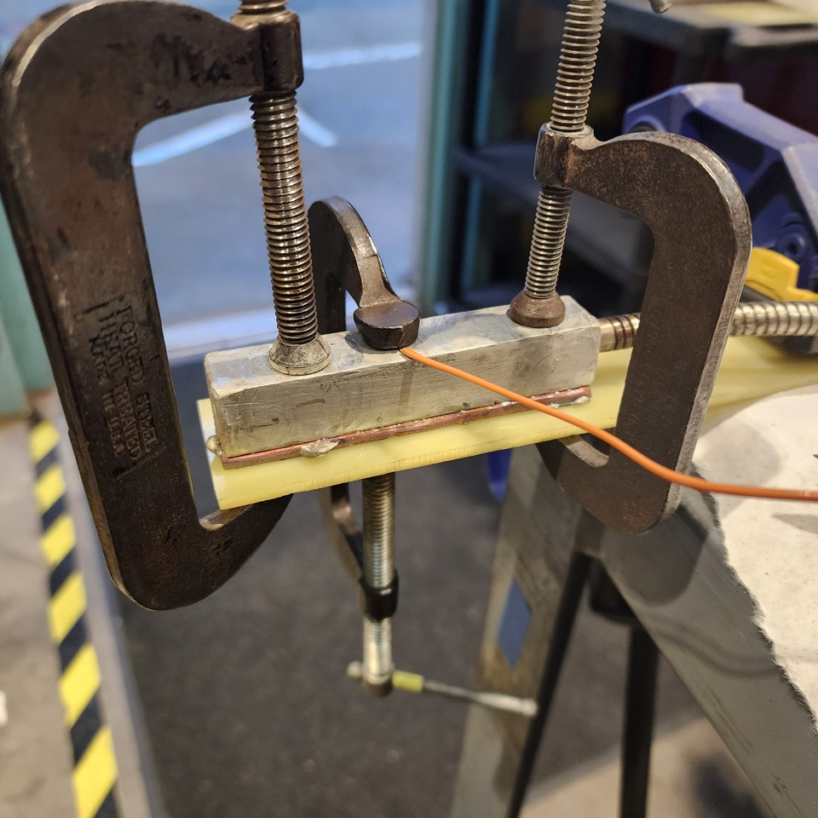
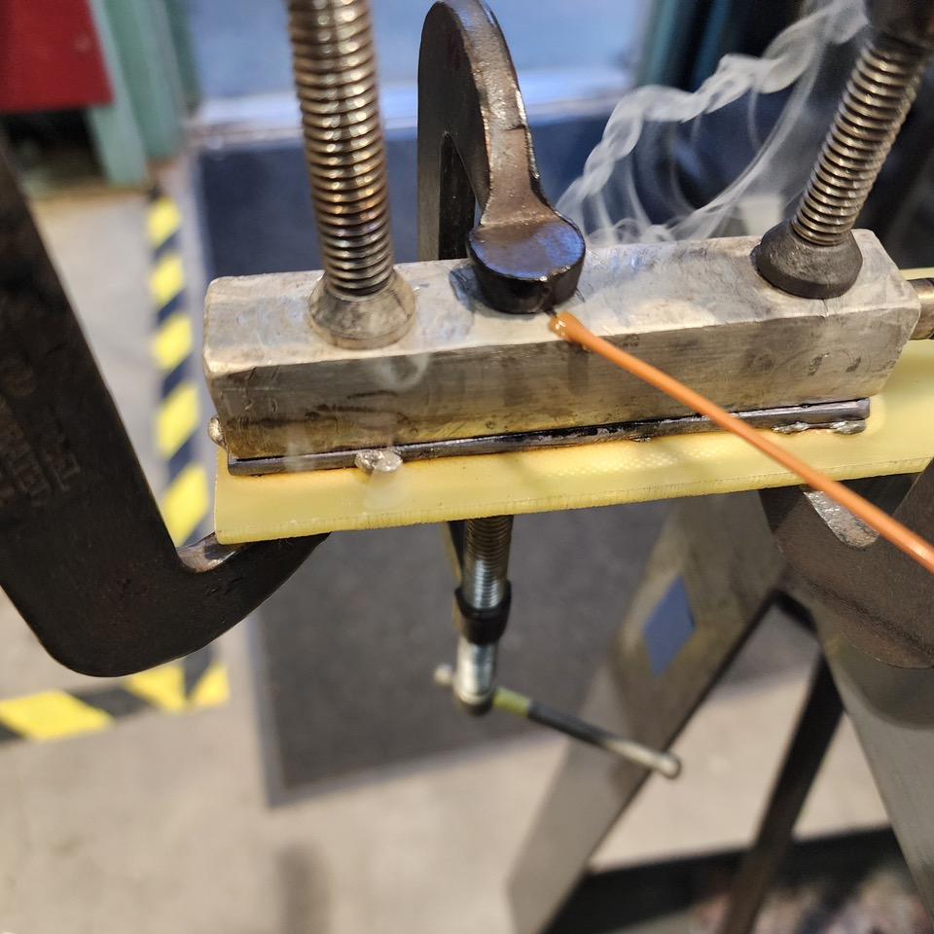
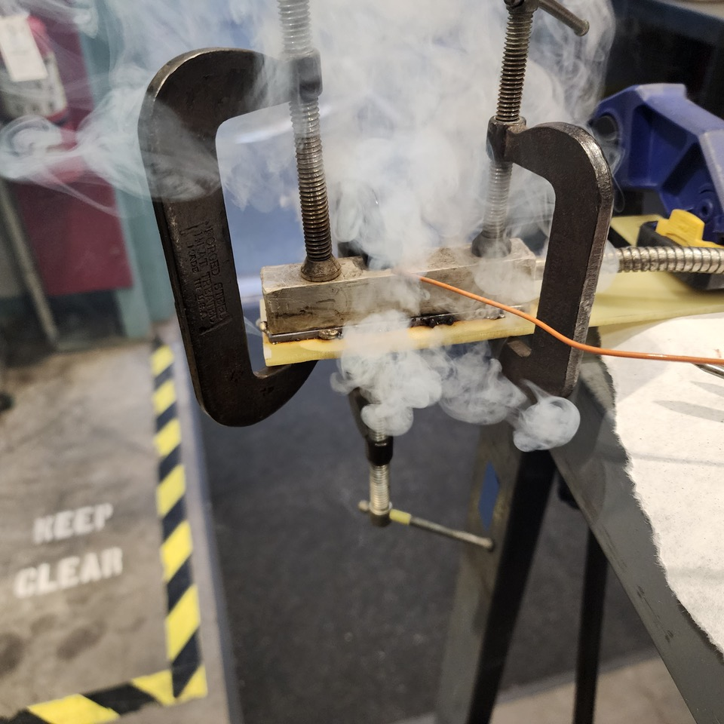
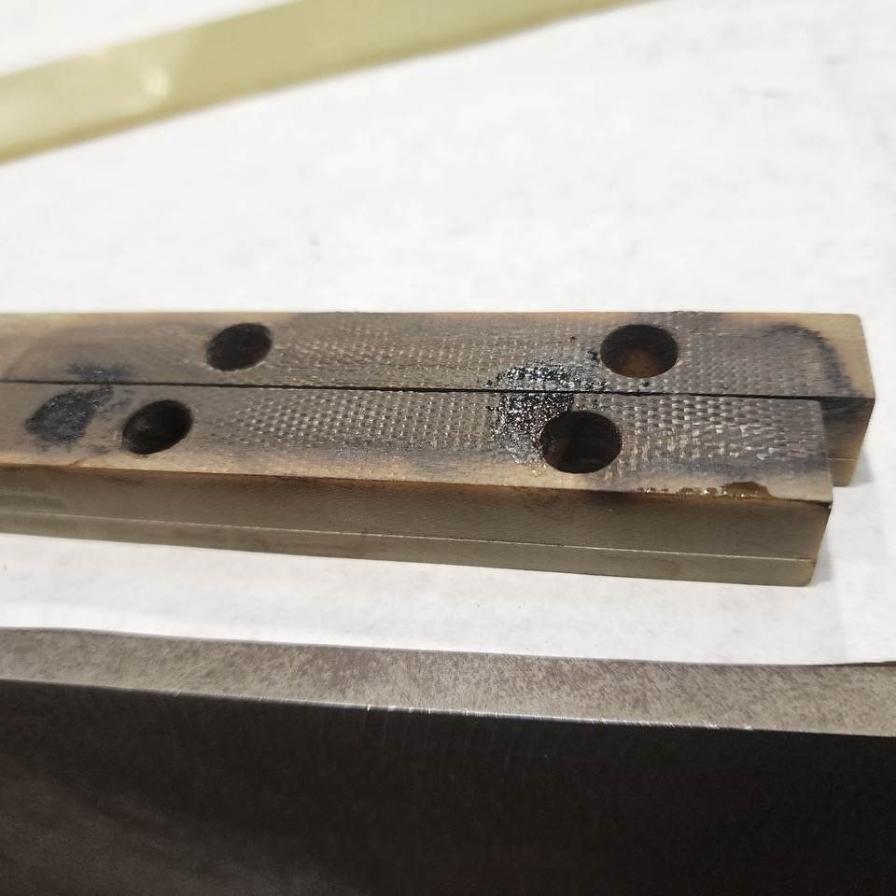
Preliminary Examination

Slide 7
Additional Examination Possible?
Can the CLIQ lead be used to determine temperature excursion in the joint?
Micrograph possible to compare with non-heated CLIQ lead?
This might be a NDE way to determine temperature excursion

Slide 8
Update
Splice joint was measured; currently showing 60 µohm resistance across the joint

Slide 9
Sectioning the NbTi splice joint
Each ~6 mm section will be cut in half
This allows metallography and magnetization measurements to be performed on the same sample section
Two samples
MQXFA17 overheated joint
Mockup sample joint
CLIQ lead
NbTi Leads

Slide 10
Proposed Replacement of NbTi Leads
Two options considered:
Option 1: Replace NbTi lead in the splice box
Will not require undoing of magnet preload
Least invasive
Dependent on the clearance of leads
This is a more complicated design solution
Option 2: Replace NbTi lead where it passes through the endplate
More invasive: Will require undoing of magnet preload (half azimuthal, full axial unload)
Fewer parts will need to be modified, but simple design

Slide 11
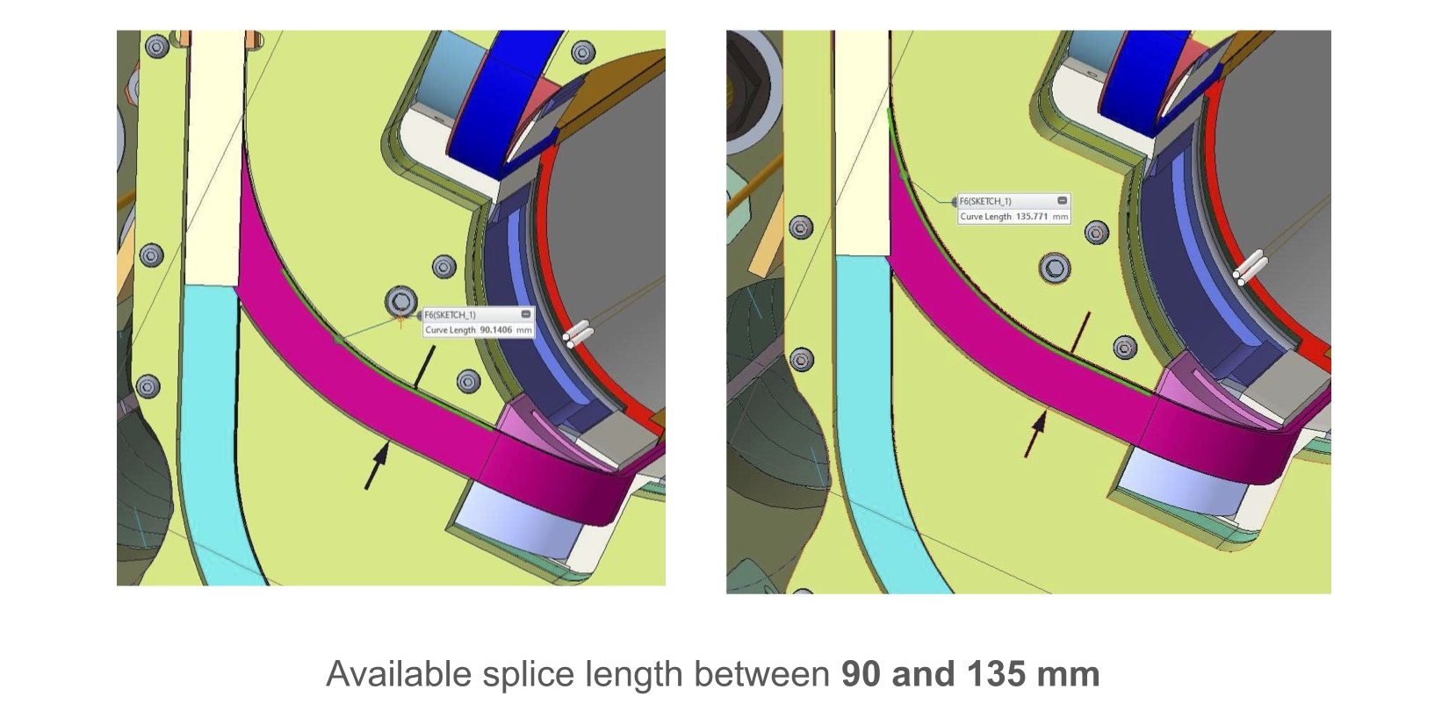
Proposed Replacement of NbTi Leads
Option 1: Examined splice box clearances
There is not enough length available to splice a NbTi lead replacement to the Q4 lead

Slide 12
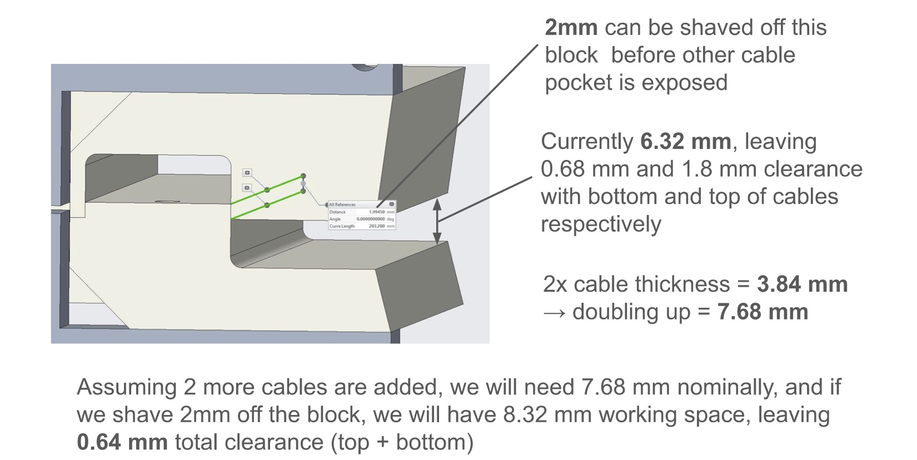
Proposed Replacement of NbTi Leads
Option 2: Placing NbTi splice in the endplate
Clearances are such that the restraint guide can be machined to provide clearance for two new NbTi leads
New NbTi leads

Slide 13
Option 2 Replacement of NbTi Leads
Option 2: Placing NbTi splice in the endplate
Replacement Lead
Cut Lead
New splice joint

Slide 14
Option 2 Replacement of NbTi Leads
Option 2: Placing NbTi splice in the endplate
Can be performed for both Q1 and Q4 leads
May also need to modify lead support ramp

Slide 15
Option 2 Replacement of NbTi Leads
Option 2: Placing NbTi splice in the endplate
115 mm splice joint (same as in normal joints) can be fit ~23 mm from the Coil theoretical end
May also need to modify lead support ramp

Slide 16
Option 2 Replacement of NbTi Leads
Option 2: Placing NbTi splice in the endplate
VT locations can be provided
Existing VT pass-thrus can accommodate 2nd wire for monitoring these new splice joints
Extra VTA01b wires from coils (currently unused and bundled) can be utilized for this pair

Slide 17
Option 2 Replacement of NbTi Leads
Summary of operations (off-normal) needed:
Undo splice joints, remove splice box
Unload magnet to half-azimuthal, no axial; remove LE endplate
Cut NbTi leads of Q1 and Q4
Modify/fabricate G11 restraint guides
Add new NbTi leads
Redo magnet preload to full axial, full-azimuthal
Make up magnet splices, include extra VT wires for NbTi splice joint monitoring
Then the usual magnet EQC/connectorization prep to finish magnet will follow

Slide 18
Recovery Update, 3/7/24
Magnetization and metallographic examination of the overheated NbTi strand appear to show no damage to current carrying ability
Sintering of strands observed, and not very much solder was present
Recovering MQXFA17 to put back into service
Tested with an overheated sample joint
Mechanically separated the cut CLIQ lead from the existing joint
Re-flowed more solder
Replace the FVT voltage taps
Complete connectorization and final finishing operations
Perform SeqR and single EQC hipot coil-structure (Final EQC was already performed and passed prior to splice joint examination)

Slide 19
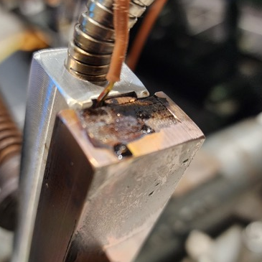
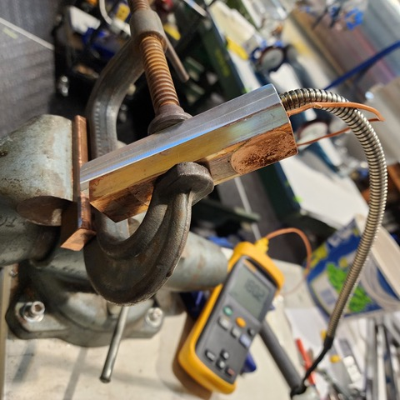
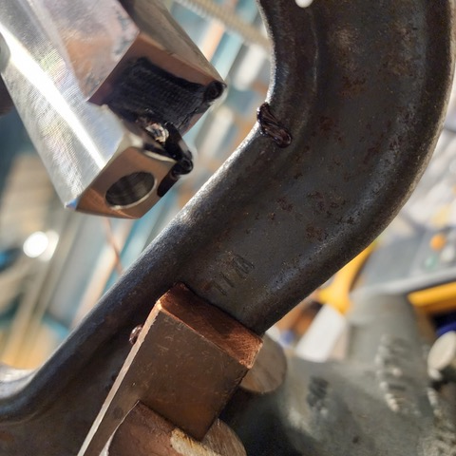
Recovery Update, Tested Samples
Overheated sample joint to ~450C for ~5 min, allowed flux to burn off and solder to drip out

Slide 20
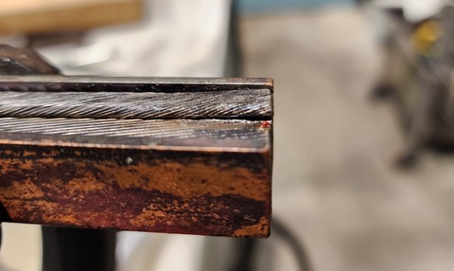
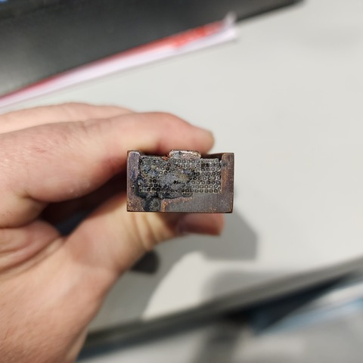
Recovery Update, Tested Samples
A cut CLIQ lead section was also part of the overheated joint; practice for separation

Slide 21
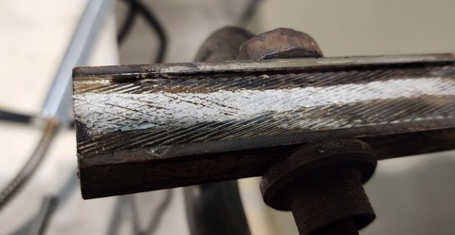
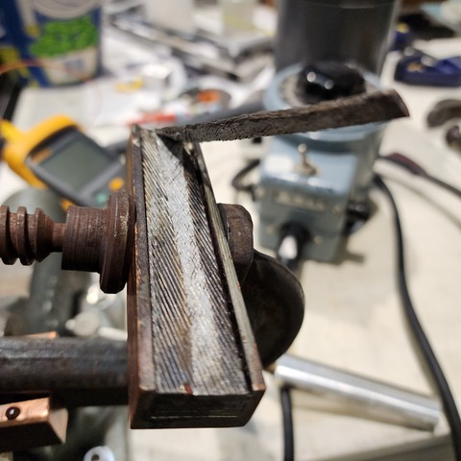
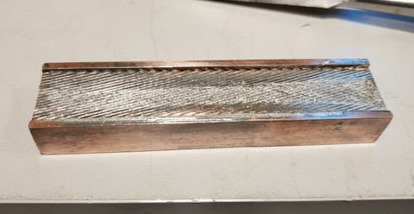
Recovery Update, Tested Samples
A chisel was used to mechanically separate the CLIQ lead from the NbTi lead
Was not difficult, and did not damage the conductor

Slide 22
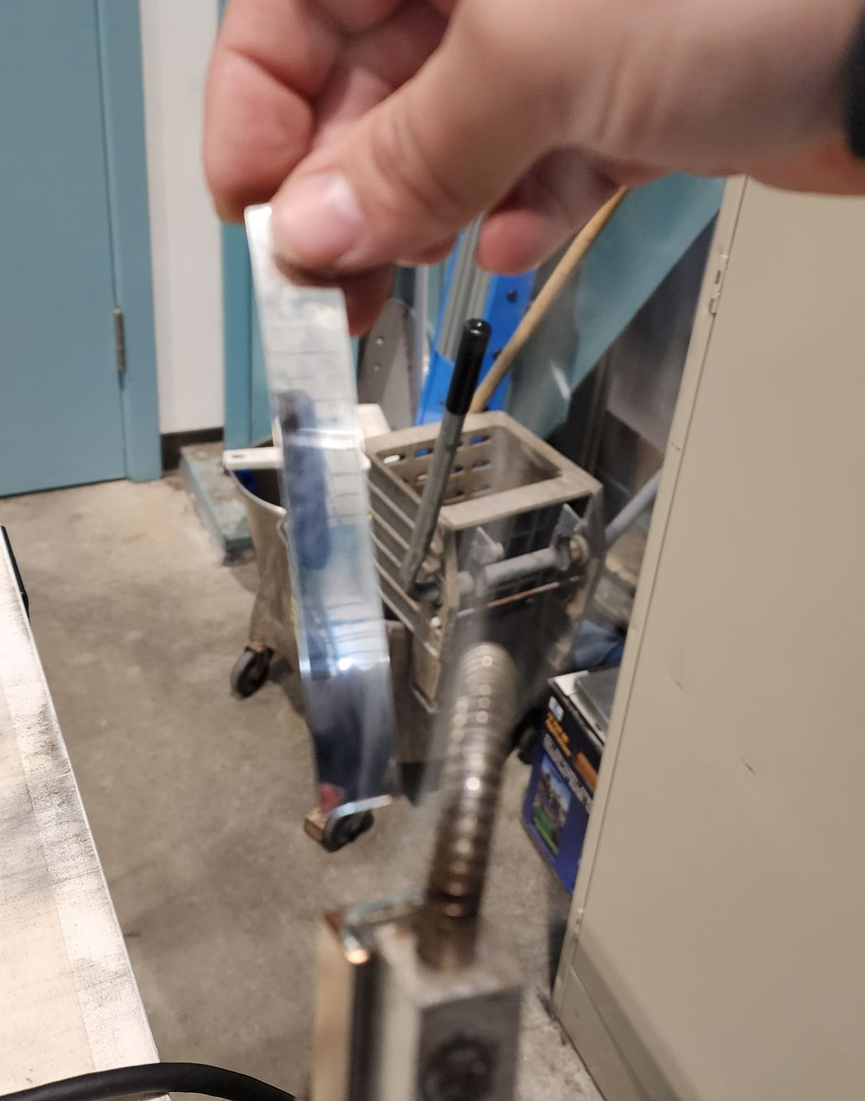
Recovery Update, Tested Samples
Cut section of the overheated joint, before backfilling
Then backfilled by feeding more ribbon solder at normal temperature

Slide 23
Recovery Update, Tested Samples
Sample was cut of the overheated joint
Joint was then set up to re-flow solder
MOB-39 flux applied
Heated joint to normal temp (290C)
Solder applied to the end and sides and everything wetted without issue
A sample of the backfilled joint was then cut
Imaging from both samples just received
May need to practice and examine the process further…

Slide 24
Recovery Update, Tested Samples
Will need to practice and examine the backfilling operation
(not much additional solder observed in sections)

Slide 25
Recovery Update, 3/12/24
Overheated sample backfill test, Take 2
Weighed joint and solder separately
Applied MOB-39 to sample joint
Attempted rewetting/flowing at 260 C
Weighed backfilled joint
Attached a new CLIQ lead
Wetted at ~260 C (weighed before and after)
Removed CLIQ lead with heat
Attempted mechanically separating a NbTi lead
Using a thinner blade instead of thick chisel wedge

Slide 26
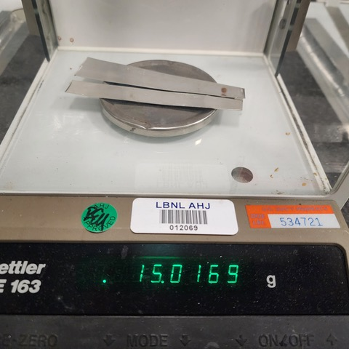
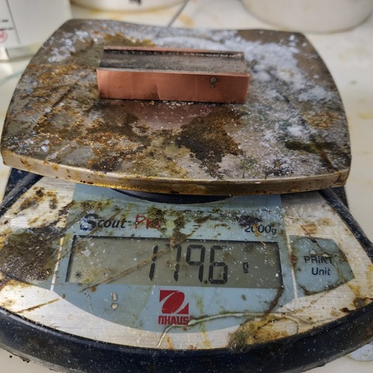
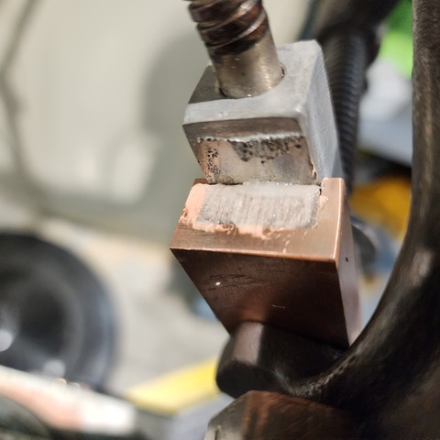
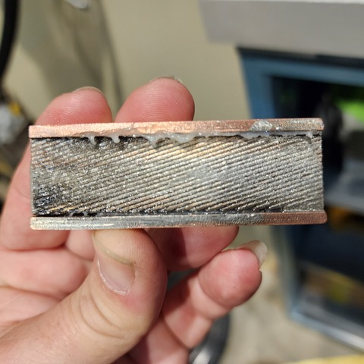
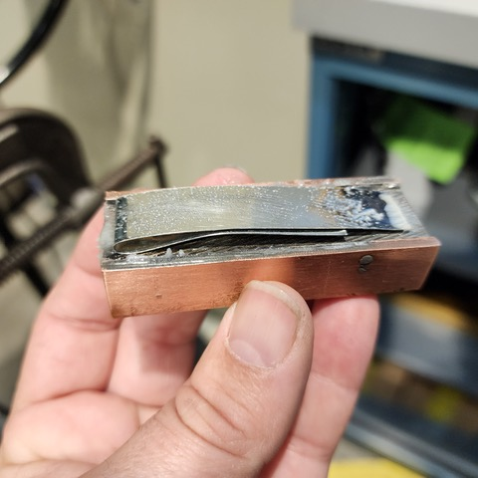
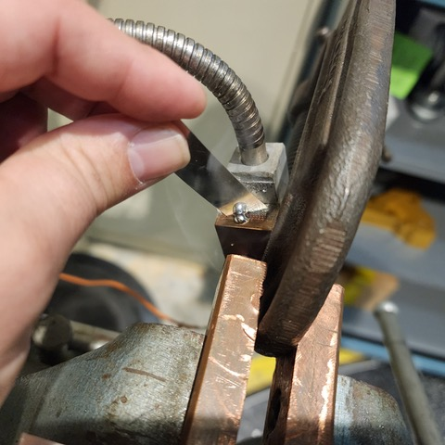
Recovery Update, 3/12/24
Overheated sample backfill test #2

Slide 27
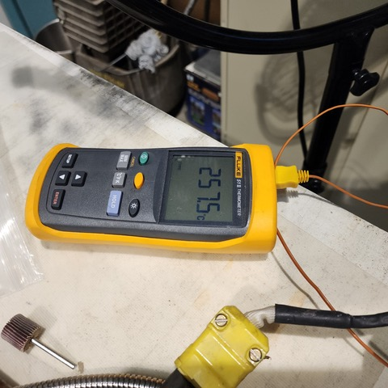
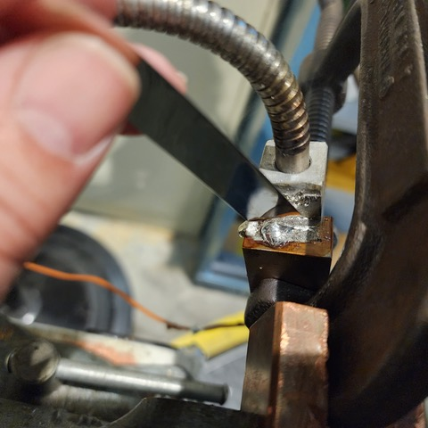
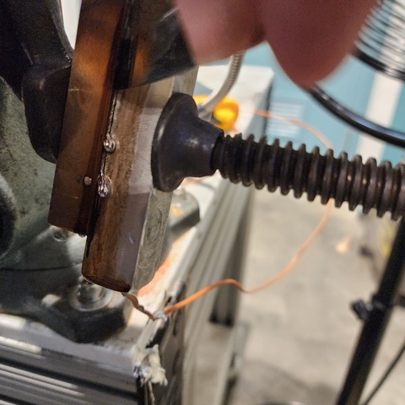
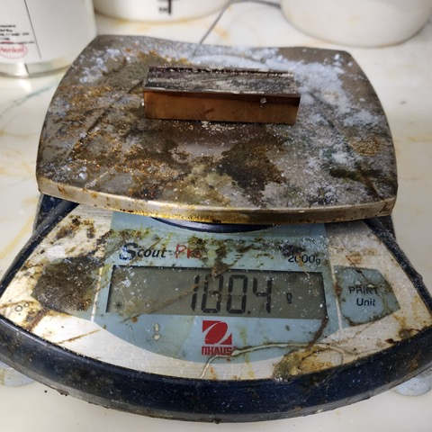
Recovery Update, 3/12/24
Overheated sample backfill test #2
Conclusion: <1g weight gain may be due to gas pockets where flux and solder cannot flow, and no more solder is able to be flowed

Slide 28
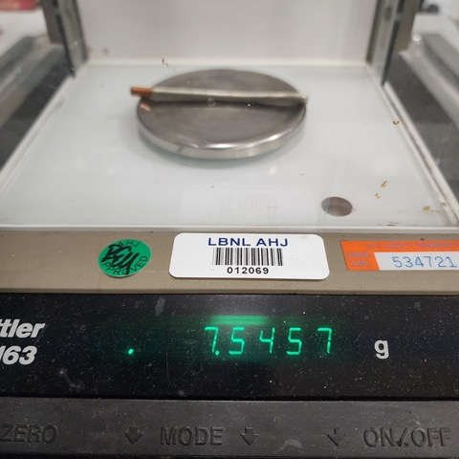
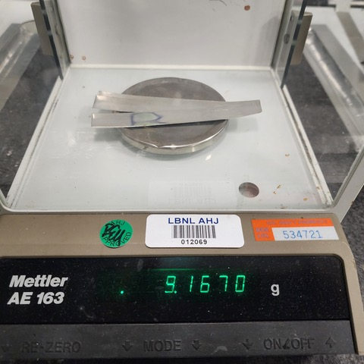
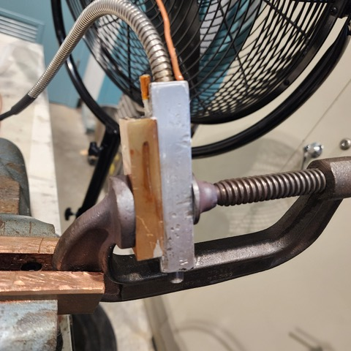
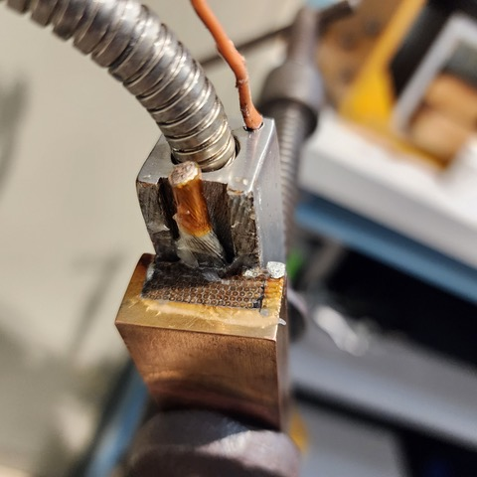
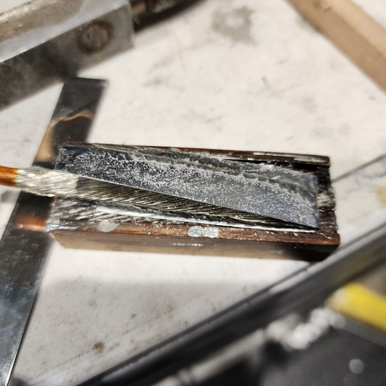
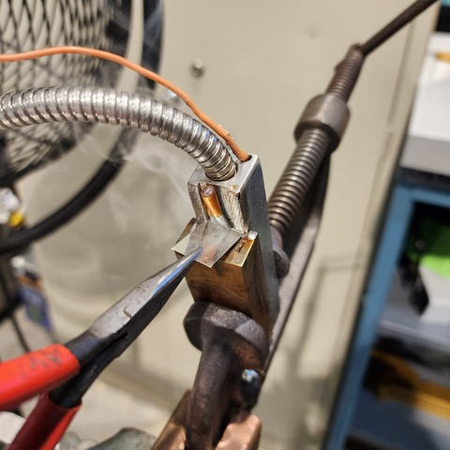
Recovery Update, 3/12/24
Add new CLIQ lead to overheated joint

Slide 29
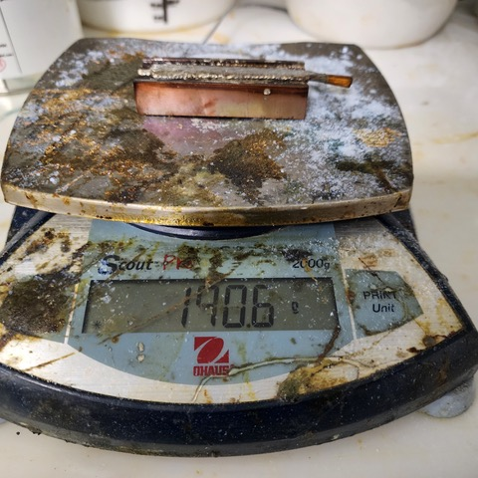
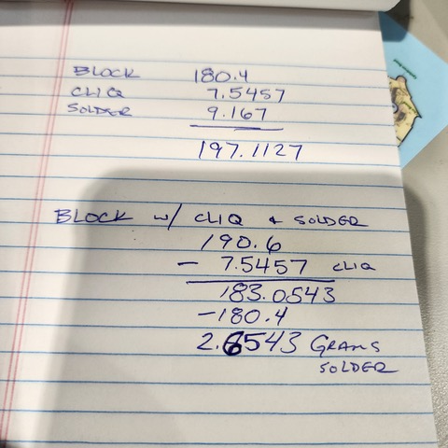
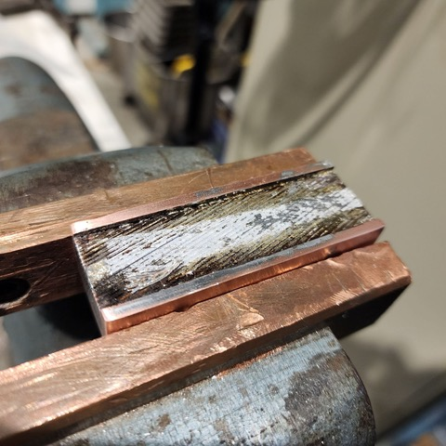
Recovery Update, 3/12/24
Add new CLIQ lead to overheated joint (and removed it)
CLIQ lead was able to be soldered just fine; ~2.65g weight gain doesn’t have any comparison to fill quality
Also, this CLIQ lead can be mechanically detached from joint, which may indicate only wetting to overheated solder surfaces

Slide 30
Recovery Update, 3/13/24
Tasks performed
Mechanically separated first NbTi lead from test joint
Used unsharpened section of 0.020” shim
Mechanically separated second NbTi lead from test joint
Used a beveled section of 0.020” shim
Prep joint for re-flowing solder with the two separated NbTi leads, as well as the new CLIQ lead section

Slide 31
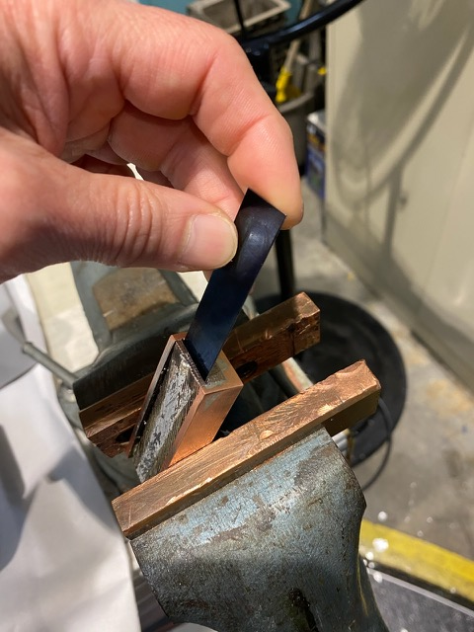
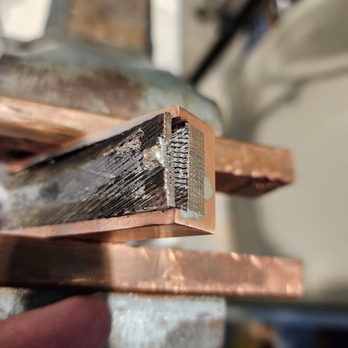
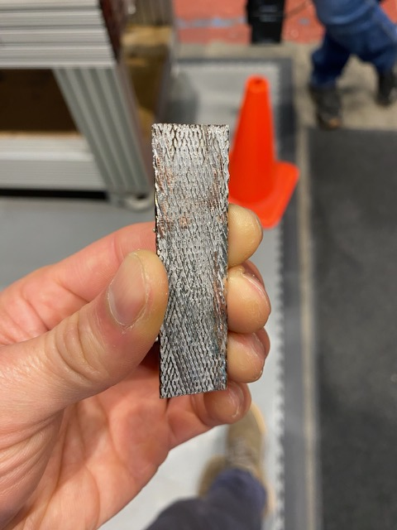
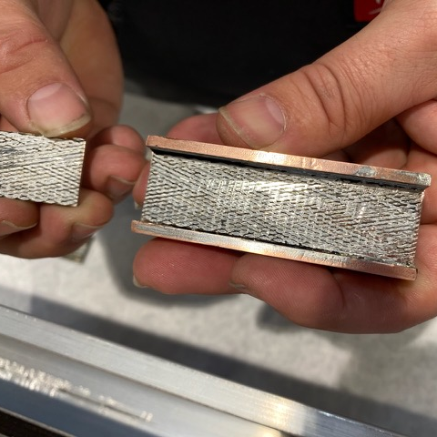
Recovery Update, 3/13/24
Separated first & second NbTi leads from sample joint
Initial removal used an unsharpened 0.020” thick shim. Appeared to scratch lead
2nd layer used a slightly sharpened shim, which didn’t appear to scratch as much

Slide 32
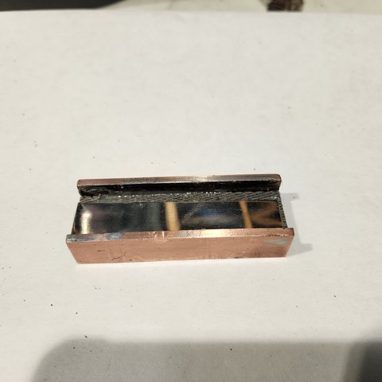
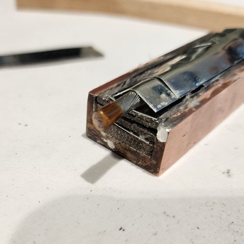
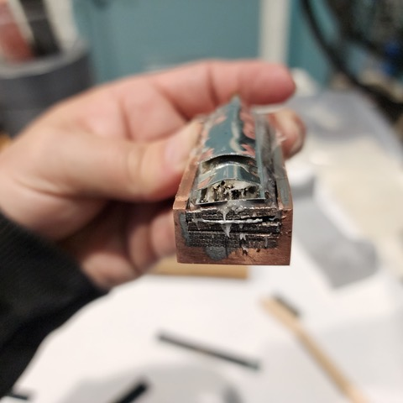
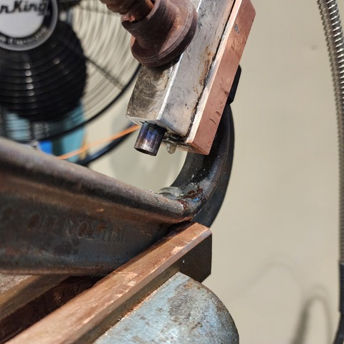
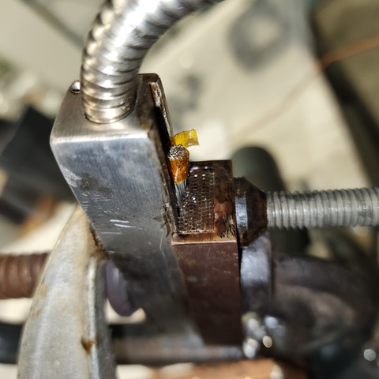
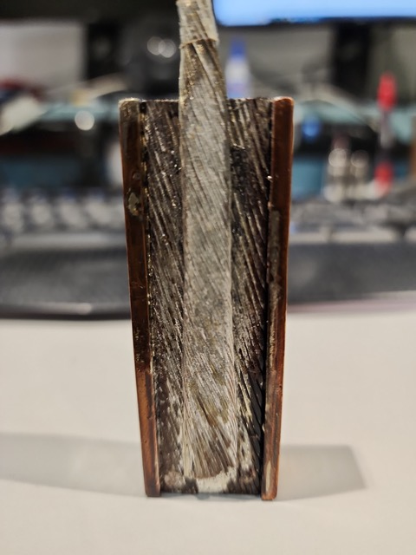
Recovery Update, 3/13/24
Resoldered a new CLIQ lead and the two NbTi layers

Slide 33
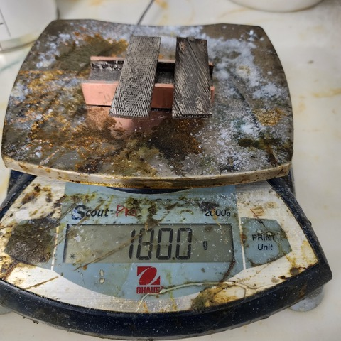
Recovery Update, 3/13/24
Before & after measurements of the test joint
Compared to before and after weight measurements it shows only about 2.9g of solder was added to this joint
However, the prior test of only the new CLIQ lead showed approximately 2.6g of weight gain. e.g. very little additional solder was added to the two NbTi lead joint interfaces

Slide 34
Recovery Update, 3/13/24
Summary of these recent tests
No significant additional solder can be added to the overheated joint, as measured by weight
Both flux and solder end up flowing and dripping out
Separation of the old CLIQ lead is possible, and soldering in a new one is possible
However the joint appears to not be as solid as with a non-overheated surface (can be mechanically separated somewhat easily)
Separation of the NbTi lead is possible as well
However very little solder remains after a re-soldering operation
Conclusion: It is best to leave the existing overheated NbTi splices in place w/o separation, but solder in a new CLIQ lead

Slide 35
Recovery Update, 3/15/24
The final plan to finish:
The overheated NbTi splices will be kept as-is w/o separation
A new CLIQ lead will soldered in
Old CLIQ lead will be mechanically removed
Mechanical surface prep and standard joint cleaning
New CLIQ lead will be soldered in
Green putty will be used as a smart shim to package splice before cover is installed
Standard finishing operations will be performed
Abbreviated EQC: Hipot Coil-Structure, SeqR

