Slide 1
48 Hour Summary
Colin T. Barrett
MCR Crew Chief
March 20, 2024

Slide 2
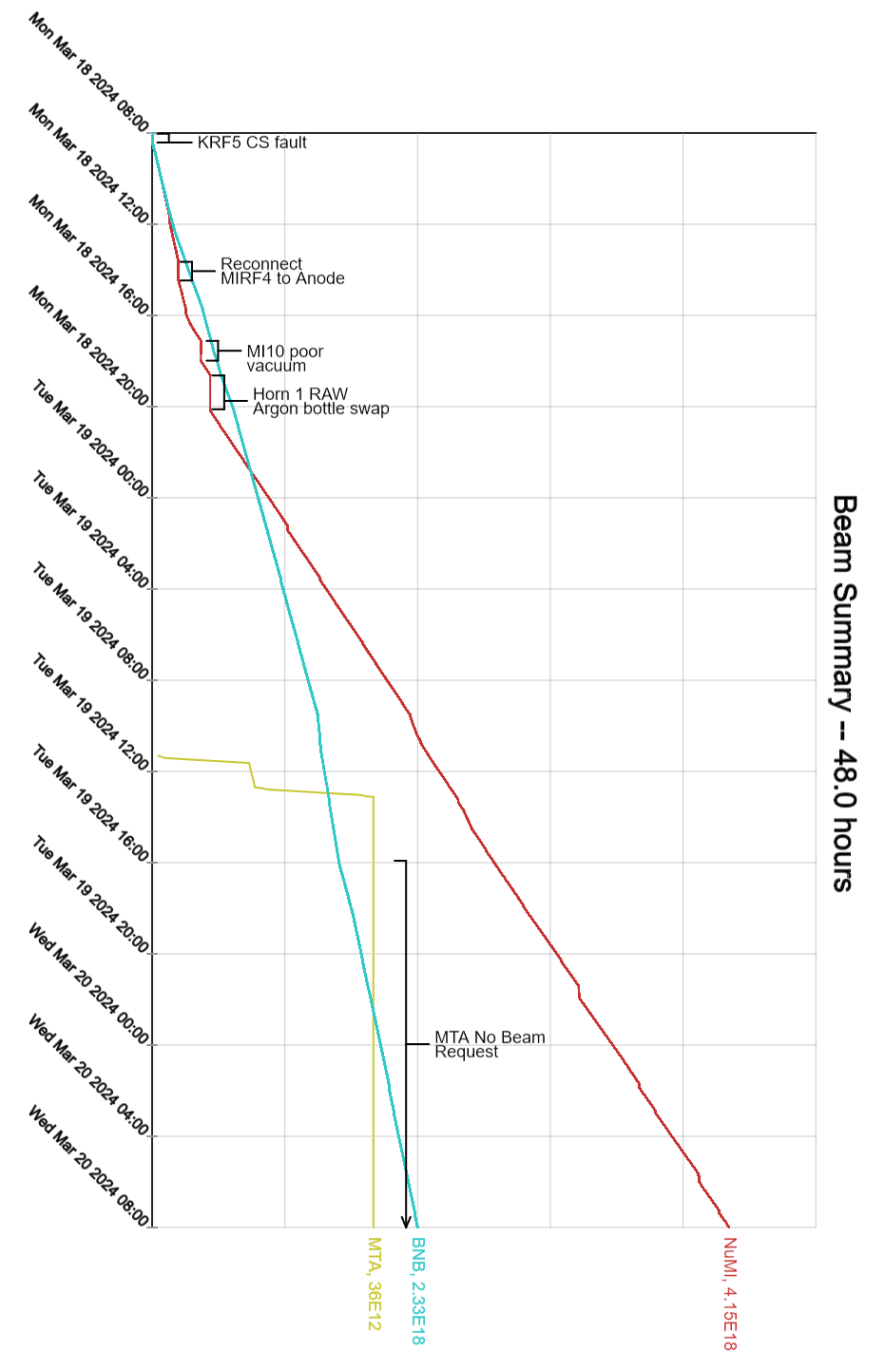
Summary
In General:
Supporting machine experts
Tuning up the machines
Monday:
KRF5 gradient regulation issues
Remnant LCW system taken down briefly for CUB LCW repair
MI/RR tuned up for slipstack beam
NuMI Argon purge adjustment required short RAW room access
MI vacuum cascades as intensity was increased
Tuesday:
CMTF outage, bad breaker preventing recovery
MTA was secured, took beam throughout the day
MINOS elevator failure, access restriction to MI-65 and MINOS underground currently in place
Today:
Brief downtime for RF experts to take a look at BRF03 filament and MIRF05
Current Conditions
Beam to NuMI, BNB

