Slide 1
From Warm to Cold
Carl Bromberg
Michigan State University

Slide 2
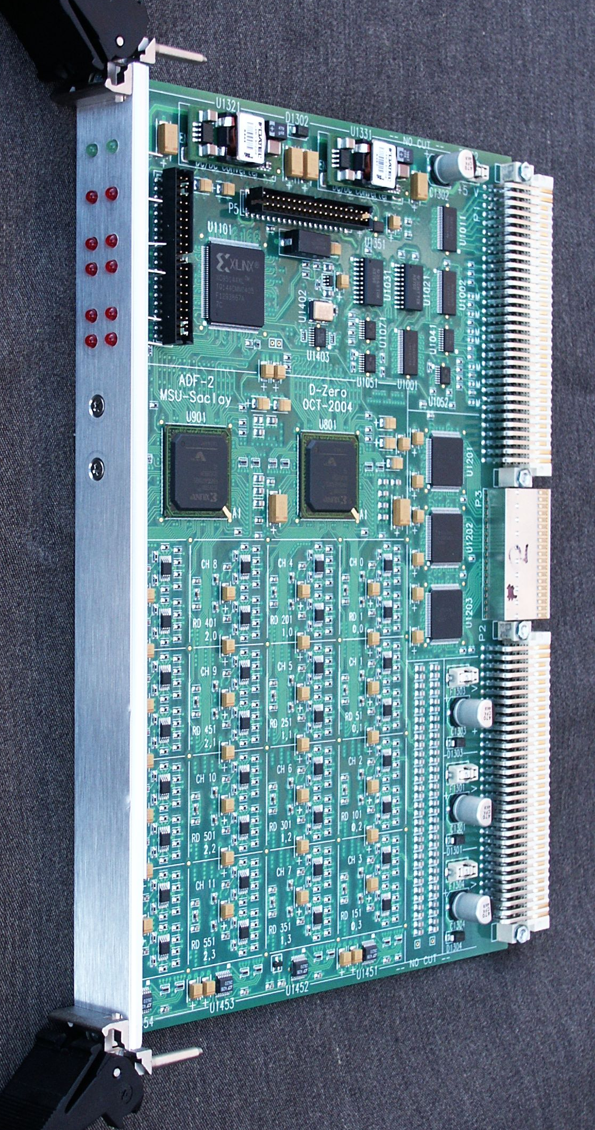
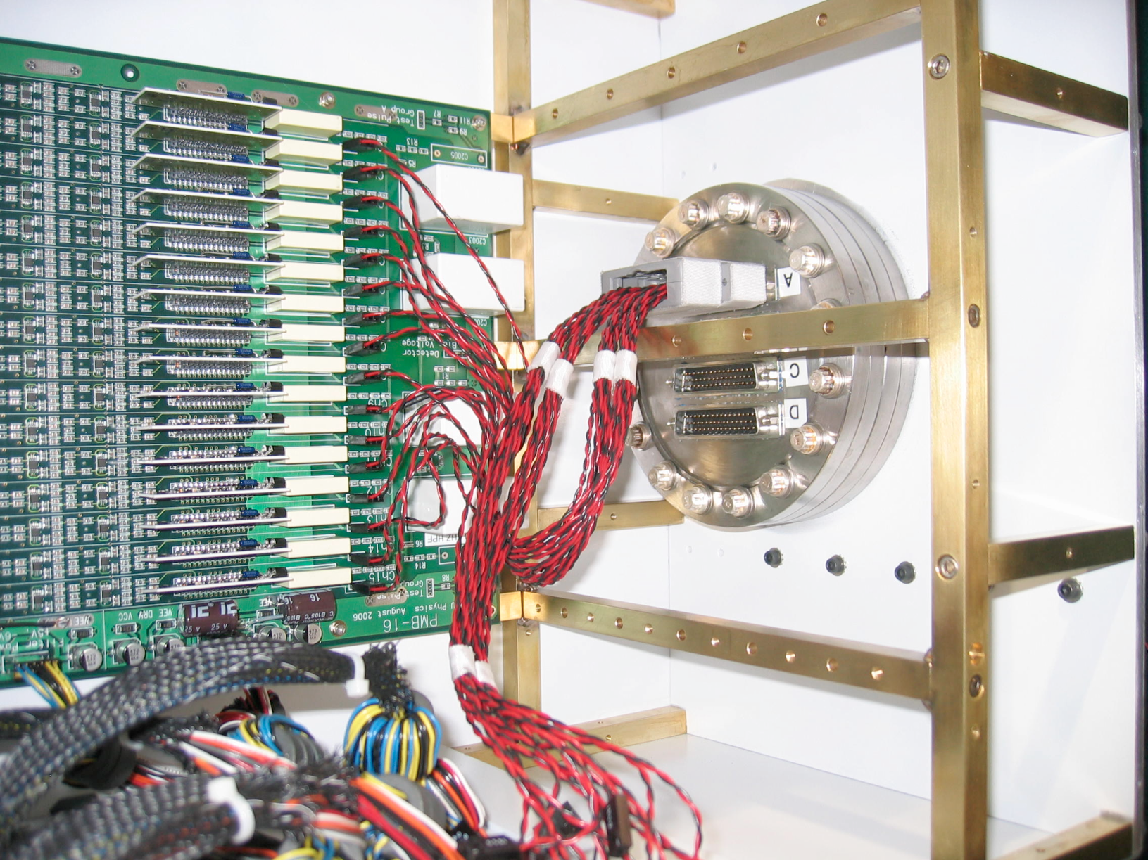
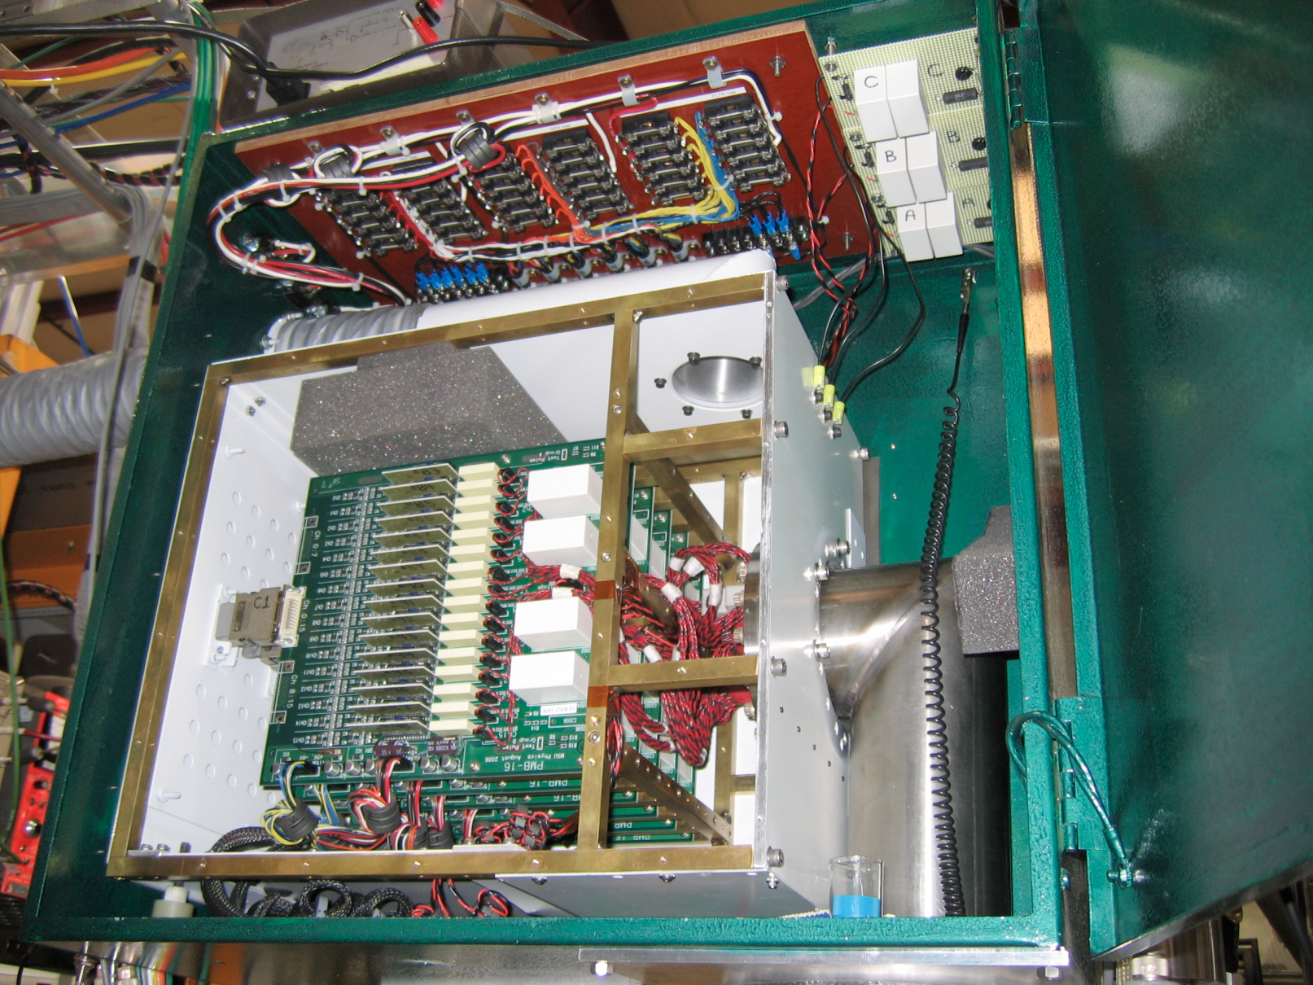
2005 – Get tracks - copy ICARUS

Slide 3
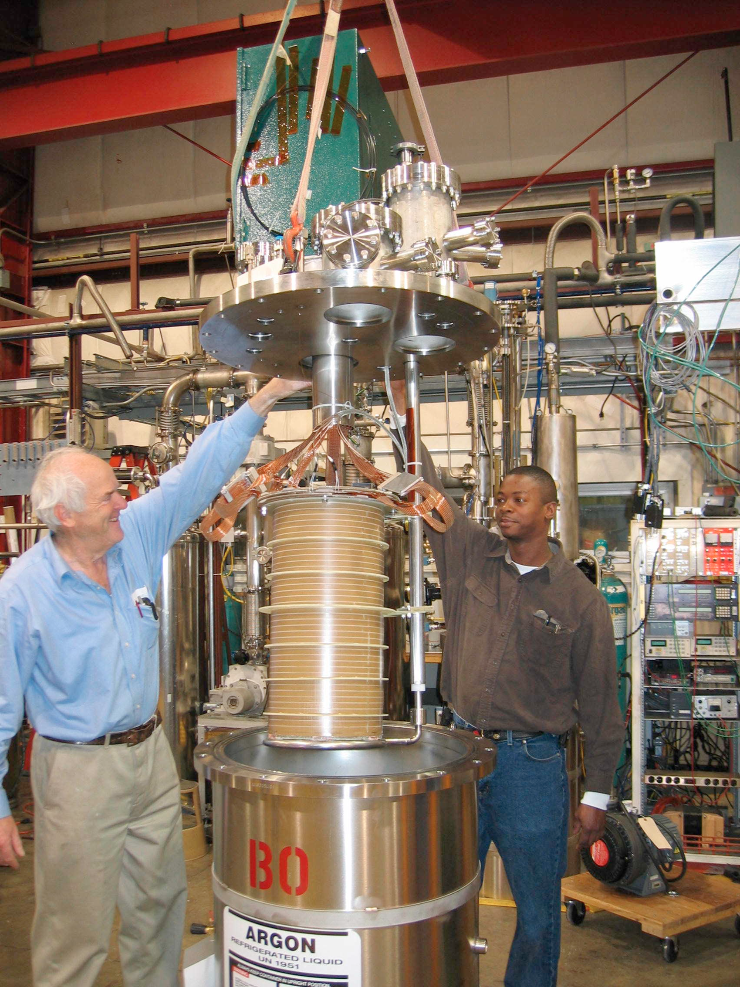
Cryogenics cannot be rushed
Electronics ready Spring ‘05
Approval to fill 8/1/05 (Friday)
Fill 8/4/05 (Monday)
Tracks 8/5/05 (Tuesday)
Cryostat is “Bo”

Slide 4
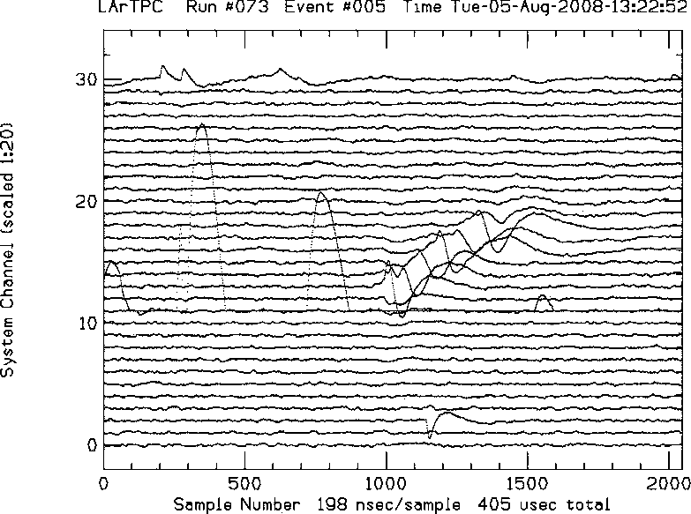
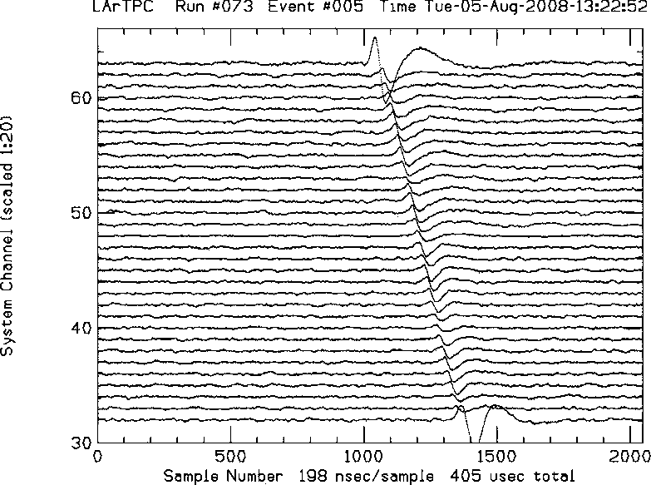
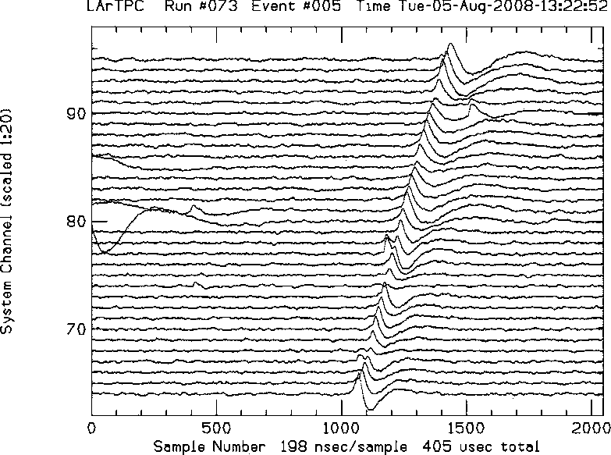
Tracks !
EVENT # 5
wire #
Plane 1
(Induction, 0°)
Most triggers
look like this:
3 wire planes
Drift time
wire #
Ionization
drift
Plane 2
(Induction, +60°)
muon
55 cm
Drift time
Cathode
25 cm
wire #
Plane 3
(Collection, –60°)

Slide 5
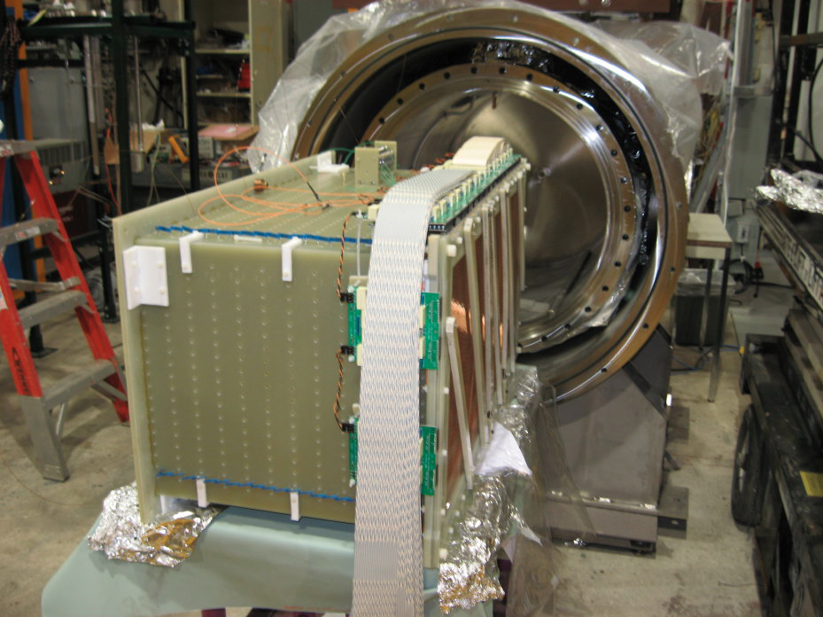
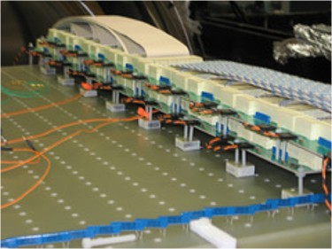
ArgoNeuT – 2006 - 2010
Move Bias Voltage off the feedthrough.
Mount distribution cards on the TPC.
Tested OK in MTS!

Slide 6
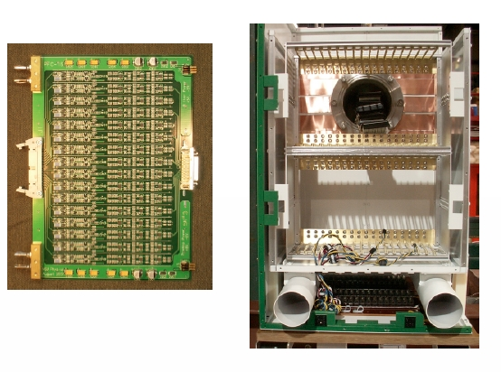
480 channels in a shoe box
Signals are a few fC!
Coherent noise worry.
Double shielding.
Feedthru inside box
Needs cooling.
Disassembly to service

Slide 7
Remarkable!

Slide 8
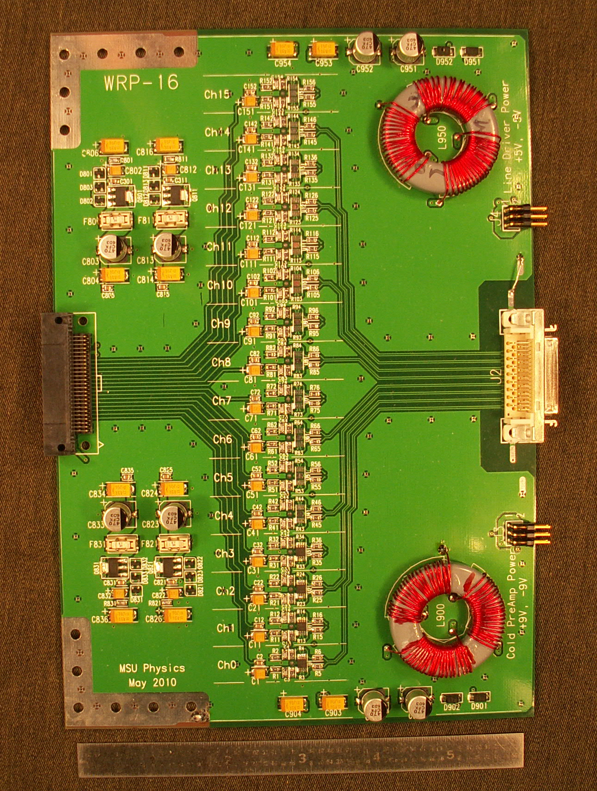
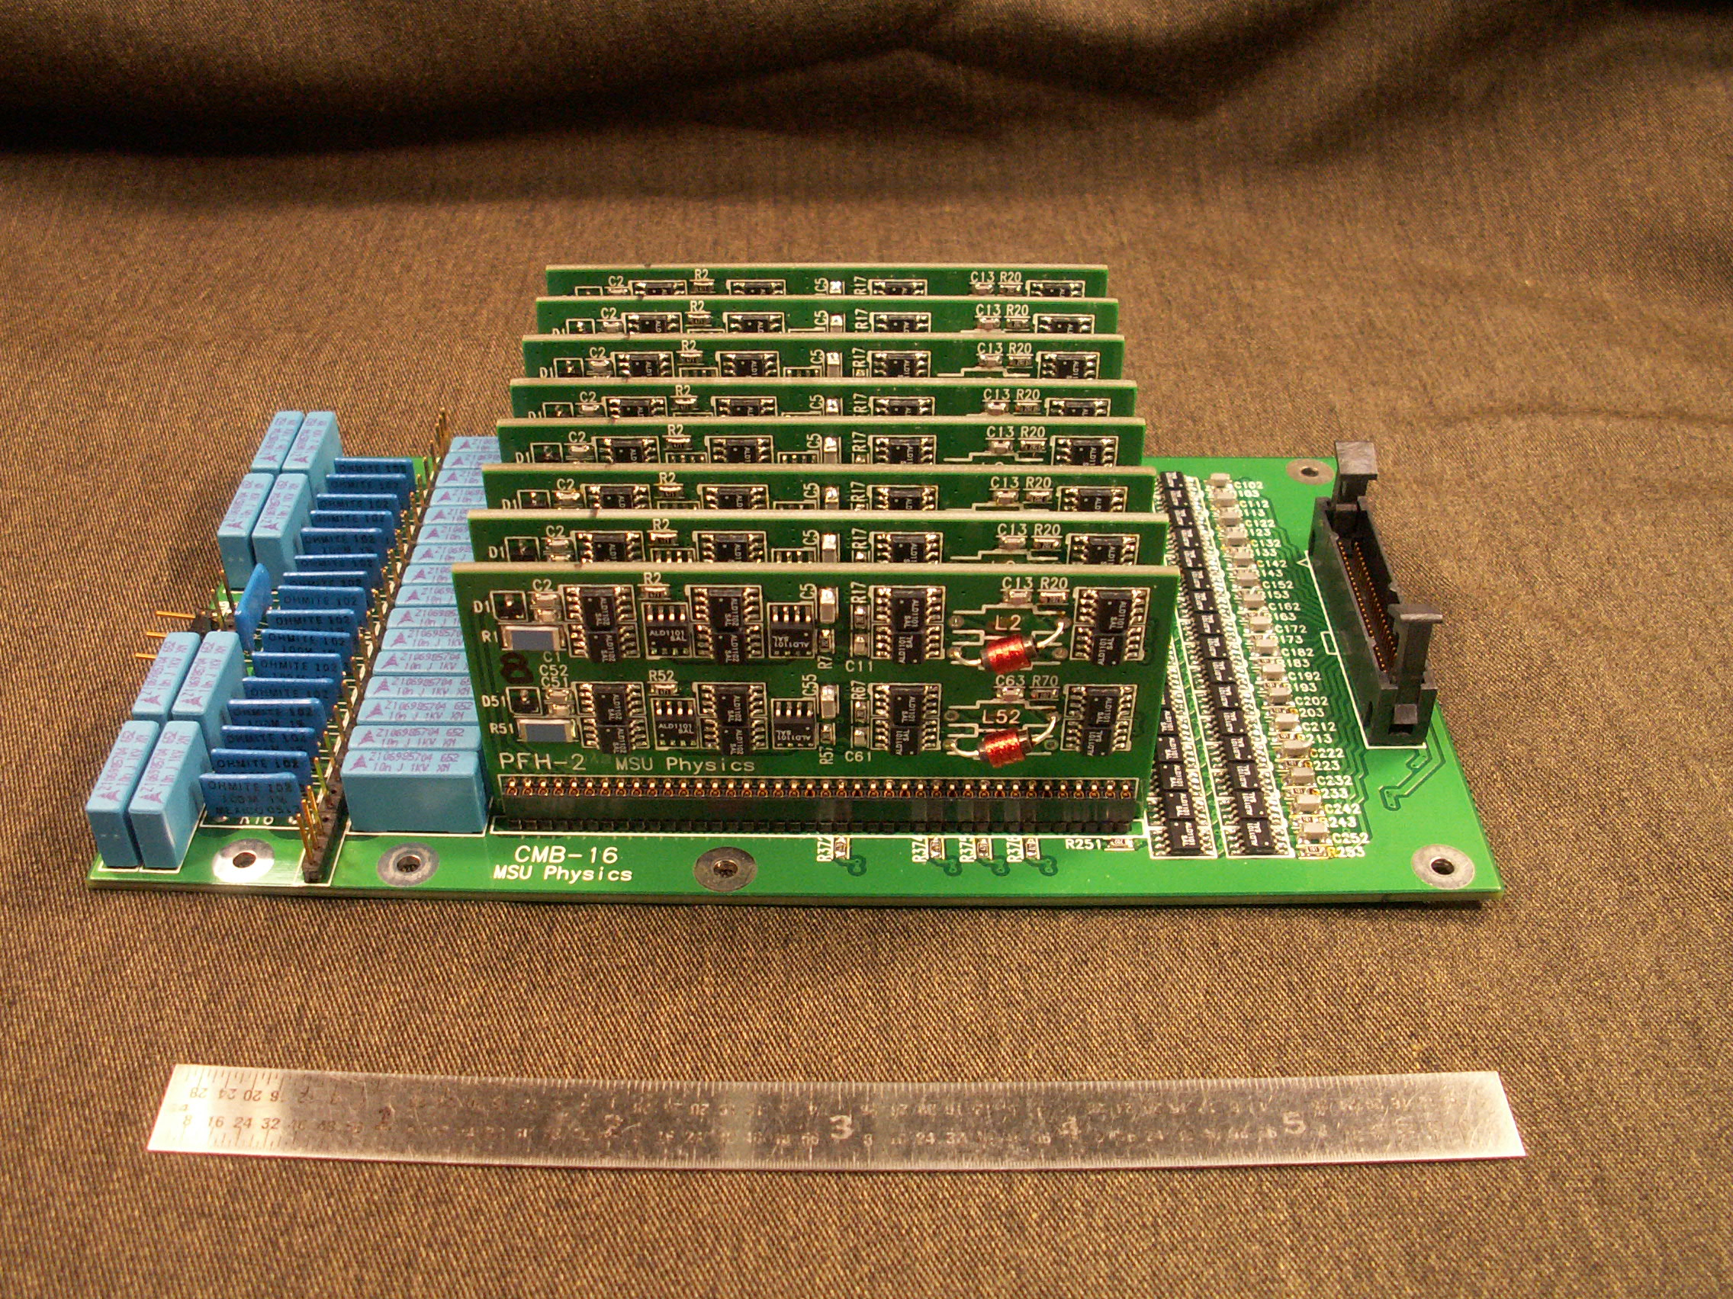
2010 - time to put preamps in the cold.
Warm signal receiver with
drivers for long cables and supply preamp power
CMOS hybrid 2ch. Preamps
Mounted on the Bo-TPC

Slide 9
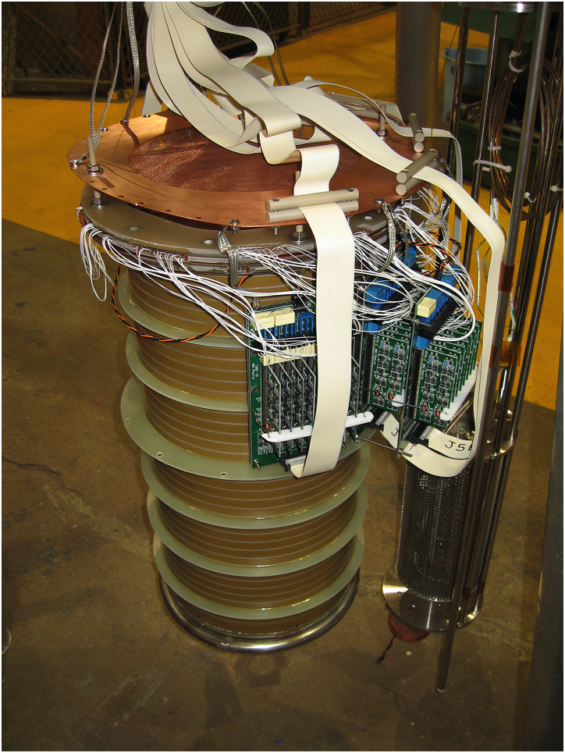
Bo-TPC 48 wires/plane readout
Wire planes reworked to provide connections to all 48 wires.
TPC + preamps are a tight fit into the Bo cryostat.
Leads from the wires to the preamps are the white spaghetti seen. Not optimal configuration.

Slide 10
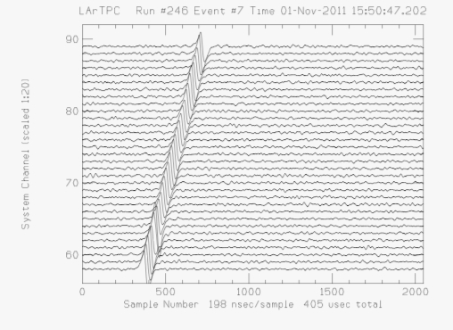
Second cold-Bo run (2011)
Noise was so low in run 1, we had to increase the gain to see it.
S/N > 30
Induction-plane, cosmic muon
(50cts pp, 1.6cts rms noise)

Slide 11
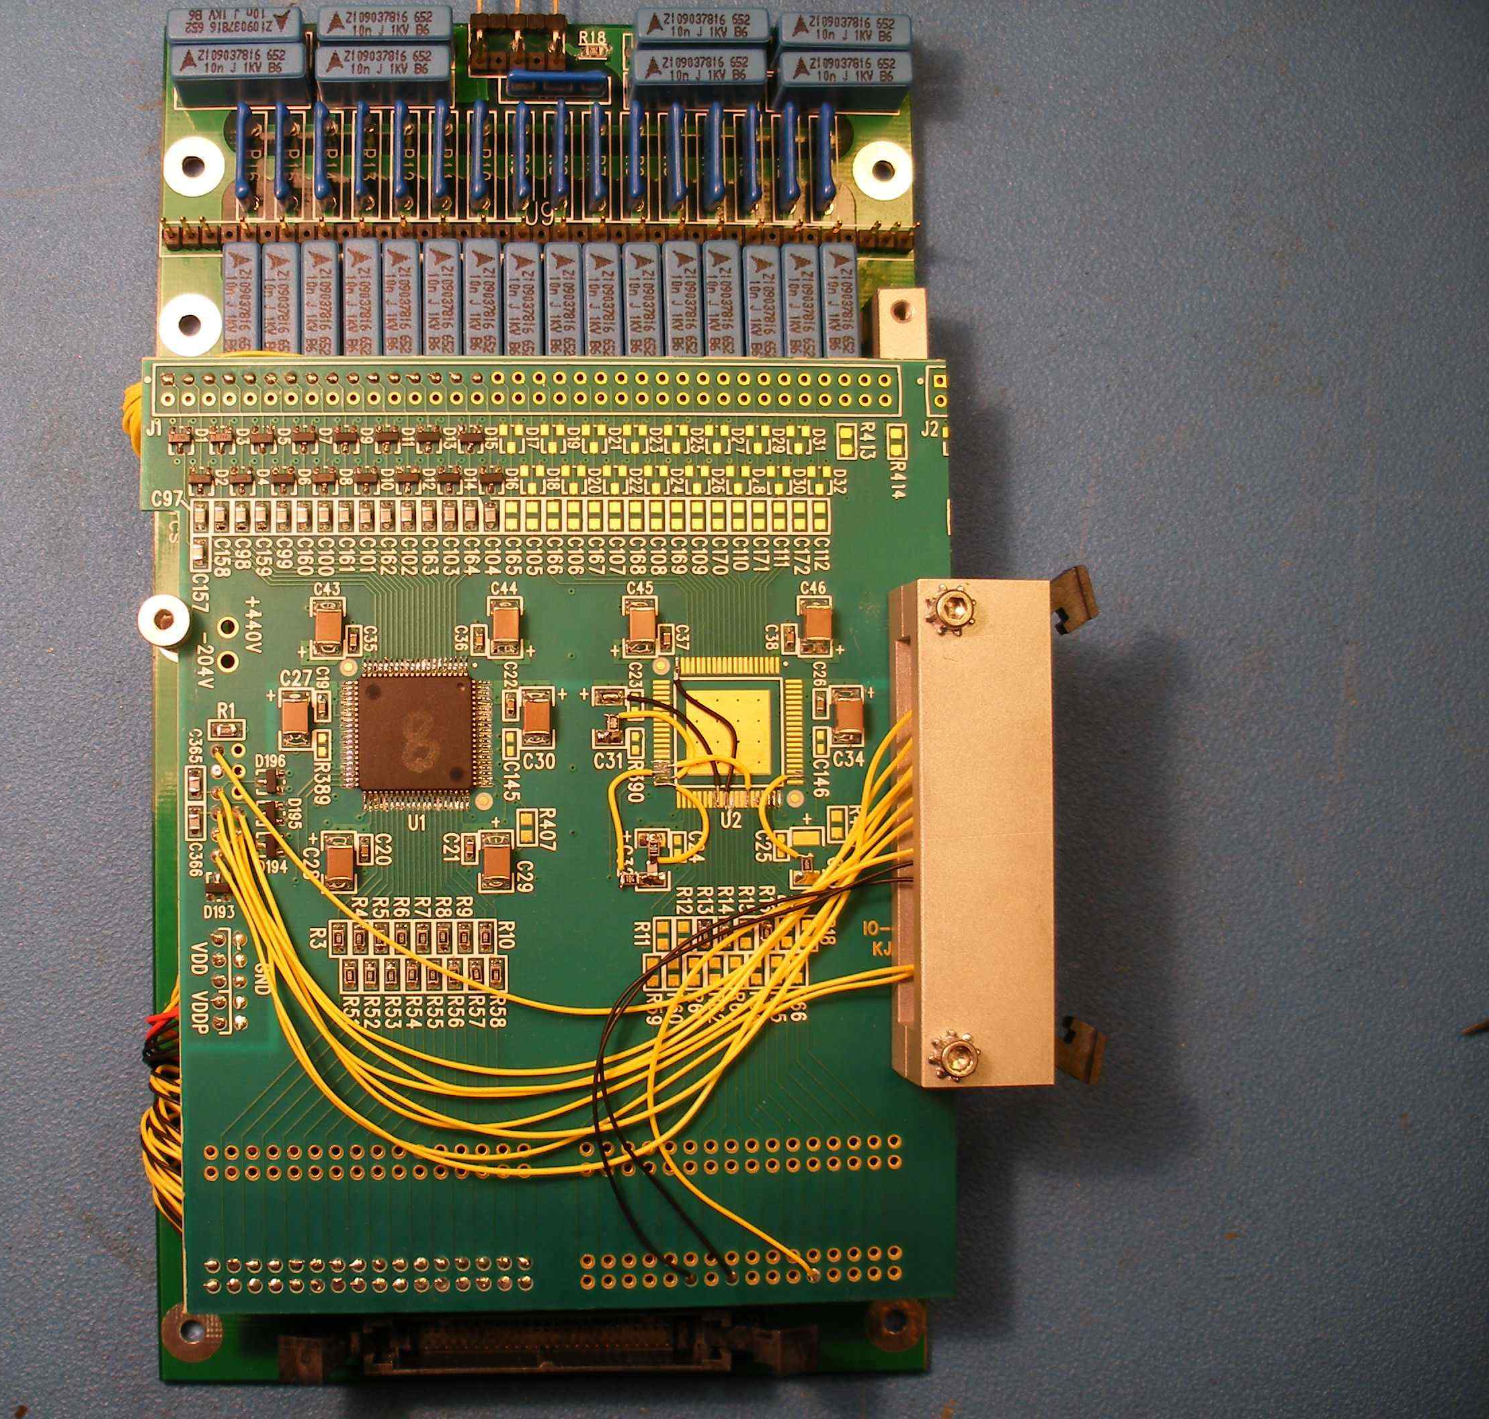
Liquid Argon Purity Demonstrator long-Bo TPC
2m LArTPC w/MSU cold preamps
2m-drift LArTPC w/MSU cold preamps
Modified an MSU 16-channel card to carry a BNL ASIC. Installed on the central induction plane
Note: LAPD testing
uBoone HV-feedthrough
BNL ASIC
Symmetric arrangement of preamps
Mezz. from uBoone
board
Note: LAPD testing
uBoone HV-feedthrough
Some issues:
1st induction plane floating
HV anomaly – have to run at 60% HV
HV sparks likely affected one ASIC channel

Slide 12
BNL ASIC response to 3.5 fC input
Cold bench testing of BNL ASIC implementation
Channel
16
12
Gain
25 mV/fC
Gain
25 mV/fC
20 ADC
cnts/ch
8
4

Slide 13
BNL ASIC - vary gain and filter
16
12
Gain
4.7 mV/fC
8
4
16
12
Gain
25 mV/fC
8
4

Slide 14
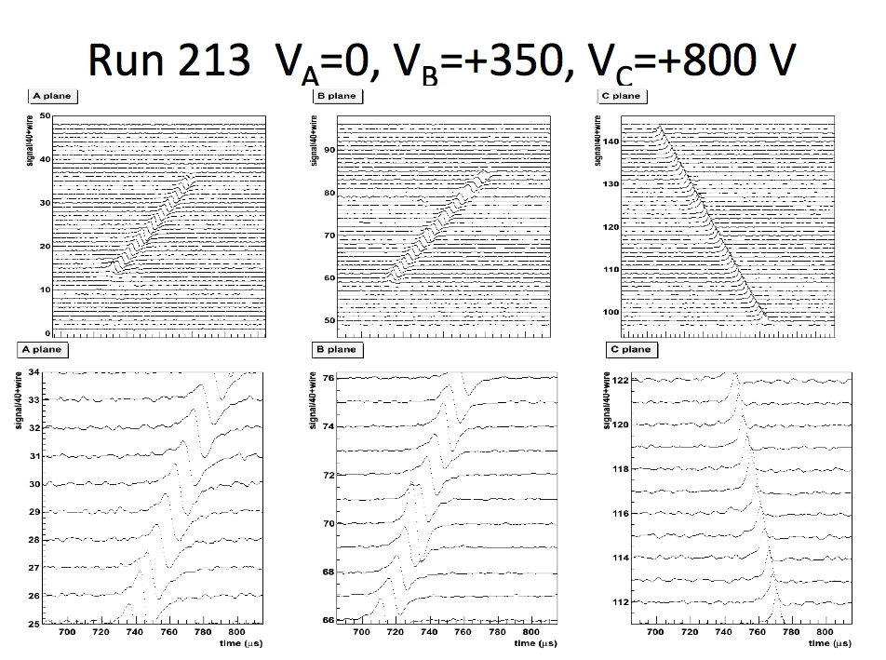

Slide 15
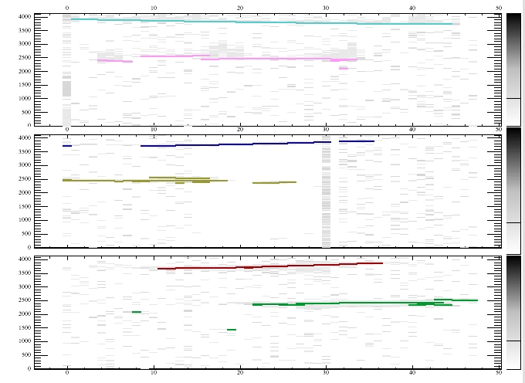
Multiple muons

Slide 17
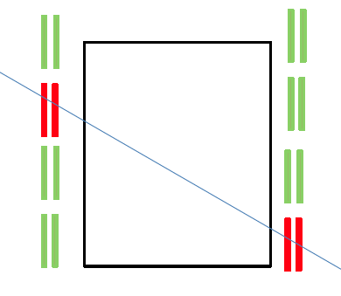
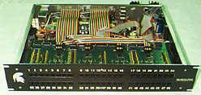
LAPD trigger counters (TSU counters from CDF) (also BSU and CSU counters)
Scintillator size in inches
CCU controls HV and signal collection from 48 counters
Single Cat5 cable to each counter
PAD - controls PMT HV, amplifies signals. ECL discriminator – w/ adj. threshold
Robust
aluminum shell
Hamamatsu PMT + CW HV from 12V.
LAPD
tank
WLS fibers

Slide 18
What can be done with long-Bo
Precision electron lifetime
muon energy spectrum is the same for groups of trigger
area of FT’d signals proportional to charge – dispersion OK
remove delta rays – use only hits on track.
use total track charge vs. drift distance to get lifetime
Positive ion effects
make rapid (0.5s) changes in HV (low to nominal) and look for track distortions
discontinuities in ion density
Investigate effects of ASIC filter parameters on various tracks
Others?

