Slide 1

The Argontube detector – overview + HV in LAr
Thomas Strauss
Albert Einstein Center for Fundamental Physics
Laboratory for High Energy Physics
University of Bern
AEC, Bern: A. Blatter, L. Bütikofer, A. Ereditato, R. Haenni,
C.C. Hsu, S. Janos, I. Kreslo, M. Lüthi, P. Lutz, C. Rudolf von Rohr,
T. Strauss, M.S. Weber, M. Zeller

Slide 2
Outline
LAr TPC technique
Argontube, a 5m drift LAr TPC
Design challenges for the HV
Conclusions

Slide 3
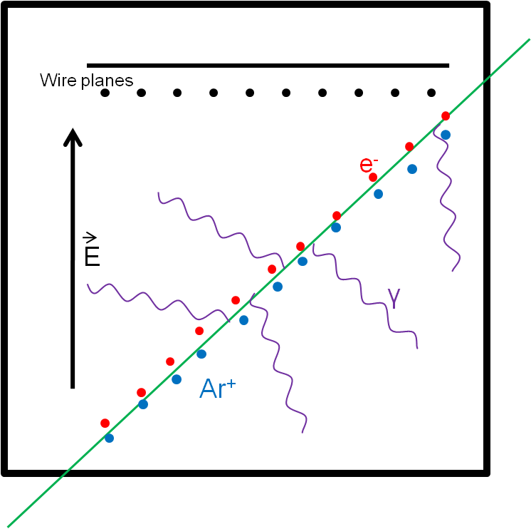
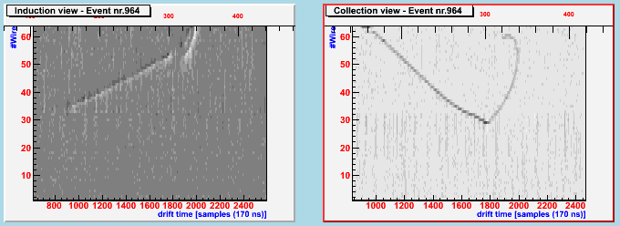
LAr TPC technique
Three dimensional tracking device
Readout of the charge deposited
Charge readout correlates to deposited energy
Momentum estimation via multiple coulomb scattering
The detector is fully homogenous
UV scintillation light
Charge yield (m.i.p.) | 6000 e⁻/mm (1fC/mm)
Photon yield (m.i.p.) | 5000 photons/mm (128 nm)
Electron drift velocity | 2mm/μs (@ 1kV/cm)

Slide 4
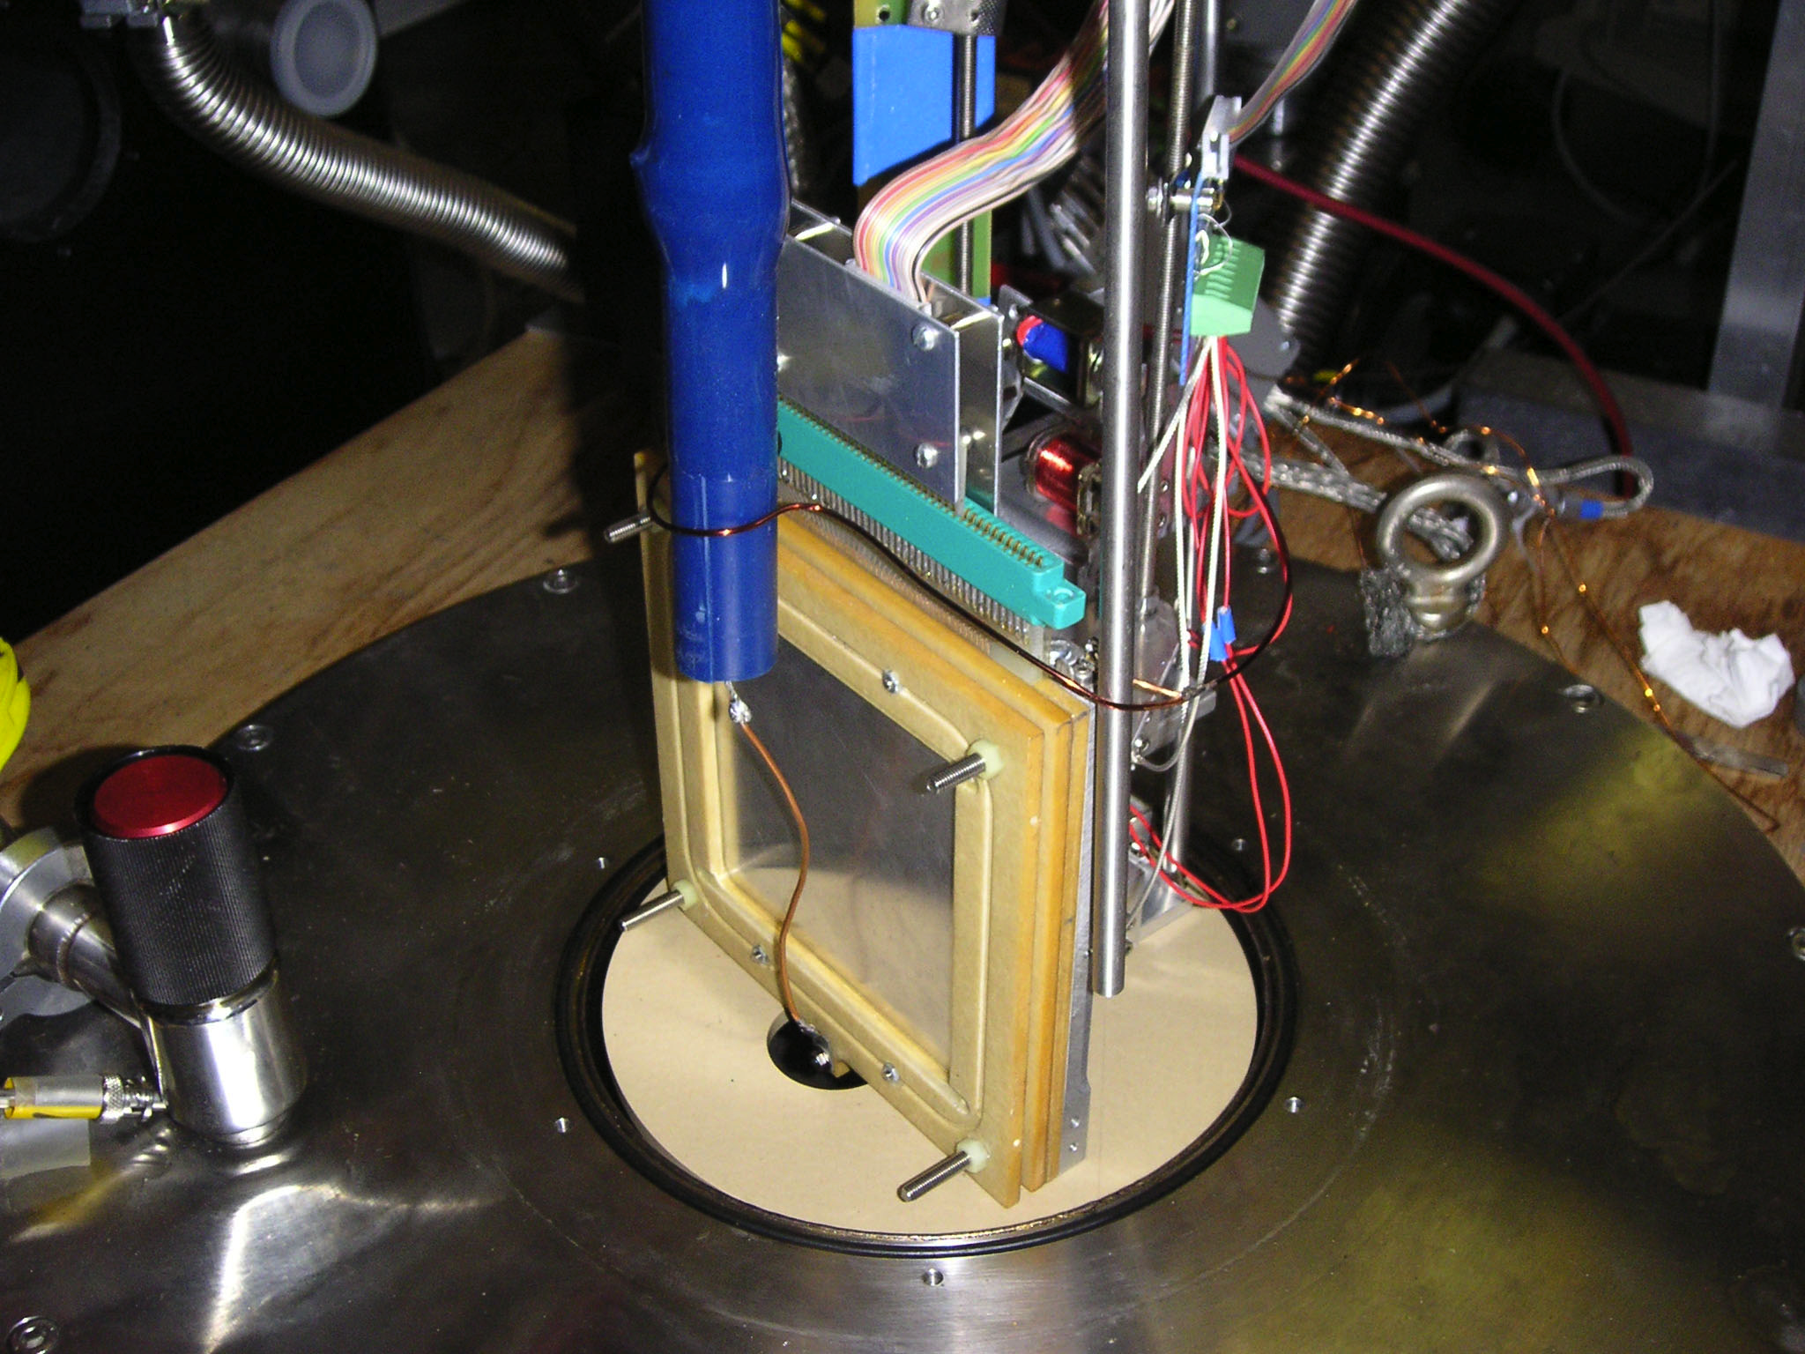
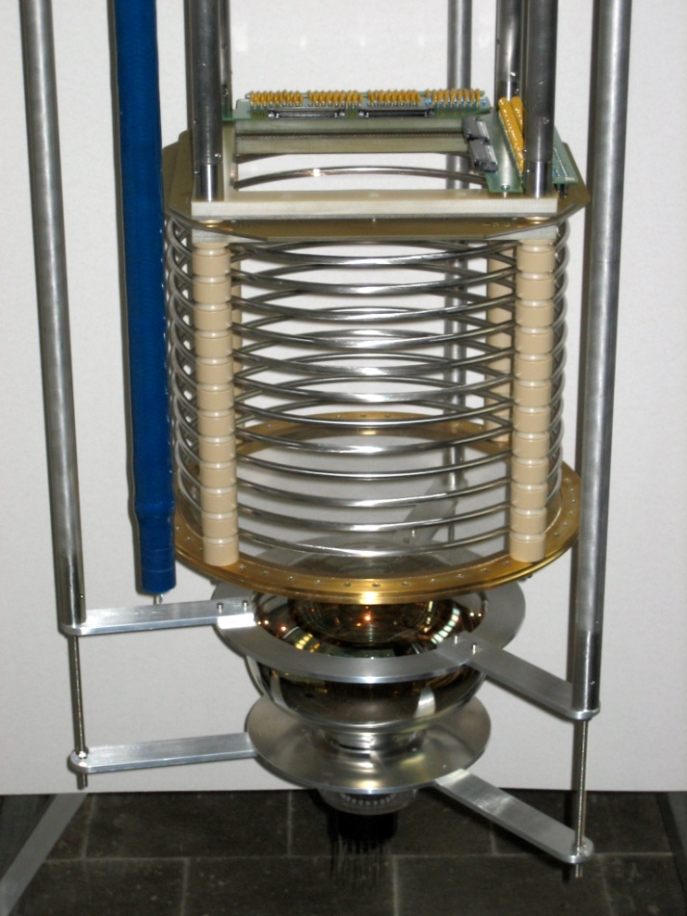
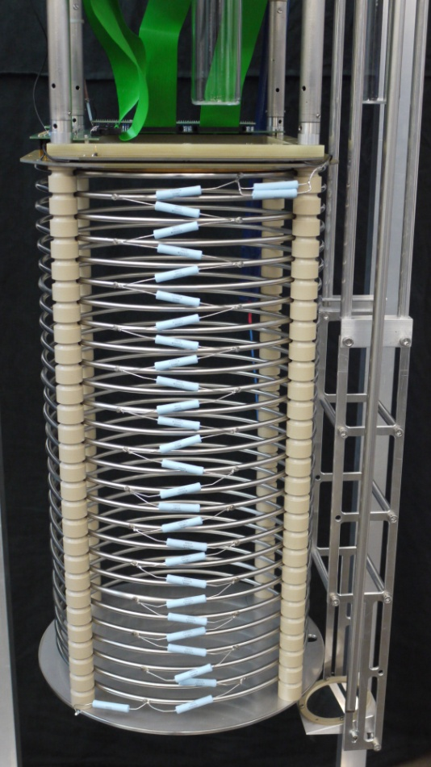
Evolution of LAr TPCs in Bern
Mini Argontube
Medium Argontube
Medium Argontube +
0.5 cm
25cm
57cm

Slide 5
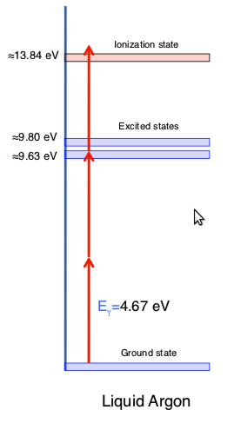
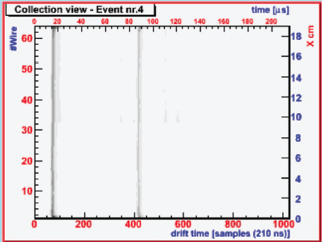
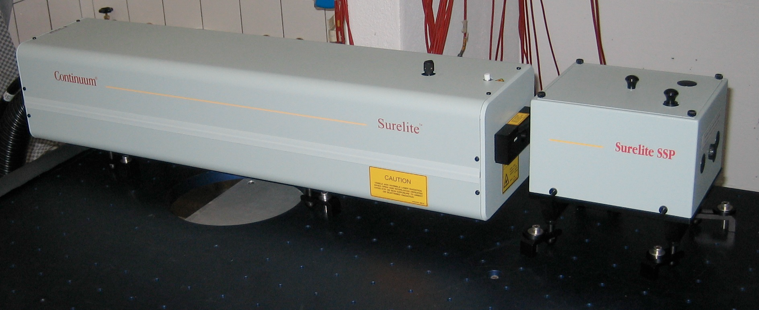
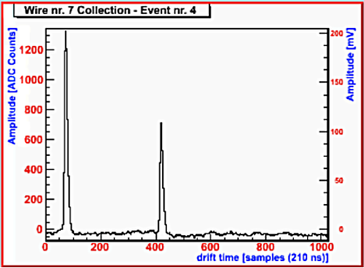
UV laser in LAr
Wait for later talk
Feasibility study of using a UV laser to ionize LAr in a multi-photon process
NJP 12 (2010) 113024
2009 JINST 4 P07011

Slide 6
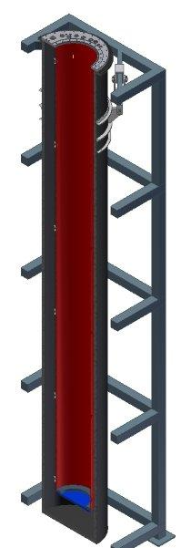
Argontube
  Prove the feasibility of 5 m drift
Main technological issues
  500 kV in liquid Argon
  Signal over noise ratio at least factor 10
  Impurities at the level of < 0.1ppb
Possible studies
  5 m particle tracks
  Measure the purity (Charge loss along the drift)
  Electron diffusion (parallel and perpendicular to E-field)
  Test new readout system and electronics
  Muon decay (Michel spectrum)
Outer volume: 1.2 m³
Inner volume : 1.1 m³
Active volume: 0.2 m³
Mass of active volume: 280 kg
JINST 7 (2012) C02011

Slide 7
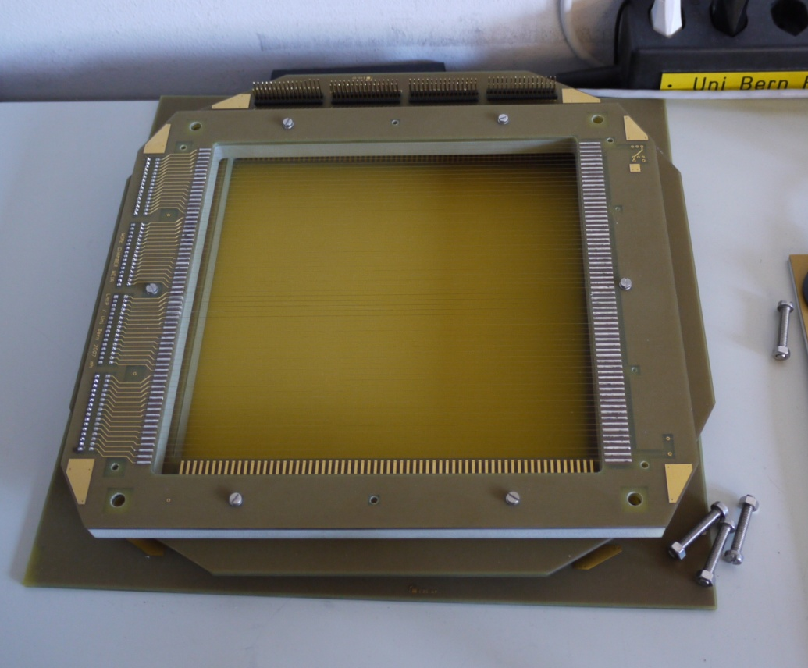
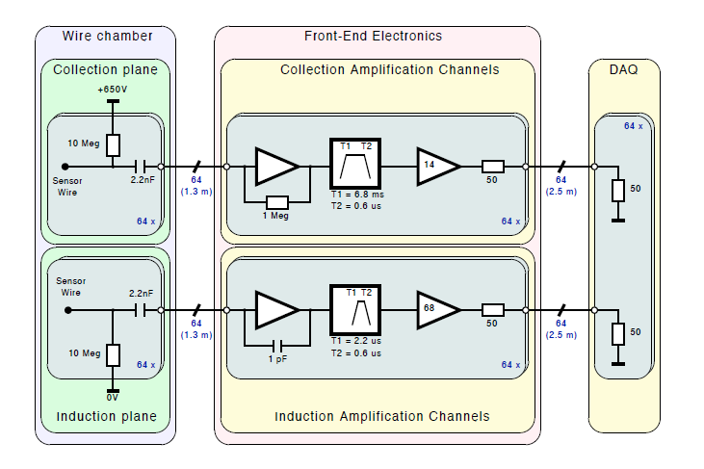
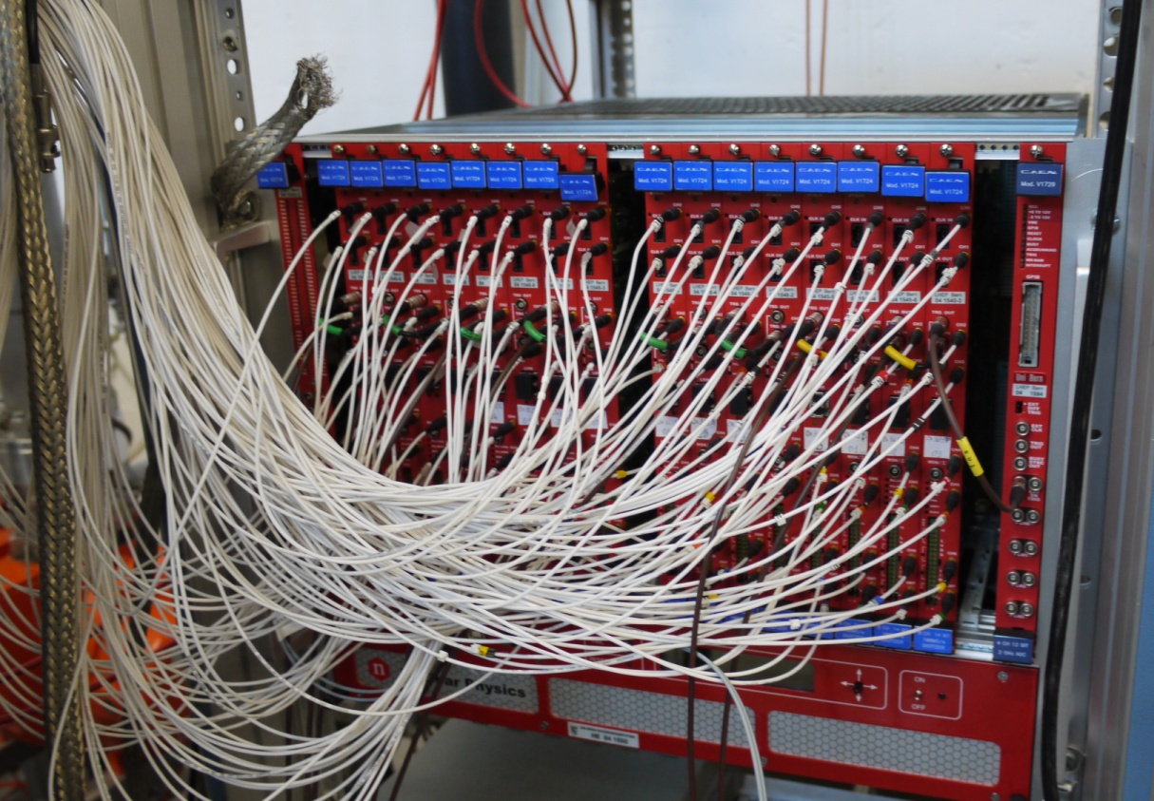
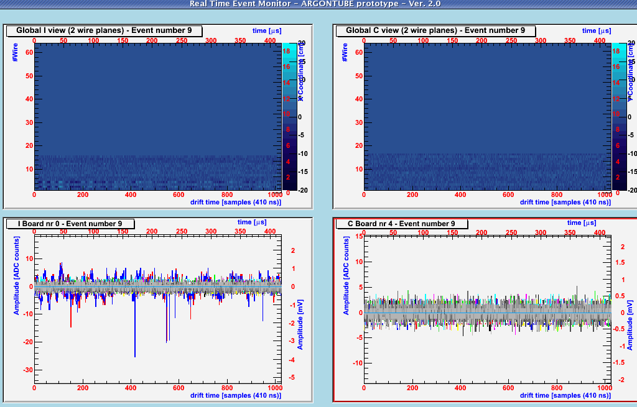
TPC, pre-amplifiers and DAQ
20cm
20cm
ADCs
Max Drift Distance: 5m
e⁻ Velocity: 2mm/μs
Max Drift Time: 2500μs
Sampling: 10 ns
DAQ window: 256kSamples/ch = 512kb/ch
Event Size = 512kb/ch * 128ch = 65MB/e
Sampling: 100 ns
DAQ window: 32kSamples/ch = 64kb/ch
Event Size = 64kb/ch * 128ch = 8MB/ev
CAEN v1724 (ADC) + v2718

Slide 8
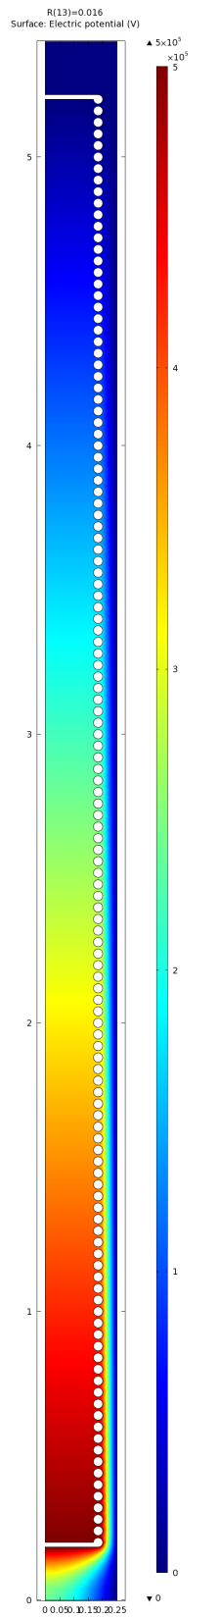
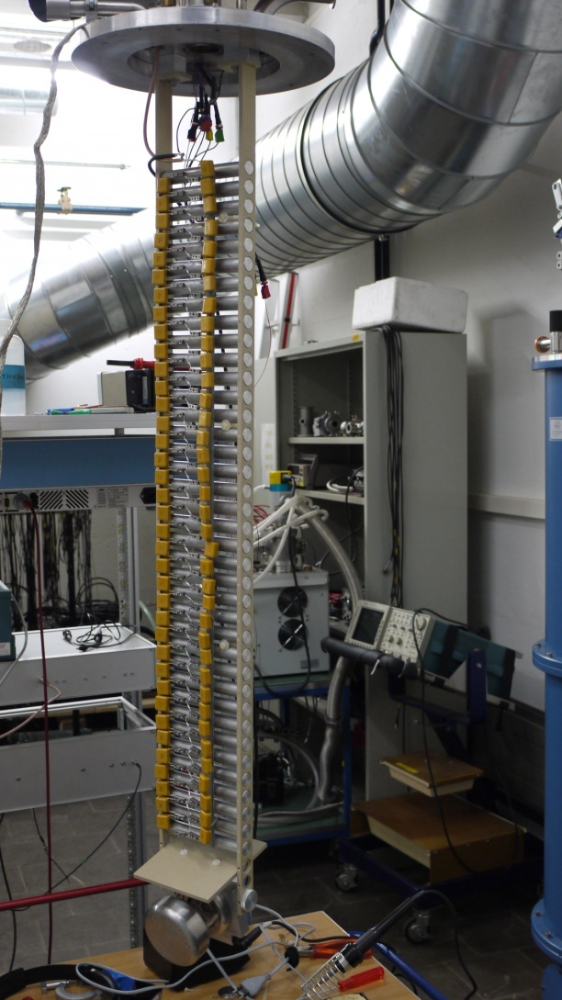
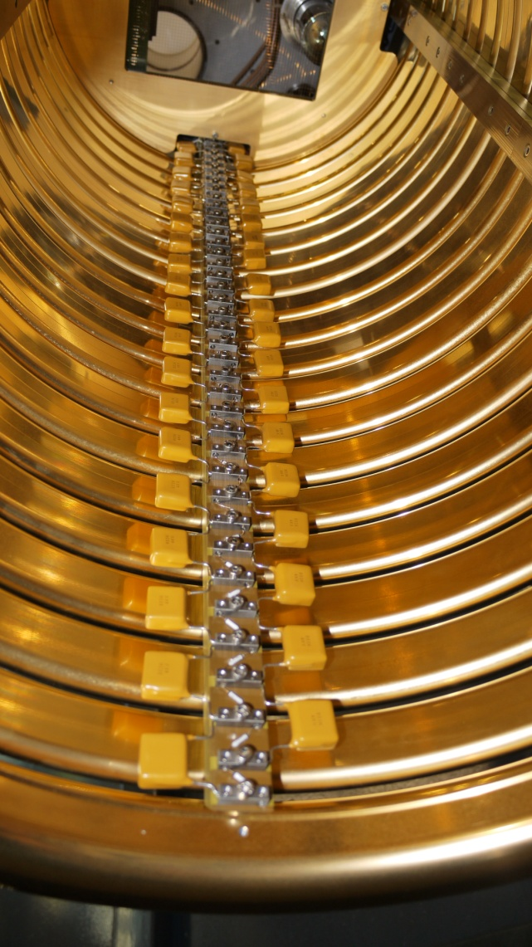
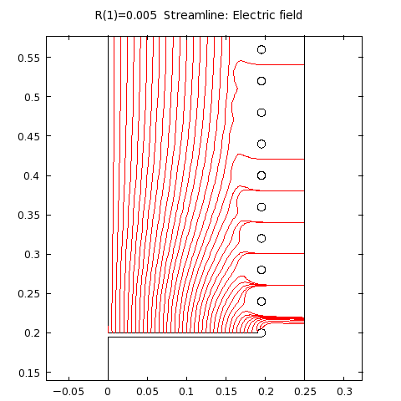
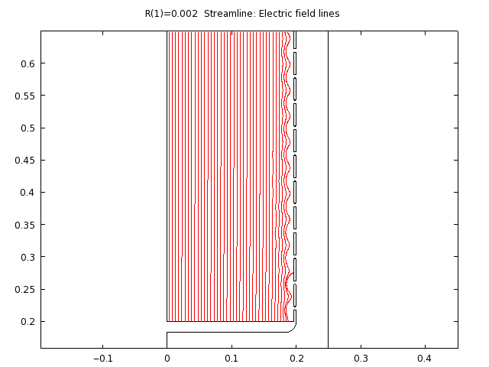
High Voltage
J.Phys.Conf.Ser. 308 (2011) 012027
Cockcroft/Walton – Greinacher circuit for charge multiplication (125 stages, input 4kV AC)
Comsol (Finite element analysis software) to obtain best field rings shapes
Goal: drift field of 1kv/cm
3.5 cm
1.6 cm
Proc Phys Soc 78 448 (1961) measured 1.1 MV/cm for gold/gold

Slide 9
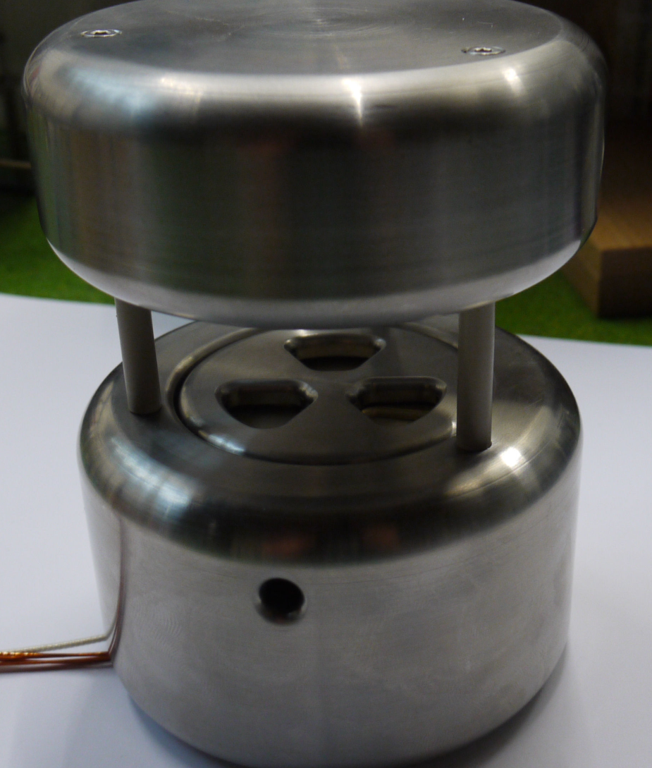
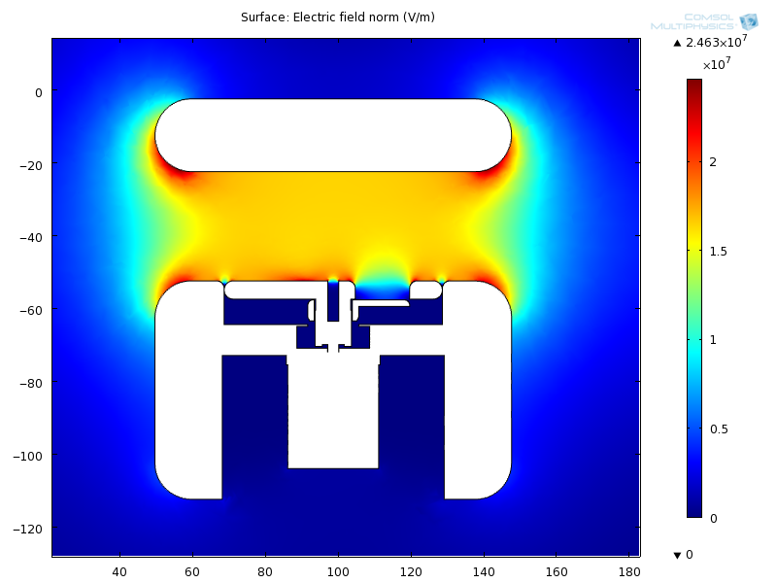
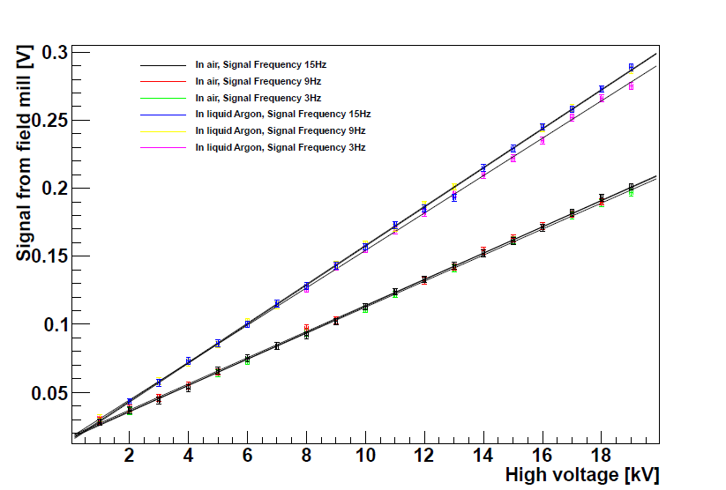
Electric Field Mill
Calibration curve of the field mill
Dielectric constant of liquid argon
Literature :1.52
Measured :1.48±0.03

Slide 10
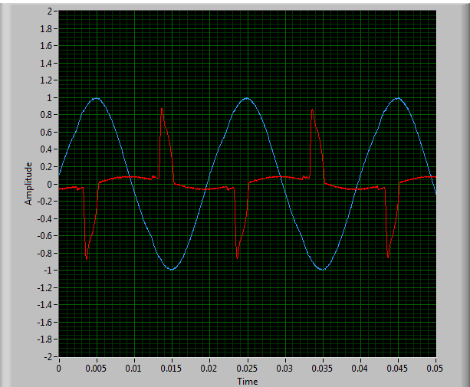
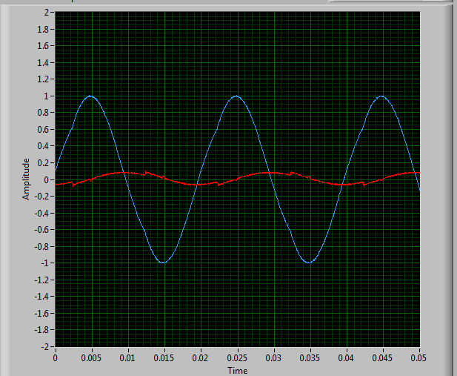
Power supply
Max Output : 4 kV peak to peak
Frequency: 50 Hz
Measuring system of output voltage and current
GC is charging up
GC is charged

Slide 11
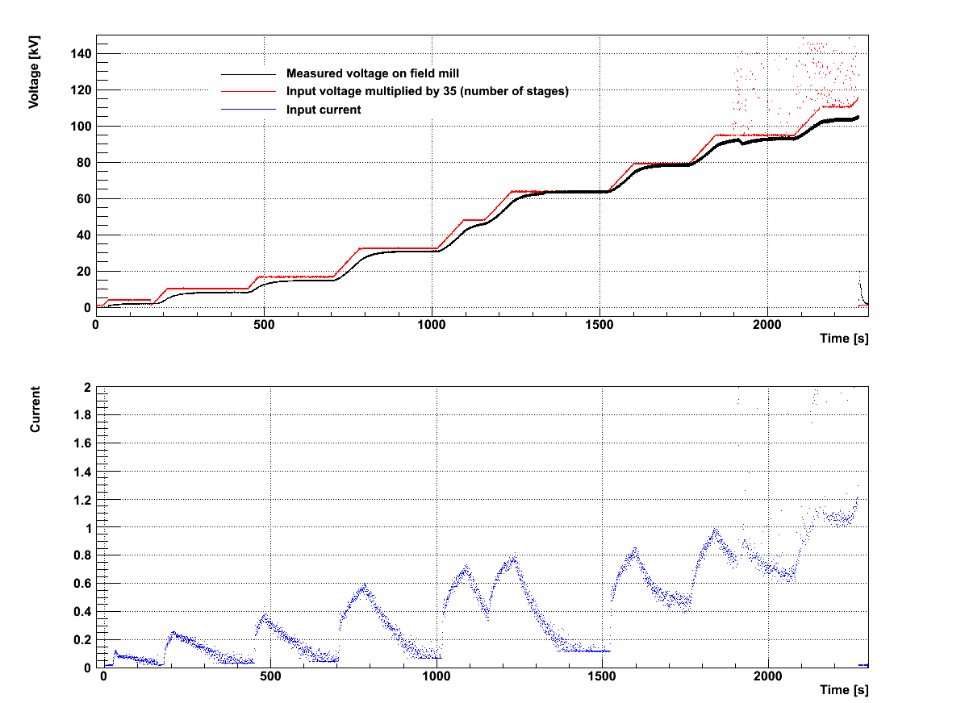
High voltage system test (Cockcroft-Walton or Greinacher multiplier)
Prototype: 35 stages installed
Electric field mill on the bottom
Filled with liquid Argon
AC input voltage 4kV
Reached voltage 110kV

Slide 12
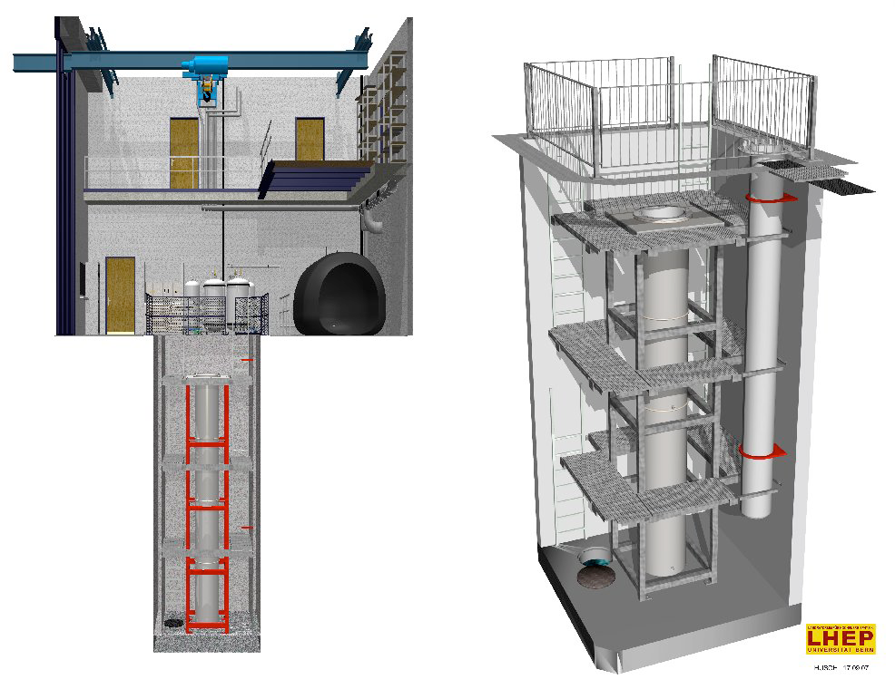
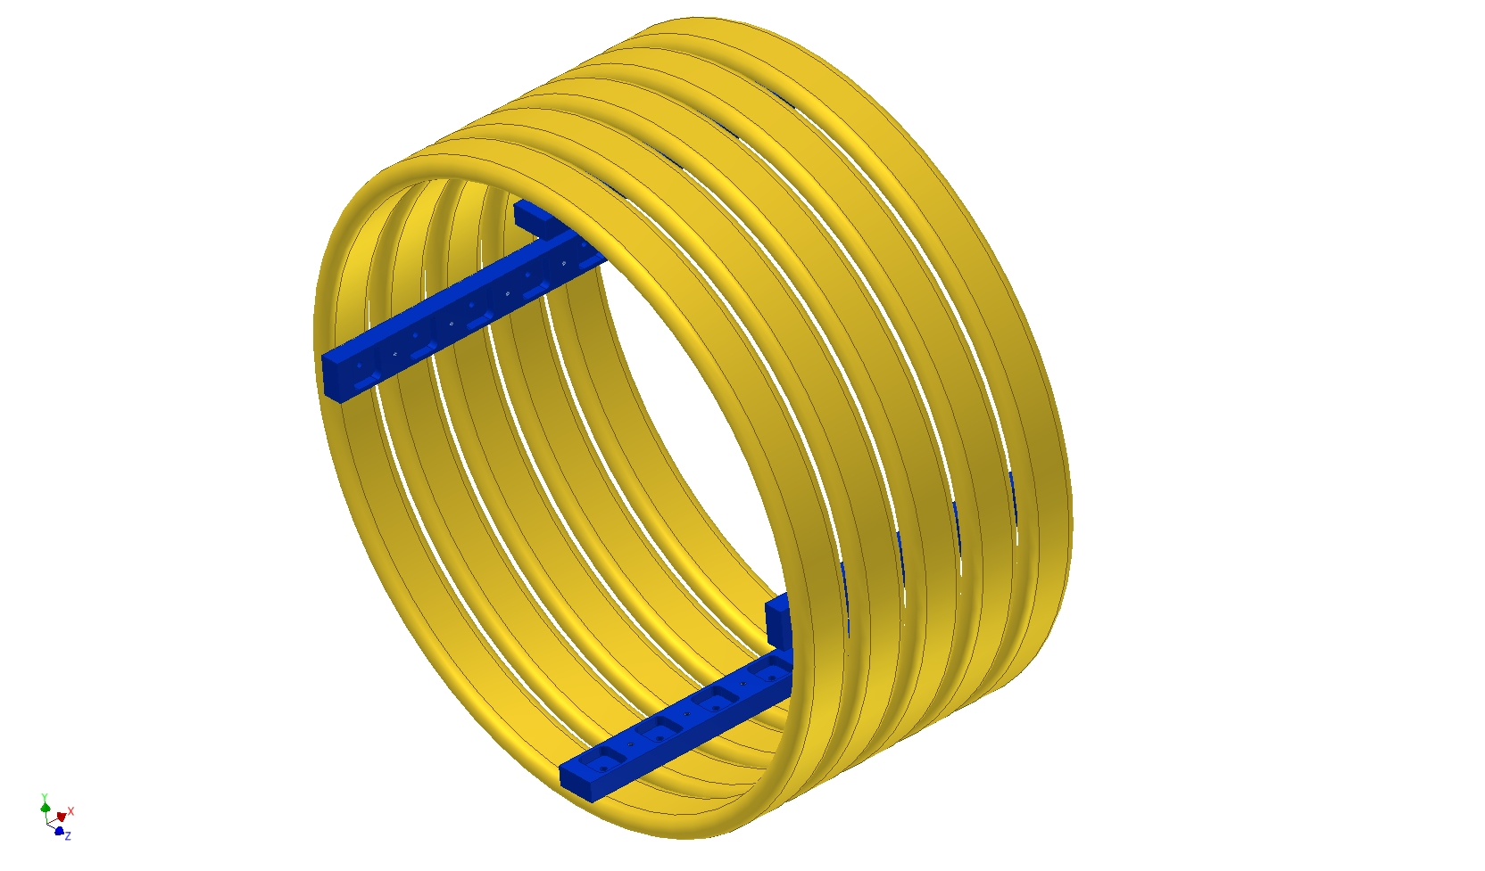
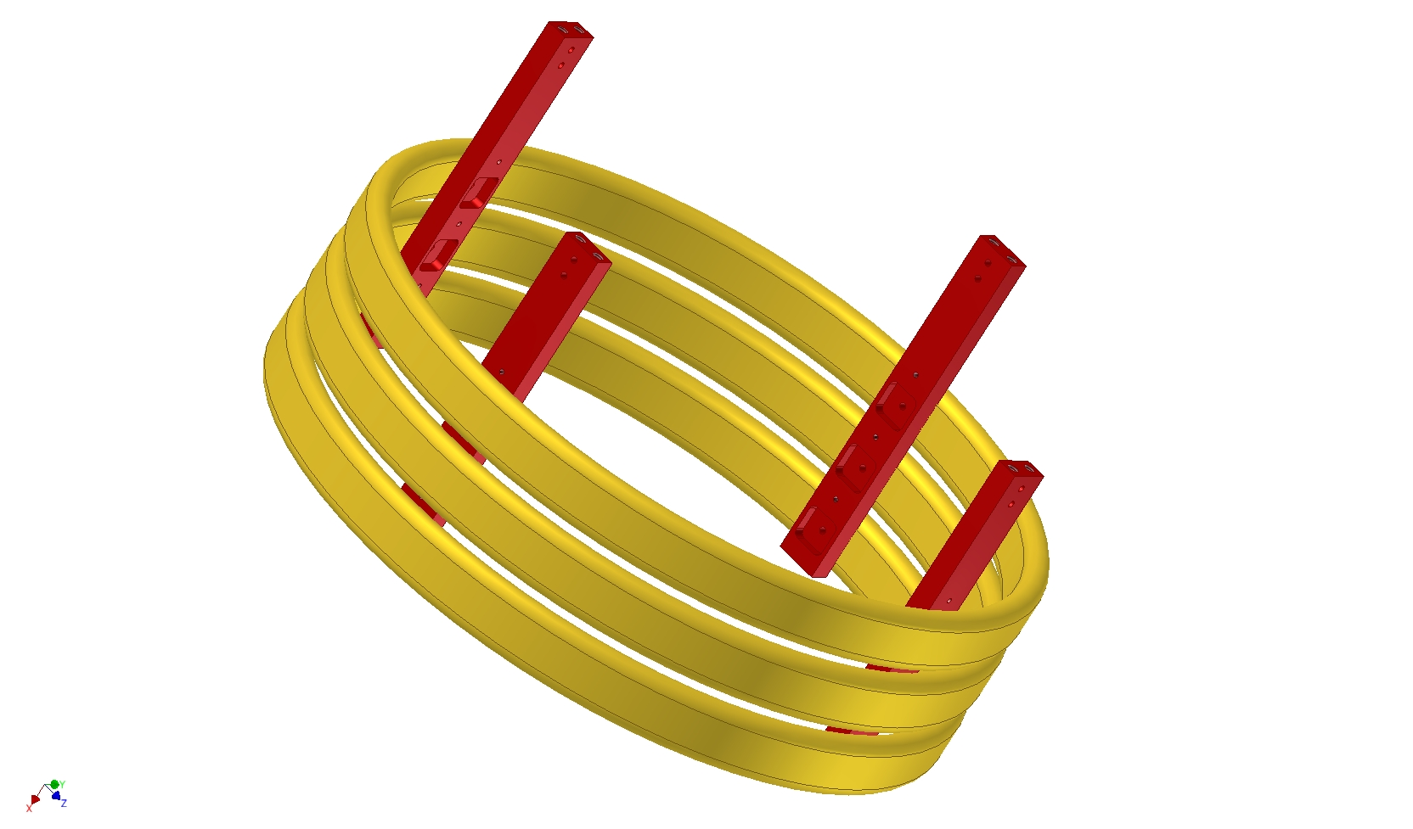
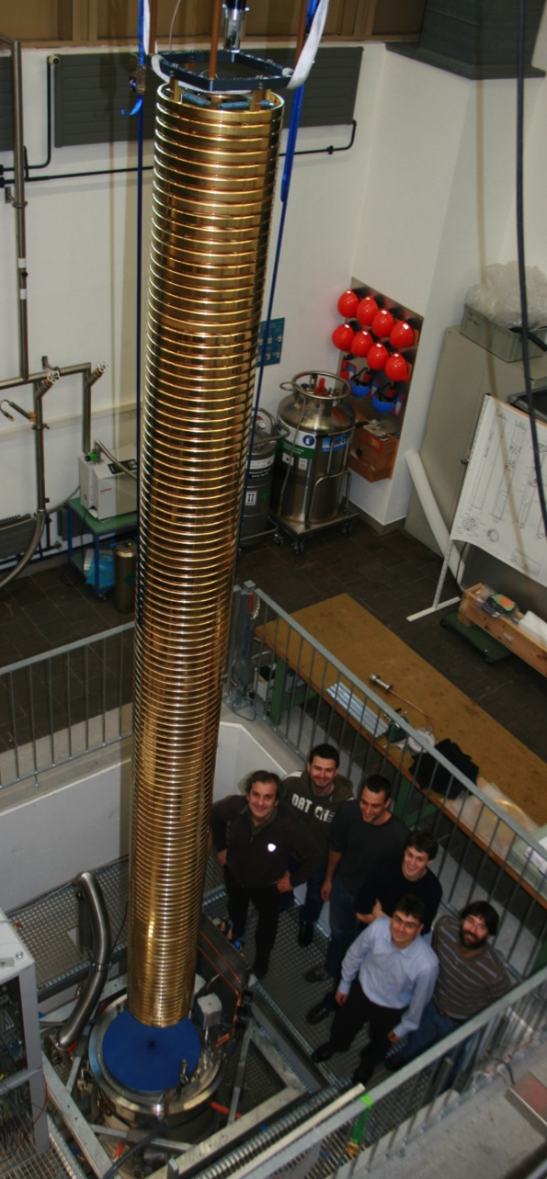
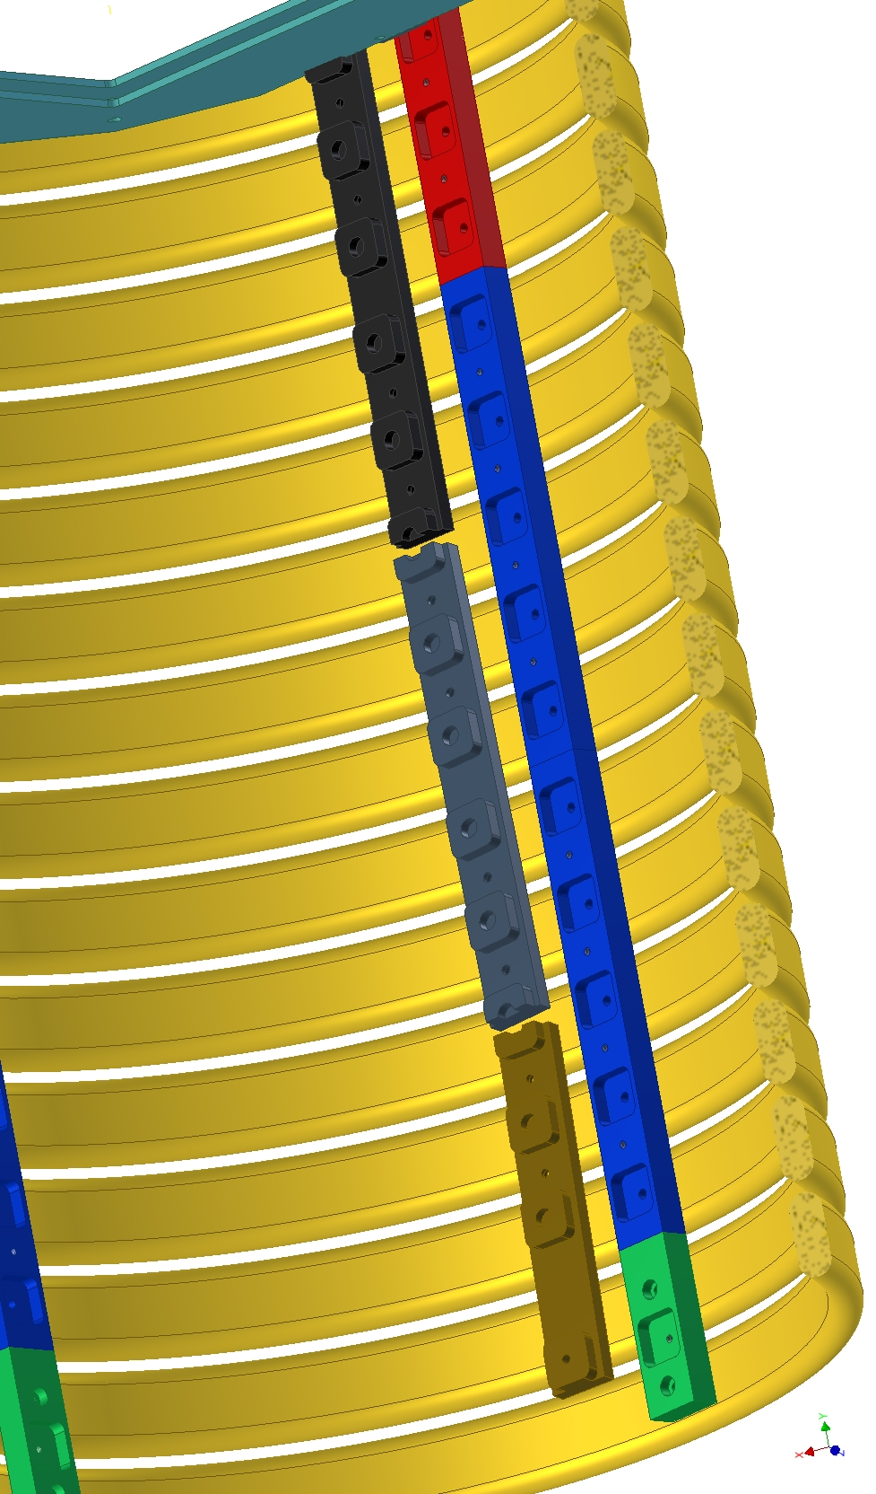
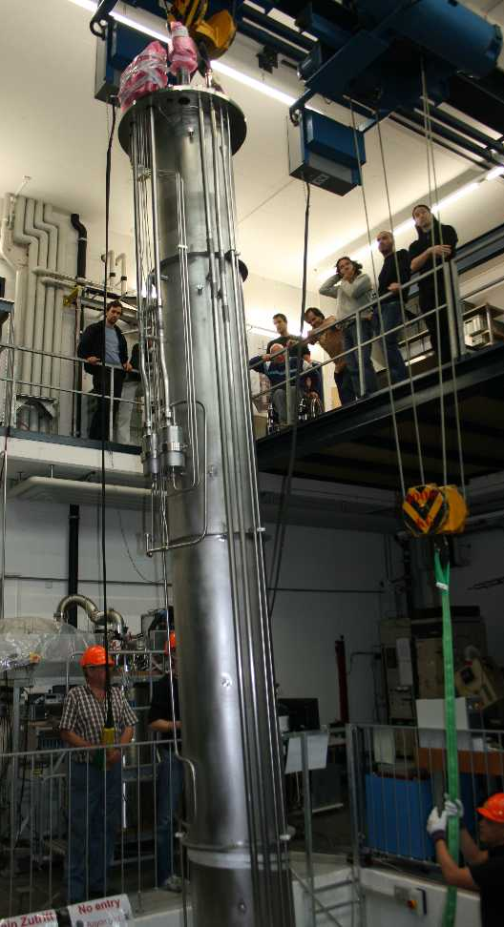
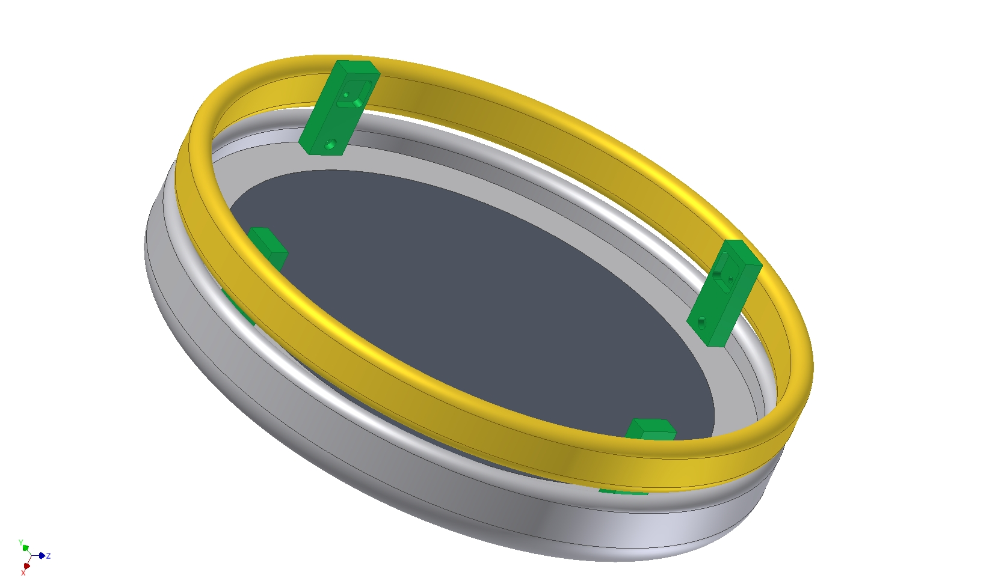
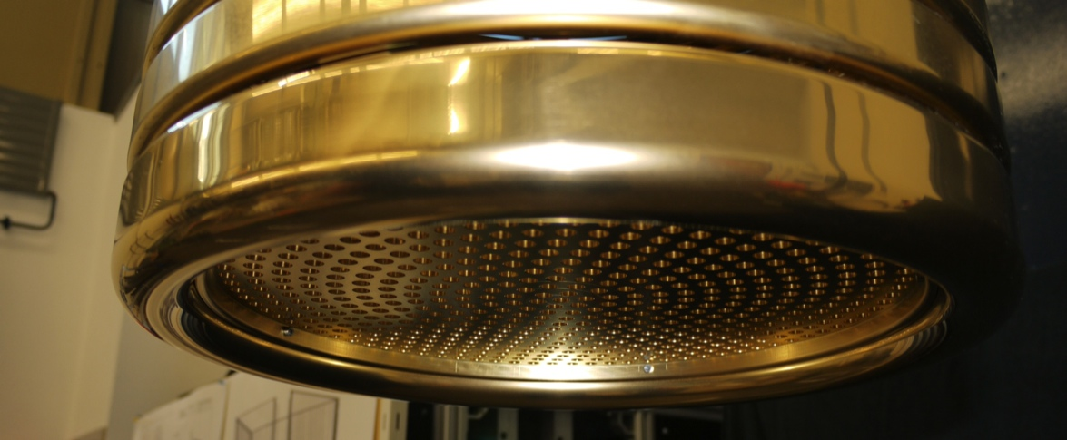
Design and construction

Slide 13
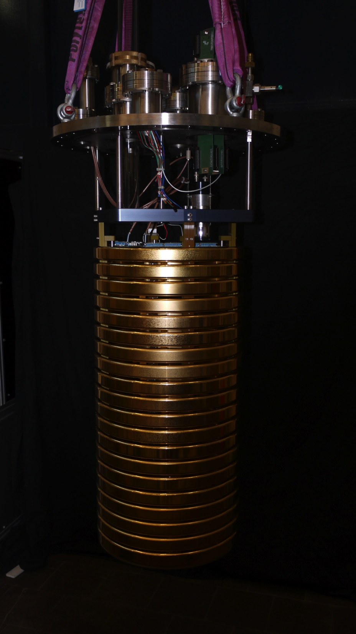
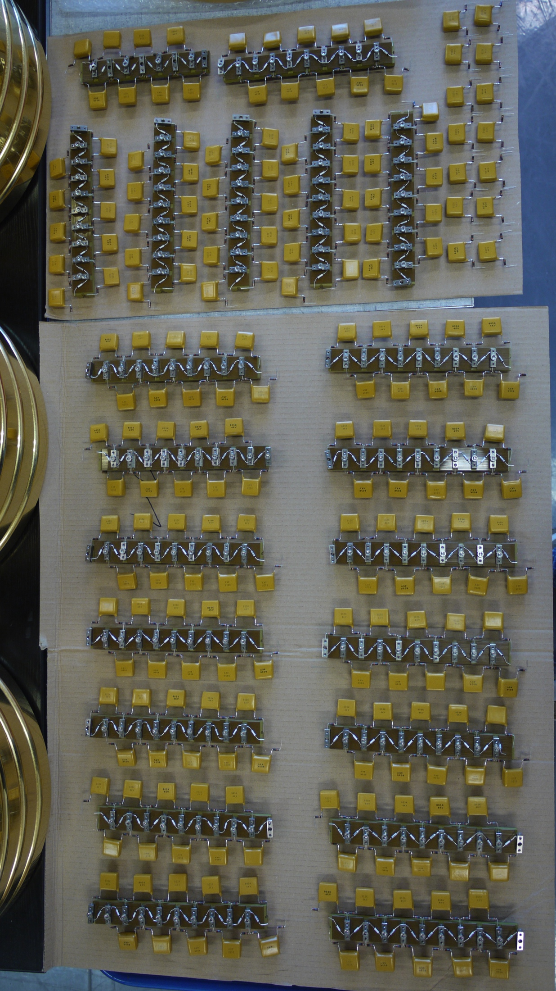
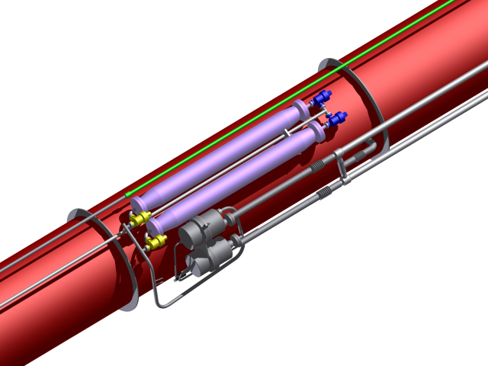
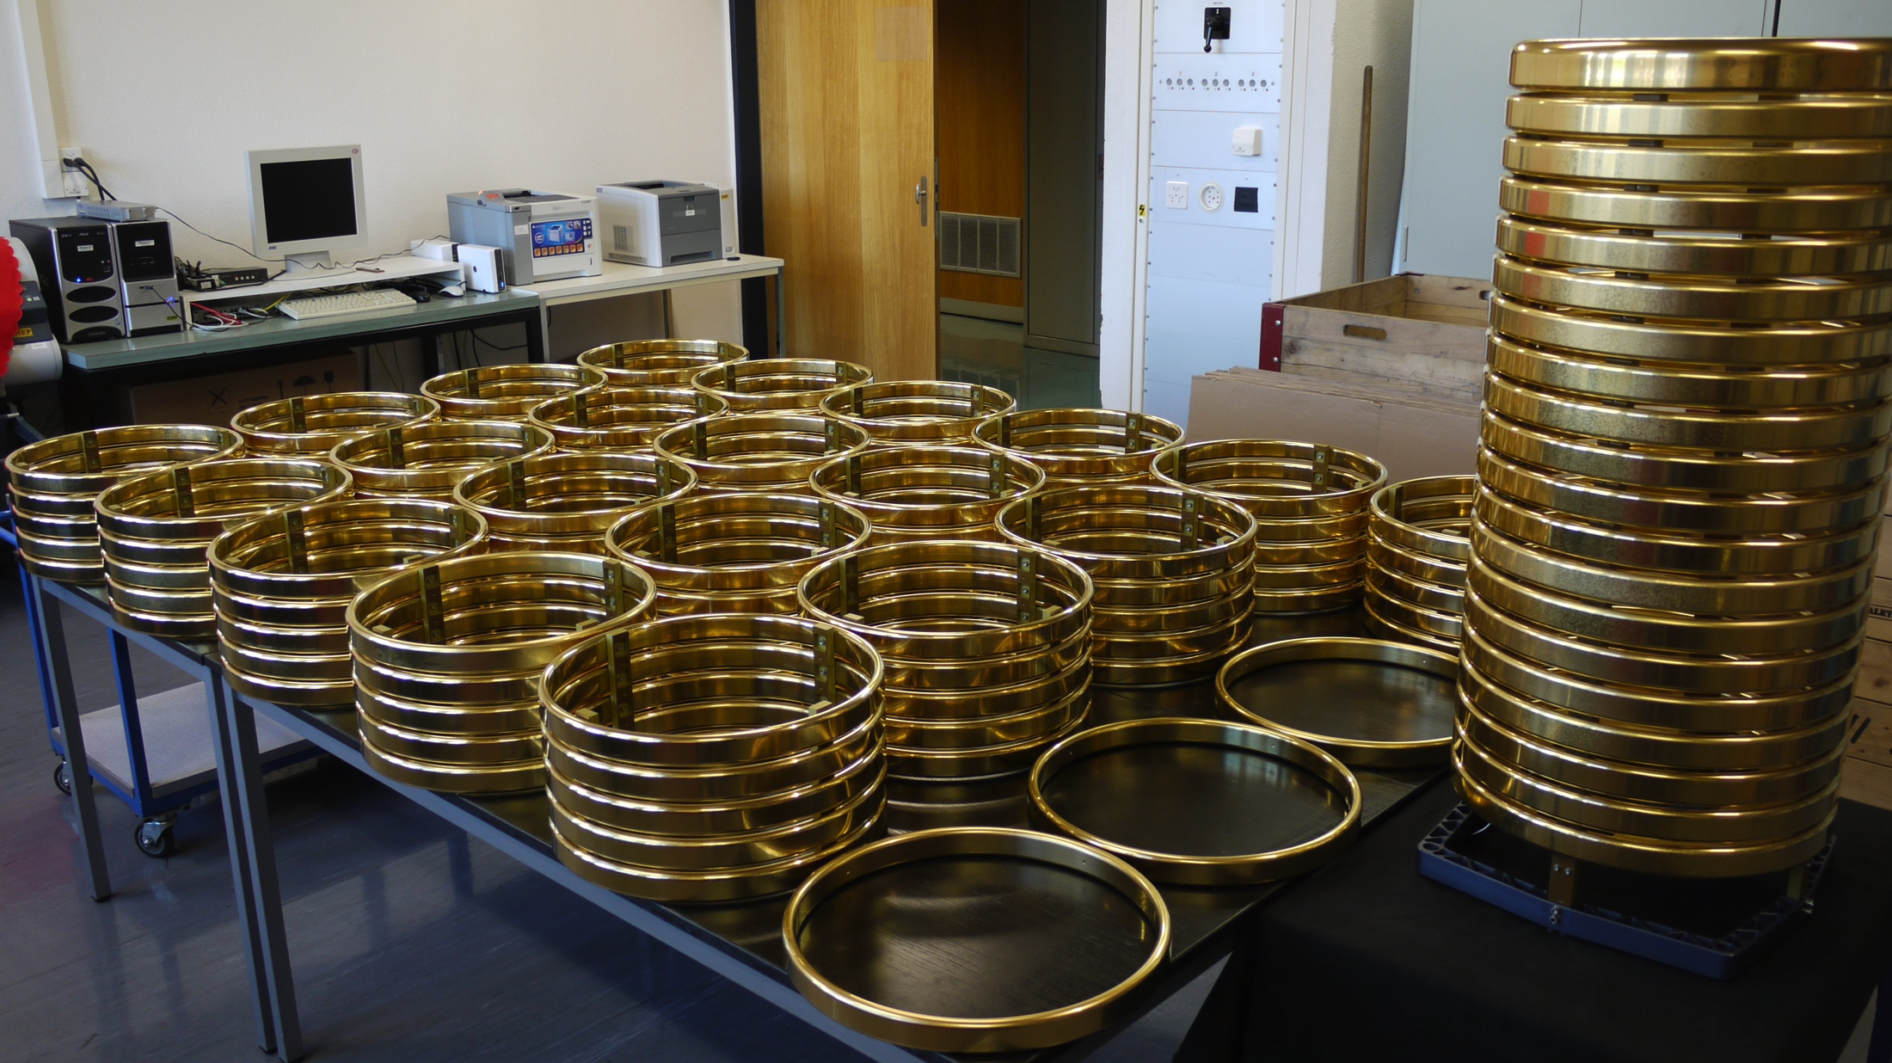
Construction, recirculation
To ensure the required purity, a Argon recirculation system was installed.
First cleaning stage filling
2nd stage with bellow pumps

Slide 14
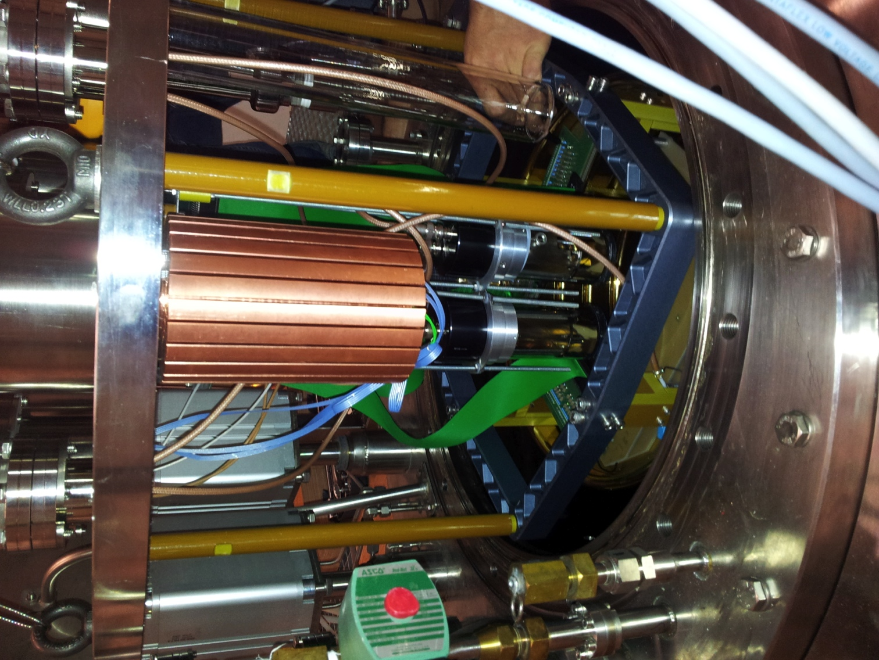
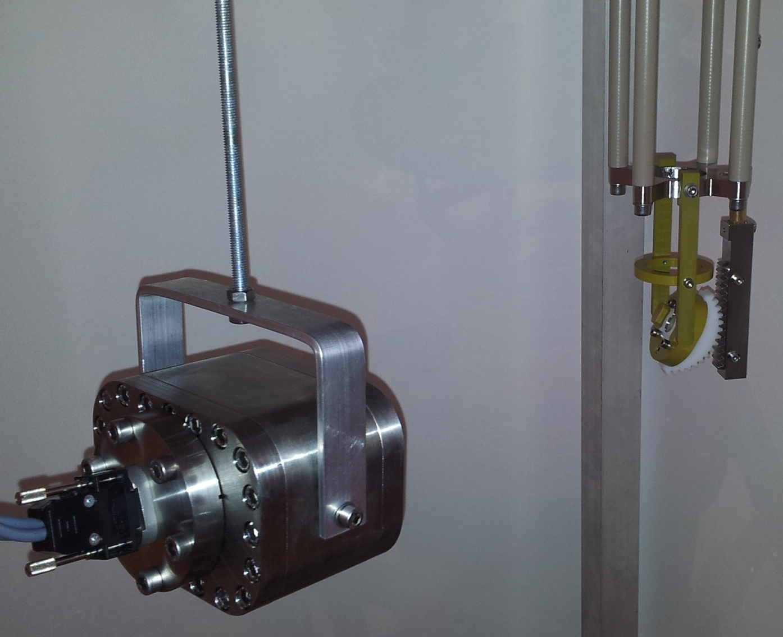
Other features of Argontube
Trigger on cosmic tracks (2 PMT’s) or on UV laser (see later talk)
EXO
Cold camera to observe movements and conditions inside the cryostat
Cryo-cooler to run 24/7 long term without refilling

Slide 15
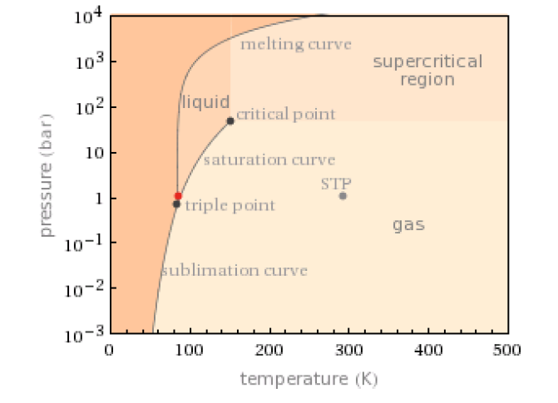
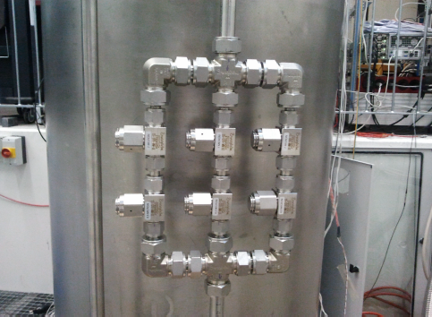
HV breakdowns
  Max stable HV achieved 150-170kV
  Around 170 kV spontaneous discharges of the Greinacher
    Run 1: Few discharges, one broken capacitor
    Run 2: O(100) discharges, one broken capacitor
    Run 3++: New capacitors, discharges at ~150kV, no destruction of Greinacher
  candidates for discharges
    Argon bubbles (triple point close)
      Change pressure
      Enrich Argon Gas with He
    Dust from filters
      Copper powder <0.5μm
    Electrostatic forces
      5m leverage in case of small misalignment along drift axis
    Breakdown voltage << 1MV/cm
      Proc Phys Soc 78 448 (1961) measured 1.1 MV/cm for gold/gold

Slide 16
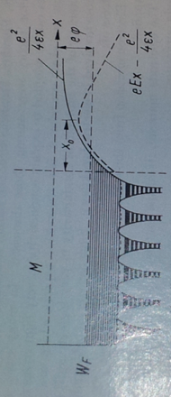
HV breakdown
Proc Phys Soc 78 423 (1961) Electric breakdown of Liquid Dielectrics and “Ionization, conductivity and breakdown in dielectric liquids” by Ignacy Adamczewski 1971 ISBN: 978-0850660272
Work function for electrons leaving the cathode:
Work function for electrons with external field in a dielectic liquid:
metal
work function
X
Notes:
Je – electron current densitiy, \mu local field enhancement factor (Lewis 1955) and A and B are constants depending on the cathode surface. Or the current I is given by Schottky or Richardson equation at temperature T where A is a material constant
E+0 angelegtes feld E_+ feld durch space charge, j_0 current density in absence of space of space charge (E_c=E_0)
Keep in mind, we are talking about the shortest distance between ground and cathode, not the drift region!!!

Slide 17
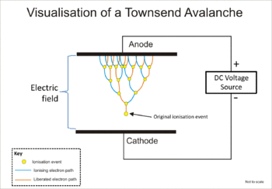
HV breakdown
We have to take more into account:
Ionization: Townsend coefficient α
The distance are short, and α < 1 but:
  Distance between wall and cathode 1mm:
    no multiplication
  Distance between wall and cathode 1-10 cm:
    multiplication in liquid become a possibility
Dependence
IF α has known dependence of E₀, than we can calculate the breakdown distance
Notes:
Still, if the mobility of the ionic components is given by k_+ and k_-, and the ionization coefficient alpha is used, we see that
Alpha depends on the applied field, while having and influence on the field at the cathode. C and D are paramters

Slide 18
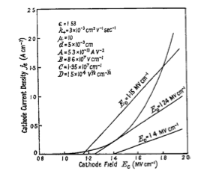
HV breakdown
We can thus calculate the cathode emission and the cathode field - emission current relation
For low Fields, two intersections (smaller one is the stable), for large fields, unstable increase of current i.e.:
Papers/Measurements are available in the mm range, we are in cm. Formulae not analytical solvable, but we are working on preparing full Comsol simulation
j

Slide 19
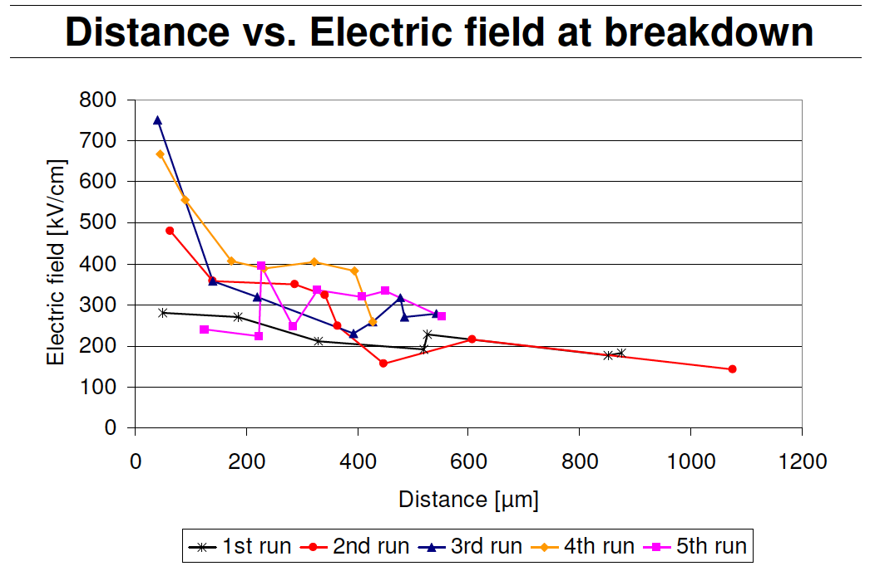
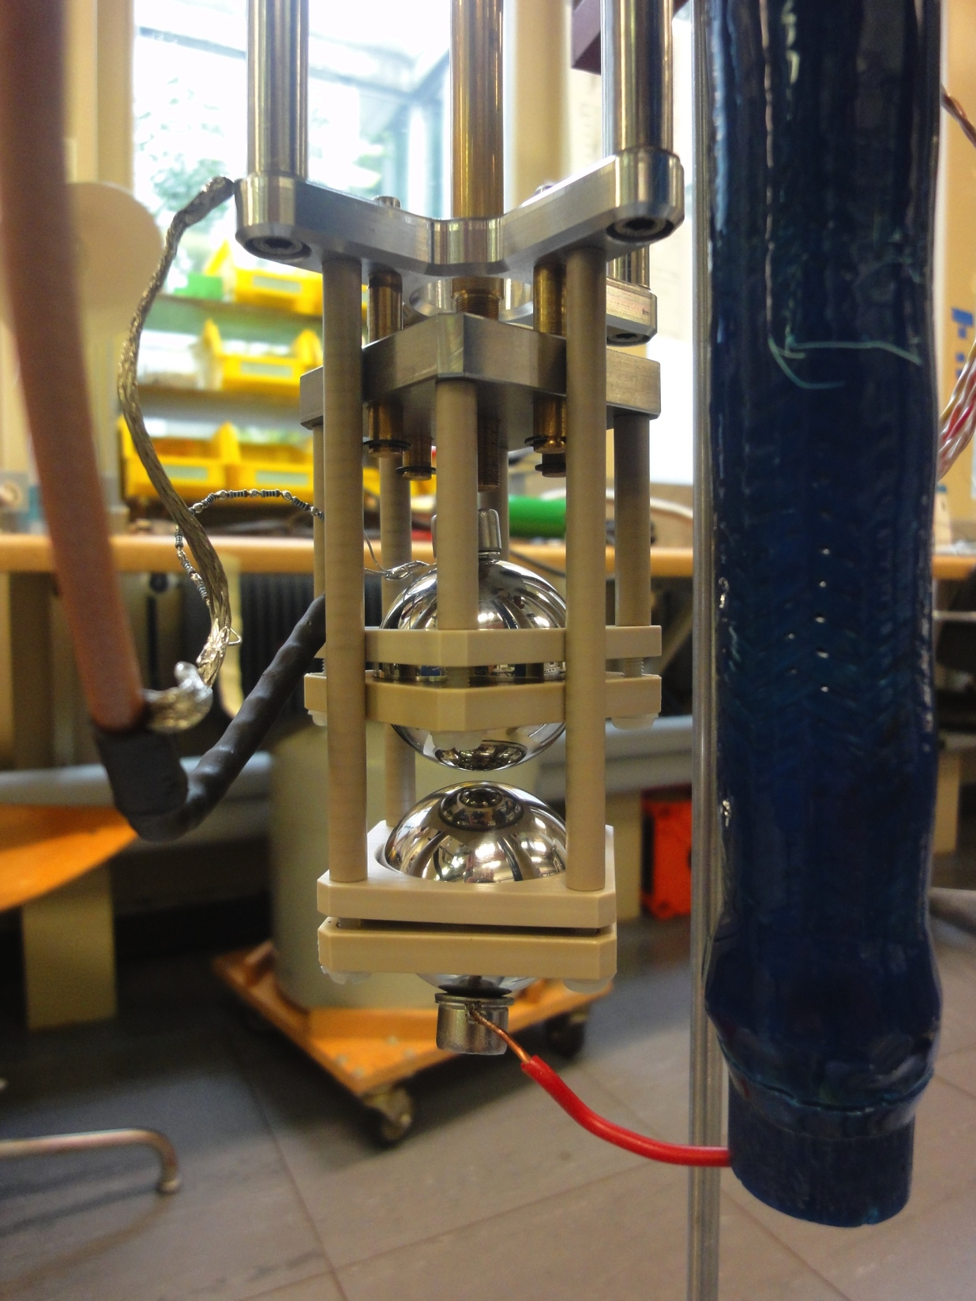
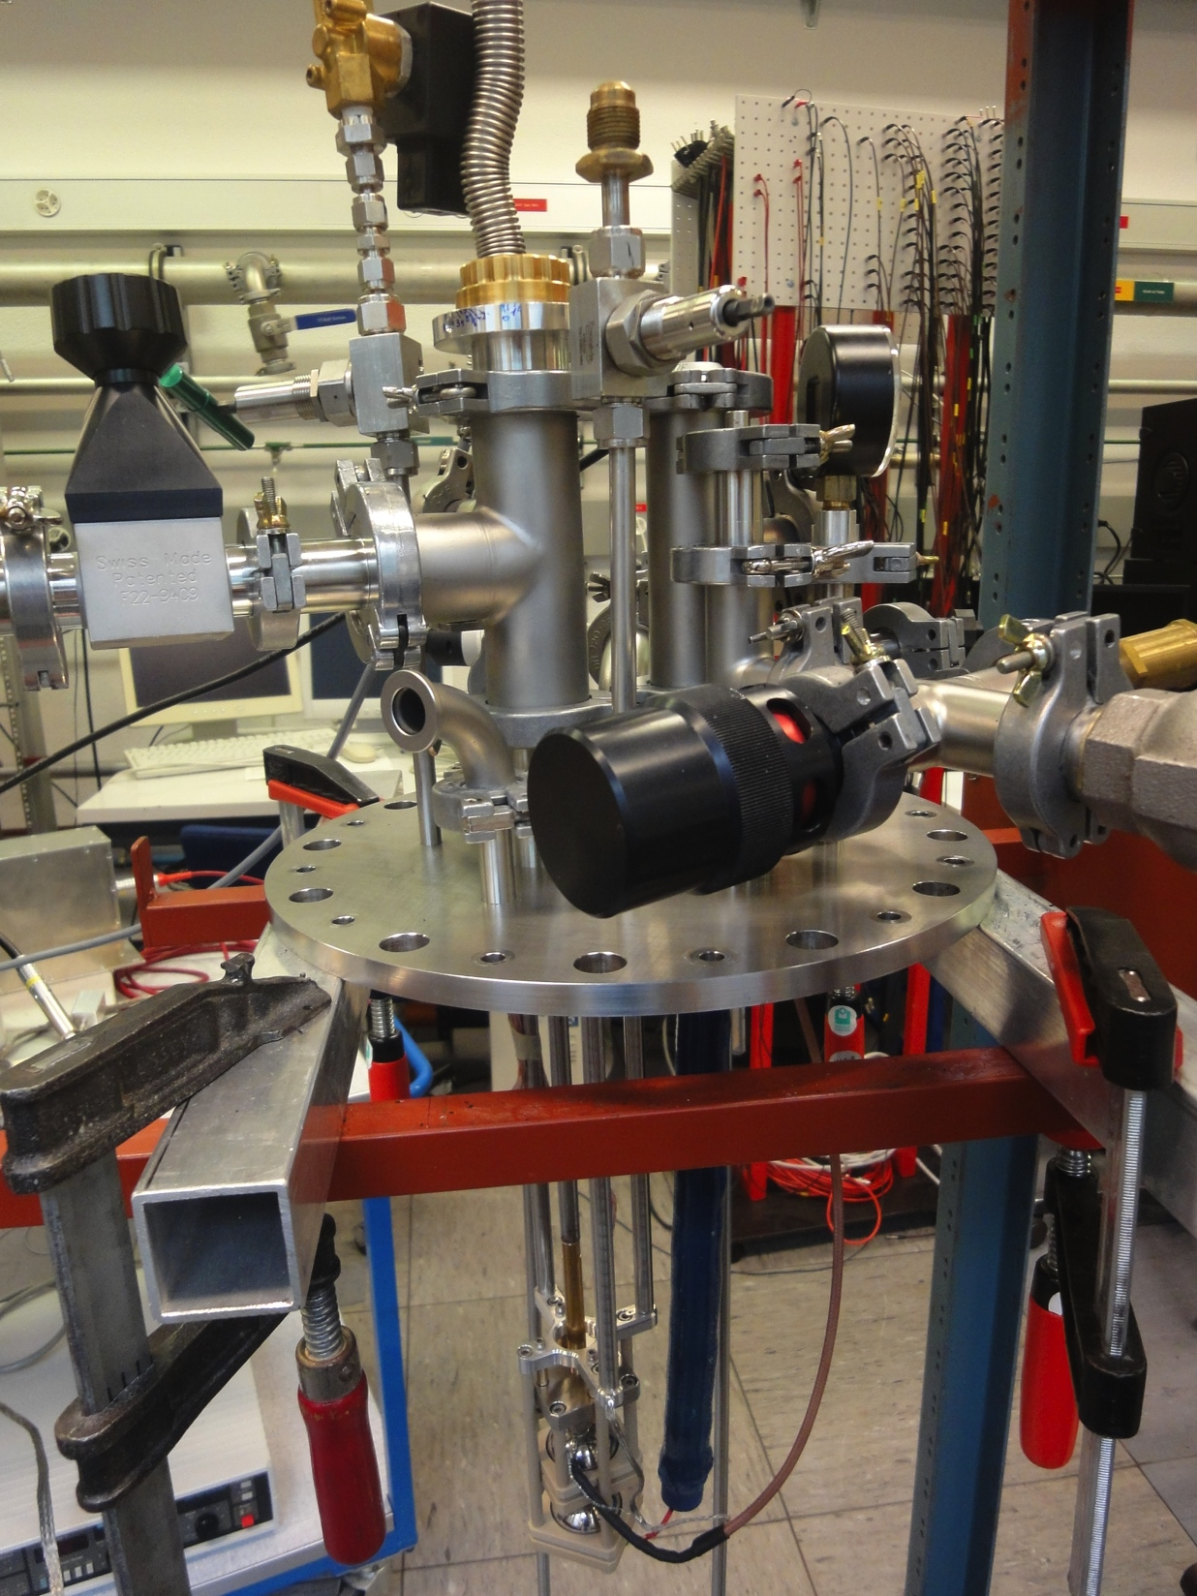
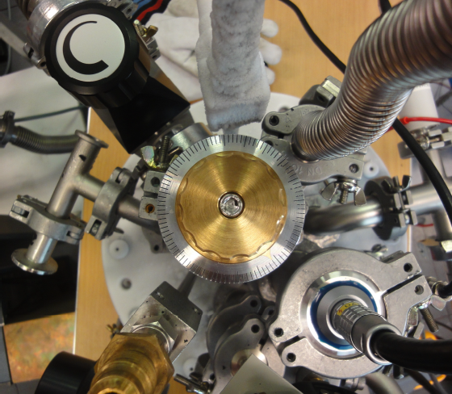
Breakdown Voltage
  Breakdown voltage measurement
  Micro Argontube with a 30kV HV feedthrough JINST 5:T11002 (2010)
  2 spheres (d=4cm), one moveable with 5μm precision
  Few micron to 1mm range
Preliminary

Slide 20
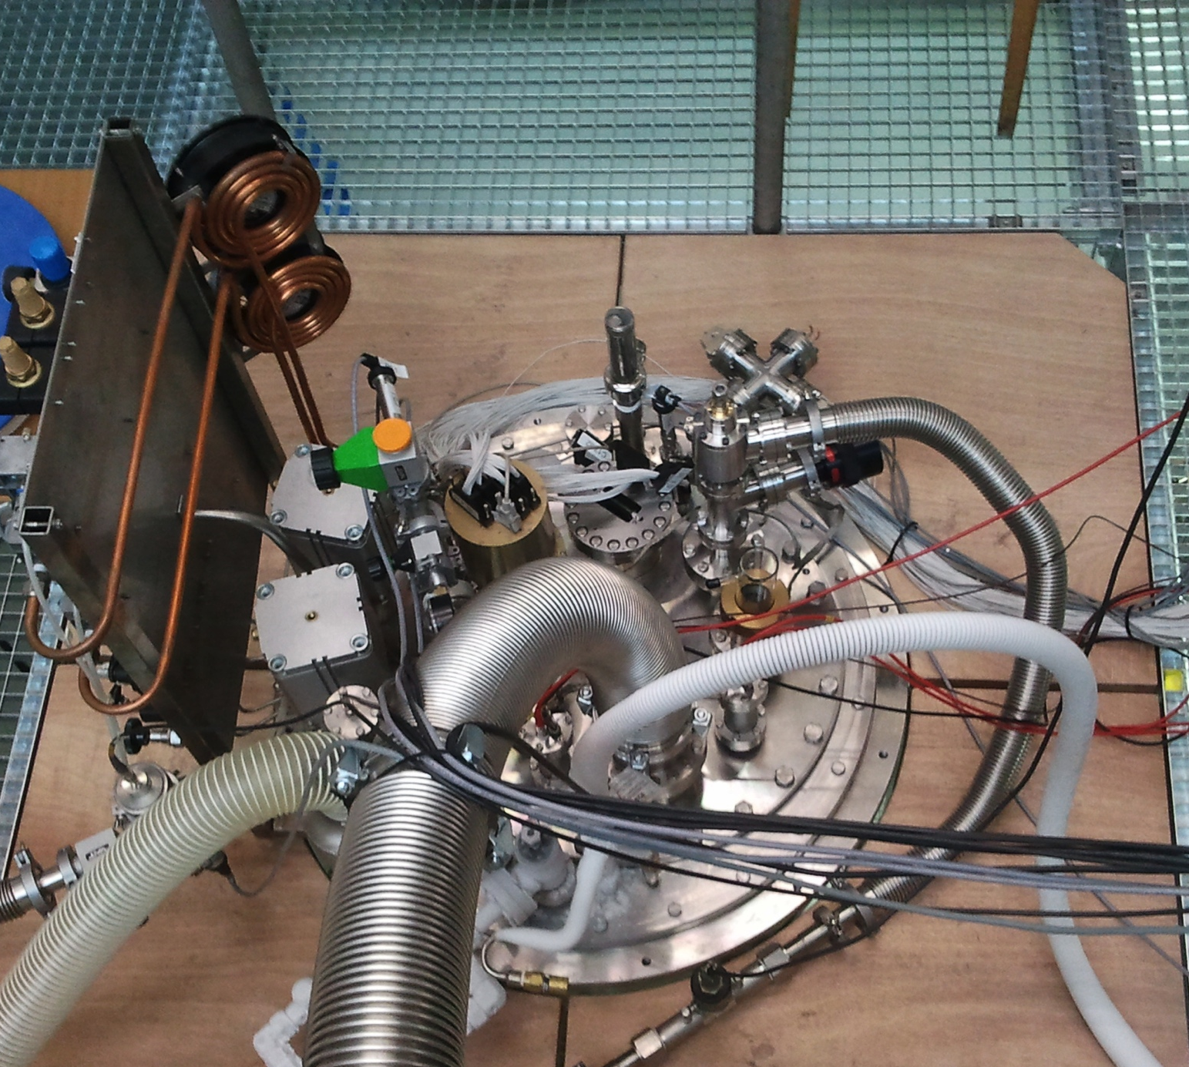
Data run
Vacuum
Pumping with pre-vacuum- and roots-pump
5 days of pumping
Vacuum: 4.8E-5 mbar
Filling
6 h to fill ARGONTUBE
2600 l of Argon used
Filtered Argon was injected (copper filter)
Before taking data one night of liquid recirculation through copper filter
Operation (last run)
HV was ramped up to 1.3kV AC input voltage (170 kV) -> discharges
Stable conditions at 1 kV AC input voltage (Drift field ~125 kV)
Collect cosmic events
Collect UV laser induced signals
2 Weeks of operation (about 10’000 events)
Next run: max purity, new filters (regeneration in progress)

Slide 21
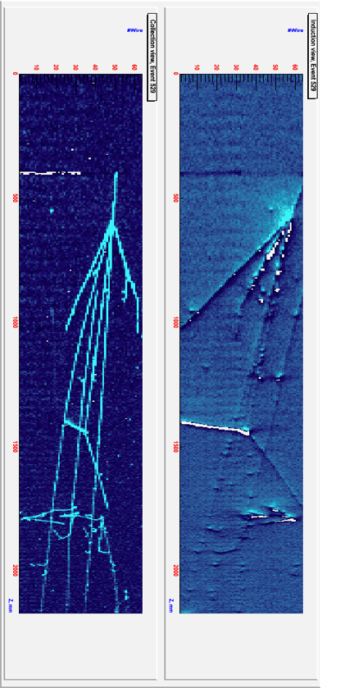


2m

Slide 22


Purity measurement with UV-laser and muons
Electronegative molecules absorb drifting electrons (Oxygen or Water)
Charge attenuation along the drift is called charge live time
Recirculation system to reduce oxygen impurities
Purity measured with muon tracks
Purity measured with UV laser beam
Preliminary
2500 ms of live time corresponds to 0.12 ppb of oxygen equivalent

Slide 23



Diffusion Measurements
D_{T}=5.18±0.58 cm²/s
or
D_{T}=10.18±0.58 cm²/s
Behavior for t>5500μs to be studied
Preliminary
Notes:
Icarus Collaboration measured: D_{L}= 4.8 cm²/s

Slide 24




Diffusion Measurements and further ideas
Micro Argontube
Test of double collection plane readout with wire planes
Cosmis Muons
Red Muons, green UV Laser

Slide 25
Conclusions
Very long drift successfully demonstrated at AEC Bern
  Recirculation system for Argon purification
  Stable HV ~ 125kV with Greinacher multiplier (Cockcroft Walton)
    Reason for discharges are understood, more R&D needed to optimize for larger HV and study LAr properties
  Muon tracks of almost 5m drift
  Laser tracks with 5m drift
  Purity of about 2.5ms
  Transversal electron diffusion D_{T} 5.2 or 10.2 cm²/s

Slide 26

Thanks for your attention

Slide 27


Slide 28


Slide 29


Slide 30


