Slide 1
Heat and Mass Transport in Ullage Space
Erik Voirin
Fermilab
630-840-5168
evoirin@fnal.gov

Slide 2
Presentation Contents
Using Computational Fluid Dynamics (CFD) methods to study heat and mass transport related to LAr purification.
Comparing to experimental data for model validation.
After methods validated use for future predications and design considerations
Sources and magnitudes of Impurities
Advection and diffusion of Impurities

Slide 3
Use Computational Fluid Dynamics (CFD) to study fluid behavior

Slide 4
CFD Model of Argon Purge

Slide 5
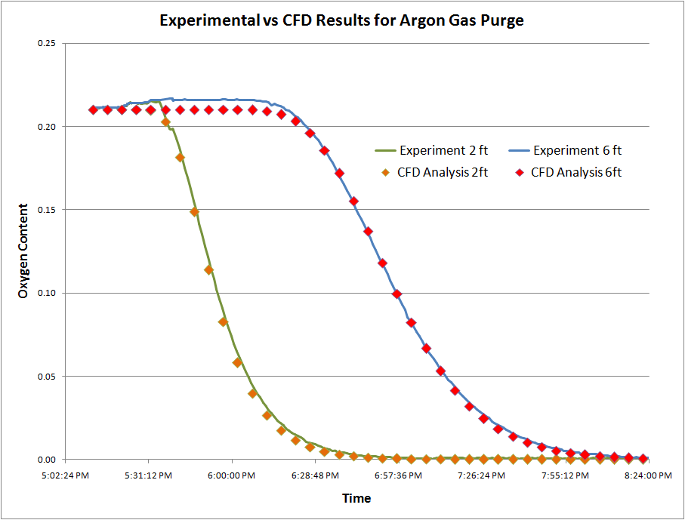
CFD Model of Argon Purge
Measurements vs. CFD model

Slide 6
LAPD Purge

Slide 7
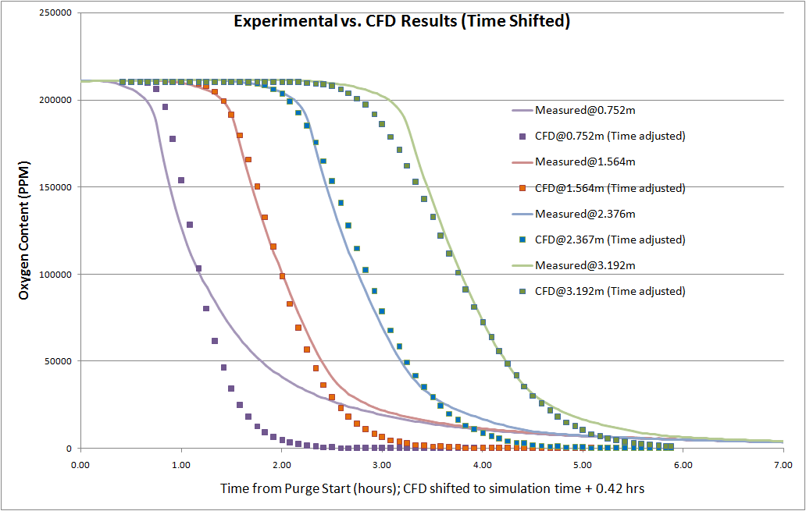
CFD vs. Measurements
Differences at lower part of cryostat due to measurement technique (siphoning gas) and inconstant pressure during purge.

Slide 8
10kT LBNE Vessel

Slide 9
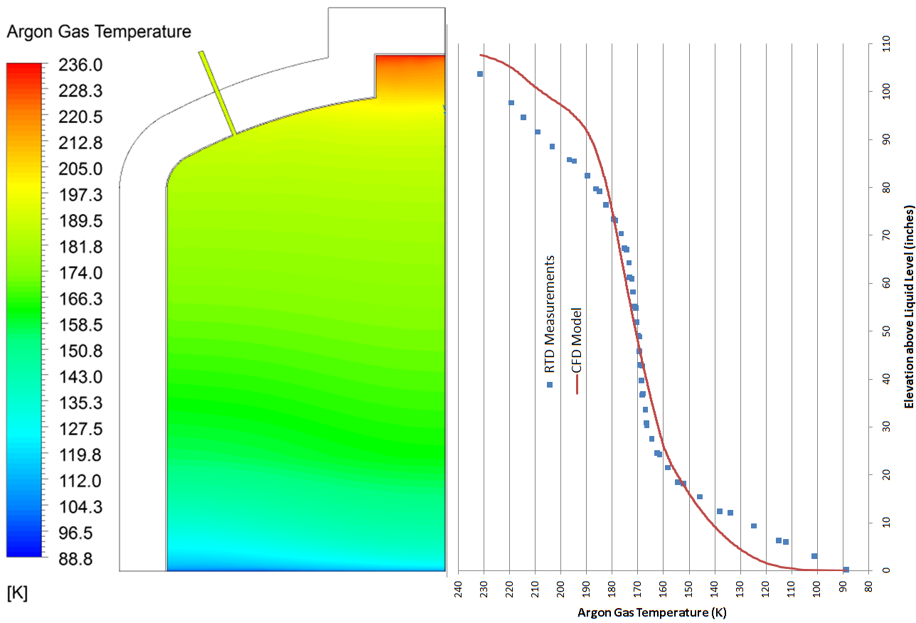
Impurities releasing into Ullage Space
Warm ullage space causes release of water.

Slide 10
Initial Impurities in Cryostat
Cryostat filled with air
Contaminants in the air
Water Sources
On surface of vessel walls
On all other surfaces
Inside of non-metallic parts
wire insulation, FR4, etc.

Slide 11
Sources of Impurities (material)
Water concentration can vary greatly in different materials.
FR4 0.2% – 0.6%
Polyolefin 0.3% - 2%
PTFE 0.02%
Teflon 0.01%
PVC 0.1% - 31%(!)
Polyethylene 0.2% - 0.6%
From NASA.outgassng.gov (Baller [1])

Slide 12
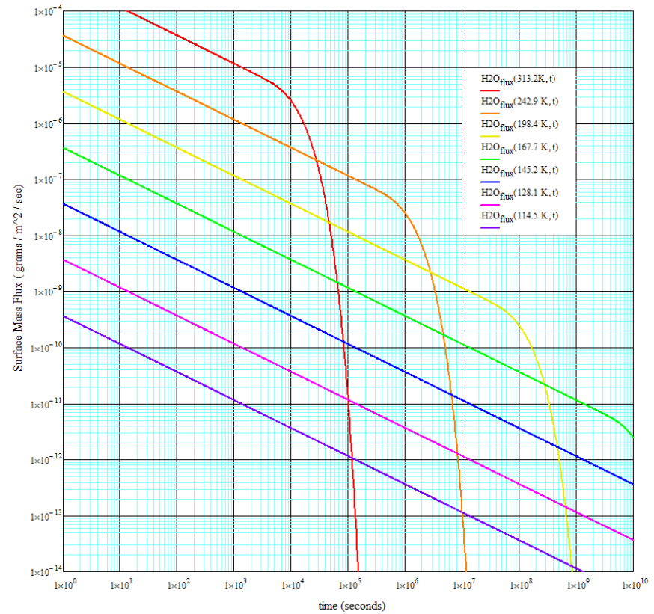
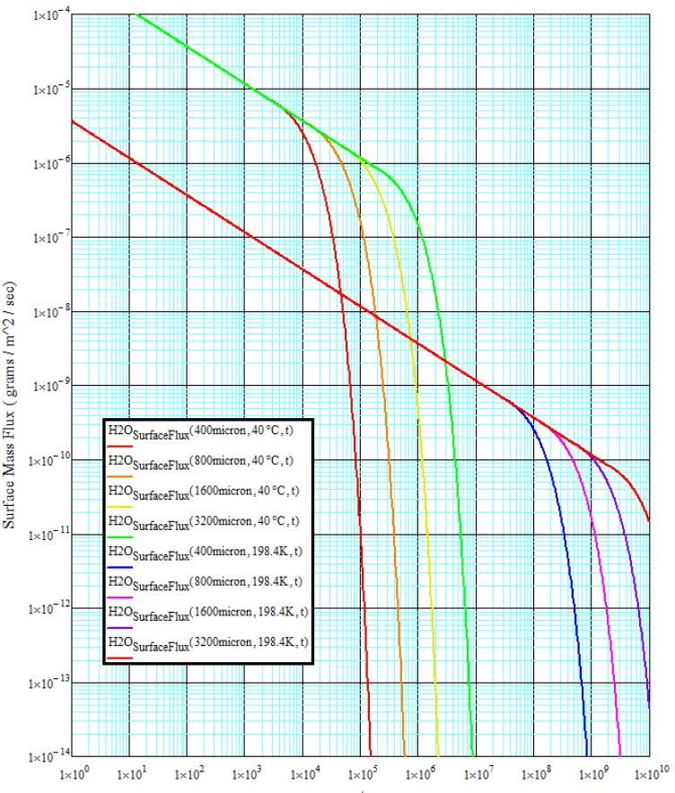
Sources of Impurities (Temperature) (using Teflon as example) Highly temperature dependent! (Arrhenius’ Law) (Baller [1])

Slide 13
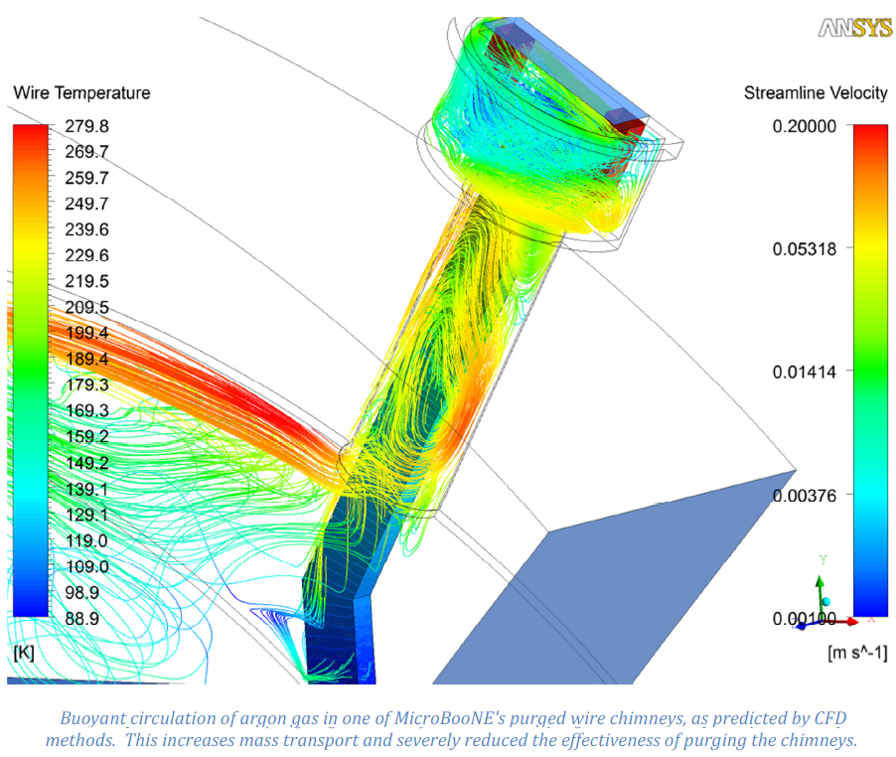
Advection of Impurities (MicroBooNE Feedthrough)
Adventive motion and turbulence will mix gas enough to cause some impurities to be absorbed by liquid surface.

Slide 14
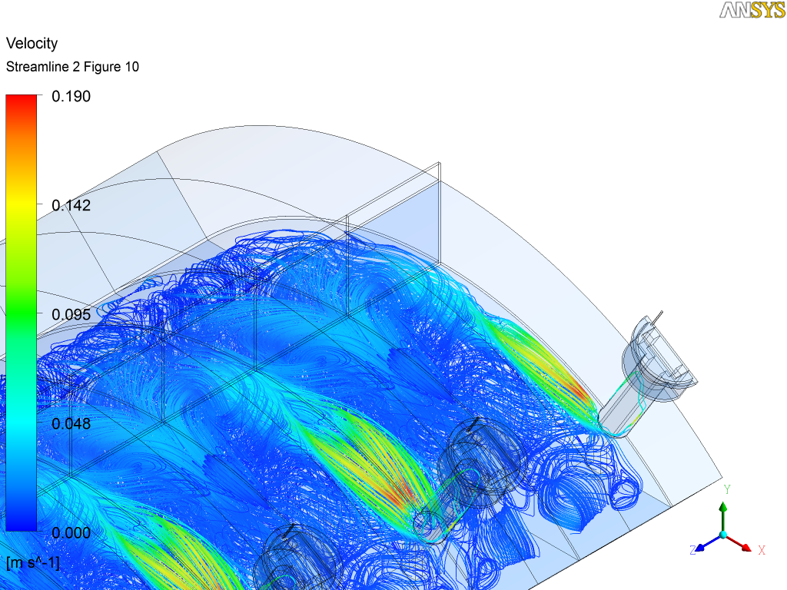
Advection of Impurities (MicroBooNE Feedthrough)

Slide 15
Estimate Impurities in LAr
~20 times higher impurity magnitude if using LDPE insulation vs. Teflon
Due to saturated water concentration difference
Impurities from wire in feed throughs 3-5 orders of magnitude higher than ullage space wires.
Due to large temperature dependence of outgassing.

Slide 16
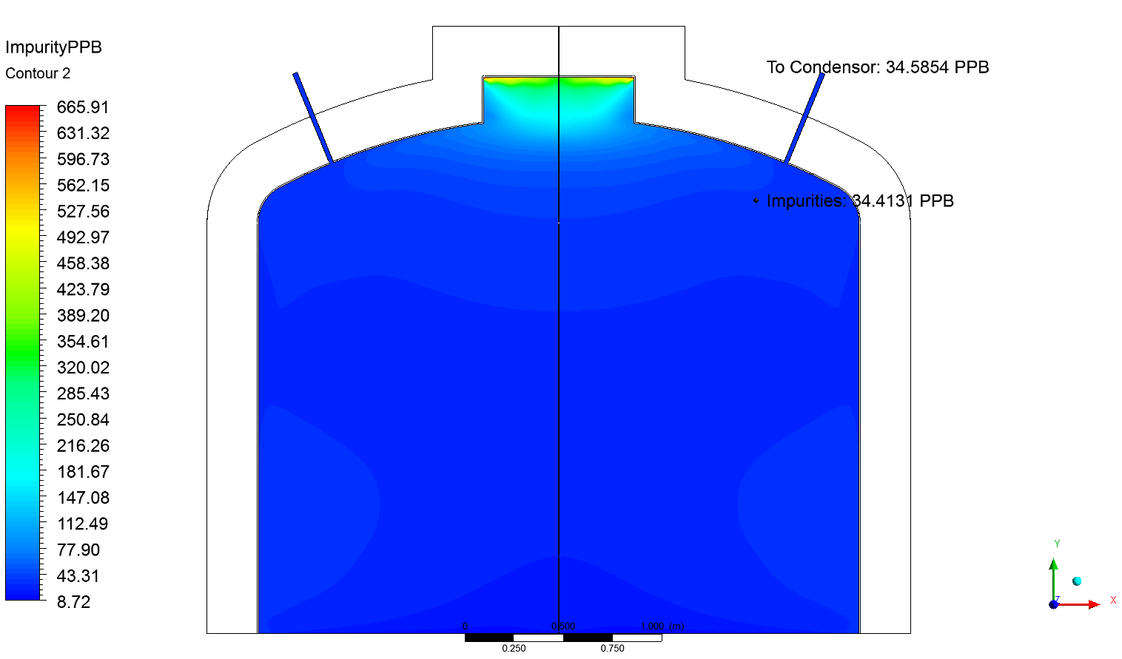
LAPD Impurities in Gas Space (Work in progress)

Slide 17
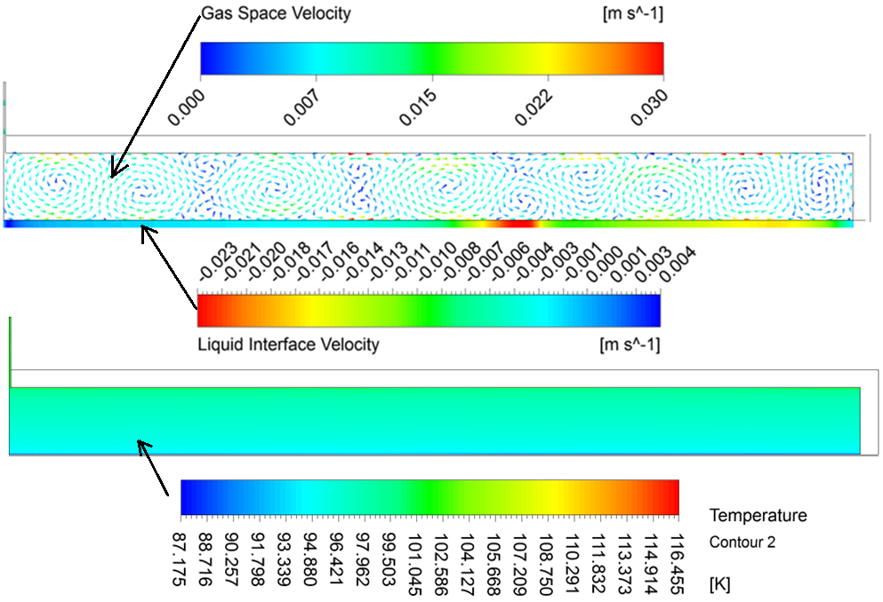
33KT Ullage (much different than LAPD)

Slide 18
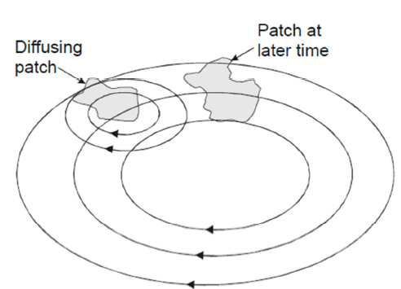
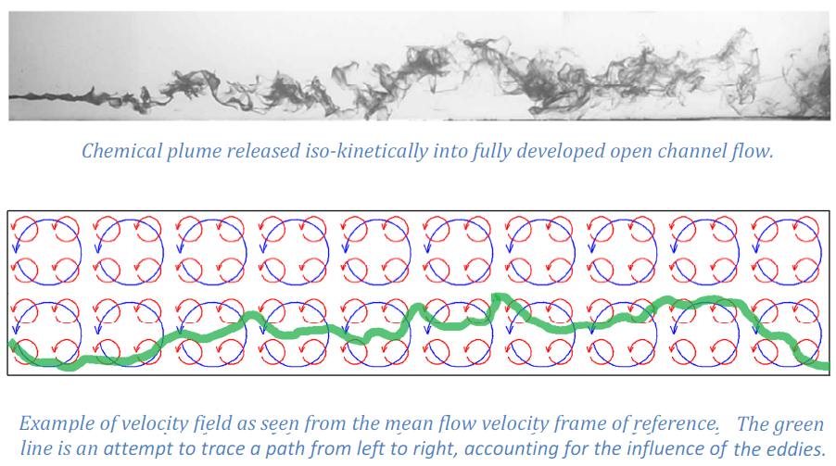
Turbulent Diffusion

Slide 19
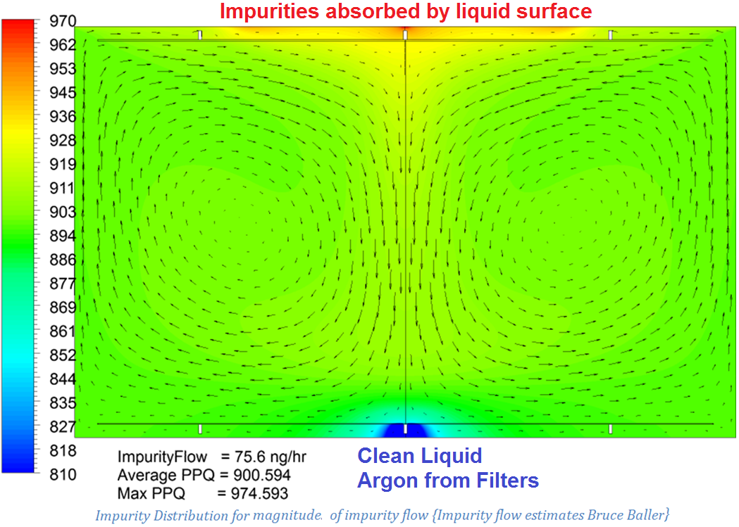
Impurities In Liquid Volume (Quite Homogeneous)

Slide 20
References and thanks to:
All LAr R&D Personnel
1.) Baller, Bruce. LBNE Doc-3171, Diffusion and Transport in the Ullage
- http://lbne2-docdb.fnal.gov:8080/cgi-bin/ShowDocument?docid=3171
2.) MicroBooNE Document 1768 - Mass Transport of Water in Teflon;
a Transient Numerical Analysis
- http://microboone-docdb.fnal.gov:8080/cgi-bin/ShowDocument?docid=1768
3.) LBNE Doc-3085 - Argon Gas Circulation,
Temperature Profile, and Molecular Diffusion in the LBNE Ullage
- http://lbne2-docdb.fnal.gov:8080/cgi-bin/ShowDocument?docid=3085
4.) LBNE Doc-3862 - Diffusion Coefficients of Water and Oxygen in Argon
- http://lbne2-docdb.fnal.gov:8080/cgi-bin/ShowDocument?docid=3862
5.) MicroBooNE Doc-1737 - CFD Models of Ullage Space: Temperature and Velocity Profiles
- http://microboone-docdb.fnal.gov:8080/cgi-bin/ShowDocument?docid=1737
6.) Turbulent Diffusion and its Effects on the Ion Distribution Field of the MicroBooNE LAr
Cryostat
- http://microboone-docdb.fnal.gov:8080/cgi-bin/ShowDocument?docid=1895

