Slide 1

The UV laser system of the Argontube detector
Thomas Strauss
Albert Einstein Center for Fundamental Physics
Laboratory for High Energy Physics
University of Bern
AEC, Bern: A. Blatter, L. Bütikofer, A. Ereditato, R. Haenni,
C.C. Hsu, S. Janos, I. Kreslo, M. Lüthi, P. Lutz, C. Rudolf von Rohr,
T. Strauss, M.S. Weber, M. Zeller

Slide 2
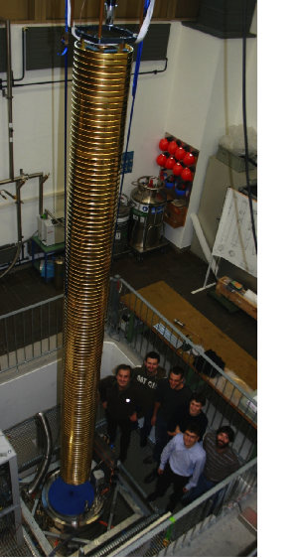
Argontube
5m drift length prototype in the LBNO/LAGUNA R&D framework
Novel HV supply:
Greinacher /Cockroft- Walton immersed in liquid Argon
Goal: 500 kV, or 1kV/cm tracks of 5m length
To realize these tracks a pre study of UV laser ionization was done (thesis B. Rossi)

Slide 3
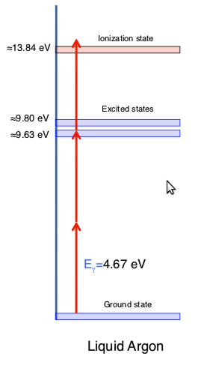
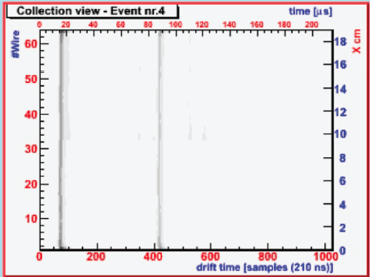
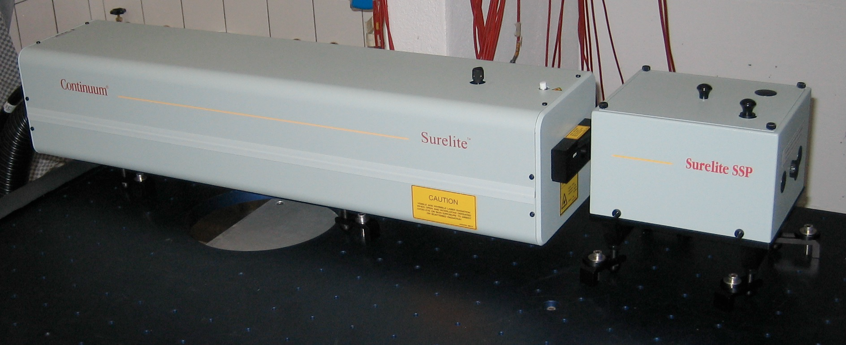
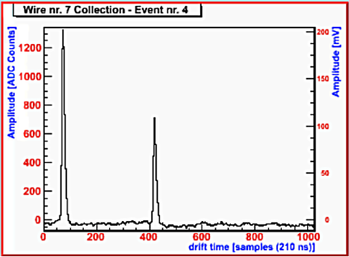
UV laser in LAr
Feasibility study of using a UV laser to ionize LAr in a multi-photon process
NJP 12 (2010) 113024
2009 JINST 4 P07011

Slide 4
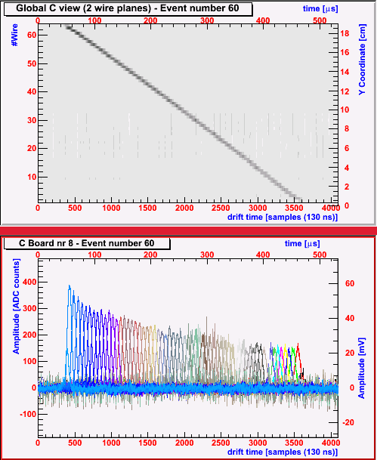
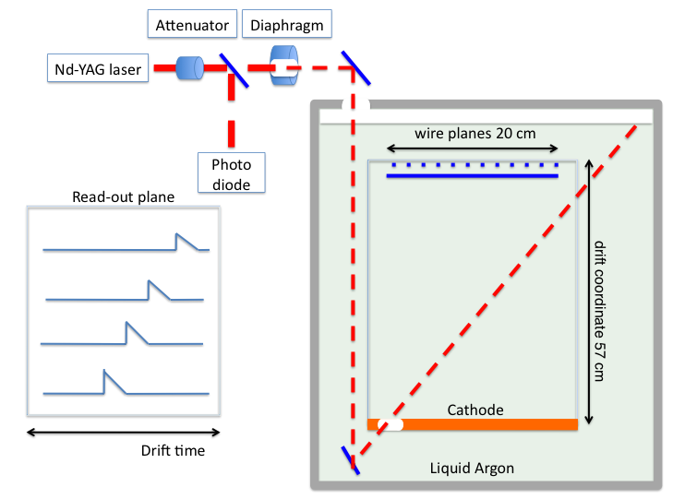
Laser beam, pt. 2
Monitor the purity of the LAr
Longest life time 2000 μs (~ 0.1 ppb) hitting the sensitivity limit of the detector.
Longer life time can only be
measured with the full ARGONTUBE
Laser track
Track projection of
the time coordinate

Slide 5
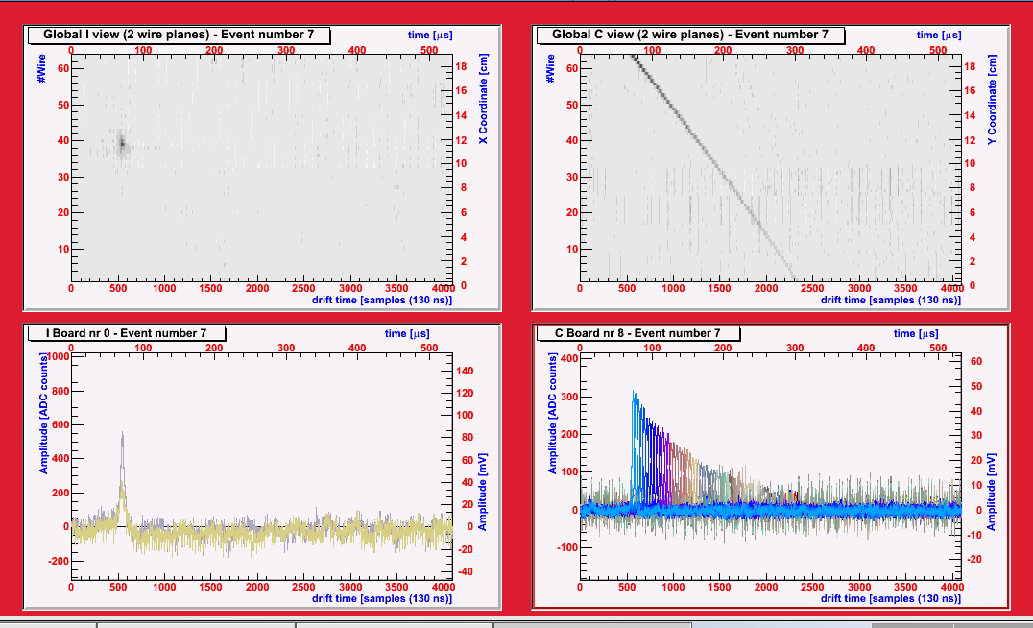
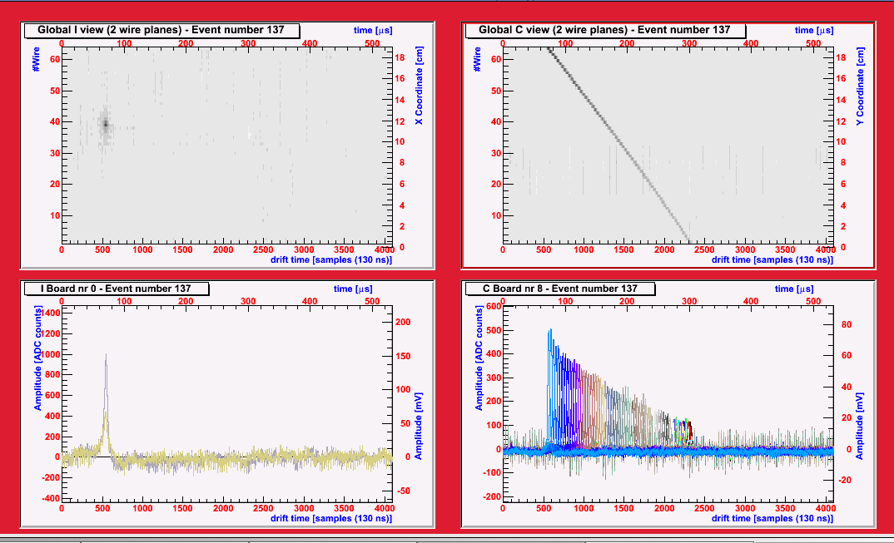
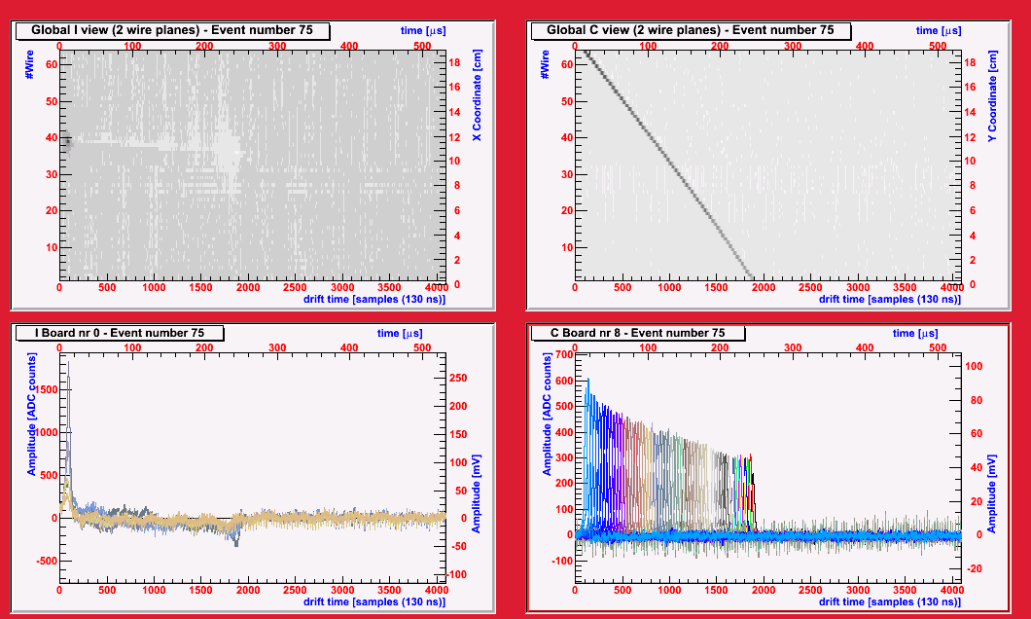
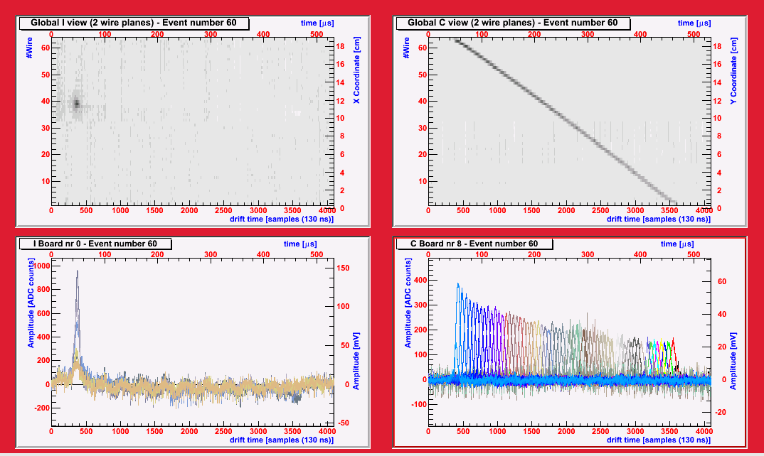
Purity measurements with UV Laser

Slide 6
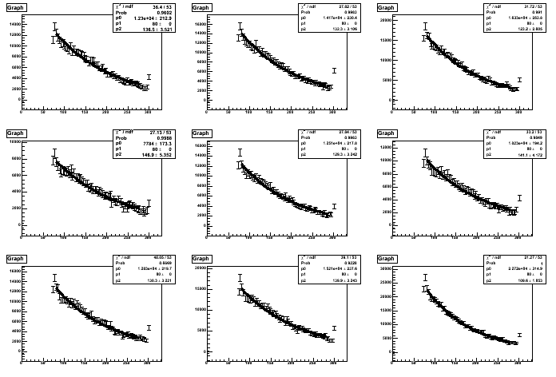
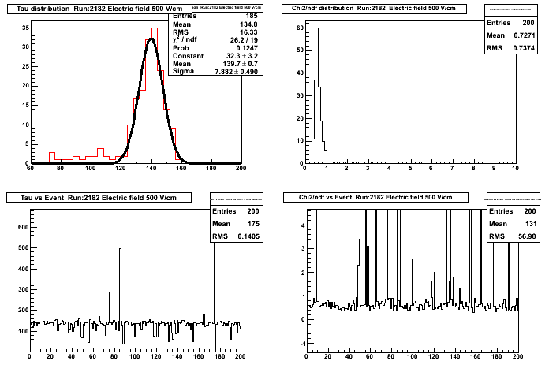
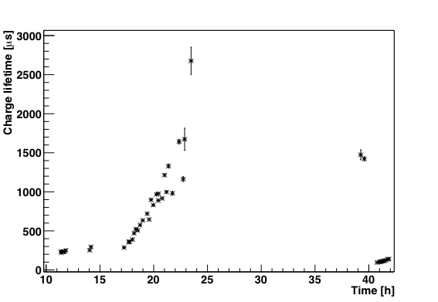
Purity measurements with UV Laser
(500 V/cm)
E_{drift} =200 V/cm
Recirculation
system running again
Recirculation system
running for 6 h. at ~50l/h. e life time increased by a factor 10
Night stop and morning
measurement
Re-fill with
dirty argon

Slide 7
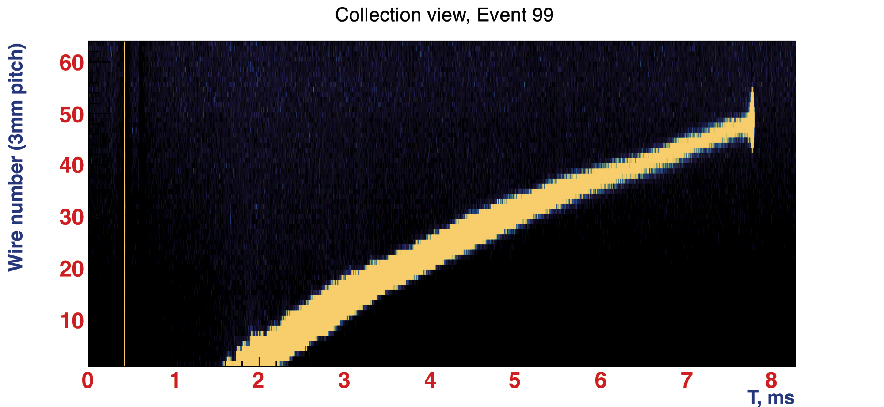
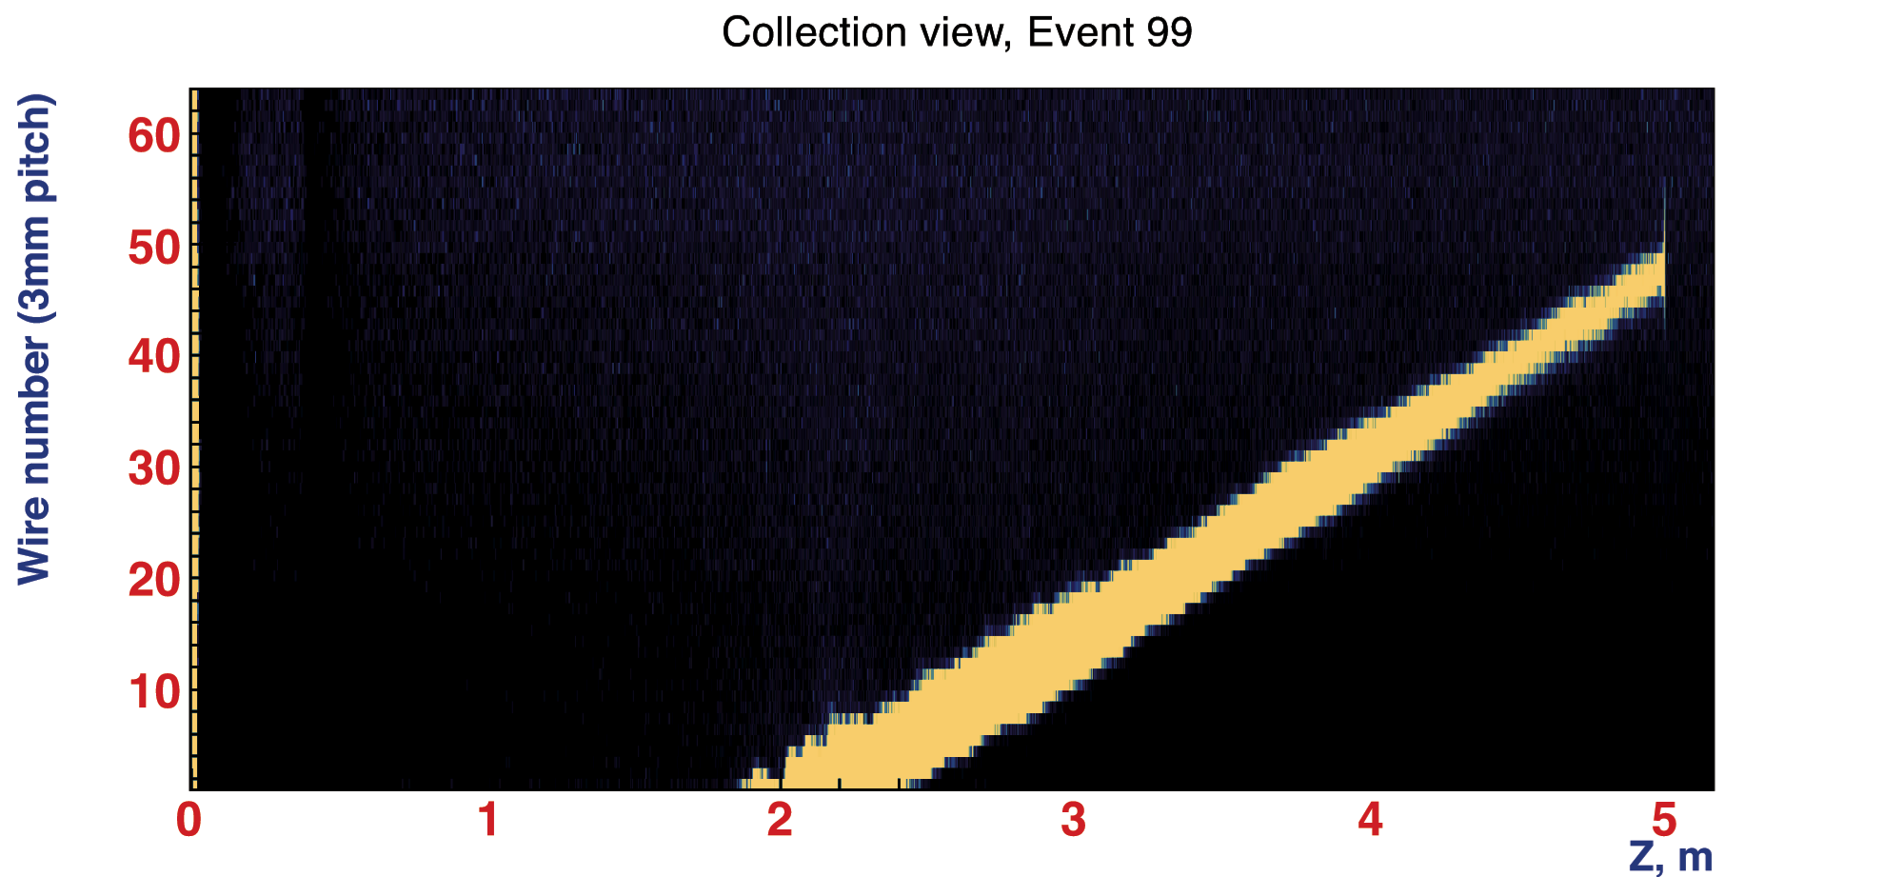
UV Laser calibration
5m, ~ 6ms
Future shallow TPC will have space charge effects, local accumulation of ions which could be as strong as the drift field, thus lead to distortion of the field
Correction needed
Argontube R&D
Non uniform drift field due to HV breakdowns after capacitor broke
From the knowledge of the laser path, we can extract the true drift field, and thus correct the drift time
5m straight cosmic are rare (~1event/6min)
Use the UV laser to generate 5m tracks, covering the whole TPC drift length
Application for future large LAr TPC’s
To be demonstrated in MicroBooNE

Slide 8
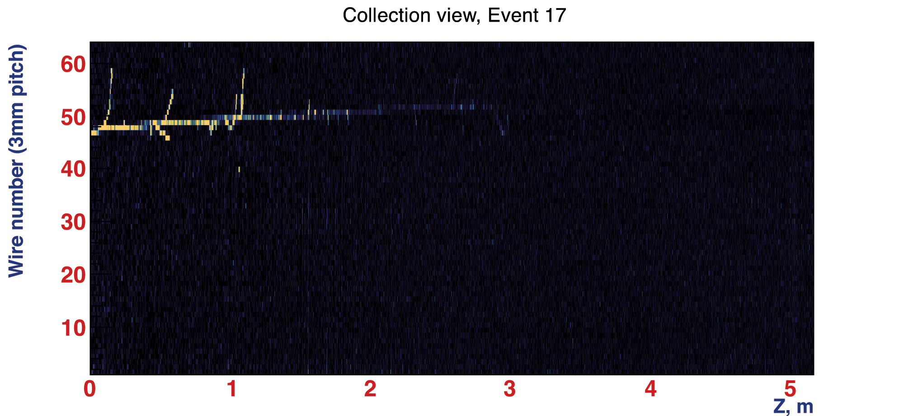
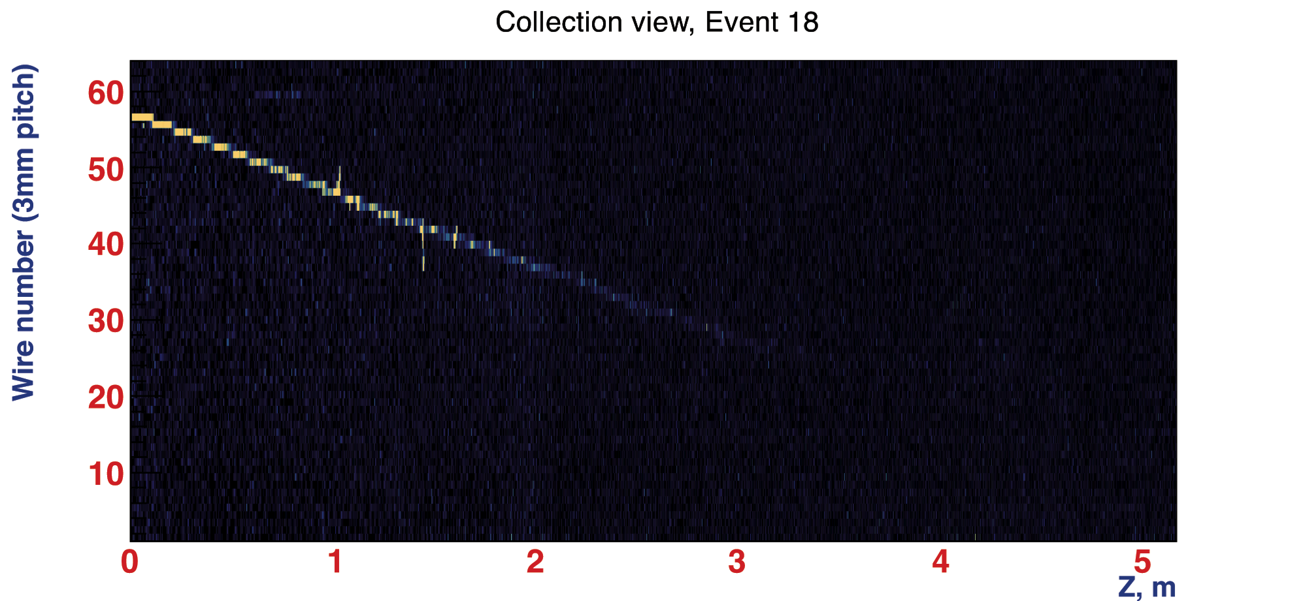
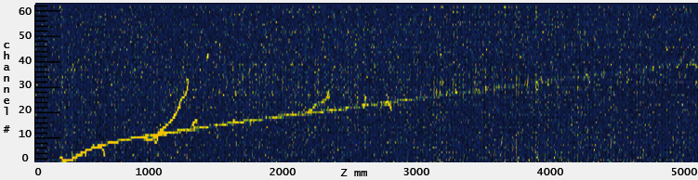
Cosmic muons
Drift field corrected
Cosmis muon with 5m drift

Slide 9
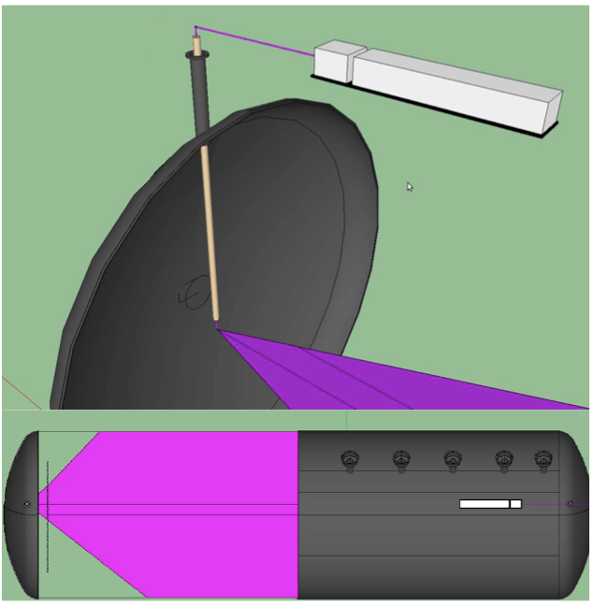
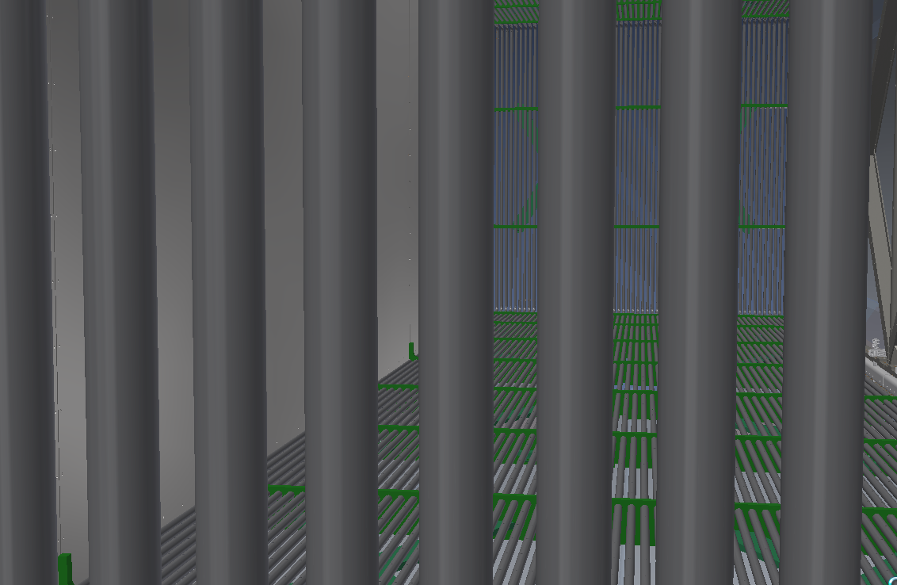
Application for large LAr TPC MicroBooNE
In large TPC, space charge effects occur, due to the 10 times lower drift of ions
Sending a laser on different positions will allow to correct these effects

Slide 10
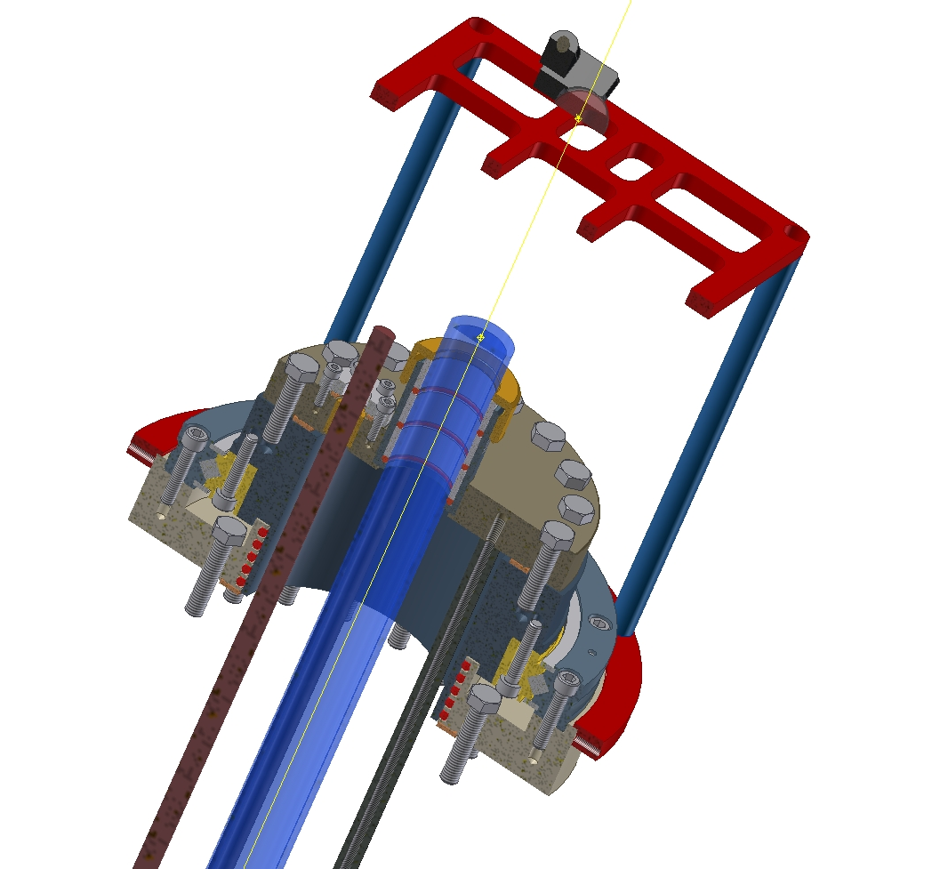
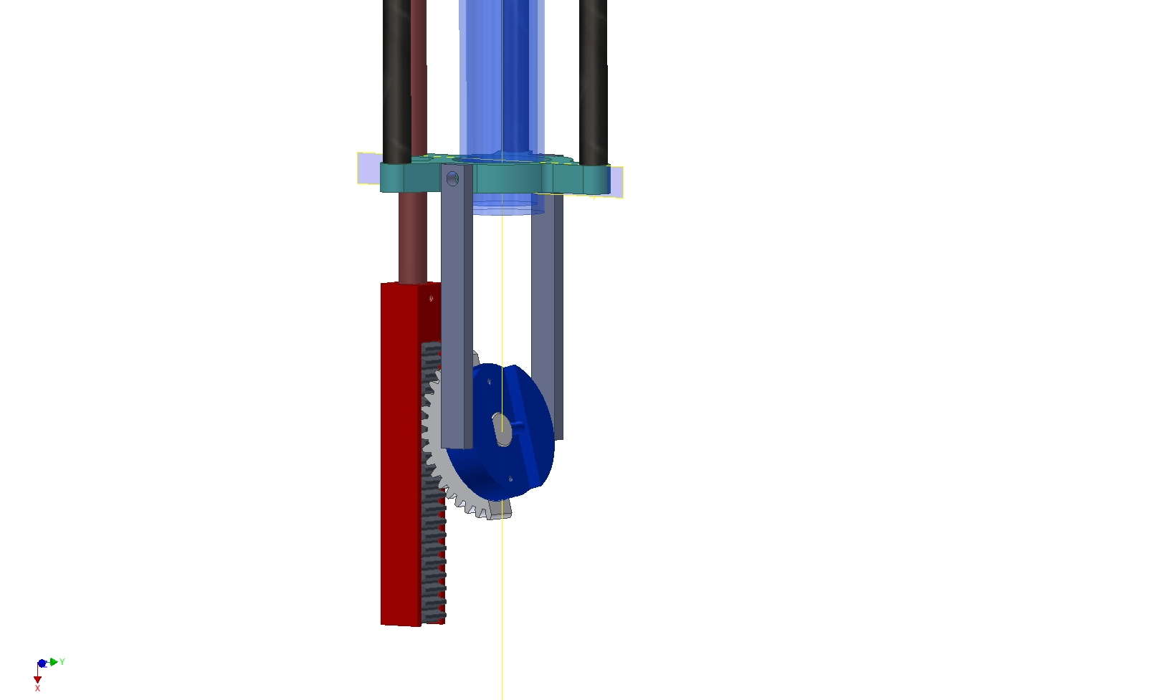
Prototype
We have a prototype of the system, to test and study its behaviour, before putting it in MicroBooNE
2 movements for steering the mirror head

Slide 11
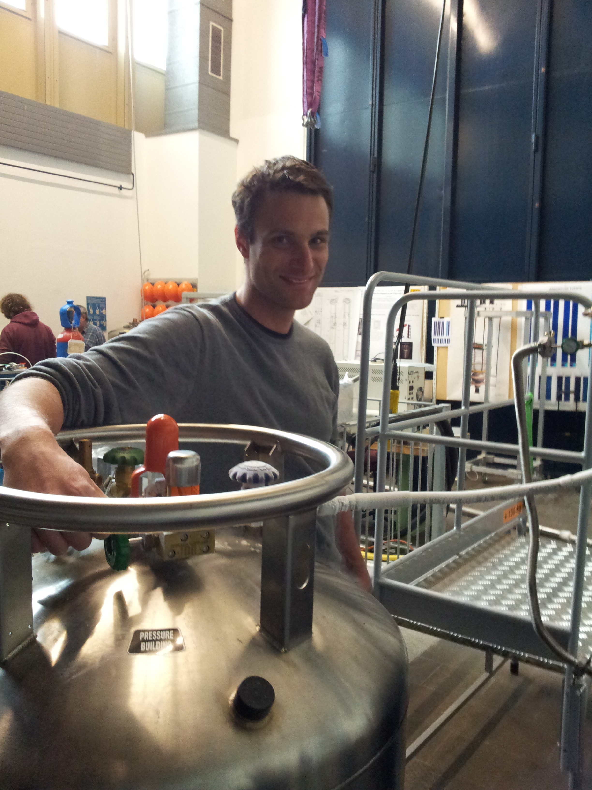
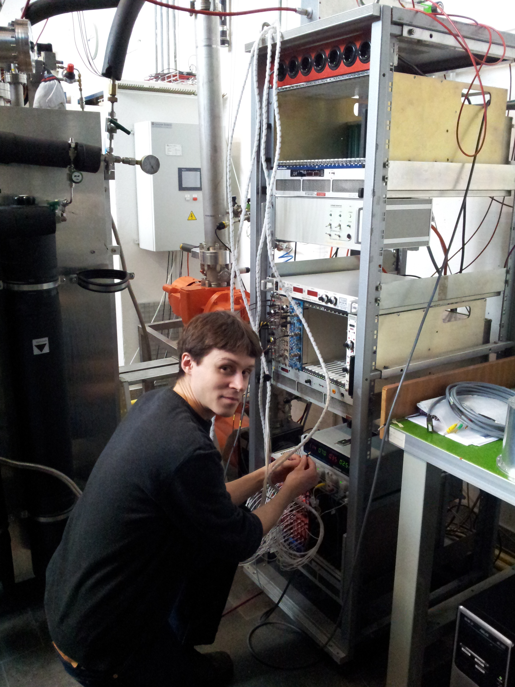
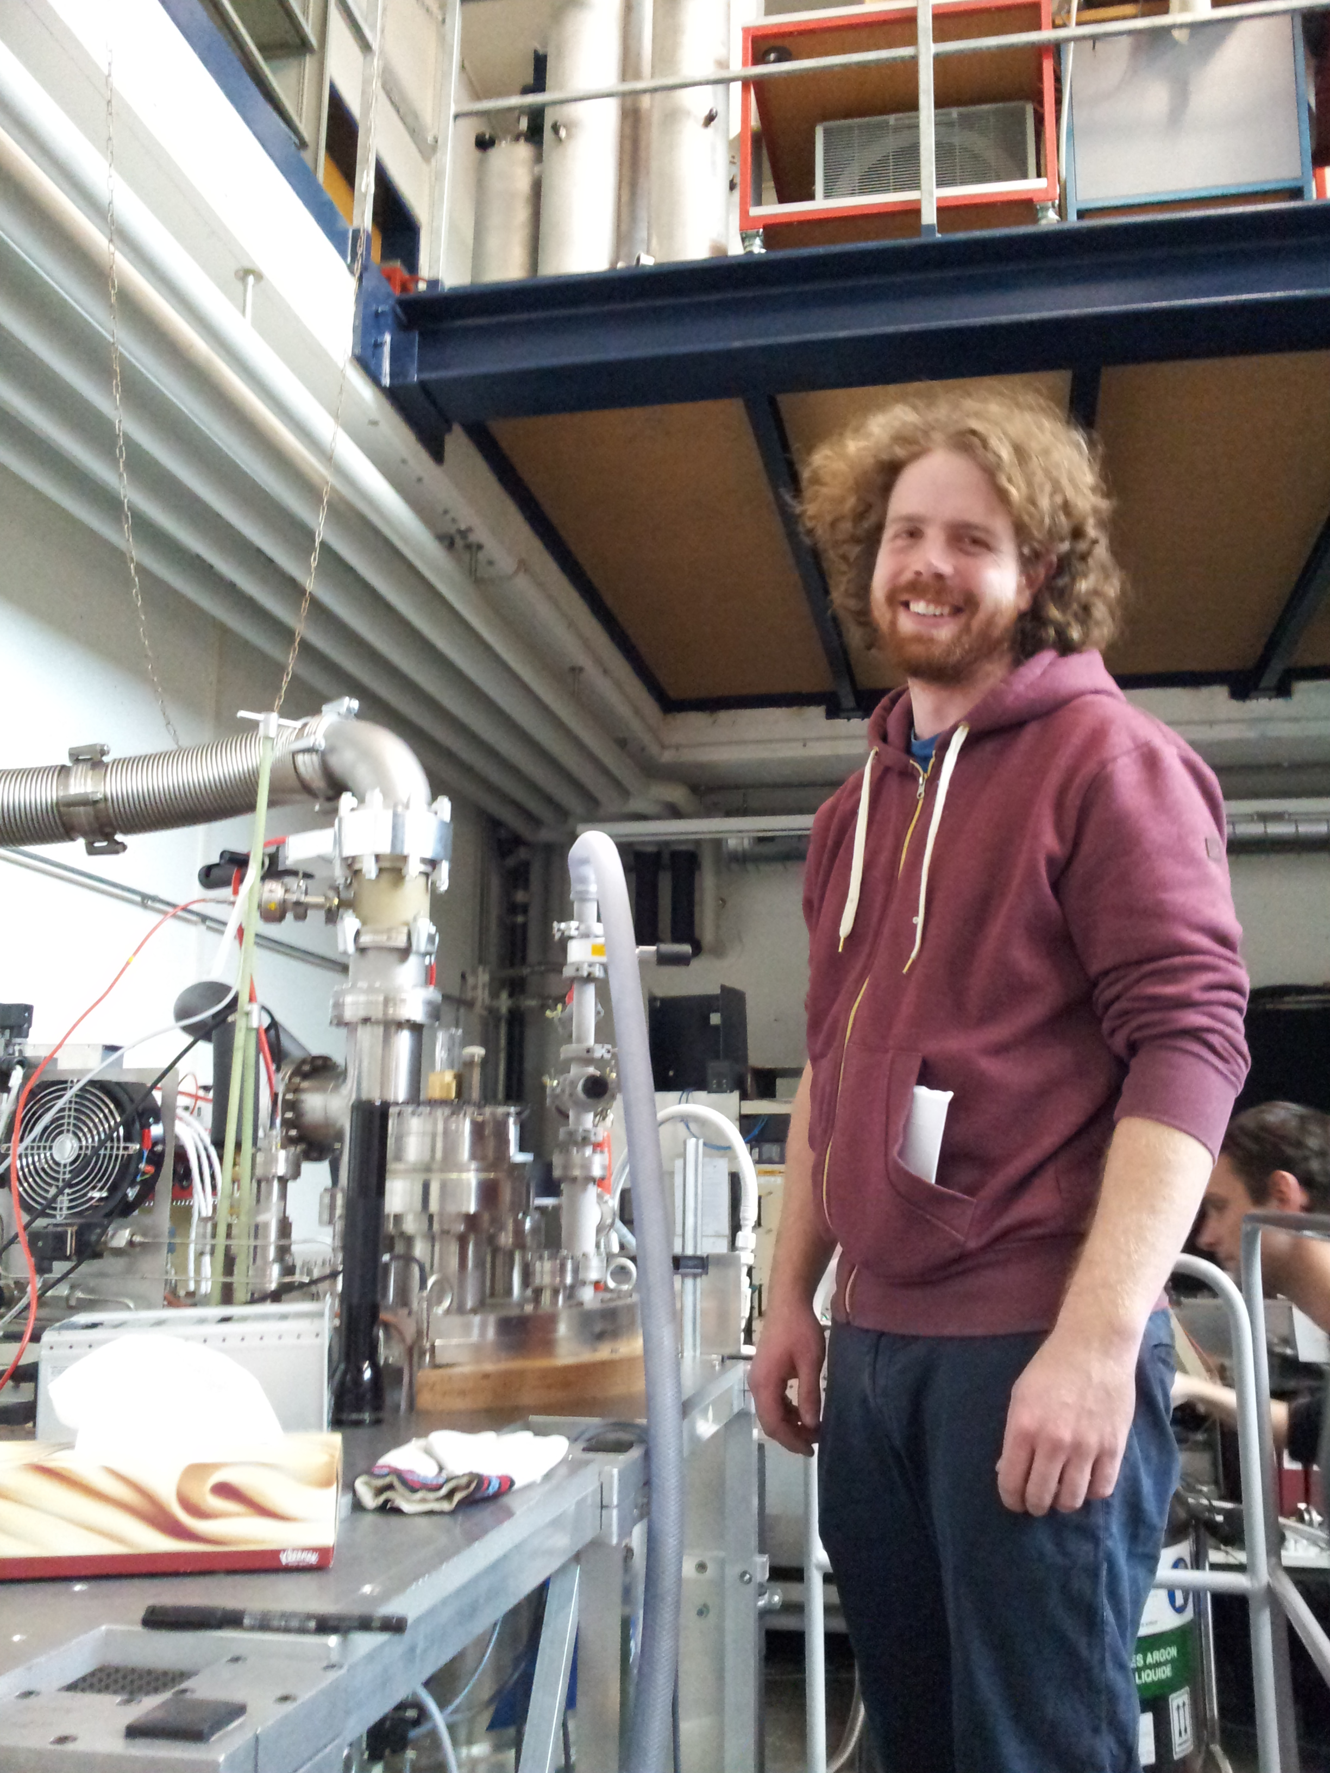
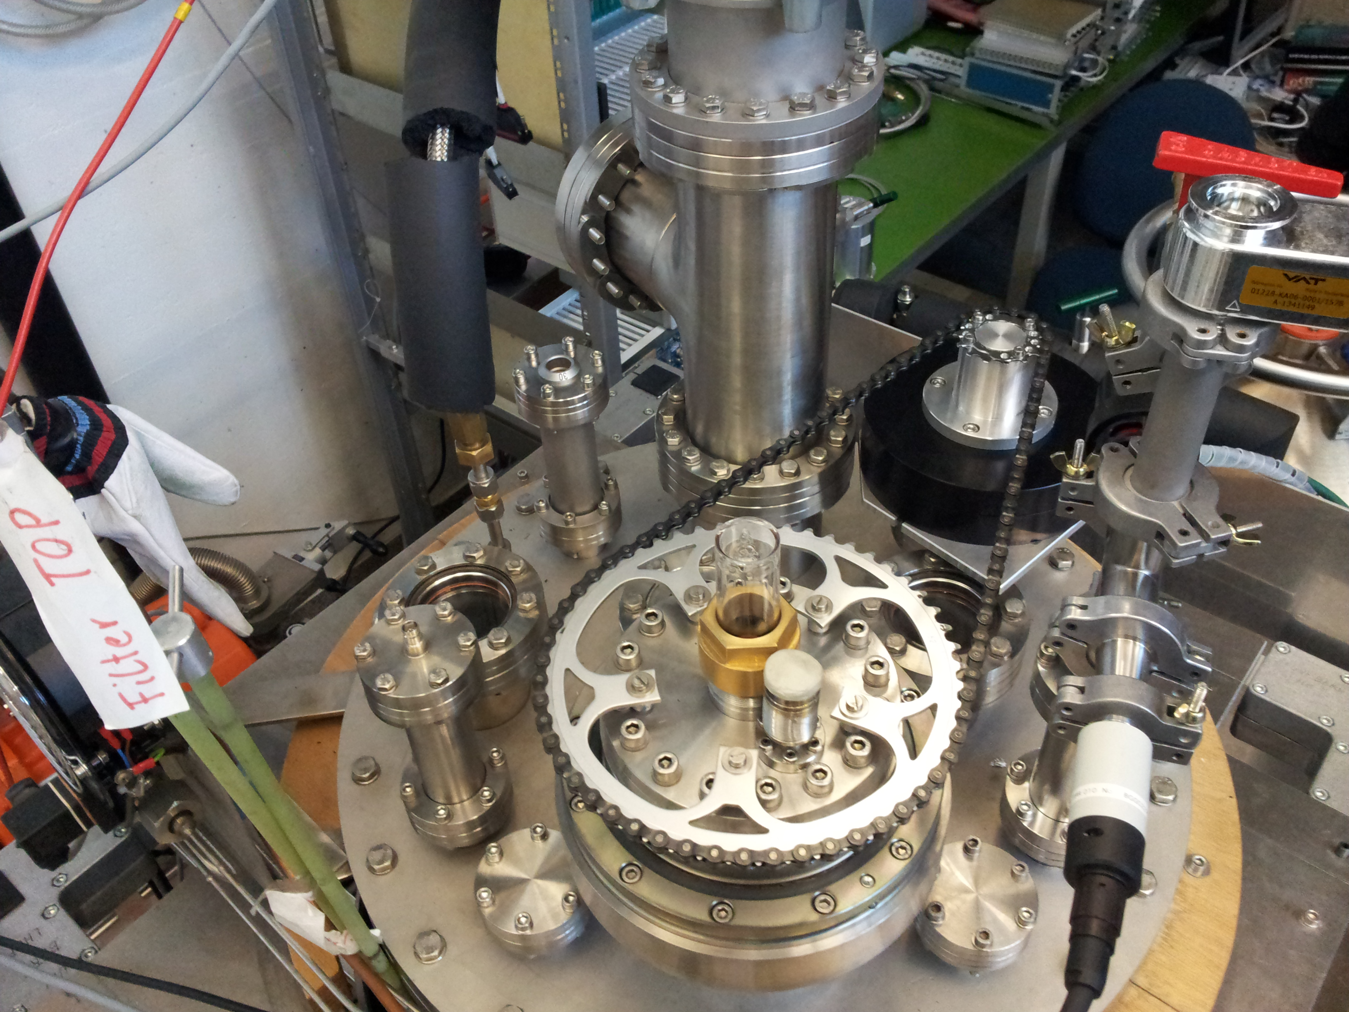
Medium Argontube cryostat
Steering Laser in a small Test TPC and collect tracks in different positions (master thesis M. Luethi)
first run pumping & cool down ✔
Leak test and vacuum tightness ✔
Readout of test TPC (CAEN firmware update needed) ✔
Run and take data

Slide 12
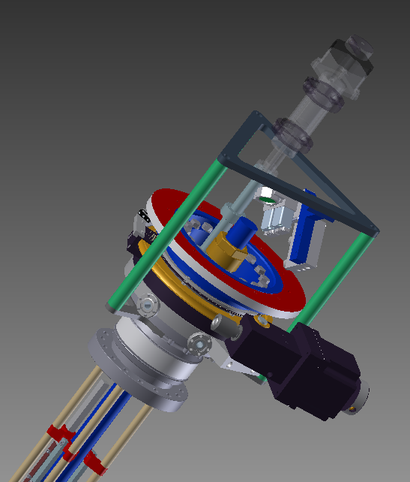
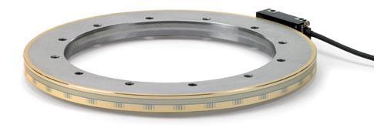
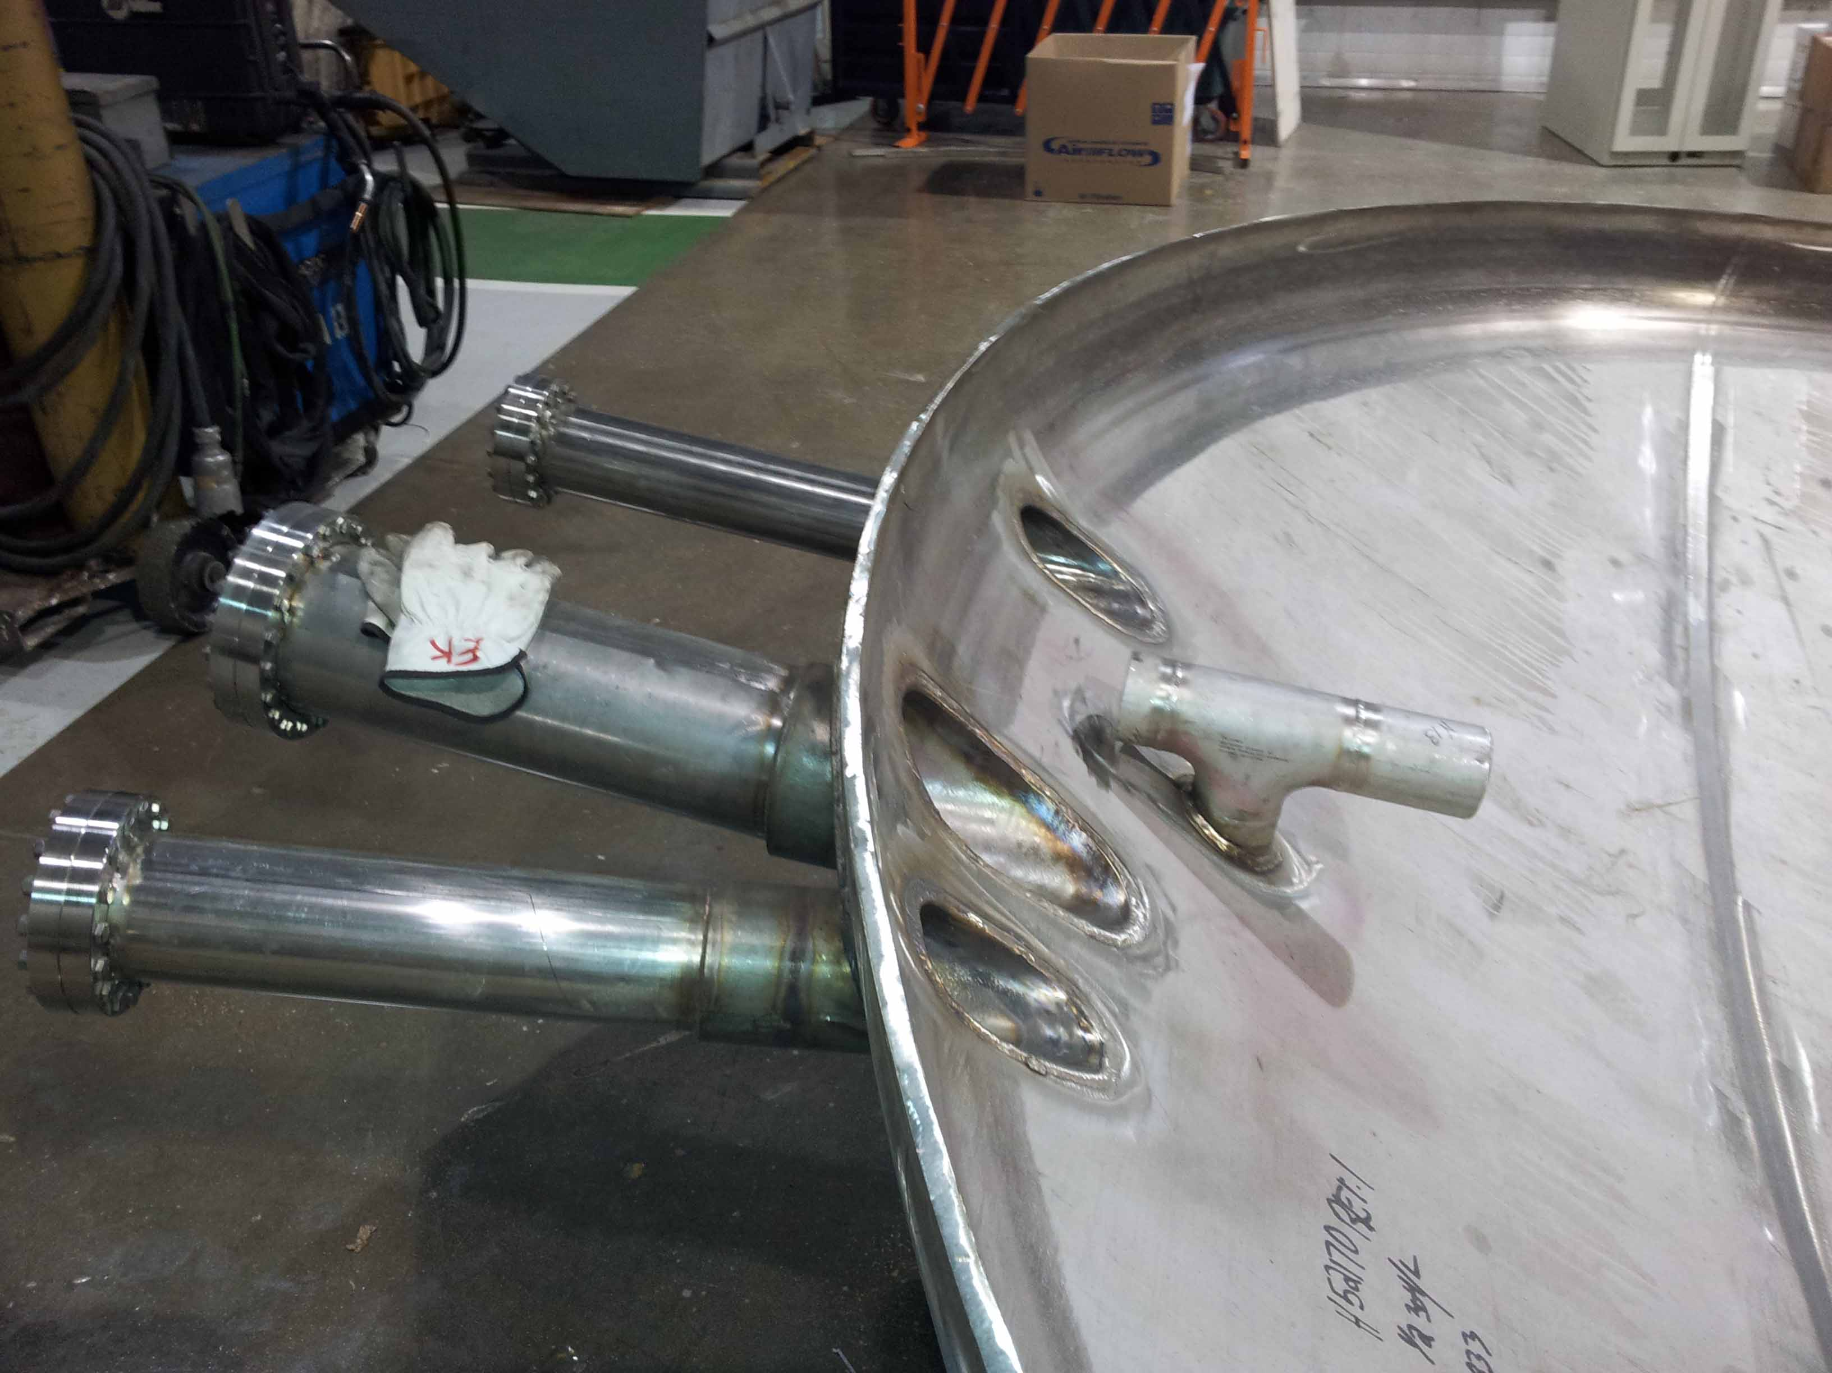
Flange design
Remote controlled system with easy slow control
Rotation:
Differentially pumped seal
Linear:
linear feed through
Both with limit switch and stepper motor

Slide 13
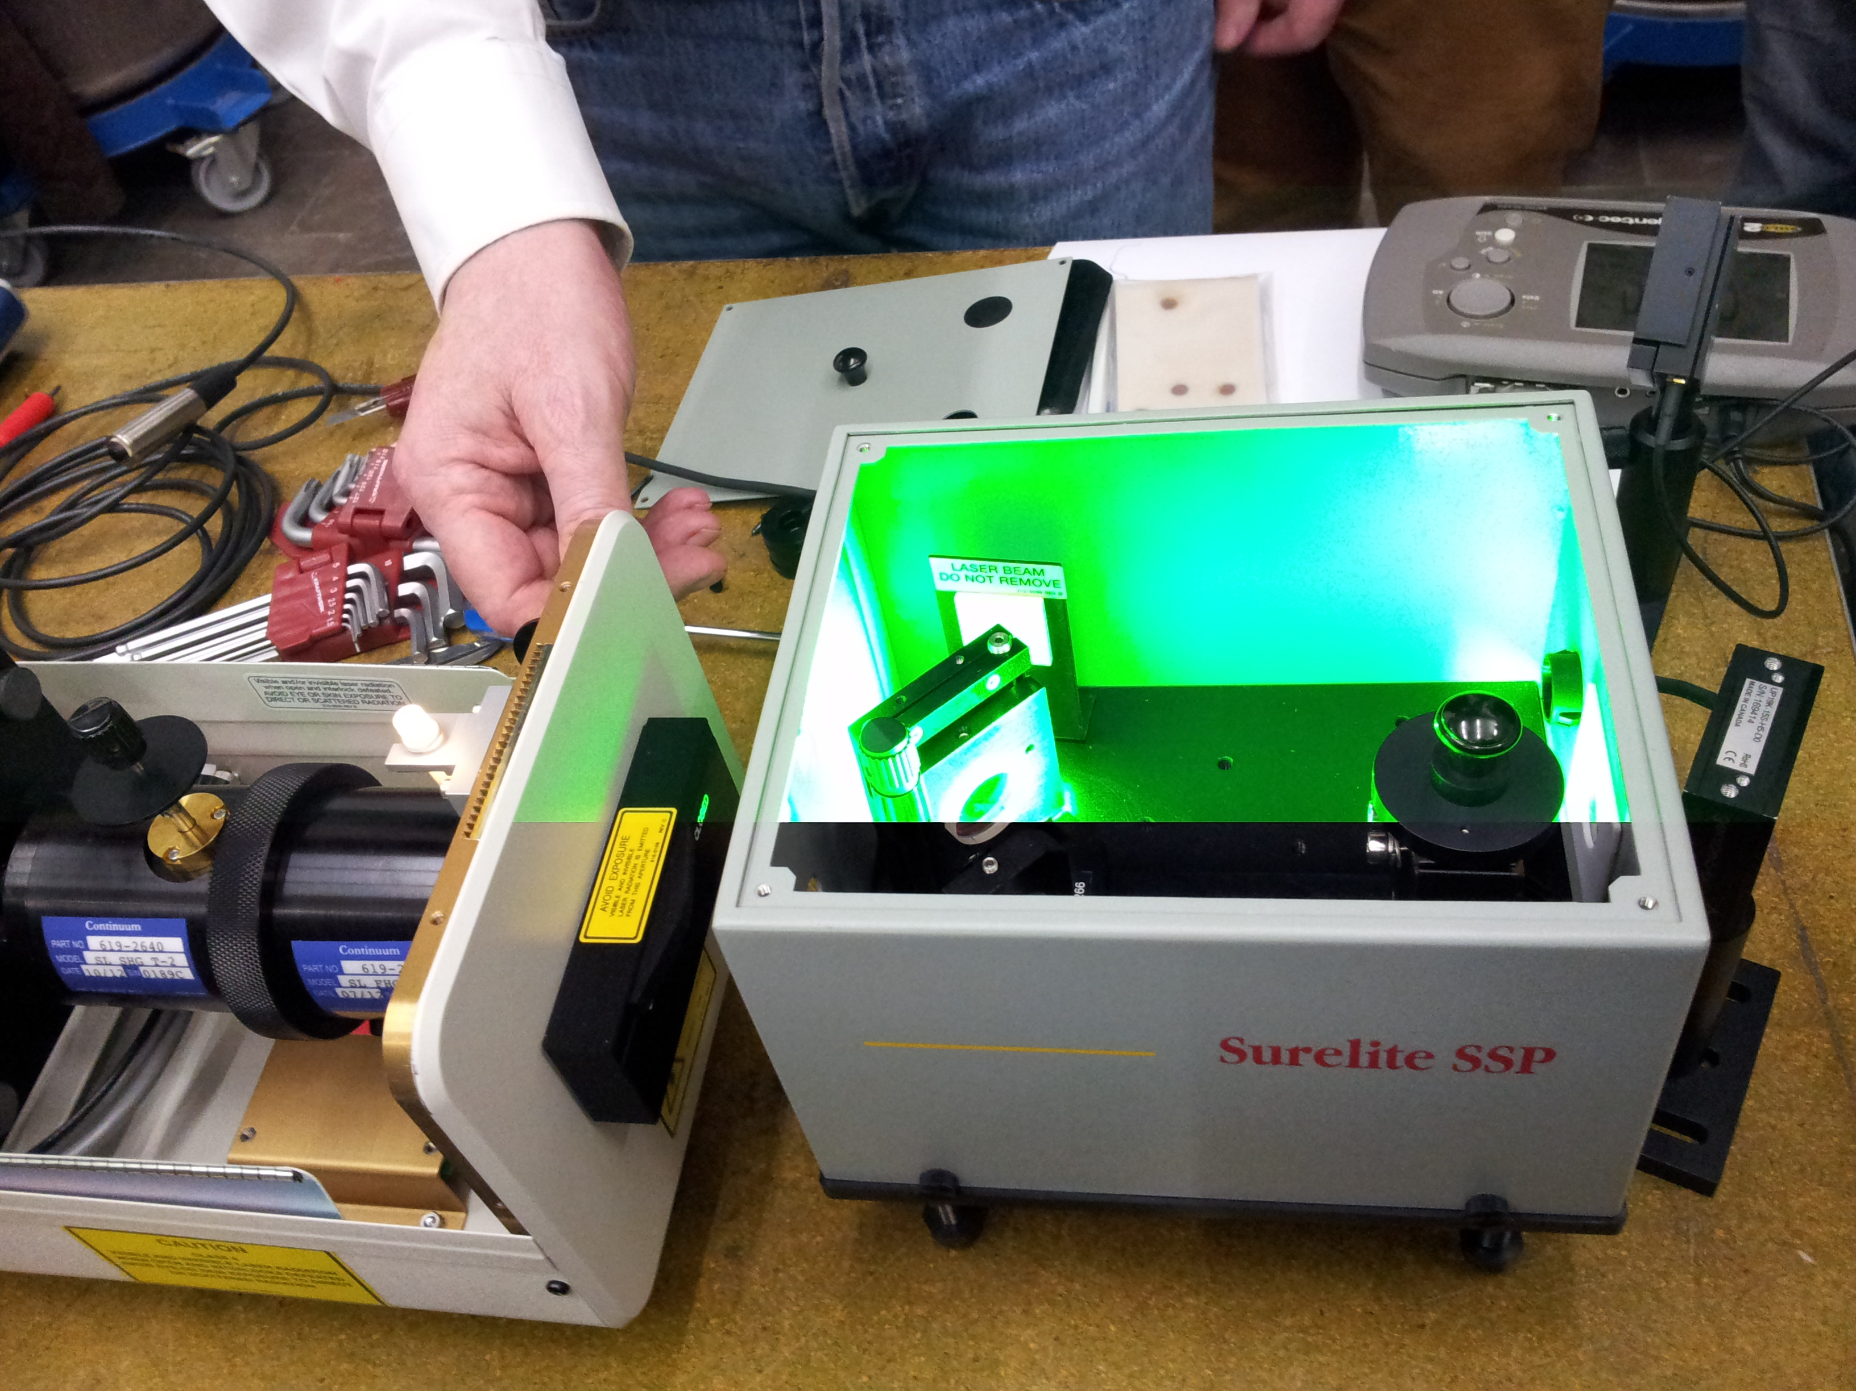
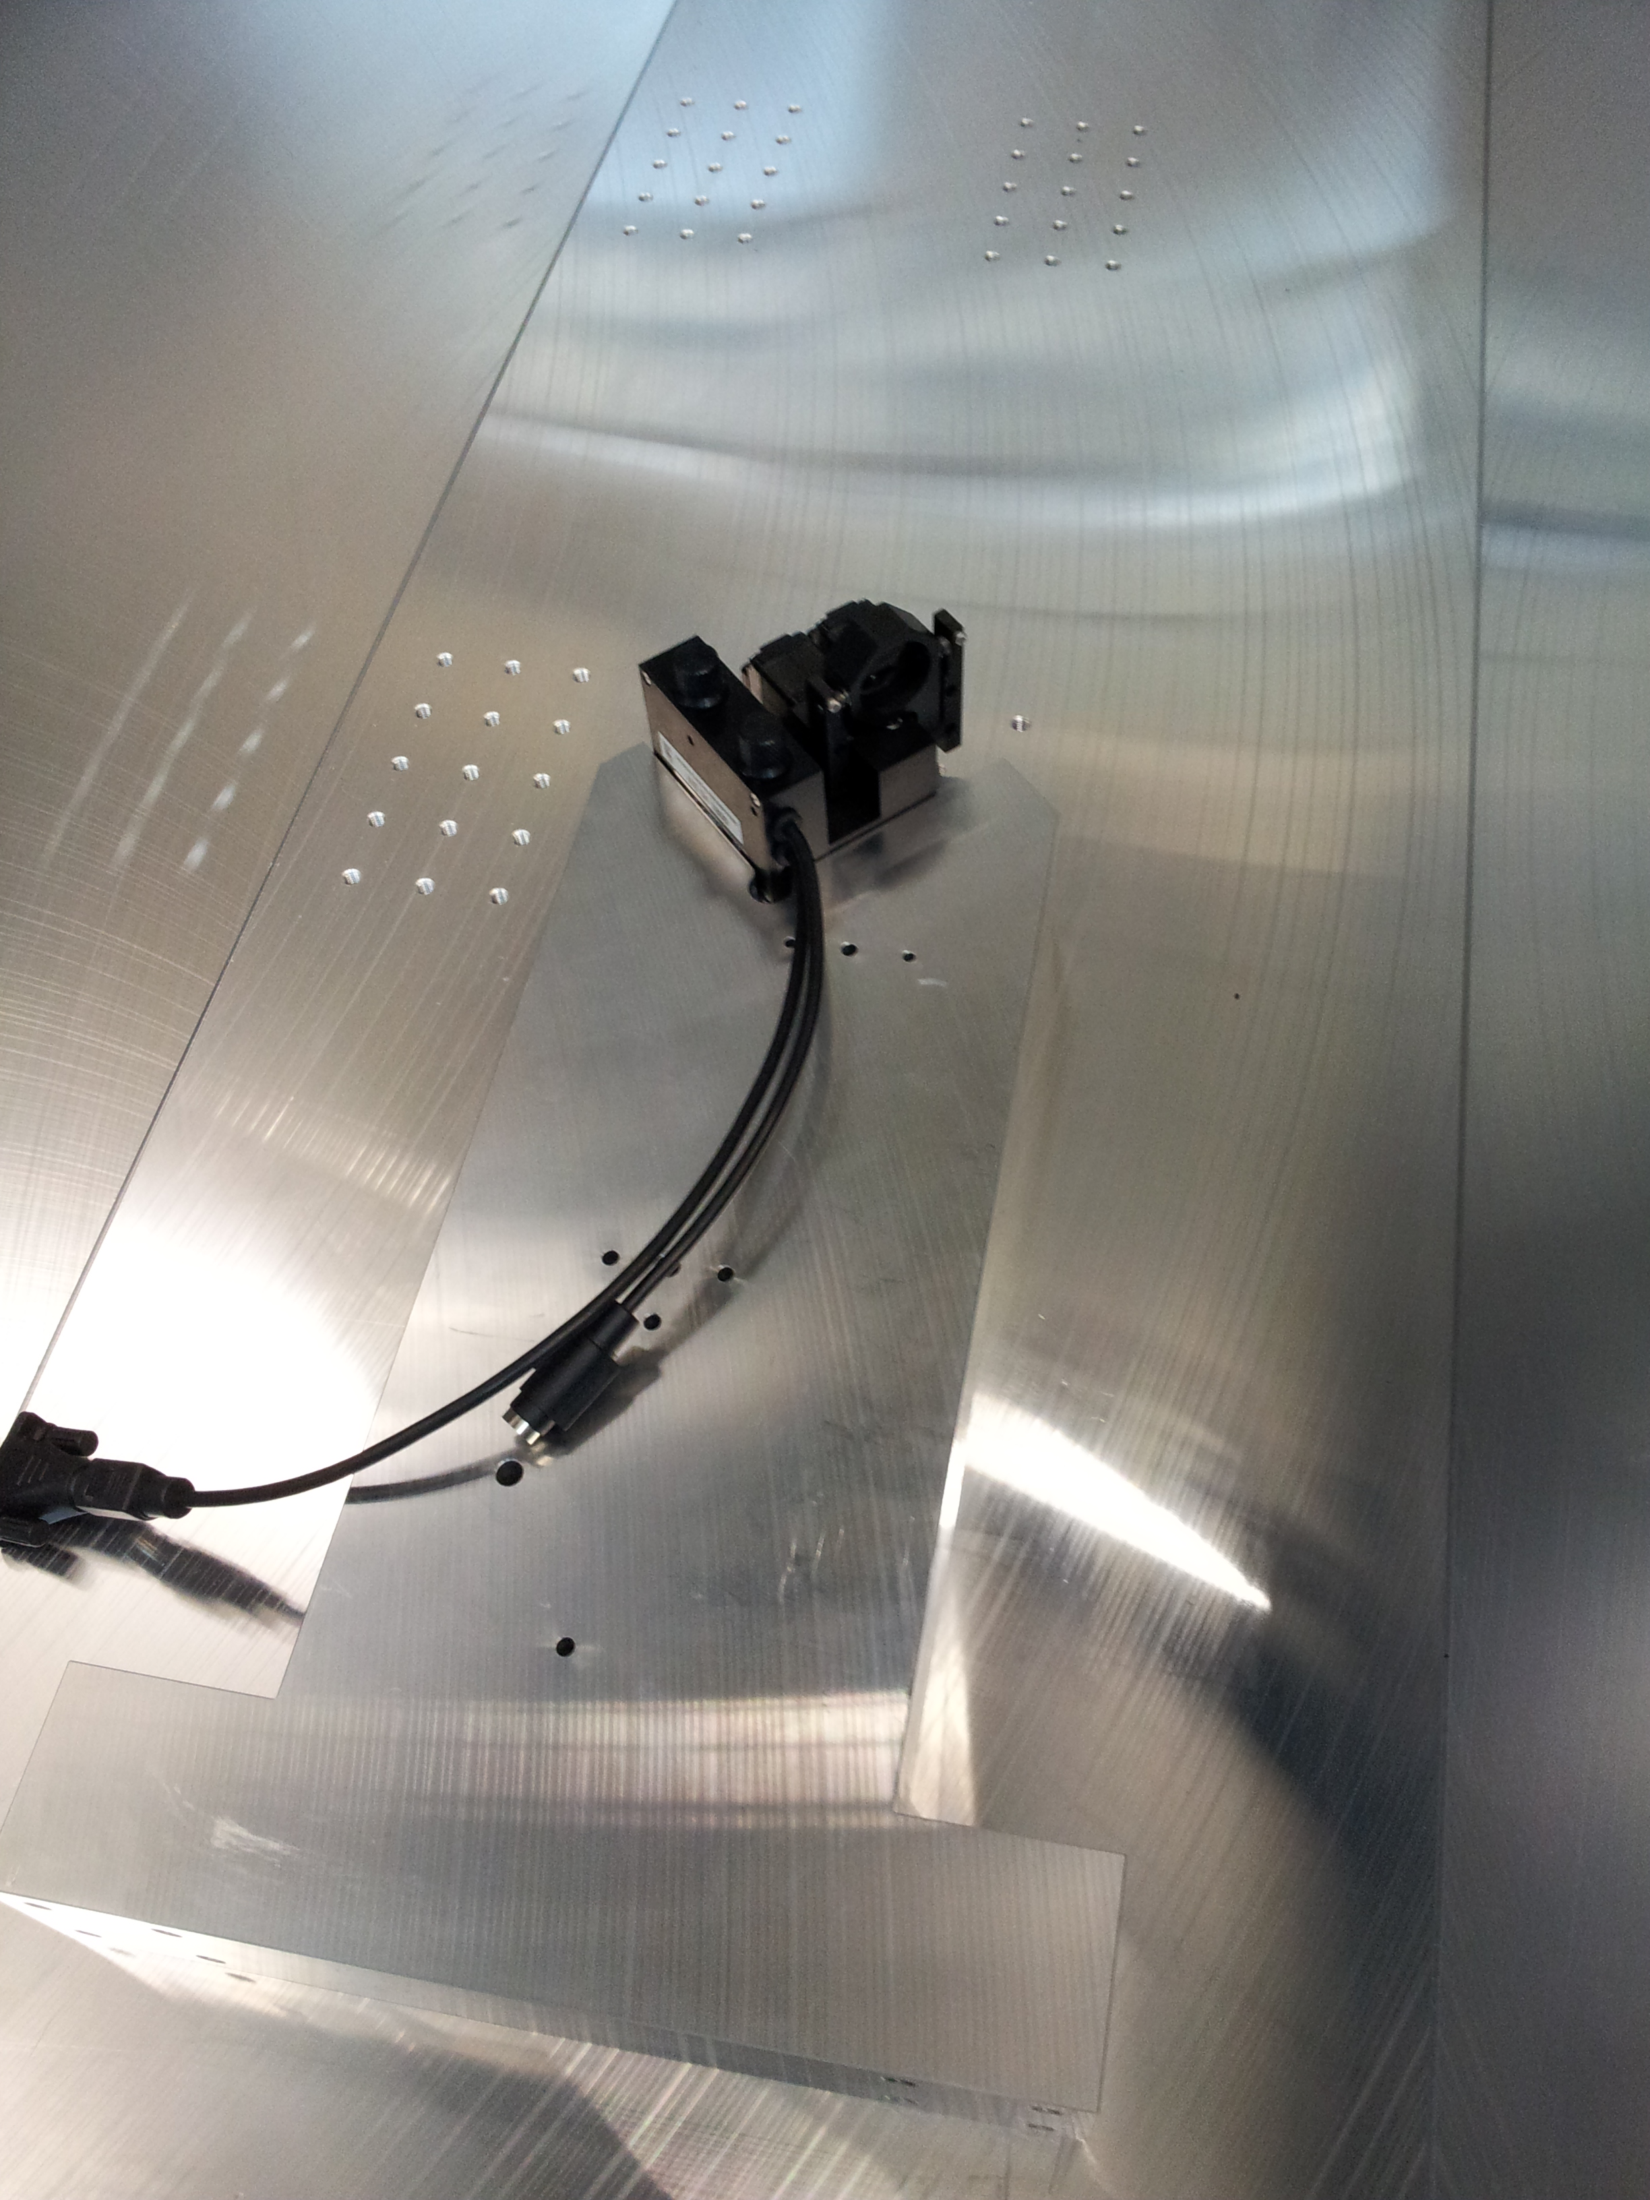
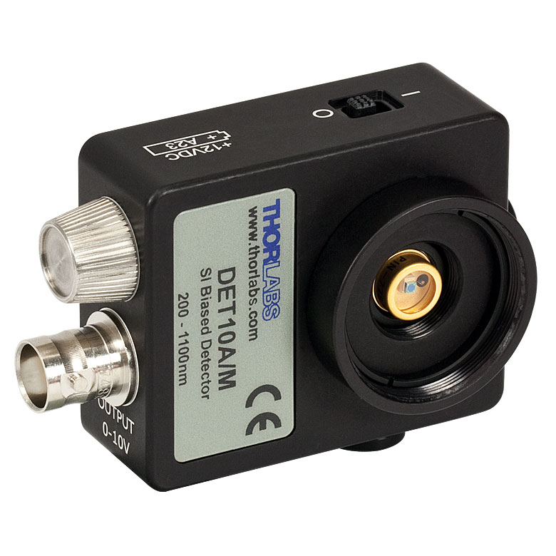
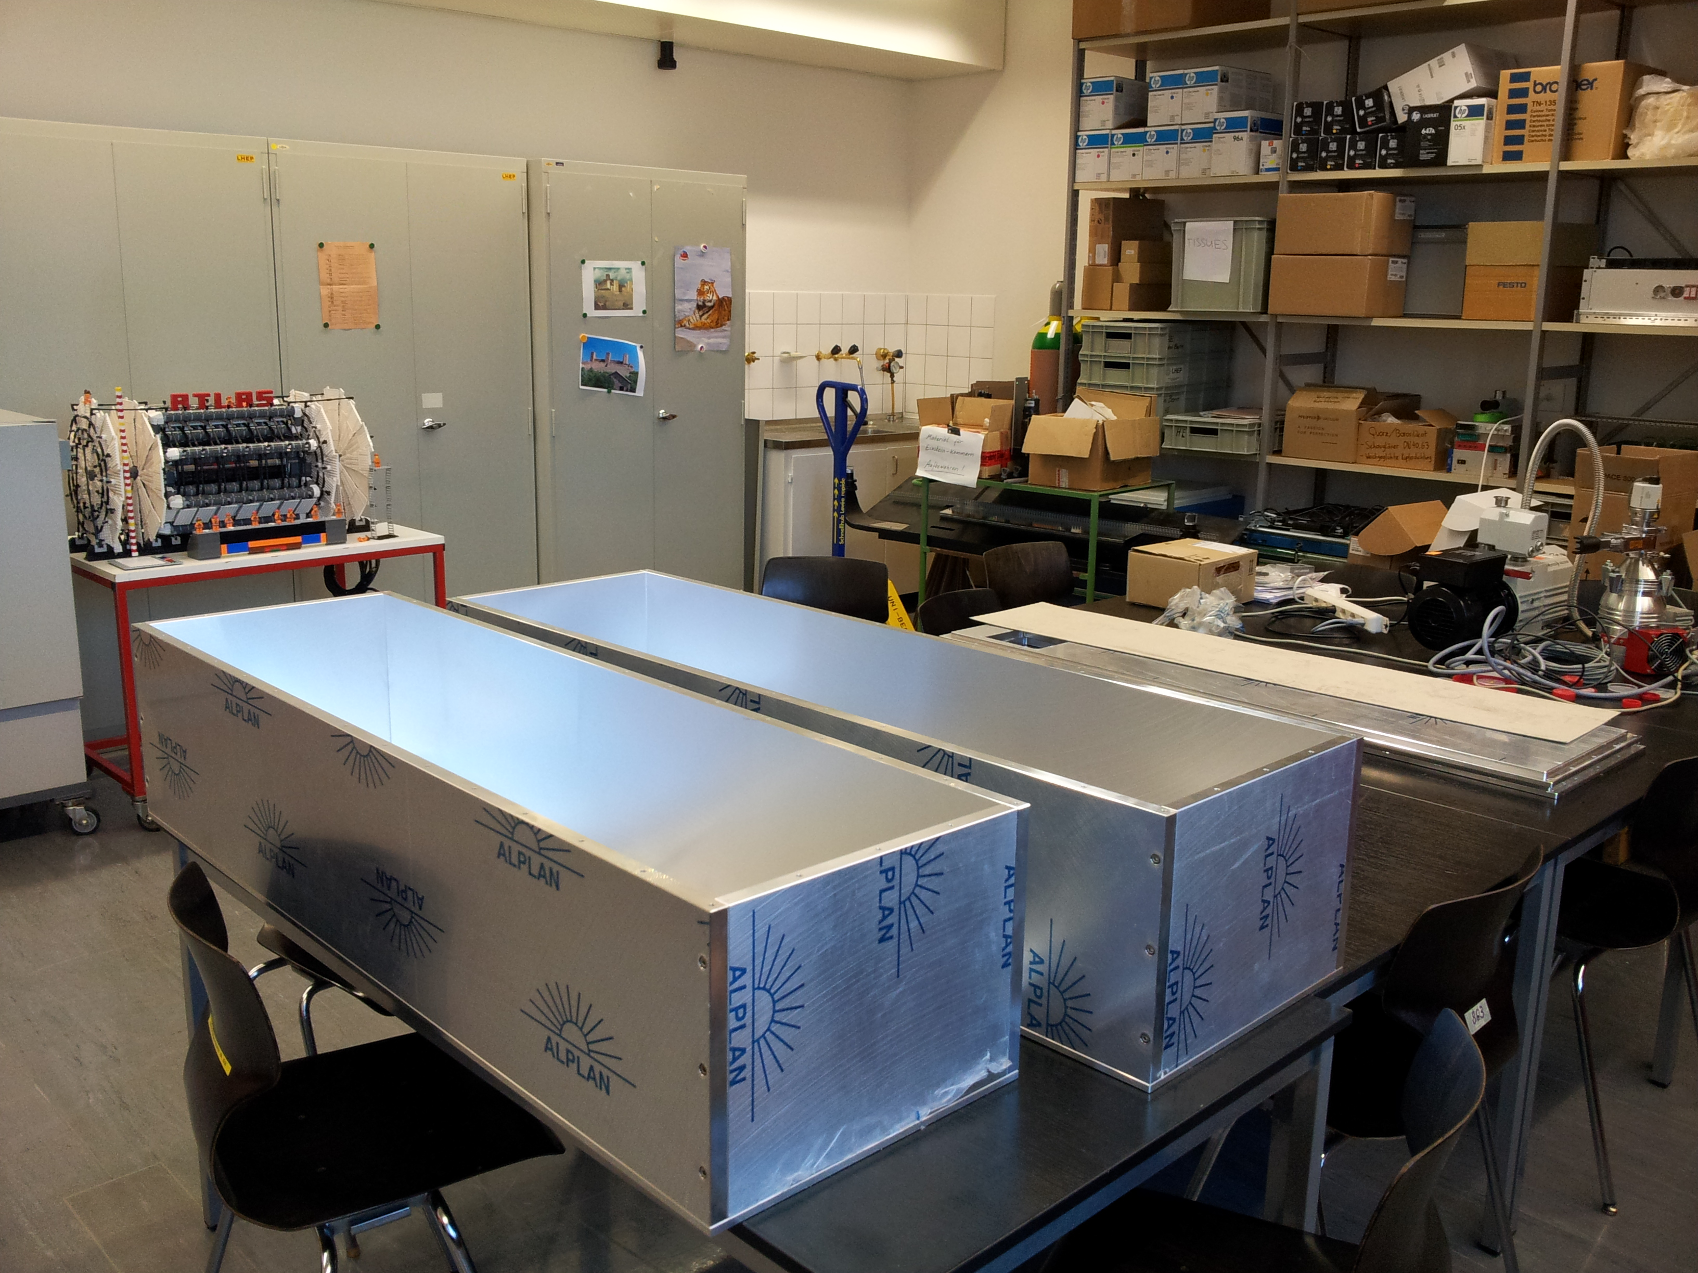
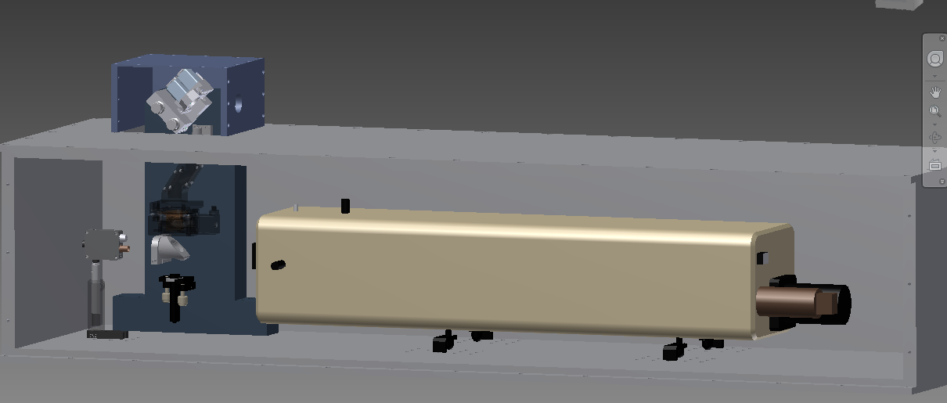
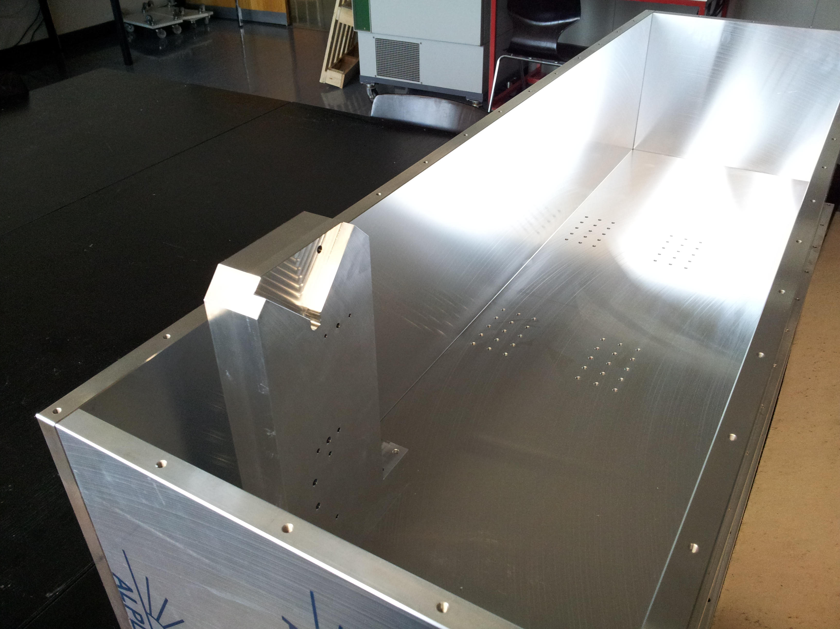
Laser box
Laser has to be in a box, due to UV radiation
Come for a visit at DAB

Slide 14
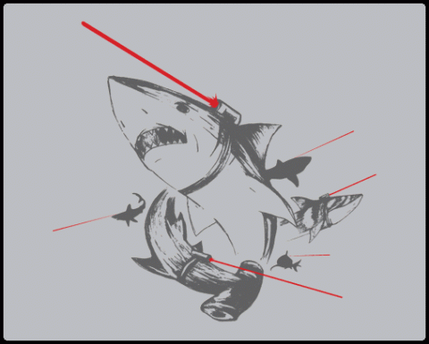
Conclusion
Reliable tool to measure the purity of LAr TPC
First application of using an UV laser to correct for electric field distortion in Bern
Design of a calibration system using a moveable UV laser path for MicroBooNE
Easy applicable for LBNE/LBNO

