Slide 1
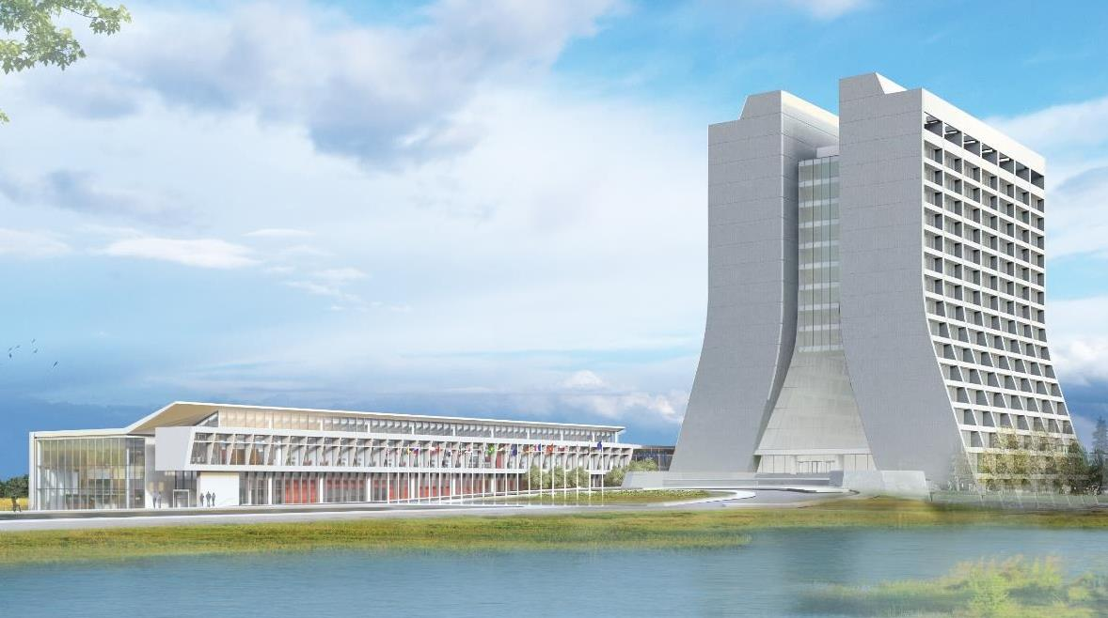
Infrastructure Services Division Updates
Pressing Issues / Special Topic: CMTF Breaker/Transformer Concern
Noteworthy Items: Slide #3 – Large Projects Update
Active Projects and Contractors Onsite: Slide #5 & #6
Mechanical and Utility Outages: Slide #4
Safety Success – An arc flash study was just completed to fill in some missing data, incomplete data, or non-existent data. This has been a year long study, piggy backing on the power outages of the lab to lower the disruptive impact. All to lower the exposure risk of electricians and technicians working on the equipment.

Slide 2
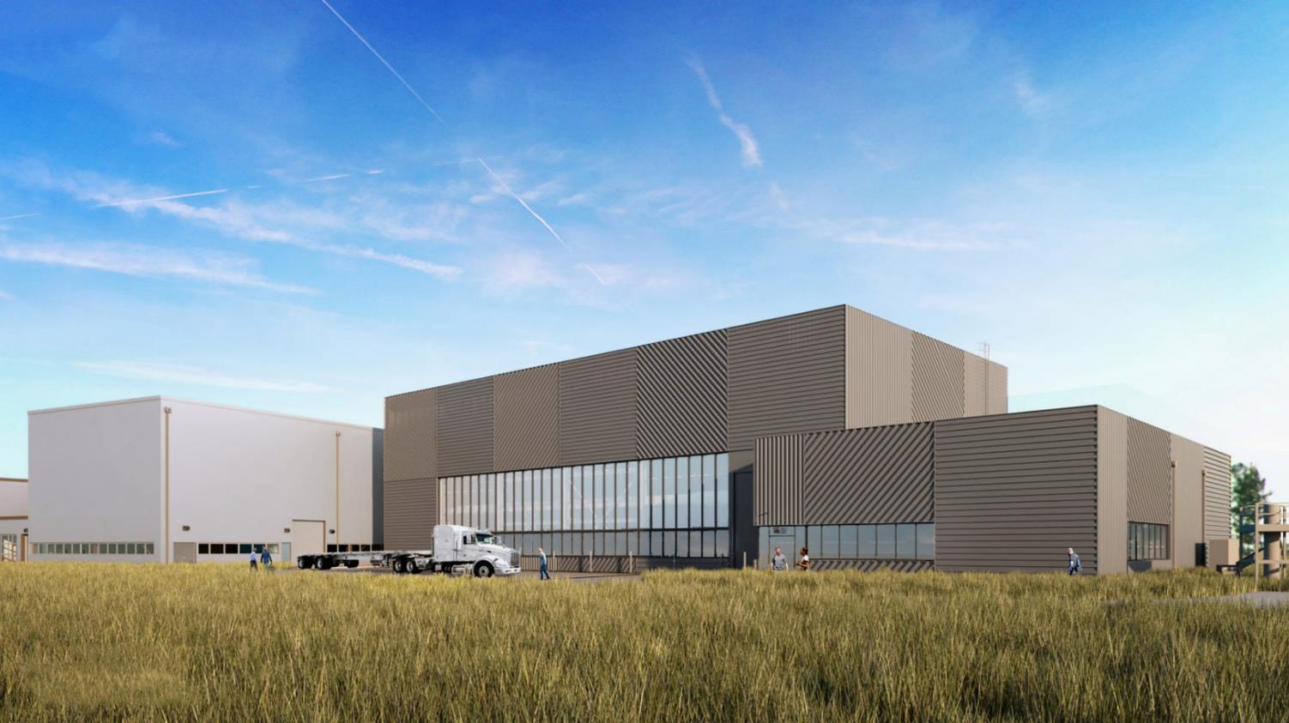
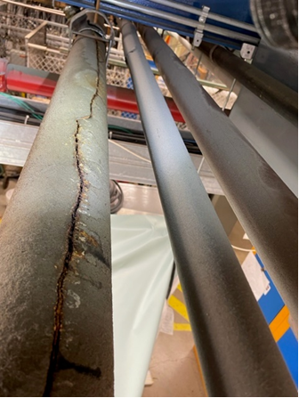
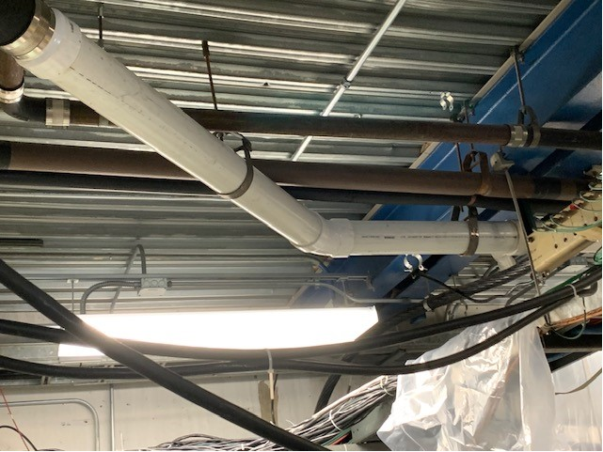
Special Topic:
Sanitary Line in Transfer Gallery – Has been completed and services that were affected have been restored. Additional work may continue upon approval as the we are not happy with some other areas of the piping.
Asbestos Abatement – Asbestos Abatement Contract has been signed so we will start to pursue more abatement projects and can move forward on existing abatement projects.
Arc Flash Study – A study to fill in the gaps in our Arc Flash exposures has been completed.

Slide 3
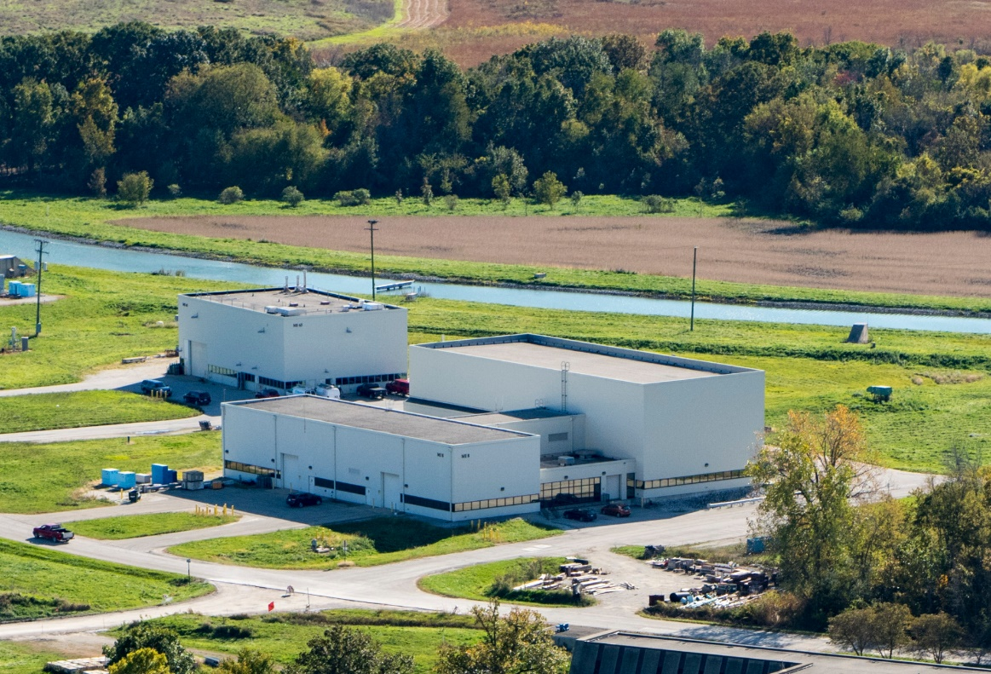
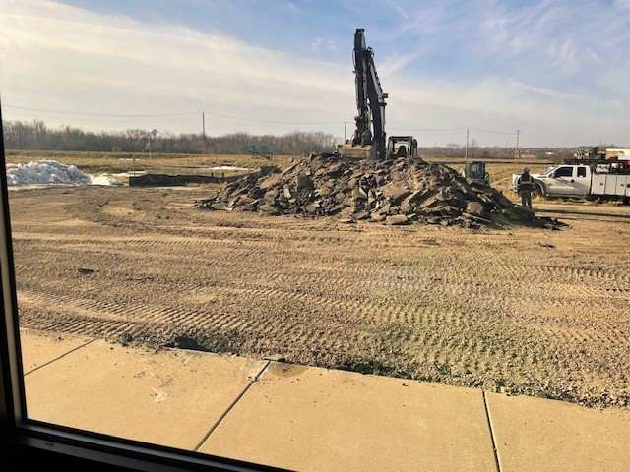
Noteworthy Items
SWA 2nd Refurbishing – Two baskets have been placed just outside near the workspace. A paper recycle bin (on wheels) will be placed downstairs for staff to fill and dump in the recycle dumpster outside. If that recycle dumpster gets full or any of the baskets get full, we will order a new one. ✅
TSIB – Form Work - Construction is shifting to form work and pot-holing (vacuum excavation) for services in front of MI-8, for today and maybe Monday there will be a single lane in front of MI-8. Following next couple of weeks will be many deliveries of material and conducting concrete pours. 😁 Steel erection in April is expected.
Generator Work – generator repairs happened at NML, the beeping has stopped. The CMTF generator is being worked on as there has been a breaker failure. Repairs are underway. Thank you ISD and Paul Neville for the fast responses. ⚠
Power Outage - Wilson Hall and IERC power outage reminder on April 19th – being confirmed.

Slide 4
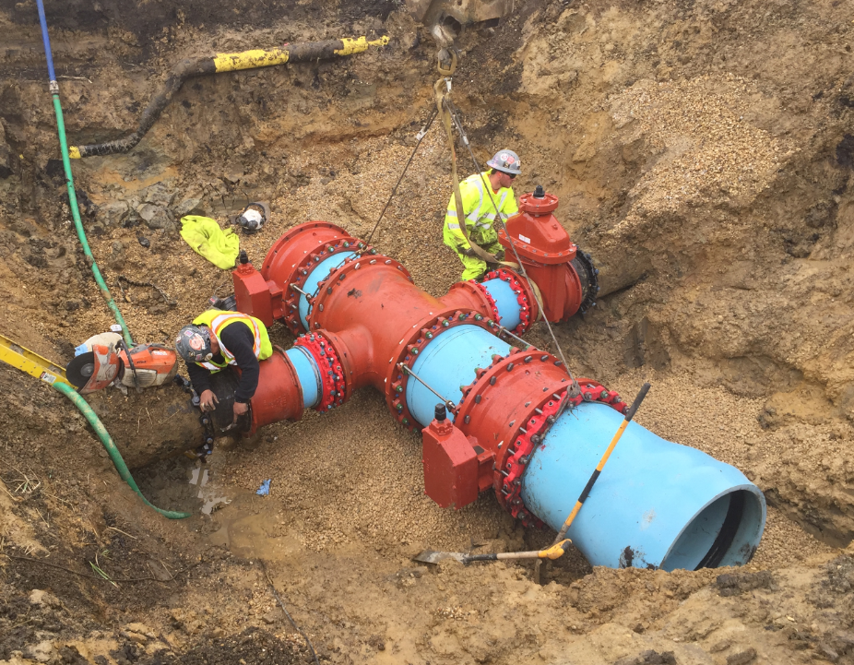
Mechanical and Utility Outages
Planned Power Outages
Current Outage Schedule is populated.
Shutdowns are scheduled to begin in May.

Slide 5
Active Projects still in motion and Contractors on Site
AD Projects:
Door EOL Replacements – Requisition for 13 doors on the eol list is in progress. Plus 4 others on a fast track working with Scott on locations like SWA, ME7, & AP0, MT Worm. No Change
Office Refurbishing – We have some movement on BTE/W carpet replacements. We are getting the finances worked out currently. No change
Exterior Ladder EOL replacements – Currently 24 ladders are targeted. SOW is being developed.
Card Reader Installation – Transfer Gallery is next on the list. Awaiting Contractor scheduling. Completed ✅
Roof Repairs in progress: MS6, MI-8, TG, MS4, and SWA. – Roofing Repair company (M. Cannon) is working through the list of roof repairs. The Scheduler/Planners are working with different groups now.
New Roofs – HAB is coming along, Minos/Village Gym/Fuel Station are next up and just waiting on different phases of the projects to firm up dates.
Prairie Burns – Prairie burns have started again. There were 2 this past week.

Slide 6
Active Projects still in motion and Contractors on Site
AD Projects:
Potential next Projects – APOTH Door & Frame Replacement (waiting on quote), A0 cleanroom sanitary line replacement (performed walkdown and waiting on quote), MI Building Concrete Coatings, C0 Service Building (in beginning phase). – No Change
Metal Roof Coatings – SOW of work is being developed; project will have to go out to bid due to size. – No Change
Lighting Work/Upgrades – A-0 is almost done except for a change order. NML high bay lights start today & CMTF have been halted due to other lab priorities.
Foundation Leaks – MT6/MC2/Wilson Hall – SOW is in progress.
Anchor Inspections – Contractor, Premier, has been brought on board as an inspection service through Safety. This work is in the beginning stages of getting the HA’s written up and all points located.

Slide 7
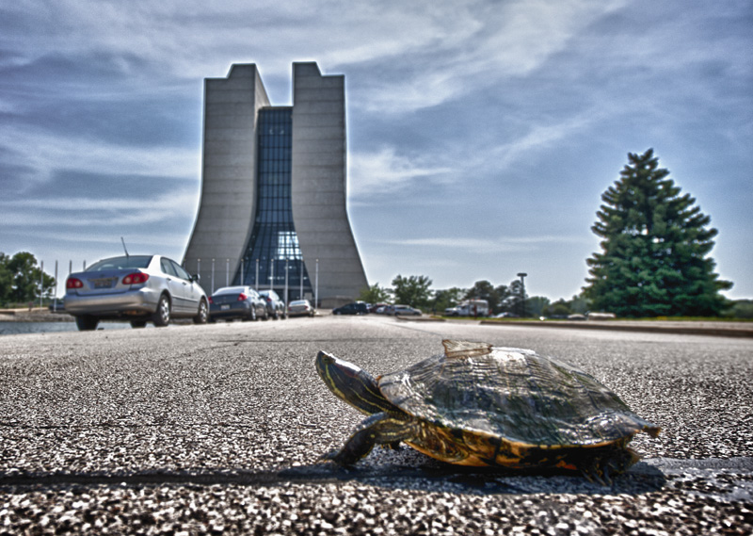
Road Closures
Closures from Fermilab today or R&G site
Lab closures
Closures close to WH

