Slide 1
Mu2e report
Tom Diehl (FNAL), Greg Rakness (FNAL)
Friday 9am AD meeting
22-Mar-2024
https://indico.fnal.gov/event/63953/

Slide 2
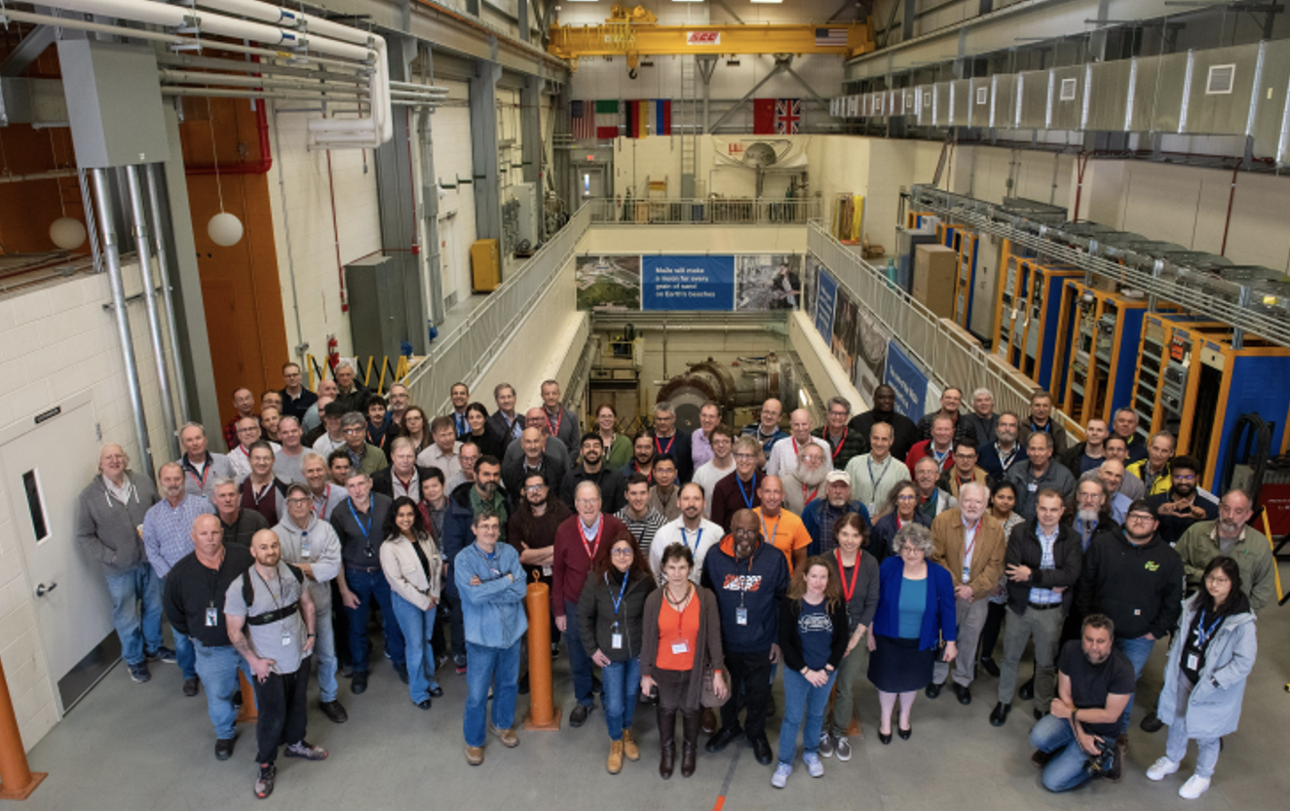
Transport Solenoid Celebration
– Friday 15-March 1:00-2:30pm
Many smiling faces in the Mu2e high bay

Slide 3
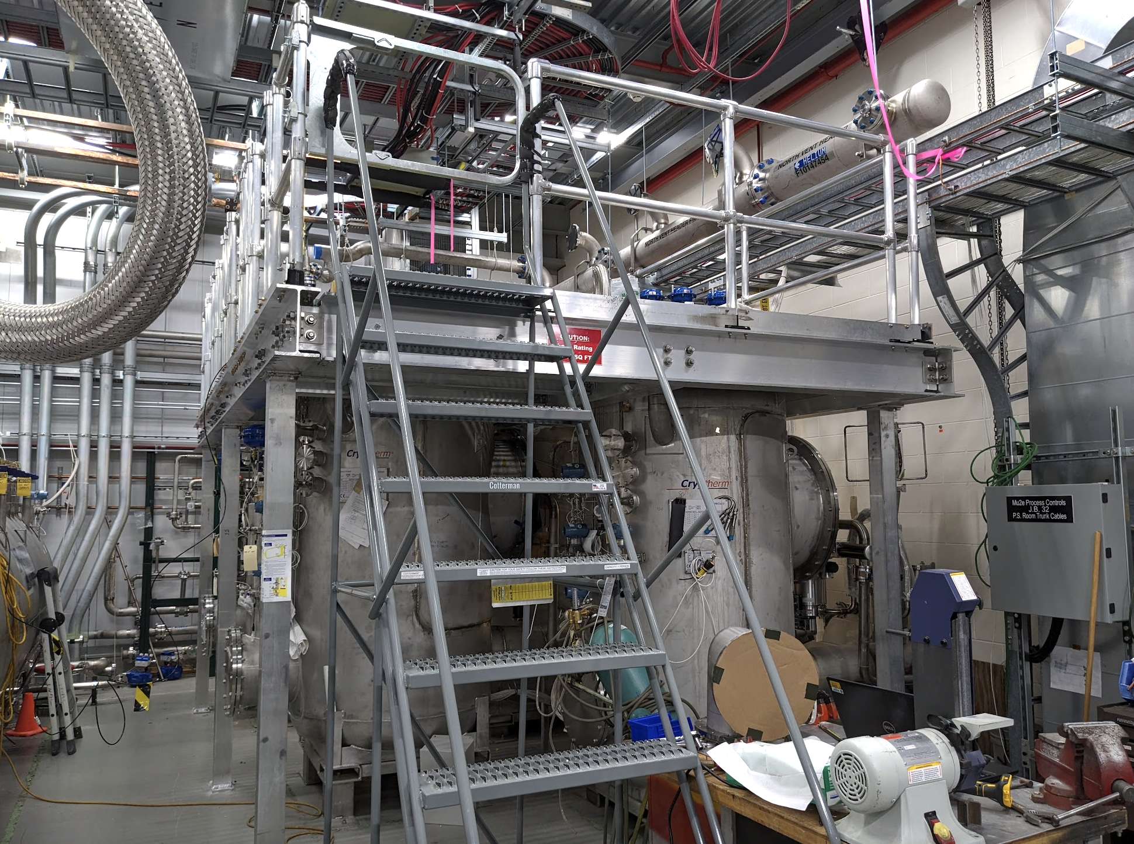
Completed platform construction in Power Supply Room
platform
Provides access on top of the feedboxes that bring power and cryogens to the 4 Mu2e solenoids

Slide 4
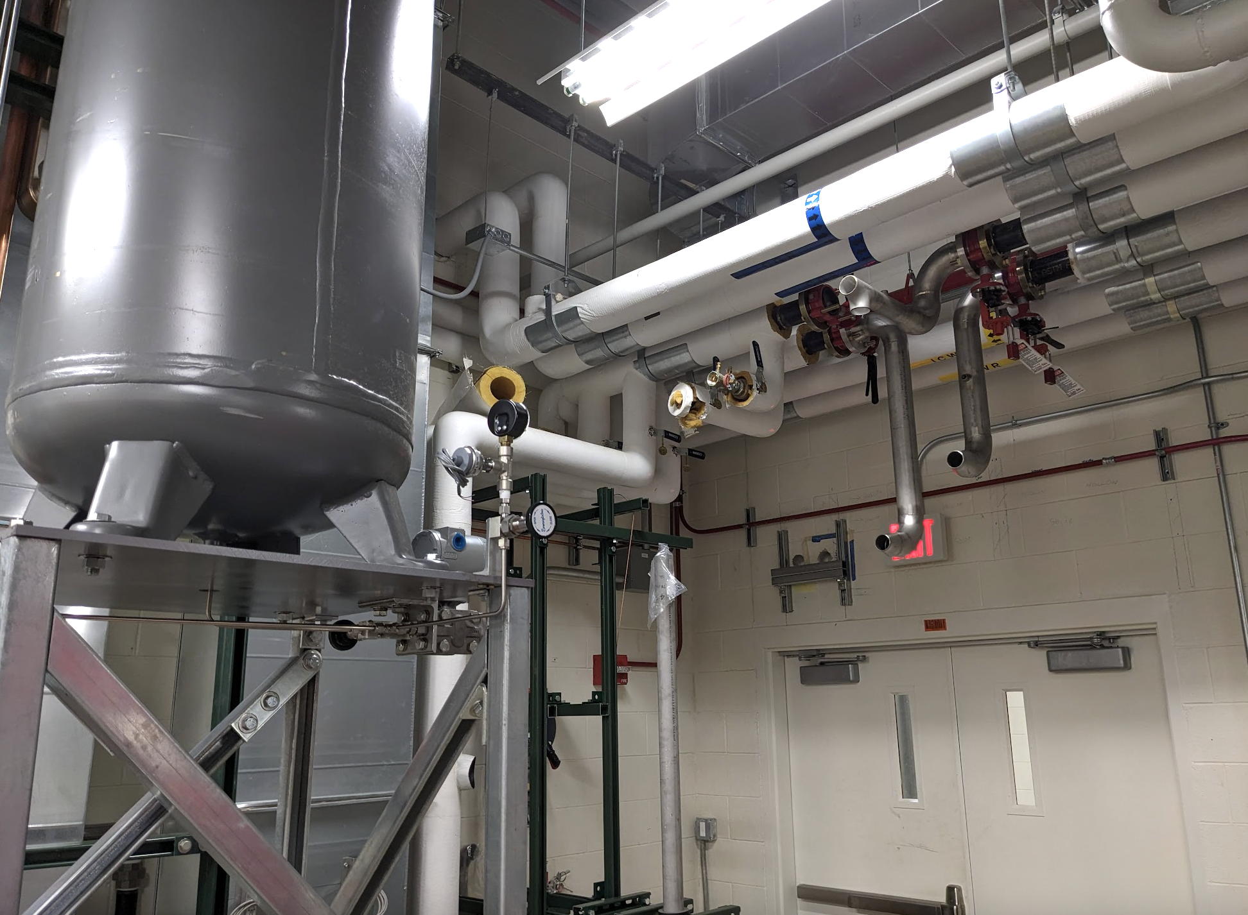
Completed cut into CUB lines
CUB supply and return
Chiller for Mu2e Tracker
Provides water to Equipment Cooling System for detector chillers as well as cryo and muon beamline vacuum pumps

Slide 5
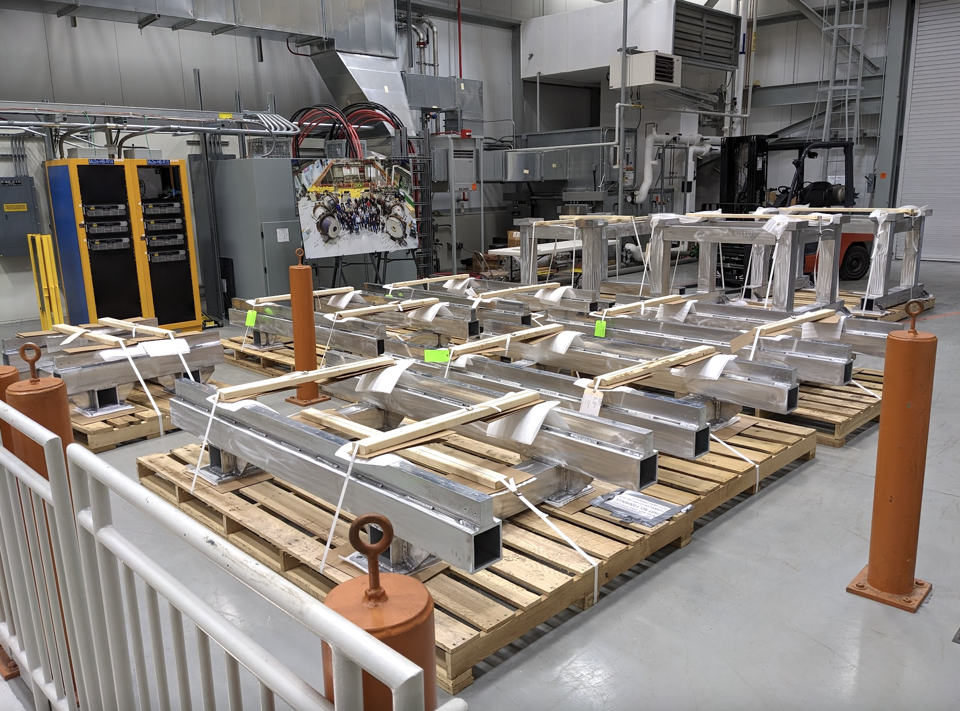
External stands arrived in Mu2e high bay
Stands on which sit the “Detector Train” (stopping target, Outer Proton Absorber, Muon Beam Stop, Tracker, when Calorimeter) when the train is extracted from Detector Solenoid for servicing

Slide 6
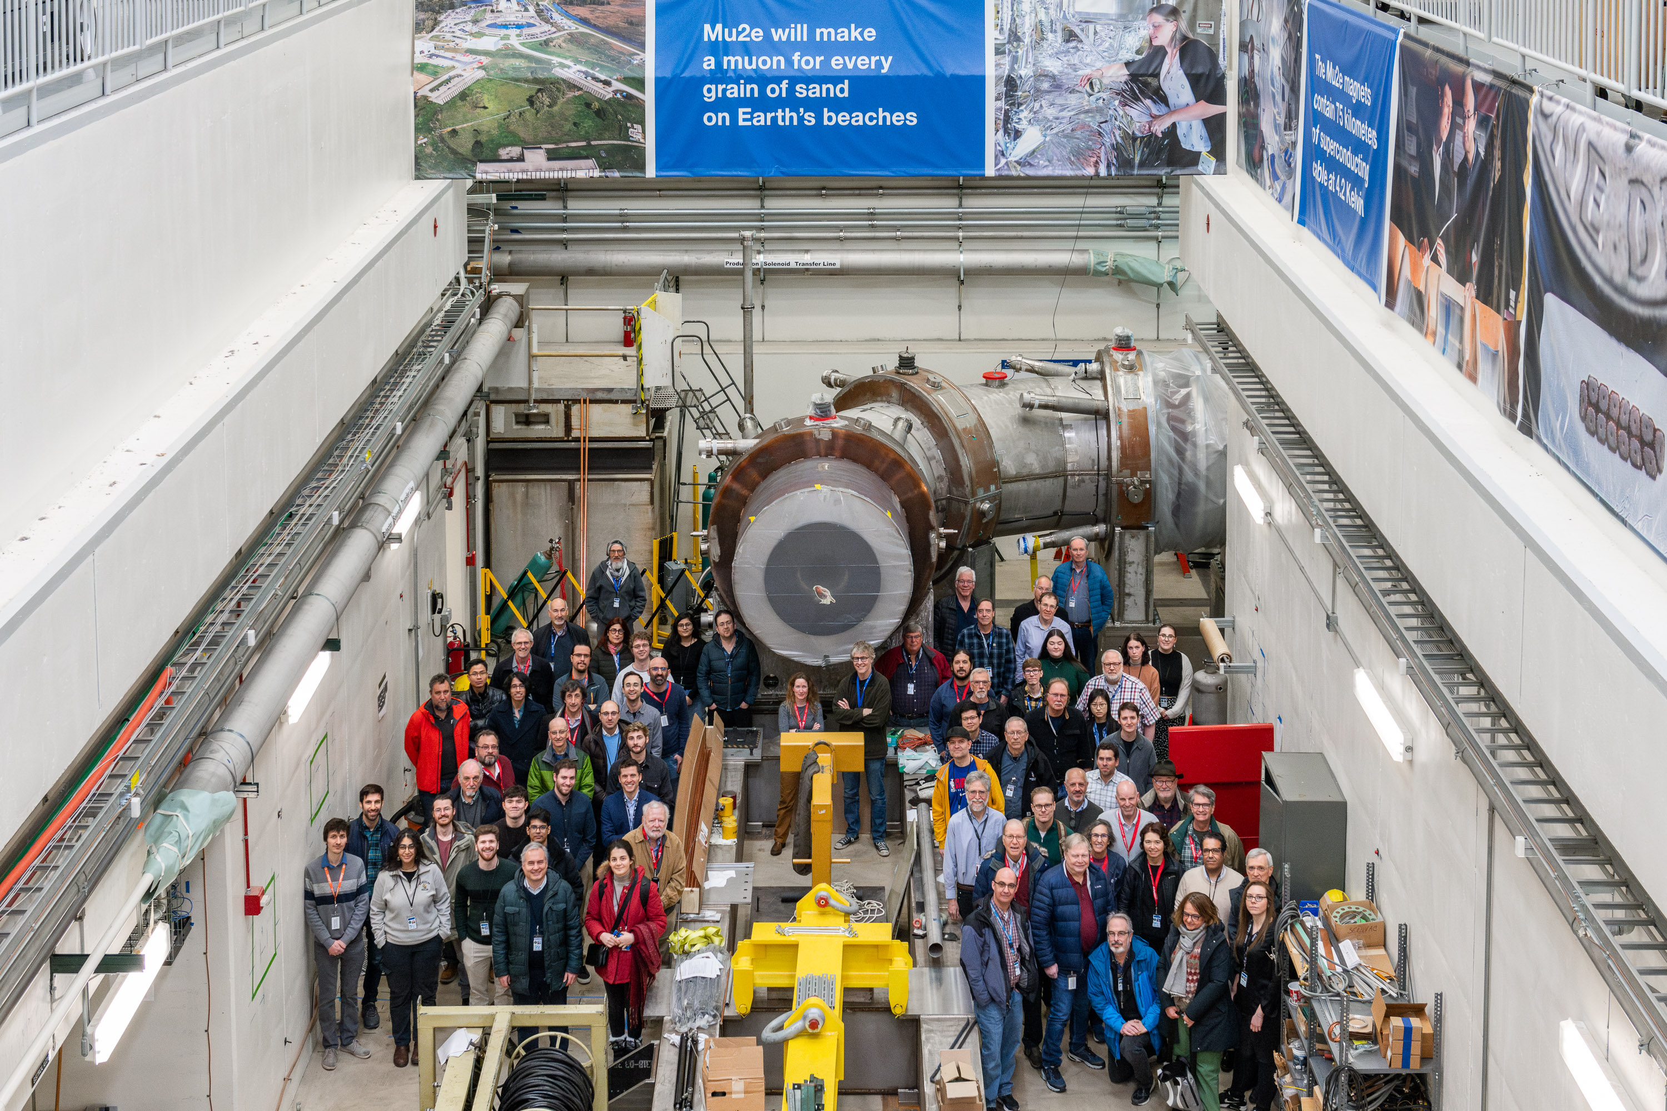
Mu2e collaboration meeting – 18-22 March
Many smiling faces surrounding the Mu2e Transport Solenoid

