Slide 1
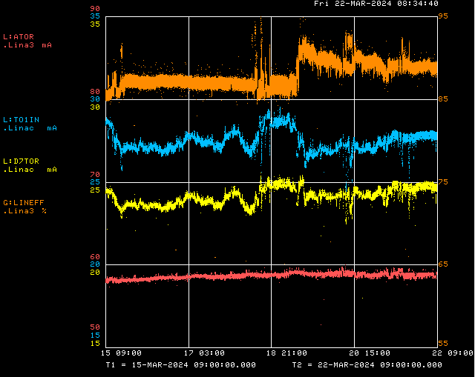
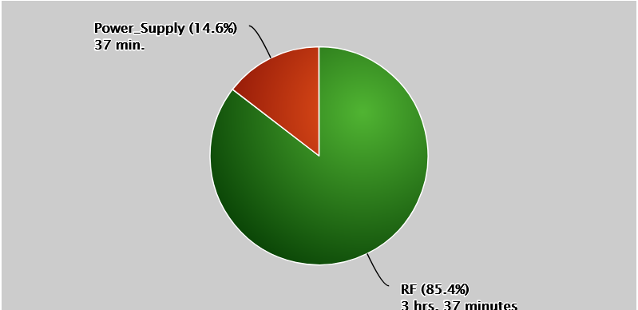
Linac/Preacc Operation (Mar 15 – Mar 22, 2024)
PREACC (N/A)
Downtime Request:
Opportunistic - ½ Day to install diagnostic equipment at KRF5 CS
LINAC (4 hr 14 min)
Notable Events:
F: Laser notcher fully operational
Su: LRF5 OI Trip, LRF1 PA Vacuum Activity Noted
M: QPS116 regulation issues
T: QPS510 regulation issues, Retuned DTL cavity phases, adjusted 750 keV collimator position
W: Debuncher phase/gradient retuned based upon study results
Th: KRF1 waveguide pressure regulator and module replaced, LRF1 driver anode overload
All Week: KRF2/5 CS Fault, KRF5 cavity phase/gradient regulation issues during trip recovery, QPS 121 regulation issues,
LRF3 PA showing signs of end of life (L:MX3VCB)
3/22/2024
John Stanton | Linac Group Meeting

