Slide 1
Project Activities for MSD
Mayling Wong-Squires
AD Operations Friday 9am Meeting
22 March 2024

Slide 2
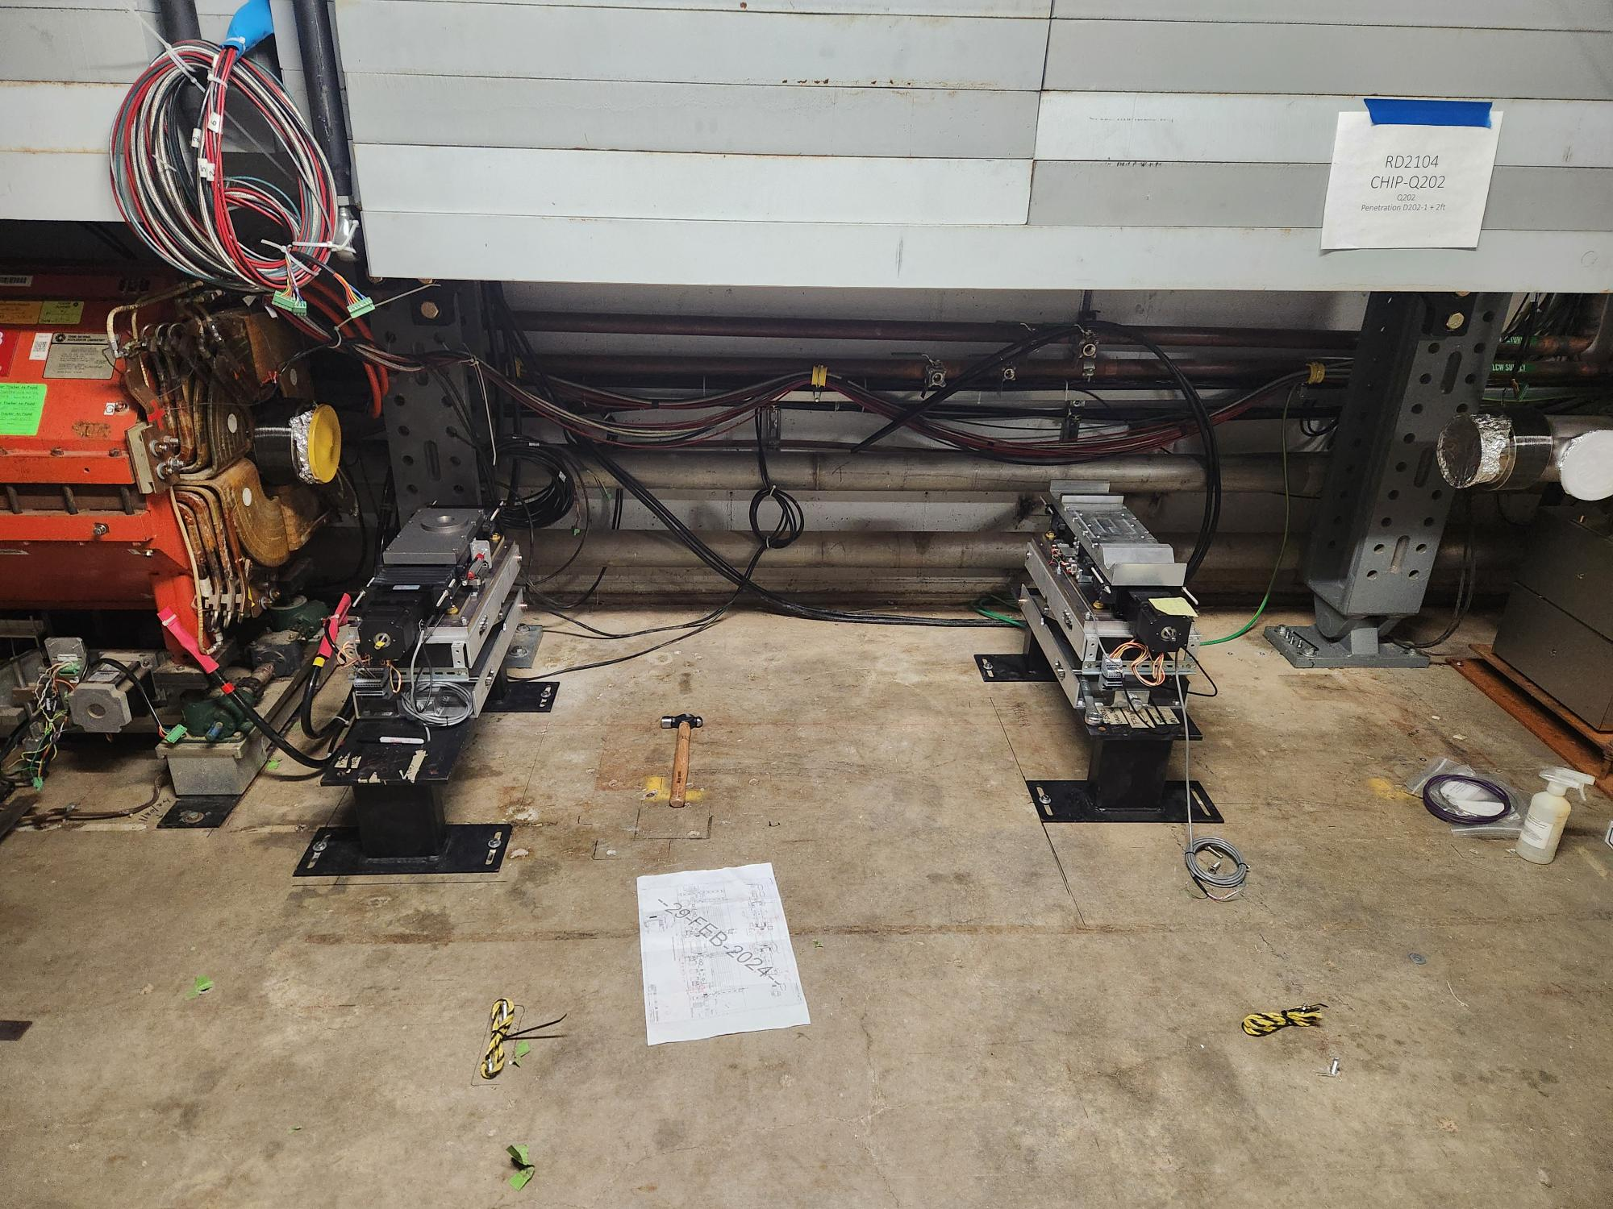
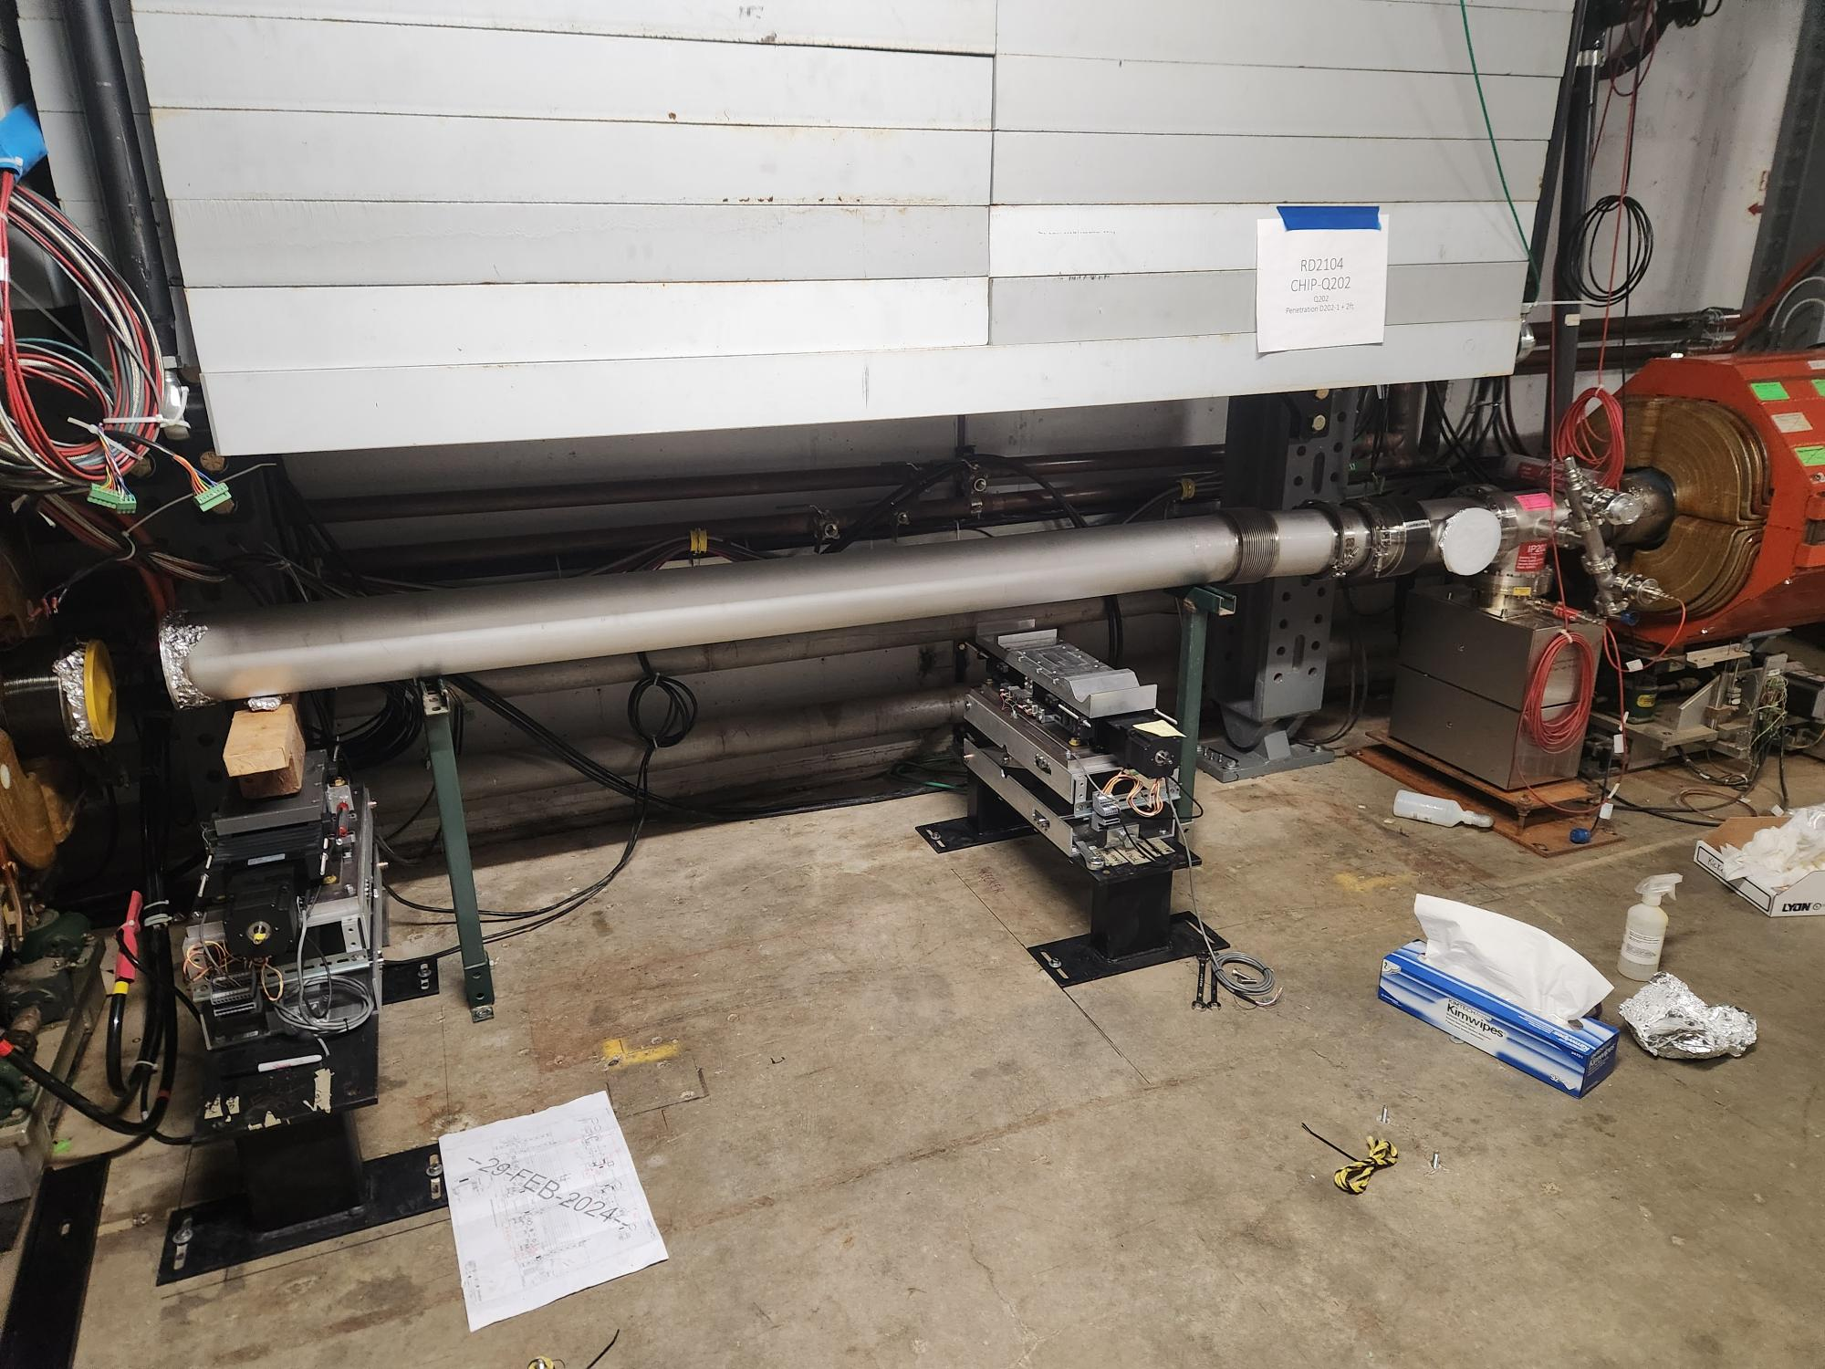
Mu2e Beamline Update Chris Ader, Jason Morin, Pat Minton, Bob Steinberg, Dirk Hurd, Dan Vrbos, Greg Bulat
Working on
The motorized stands for ESS 1 have been installed and tested. The spool piece has been installed, awaiting the completion of ESS 1. The stands for ESS2 are assembled and ready to be installed once we are given the go ahead to do so. Parts needed for the installation are done
Beam Sheet of layout by Project for collimators continues to be worked on
Coming up
Planning and procurement package for the installation of the entrance and exit collimators
Department resources needed
Engineering (Septa cart engineering note, collimator installation planning and oversight)
Technician (assembly, testing of septa cart) and planning of collimator installation
Fabrication Procurement (septa cart modifications)

Slide 3
PIP-II Instrumentation Update Dakota Krokosz
Wirescanners
Due to hybrid-tek going out of business a new vendor for ceramic frames (CERcuits) was located and an order placed for MEBT frames. It will take 4-6 weeks for them to get registered as a vendor for this.
Actuator order was placed with UHVD. All high-priced items have had orders placed at this time.
Feedthrough and flanged components have been received.
Next procurements are hardware and cables.
Will require a mechanical technician for assembly of units in September (pushed back due to wait times on orders).
Emittance Scanners
All prints and models are fully released.
Actuator orders are expected to be placed with vendor next week. There were many procurement issues with getting this order approved without having to go out for bids.
All machined and major components have been ordered at this time.
Motors, flanges, feedthrough components have been received.
Next procurements are hardware and high voltage cables.
Will require a mechanical technician for assembly of units in June.
Diagnostic Cart
Thermal simulation of the SNS Faraday Cup for air cooling is complete.
Transportation plan is complete.
Internal design review scheduled for April 25th. Procurements scheduled to begin in July.
BPM’s
Replacement MEBT BPM buttons and housings have been received.
Shoebox BPM simulations to restart the week of March 25th.

