Slide 1
Muon Campus Operation Report
Jim Morgan
Friday 09:00 Operations Meeting
March 22, 2024

Slide 2
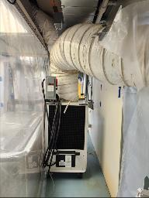
Muon Campus status
ARR Completed
Some remaining tasks before permission to run beam
Q206 water leak has been fixed by TD
Preparing for AP-0 A/C work to resume
ESS1 Electrostatic Septum at A0 Clean Room
Work briefly paused for installation of portable A/C unit
ESS1 assembled and rough-aligned
Final survey and alignment planned for next week
Vessel needs to remain open until final survey is completed
Preparations for Electrostatic Septa mechanical installation in tunnel
ESS1 stands and vacuum spool are installed
ESS2 stands will be installed during relocation closer to Q203
ESS2 move requires septum cart, which is also needed for moving ESS1
Waiting to remove blocks from D40 Hatch for incoming and outgoing magnets
Parts have largely been received from Machine Shop
8Q24 with rad hardened water lines at AP-50, ready to be lowered into tunnel
Some installation complications due to protrusion of new water manifolds on quad
Study – M1-M3 Optics
Study – Alternative M5 optics
KPS5A PFL Repair
MC-1 Controlled Access
G-2 Trolley Run
Intentional Accelerator
Standby Period
<------------Week Days -------------------→

Slide 3
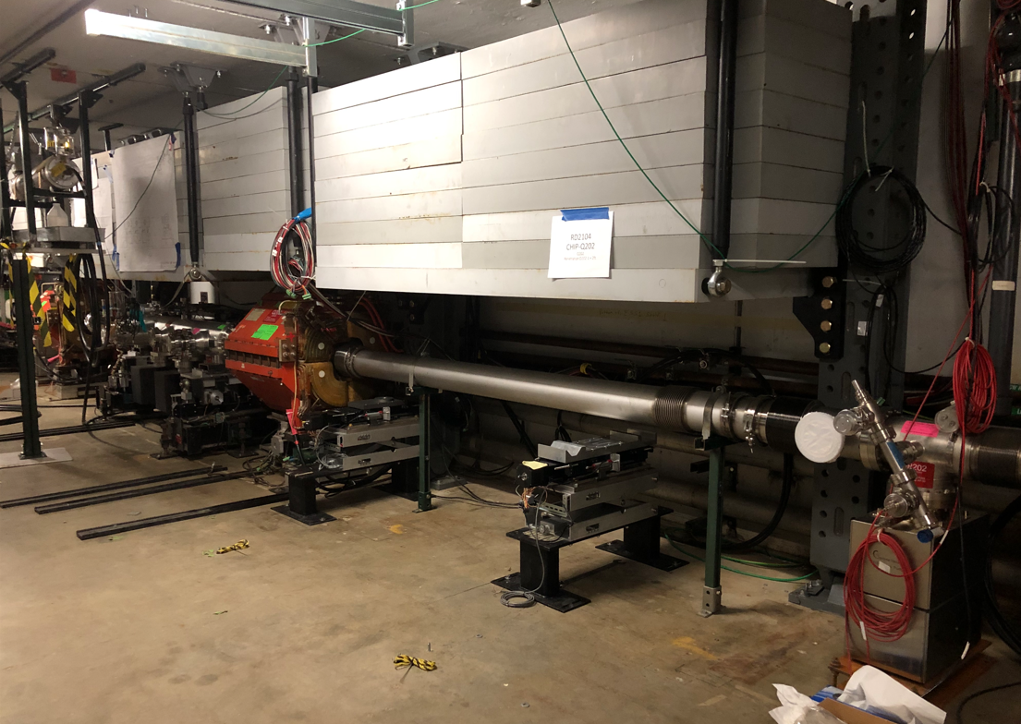
ESS1 vacuum spool and other parts
ESS1 vacuum spool
New ESS stands

Slide 4
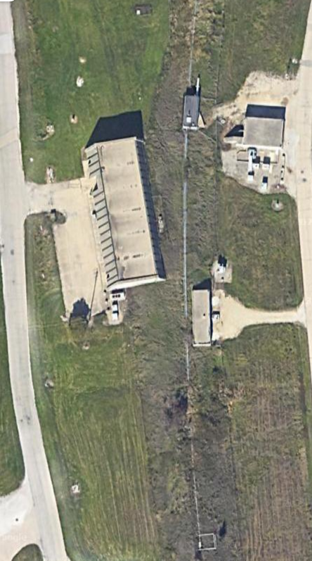
Rad fence area near AP-0
A/C system behind AP-0 in rad fence area
Extension of Tevatron (now P2/P3 Lines) fenced area
Radiological hazards near AP-0 in fenced area
SY120 beam in P3 Line
Muon beam in M1, M2 & M3 Lines
RAW systems in AP-0 (no longer targeting beam)
Access to rad fence area controlled by RSO
Plan to not run beam to Muon Campus while contractors are in water cage or rad fence area
Installed temporary fencing last year to separate the SY120 berm from access to rear of AP-0
Temporary fencing behind AP-0 to the existing fenced area around A/C units
Temporary
fencing
Vault Unit
Rad Fence Area
Main Unit

Slide 5
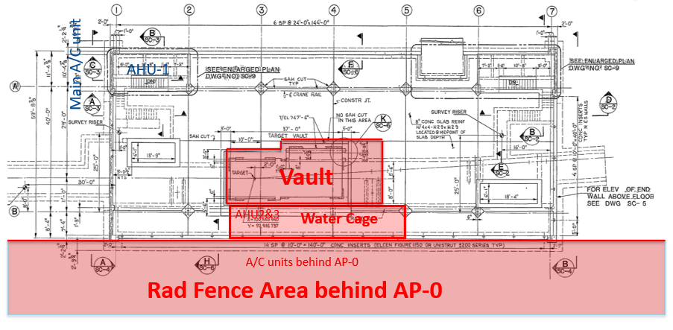
Areas that can’t be accessed when running beam to Muon

Slide 6
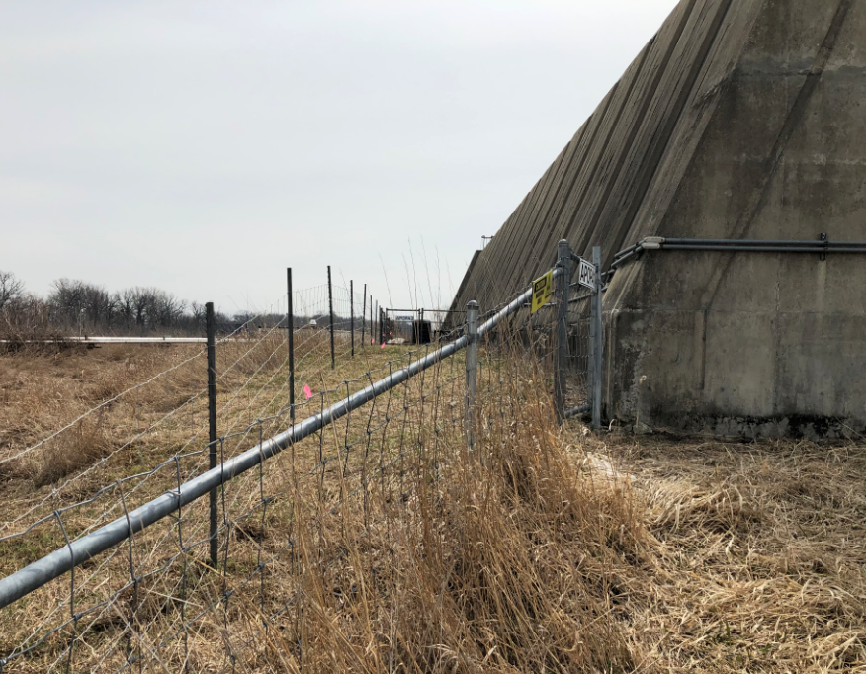
Temporary fence behind AP-0 to isolate it from SY120 berm

Slide 7
Upcoming work
ESS1 work will continue in the A0 Clean Room
ESS1 survey scheduled to take place next week
Installation of end flanges and ion pumps next, then vacuum leak check
Transport to NWA next for vacuum pump-down and high voltage conditioning
ESS2 assembly will follow (operational version, prototype presently in tunnel)
Portable A/C unit appears to be working well
Q203 reconfiguration and preparation for eventual ESS1 installation
ESS2 will be moved upstream and mounted on new stands
Short section of M4 beamline above Q206 will be reinstalled
Q205 magnet swap and special vacuum pipe replacement
Key personnel for opening D40 hatch will be gone next week
Need to alter installation plan for greater manifold protrusion on rad hard quad
Hatch should be opened the week of April 1
AP-0 A/C work set to resume next week (began April 17, 2023)
Access to AP-0 Water Cage and rad fence area simplified with no beam to target
Working towards getting approvals to run beam to the Muon Campus

