Slide 1
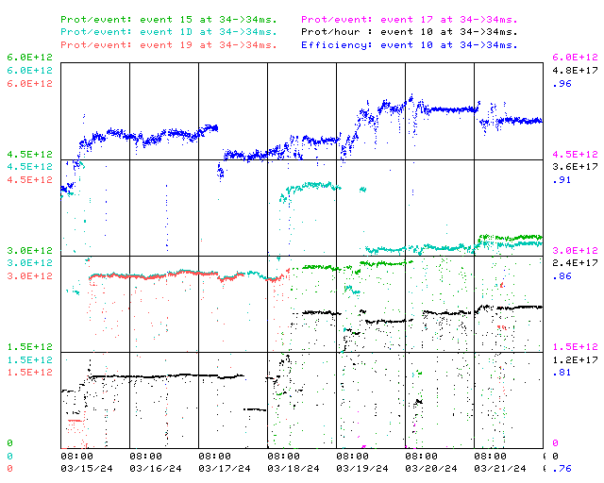
Booster Operations 03/15/24 – 03/22/24
Also:
F
Worked with Linac Folks as they re-tuned for lower Linac losses, Booster retuned as needed. Thanks for 750KeV collimator adjustments.
Re-established cogging operation for multibatch operation.
Wednesday morning RF folks replaced BRF03 PA Filament PS.
Worked with Linac Folks for different 400MeV Debuncher tune to help reduce incoming beam energy spread. Tuning continues for that but looks good so far.
20Hz upgrade effort at E4R continues.
IPM data files are being written but not viewable, Controls & Instrumentation looking
B40 save issues to UTI file directory, Controls investigating
BGW already having warm gallery temperatures. Repairs in progress for a couple of the rooftops. Also ISD to change air handler filers.
BRF19 has a flakey cavity flow turbine that needs to be replaced at next opportunity.
BRF21 has upstairs bias supply problem, investigating.
VTQ13 regulator is still down, will replace at next good opportunity.
Thanks to Ops for diligence & tuning on the off shifts
F
Sa
Su
M
Tu
W
Th
F
This week:
Week 2 of start up
Beam on $19’s for MI tune up
Beam on $15’s for NuMI tune up
Beam on $1D’s for BNB tune up ~4.3E12, 14T@ 5Hz , ~ 8E16 pph
Beam on $17’s for Booster Commissiong
Have been delivering 15Hz beam since Monday

