Slide 1
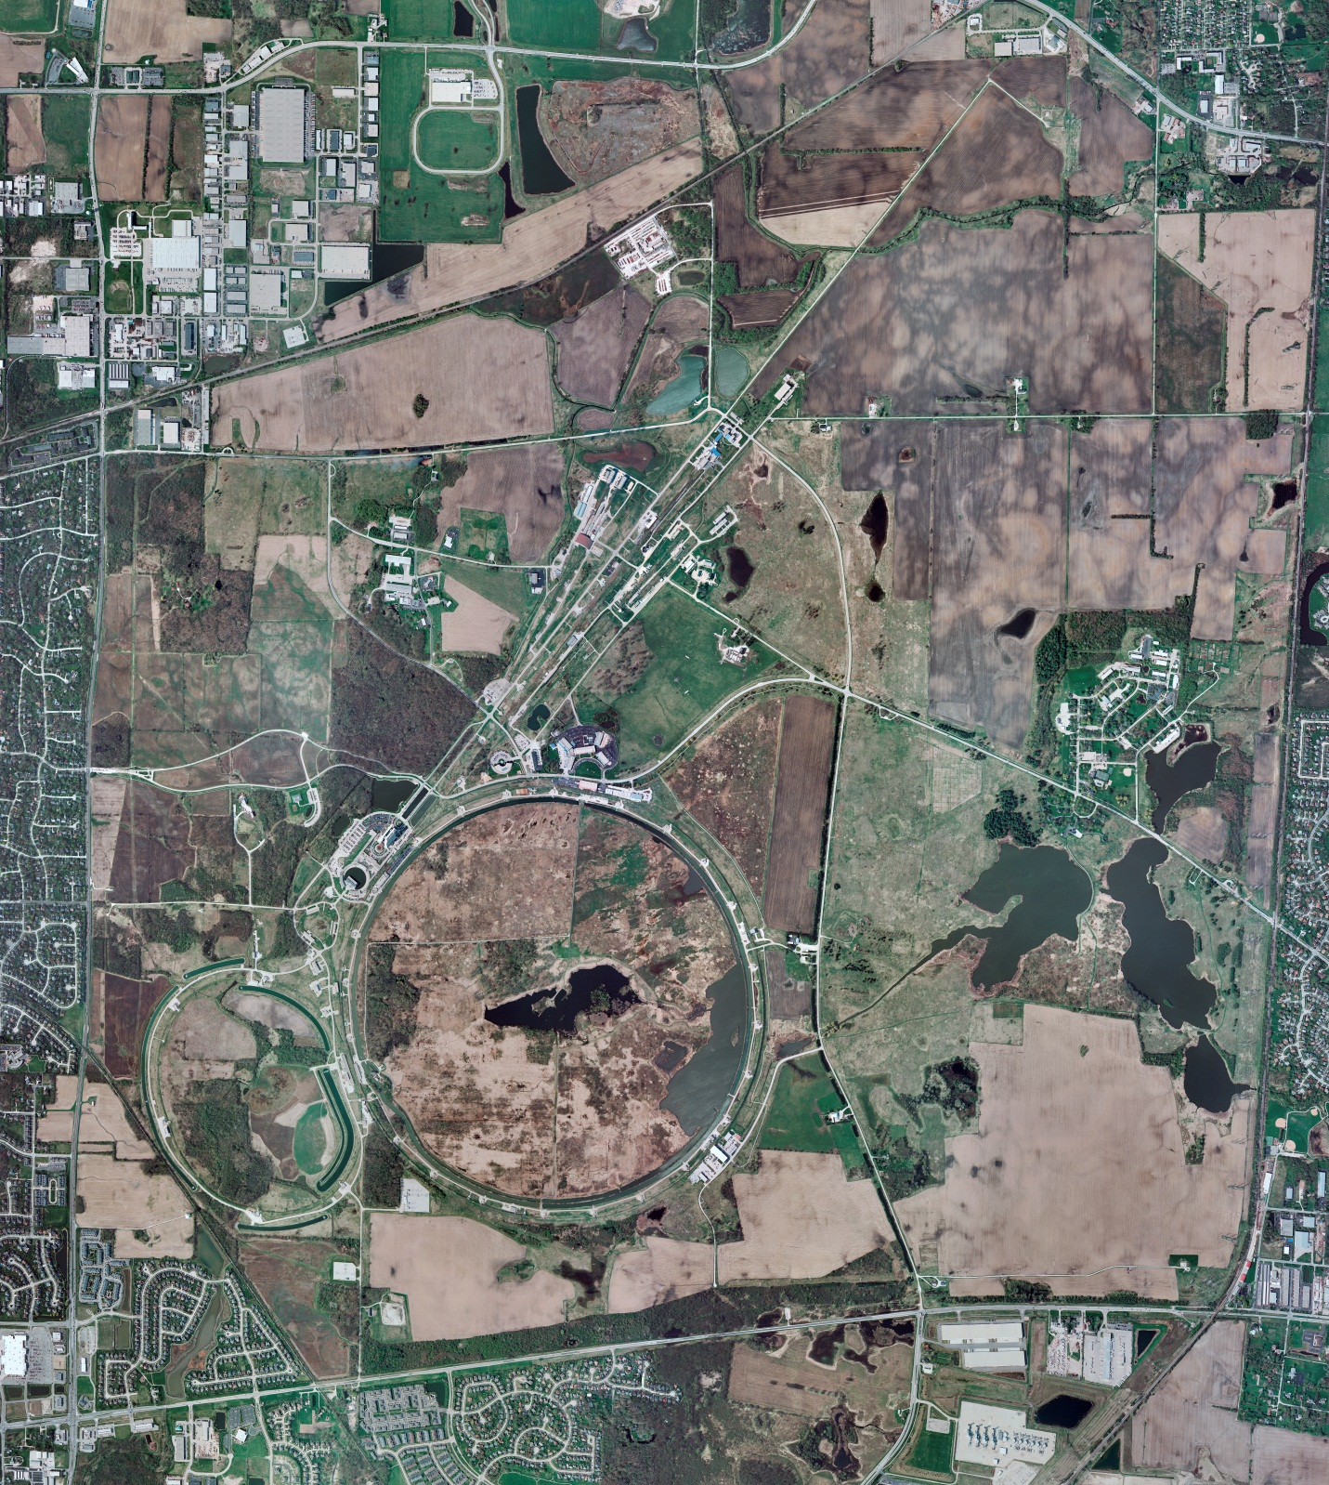
Helium Cryogenics
Status 3/22/2024 J.Makara
CMTF: SCP is startup activies in progress with 1 compr and Purifier operational; scheduled bldg. power outage recovery after breaker repairs (thanks AD & ISD for quick response)
CMTS: HECM29 expected Mar25
PIP2IT: South CM stand being modified for SSR2 pCM
North CM stand empty but HB650 expected Mar28
MCTF: cryo system is shut dpwm at RT
MDB/HTS: at RT
MDB/STC: at RT
MDB Magnet: at RT
IB1: cryo system cold at 5 K and 2 K operations; NOTE ODH sensors readbacks are in ACNET and alarms working
NML/FAST: Cryo system is shut down and isolated for extended shutdown period; scheduled bldg. power outage for elec maintenance went well
CC1: at RT
CC2: at RT
CM: at RT
Muon Campus: at RT with comprs off and system depressurized; LN2 off with LN2 Tank 50 being warmed up
Misc:…ODH issues addressed for CMTF, IB1, and NML

