Slide 1
9 O’Clock Meeting
Anders Petterson
MCR Crew Chief
Friday, March 22nd, 2024

Slide 2
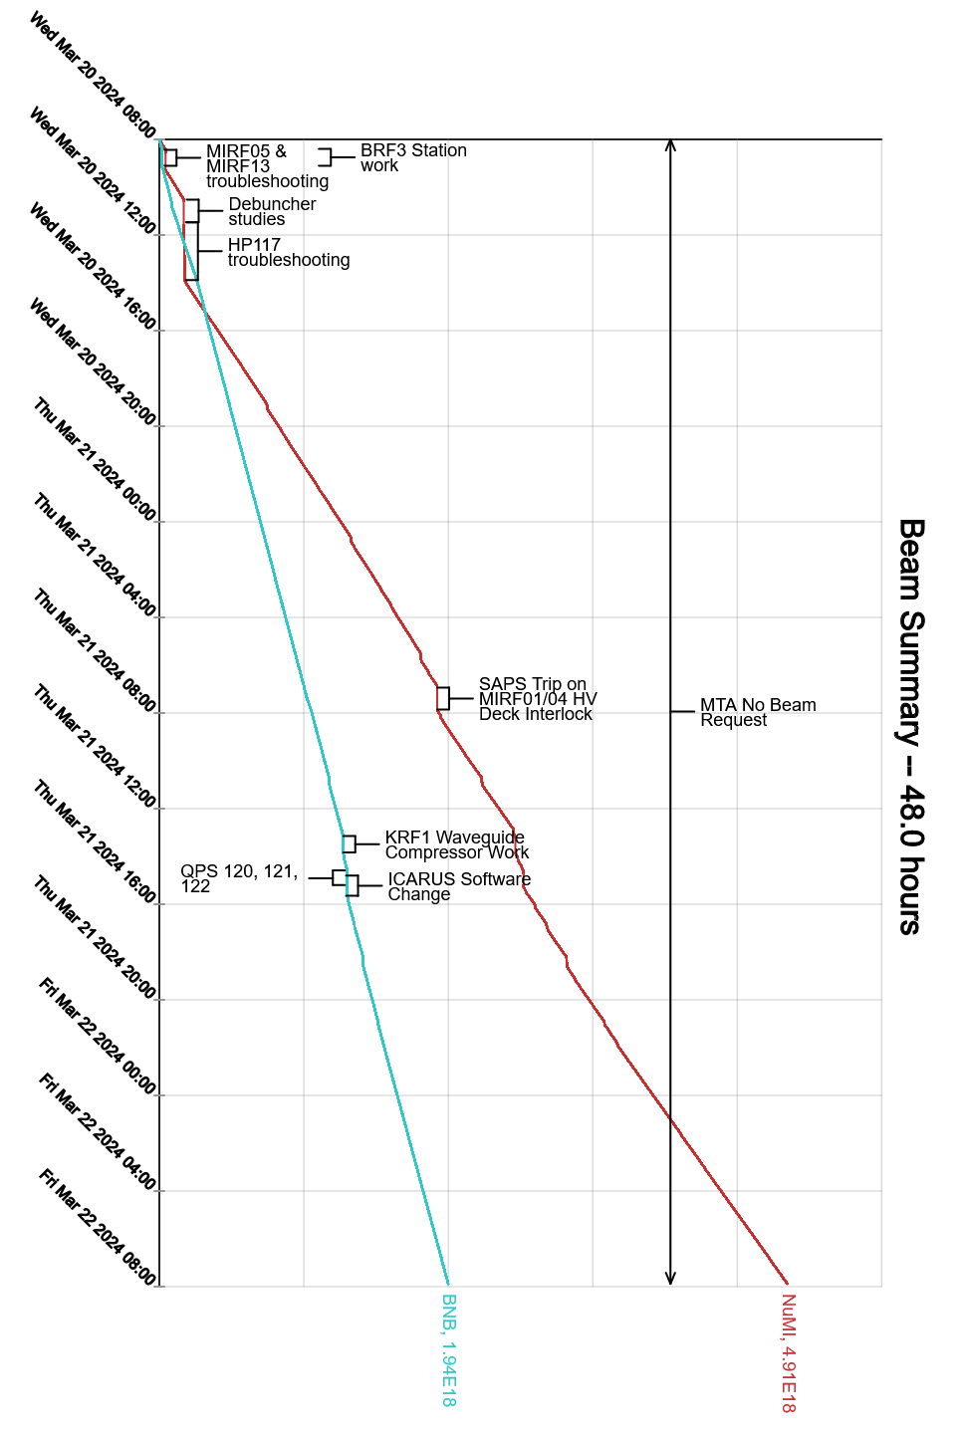
Since Wednesday…
Wednesday
Booster & MI/RR Studies all week
Power Outages proceed as scheduled
Thursday
Linac Waveguide issues fixed
CMTF Breaker Repaired
Off-Shift tuning

