Slide 1
TMS MAGNET DESIGN UPDATE -- FORCES
Wes Craddock SLAC
March 29, 2024

Slide 2
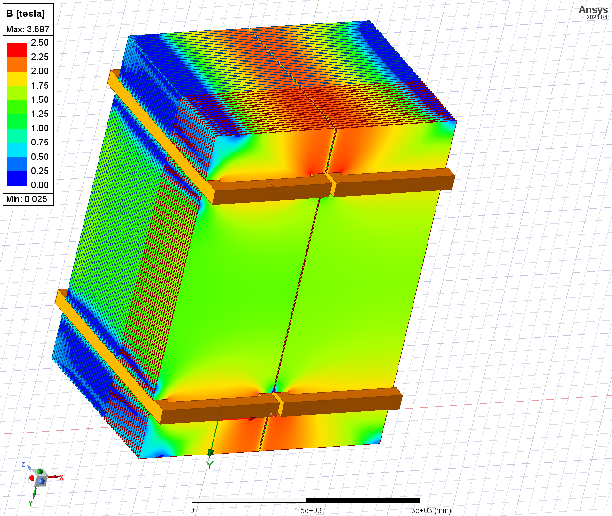
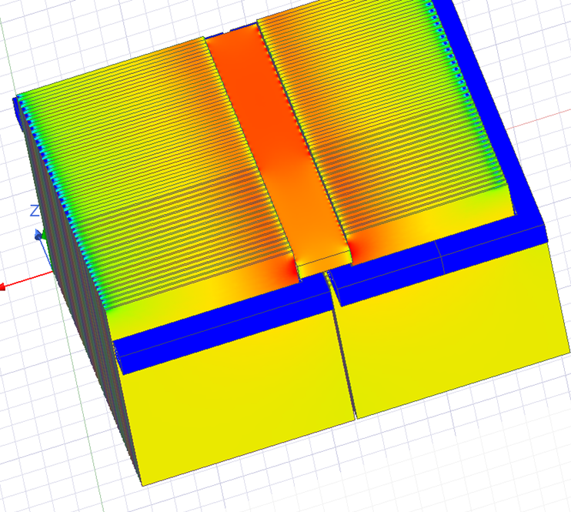
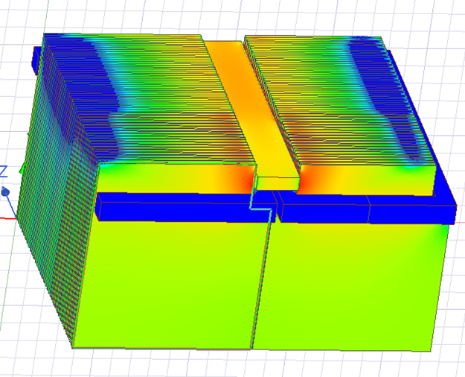
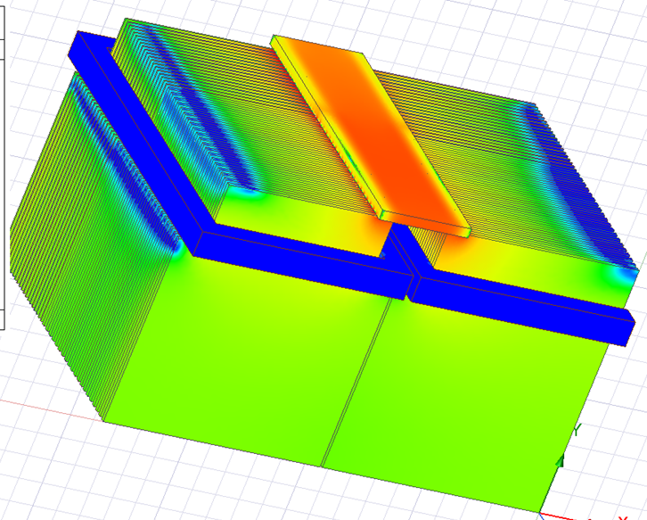
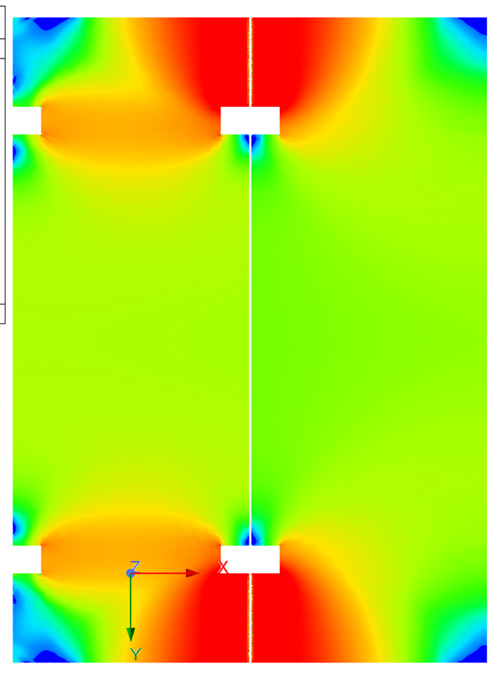
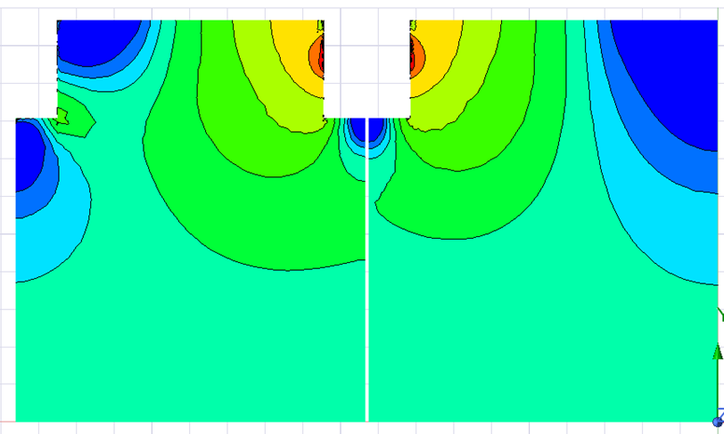
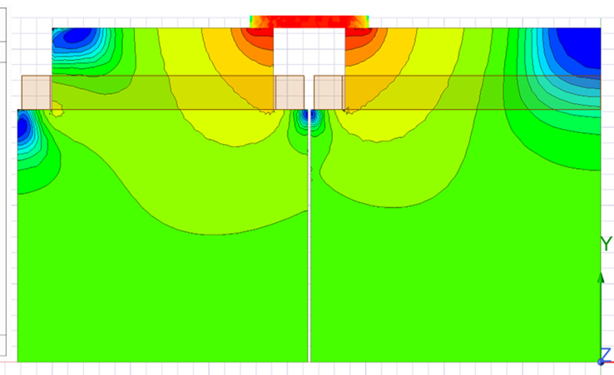
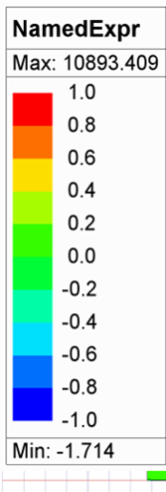
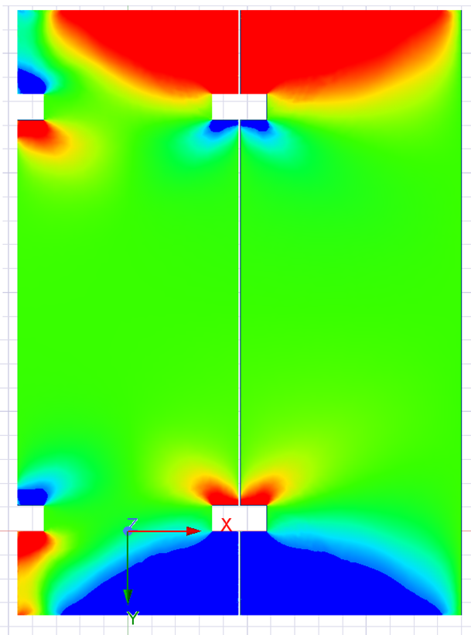
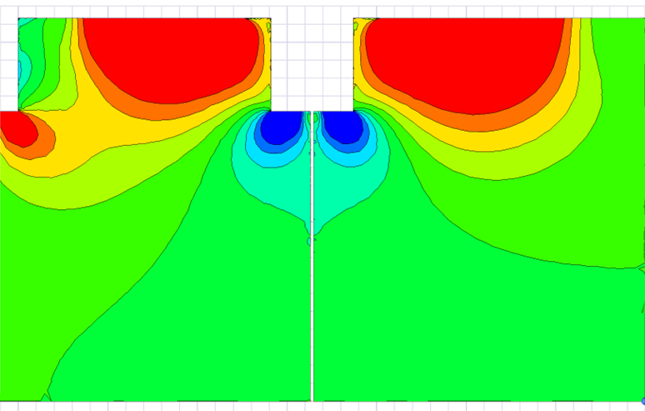
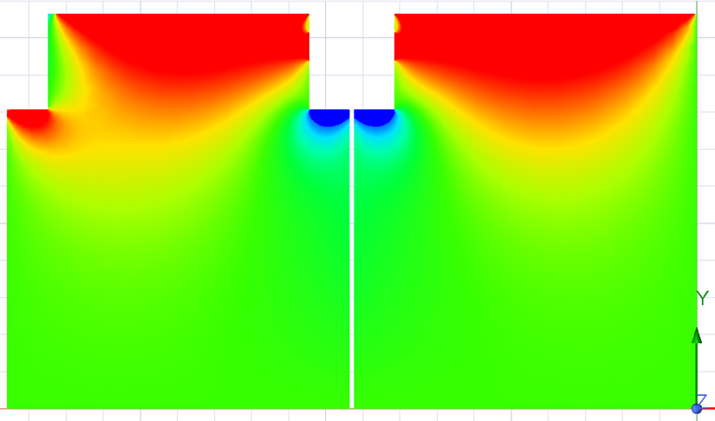
Summary Cases
20+20 Plates ½ and 1/4 Models
Baseline Case
Case 1: Slot Iron Touching
Case 2: Slot Iron 1+1 cm gap
Case 3: Iron Plate on Top
Bmag Middle 40 mm Plate
Bx Fraction Middle 40 mm

Slide 3
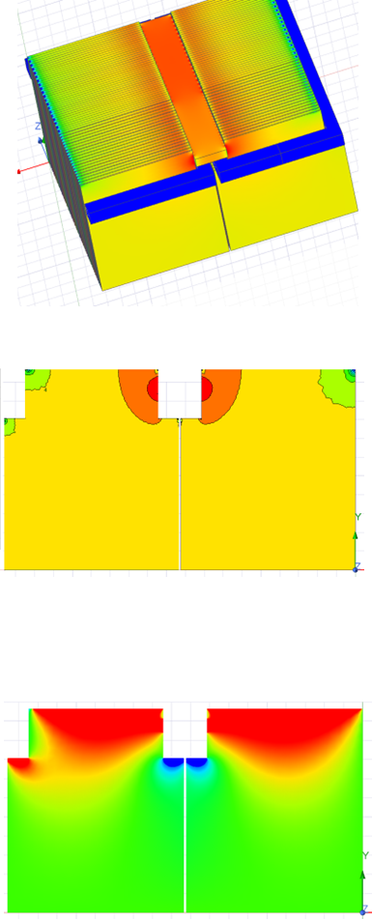
Summary Cases
20+20 Plates 1/4 Models – MINOS Steel vs 1008 Steel
Case 3: 1008 Steel Slot Iron Touching
Case 3: Slot Iron Touching
Bmag Middle 40 mm Plate
Bx Fraction Middle 40 mm

Slide 4
Baseline Case
Solid Edge 20+20 Plates 1/2 Model
WorkBench 20 + 20 Plate Half Symmetry and 2 cm Plate Gap
Bmag on Region
Plate Height = 5066 mm
2 cm gap between plates
30 kA
Iron Center Bmag = 1.17 T

Slide 5
Solid Edge 20+20 Plates 1/2 Model
WorkBench 20 + 20 Plate Half Symmetry and 2 cm Plate Gap
Baseline Case
10th 15 mm Plates Bmag
10th 40 mm Plates Bmag

Slide 6
TEST PROBLEMS
Upper Coil Force = -27749 N
Lower Coil Force = 27707 N
Iron Force < 30 N in all directions
Total Energy = 57.4 kJ
Upper Coil Force = -13825 N x 2 = -27650; Fy = -9309
Lower Coil Force = 13836 N x 2 = 27670; Fy = -9456
Iron Force Fy = 22476
Total Energy = 28369 J x 2 = 56.7 kJ

Slide 7
TEST PROBLEMS
Upper Coil Force = -27749 N
Lower Coil Force = 27707 N
Iron Force < 30 N in all directions
Total Energy = 57.4 kJ
Upper Coil Force = -13825 N x 2 = -27650; Fy = -9309
Lower Coil Force = 13836 N x 2 = 27670; Fy = -9456
Iron Force Fy = 22476
Total Energy = 28369 J x 2 = 56.7 kJ

Slide 8
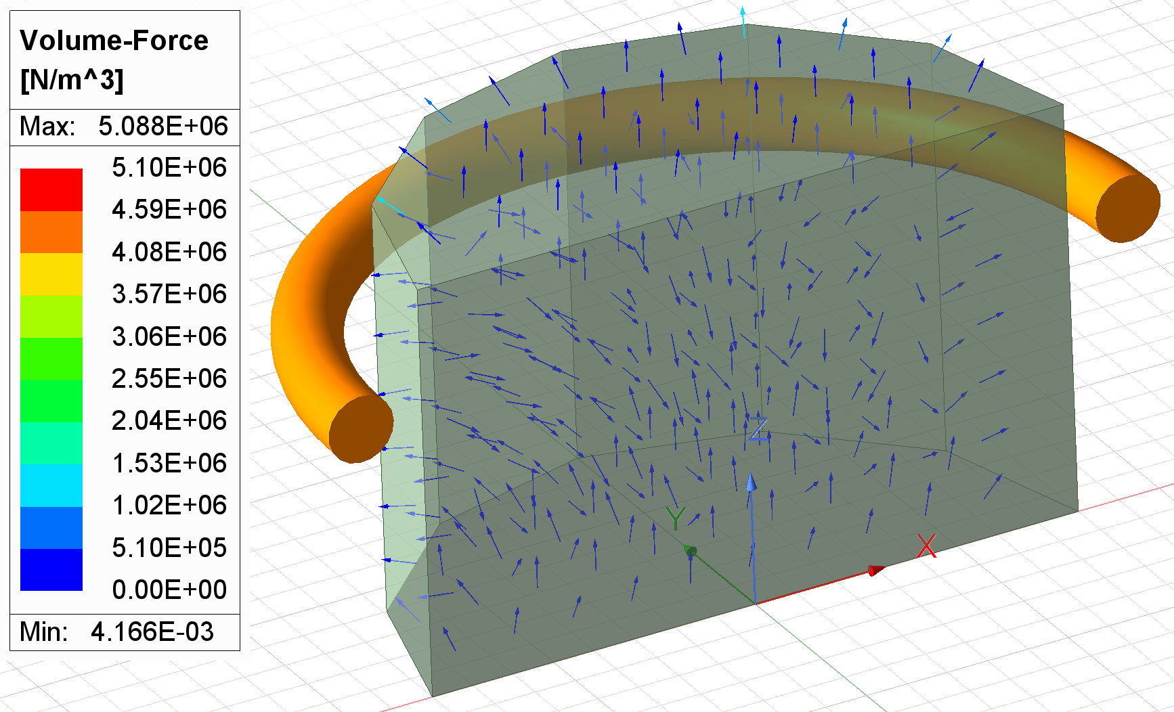
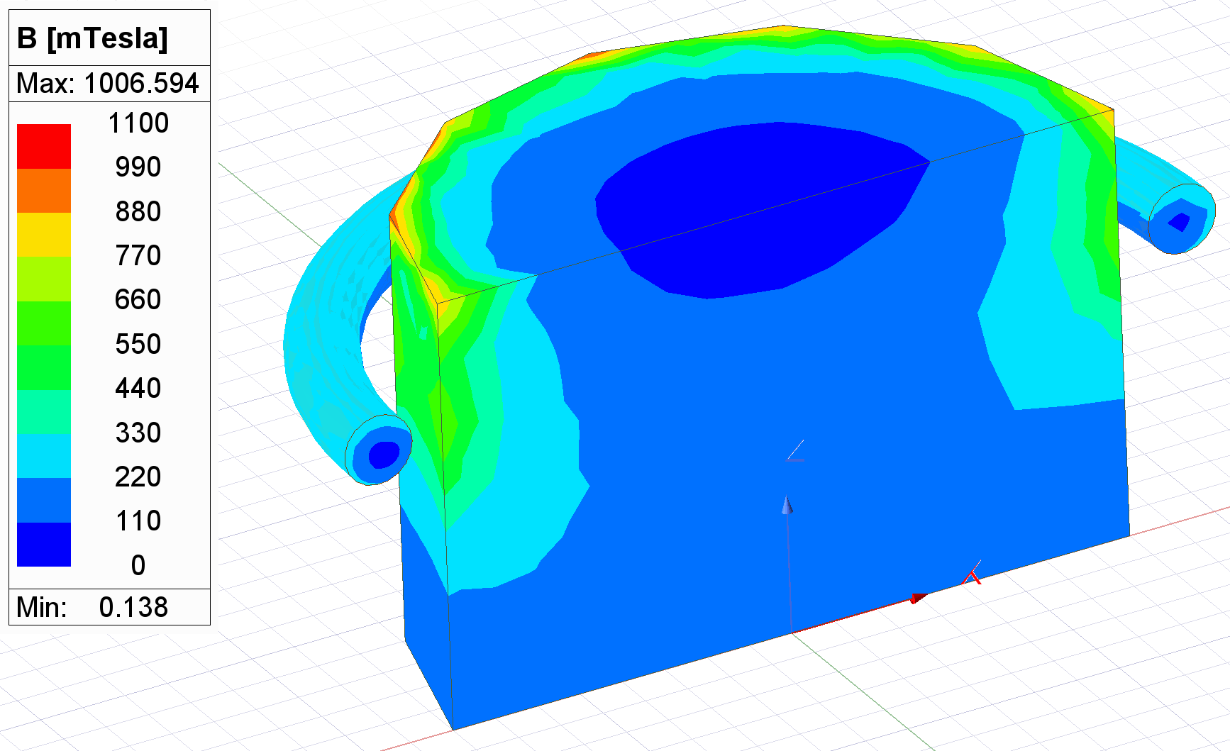
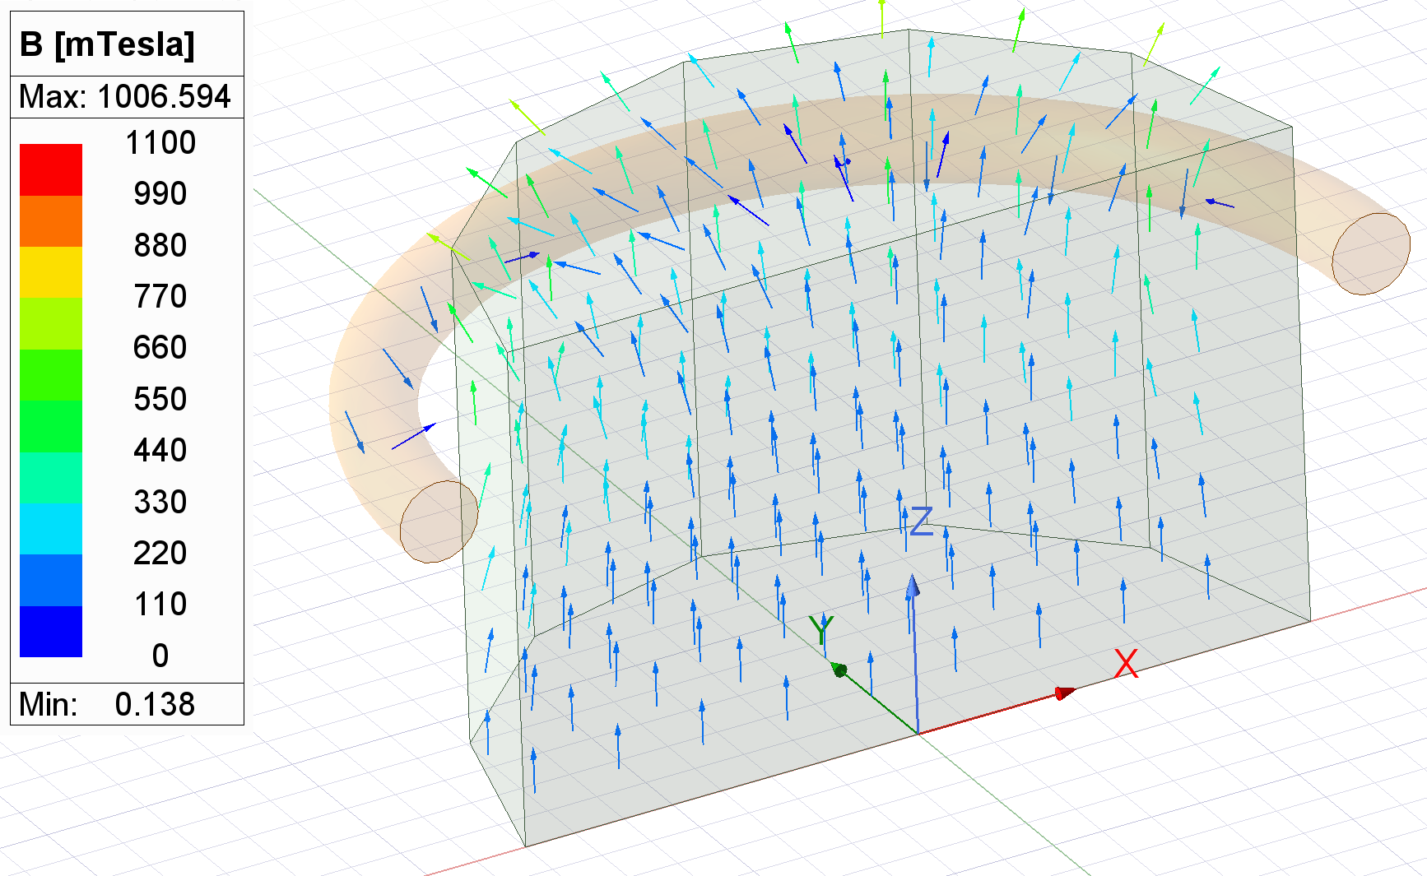
TEST PROBLEMS
Upper Coil Force Fz = -27749 N
Lower Coil Force Fz = 27707 N
Iron Force < 30 N in all directions
Total Energy = 57.4 kJ
Self Inductance of each coil = 5.09 uH
Mutual Inductance of coils = 0.57 uH
Upper Coil Force = -13825 N x 2 = -27650; Fy = -9309
Lower Coil Force = 13836 N x 2 = 27670; Fy = -9456
Iron Force Fy = 22476
Total Energy = 28369 J x 2 = 56.7 kJ
Self Inductance of each coil = 2.53 x 2 = 5.06 uH
Mutual Inductance of coils = 0.29 x 2 = 0.58 uH
Upper Coil Force = -13821 N x 2 = -27640; Fy = -9575 N
Iron Force Fy = 10914 x 2 = 21830; Fz = 7414 x 2 = 14830
Total Energy = 14229 J x 4 = 56.9 kJ
Inductance Upper Coil = 2.82 x 2 = 5.64 uH

Slide 9
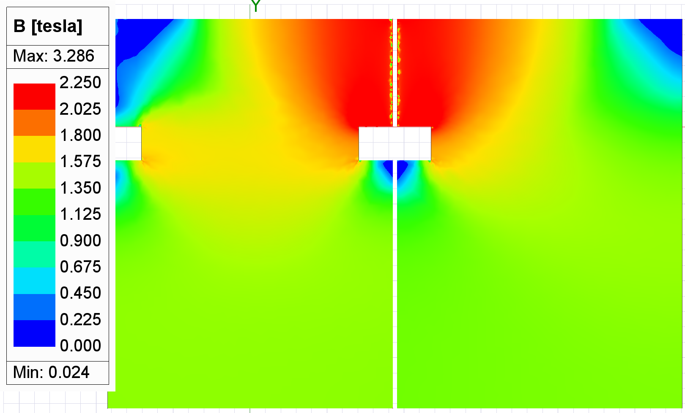
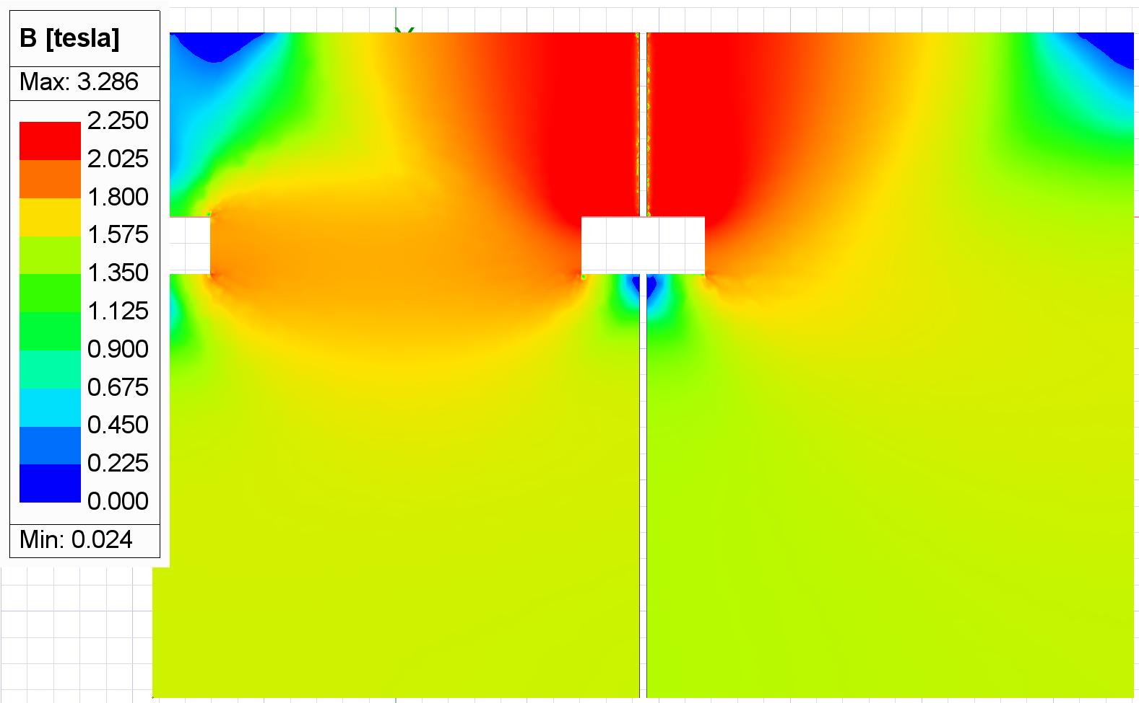
Solid Edge 20+20 Plates 1/4 Model
WorkBench 20 + 20 Plate Quarter Symmetry and 3 cm Plate Gap
Baseline Case
10th 40 mm Plates Bmag
10th 15 mm Plates Bmag

Slide 10
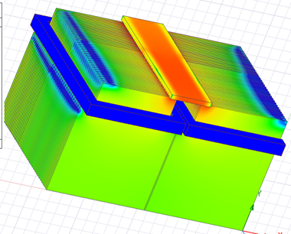
Solid Edge 20+20 Plates 1/4 Model
WorkBench 20 + 20 Plate Quarter Symmetry and 2 cm Plate Gap
Top Iron Case
Case 3b: Iron Plate on Top
Bmag (T)
Fx component of Volume Force Density
10th 15 mm Plates
Volume Force Density
10th 40 mm Plates
Volume Force Density
10th 15 mm Plates

Slide 11
PRELIMINARY FORCE SUMMARY
From ANL “Flux Density and Magnetic Force Analysis”
Outer Plates: Fx = 26 kN for 40 mm plates and 4 kN for 15 mm plates
This analysis
Baseline Design (5066 mm plate height and 5 mm gap):
Outer Plates: Fx = 216 kN for 40 mm plates and 82 kN for 15 mm plates
Baseline Design (5066 mm plate height and 20 mm gap):
Outer Plates: Fx = 57 kN for 40 mm plates and 12 kN for 15 mm plates
Baseline Design (5066 mm plate height and 30 mm gap):
Outer Plates: Fx = 55 kN for 40 mm plates and 12 kN for 15 mm plates
Top Iron Bar and Iron Plate Height reduced by 2 x 400 mm = .8 meter
Outer Plates: Fx = 1.5 kN for 40 mm plates and 1 kN for 15 mm plates
Top Iron Bar: Fz = 2.3 kN and Fy = -666 kN
NOTE: Stored energy is reduced from 260 kJ in prior three cases to 120 kJ

