Slide 1
TMS Detector Panels: Basics: A Request for “Working Numbers”
29 March 2024

Slide 2
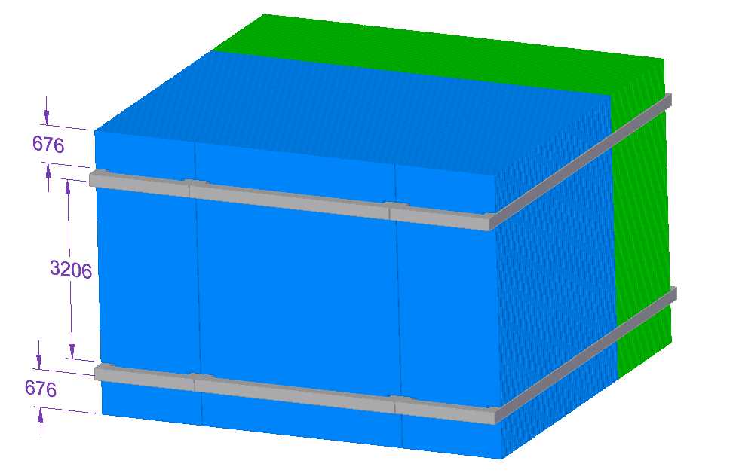
ANL Step File of CDR Design
Smaller coil box 220x216mm^2 than 300x300mm^2 quoted in CDR text

Slide 3
Stereo Counter Dimensions

Slide 4
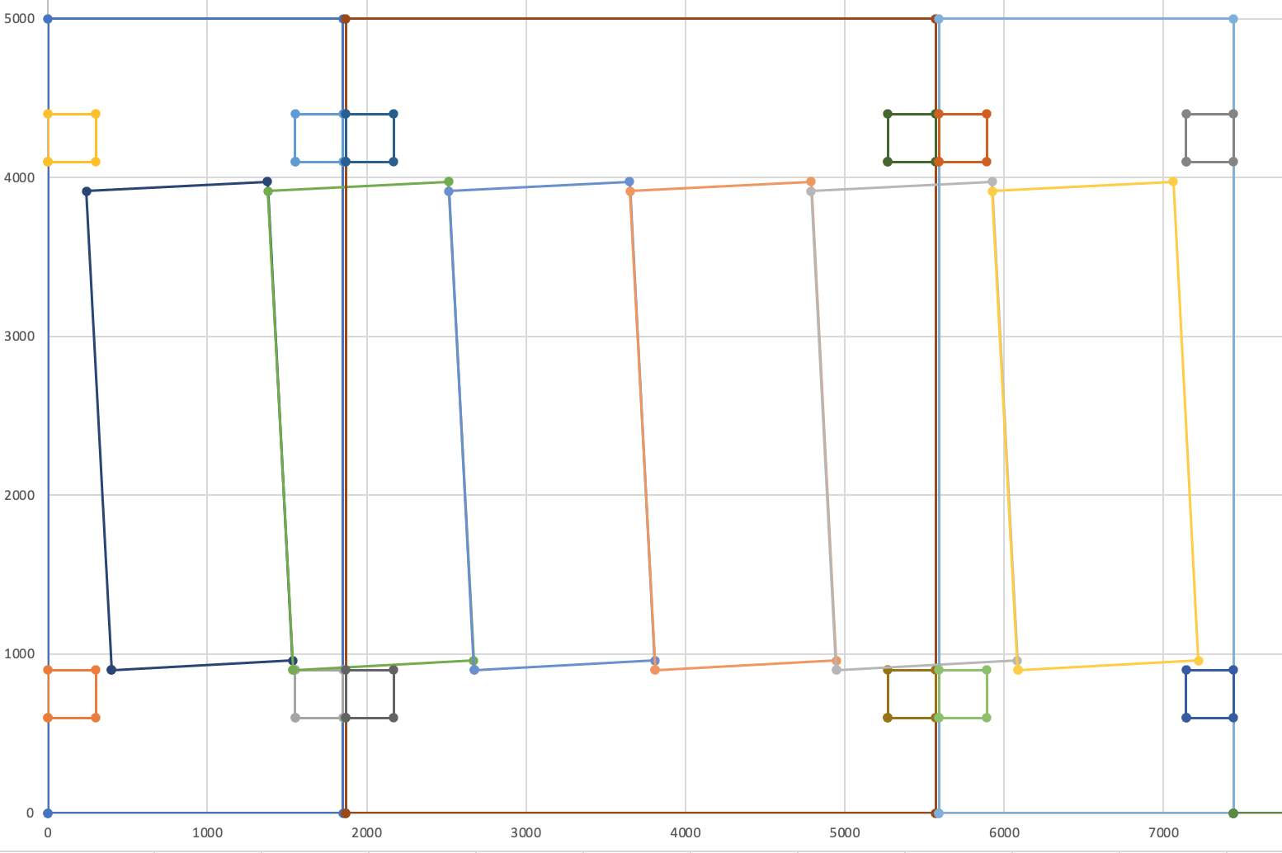
CDR w/ 300mm x 300mm notches and 3200mm between coils
Panels drawn w/ dimension quoted
With 7440mm width available there are 589mm of surface w/o scintillator

Slide 5
Horizontal Counter Dimensions

Slide 6
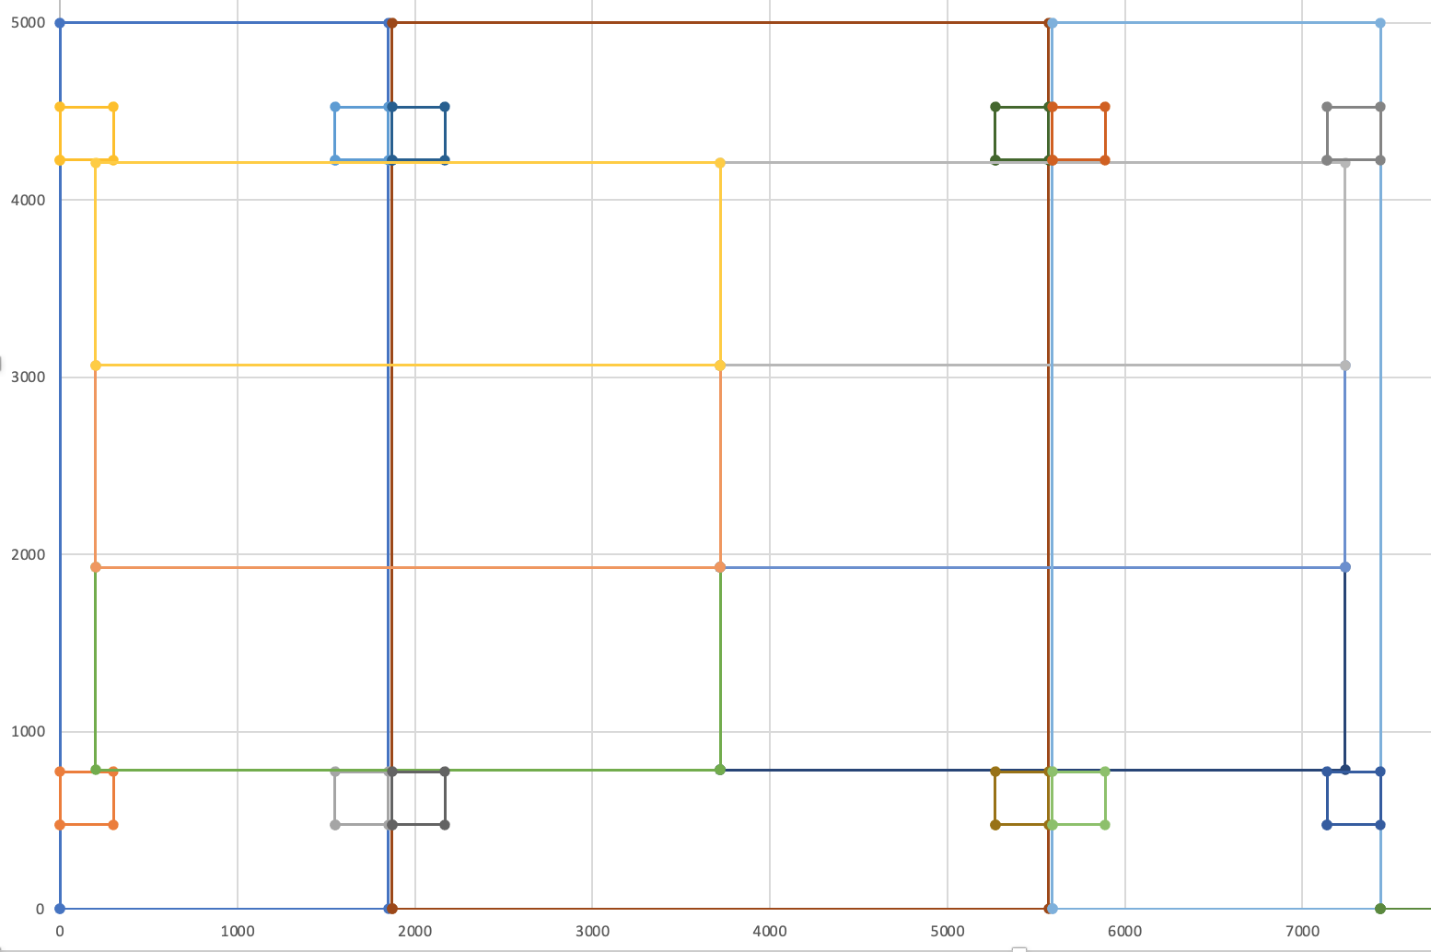
CDR w/ 300mm x 300mm notches and 3445mm between coils
Wes Craddock currently assuming 3440mm between coil notches (or slots).
We should agree on a working number.
What do we do with u, v counters if we increase this dimension?

Slide 7
Would be good to have and use commonly agreed dimensions
Steel: all slightly different
Text and Tables in CDR
STP CAD file from ANL
ANSYS CAD File used for magnetic analysis
Scintillator
CDR uses 35mm
CAD uses 35.4mm

Slide 8
Additional Considerations from Tom LeCompte (1)
The 3-degree tilt was chosen to avoid interferences with coils, spacers and such.
The cassette makes this constraint obsolete.
How much tilt is best?
The more tilt, the less need for stereo, because the y-resolution improves.
But the counters get longer, and the difference between the three definitions of coverage grows.
Tom suspects that we want a slightly bigger tilt but not hugely bigger. Five degrees?

Slide 9
Additional Considerations from Tom LeCompte (2)
Do we make the steel tall enough to get the 2:1 aspect ratio rather than 7:3?
This would require us to increase the space between the coils by ~50 cm. and
It would also have us make all the counters 50 cm longer.
This makes the y-counters much simpler, but it costs real money
- Certainly, several hundred thousands.
We would probably need a good answer to the question
"If you are making TMS bigger, why do you want to do this in the y-direction, where you already have coverage and not the x-direction where you don't?"

Slide 10
Additional Considerations from Tom LeCompte (3)
With stereo, the size of the active region has some ambiguity.
It can be the largest rectangular area where the entire interior is covered by detector,
it can be the area actually covered,
or it can be the smallest rectangle that completely encloses the active area.
It doesn’t really matter so much which one we pick, but to compare, we should pick one.
How much space do we need between the plates?
This is a dagger over our heads
if we need more space than we have planned for, the whole design needs to be re-thought.
How much thinking depends on how much extra space we need

