Slide 1
302.02.07 Structures Status
Magnet | Status | Notes
Pre-Series
MQXFA03 | Complete; report released
MQXFA04 | Complete; report released
MQXFA05 | Complete; report released
MQXFA06 | Complete; report released
MQXFA07b | Complete | SG Test report drafted; Prepping to ship to FNAL
MQXFA08b | Complete; report released | No coil SG data with 2nd thermal cycle
Series
MQXFA10 | Complete; report released
MQXFA11 | Complete; report released
MQXFA14b | Test complete | Fab & Test report drafts completed

Slide 2
302.02.07 Structures Status
Magnet | Status | Notes
Series
MQXFA09 | Disassembled | Two coils no longer available (in A14b, A15); Structures used in MQXFA11; will be renamed MQXFA24
MQXFA12b | Shell-yoke assemblies this week; adding additional SG instrumentation for tapered shim demonstration | Shims & Loading Review report draft released
MQXFA13b | Preload operations completed, EQC next | Coil 150 replaces Coil 241
MQXFA15 | At BNL, 2nd thermal cycle in process | No SG data uploaded last week
MQXFA16 | At FNAL10/13 | Fabrication Report drafts edited
MQXFA17 | CLIQ lead replaced everything signed off | Shipped to BNL 3/23
MQXFA18 | Measuring Coils, processing for CSR | Expected to be shipped direct to FNAL

Slide 3
302.02.07 Structures Status 2
Series Magnets (cont.)
Updated Magnet specifications to allow for 120 MPa excursions, increased from 110 MPa
MQXFA07b, MQXFA16, MQXFA15 reload did not require 120 MPa
MQXFA17 reached 120 MPa during preload
MQXFA13b coil 2 reached 126 Mpa in last excursion

Slide 4
Coils in Storage at LBNL
 |  | LE CMM | Nom. CMM | RE CMM
241 | (Was) Replacement coil for MQXFA13b (large) | ✓ | ✓ | ✓
158 | Small coil (was originally for MQXFA12b) | ✓ | ✓ | ✓
242 | Spare (was for MQXFA17 and/or MQXFA13b) | ✓ | ✓ | ✓
234 | On Hold. (Too small spare for MQXFA16) | ✓ | ✓ | ✓
240 | Arrived from BNL 12/4; CMM complete | ✓ | ✓ | ✓
248 | Arrived from BNL 12/4; CMM complete | ✓ | ✓ | ✓
243 | Arrived from BNL 2/5/24 | ✓✓ | ✓ | ✓✓
244 | Arrived from BNL 2/5/24 | ✓✓ | ✓ | ✓✓
160 | CMM Measurements on LE/RE 3x | ✓✓ | ✓ | ✓✓
161 | CMM Measurements on LE/RE 3x | ✓✓ | ✓ | ✓✓
✓✓ Averaged 3x extra measurements taken on ends

Slide 5
302.02.07 Structures Status
Other topics
Technicians
New techs are getting up to speed
Bladders:
200 pcs order fabrication and testing is complete
Working with CERN to source tubing for their style bladders for MQXFA lengths
Planning upgrade for HP cart to accommodate additional circuits
FY22 Procurements
Extra ARMCO is stored in Berkeley
BCR approved for $33k duty and shipping costs
Additional, non-MA, procurements have been placed; ongoing for consumables
Property Transfer from LBNL to FNAL
MQXFA07b property documents processing will start
Transfers to happen in “bulk”
MQXFA spare parts
Obtained new updated quotes from vendors for spares and compiled for BCR; orders paperwork being prepared

Slide 6
MQXFA17 Recovery Update, 3/25/24
Final Update:
The overheated NbTi splices was kept as-is w/o separation
A new CLIQ lead was soldered in
Old CLIQ lead mechanically removed
New CLIQ lead was soldered in
Green putty was used as a smart shim to package splice before cover was installed
Standard finishing operations completed successfully
Abbreviated EQC: Hipot Coil-Structure, SeqR
Magnet was shipped to BNL 3/23/24

Slide 7
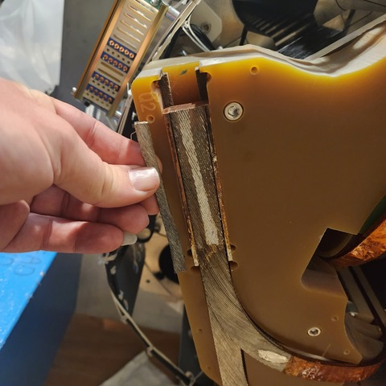
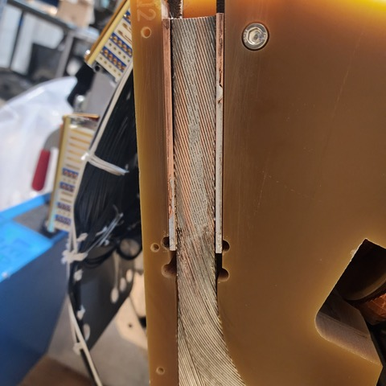
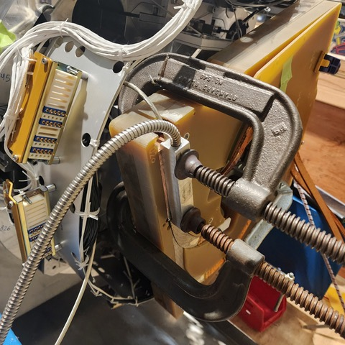
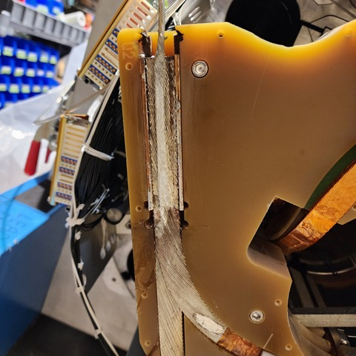
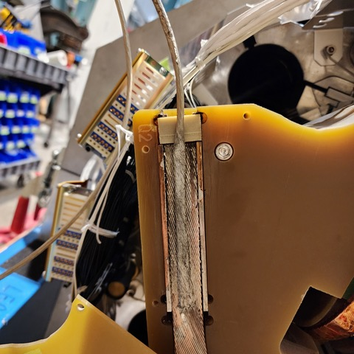
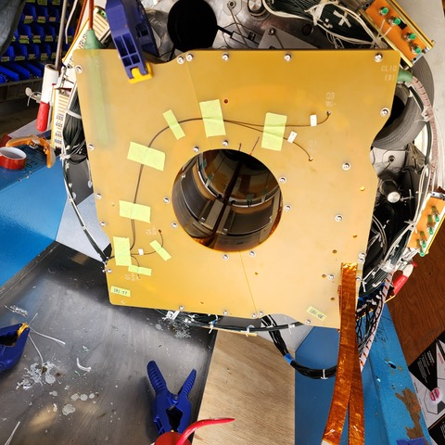
MQXFA17 Recovery Update, 3/25/24
New CLIQ Lead and packaging

