Slide 1
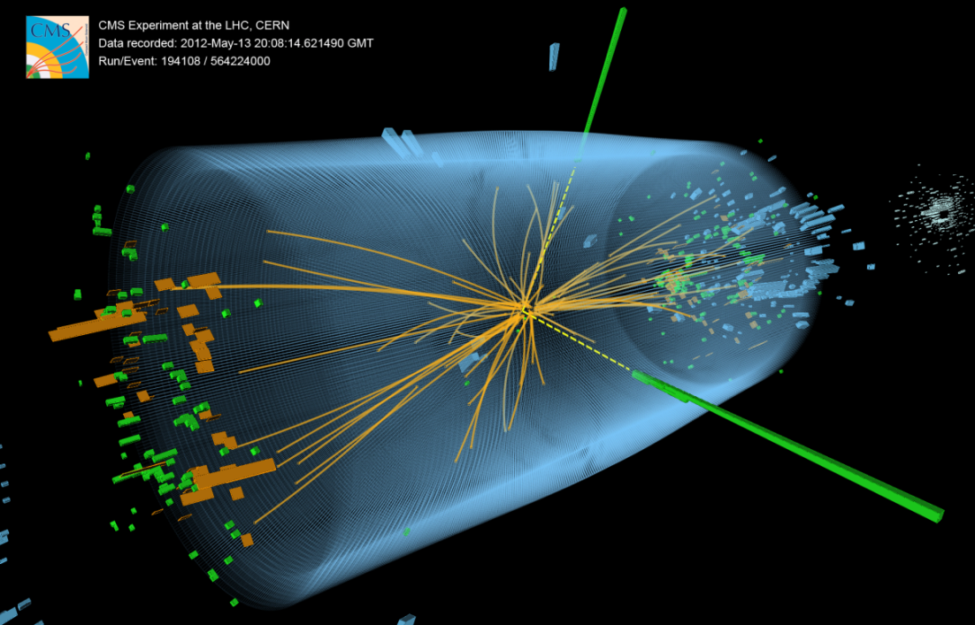
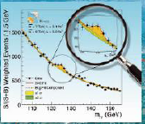
Fermilab Budget Review
U.S. CMS Operations Program
FY’14-FY’15 Budget for Fermilab
Joel Butler
February 6, 2013

Slide 2
B&R Codes and Budget Guidance
KA2102022: CMS Detector and Computing Support
34,511 FY’12 budget
28,490 FY’13 budget – February plan
27,580 FY’13 budget – current guidance
25,580 FY’14 Case B This will be a calamity
28,580 FY’15 Case B This is where we should have been
KA2103011: LHC CMS Upgrade Project OPC
0 FY’12 budget
1,000 FY’13 budget – February plan
1,000 FY’13 budget – Current guidance DOE TOLD US $2.0M
3,000 FY’14 budget --
0 FY’15 budget – OPC ends, project starts
0 FY’16 budget – No OPC
KA2103011: LHC CMS Upgrade Project TEC
8,500 FY’15 budget
11,000 FY’16 budget

Slide 3
U.S. CMS FY’13 Budget
2013 Budgets | DOE | NSF | Total |  |  | 5-Feb-13
Com Op | 7,995,711 | 1,656,650 | 9,652,361 | r23.04
S&C | 10,436,881 | 5,538,898 | 15,975,779 | v5.1
Det Op M&O | 5,475,226 | 465,067 | 5,940,293
Det Improvements | 3,883,012 | 345,253 | 4,228,265
Upgrade R&D Ph1 | 1,119,074 | 142,810 | 1,261,884 | v4.14
Upgrade R&D Ph2 | 294,607 | 43,969 | 338,576 | v4.14
Total | 29,204,511 | 8,192,647 | 37,397,158
2013 Funding
2012 Carryover | 7,232,835 | - | 7,232,835 | Includes 1,020,000 rec'd near the end of FY 12.
New 2013 Funding | 27,580,000 | 9,000,000 | 36,580,000 | DOE funding is Op only, not including Upgrade OPC.
Total | 34,812,835 | 9,000,000 | 43,812,835
This is Phase 1 Upgrade OPC estimate, without management, from Upgrade budget spreadsheet v4.14.
Upgrade Ph1 OPC | 1,297,158 | 733,856 | 2,031,014 | Does not include any management cost.

Slide 4
Additional Funds
This does not include
$2.2M for USLHCNET
$140K for the U.S. LHC communicators at CERN
Half of this money is USATLAS’s share
We believe that these are from separate FWP’s also in the lab’s understanding

Slide 5
SWF in FY’13
This is ~what is budgeted in FY’13 for SWF
Project 45: Detector Operations -- $2.06 M
Project 55: S&C -- $6.50M
Project 47: $1.42 M
OPC: $1.50 M*
*Since DOE tells us we will get more and the initial guidance was $2.0M we are budgeting for that and will use MR to compensate if necessary.
0.7M is project management cap
$1.3M for R&D, pre-production prototypes, final design and engineering

Slide 6
Projecting to FY’14
We expect the lab to get the same of less in labor than they got in FY’13 since the total budget is ~flat
Project 45: Detector Operations -- should go down since the labor used on “improvement program” will end
Project 55: S&C -- SWF is the largest component and will be held constant unless I can find a way to reduce it
Project 47: Common Operations – support of Project Offices, ROC, and Run Coordination will stay constant or decline by 1.
OPC: This may go up but will probably compensate for decline in Project 45 at Fermilab
Lots of M&S will be needed and we will still not have had enough OPC in FY’13 + FY’14
One source of increase is Project Management, which we will hold down in various ways

Slide 7
Uncertainties and Issues FY’14-FY’15
NSF CA Budget and DOE budget
M&O A – share of CMS budget (both share and total budget) are not yet set
Exchange rate i(USD to CHF and Euro) s unpredictable
How much Operations funding will be needed to help mitigate the DOE impact of CMS University Energy Frontier Programs
BTW – ATLAS has the same problem
Will the big computing build up (doubling) be in FY’14 or FY’15
If in FY’15, this will help us in FY’14
CMS is developing its proposal for how to prepare for the FY’15 startup
They seem to be leaning to waiting
Will we need a “surge” in the 8 months before the run starts as we did last time

Slide 8
FY’15
Budget goes back up to past planning levels
Upgrade Construction Project may kick in
If it does, we will use more lab labor

Slide 9
Milestones Operations Program
FY’13:
Complete ME/4 chambers
Complete HO electronics and install(?)
Complete HF improvements
Complete ME1 electronics
Remove and Refurbish Forward Pixel detector
FY’14:
Complete ME1 improvements
Complete ME4 installation
Reinstall and recommission Forward Pixels
Recommisson HCAL and EMU
Prepare for acquisiont and installation of major Tier-1 upgrade

Slide 10
Upgrade Construction and OPC
FY’13
Get CD-1
Develop resource loaded cost and schedule
Demonstrate Stage 1 Trigger Upgrade
Select/quality SiPMs for the HCAL upgrade
Demonstrate uTCA control chain
FY’14
Get CD-2 (before the end of the calendar year)
Install and commission Stage 1 Trigger Upgrade
Construct/Install the “pilot pixel” system (joint with NSF MRI)

Slide 11
Conclusion
Sorry if I was not able to fill out some official spread sheet but I hope you have a good picture of the situation
We have usually arrive at a good understanding on labor costs with Divisions after our summer budget exercise
You may have a realistic view of the true FY’14 situation by next August

