Slide 1
Fermilab Budget Briefing FY 2014
Intensity Frontier Proton Research
KA 22 01 02 Breakout
February 28, 2013
Office of High Energy Physics
Germantown, MD
Notes:
PRINT THIS SLIDE ALONE. THEN PRINT 2 to the end AND THE FORMAT FOR THE BOOKS WILL BE CORRECT. TITLE PAGES SHOULD BE EVEN-NUMBERED.

Slide 2
Scenarios
Scenario B for Intensity Research
  FY12: 15,751 (FY13 FNAL Budget:14,645)
  FY14: 16,623
  FY15: 17,039
  FY16: 17,720
For Intensity Research assume Scenario C identical to Scenario B
Need guidance on what to assume for Intensity Research in Scenario A
  Assume Intensity Research will *not* follow the overall scenario (-3% in FY13 then flat-flat in future years)

Slide 3
Priorities
Fully exploiting the running experiments
  MINOS+, MINERvA, SeaQuest
Timely first results from the upcoming experiments
  NOvA, MicroBooNE
Technology development for muon experiments and LBNE
Laying the foundation for a Project X program

Slide 4
Overarching Themes
Ramp up of Intensity Research as Tevatron effort ramps down
  Account for mismatch in FY13 Intensity Research request
Establishing Fermilab as worldwide leader in Intensity research

Slide 5
Planned FY14 Changes
Increase number of postdocs
  Currently only 11.5 postdoc FTEs out of ~50 FTEs on Intensity Research
Implement Intensity Frontier Fellowships
  Modeled after LPC Fellowships
  FWP submitted
Foster an environment that ensures Fermilab is *the* intellectual hub for Intensity Research

Slide 6
Concerns
Resources to mount the necessary LAr TPC testbeam program
Supporting early stages of efforts leading to Project X
  ORKA, NuSTORM, n-nbar oscillation, EDMs, Coherent Neutrino Scattering, …
Resources needed to carry out the full MINERvA program
  Further testbeam running, H and D targets
Future neutrino program will need better modeling/understanding of GeV neutrino-nucleus interactions
  New lab hire? University hires? Stimulate postdoc involvement?

Slide 7
Last Year’s Intensity Research
Breakout Slides Follow

Slide 8
Running Experiments
Scenarios B and C
Shutdown: May. 2012 – Mar. 2013
Shut-down
Running with a partial detector
Page 8

Slide 9
Project Timeline
Scenario C:
Scenarios A & B: delay muon g-2 by 1 year; delay LBNE; Project X in R&D mode
R&D
Construction
Operations
Page 9

Slide 10
Overall Proton Research FTE’s
Page 10

Slide 11
Overall Proton Research Requests
Page 11

Slide 12
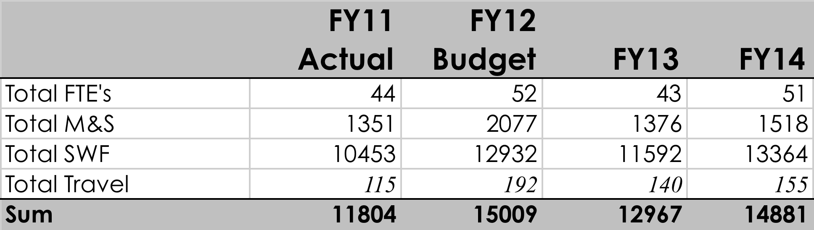
B: Summary FY11 – FY15 Intensity Frontier
Growth here to support ramp up in future programs
Many different projects/experiments. Total FTE’s on any given project small, and spread over larger number of people
Single consolidated NOvA Shutdown of 12 months beginning May 1, 2012
LAr TPC efforts – LBNE + MicroBooNE are scale of CDF or Dzero, but the scientific effort is not in place at a comparable scale
Page 12

Slide 13
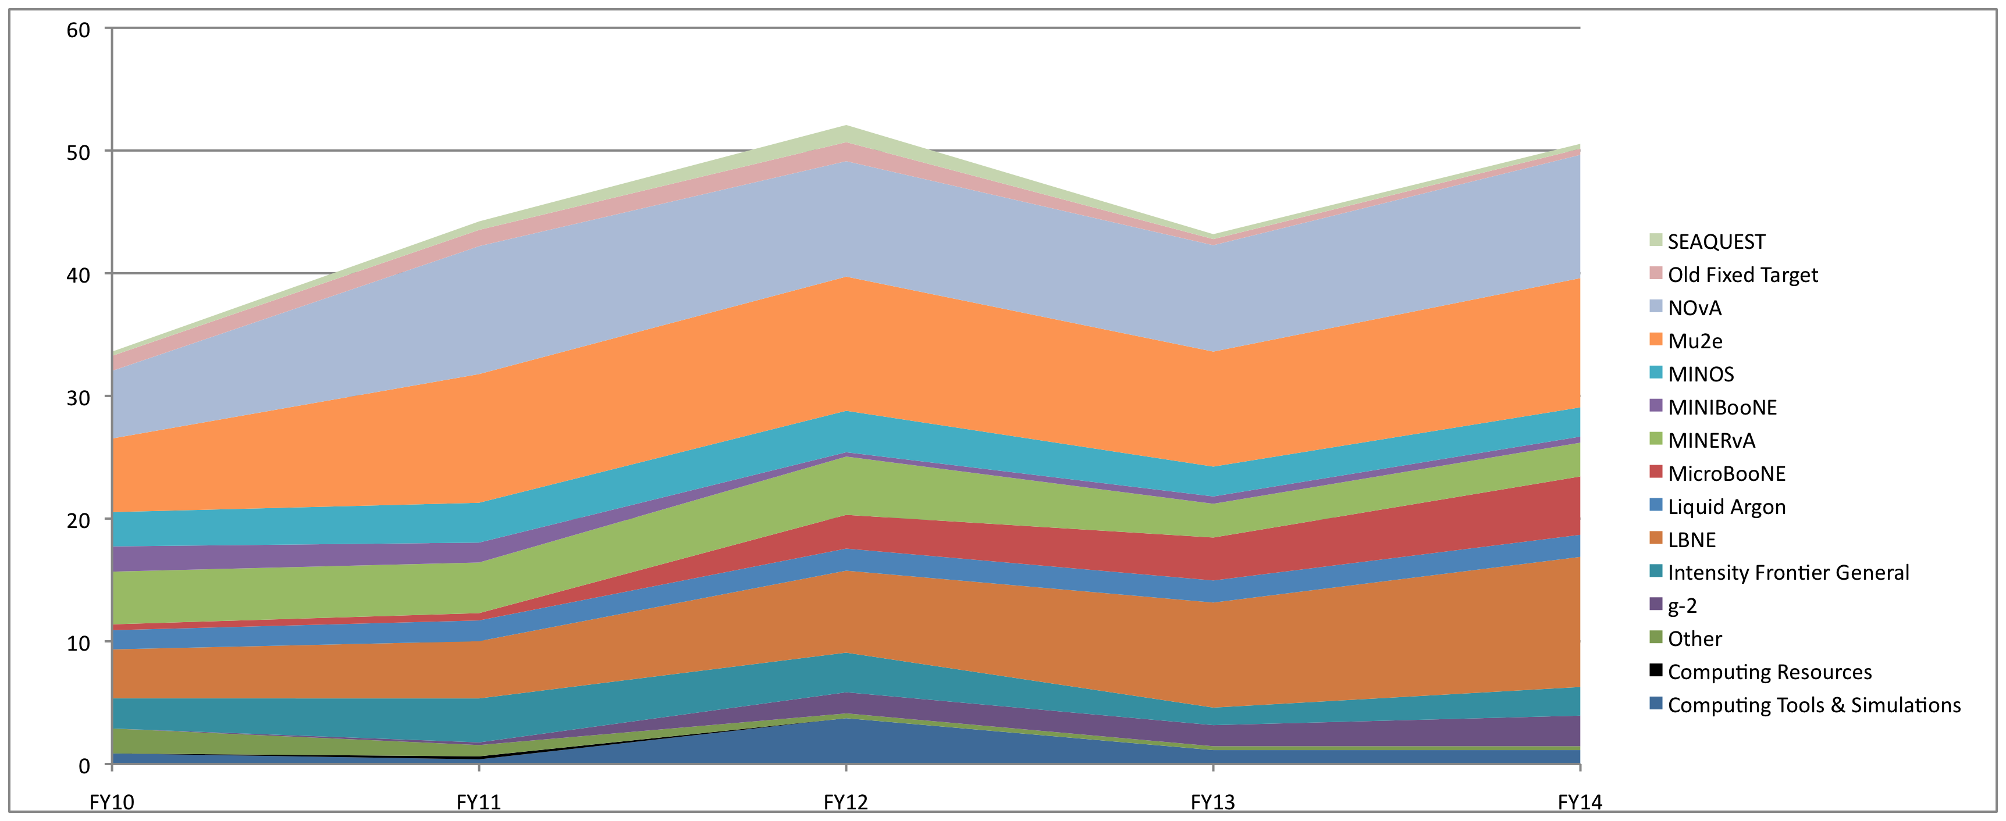
B: Summary FY11 – FY15 – FTE’s
Page 13

Slide 14
B: Summary FY11 – FY15 Funding
Page 14

Slide 16
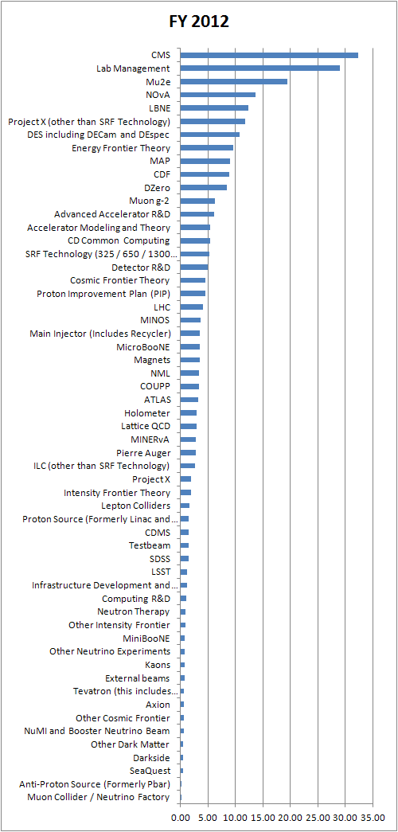
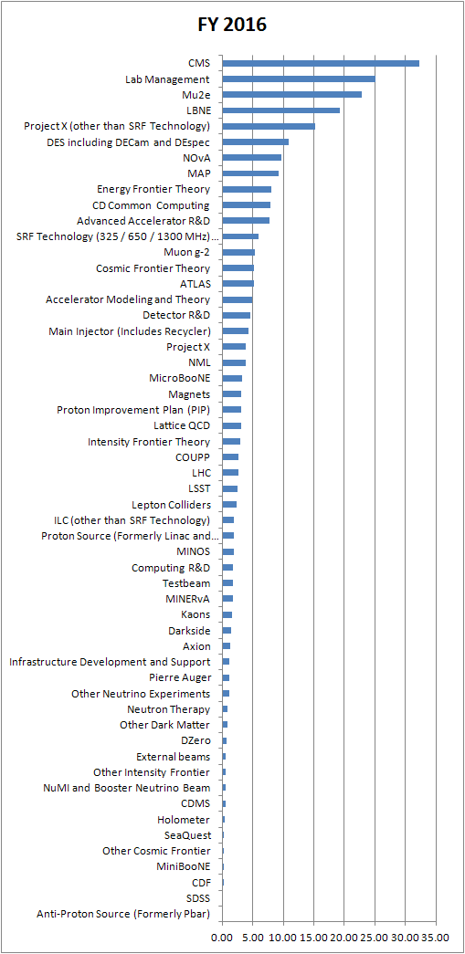

Slide 17
B: Intensity Frontier Summary Discussion
Priorities
  NOvA, MINERvA, MINOS, MiniBooNE, SeaQuest science leadership and data collection and analysis
  Advance broad program of Intensity Frontier research
  Scientific support for Mu2e, MicroBooNE, LBNE projects
Planned Accomplishments
  Achieve present running plan of MINOS, Minerva, MiniBooNE and production of final results
  Commission, first operations, data analysis of SeaQuest
  NOvA and MicroBooNE project completion, first results, further running and results from MINOS and MiniBooNE
  Demonstrate science and technology for muon and LAr programs
Issues and Concerns
  g-2 plan is complicated – need to line up some experienced staff in key places
  LAr TPC effort on technology, understanding detector response (need test beam effort), project support, analysis techniques all require substantial, focused, long term scientific effort
  Need to find effort to initiate Project X science program
Page 17

Slide 18
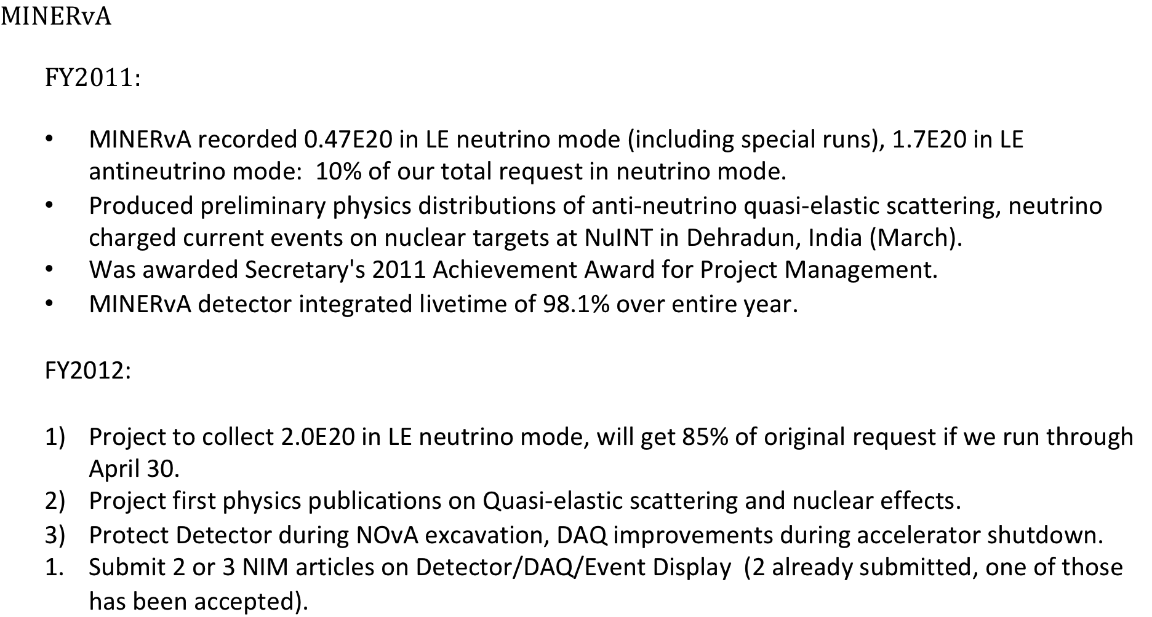
MINERvA

Slide 19
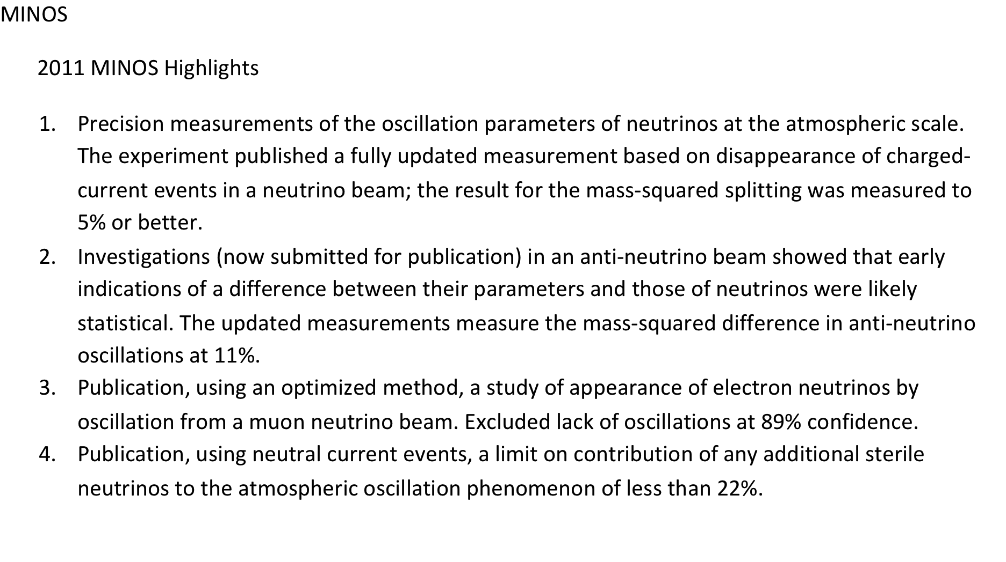
MINOS

Slide 20
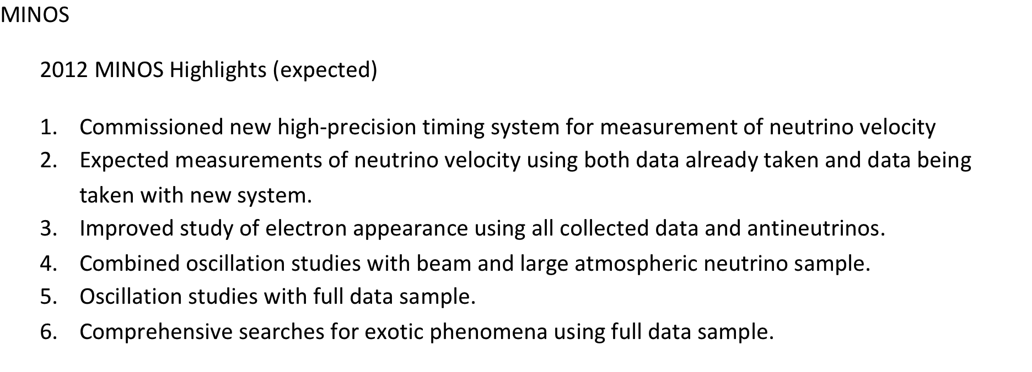
MINOS

Slide 21
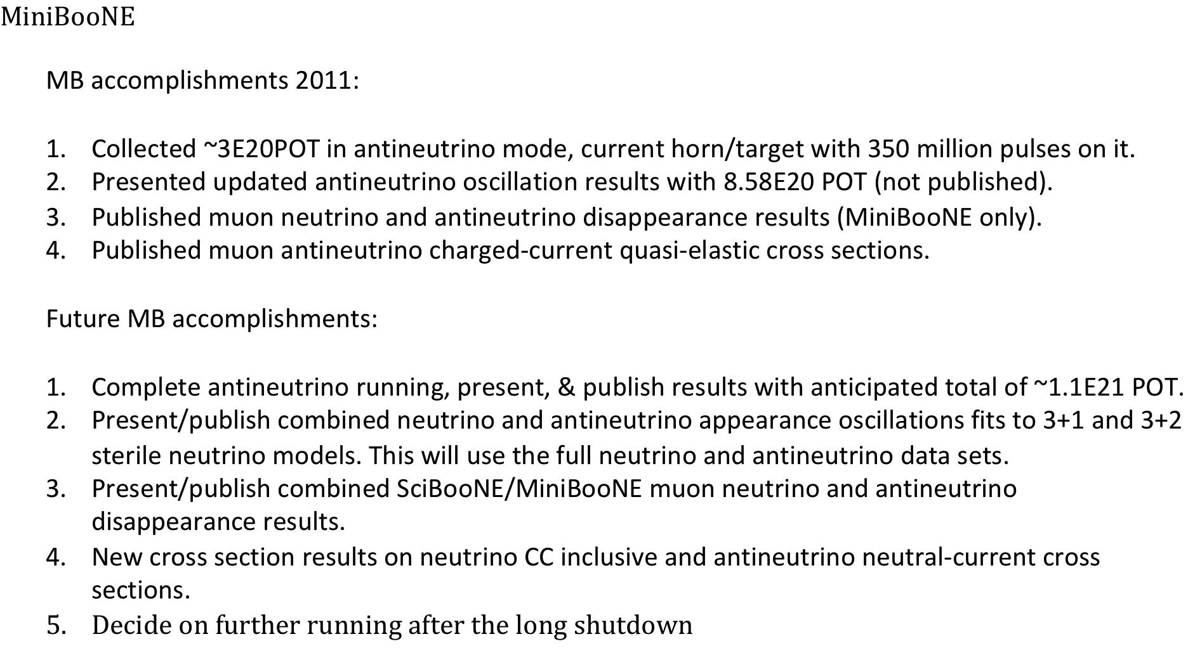
MiniBooNE

Slide 22
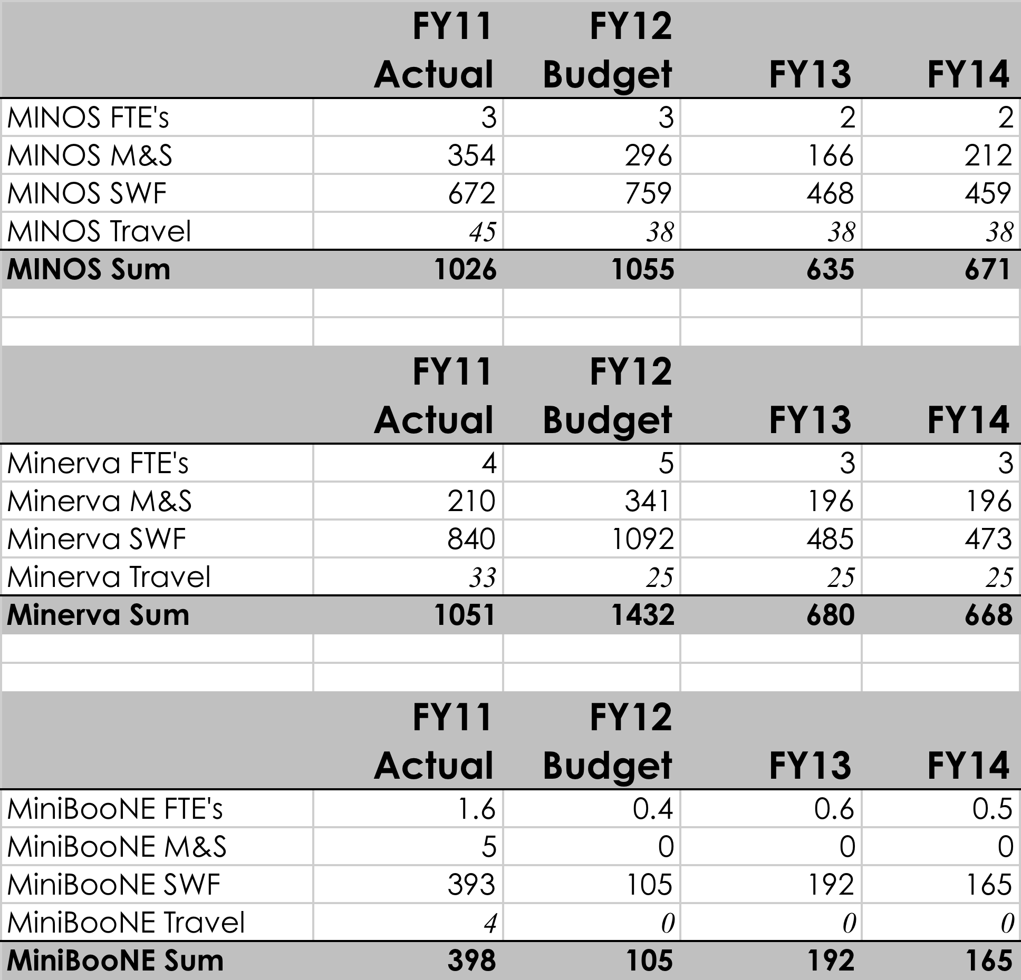
B: FY11-15, MINOS, MiniBooNE, Minerva
Page 22

Slide 23
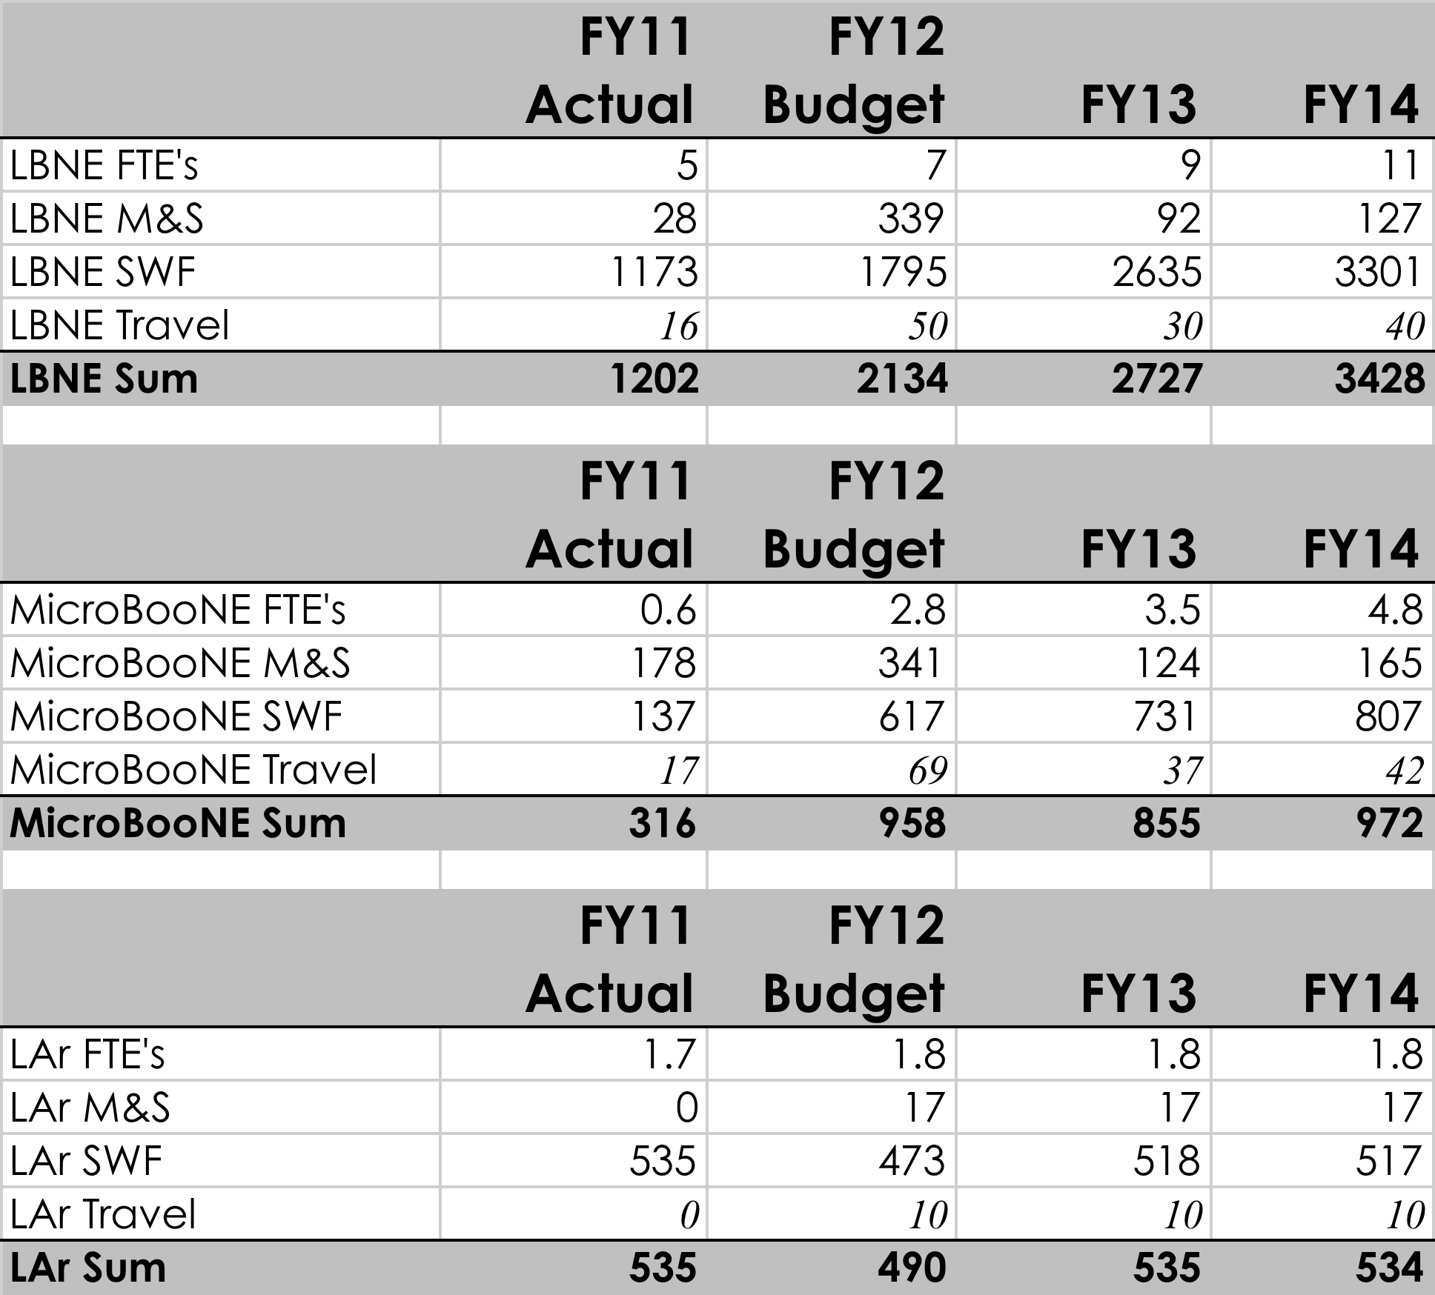
B: FY11-15, LBNE, MicroBooNE, LAr TPC
Effort here ramped up, should be sufficient
MicrBooNE on track for FY14
LAr Purity Demonstrator and Test Beam effort
Page 23

Slide 24
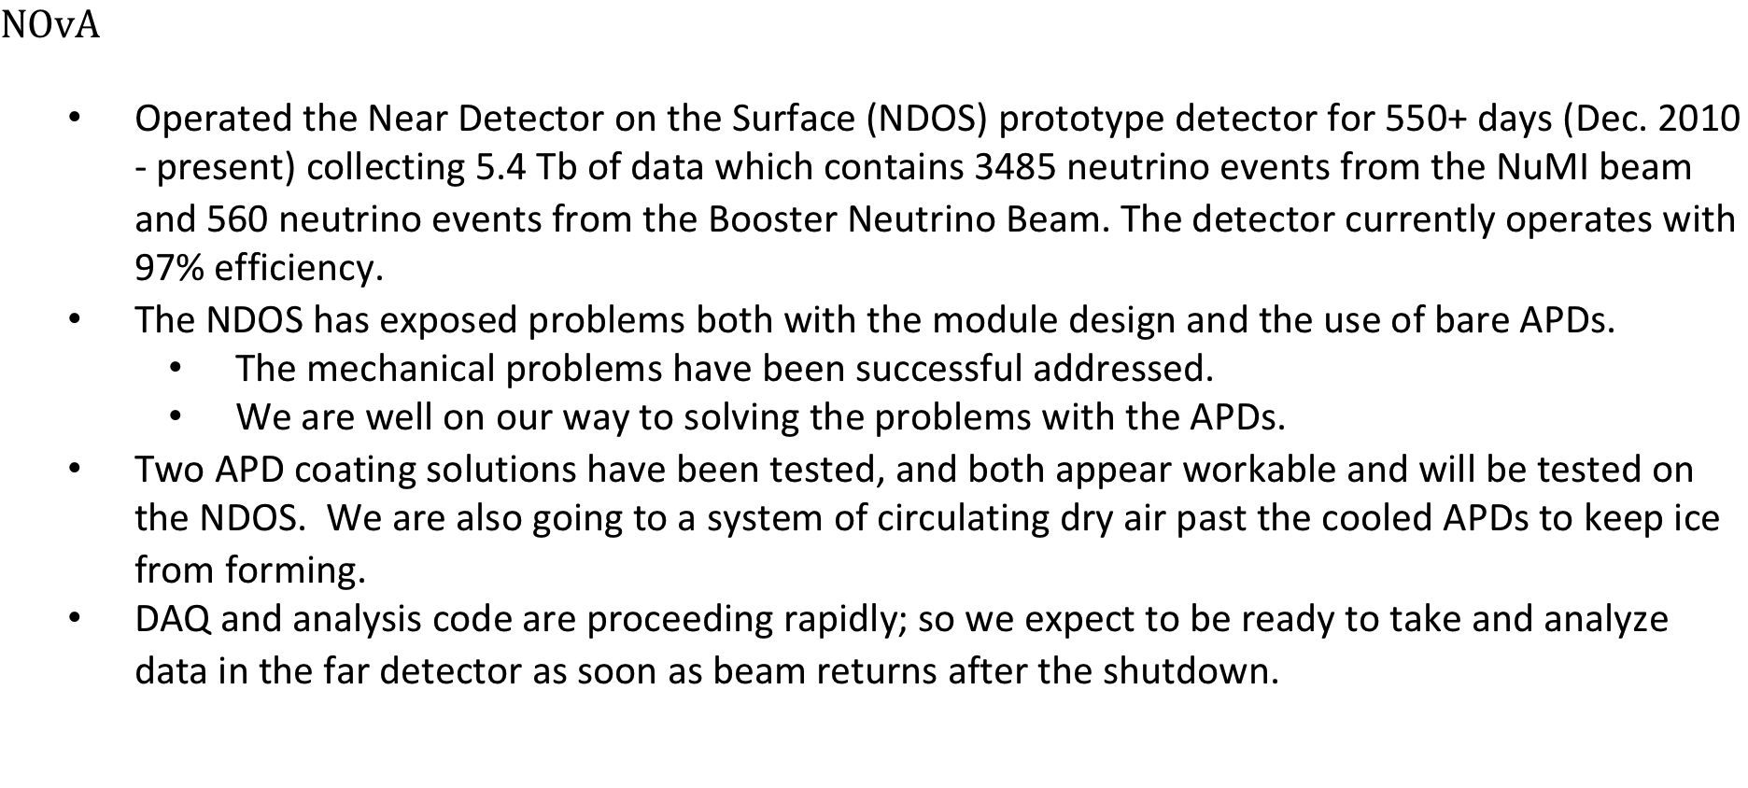
NOvA

Slide 25
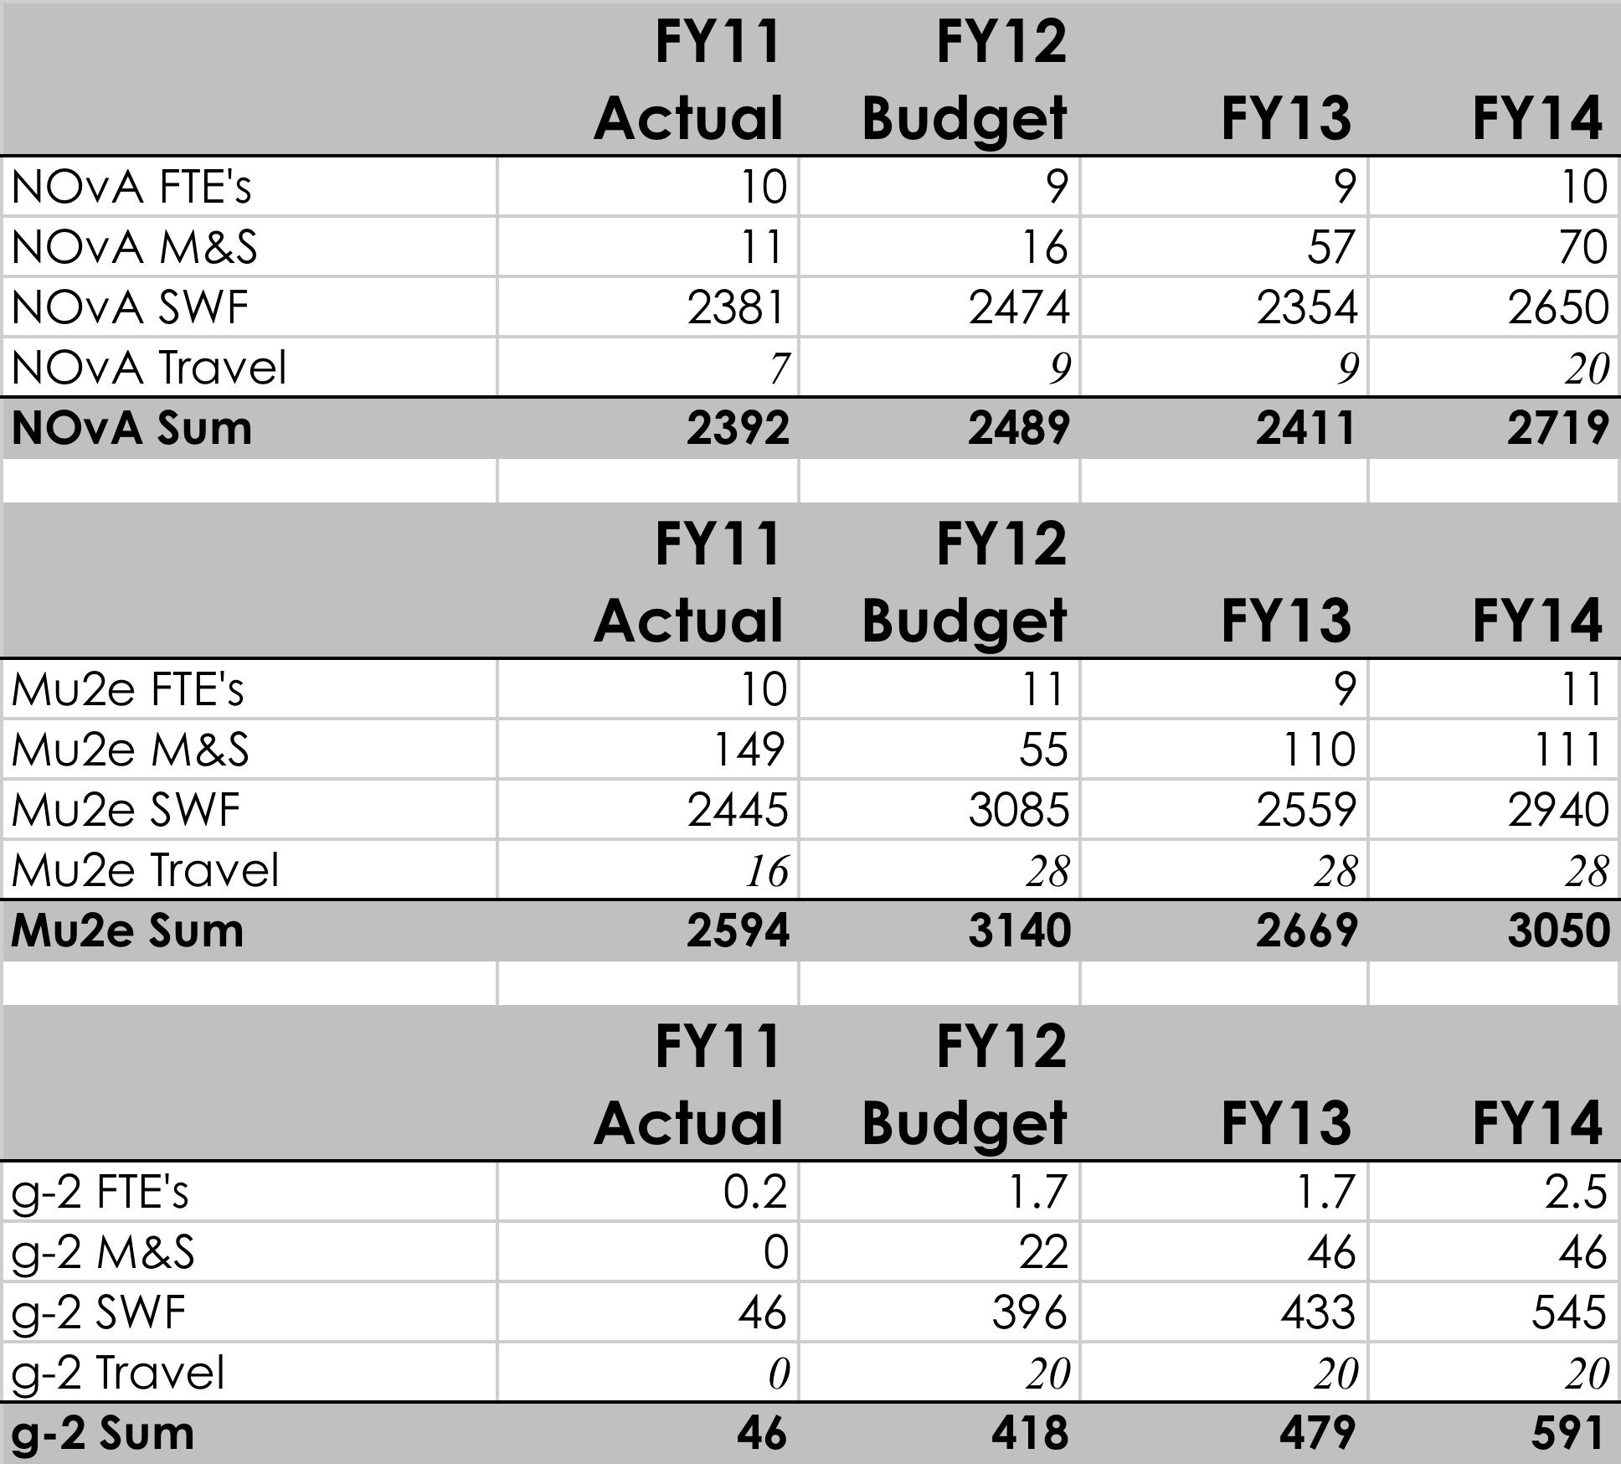
B: FY11-15, Mu2e, MIPP, NOvA
NOvA scientific effort slowly grows as people move off project and onto analysis
Mu2e scientific effort ramps up, and then some move to project
Page 25

Slide 26
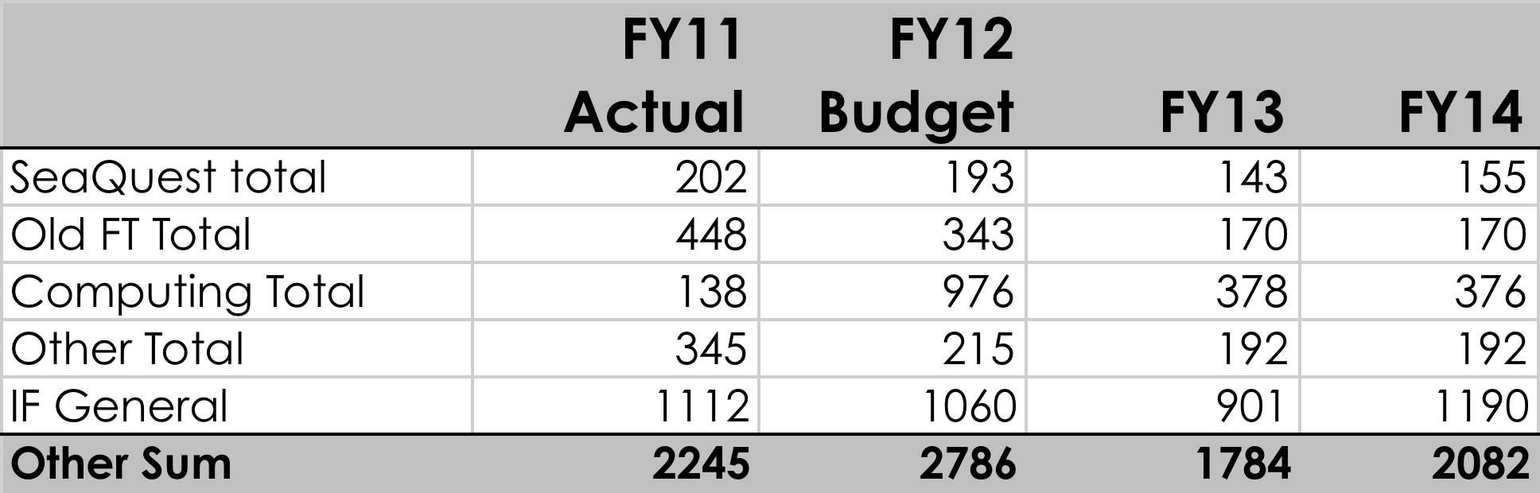
B: FY11-15 – Other
SeaQuest scientific effort to lead running of experiment, analysis
Outreach – Conf. Travel SWF in APC/AD in support of IF research
Old Fixed Target – KTeV, Focus, SELEX, SciBooNE , MIPP analysis, etc.
IF General – Management, Scientist Test Beam support, new hires prior to job assignment, efforts not exclusively directed at a single experiment
Scientific Simulations increasingly important in program. Growth minimal for wide program
Page 26

Slide 27
B: Intensity – FY12 Plan
Priorities
  Run neutrino program until ~May 1, produce physics results from MINOS, Minerva, MiniBooNE
  Continue transition of scientific effort to NOvA, MicroBooNE, LBNE, Mu2e
Planned Accomplishments
  Receive CD-1 for Mu2e; CD-2 for MicroBooNE
  Continue planned progress toward CD-1 for LBNE
  World-leading results in MINOS, MINERvA, MiniBooNE
Issues and Concerns
  Scientific staff spread thin over a broad program
    All new projects low in off-project scientist effort
Page 27

Slide 28
B: Intensity – FY13 Plan
Priorities
  Continued scientific support of running experiments
  NOvA, MicroBooNE progress on schedule
  LBNE and Mu2e scientific support ramp up
Planned Accomplishments
  World-leading results in MINOS, MINERvA, MiniBooNE
  Beam and analysis commissioning of Nova Far detector
  Continue scientific efforts on established projects to prepare for physics
  Continue leadership roles in new project science collaborations
Issues and Concerns
  Scientific effort needed to deliver world leading IF program, with leadership in science output, in experiments leadership, and off project effort ramps up well this year, but it is a very ambitious program.
Page 28

Slide 29
B: Intensity – FY14 Plan
Priorities
  Scientific support of running neutrino experiments after NOvA tie-in
  Scientific support of NOvA, Mu2e, MicroBooNE, LBNE projects
Planned Accomplishments
  World-leading results in MINOS, MINERvA
  NOvA commissioning, data taking, and initial results
  Provide scientific support needed for baselining Mu2e
    Some scientists move to project roles
  Support initial data analysis and commissioning MicroBooNE
  SeaQuest data analysis and early results
Issues and Concerns
  Overall support level flattens out at point where perhaps more scientist effort will be needed to deliver the program
Page 29

Slide 30
Scenario A:
Plan essentially similar to scenario B
Intensity Frontier is high priority
Page 30

Slide 31
Possible topics for further discussion
Energy-to-Intensity transition well underway
Operations tasks and research boundary
Organization
  Working on establishing overall Intensity frontier organization
  Visitor Program
  Staffing and New hires
  XOC status
New experiments on horizon
  ORKA
  Shortbaseline Neutrino Taskforce

Slide 32
Backups
Page 32

Slide 33
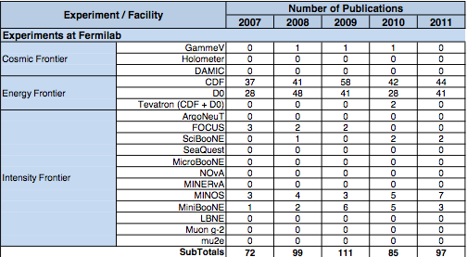
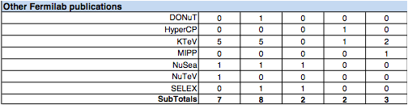

Slide 34
