Slide 1
TMS Magnet Update
Tom Markiewicz/SLAC
27 March 2024

Slide 2
ANL Step File of CDR Design
Smaller coil box 220x216mm^2 than 300x300mm^2 quoted in CDR text

Slide 3
Fringe Fields in CDR Design w/ Perfect Plate Alignment
Marco Oriunno has a full ANSYS EMAG model of the CDR design. The fringe field produced by that design is shown in two attached slides. See the linked presentation at the I&I meeting for more views.
At the spectrometer midplane in Y, the field goes from 5 Gauss near the steel to ~38 Gauss ~1.5-2m from the steel then falls off to ~5 Gauss.
At >~2.5m from the front (NDLAr side) or back of TMS (SAND side) the field is below 10 Gauss
These numbers are preliminary and are for perfect plate alignment

Slide 4
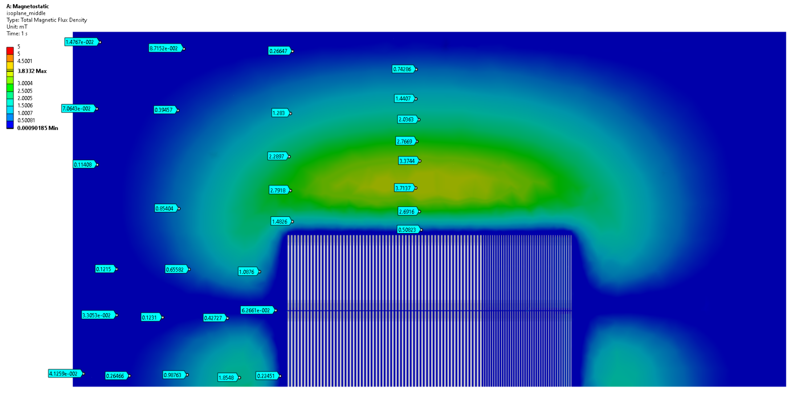
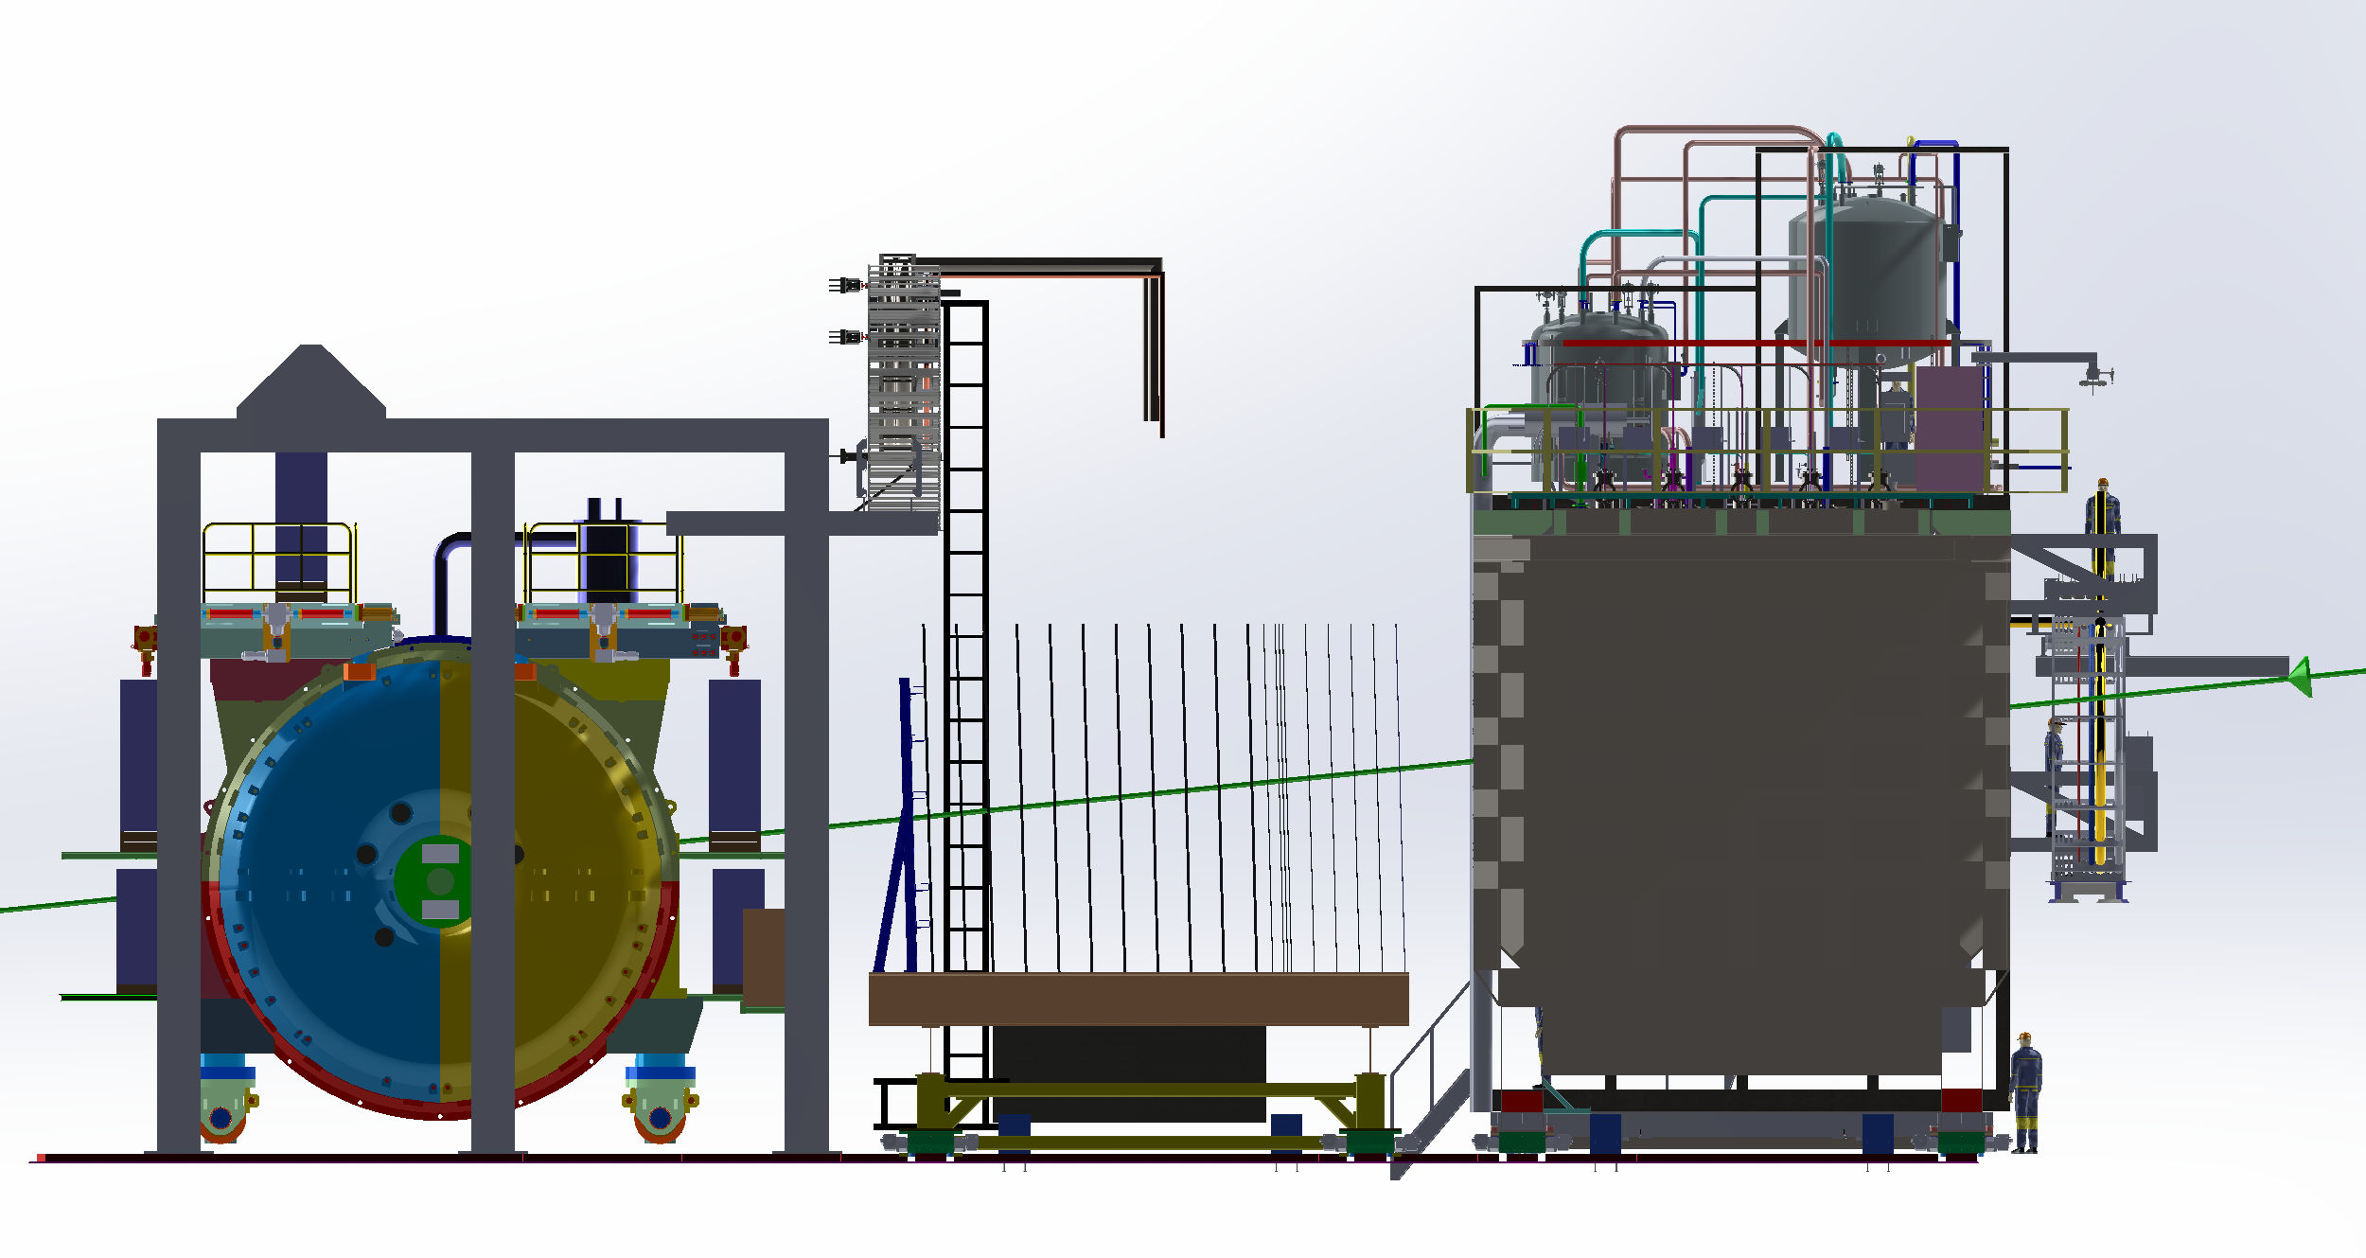
TMS Fringe Field - Midplane
Color scale:
Red = [50 gauss, maximum]

Slide 5
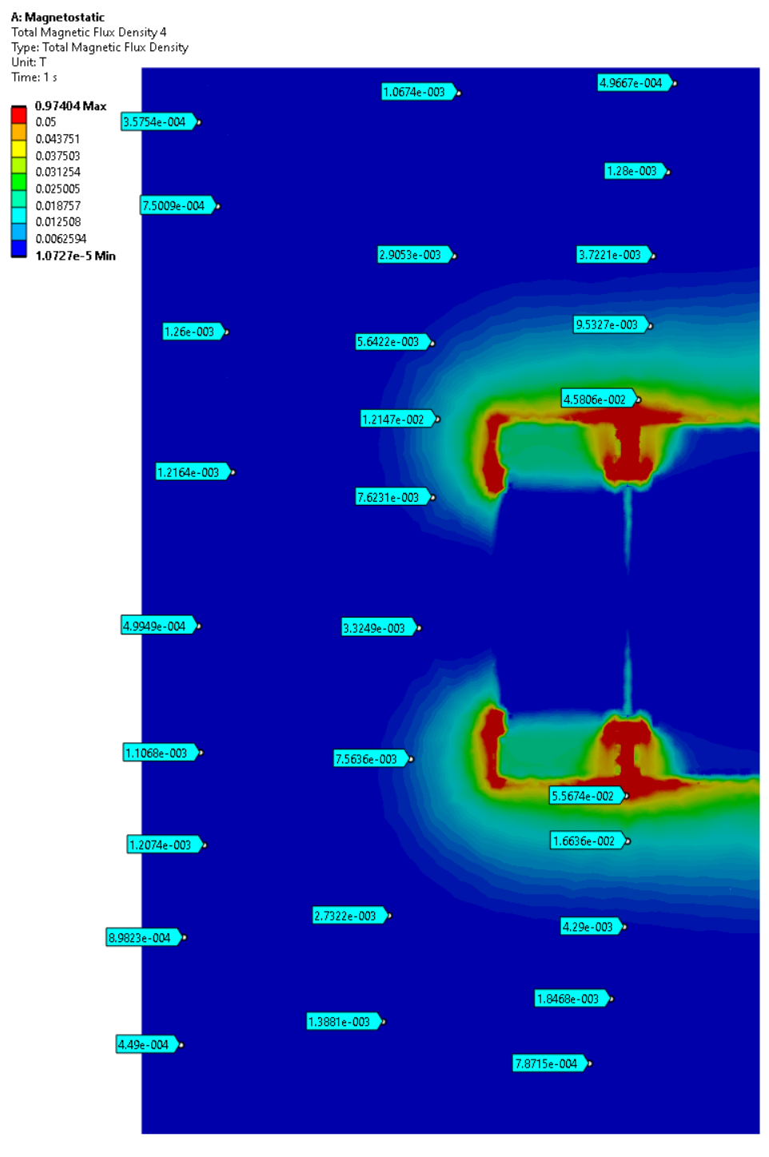
TMS - Front
Color scale:
Red = [500 gauss, maximum]

Slide 6
Coil onstruction and Installation
The preferred concept for assembling the coil is that used by MINOS (see slide) where corner pieces are used to join two sets of copper bars at 90 degrees. Each side is a “plank”. MINOS assembled these corners in the field.
The group currently prefers the proposed scheme of pre-assembling and testing the coil (by a vendor, if possible) and to load the steel plates over the lower coils through SLOTS cut in the corners of the plates. Coils would sit on stands. The upper coils would be lowered into slots at the top of the plates.
Ideally coils would be in a thin-walled non-magnetic (Stainless steel or aluminum) box.

Slide 7
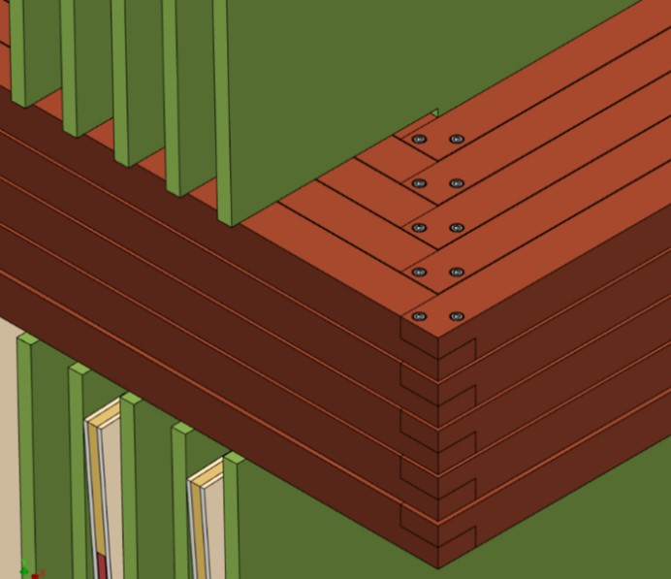
CDR Coil Design and Assembly Concept 25 loop Series connected coils 200mm x 200mm Coil Package Inserted into 220mm x 220mm Notch Assembled into notches and first tested after steel plates stacked and detector panels mounted

Slide 8
Idea: Avoid 4x25 in-situ installed corner joints and jumpers per coil
Vendor pre-assembled coil, boxed and pre-tested. Lowered/raised through 30cm x 90cm slots. Center pairs of slots 62cm x 60cm must be “patched” closed afterwards.
CDR Steel Plate Design but MINOS ND style coil “planks” of 5 bars installed in-situ in 30cm x 30cm notches after plates assembled, joined and tested in pit

Slide 9
Magnet Studies (1)
Wes Craddock has compared the CDR design to many variants using a simplified 20 thin plus 20 thick plate ¼ symmetric model (to speed calculation time) using MAXWELL code in ANSYS Workbench. They key conclusions to date are:
The flux between side and center plates can be effectively bridged by placing a 80mm thick x 760mm wide plate across the 460mm gap between center and side plates. 460mm = 2x220mm (slots for the coils in the plates) + 20mm plate-to-plate gap.
The distance between the bottom of the coil slot and the top of the plate can be reduced by 400mm. Meaning overall plate height can be reduced from 5, to 4.2m.
The gap between the upper and lower coils can be increased from 3266mm (CDR) to 3440mm, allowing for Y-detector panels of the same width and channel count as the u,v detector panels.
Studies optimizing the coil placement in the slot, tuning the 2-cm plate-to-plate gap below the slot (i.e. enlarging the gap from 20mm to 40mm for 100m below the slot bottom) are in progress. This prevents the flux from “shorting out” below the coils and enhances vertical field uniformity.

Slide 10
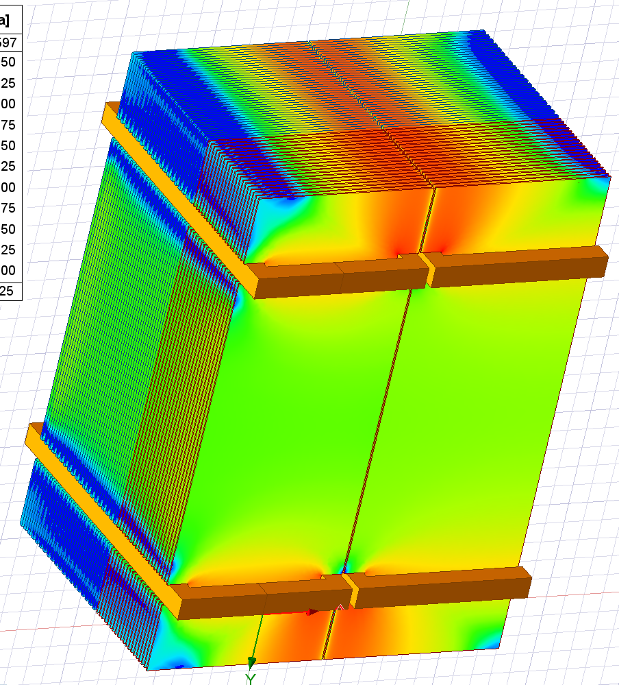
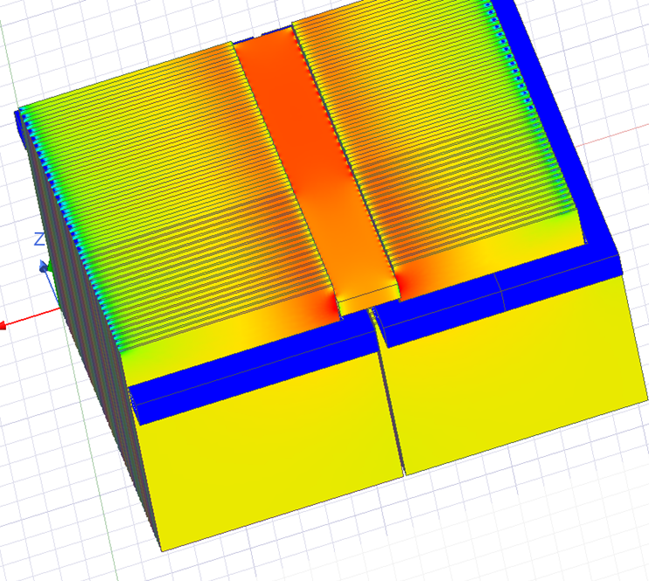
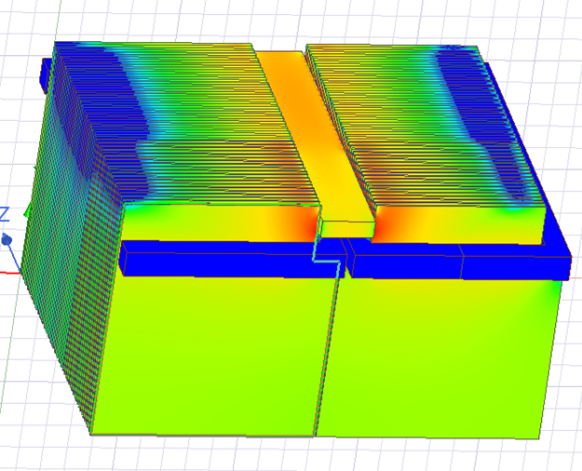
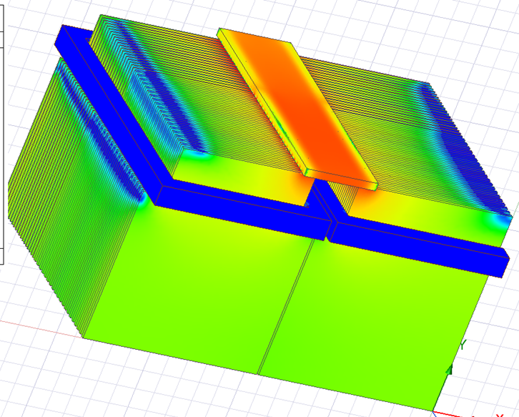
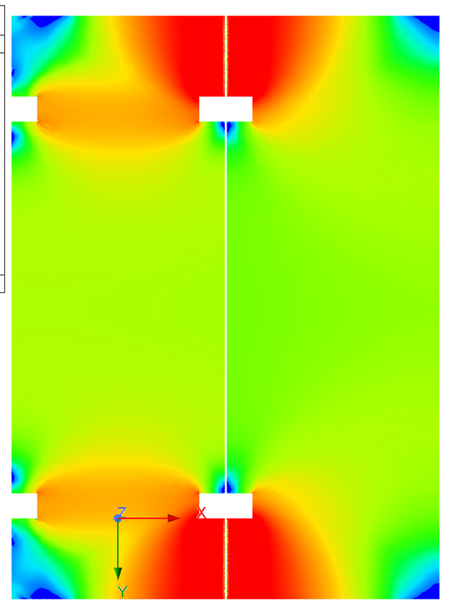
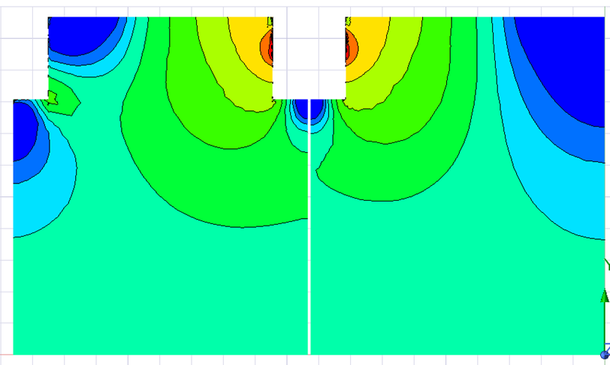
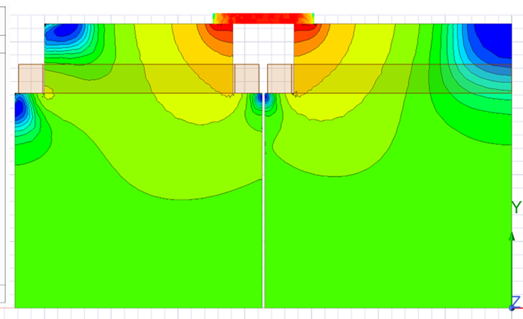
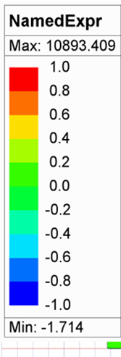
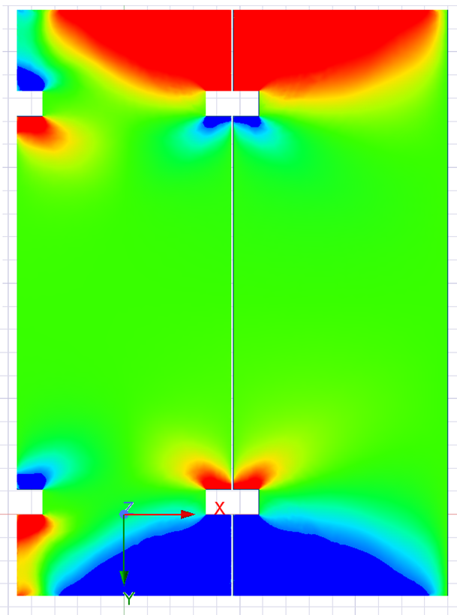
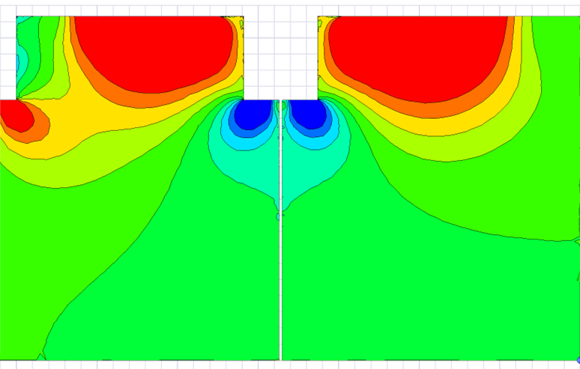
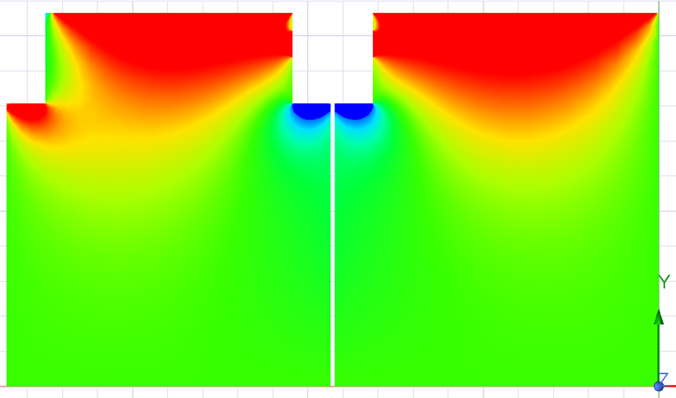
Summary Cases
20+20 Plates ½ and 1/4 Models
Baseline Case
Case 1: Slot Iron Touching
Case 2: Slot Iron 1+1 cm gap
Case 3: Iron Plate on Top
Bmag Middle 40 mm Plate
Bx Fraction Middle 40 mm

Slide 11
20+20 Plates 1/4 Models – Coil Separation 3226 mm vs. 3460 mm- Overall iron plate dimensions unchanged
Case 3b: Iron Plate on Top
Case 8 TMS Quarter Model 4:
Coil notch separation increased: 3226 mm to 3440 mm
Coil Gap Above Notch Bottom Increased from 0 to 1 mm
Vertical mid-plane gap at notch bottom 40mm x 100 mm
Abs Value By Middle 40 mm
By Middle 40 mm

Slide 12
Magnet Studies (2)
It appears that 1006 (MINOS) steel is much preferred to 1008 steel.
It appears that 30,000 amp-turns of current gives more than enough B field.
It seems that there are power supplies that can be easily acquired to provide this current. Changing the current to limit the field to ~1 Tesla and reducing heat and magnetic forces will be studied. See for example, https://magna-power.com/ .
Coil optimization studies will begin soon. Currently the coil package is 220mm x 220mm. It is thought that a taller-thinner cross section may be beneficial.
Craddock is in contact with EversonTesla (https://www.eversontesla.com/) about winding or otherwise fabrication the coil packages.

Slide 13
Concluding Remarks
Studies are needed to evaluate the FORCES on the plates as are designs of blocks, etc. to hold the plates steady in x and z in the face of those forces. Studies on the forces on the coils are needed.
Thermal mechanical analysis is still to be done.
Nonetheless, the baseline model is evolving to installation of preassembled coils through slots that are then bridged.
The concept of installing coil “planks” as MINOS did, after all the steel is assembled, and having the coils reside in CDR-like NOTCHES (which limit the plate-to-plate gap to 20mm instead of 460mm (for slots)) seems disfavored.

