Slide 1
ROI study for data reduction and improving low energy sensitivity
Matthew Man,
Nikolina Ilic,
Danaisis Vargas
March ${18}^{th}$, 2024

Slide 2
Motivation
Trigger threshold is limited by data volume, 30 PB/year for DUNE
ROI reduces data volume by removing “empty” channels from trigger records (zero suppression)
Goal to increase sensitivity to low energy events ( <10 Mev ) by permitting a lower threshold
ROI to be implemented in DAQ data filter

Slide 3
Slide from Josh Klein

Slide 4
ROI details
ROI is threshold based. When a channel goes above an ADC peak threshold, ROI is applied
Neighboring channels stored, width of 10 wires on each side
Recommended by Wirecell experts as the effective induction range for a point charge
ROI time granularity is width of the frame, 6000 ticks ~= 100 μs
Outside the ROI is zero suppressed
Tunable parameters are the peak threshold, and neighboring channel width

Slide 5
Simulations
2DROIAna package in duneana fork here:
https://github.com/matthew-man-457/duneana/tree/mman/2D_ROI
Simulation workflow (dune10kt_1x2x6):
MARLEY gen using solar boron 8 flux + latest decay0 backgrounds
Standard G4
Detsim uses notpcsigproc (outputs rawdigits)
ROIAna
Uses:
larsoft_v09_82_02d01
dune10kt_v6_refactored_1x2x6.gdml
dunefd_hd_backgrounds_1x2x6_v3_5

Slide 6
ROIAna
In the analysis the ROI is applied on RawDigits, which are simulated raw waveforms
In the Data Filter we would run on Trigger Records (not yet implemented/tested)
Applies ROI on RawDigits and calculates various performance metrics:
Energy fraction captured within ROI
Charge fraction captured within ROI
Data reduction rate estimate (as fraction of channels within ROI)
Sensitivity to signal
Definitions:
sim::IDE.energy – amount of energy released by ionization (from G4 simulation)
sim::IDE.numElectrons – amount of electrons reaching the readout channel after drifting

Slide 7
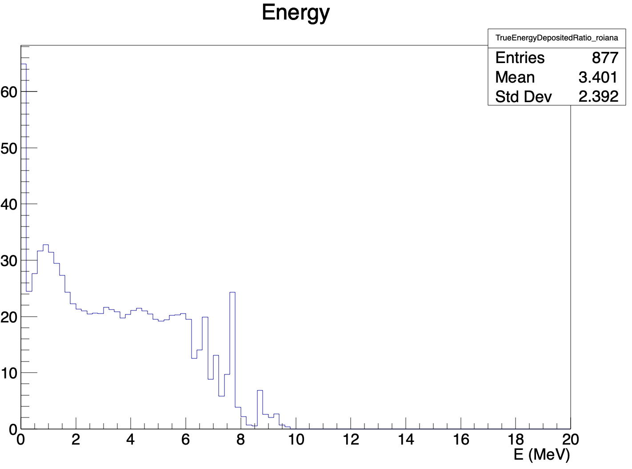
ROIAna output
n=10000 events
Threshold is 100 ADC counts
Proportion of ionization energy deposited captured within ROI
%

Slide 8
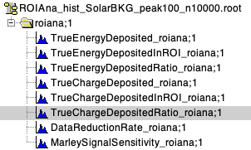
ROIAna output
n=10000 events
Threshold is 100 ADC counts
Proportion of electrons reaching the within ROI
%

Slide 9
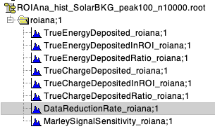
ROIAna output
n=10000 events
Threshold is 100 ADC counts
Proportion of channels with ROI
With this threshold on average ~80% fewer channels stored

Slide 10
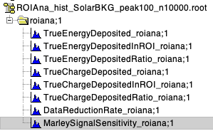
ROIAna output
n=10000 events
Threshold is 100 ADC counts
Sensitivity of ROI to Marley signal, as given by fraction of energy of Marley events within ROI
With this threshold on average 42% of energy from signal events is contained within ROI

Slide 11
Discussion
From DAQ side this is another knob to tune data rate sent offline
From LowE side this tunes sensitivity and statistics of <10 MeV events, eg. Solar neutrinos
Reality is a balance of the two
Input from low energy and DAQ groups on setting the ROI threshold
Should check reconstruction performance on ROI-applied data, that deconvolution doesn’t introduce aliasing
Can Readout keep up with a rate corresponding to a lower threshold?
Working on sensitivity study of ROI on solar B8 and background rejection
Would be interesting to break down each metric by their source

Slide 12
Backup slides

Slide 13
Solar B8 spectrum
We expect a solar neutrino event rate of ~100 per day in a 40kt LArTPC
So our sample of 10000 events represents 100 days

Slide 14
Decay0 backgrounds
Slide from Sergio Manthey

Slide 15
OLD version of ROI
Implemented in Wirecell
The width ROI in time was too tight, it introduced artifacts upon deconvolution, which were too troublesome to work around

Slide 16
Example event

