Slide 1
Muon Campus Operation Report
Jim Morgan
Friday 09:00 Operations Meeting
March 29, 2024

Slide 2
Muon Campus status
ESS1 Electrostatic Septum
Survey of internal components completed on Tuesday (no report yet)
ESS1 closed up and moved on cart out of A0 Clean Room, leak check underway
Preparing for transport to NWA for pump-down and high voltage conditioning
Existing transport cart will be used for ESS1 move and NWA testing
ESS2 assembly underway
ASE approved, working towards permission for beam operation
AP-0 A/C work resumed
Q206 water repairs finished, ready to reinstall M4 components above
Preparations for Electrostatic Septa mechanical installation in tunnel
ESS1 stands and vacuum spool are installed
Probably won’t be able to put prototype ESS2 into final position with new stands
Prototype ESS2 will eventually be replaced by operational ESS2
Have elected not to do Q205 replacement and modified pipe installation
Have found that original installation method will no longer work
Prefer to carefully engineer new method, with eye towards ALARA in Mu2e era
TD won’t get 8Q24 in tunnel to upgrade with rad hard water lines
Study – M1-M3 Optics
Study – Alternative M5 optics
KPS5A PFL Repair
MC-1 Controlled Access
G-2 Trolley Run
Intentional Accelerator
Standby Period
<------------Week Days -------------------→

Slide 3
ESS2 move requires transport cart
New compact vacuum pipe installed
ESS2 needs to move upstream or have spool installed
ESS1
Temporary Pbar cooling stand, to be replaced

Slide 4
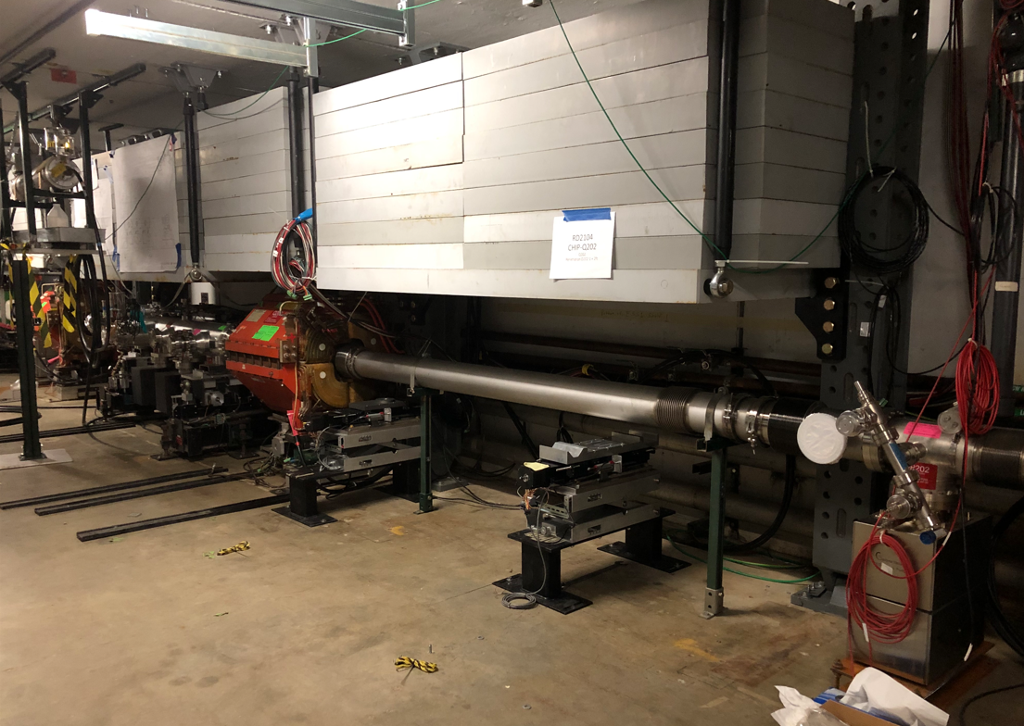
ESS1 vacuum spool and other parts
ESS1 vacuum spool
New ESS stands

Slide 5
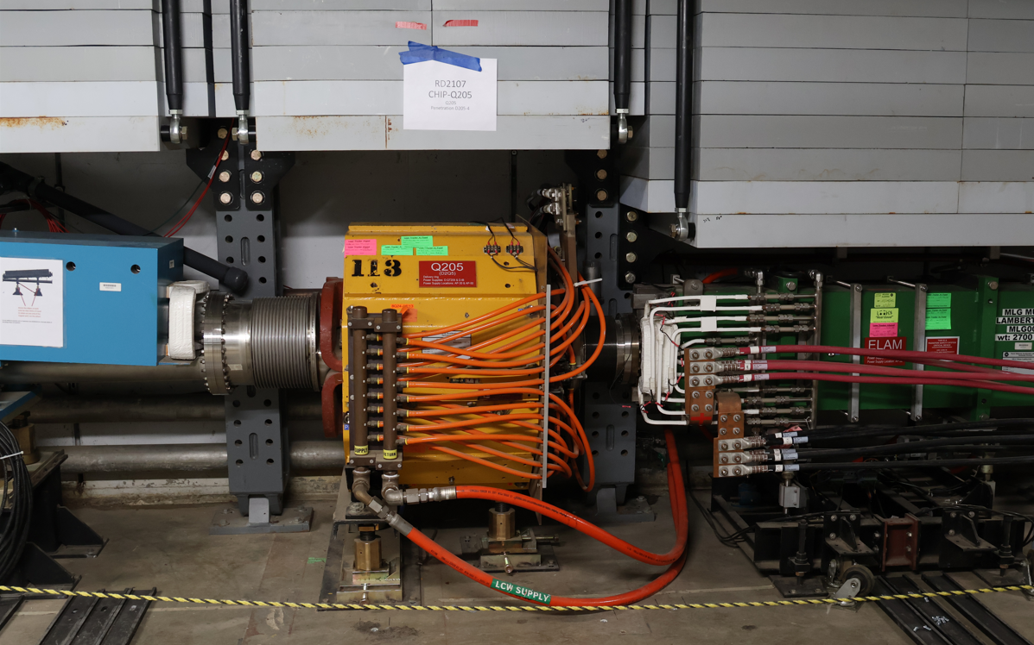
Q205 and in-tunnel shielding

Slide 6
Upcoming work
ESS1 and ESS2 work
ESS1 scheduled to be transported to NWA on Tuesday
Once at NWA, vacuum pump-down and high voltage conditioning follows
ESS2 assembly will continue
Portable A/C unit appears to be working well
ISD needs to schedule installation of new A0 and new A0 Clean Room A/C units
Mechanical installation in D30 has been deferred
Will probably put a spool upstream of prototype ESS2
Small chance it will be moved upstream if new cart is ready soon
No work on Q205 or vacuum pipe
M4 line above Q206 will be reinstalled
Vacuum leak check and pump-down will follow
Hope to resume beam operation in April
Will begin working on sign-offs (mechanical will take another week or two)
AP-0 A/C work continues
Access to AP-0 Water Cage and rad fence area simplified with no beam to target

