Slide 1
0900 AD Scheduling Meeting
Marty Murphy
29 March 2024

Slide 2
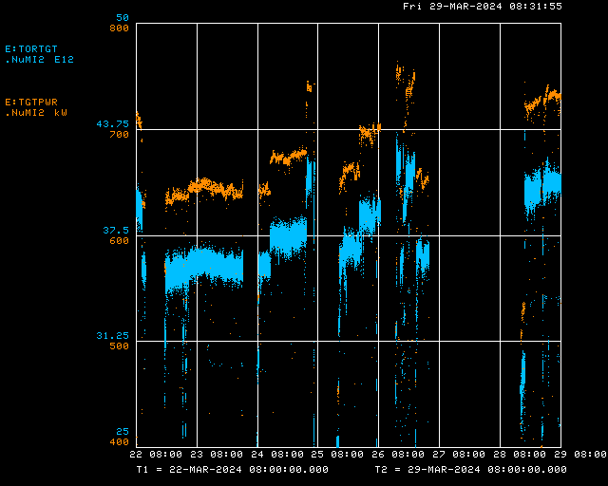
Beam to NuMI

Slide 3
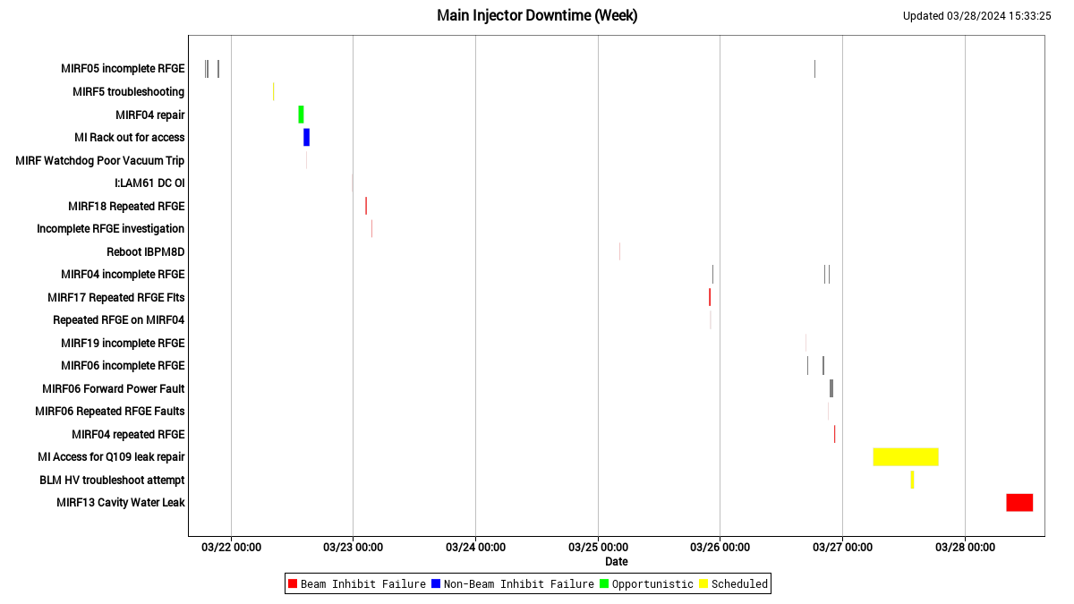
Main Injector Down Time

Slide 4
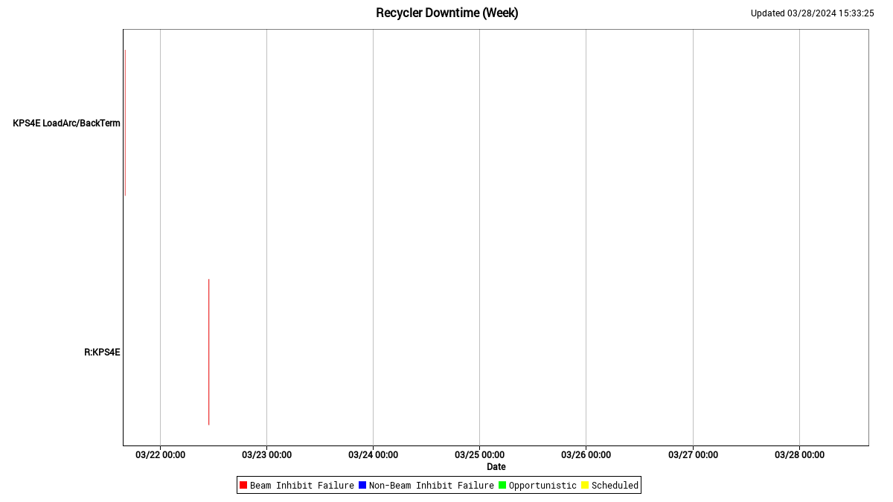
Recycler Down Time

Slide 5
Last Week This Week
Last Friday: Dedicated 8-GeV lattice measurements; results were mixed.
This week:
Monday:
Access MI 20-62 for NuMI LCW leak.
Instrumentation repaired I:HP333 readback in tunnel.
Tuesday: Beam off most of day shift, but data were collected for R:QCLP modifications.
Wednesday: Access MI 20-62 to repair NuMI magnet leaks.
Thursday: Access to repair a leak on MI RF13 LCW leak.
Friday: Beam to NuMI; tuning; commissioning activities.

Slide 6
Current Status
Current beam power to NuMI is 720 KW
MI8 BPM and BLM issues being addressed.
Two-PA RF stations (MIRF04 & 05) have been running inconsistently and at least one gets turned off by Ops overnight because it will not stay on. RF experts continue investigating.
Accelerator Readiness Review is complete.
Plan for Friday & Next Week
Continue beam commissioning activities and send (low power) beam to NuMI when possible.
8-GeV Lattice measurements once we resolve technical difficulties
Move MI8 collimators in.
Raise beam intensity and reduce losses
Support beam to SY

