Slide 1
Linac 9am Report
Daniel C. Jones

Slide 2
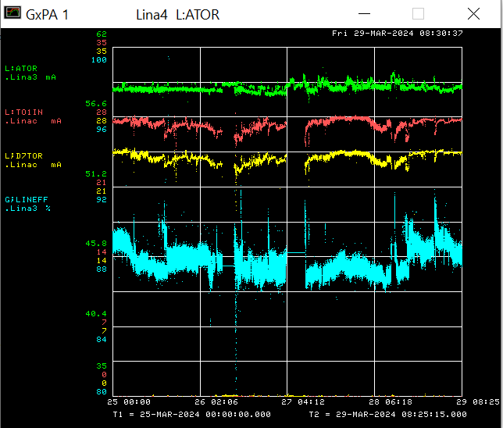
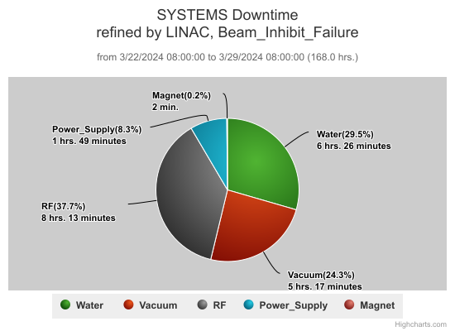
Linac/Preacc Operation Mar 25th – Mar 29th 2024
Tuesday - LCW temperature too high resulting in Linac turning off
Wednesday – 400MeV vacuum leak at MW3 signal feedthrough
Thursday – KR5 gradient and phase mis-regulation issue

