Slide 1
9 O’Clock Meeting
Nathan Ruffatti
MCR Crew Chief
Monday, April 1st, 2024

Slide 2
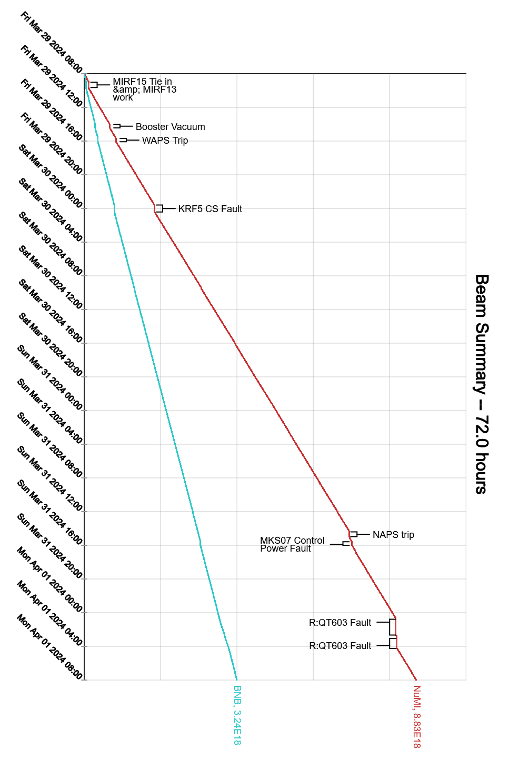
Since Friday…
Friday:
KRF5 tune-up study, MIRF15 tie-in
8 GeV collimators partially put in, 8 GeV BPM issues
GMPS trip on vacuum activity
Saturday:
FAST Laser Room HVAC trip, Contractors replaced Condensate pump
B:IPINJ1 bad ‘A’ cable, was unplugged from PS
R:KPS4D thyratron delay fire trips, Pete raised filament and reservoir voltages
F4 SB power loss, Tripped main breaker for upper circuits. DE recovered

Slide 3
Since Friday…
Sunday:
MI abort vacuum alarms high, took a couple steps up since Saturday
MIRF14 HV deck interlock faults, station bypassed
I:LD5FP, MI damper forward power, dropped to zero
Monday:
R:QT306 tripped on ground fault indication, replaced with spare. Regulator breaker had also tripped.

