Slide 1
DUNE FD1 CE/PD penetration
cable strain relief design

Slide 2
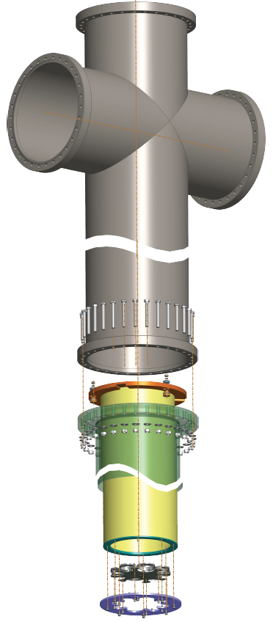
We are suggested to explore the possibility of using the NP02 BDE penetration cable support design to the FD1 CE penetration cable support design.
Current FD1 CE/PD penetration design
FD2/NP02 Module-0 BDE/PDS penetration design
Cryostat crossing tube
Solid inner tube
Four supporting rods

Slide 3
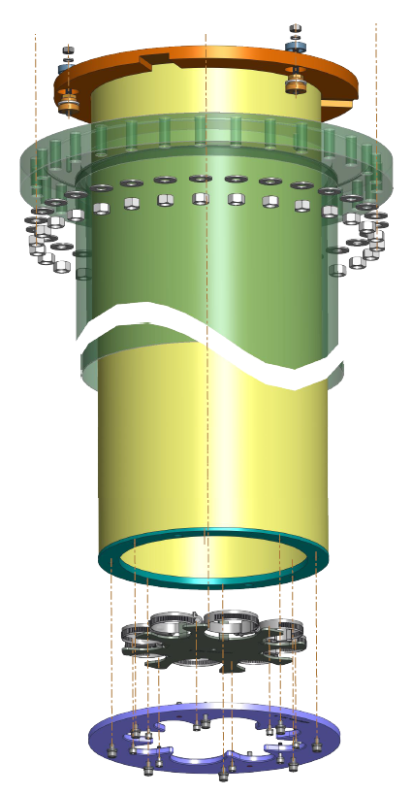
Height adjusting screws
Current design of FD1 CE/PD penetration:
A solid inner tube (yellow) is installed in the cryostat crossing tube (green). The cable strain relief plates are mounted at the bottom of the solid inner tube. The CE and PD cables and fibers are strain relived at the cable strain relief plates.
The cryostat crossing tube provides three tapped threaded holes on its flange. The top flange (brown) of the inner solid tube is mounted on the cryostat crossing tube flange with three sets of height adjusting screws. The concentricity between the cryostat crossing tube and the solid inner tube is achieved by adjusting the three sets of screws.
A good concentricity between the cryostat crossing tube and the solid inner tube guarantees that the inner tube doesn’t touch the cryostat crossing tube.
Cryostat crossing tube
Solid inner tube
Cable strain relief plates

Slide 4
FD2/NP02 Module-0 BDE/PDS penetration design
In the NP02 Module-0 design, the solid inner tube is replaced with four supporting rods. The cable strain relief plates are supported at the bottom of the four supporting rods.
NP02 Module-0 design is a simpler and cheaper design. There is more usable space in the tube for cables. It is easier to install.
As the long rods are not as stiff as the solid inner tube, the cable strain relief plates may touch the cryostat crossing tube, if lateral force is applied. This can be avoided (see next slide).
Four supporting rods

Slide 5
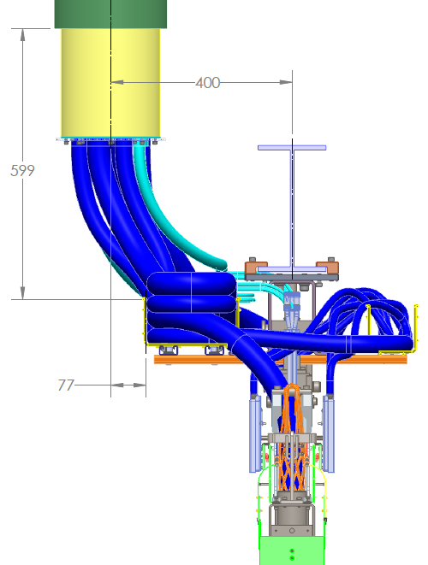
The FD1 penetration for CE is very close to the cable tray on APA.
The penetration center line is 400 mm away from the center line of DSS beam, and is 77 mm away from the cable tray. The cable tray is pretty much aligned with the penetration.
If the solid inner tube is replaced with four supporting rods
The cable bundles have some stiffness. By positioning the cable bundles properly inside the cable tray, the cable strain relief plates will not touch the cryostat crossing tube.

Slide 6
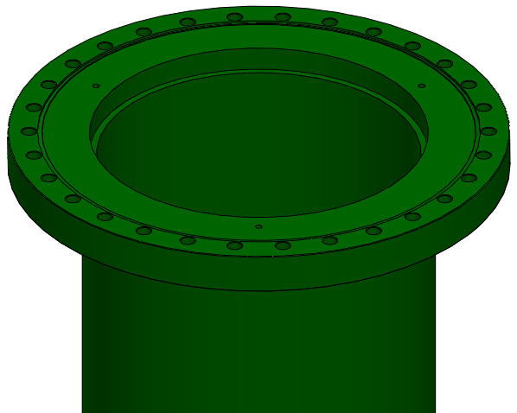
New design #1 for FD1:
The cryostat crossing tube and its flange remain the same as in the Current design of FD1 penetration.
The solid inner tube is replaced with four long rods to simplify the design. A top ring plate is mounted on the cryostat crossing tube flange.

Slide 7
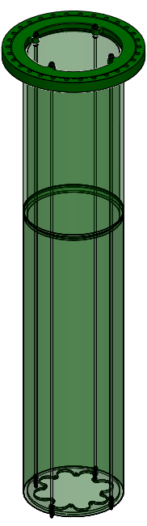
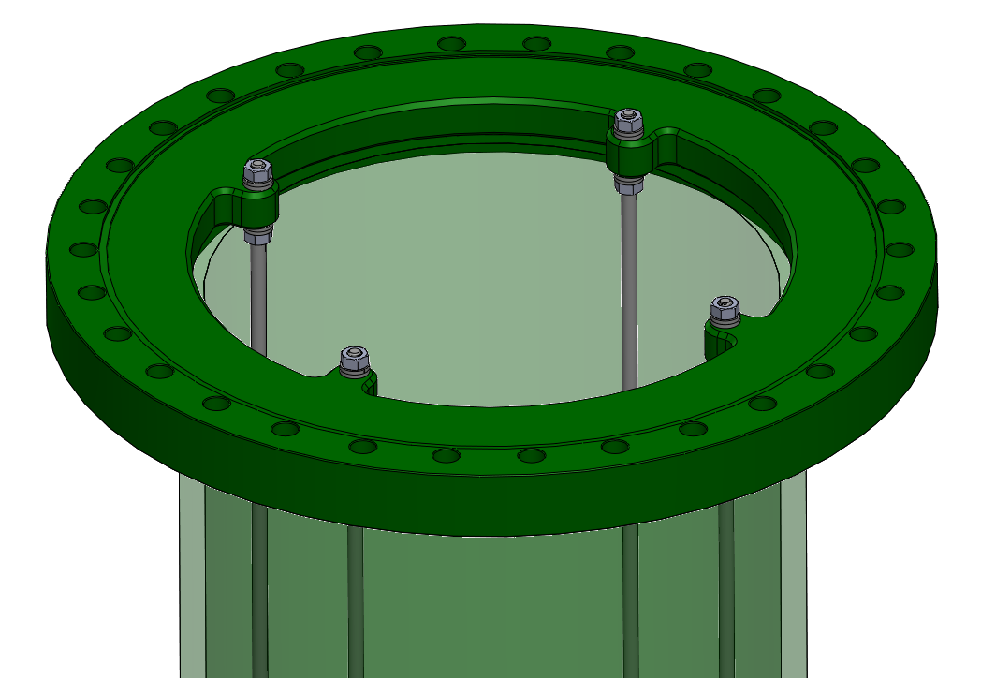
New design #2 for FD1:
Four tabs are added to the flange of the cryostat crossing tube.
The top ring plate of the rods system is further eliminated.

