Slide 1
Items for Discussion
Eric James
FD1 Technical Board
April 10, 2024

Slide 2
LBNC Review (Feb 26-28)
The recommendation from the October 2023 LBNC remains open: develop an updated APA production plan and schedule, which would then be reviewed and validated at an internal review (now foreseen for May 2024)
Form or strengthen a dedicated task force to investigate the source of the wire damages that led to broken wires. Consider if additional actions could be implemented during winding and assembly that could facilitate post-mortem investigations

Slide 3
NSG Review (Mar 27-28)
The recommendation “Set up a formal tracking process with each partner by the end of the year” is considered closed. However, the NSG would like a report about status and lessons learned at the next NSG meeting about the implemented process
The recommendation “Complete by the end of the year a uniform set of high-level milestones across FDC project to help follow the design/ construction progress in a concise way ” is still open. The NSG kindly requires a follow up at the next NSG meeting
The recommendation “Credibility of the schedule will be improved by a dashboard showing progress in production of the key components, like LHC magnets production dashboard. Present such dashboard(s) for the FD1 and FD2 components already in production.” is still open. The NSG kindly requires a follow up at the next NSG meeting

Slide 4
Production Readiness Reviews
Stage 1
FD1 PDS DAPHNE Component Procurements : November 9, 2023
FD1 HVS CPA Resistive Panel Procurements: January 23, 2024
FD1 TPC-ELEC PTC Component Procurements: March 25, 2024
FD1 DAQ Timing System (AMC FMC Procurements): April 19, 2024
Stage 3
FD1 CALCI APA Temperature Sensors Site Visit: March 11, 2024
FD1 PDS SiPM Testing Site Visits: March 13-14, 2024
Stage 2
First big documentation reviews expected to occur within next few months (APA board production at PSL, HVS CPA Module Assembly, and TPC-ELEC FEMB Production)

Slide 5
Items Needing Approvals
There are a couple of small items with potential impacts on physics, which the Technical Board should sign-off on and send to Executive Board for final approval
Increase in gap between APAs in doublet (first introduced by Kyle last year but not yet formally approved by Executive Board)
Procedure for handling problematic wires encountered during APA fabrication

Slide 6
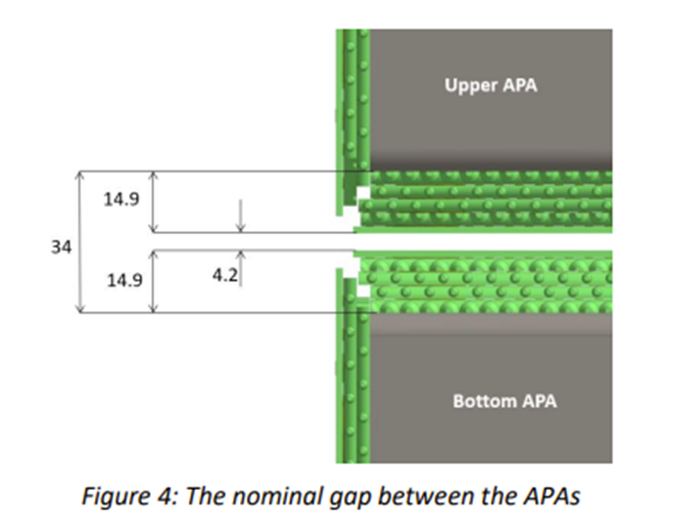
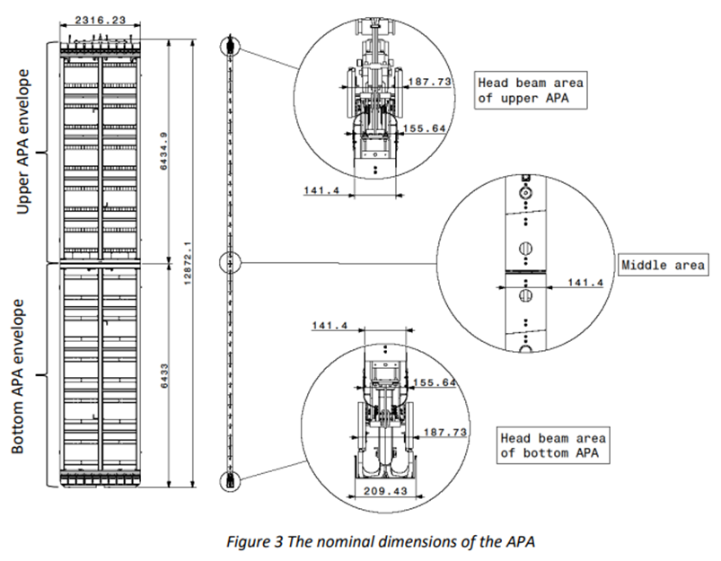
Increasing Gap between APAs in Doublet
The baseline nominal gap between two APAs in an APA Pair is 34mm (as shown in the left-hand image)
A proposal was made to increase this value by 6mm
Initially presented by Kyle at November meeting

Slide 7
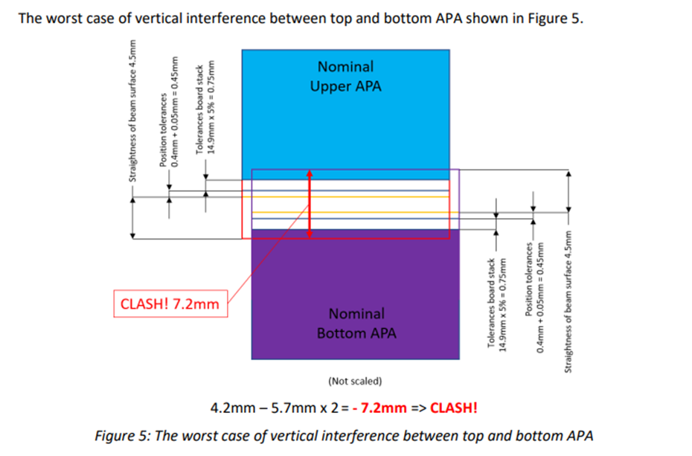
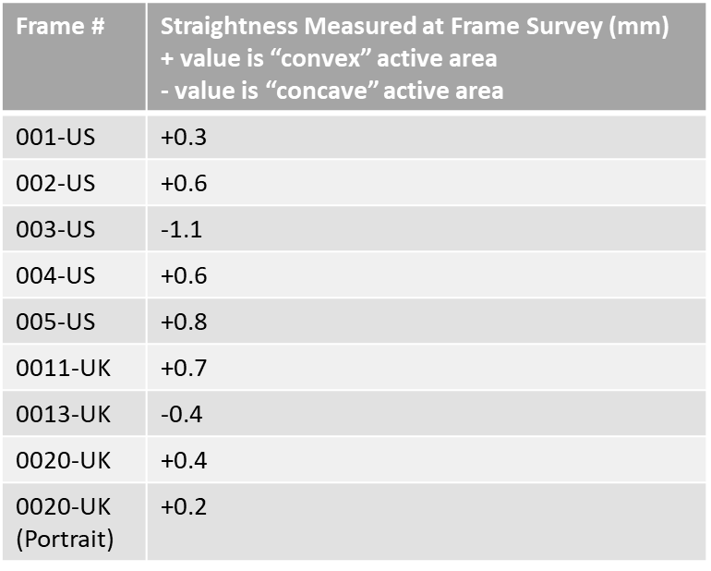
Motivation
One of the DUNE requirements for individual frame members is straightness of +/-4.5mm, regardless of length
Thickness tolerance of circuit boards is 5%
Using these two criteria, the baseline nominal gap (of ~4mm) is insufficient.
Image showing both APAs at their “worst” case
A very quick and informal query of surveyed frames

Slide 8
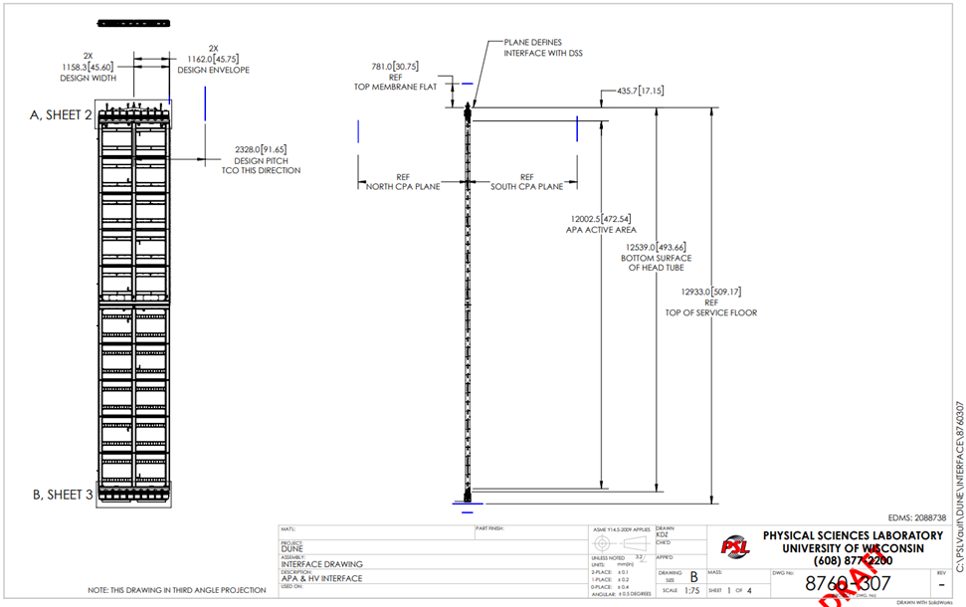
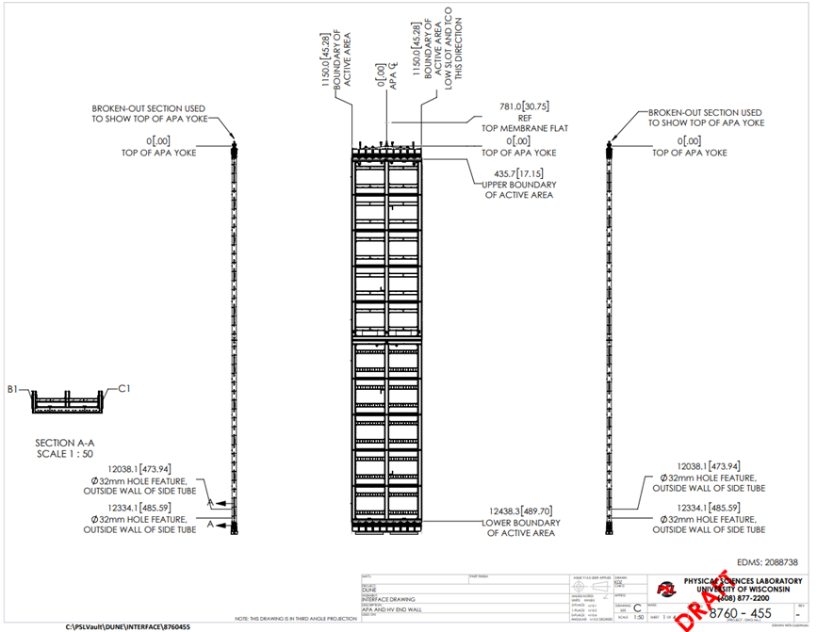
Implementation
The proposed method is to increase the gap by 6mm by lowering the bottom APA
HVS consortium has nominally signed-off on this proposal

Slide 9
APA Wires
Our goal is to produce “perfect” APAs, but this is not always possible
If a wire on a particular layer is damaged or identified as problematic after the next-layer geometry boards are installed, it cannot be replaced (only removed)
Need a policy (driven by physics considerations) as to what to do in these cases

Slide 10
Proposed Policy
Wire is or suspected to be damaged – Remove
Wire is shorted to neighbor (on same layer) but no suspected damage – leave in place
Wire is open (no connection) but no suspected damage – leave in place and short to neighbor on same layer
Must be properly documented so that future data analyzers can understand exactly what was done

